Slide 1
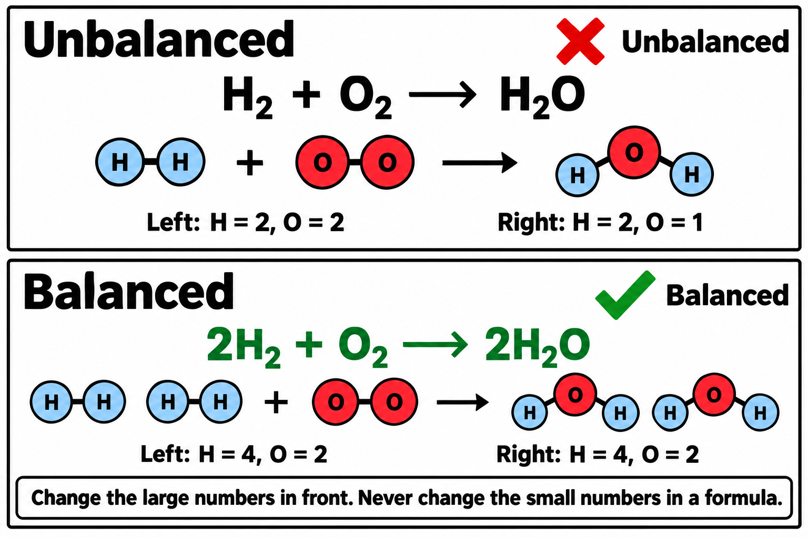
Notes:
How balancing equations works

Slide 2
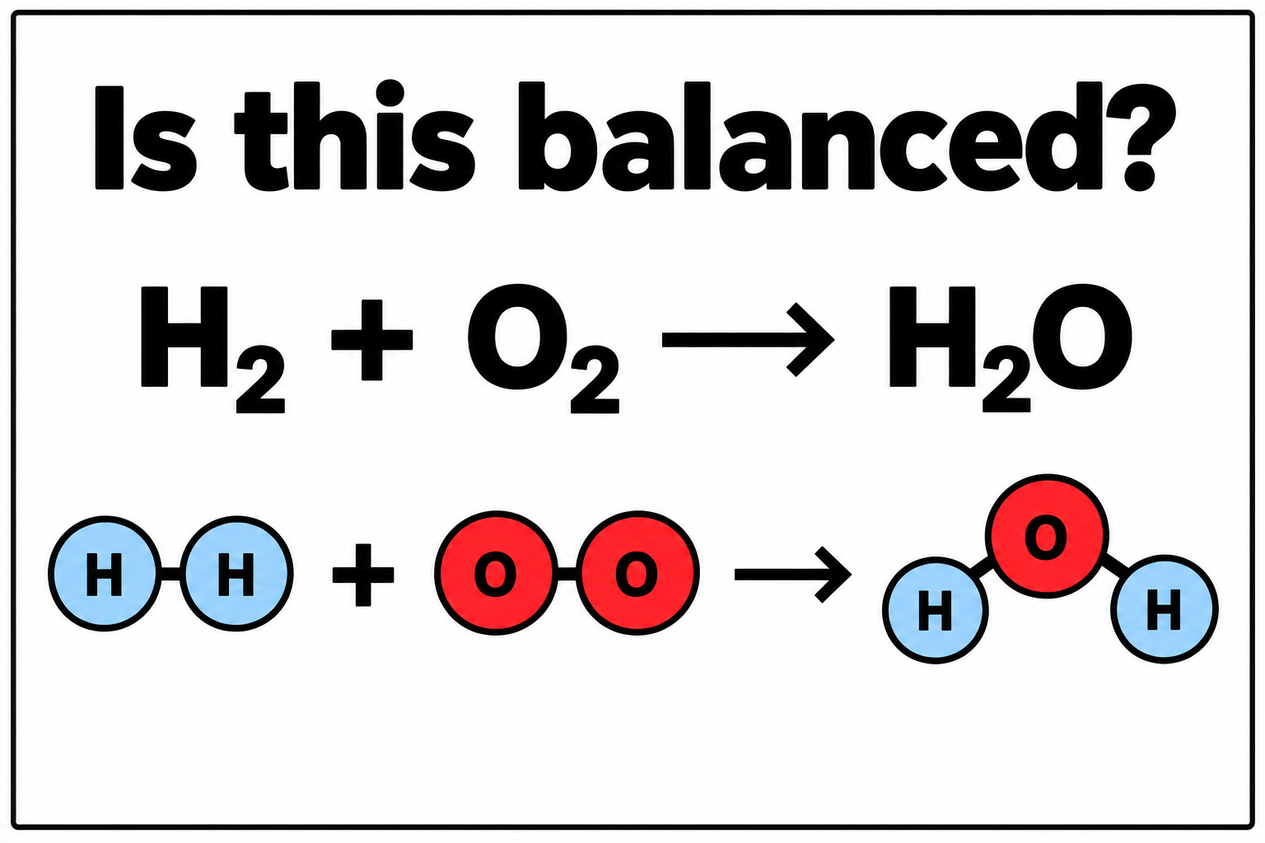
Notes:
Is this equation balanced?

Slide 3
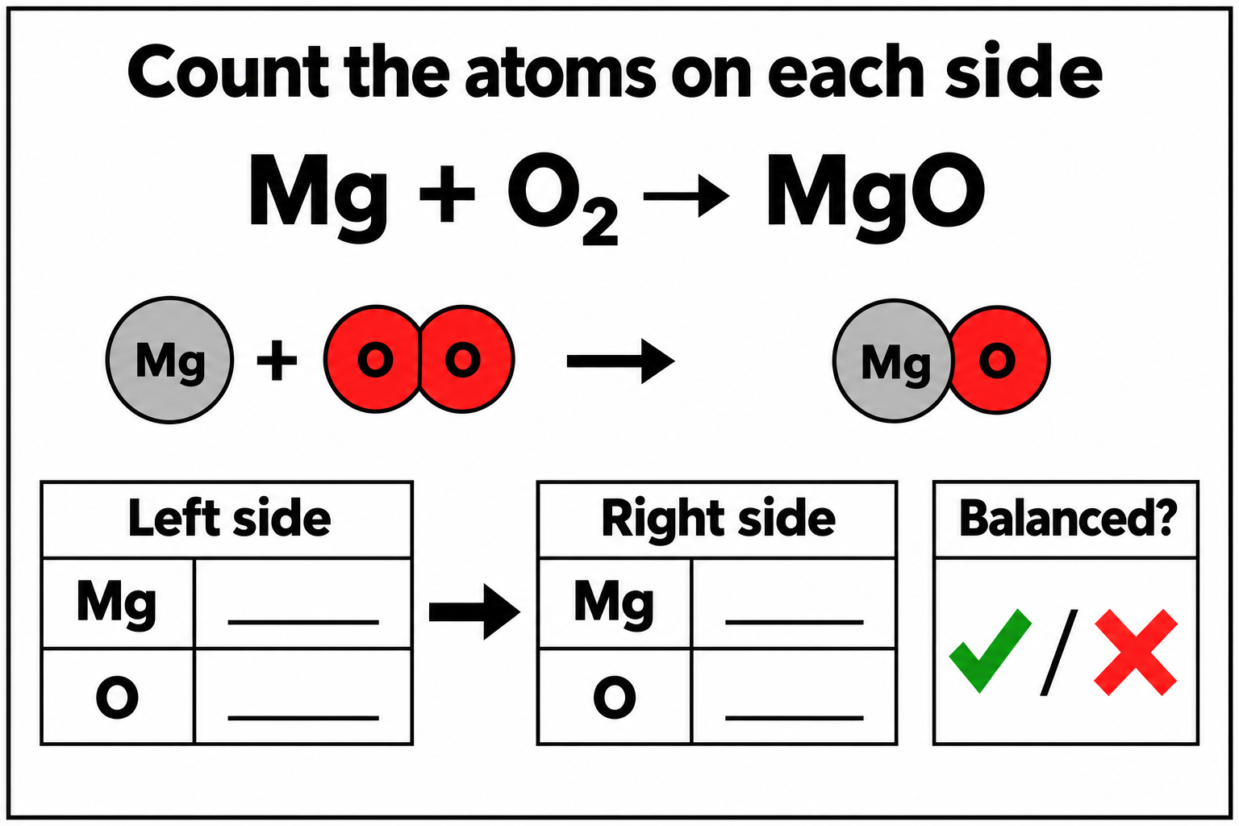
Notes:
Count atoms: magnesium and oxygen

Slide 4
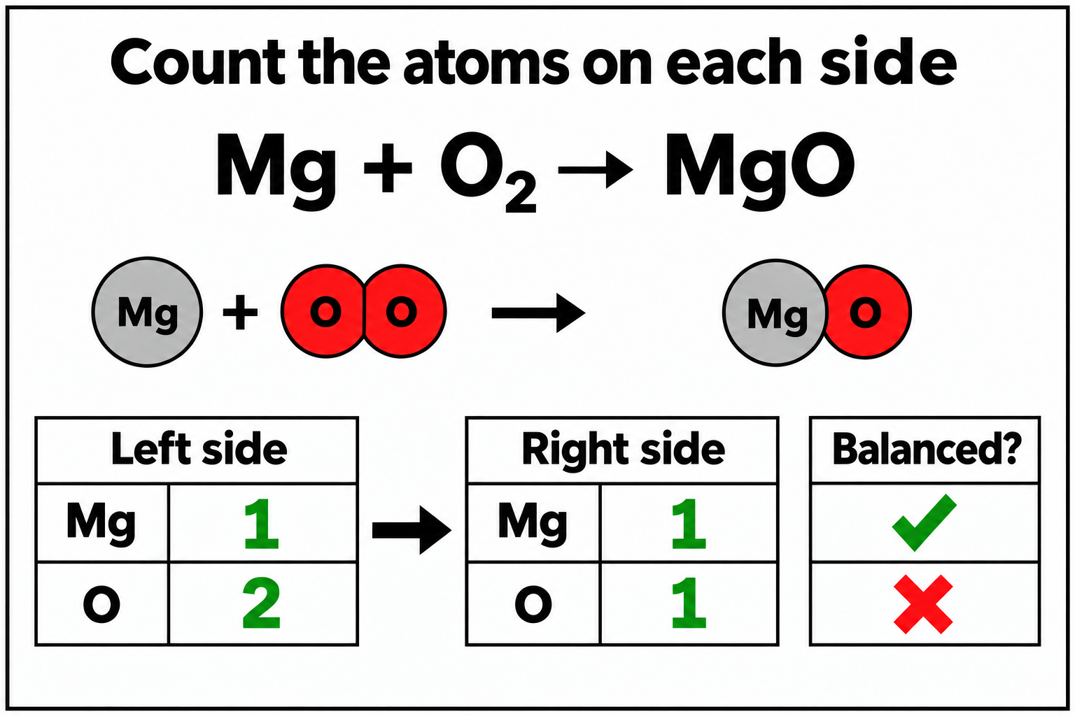
Notes:
Count atoms answer: magnesium and oxygen

Slide 5
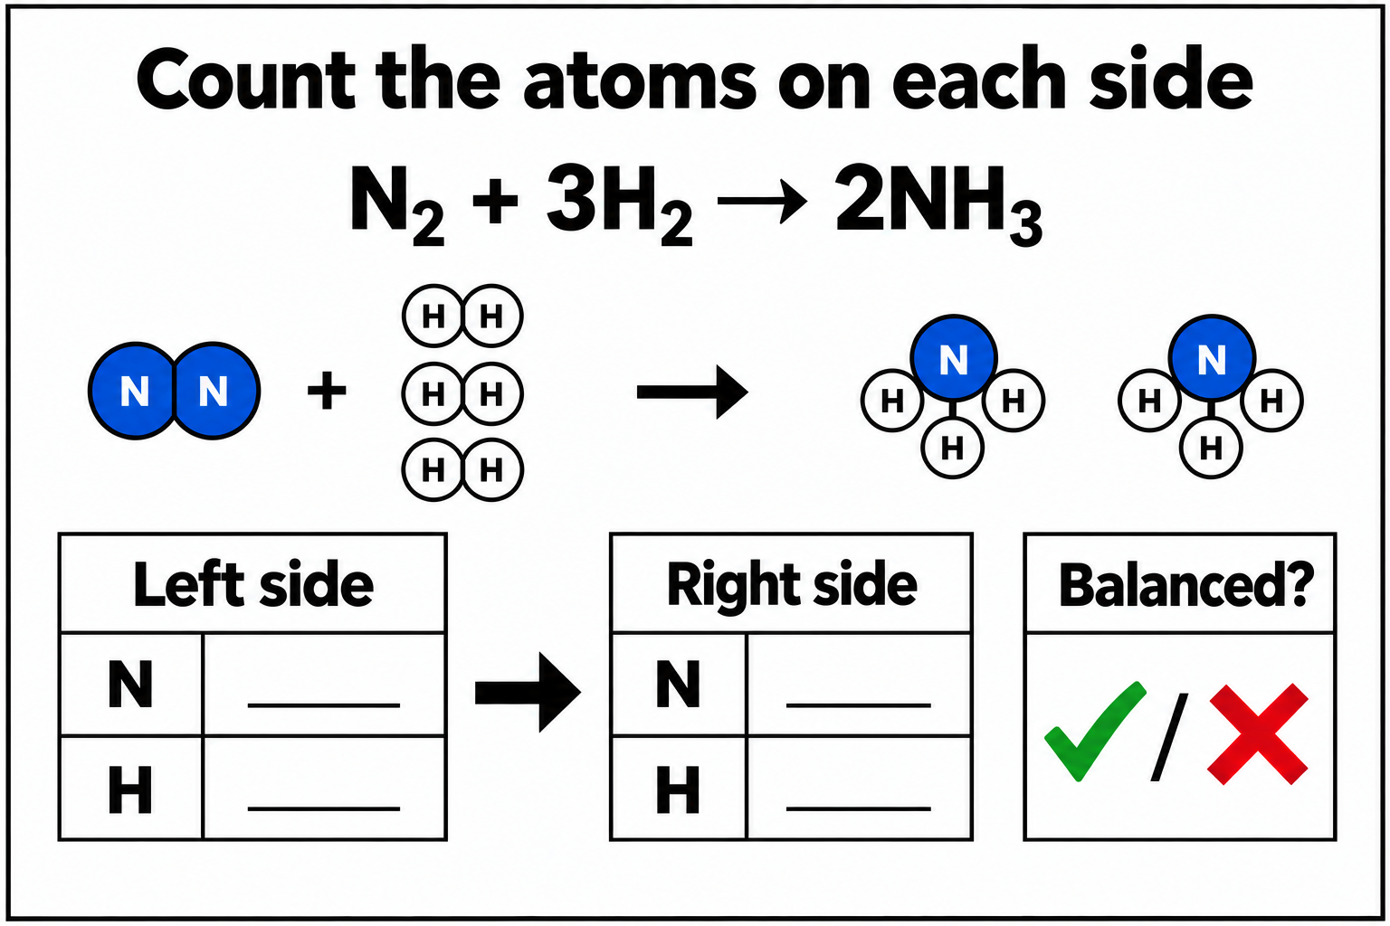
Notes:
Count atoms: nitrogen and hydrogen

Slide 6
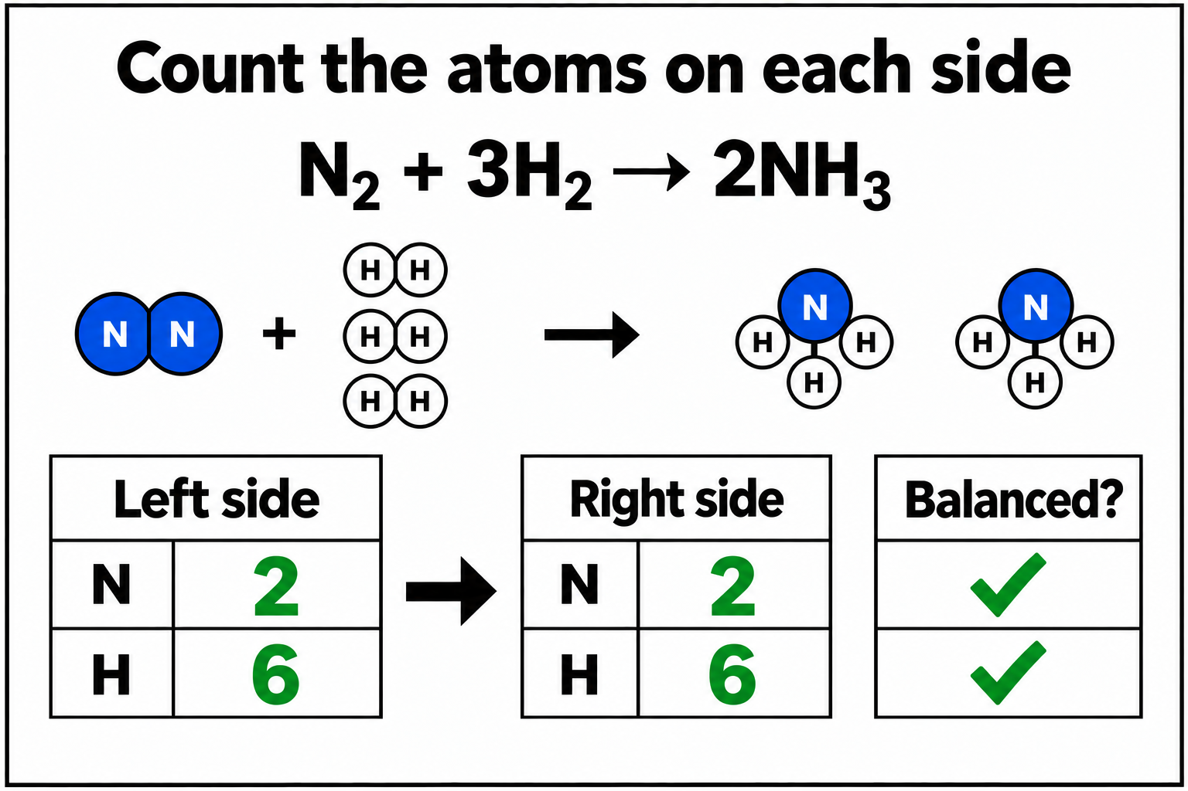
Notes:
Count atoms answer: nitrogen and hydrogen

Slide 7
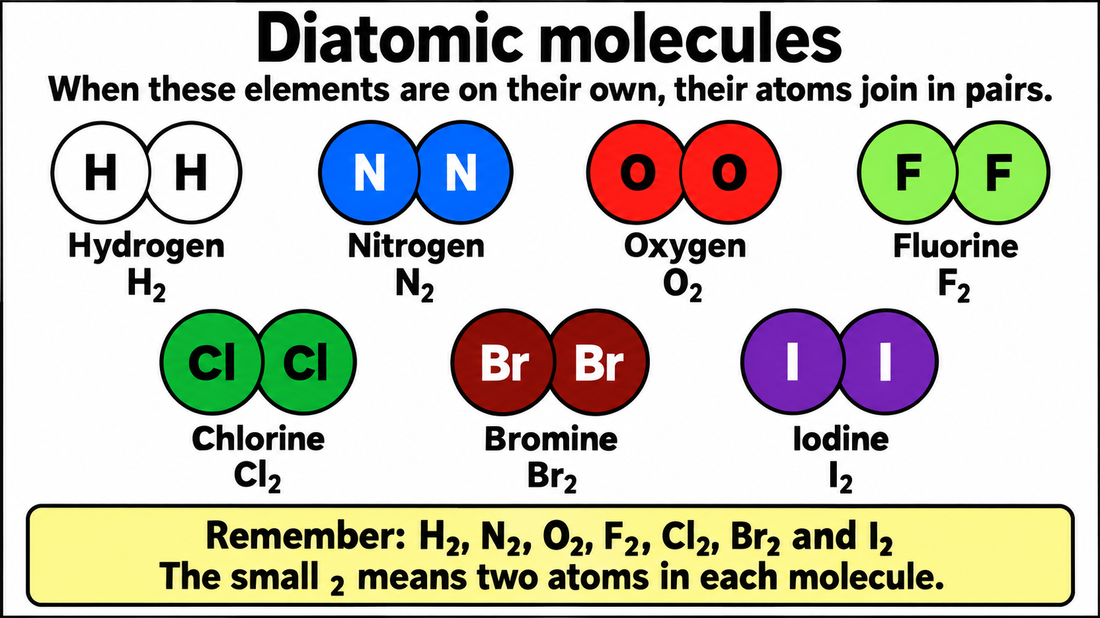
Notes:
Diatomic molecules

Slide 8
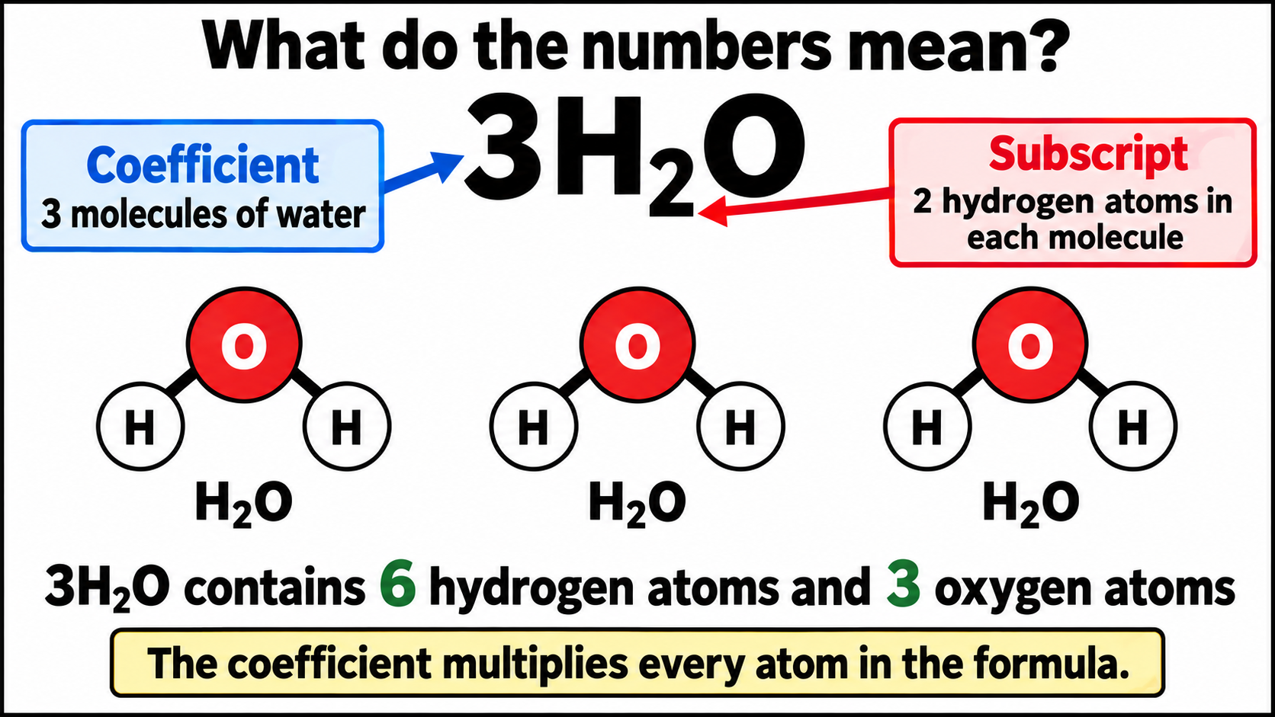
Notes:
Coefficients and subscripts

Slide 9
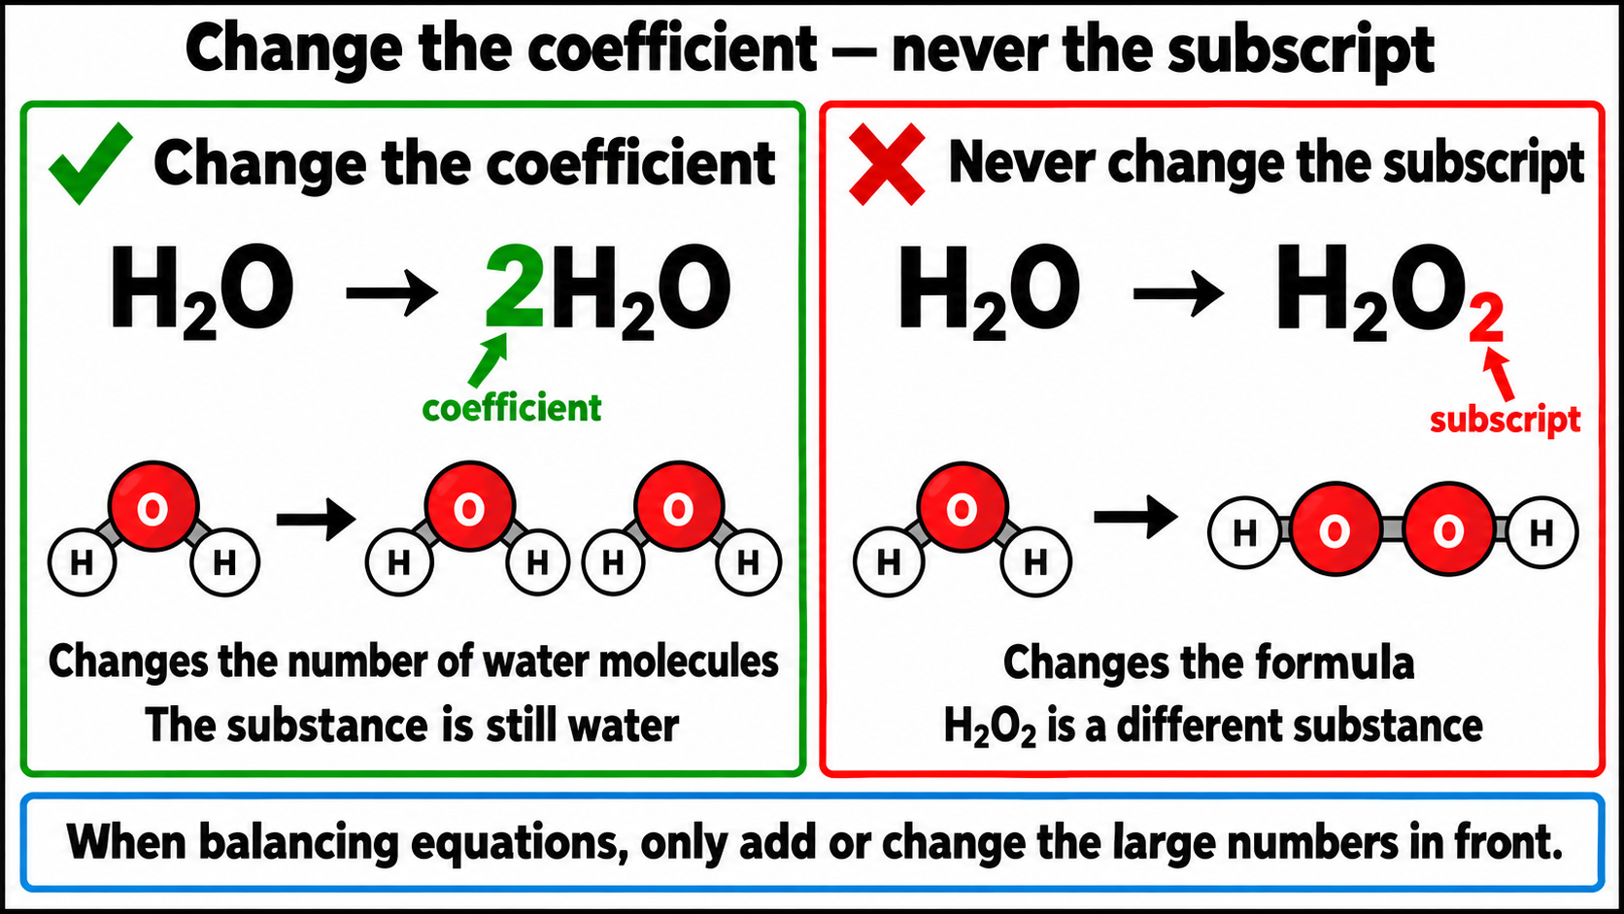
Notes:
Change coefficients, not subscripts

Slide 10
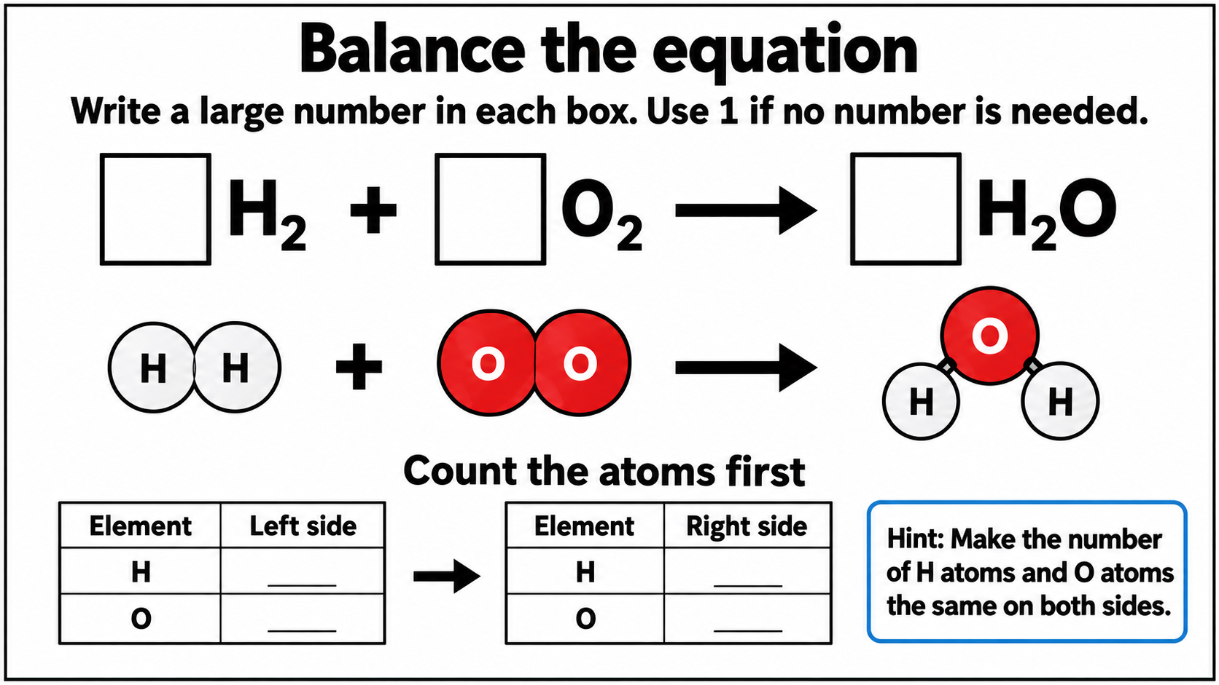
Notes:
Guided balancing problem

Slide 11
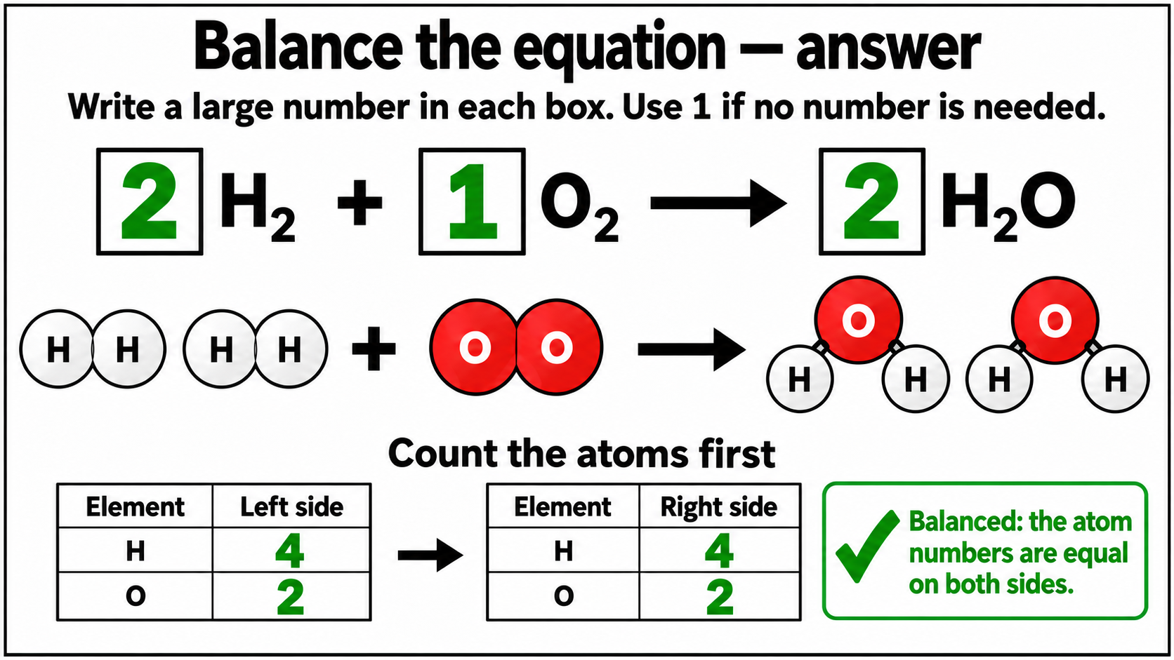
Notes:
Guided balancing answer

Slide 12
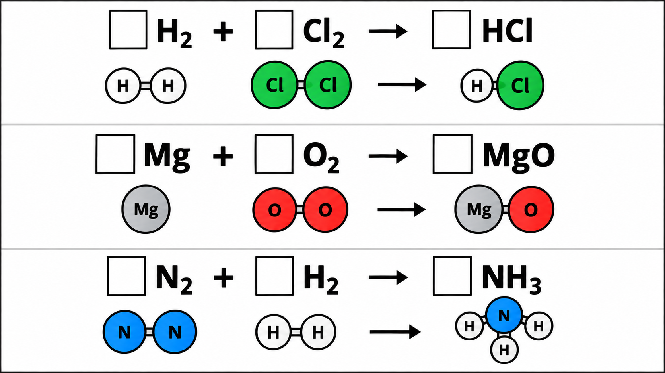
Notes:
Three balancing problems

Slide 13
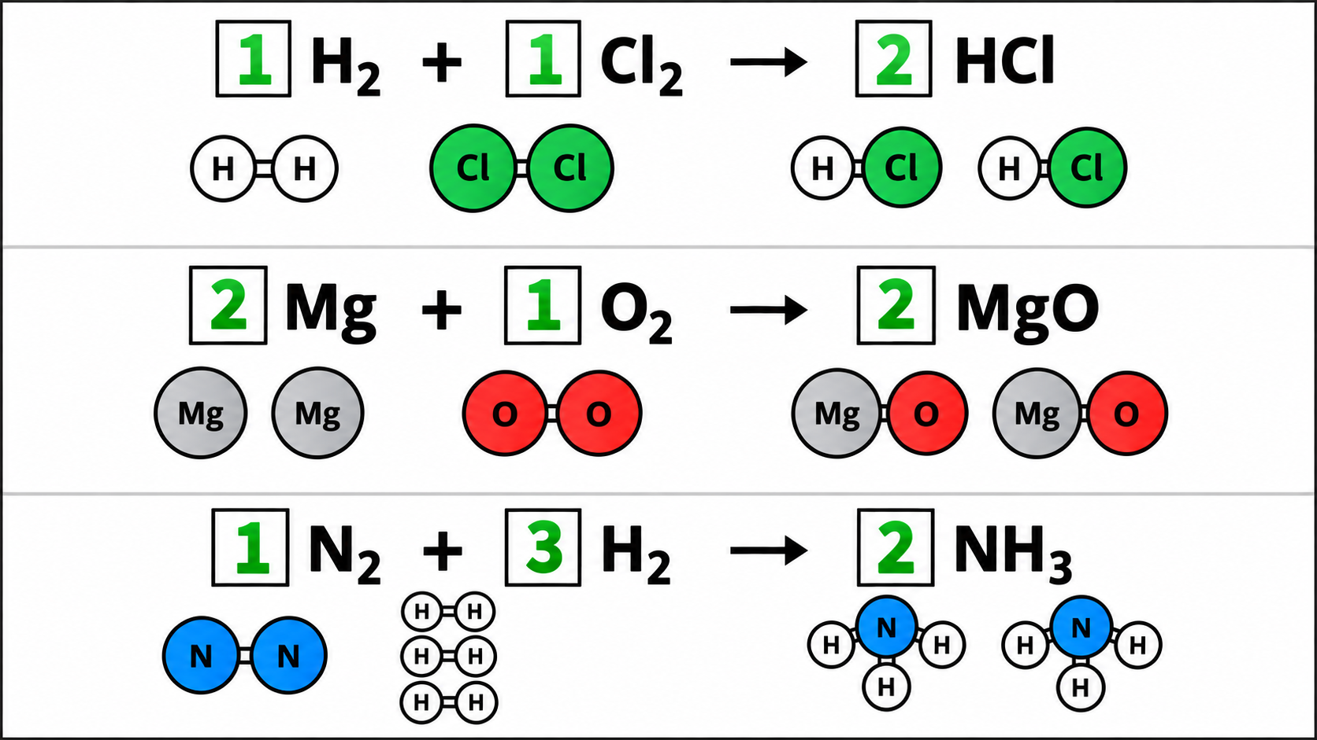
Notes:
Three balancing answers

Slide 14
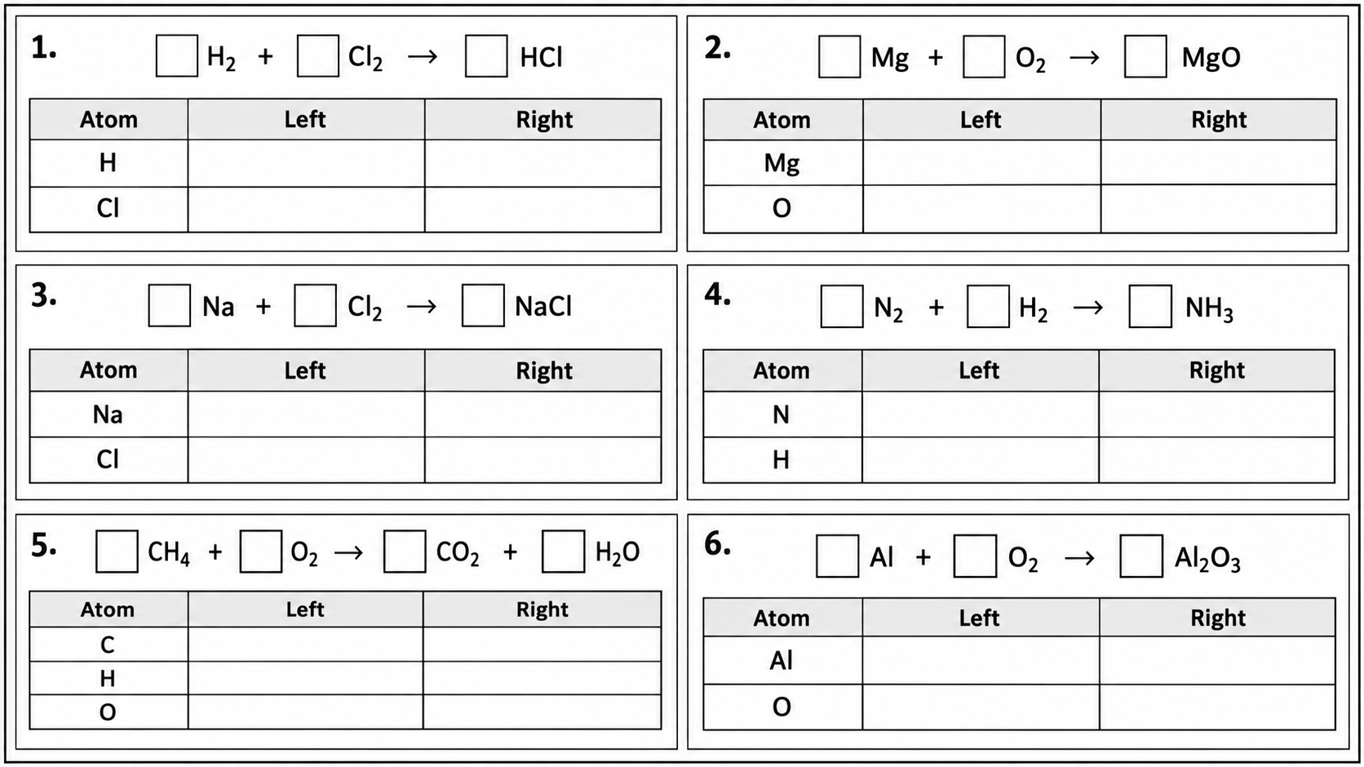
Notes:
Six balancing problems

Slide 15
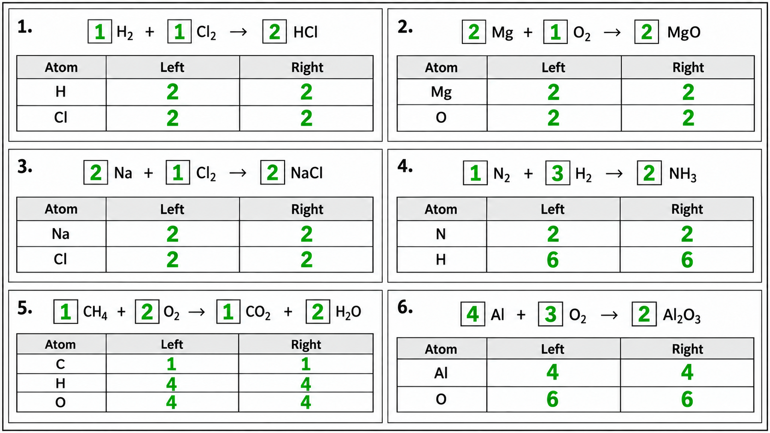
Notes:
Six balancing answers

