Slide 1
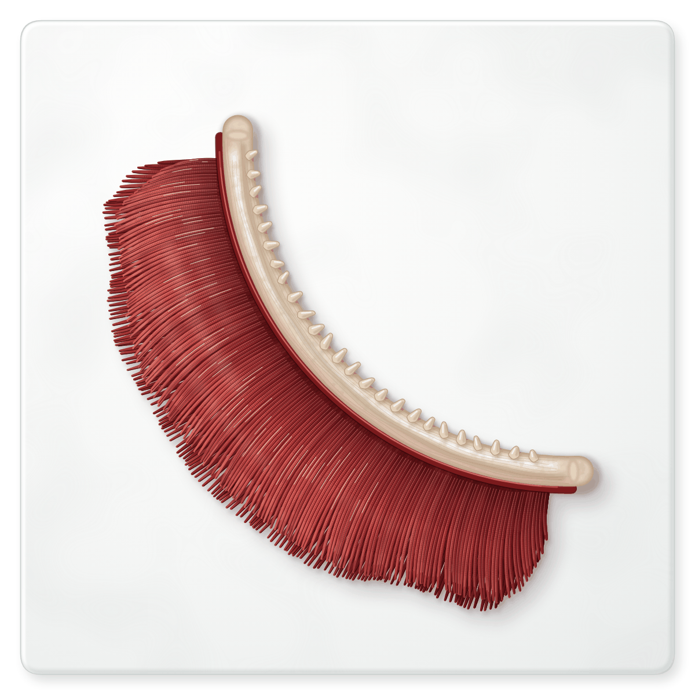
sciencegcse.co.uk · Biology B1 L10
DATE
B1 L10: Active transport and exchange surfaces
24/09/2026
DO NOW
KEYWORDS
1. Osmosis is the movement of which substance?
2. What type of membrane does osmosis need?
3. Diffusion moves particles from a ___ concentration to a ___ concentration.
Active transport
Mineral ions
Surface area to volume ratio
Exchange surface
Gills
A painting of a fish gill, as seen in a dissection.
B1 Cell biology
AQA Combined Science
Notes:
Do now: retrieval from B1 L9 (Q1, Q2) and B1 L8 (Q3). The picture is a painting of one gill from a fish, on a white tile, as you might see in a dissection. It is not a photograph. Ask: what do you think this is? What do you notice about its colour and its shape? Why might it be so red? Link: Q3 (diffusion) is how oxygen gets from the water into the blood in a gill; Q1 and Q2 (osmosis) are how water gets into root hair cells. Today: a third way substances move, active transport, and how exchange surfaces such as gills are adapted. Teacher note: the gill comes from a fish bought for food. If you show a real gill, keep it clean, on a white tile, and offer anyone who prefers not to take part another way to join in (this painting and screen 2 of the online lesson). Suggested 60 min: slides 1-3 (7 min); slides 4-9 (15 min); slides 10-13 (12 min); slides 14-18 (12 min); Mandatory worksheet started in class (9 min), finished for homework; exit ticket slides 22-23 (5 min). Use slides 19-21 if time allows. Homework: online lesson quiz and the B1 L10 Exam questions worksheet.

Slide 2
sciencegcse.co.uk · Biology B1 L10: Active transport and exchange surfaces
Do now answers and lesson focus
Do now answers
In this lesson
1. Water.
2. A partially permeable membrane.
3. Higher, lower.
• Compare a real gill with a diagram.
• Describe active transport in roots and the gut.
• Compare diffusion, osmosis and active transport.
• Calculate surface area to volume ratios.
• Explain how exchange surfaces are adapted.
Key idea
Active transport moves substances against a concentration gradient, using energy from respiration.
Large organisms need exchange surfaces with a large surface area and a short diffusion path.
2
B1 L10 · sciencegcse.co.uk
Notes:
Go through the answers. Then share the lesson focus. The online lesson (sciencegcse.co.uk, B1 L10) follows the same 12 screens as this PowerPoint, so students can go over it at home. There are three checkpoints along the way. Answer 1: osmosis is the diffusion of water (B1 L9 Osmosis). Answer 3: diffusion goes from a higher to a lower concentration (B1 L8 Diffusion). Ask: could anything move the other way, from a lower to a higher concentration? Keep the answer for slide 6.

Slide 3
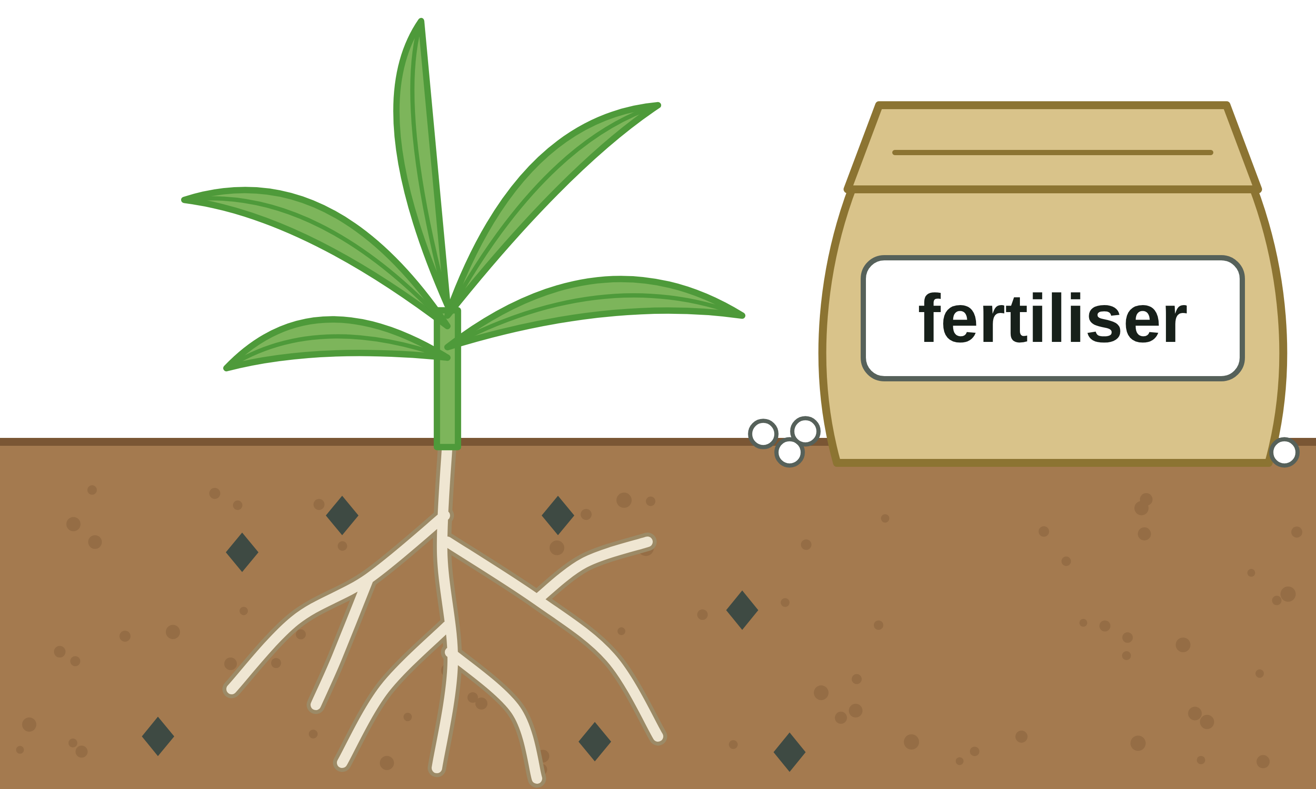
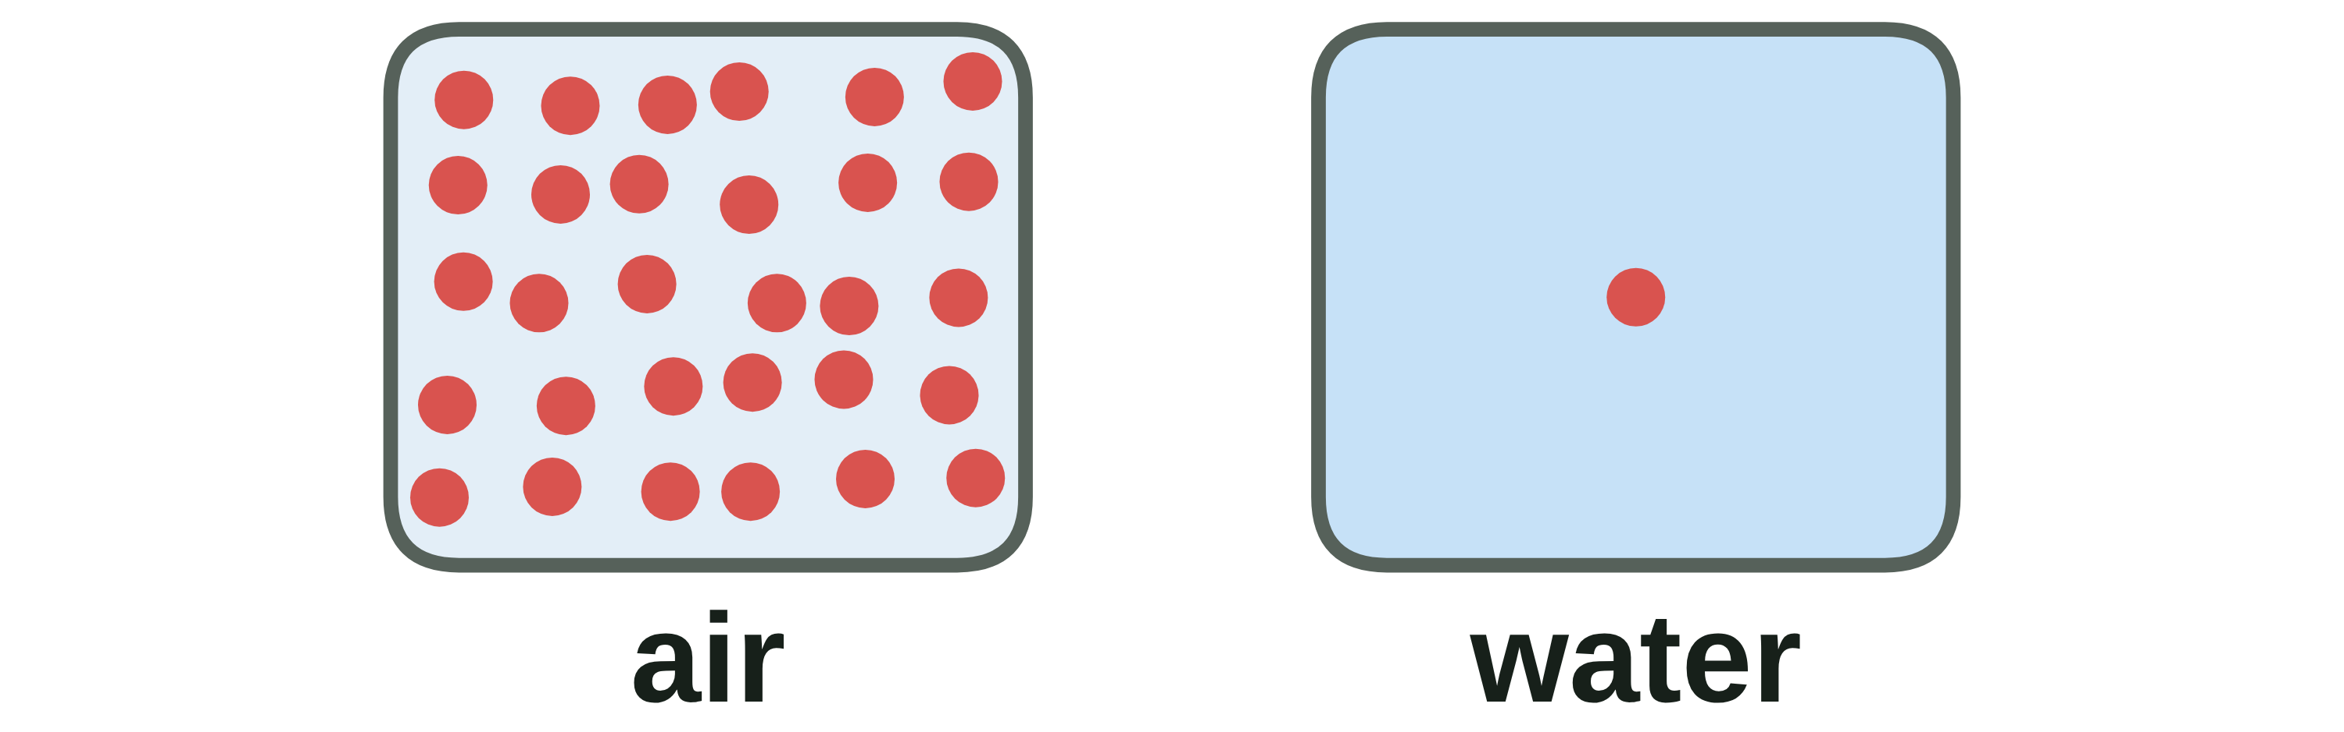
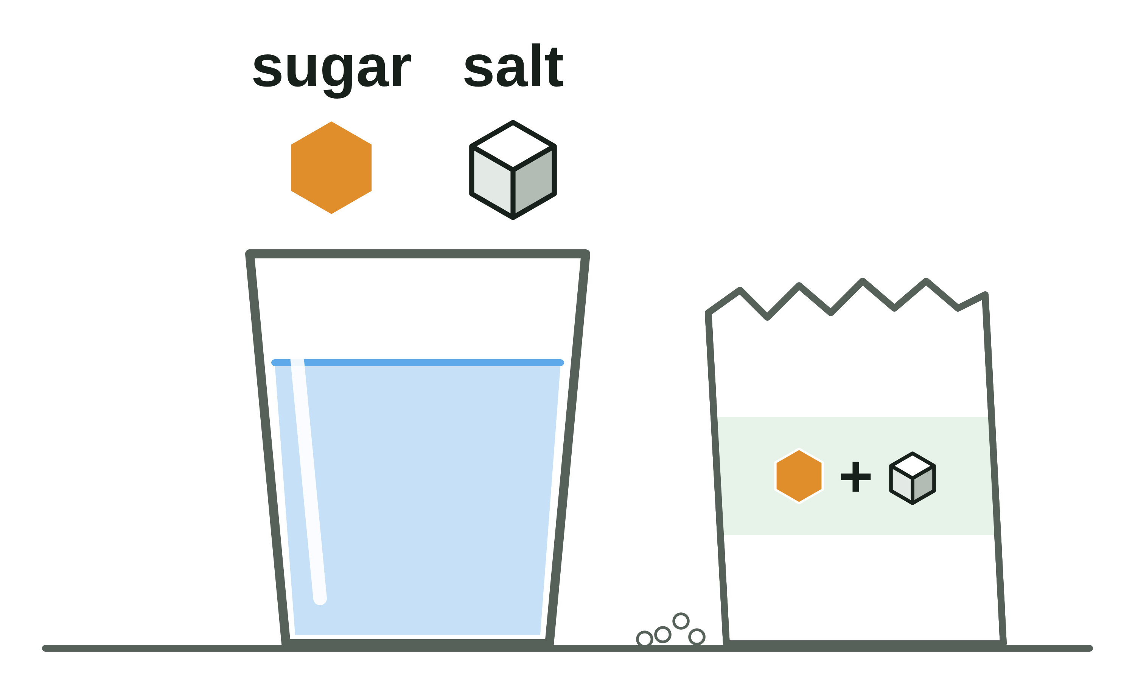
sciencegcse.co.uk · Biology B1 L10: Active transport and exchange surfaces
Why this matters in the real world
Cells must take in what they need, even when there is very little of it outside.
Feeding crops
Oxygen for fish
Rehydration drinks
30 ×
as much oxygen in air as in water
Farmers add fertiliser to give crops mineral ions, such as nitrate. Root hair cells take the ions in by active transport.
A litre of air holds about 30 times as much oxygen as a litre of water. So gills need a huge surface area and a constant flow of water.
These drinks contain sugar and salt. The gut takes them in by active transport, and water follows by osmosis.
Farming
Exchange surfaces
Medicine
3
B1 L10 · sciencegcse.co.uk
Notes:
Hook. Ask: why do farmers spread fertiliser when the soil already has mineral ions in it? (The ions in soil water are very dilute, and crops grow better with more; root hair cells still have to take them in by active transport.) Oxygen for fish: the 30 times compares a litre of air with a litre of water at about 20 °C. Rehydration drinks help someone who has lost a lot of water and salts, for example after a stomach bug; the sugar helps the gut take in the salt, and water follows by osmosis. Ask: which of today's ideas could explain each card?

Slide 4
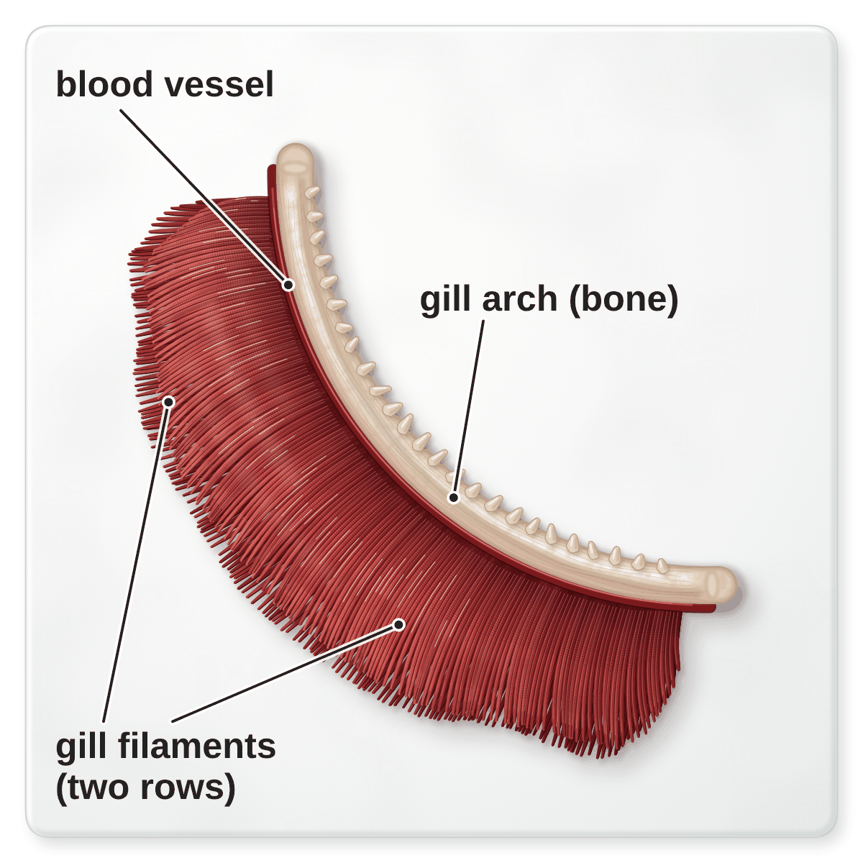
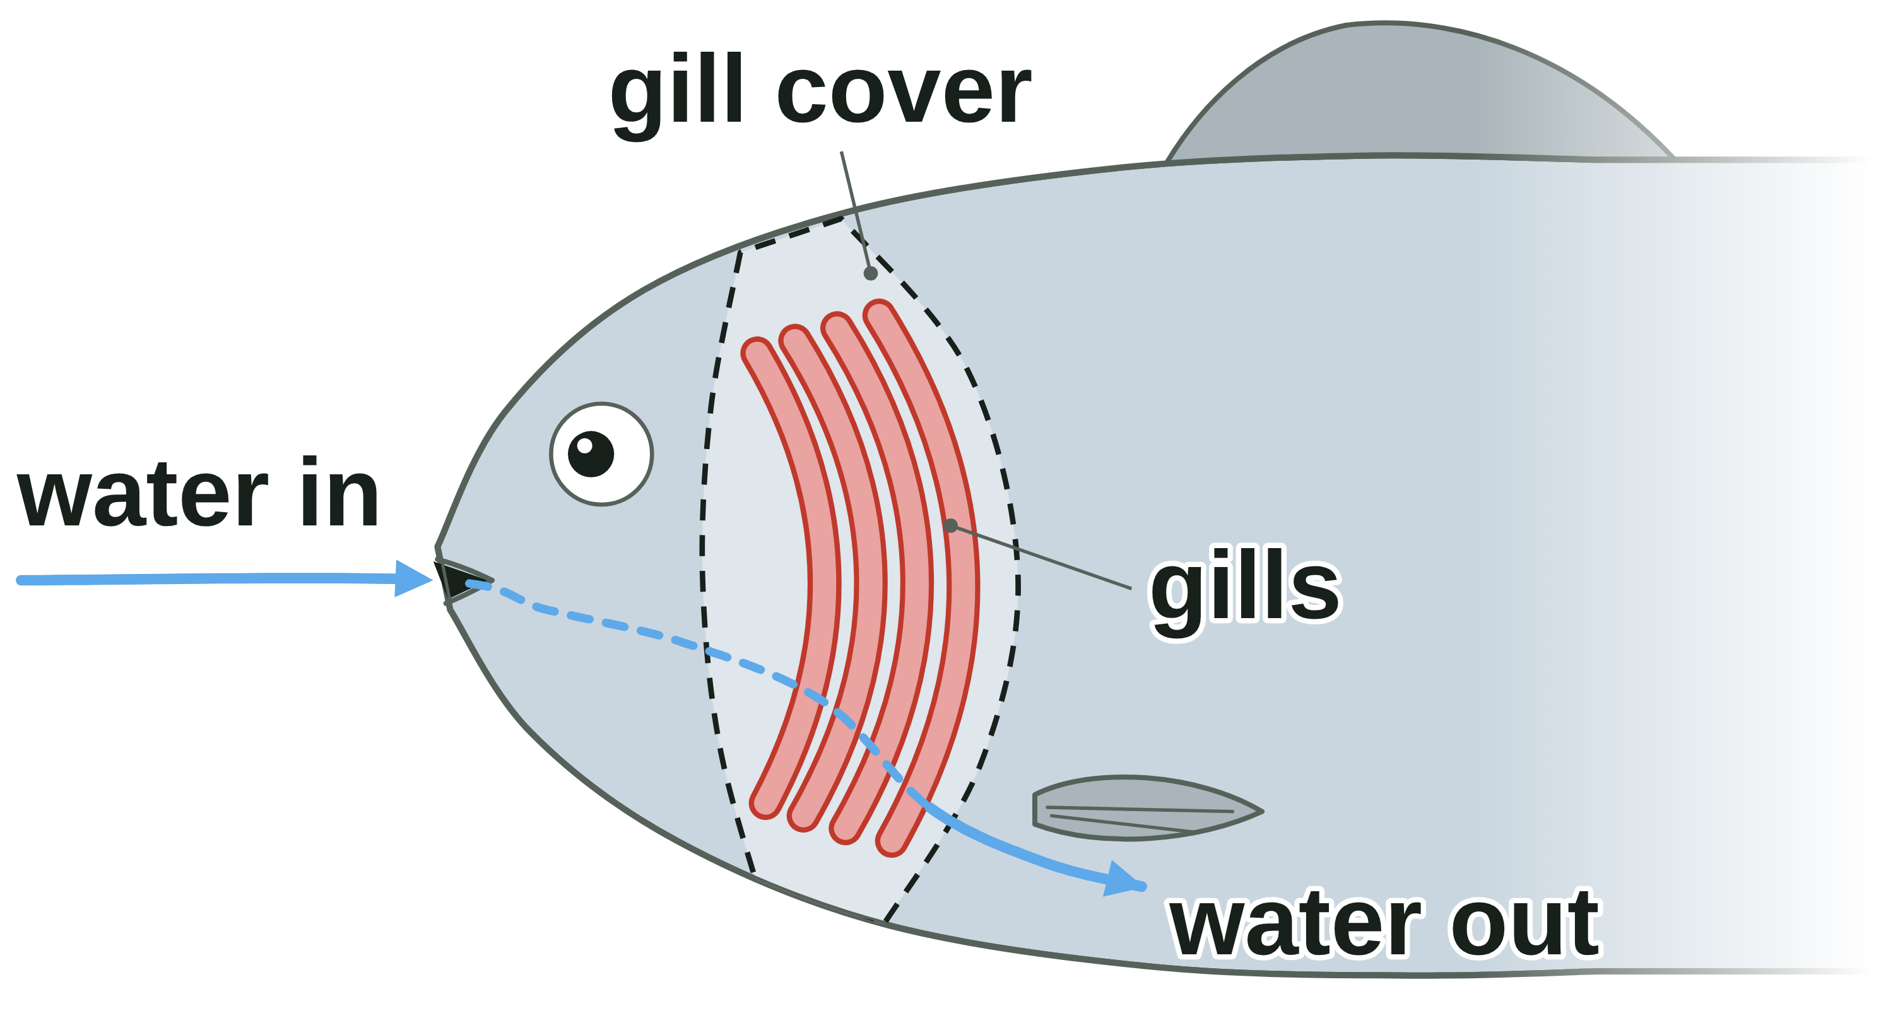
sciencegcse.co.uk · Biology B1 L10: Active transport and exchange surfaces
Online lesson: screen 1 of 12
A fish gill: an exchange surface
A real fish gill
Key facts
An exchange surface is where substances move into or out of an organism.
A fish's gills take in oxygen from the water and get rid of carbon dioxide.
Each gill has a bony gill arch that holds two rows of thin gill filaments.
Real gills are deep red because they are full of blood.
Many thin filaments give the gills a huge surface area.
Where are the gills?
Four gills on each side of the head, under the gill cover.
Water flows in at the mouth, over the gills and out under the gill cover.
A painting of one gill from a fish, on a white tile.
4
B1 L10 · sciencegcse.co.uk
Notes:
Ask: how does a fish get oxygen under water? Take ideas. Fish take in the oxygen dissolved in the water, through their gills. This is a painting of one gill from a fish bought for food, laid on a white tile, as you might see in a dissection. Point out the bony arch, which supports the filaments, and the two rows of deep red filaments. Link to B1 L8 Diffusion: oxygen diffuses from the water into the blood in the gills, and carbon dioxide diffuses out. Today: a third way substances move, active transport, and why big organisms need exchange surfaces like this one. Next we compare the painting with the diagram used in exams. One key fact a click, then the 'Where are the gills?' panel (online, screen 1 has the switch 'View: In the fish').

Slide 5
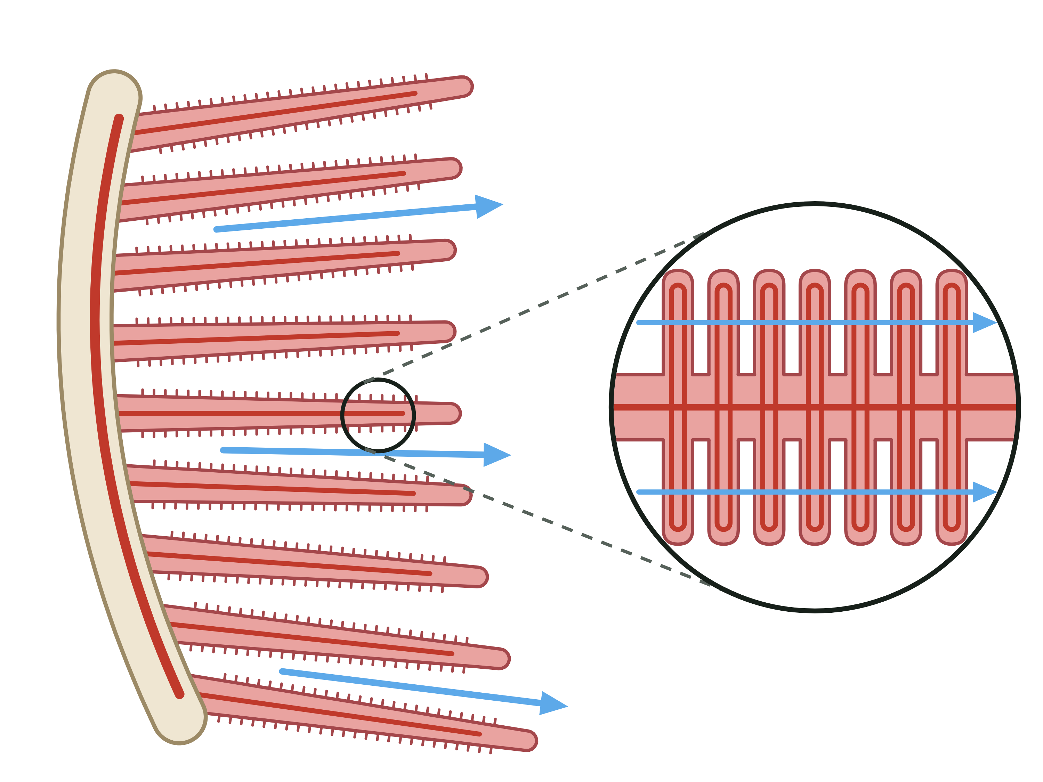
sciencegcse.co.uk · Biology B1 L10: Active transport and exchange surfaces
Online lesson: screen 2 of 12
A real gill and a diagram
Same thing, two ways
Spot the differences
1
Colour: Real gills are deep red all over, because their many capillaries are full of blood. The diagram is pale, with thin red lines for the blood vessels.
2
2
2
Number: A real gill has hundreds of filaments. The diagram shows only a few.
1
4
3
3
Tiny plates: Each real filament is covered in tiny plates, too small to see without a microscope. The diagram draws them much bigger, in an enlarged circle.
1
4
5
3
5
4
Two rows: A real gill has two rows of filaments, in a V shape. The diagram shows one row.
A real gill
A diagram
5
Water flow: In a living fish, the gills sit under a flap on each side of the head, with water flowing over them. The diagram shows the flow with arrows; a gill on a tile has none.
bony arch + thin filaments
bony arch + thin filaments
Real gills are deep red because they are full of blood. The diagram is simplified.
Both show a curved, bony gill arch that supports many thin gill filaments.
5
B1 L10 · sciencegcse.co.uk
Notes:
Cover the differences and ask: what is different between the painting and the diagram? Take ideas, then reveal them one by one: each click shows one difference and puts its number on both pictures; the last click shows what is the same in both. Key message: exam diagrams are simplified on purpose. A real gill has hundreds of filaments in two rows, and each filament is covered in tiny plates, far too small to see by eye. The diagram draws a few filaments and shows the plates in an enlarged circle. The deep red colour comes from the blood in the many capillaries in the filaments and plates. In a living fish the gills sit under a bony flap, the gill cover, and water flows over them all the time. You do not need the name of the tiny plates. The online lesson, screen 2, has the same pictures and differences.

Slide 6
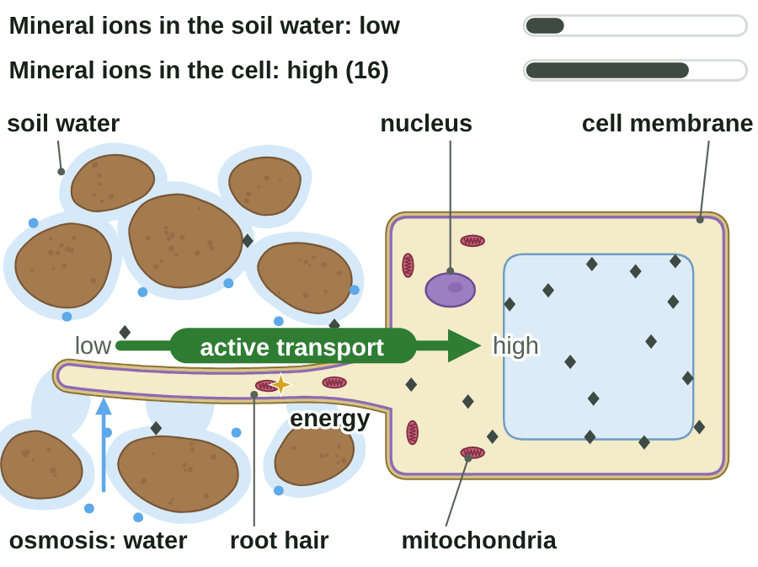
sciencegcse.co.uk · Biology B1 L10: Active transport and exchange surfaces
Online lesson: screen 3 of 12
Active transport: against the gradient
A root hair cell
Step by step
1
Dilute soil water: The soil water has only a few mineral ions.
2
More inside: The root hair cell has many more mineral ions inside.
3
Energy: Respiration in the mitochondria releases energy.
4
Ions in: The cell uses the energy to move the ions in, against the gradient.
5
Water in: Water enters by osmosis, which needs no energy.
Active transport: lower → higher concentration, using energy from respiration.
▶ Online lesson, screen 3: Active transport: against the gradient
◆ mineral ion • water ★ energy
Few mineral ions in the soil water, many in the cell.
6
B1 L10 · sciencegcse.co.uk
Notes:
Run screen 3 of the online lesson with Next step, or let the GIF play (print and PDF show its first frame). AQA wording: active transport moves substances from a more dilute solution to a more concentrated solution (against a concentration gradient), and this requires energy from respiration. Ask at step 2: which way would diffusion move the ions? (Out of the cell, from the higher to the lower concentration.) Plants need mineral ions, such as nitrate, to stay healthy. Root hair cells have many mitochondria to release the energy (B1 L5 Specialised cells). Respiration in root cells needs oxygen from the air spaces in the soil. The gate in the membrane that carries each ion across is a carrier protein; the name is not needed at GCSE. Watch out: water enters by osmosis and mineral ions by active transport, not the other way round (B1 L9 Osmosis). Online, try the What if? button: stop respiration, and active transport stops. Each click shows the next step, then the green summary line.

Slide 7
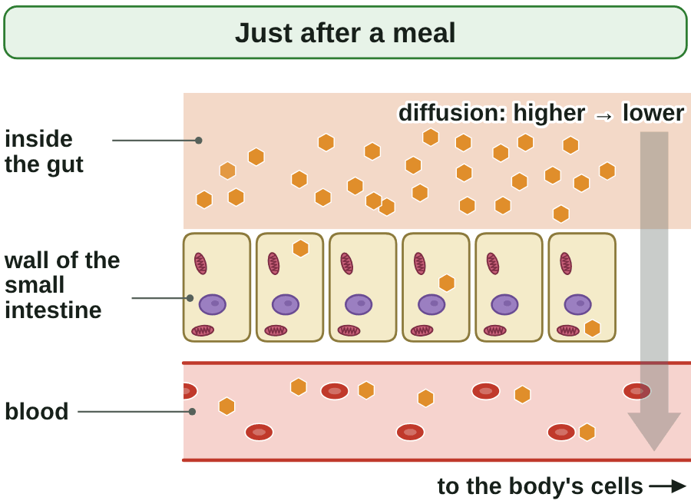
sciencegcse.co.uk · Biology B1 L10: Active transport and exchange surfaces
Online lesson: screen 4 of 12
Active transport in the gut
The gut wall
Two ways in
Just after a meal: the gut has more sugar than the blood. Sugar diffuses into the blood.
Later: the gut has less sugar than the blood. Active transport moves sugar into the blood, against the gradient.
Energy: active transport uses energy from respiration in the gut wall cells.
Then: the blood carries the sugar to the body's cells, for respiration.
Active transport means sugar is still absorbed when the gut has less than the blood.
⬡ sugar (glucose) ★ energy
▶ Online lesson, screen 4: Active transport in the gut
7
B1 L10 · sciencegcse.co.uk
Notes:
Ask: if diffusion only goes from a higher to a lower concentration, what would happen to the last of the sugar in the gut? (It would stay there and be lost in the faeces.) So glucose is absorbed by diffusion and by active transport. The gut wall cells have many mitochondria to release the energy. The wall of the small intestine is covered in villi, which give it a large surface area (B2 L2 The digestive system). Link to slide 3: rehydration drinks contain sugar and salt; the gut takes them in by active transport, and water follows by osmosis. The GIF shows 'Just after a meal' and 'Later' in turn, as the switch on screen 4 of the online lesson does (print and PDF show its first frame). One line a click.

Slide 8
sciencegcse.co.uk · Biology B1 L10: Active transport and exchange surfaces
Online lesson: screen 5 of 12
Checkpoint 1
✓
CHECKPOINT 1 of 3
Quick check on slides 4 to 7 (online screens 1 to 4). Show A, B or C on your whiteboard.
Question 1
Question 2
Question 3
Why are real fish gills deep red?
Which of these describes active transport?
Some hours after a meal, the gut has less sugar than the blood. How is sugar still absorbed into the blood?
A. They are stained red to make them easier to see.
A. Particles move from a higher to a lower concentration, with no energy needed.
A. By active transport
B. They are full of blood, in many capillaries.
B. Water moves through a partially permeable membrane into a more concentrated solution.
B. By diffusion
C. They are made of muscle.
C. Substances move from a lower to a higher concentration, using energy from respiration.
C. By osmosis
✓ Check your answers on the next slide
8
B1 L10 · sciencegcse.co.uk
Notes:
Checkpoint 1. Hinge check. Everyone shows A, B or C at the same time. Q1 A tests the idea that the gills are stained; Q2 A and B are diffusion and osmosis; Q3 B is the big one: diffusion cannot move sugar against the gradient. If several get Q1 wrong, go back to slide 5 (difference 1); Q2, slide 6; Q3, slide 7.

Slide 9
sciencegcse.co.uk · Biology B1 L10: Active transport and exchange surfaces
Online lesson: screen 5 of 12
Checkpoint 1 answers
✓
CHECKPOINT 1 of 3
Quick check on slides 4 to 7 (online screens 1 to 4). Show A, B or C on your whiteboard.
Question 1
Question 2
Question 3
Why are real fish gills deep red?
Which of these describes active transport?
Some hours after a meal, the gut has less sugar than the blood. How is sugar still absorbed into the blood?
A. They are stained red to make them easier to see.
A. Particles move from a higher to a lower concentration, with no energy needed.
A. By active transport
A. By active transport ✓
B. They are full of blood, in many capillaries.
B. They are full of blood, in many capillaries. ✓
B. Water moves through a partially permeable membrane into a more concentrated solution.
B. By diffusion
C. They are made of muscle.
C. Substances move from a lower to a higher concentration, using energy from respiration.
C. Substances move from a lower to a higher concentration, using energy from respiration. ✓
C. By osmosis
The filaments and their tiny plates have a very good blood supply, so real gills look deep red.
Active transport moves substances against a concentration gradient, so it needs energy.
Active transport moves the sugar against the concentration gradient, using energy from respiration.
Got one wrong? Look back: Q1 slide 5 · Q2 slide 6 · Q3 slide 7
9
B1 L10 · sciencegcse.co.uk
Notes:
1 B, 2 C, 3 A. Each click shows one answer and why. Ask a student who got Q2 right: where does the energy come from? (Respiration, in the mitochondria.)

Slide 10
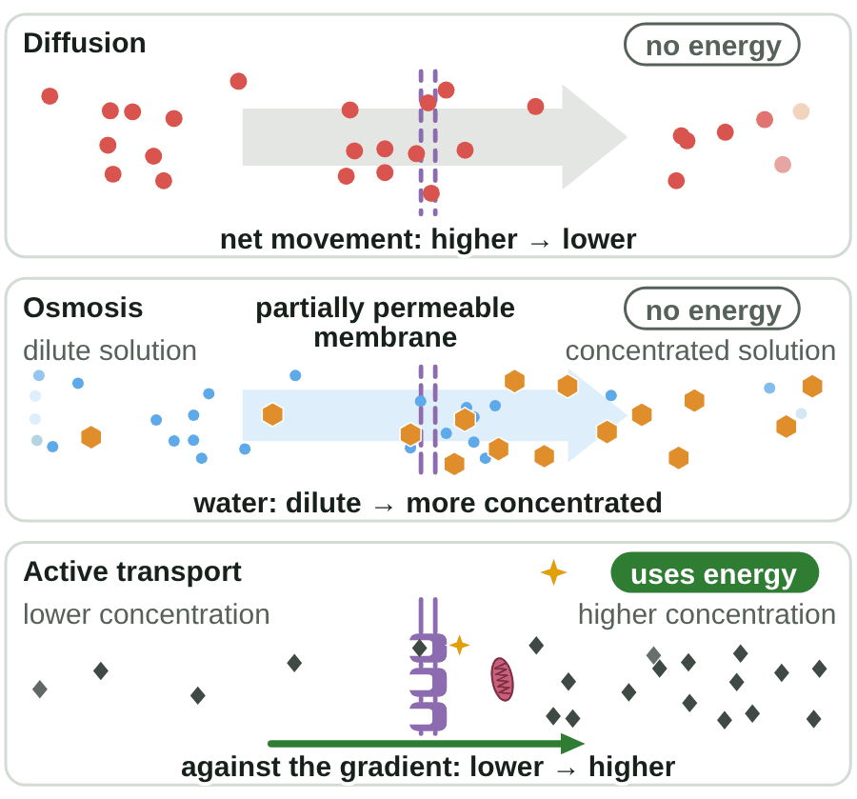
sciencegcse.co.uk · Biology B1 L10: Active transport and exchange surfaces
Online lesson: screen 6 of 12
Diffusion, osmosis and active transport
Three ways across a membrane
Compare them
Process
What moves
Which way
Energy from respiration?
Diffusion
particles of a gas or a dissolved substance
higher → lower concentration
no
Osmosis
water only
dilute → more concentrated solution
no
Active transport
substances such as mineral ions and sugar
lower → higher concentration
yes
Watch out!
Only active transport goes against a concentration gradient.
Only active transport needs energy from respiration.
● oxygen • water ⬡ sugar ◆ mineral ion ★ energy
10
B1 L10 · sciencegcse.co.uk
Notes:
Let the GIF run, then open screen 6 online and tap each chip. Ask: what do all three have in common? (Substances move into or out of cells across membranes.) What is different? (What moves, which way, and energy.) Osmosis is a special case of diffusion: the diffusion of water through a partially permeable membrane (B1 L9 Osmosis). Watch out: the AQA wording for both osmosis and active transport says 'from a dilute solution to a more concentrated solution'. The difference is what moves. In osmosis, water moves, down its own gradient: the dilute solution has more water. In active transport, the dissolved substance (such as mineral ions) moves, from where there is less of it to where there is more, so energy is needed. Exam tip: in a compare question, make the same point about each process: 'diffusion and osmosis need no energy, but active transport needs energy from respiration'. Clicks: one table row each, then the two Watch out lines. The GIF's first frame is the finished still.

Slide 11
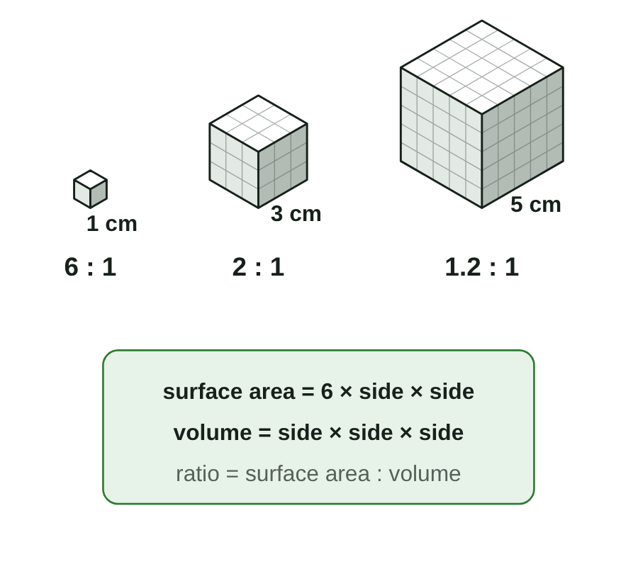
sciencegcse.co.uk · Biology B1 L10: Active transport and exchange surfaces
Online lesson: screen 7 of 12
Surface area to volume ratio
Three cubes
Compare the cubes
Side
Surface area
Volume
Surface area : volume
1 cm
6 cm²
1 cm³
6 : 1
3 cm
54 cm²
27 cm³
2 : 1
5 cm
150 cm²
125 cm³
1.2 : 1
Worked example 1: a cube with 3 cm sides
surface area = 6 × side × side = 6 × 3 × 3 = 54 cm²
volume = side × side × side = 3 × 3 × 3 = 27 cm³
ratio = 54 : 27 = 2 : 1 (divide both by 27). Check: 6 ÷ 3 = 2 ✓
Worked example 2: a cuboid, 4 cm × 2 cm × 1 cm
It has 6 faces: two of 4 × 2, two of 4 × 1 and two of 2 × 1.
surface area = 2 × (8 + 4 + 2) = 28 cm²
volume = length × width × height = 4 × 2 × 1 = 8 cm³
ratio = 28 : 8 = 3.5 : 1 (divide both by 8). Check: 3.5 × 8 = 28 ✓
A bigger cube has more surface area, but less for each cm³.
11
B1 L10 · sciencegcse.co.uk
Notes:
Open the cube calculator on screen 7 online and move the slider from 1 cm to 10 cm: the ratio falls from 6 : 1 to 0.6 : 1. Method for any cube: surface area = 6 × side × side (6 square faces); volume = side × side × side. Write the ratio with surface area first, then divide both numbers by the volume to get 'something : 1'. Units: surface area in cm², volume in cm³. We write the ratio without a unit, but both numbers must be worked out in the same length unit (here cm). The same cube worked out in mm gives a different number, so only compare ratios worked out in the same unit. For a cuboid, find the area of each pair of faces and add them. Common errors: writing the ratio the wrong way round (27 : 54); forgetting that a cube has 6 faces; mixing up cm² and cm³. Quick check for a cube: the ratio is always 6 ÷ side : 1. The GIF unfolds each cube into its net (print and PDF show the three cubes). Clicks: the three table rows, then worked example 1 line by line, then worked example 2 line by line.

Slide 12
sciencegcse.co.uk · Biology B1 L10: Active transport and exchange surfaces
Online lesson: screen 8 of 12
Checkpoint 2
✓
CHECKPOINT 2 of 3
Quick check on slides 10 and 11 (online screens 6 and 7). Show A, B or C on your whiteboard.
Question 1
Question 2
Question 3
Which of these needs energy from respiration?
A cuboid has a surface area of 40 cm² and a volume of 16 cm³. What is its surface area to volume ratio?
A cube gets bigger. What happens to its surface area to volume ratio?
A. Oxygen moving into a respiring cell
A. 2.5 : 1
A. It gets bigger.
B. Water moving into a root hair cell
B. 1 : 2.5
B. It gets smaller.
C. Mineral ions moving into a root hair cell
C. 24 : 1
C. It stays the same.
✓ Check your answers on the next slide
12
B1 L10 · sciencegcse.co.uk
Notes:
Checkpoint 2. Mini whiteboards: A, B or C. Q1 A and B are the classic mix-up: only active transport needs energy. Q2 B is the ratio written the wrong way round; C is a subtraction. Q3 A is the big misconception: a bigger object has more surface area in total, but less for each cm³ of volume. If several get Q1 wrong, go back to slide 10; Q2 or Q3, slide 11.

Slide 13
sciencegcse.co.uk · Biology B1 L10: Active transport and exchange surfaces
Online lesson: screen 8 of 12
Checkpoint 2 answers
✓
CHECKPOINT 2 of 3
Quick check on slides 10 and 11 (online screens 6 and 7). Show A, B or C on your whiteboard.
Question 1
Question 2
Question 3
Which of these needs energy from respiration?
A cuboid has a surface area of 40 cm² and a volume of 16 cm³. What is its surface area to volume ratio?
A cube gets bigger. What happens to its surface area to volume ratio?
A. Oxygen moving into a respiring cell
A. 2.5 : 1
A. 2.5 : 1 ✓
A. It gets bigger.
B. Water moving into a root hair cell
B. 1 : 2.5
B. It gets smaller.
B. It gets smaller. ✓
C. Mineral ions moving into a root hair cell
C. Mineral ions moving into a root hair cell ✓
C. 24 : 1
C. It stays the same.
Mineral ions move in by active transport, against the concentration gradient, so energy is needed.
40 : 16. Divide both numbers by 16 to get 2.5 : 1.
The volume grows faster than the surface area, so there is less surface for each cm³ of volume.
Got one wrong? Look back: Q1 slide 10 · Q2 and Q3 slide 11
13
B1 L10 · sciencegcse.co.uk
Notes:
1 C, 2 A, 3 B. Each click shows one answer and why. Follow-up for Q2: check it. 2.5 × 16 = 40 ✓. The cuboid was 4 cm × 2 cm × 2 cm.

Slide 14
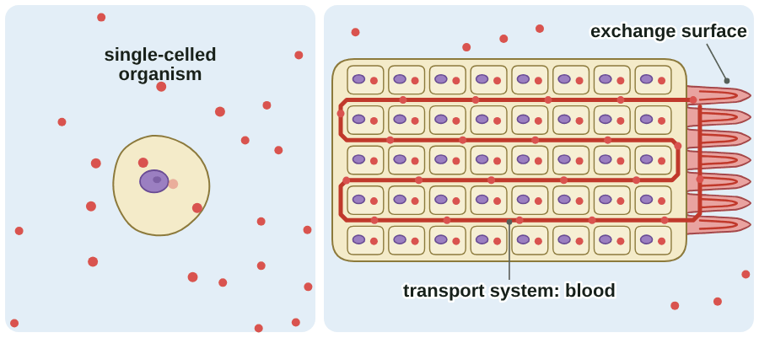
sciencegcse.co.uk · Biology B1 L10: Active transport and exchange surfaces
Online lesson: screen 9 of 12
Why big organisms need exchange surfaces
Small and large
Key ideas
A single-celled organism has a large surface area to volume ratio. Diffusion meets its needs.
A larger organism has a smaller ratio, and its middle is far from the surface.
So multicellular organisms need exchange surfaces and a transport system.
Exchange surfaces take substances in; the transport system carries them to every cell.
● oxygen. Cells in the middle of a large body are far from the surface.
Watch out!
▶ Online lesson, screen 9: Why big organisms need exchange surfaces
A bigger organism has more surface area in total, but less surface area for each cm³ of volume.
14
B1 L10 · sciencegcse.co.uk
Notes:
Ask: why can a whale not take in oxygen through its skin, as a single-celled organism does? (Its surface area to volume ratio is far too small, and its middle is far from the surface.) Link to B1 L2 Bacterial cells: bacteria are single-celled organisms. Shape matters too: a flat or thin shape has a large ratio for its volume, so a flatworm can rely on diffusion, and a leaf is flat and thin (slide 16). In animals the transport system is the blood, pumped by the heart (B2 L6 The heart and circulation); in plants it is the xylem and phloem (B2 L13 Plant transport: xylem and phloem). The GIF follows the three steps of screen 9 online: one cell; a big body whose middle cells go grey; then an exchange surface and blood that supply every cell (print and PDF show its first frame). One key idea a click, then the Watch out line.

Slide 15
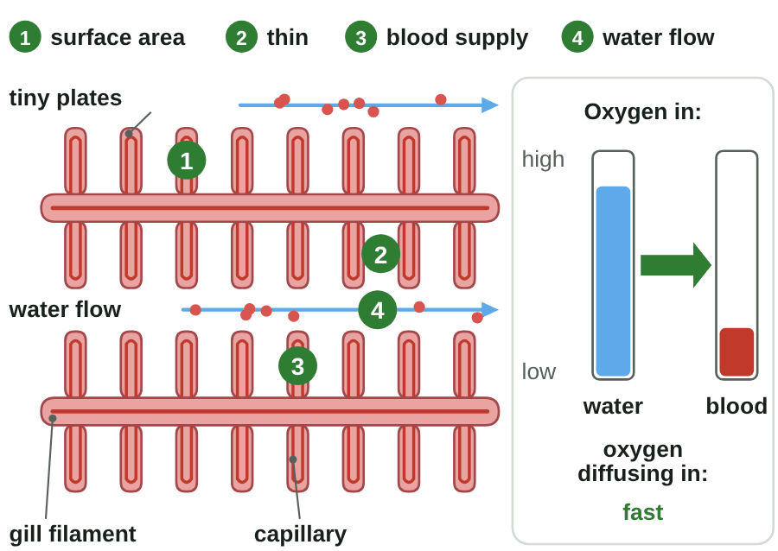
sciencegcse.co.uk · Biology B1 L10: Active transport and exchange surfaces
Online lesson: screen 10 of 12
Gills: built for exchange
Gill filaments, close up
Four features
1. Large surface area: many thin filaments, covered in tiny plates.
2. Thin membrane: a short diffusion path into the blood.
3. Efficient blood supply: capillaries carry oxygen away.
4. Ventilated: water flows over the gills, bringing fresh oxygen.
3 and 4 keep the concentration gradient steep, so diffusion stays fast.
● oxygen → water flow. Red: blood in the capillaries.
▶ Online lesson, screen 10: Gills: built for exchange
15
B1 L10 · sciencegcse.co.uk
Notes:
These are the four features of an effective exchange surface (AQA): a large surface area; a thin membrane, giving a short diffusion path; an efficient blood supply (in animals); ventilation (in animals, for gas exchange). The numbers on the picture match the four lines. Ask the What if? questions from screen 10 online. Out of water? (The filaments stick together, the surface area falls, and the fish cannot get enough oxygen, even though air has more oxygen than water.) Blood stops? (No gradient, so no net diffusion.) In exam answers, link each feature to its effect: 'thin, so a short diffusion path'. Water holds much less oxygen than air, so gills need all four features. You do not need the name of the tiny plates. The GIF runs the four steps of screen 10 (print and PDF show the overview with the numbers). Each line wipes in from the left.

Slide 16
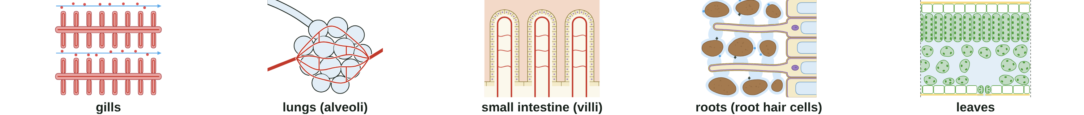
sciencegcse.co.uk · Biology B1 L10: Active transport and exchange surfaces
Online lesson: screen 11 of 12
Exchange surfaces in animals and plants
Five exchange surfaces
Compare them
Watch out!
Exchange surface
What is exchanged
Adapted by
Plants have no blood.
A leaf's features are being flat and thin, its stomata and its air spaces.
Every exchange surface has a large surface area and a short diffusion path.
Gills (fish)
oxygen in, carbon dioxide out
many thin filaments with tiny plates; a good blood supply; water flowing over them
Lungs
oxygen in, carbon dioxide out
many alveoli with thin walls, capillaries and breathing (B2 L9 Lungs and gas exchange)
Small intestine
sugar and other food molecules in
villi: a large surface area, a thin wall and a good blood supply (B2 L2 The digestive system)
Roots
water and mineral ions in
root hair cells give a large surface area
Leaves
carbon dioxide in, oxygen out (in the light)
flat and thin; stomata; air spaces inside
16
B1 L10 · sciencegcse.co.uk
Notes:
Screen 11 online has a chip for each exchange surface, with a tick list of the four features. Ask: which features do all five share? (A large surface area and a short diffusion path.) Which do only animals have? (A blood supply, and for gas exchange, ventilation.) The lungs and the villi were taught in B2 L9 Lungs and gas exchange and B2 L2 The digestive system: one row each here. Leaf tissues and stomata are in B2 L12 Leaf tissues and stomata. In the light, a leaf takes in carbon dioxide for photosynthesis and gives out oxygen (B4 Bioenergetics). Clicks: one table row each, then the three Watch out lines.

Slide 17
sciencegcse.co.uk · Biology B1 L10: Active transport and exchange surfaces
Online lesson: screen 12 of 12
Checkpoint 3
✓
CHECKPOINT 3 of 3
Quick check on slides 14 to 16 (online screens 9 to 11). Show A, B or C on your whiteboard.
Question 1
Question 2
Question 3
Why does a single-celled organism not need an exchange surface such as gills?
How does water flowing over a fish's gills help the fish take in oxygen?
Which feature helps a leaf to exchange gases?
A. It does not need oxygen.
A. It brings fresh oxygen, so the concentration gradient stays steep.
A. An efficient blood supply
B. Its large surface area to volume ratio lets enough substances diffuse across its surface.
B. It pushes oxygen into the blood by force.
B. Villi on its surface
C. It takes in everything by active transport.
C. It makes the gill filaments thicker.
C. Stomata and air spaces
✓ Check your answers on the next slide
17
B1 L10 · sciencegcse.co.uk
Notes:
Checkpoint 3. Mini whiteboards. Q1 A tests whether students think a single-celled organism needs no oxygen; C mixes up active transport and diffusion. Q3 A is the trap: plants have no blood supply. If several get Q1 wrong, go back to slide 14; Q2, slide 15; Q3, slide 16.

Slide 18
sciencegcse.co.uk · Biology B1 L10: Active transport and exchange surfaces
Online lesson: screen 12 of 12
Checkpoint 3 answers
✓
CHECKPOINT 3 of 3
Quick check on slides 14 to 16 (online screens 9 to 11). Show A, B or C on your whiteboard.
Question 1
Question 2
Question 3
Why does a single-celled organism not need an exchange surface such as gills?
How does water flowing over a fish's gills help the fish take in oxygen?
Which feature helps a leaf to exchange gases?
A. It does not need oxygen.
A. It brings fresh oxygen, so the concentration gradient stays steep.
A. It brings fresh oxygen, so the concentration gradient stays steep. ✓
A. An efficient blood supply
B. Its large surface area to volume ratio lets enough substances diffuse across its surface.
B. Its large surface area to volume ratio lets enough substances diffuse across its surface. ✓
B. It pushes oxygen into the blood by force.
B. Villi on its surface
C. It takes in everything by active transport.
C. It makes the gill filaments thicker.
C. Stomata and air spaces
C. Stomata and air spaces ✓
It is tiny, so diffusion across its surface meets its needs.
Fresh water keeps more oxygen in the water than in the blood.
Gases diffuse in and out through the stomata and move through the air spaces inside the leaf.
Got one wrong? Look back: Q1 slide 14 · Q2 slide 15 · Q3 slide 16
18
B1 L10 · sciencegcse.co.uk
Notes:
1 B, 2 A, 3 C. Each click shows one answer and why. Follow-up for Q2: what would happen if the water stopped flowing? (The water next to the plates would run low in oxygen, the gradient would be less steep, and diffusion would slow down.) Next: practise surface area to volume ratios.

Slide 19
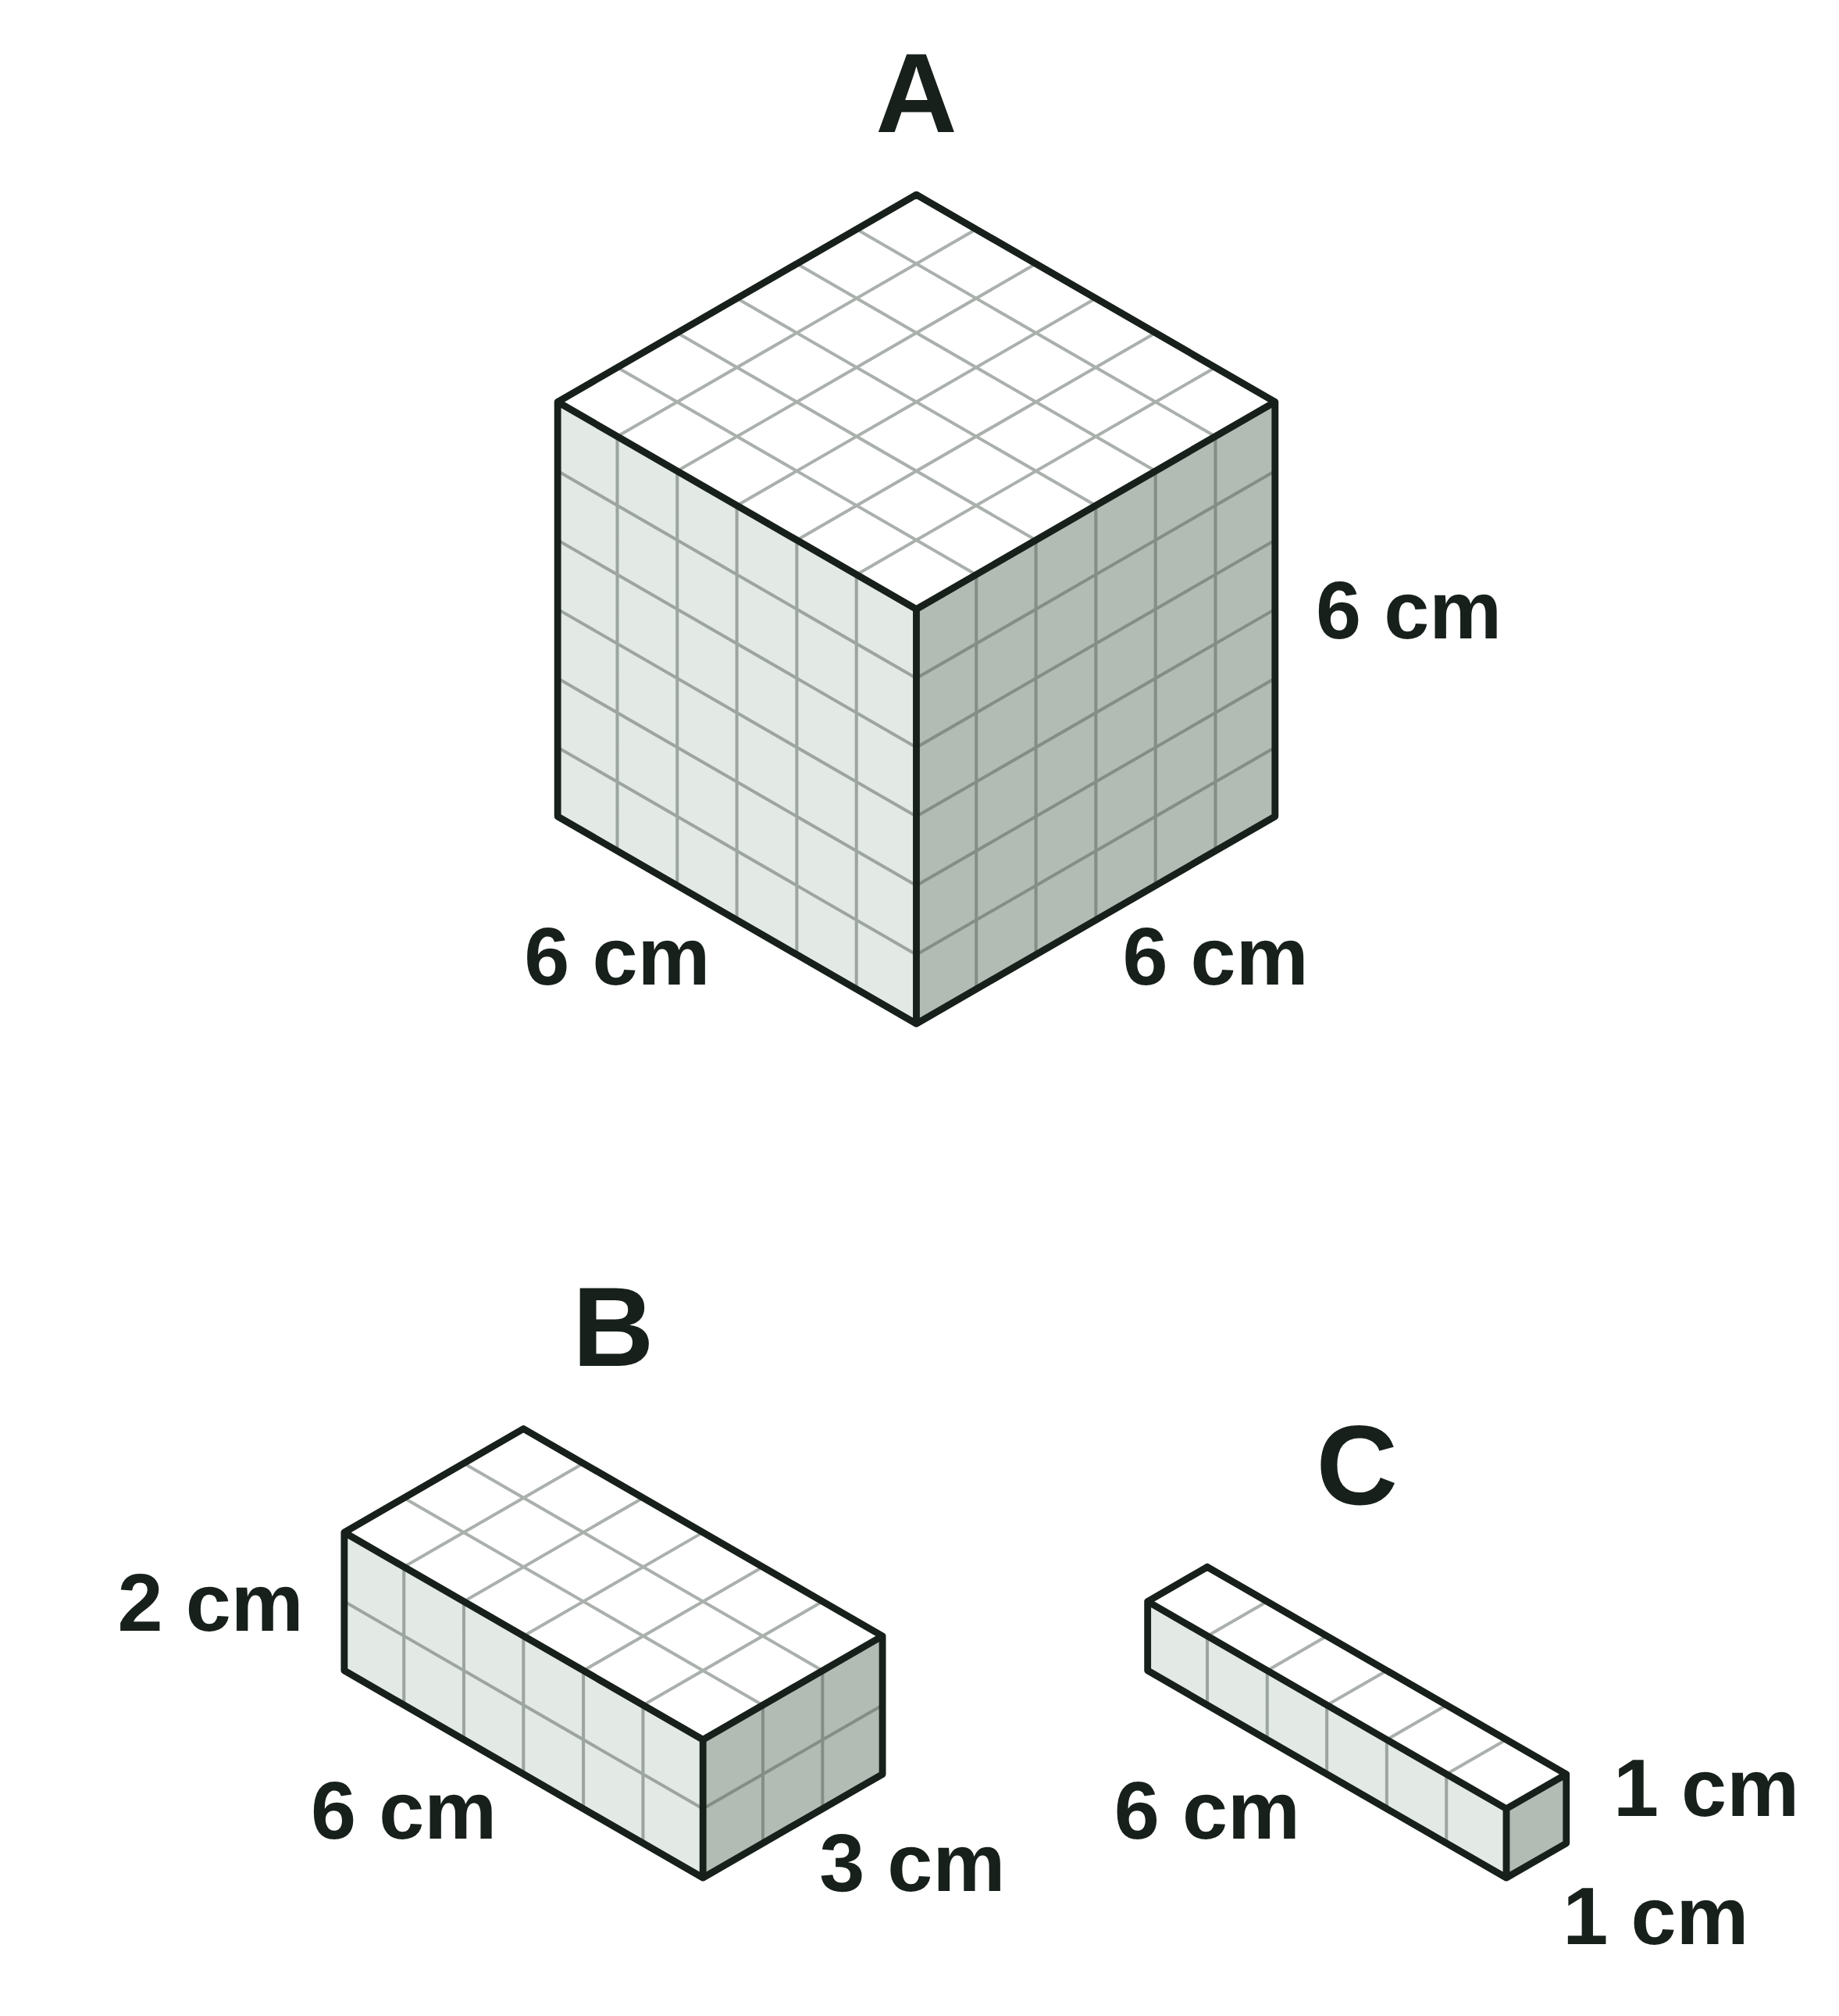
sciencegcse.co.uk · Biology B1 L10: Active transport and exchange surfaces
Practice: surface area to volume ratio
Three shapes
Questions
1. Calculate the surface area of shape A.
______________
2. Calculate the volume of shape A.
______________
3. Write the surface area to volume ratio of shape A in its simplest form.
______________
4. Shape B has a surface area of 72 cm². Calculate its volume and its surface area to volume ratio.
______________
5. Calculate the surface area to volume ratio of shape C.
______________
6. Which shape could take in substances fastest for its size? Give a reason.
______________
Drawn to the same scale. Each grid square is 1 cm.
19
B1 L10 · sciencegcse.co.uk
Notes:
Pairs, 5 minutes. Surface area in cm², volume in cm³. Write the ratio with surface area first, then divide both numbers by the volume. Shape A is a cube; B and C are cuboids: find the area of each pair of faces and add them.

Slide 20
sciencegcse.co.uk · Biology B1 L10: Active transport and exchange surfaces
Surface area to volume ratio: answers
Three shapes
Answers
1. Calculate the surface area of shape A.
6 faces of 6 × 6: 6 × 6 × 6 = 216 cm²
2. Calculate the volume of shape A.
6 × 6 × 6 = 216 cm³
3. Write the surface area to volume ratio of shape A in its simplest form.
216 : 216 = 1 : 1
4. Shape B has a surface area of 72 cm². Calculate its volume and its surface area to volume ratio.
6 × 3 × 2 = 36 cm³. 72 : 36 = 2 : 1
5. Calculate the surface area to volume ratio of shape C.
2 × (6 + 6 + 1) = 26 cm²; 6 × 1 × 1 = 6 cm³. 26 : 6 = 4.3 : 1 (to 1 decimal place)
6. Which shape could take in substances fastest for its size? Give a reason.
Shape C: it has the largest surface area to volume ratio.
Drawn to the same scale. Each grid square is 1 cm.
20
B1 L10 · sciencegcse.co.uk
Notes:
Q1 and Q2: the numbers are the same, but the units are not: 216 cm² and 216 cm³. Q5: 26 ÷ 6 = 4.33..., so about 4.3 : 1. Q6: the long, thin shape has the largest ratio, like a root hair or a flatworm. All three shapes are 6 cm long, but C is the thinnest. Common errors: adding the sides instead of multiplying; forgetting one pair of faces of a cuboid; writing the ratio the wrong way round.

Slide 21
sciencegcse.co.uk · Biology B1 L10: Active transport and exchange surfaces
Exam practice
1. Root hair cells take in water and mineral ions from the soil. Describe how each one gets into the root hair cell. [3]
Water moves in by osmosis (1). Mineral ions move in by active transport (1), from a lower to a higher concentration, using energy from respiration (1).
2. A fish soon dies if it is taken out of water, even though air has more oxygen than water. Suggest why. [3]
Out of water, the gill filaments stick together (1). So the surface area for gas exchange is much smaller (1). Not enough oxygen diffuses into the blood for respiration (1).
21
B1 L10 · sciencegcse.co.uk
Notes:
Model answers with mark points in brackets. Students try each question first, then mark their own work in green. Q1: give the process for each substance; 'they are absorbed' scores nothing. Q2 is a 'suggest' question: use what you know about surface area in a new situation (screen 10 online, the What if? 'Take the fish out of water'). For more, the B1 L10 Exam questions worksheet (PDF) has five questions, 20 marks; its mark scheme is at the end of this PowerPoint. The same questions are in the online lesson, after the quiz.

Slide 22
sciencegcse.co.uk · Biology B1 L10: Active transport and exchange surfaces
Exit ticket
Answer on your own
How confident am I?
1. Name the process that moves mineral ions into root hair cells. [1]
I can describe active transport.
2. Give one feature of an effective exchange surface. [1]
I can calculate a surface area to volume ratio.
A painting of a real fish gill
3. Which has the larger surface area to volume ratio: a mouse or an elephant? [1]
I can explain how an exchange surface is adapted.
4. Explain why active transport needs energy, but diffusion does not. [2]
22
B1 L10 · sciencegcse.co.uk
Notes:
Students answer on their own, then rate their confidence: red, amber or green for each line. Q4 checks the big idea of the lesson: active transport goes against the concentration gradient. Use the red and amber lines to plan the start of the next lesson.

Slide 23
sciencegcse.co.uk · Biology B1 L10: Active transport and exchange surfaces
Exit ticket answers
Answers
Next lesson
1. Active transport.
2. Any one: a large surface area; a thin membrane (a short diffusion path); an efficient blood supply; being ventilated.
3. A mouse.
4. Active transport moves substances against a concentration gradient, from a lower to a higher concentration (1). Diffusion goes from a higher to a lower concentration, so it needs no energy from respiration (1).
Next: B2 L1 Cells, tissues and organs
How cells build tissues, organs, organ systems and organisms.
Worksheets:
• Mandatory (everyone)
• Alternative (easier, with key notes)
• Challenge (when you finish the Mandatory)
• Exam questions (exam style, 20 marks, homework)
▶ Online lesson: quiz and exam questions
23
B1 L10 · sciencegcse.co.uk
Notes:
Go through the answers. Q3: the mouse is smaller, so it has more surface area for each cm³ of volume. This is the last lesson of B1 Cell biology. Next, B2 L1 Cells, tissues and organs shows how specialised cells work together in tissues, organs and organ systems. After this slide: the B1 L10 revision notes (4 printable pages), then the worksheets with answers in green: the Mandatory worksheet (everyone), the Challenge worksheet (stretch) and the Alternative worksheet (easier: key notes and very simple tasks). The B1 L10 Exam questions worksheet (exam style, black and white, 20 marks) is a separate PDF for homework; its mark scheme is the last two slides. The link bar opens the online lesson's quiz and exam questions. Homework: the online lesson quiz and the B1 L10 Exam questions worksheet.

Slide 24
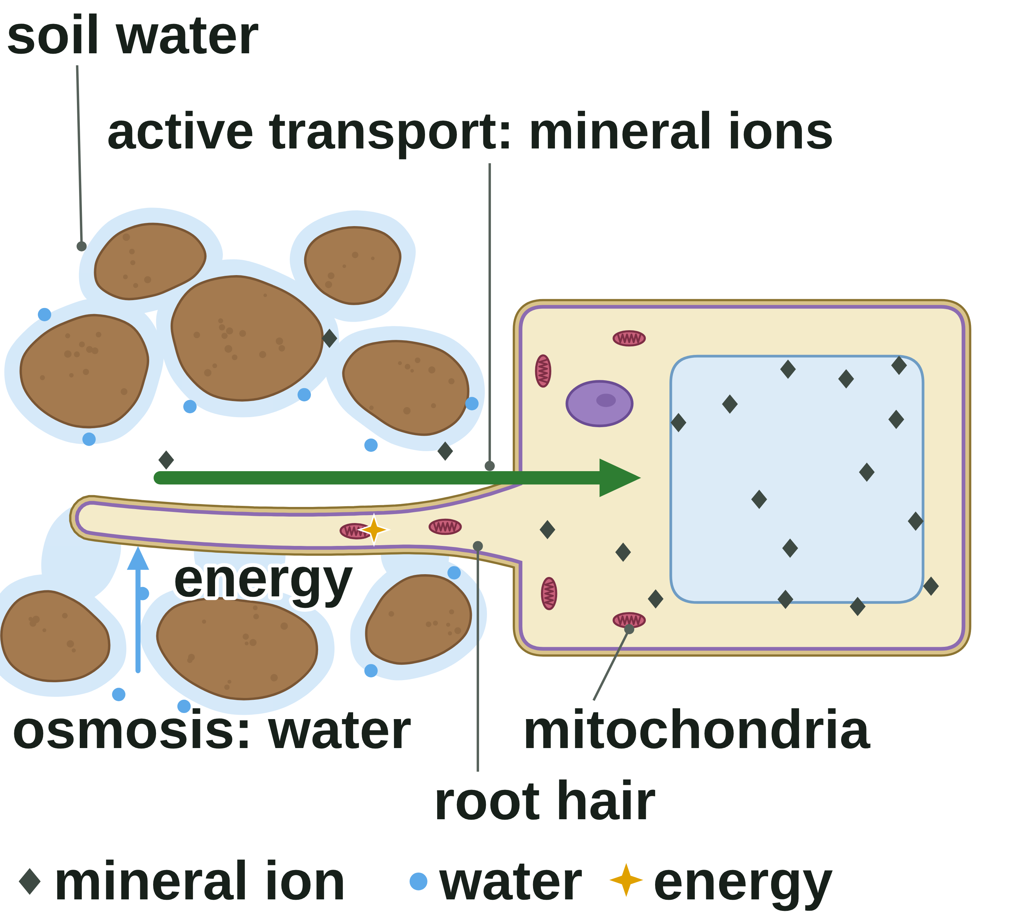
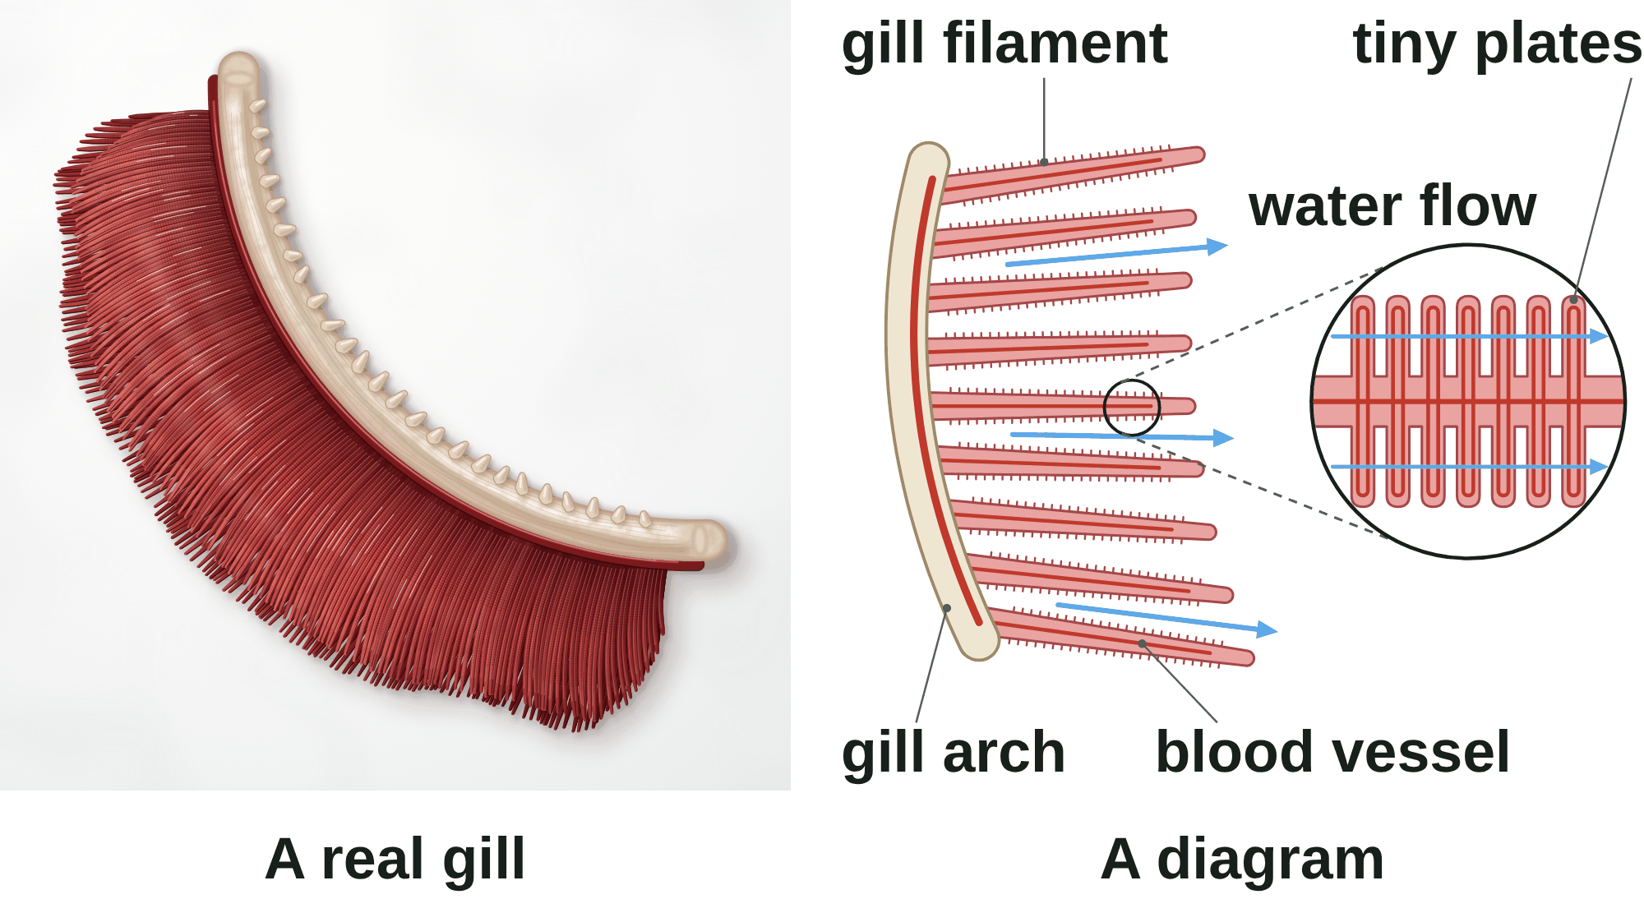
B1 L10 Revision notes 1 of 4
Active transport, exchange surfaces
Exchange surfaces, a real gill and a diagram, active transport, root hair cells
1. Getting substances in and out
3. Active transport
Cells need substances such as oxygen, water, sugar (glucose) and mineral ions. Plants take in their water and mineral ions from the soil. Cells must get rid of waste, such as carbon dioxide. Substances move into and out of cells in three ways:
diffusion (B1 L8 Diffusion)
osmosis, for water only (B1 L9 Osmosis)
active transport (this lesson).
An exchange surface is a surface specialised for substances to move into or out of an organism, such as the alveoli or the gills.
A fish's gills are the organs it uses to take in oxygen from water and get rid of carbon dioxide. Each gill has a curved, bony gill arch that holds two rows of gill filaments: many thin, feathery strands, covered in tiny plates, which give a large surface area.
Active transport is the movement of substances from a more dilute solution to a more concentrated solution (against a concentration gradient), which requires energy from respiration.
It moves substances from a lower to a higher concentration.
The energy is released by respiration, which happens in the mitochondria.
Cells that do a lot of active transport have many mitochondria.
Watch out: only active transport goes against a concentration gradient. Diffusion and osmosis go the other way and need no energy from respiration.
4. Root hair cells
Plants need mineral ions, such as nitrate, to stay healthy. The water in the soil is a very dilute solution of mineral ions, so there are more ions inside a root hair cell than in the soil water.
Diffusion would move the ions out of the cell. So the root hair cell uses active transport to move mineral ions in, against the concentration gradient.
Root hair cells have many mitochondria to release the energy.
Root hair cells take in water from the soil by osmosis (B1 L9 Osmosis). Osmosis needs no energy.
The long, thin root hair gives a large surface area (B1 L5 Specialised cells).
2. A real gill and a diagram
Exam pictures of gills are usually diagrams. A diagram is simplified on purpose:
Colour: real gills are deep red all over, from the blood in their many capillaries. A diagram is pale, with thin red lines for the blood vessels.
Number: a real gill has hundreds of filaments. A diagram shows a few.
Real gills are deep red because they are full of blood. The diagram is simplified.
Watch out: water enters root hair cells by osmosis; mineral ions enter by active transport. Not the other way round.
Tiny plates: these are too small to see without a microscope. A diagram draws them big, in an enlarged circle.
Two rows: a real gill has two rows of filaments. A diagram usually shows one.
Water flow: in a living fish, the gills sit under a bony flap, the gill cover, and water flows over them. A diagram shows the flow with arrows.
Both show a bony gill arch that supports many thin gill filaments.
B1 L10 · Active transport and exchange surfaces · sciencegcse.co.uk · free GCSE science resources
Notes:
Revision notes page 1 of 4. These pages are the textbook for B1 L10: students read them before the lesson, use them to catch up, or revise from them. Page 1 covers screens 1 to 3: exchange surfaces and gills, the real gill and the diagram, and active transport in root hair cells.

Slide 25
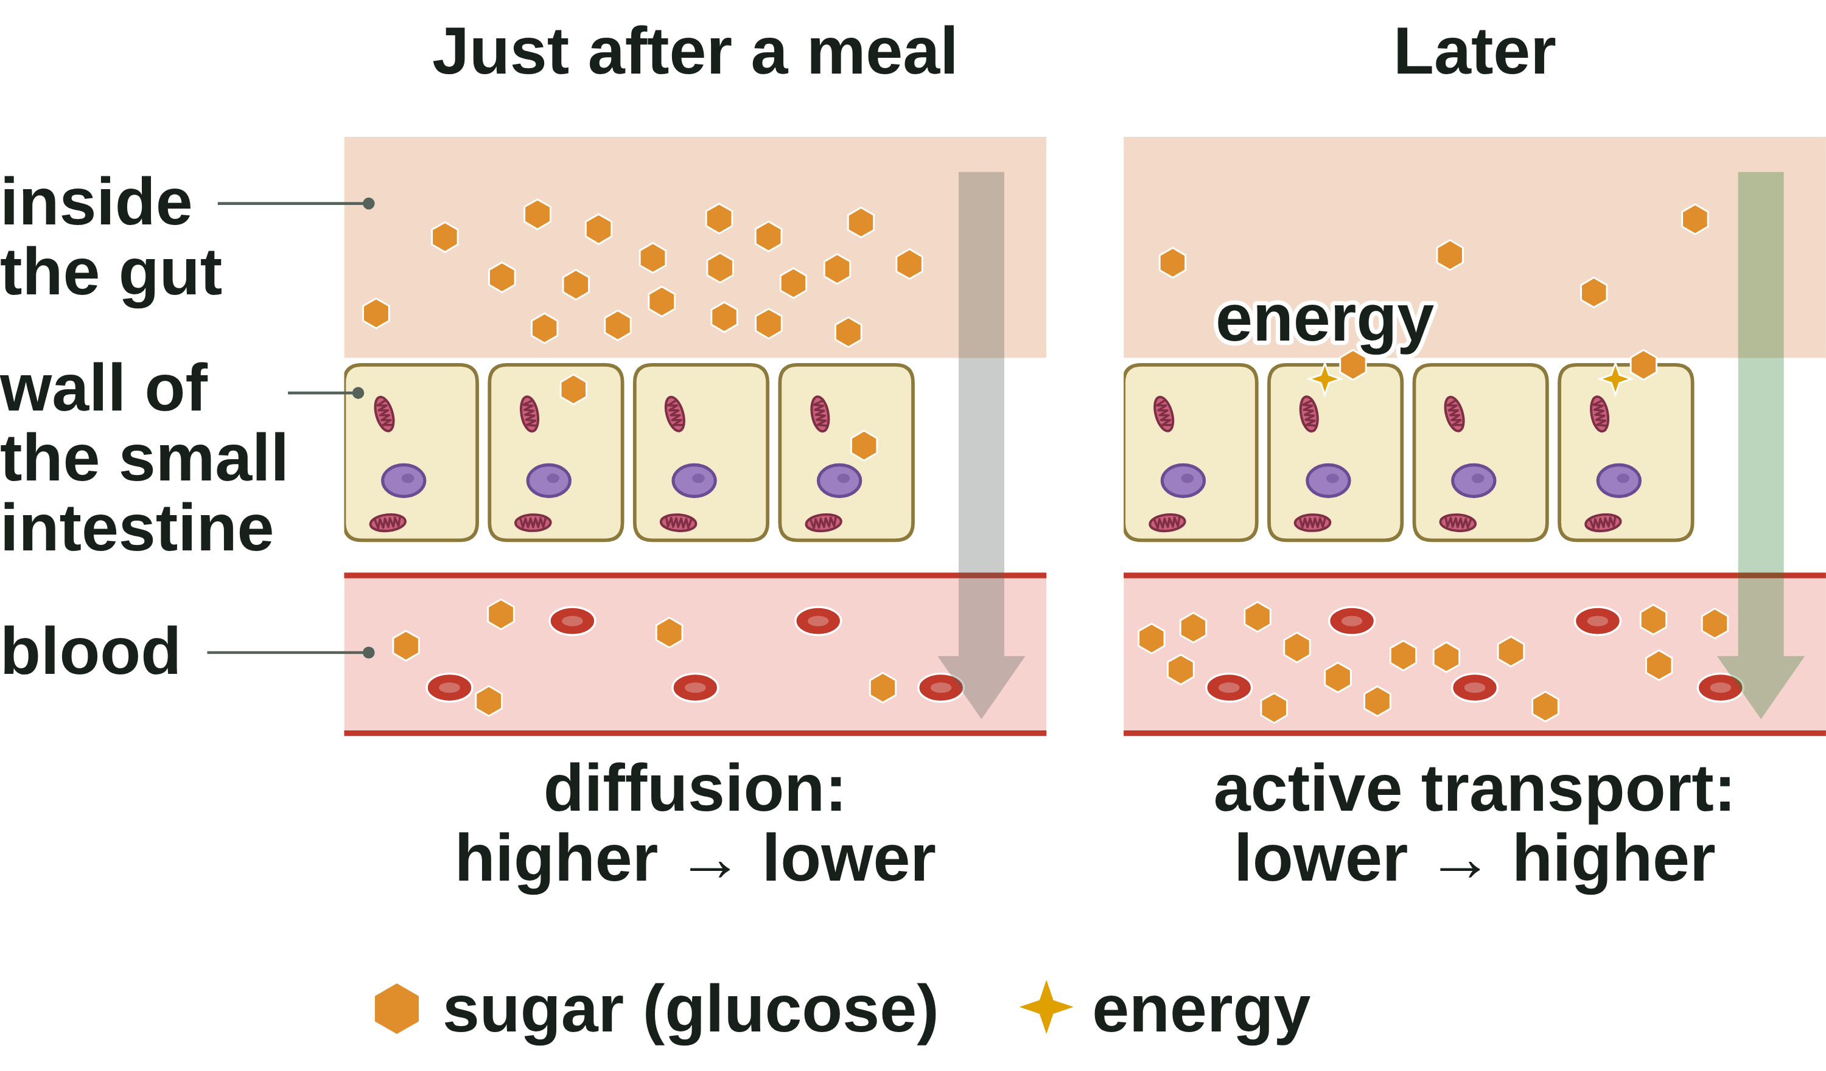
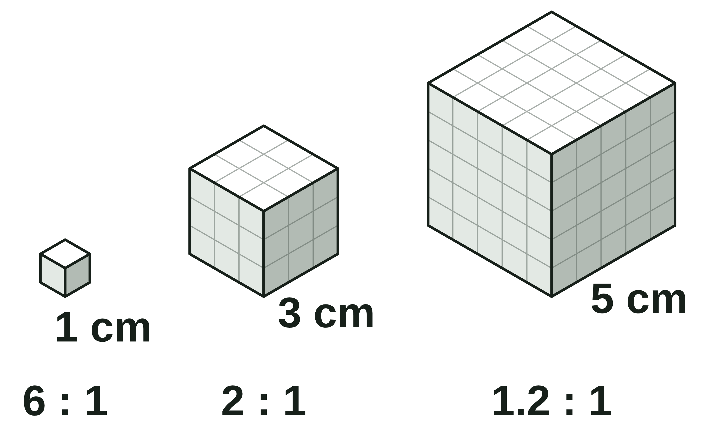
B1 L10 Revision notes 2 of 4
Active transport, exchange surfaces
The gut, comparing the three processes, surface area to volume ratio
5. Active transport in the gut
Watch out (section 6): osmosis and active transport can both be described as "from a dilute solution to a more concentrated solution". In osmosis, water moves. In active transport, the dissolved substance (such as mineral ions) moves, from where there is less of it to where there is more.
Digested food in the small intestine includes sugar (glucose). It is absorbed into the blood, which carries it to the body's cells for respiration.
Just after a meal, there is more sugar in the gut than in the blood, so sugar diffuses into the blood.
Later, the gut has less sugar than the blood. Active transport keeps moving sugar into the blood, against the gradient, so very little sugar is left in the gut. The gut wall cells have many mitochondria to release the energy.
7. Surface area to volume ratio
Surface area is the total area of the outside of an object (in cm²). Volume is the space inside it (in cm³).
The surface area to volume ratio is the surface area of an object compared with its volume, written as a ratio such as 6 : 1.
The wall of the small intestine is folded into villi (B2 L2 The digestive system), which give a large surface area.
For a cube: surface area = 6 × side × side; volume = side × side × side
Watch out: sugar is absorbed by diffusion and by active transport. Active transport lets absorption carry on when the gut has less sugar than the blood.
Side of cube | Surface area | Volume | Ratio
1 cm | 6 cm² | 1 cm³ | 6 : 1
3 cm | 54 cm² | 27 cm³ | 2 : 1
5 cm | 150 cm² | 125 cm³ | 1.2 : 1
6. Diffusion, osmosis and active transport
 | Diffusion | Osmosis | Active transport
What moves | particles of a gas or a dissolved substance | water only | substances such as mineral ions and sugar
Which way | higher → lower concentration | dilute → more concentrated solution | lower → higher concentration
Energy from respiration? | no | no | yes
Membrane | not always needed (in cells: the cell membrane) | partially permeable | a cell membrane
Example | oxygen into the blood in the gills | water into a root hair cell | mineral ions into a root hair cell
Worked example: a cuboid, 5 cm × 2 cm × 1 cm.
It has 6 faces: two of 5 × 2, two of 5 × 1 and two of 2 × 1.
Surface area = 2 × (10 + 5 + 2) = 34 cm².
Volume = length × width × height = 5 × 2 × 1 = 10 cm³.
Ratio = 34 : 10. Divide both numbers by 10: 3.4 : 1. Check: 3.4 × 10 = 34 ✓
Watch out: a bigger cube has more surface area in total, but less surface area for each cm³ of volume. Put surface area first and simplify the ratio (54 : 27 = 2 : 1).
B1 L10 · Active transport and exchange surfaces · sciencegcse.co.uk · free GCSE science resources
Notes:
Revision notes page 2 of 4. These pages are the textbook for B1 L10: students read them before the lesson, use them to catch up, or revise from them. Page 2 covers screens 4, 6 and 7: active transport in the gut, diffusion, osmosis and active transport compared, and the surface area to volume ratio, with a worked example.

Slide 26
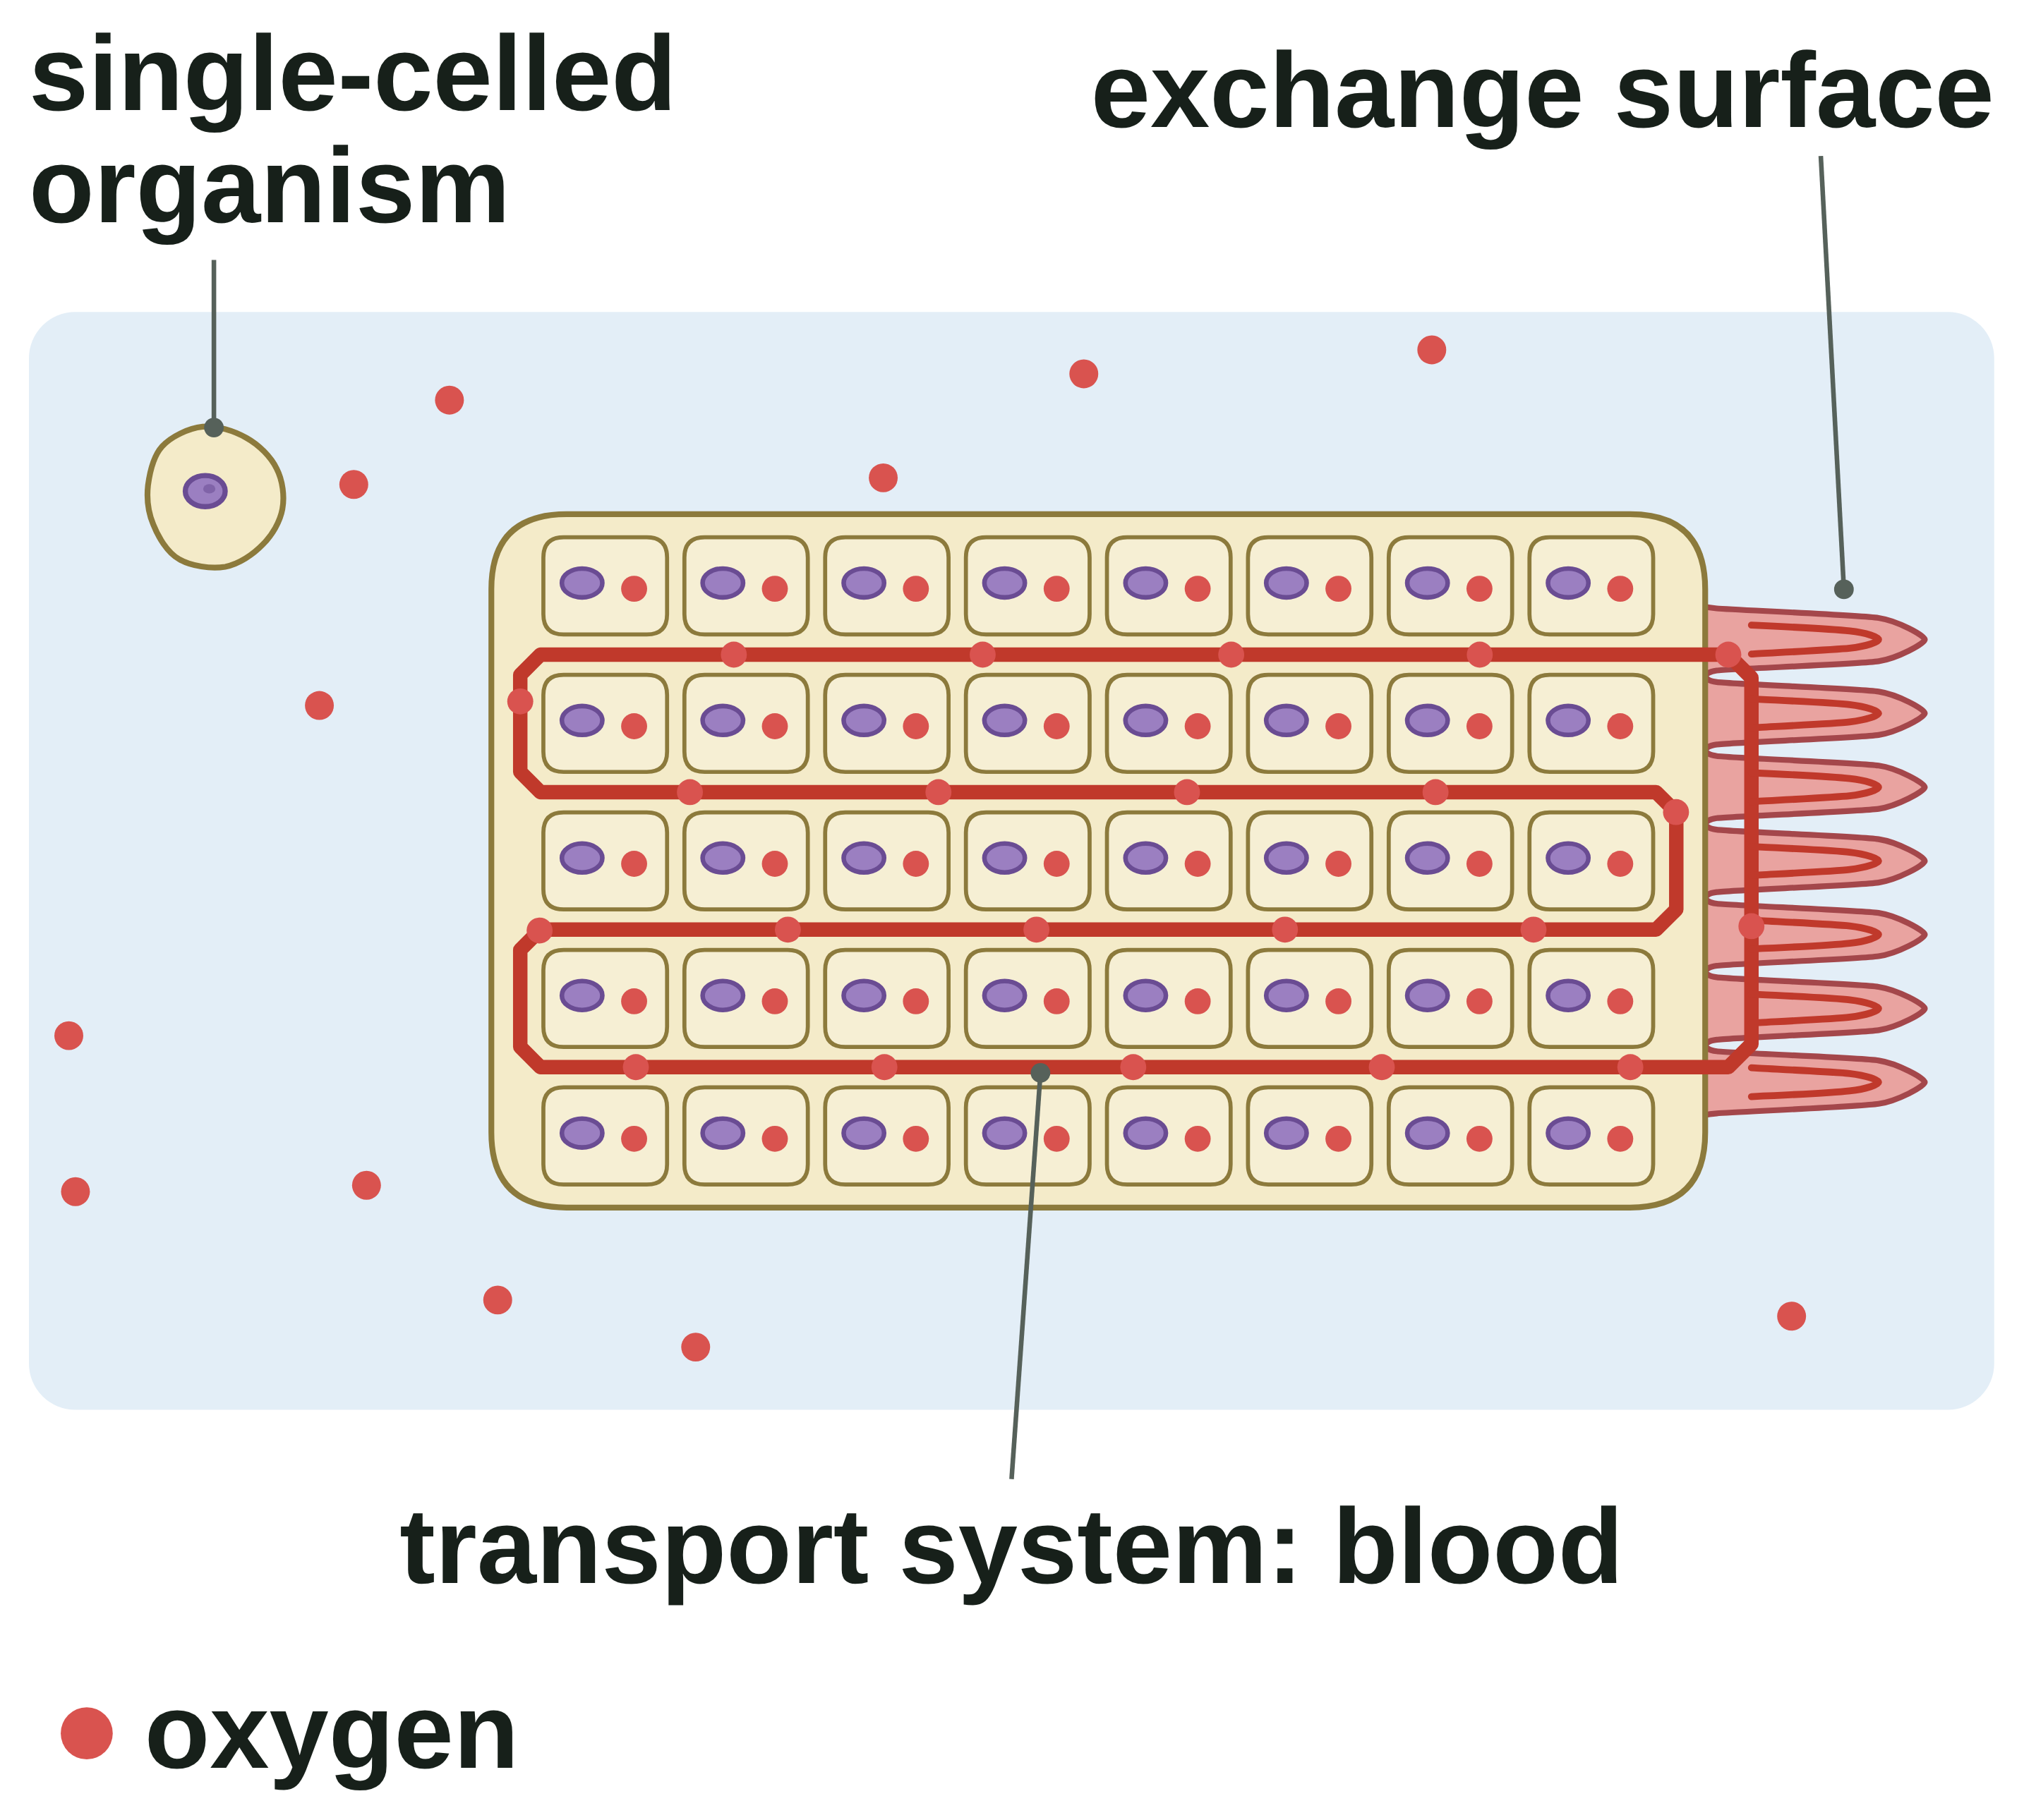
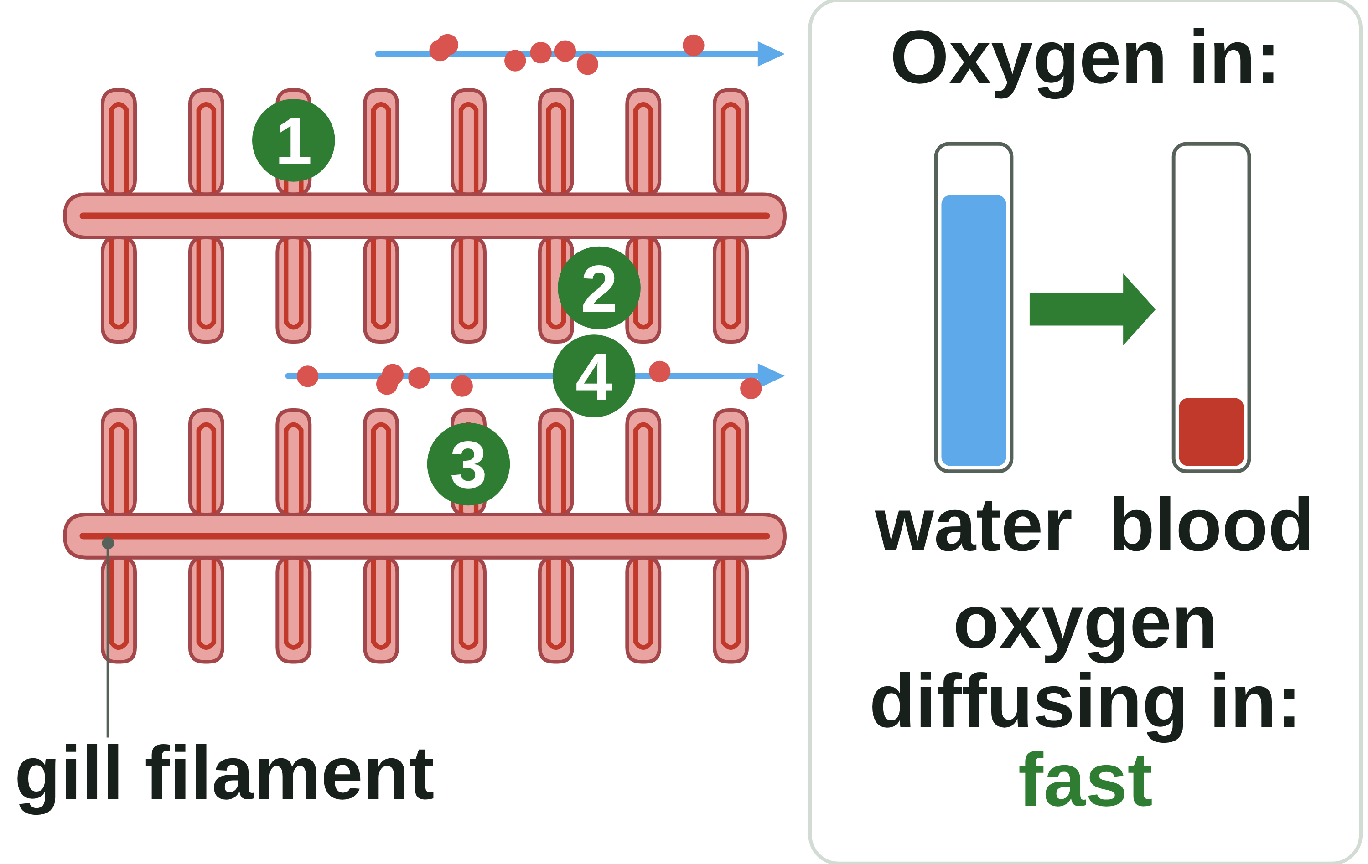
B1 L10 Revision notes 3 of 4
Active transport, exchange surfaces
Size and exchange, the four features, gills, exchange surfaces in animals and plants
8. Why big organisms need exchange surfaces
10. Gills
A single-celled organism (an organism made of only one cell, such as a bacterium) has a large surface area to volume ratio. Every part of it is close to the surface, so diffusion across its surface meets its needs.
A multicellular organism (an organism made of many cells, such as a human or a tree) has a much smaller surface area to volume ratio, and most of its cells are far from the surface. Diffusion alone would be far too slow.
So multicellular organisms need:
exchange surfaces, to take substances in and get rid of waste
a transport system, to carry substances to and from every cell (in animals, the blood: B2 L6 The heart and circulation; in plants, the xylem and phloem: B2 L13 Plant transport: xylem and phloem).
Gills have all four features:
1. Many thin gill filaments, each covered in tiny plates, give a huge surface area.
2. The plates are very thin, so oxygen has a short diffusion path into the blood.
3. Each plate has a good blood supply. Flowing blood carries oxygen away, so the blood arriving always has less oxygen than the water.
4. The fish keeps water flowing over its gills, in through the mouth and out under the gill cover. This brings fresh oxygen and keeps the gradient steep.
Out of water, the filaments stick together. The surface area becomes much smaller, so the fish cannot take in enough oxygen.
11. Exchange surfaces in animals and plants
9. Effective exchange surfaces
Exchange surface | What is exchanged | Adapted by
Gills (fish) | oxygen in, carbon dioxide out | many thin filaments with tiny plates; a good blood supply; water flowing over them
Lungs | oxygen in, carbon dioxide out | many alveoli with thin walls, capillaries and breathing (B2 L9 Lungs and gas exchange)
Small intestine | sugar and other food molecules in | villi: a large surface area, a thin wall and a good blood supply (B2 L2 The digestive system)
Roots | water and mineral ions in | root hair cells give a large surface area
Leaves | carbon dioxide in, oxygen out (in the light) | flat and thin; stomata; air spaces inside (B2 L12 Leaf tissues and stomata)
Feature | How it helps
1. A large surface area | More substances can move across at the same time.
2. A thin membrane | A short diffusion path, so substances cross quickly.
3. An efficient blood supply (animals) | Blood carries substances away, so the concentration gradient stays steep.
4. Ventilation (animals, for gas exchange) | Fresh air or water keeps the concentration gradient steep.
Watch out: "thin" means a short diffusion path, often only one cell thick. Do not just write "thin": say what it does.
Watch out: plants have no blood. A leaf's features are being flat and thin, its stomata and its air spaces.
B1 L10 · Active transport and exchange surfaces · sciencegcse.co.uk · free GCSE science resources
Notes:
Revision notes page 3 of 4. These pages are the textbook for B1 L10: students read them before the lesson, use them to catch up, or revise from them. Page 3 covers screens 9 to 11: why large organisms need exchange surfaces, the four features, gills, and the exchange surfaces of animals and plants.

Slide 27
B1 L10 Revision notes 4 of 4
Active transport, exchange surfaces
Key words, exam tips and check yourself
Key words
Check yourself
Cover the answers, then check.
Active transport: the movement of substances from a more dilute solution to a more concentrated solution (against a concentration gradient), which requires energy from respiration.
Concentration gradient: the difference in concentration between two areas.
Diffusion: the net movement of particles from an area of higher concentration to an area of lower concentration.
Exchange surface: a surface specialised for substances to move into or out of an organism, such as the alveoli or the gills.
Gill filaments: the many thin, feathery strands of a gill, covered in tiny plates, which give it a large surface area.
Gills: the organs a fish uses to take in oxygen from water and get rid of carbon dioxide.
Mineral ions: substances from the soil, such as nitrate, that a plant needs to stay healthy.
Mitochondria (one mitochondrion): the structures in the cytoplasm where aerobic respiration happens, releasing energy for the cell.
Osmosis: the diffusion of water from a dilute solution to a concentrated solution through a partially permeable membrane.
Respiration: a chemical reaction in every living cell that releases energy.
Stoma (plural stomata): a tiny hole (pore) in the surface of a leaf that lets gases diffuse in and out.
Surface area: the total area of the outside of an object.
Surface area to volume ratio: the surface area of an object compared with its volume, written as a ratio such as 6 : 1.
Villi (one villus): tiny finger-shaped parts that stick out from the inside wall of the small intestine and give it a large surface area.
1. What is active transport?
2. Give two places where active transport happens.
3. Some hours after a meal, the gut has less sugar than the blood. Why can diffusion not absorb this sugar?
4. Give one way a diagram of a gill is different from a real gill.
5. Calculate the surface area to volume ratio of a cube with sides of 8 cm.
6. Explain why a large multicellular organism needs exchange surfaces and a transport system.
7. Give the four features of an effective exchange surface.
8. Give two ways a leaf is adapted for exchanging gases.
Answers
1. The movement of substances from a more dilute solution to a more concentrated solution (against a concentration gradient), which requires energy from respiration.
2. Root hair cells (taking in mineral ions) and the small intestine (absorbing sugar into the blood).
3. Diffusion only moves particles from a higher to a lower concentration. Here the blood has more sugar than the gut, so active transport is needed, using energy from respiration.
4. Any one: it is pale, not deep red; it shows a few filaments, not hundreds; it draws the tiny plates big; it shows one row of filaments, not two; it shows the water flow with arrows.
5. 6 × 8 × 8 = 384 cm²; 8 × 8 × 8 = 512 cm³; 384 : 512 = 0.75 : 1.
6. It has a small surface area to volume ratio, and most of its cells are far from the surface, so diffusion across its outer surface would be too slow to supply them.
7. A large surface area; a thin membrane (a short diffusion path); an efficient blood supply (in animals); ventilation (in animals, for gas exchange).
8. Any two: it is flat and thin; it has stomata; it has air spaces inside.
Exam tips
For active transport, say "against the concentration gradient" and "uses energy from respiration".
Water enters root hair cells by osmosis; mineral ions enter by active transport.
Energy is released by respiration. Never write that energy is "made".
Ratios: surface area first, then volume. Simplify to "something : 1". Use cm² and cm³ in your working.
A bigger object has a smaller surface area to volume ratio.
Link each feature of an exchange surface to its effect: "thin, so a short diffusion path".
B1 L10 · Active transport and exchange surfaces · sciencegcse.co.uk · free GCSE science resources
Notes:
Revision notes page 4 of 4. These pages are the textbook for B1 L10: students read them before the lesson, use them to catch up, or revise from them. Page 4: key words, exam tips and check yourself. Students cover the answers, try every question, then check.

Slide 28
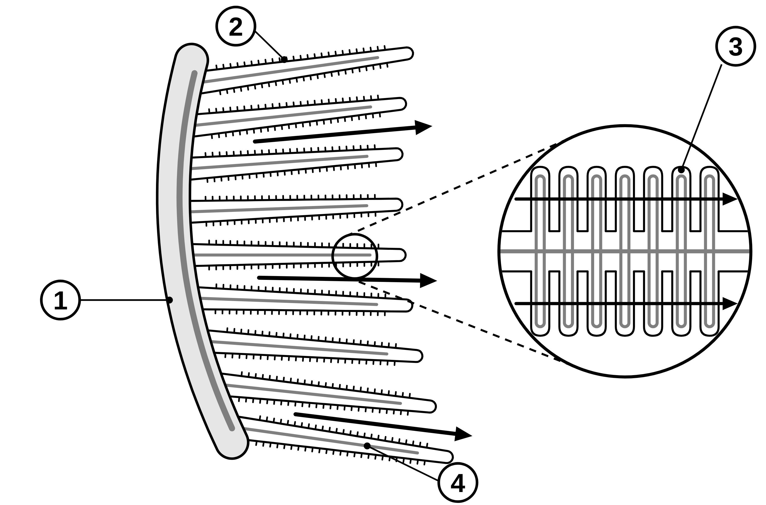
B1 L10 Mandatory worksheet: Active transport and exchange surfaces
Page 1 of 2
Name: ______________________________ Class: __________
A. Label the gill
C. Diffusion, osmosis or active transport?
[5]
[6]
Help: online screens 1 and 2
Name the parts labelled 1 to 4. Then answer the question under them.
Tick (✓) one box in each row.
Help: online screens 3, 4 and 6
Movement | Diffusion | Osmosis | Active transport
1. Oxygen moves from the water into the blood in a fish's gills.
2. Water moves from the soil into a root hair cell.
3. Mineral ions move from the soil into a root hair cell.
4. Sugar moves from the gut into the blood, when the gut has less sugar than the blood.
5. Carbon dioxide moves from a respiring cell into the blood.
6. Water moves out of a plant cell into a concentrated sugar solution.
1
2
3
4
5. Part 3 is drawn big in the diagram. Why can you not see it on a real gill? [1]
B. Fill in the gaps
[5]
Help: online screen 3
Use words from the box. Use each word once. One word is not needed.
diffusion
energy
higher
lower
mineral ions
osmosis
1. Active transport moves substances from a ____________ concentration to a ____________ concentration.
2. Active transport needs ____________ from respiration.
3. Root hair cells take in ____________ by active transport.
4. Root hair cells take in water by ____________.
B1 L10 · Active transport and exchange surfaces · sciencegcse.co.uk · free GCSE science resources

Slide 29
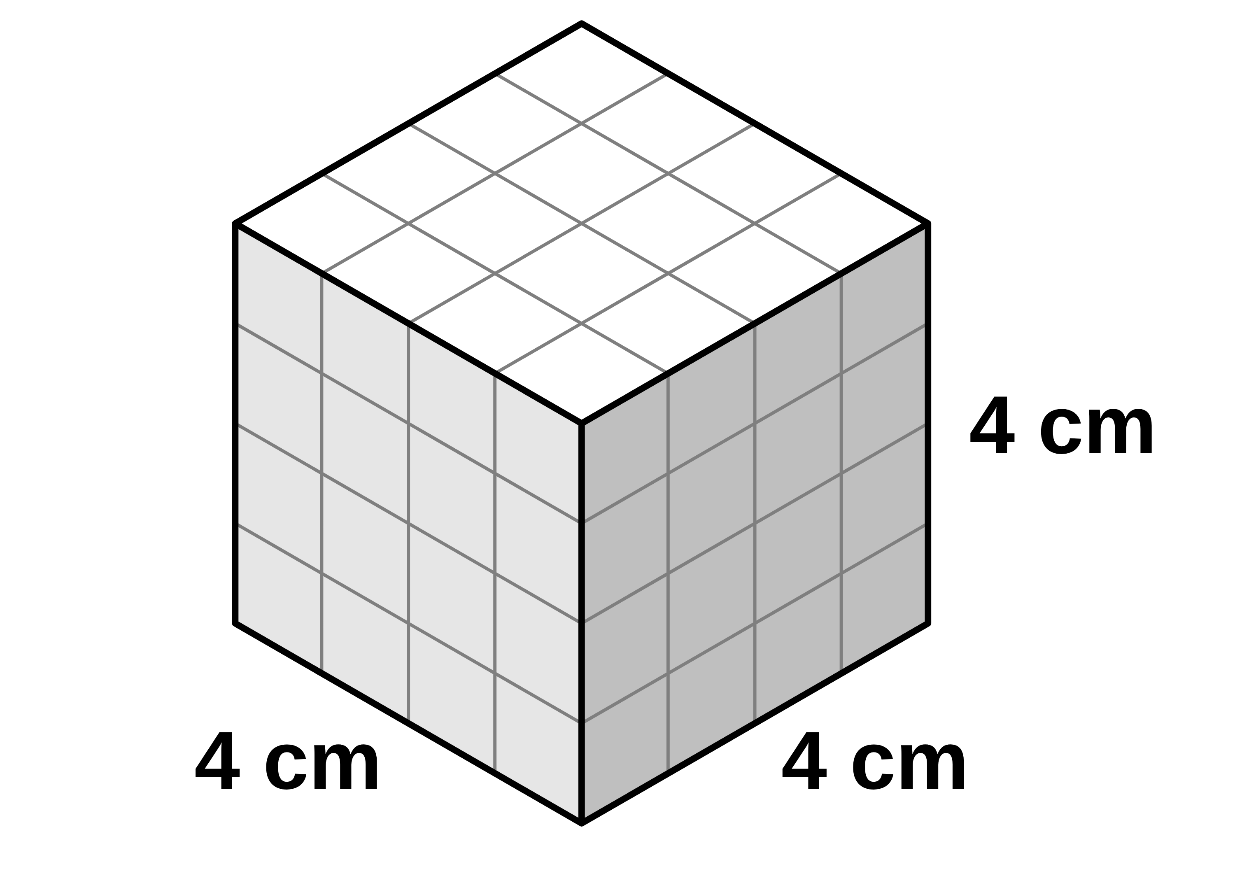
B1 L10 Mandatory worksheet: Active transport and exchange surfaces
Page 2 of 2
Name: ______________________________ Class: __________
D. Short answers
E. Surface area to volume ratio
[8]
[5]
Help: online screens 3, 4, 9, 10 and 11
Help: online screen 7
1. Name the process in cells that releases the energy for active transport. [1]
The diagram shows a cube with sides of 4 cm.
surface area of a cube = 6 × side × side
volume of a cube = side × side × side
2. Name the structures in a cell where this process happens. [1]
(a) Calculate the surface area of the cube. [1]
cm²
3. Give one example of active transport in animals. [1]
(b) Calculate the volume of the cube. [1]
cm³
4. Name the exchange surface in the lungs and the exchange surface in the small intestine. [2]
(c) Write the surface area to volume ratio of the cube in the form ___ : 1. [2]
: 1
(d) A cube with 1 cm sides has a ratio of 6 : 1. Which cube has the larger surface area to volume ratio? [1]
5. Name the tiny holes in the surface of a leaf that let gases diffuse in and out. [1]
F. Explain
[3]
Help: online screen 3
A field is flooded. The soil is waterlogged, so there is very little oxygen in it. Explain why the root hair cells of the crop plants take in fewer mineral ions. [3]
6. Which has the larger surface area to volume ratio: a single-celled organism or a fish? [1]
7. Why is a thin exchange surface better than a thick one? [1]
B1 L10 · Active transport and exchange surfaces · sciencegcse.co.uk · free GCSE science resources

Slide 30
B1 L10 Mandatory worksheet answers - page 1
Answers 1 of 2
A. Label the gill
C. Diffusion, osmosis or active transport?
[5]
[6]
Name the parts labelled 1 to 4. Then answer the question under them.
1 mark for each correct row.
1
gill arch (1)
Movement | Diffusion | Osmosis | Active transport
1. Oxygen moves from the water into the blood in a fish's gills. | ✓
2. Water moves from the soil into a root hair cell. |  | ✓
3. Mineral ions move from the soil into a root hair cell. |  |  | ✓
4. Sugar moves from the gut into the blood, when the gut has less sugar than the blood. |  |  | ✓
5. Carbon dioxide moves from a respiring cell into the blood. | ✓
6. Water moves out of a plant cell into a concentrated sugar solution. |  | ✓
2
gill filament (1)
3
tiny plates (1)
4
blood vessel (1)
Allow: 1 arch or bony arch; 2 filament(s); 3 plates; 4 capillary, artery or vein. Allow small spelling errors if the word is clear. Do not accept “gill” alone for 1 or 2.
5. Part 3 is drawn big in the diagram. Why can you not see it on a real gill? [1]
They are too small to see without a microscope (1).
B. Fill in the gaps
[5]
1 mark for each gap. “diffusion” is not needed.
diffusion
energy
higher
lower
mineral ions
osmosis
1. Active transport moves substances from a lower (1) concentration to a higher (1) concentration.
2. Active transport needs energy (1) from respiration.
3. Root hair cells take in mineral ions (1) by active transport.
4. Root hair cells take in water by osmosis (1).
Two ticks in one row score 0 for that row. Water always moves by osmosis; mineral ions move into root hair cells by active transport. In osmosis water moves; in active transport a dissolved substance moves.
Do not accept “higher, lower” in 1: that is the direction of diffusion.
B1 L10 · Active transport and exchange surfaces · sciencegcse.co.uk · free GCSE science resources

Slide 31
B1 L10 Mandatory worksheet answers - page 2
Answers 2 of 2
D. Short answers
E. Surface area to volume ratio
[8]
[5]
1. Name the process in cells that releases the energy for active transport. [1]
(a) Calculate the surface area of the cube. [1]
Respiration (1).
Do not accept “breathing”.
6 × 4 × 4 = 96 (cm²) (1).
(b) Calculate the volume of the cube. [1]
2. Name the structures in a cell where this process happens. [1]
4 × 4 × 4 = 64 (cm³) (1).
Mitochondria (1).
Allow mitochondrion.
(c) Write the surface area to volume ratio of the cube in the form ___ : 1. [2]
96 : 64 (1) = 1.5 : 1 (1)
Allow 3 : 2 for 1 mark (it is not in the form asked for). Allow their (a) and (b), correctly used. Do not accept 64 : 96 or 1 : 1.5 (the wrong way round) for the second mark.
3. Give one example of active transport in animals. [1]
Sugar (glucose) moving from the gut into the blood (1).
Allow “absorbing sugar in the small intestine”.
(d) A cube with 1 cm sides has a ratio of 6 : 1. Which cube has the larger surface area to volume ratio? [1]
4. Name the exchange surface in the lungs and the exchange surface in the small intestine. [2]
The 1 cm cube (1).
Model answer: (a) 6 × 4 × 4 = 96 cm². (b) 4 × 4 × 4 = 64 cm³. (c) 96 : 64. Divide both by 64: 1.5 : 1. Check: 6 ÷ 4 = 1.5 ✓ (d) The 1 cm cube (6 : 1 is larger than 1.5 : 1).
Lungs: alveoli (1). Small intestine: villi (1).
Allow alveolus, villus.
F. Explain
5. Name the tiny holes in the surface of a leaf that let gases diffuse in and out. [1]
[3]
Less oxygen, so less (aerobic) respiration in the root hair cells (1).
So less energy is released (1).
Mineral ions are taken in by active transport, which needs this energy, so less active transport happens (1).
Allow “the cells cannot respire properly” for the first mark. Do not accept “less energy is made / produced” (no second mark; the other marks can still score). Do not accept “the water stops the ions getting in”.
Model answer: There is very little oxygen in the waterlogged soil, so the root hair cells carry out less respiration. Less energy is released. Mineral ions are taken in by active transport, which needs energy from respiration, so fewer mineral ions are taken in.
Stomata (1).
Allow stoma.
6. Which has the larger surface area to volume ratio: a single-celled organism or a fish? [1]
A single-celled organism (1).
7. Why is a thin exchange surface better than a thick one? [1]
It gives a short diffusion path, so substances cross it quickly (1).
Allow “a short distance to diffuse”. Do not accept “it is thin” alone.
B1 L10 · Active transport and exchange surfaces · sciencegcse.co.uk · free GCSE science resources

Slide 32
B1 L10 Challenge worksheet: Active transport and exchange surfaces
Page 1 of 2
Name: ______________________________ Class: __________
A. Potassium in a pond alga
B. Sizing up organisms
[6]
[6]
Help: online screens 3 and 6
Help: online screens 7 and 9
A pond alga is made of large cells. A student measured the concentration of potassium ions in the pond water and inside the alga's cells. Table 1 shows the results.
A single-celled organism is roughly a cube with sides of 50 µm. A small water animal is roughly a cube with sides of 5 mm. 1 mm = 1000 µm.
Where | Concentration of potassium ions (arbitrary units)
pond water | 0.05
inside the alga's cells | 50
surface area of a cube = 6 × side × side
volume of a cube = side × side × side
(a) Convert 50 µm into mm. [1]
mm
(a) Calculate how many times greater the concentration is inside the cells than in the pond water. [2]
(b) Calculate the surface area to volume ratio of the single-celled organism. Use your answer to (a). [2]
times
(b) Name the process the cells use to take in potassium ions. [1]
: 1
(c) The small animal has a surface area to volume ratio of 1.2 : 1. How many times larger is the single-celled organism's ratio? [1]
(c) Explain why the cells cannot take in potassium ions by diffusion. [2]
times
(d) The small animal has gills and blood. Use your answers to explain why it needs them, but the single-celled organism does not. [2]
(d) The student adds a substance that stops respiration. Predict what happens to the uptake of potassium ions. [1]
B1 L10 · Active transport and exchange surfaces · sciencegcse.co.uk · free GCSE science resources

Slide 33
B1 L10 Challenge worksheet: Active transport and exchange surfaces
Page 2 of 2
Name: ______________________________ Class: __________
C. Gill area and lifestyle
D. Extended response
[5]
[6]
Help: online screens 10 and 11
Help: online screens 3, 10 and 11
Table 2 shows the gill surface area of three kinds of fish, for each gram of body mass.
Compare how fish gills and plant roots are adapted for exchanging substances. [6]
Fish | How it lives | Gill surface area in mm² per g of body mass
A | swims fast all the time | 1100
B | swims at a medium speed | 450
C | rests on the sea bed | 200
Say what is the same and what is different. Name the substances each one takes in, and how they get in.
(a) How many times larger is the gill surface area of fish A than that of fish C? [1]
times
(b) Suggest why fish A has the largest gill surface area. [3]
(c) Fish A swims with its mouth open. Suggest how this helps it take in oxygen. [1]
B1 L10 · Active transport and exchange surfaces · sciencegcse.co.uk · free GCSE science resources

Slide 34
B1 L10 Challenge worksheet answers - page 1
Answers 1 of 2
A. Potassium in a pond alga
B. Sizing up organisms
[6]
[6]
A pond alga is made of large cells. A student measured the concentration of potassium ions in the pond water and inside the alga's cells. Table 1 shows the results.
(a) Convert 50 µm into mm. [1]
50 ÷ 1000 = 0.05 (mm) (1).
Where | Concentration of potassium ions (arbitrary units)
pond water | 0.05
inside the alga's cells | 50
(b) Calculate the surface area to volume ratio of the single-celled organism. Use your answer to (a). [2]
Surface area = 6 × 0.05 × 0.05 = 0.015 mm² and volume = 0.05 × 0.05 × 0.05 = 0.000125 mm³ (1)
0.015 : 0.000125 = 120 : 1 (1)
Allow 6 ÷ 0.05 = 120, so 120 : 1, for both marks. Working in µm and getting 0.12 : 1 scores 1 mark only: the ratio must be in mm, the same unit as the animal's, before the two can be compared.
(a) Calculate how many times greater the concentration is inside the cells than in the pond water. [2]
50 ÷ 0.05 (1) = 1000 (times) (1)
Correct answer with no working scores 2.
(c) The small animal has a surface area to volume ratio of 1.2 : 1. How many times larger is the single-celled organism's ratio? [1]
(b) Name the process the cells use to take in potassium ions. [1]
120 ÷ 1.2 = 100 (times) (1).
Allow their (b) ÷ 1.2, correctly worked.
Active transport (1).
(c) Explain why the cells cannot take in potassium ions by diffusion. [2]
(d) The small animal has gills and blood. Use your answers to explain why it needs them, but the single-celled organism does not. [2]
The concentration is higher inside the cells than in the pond water (1).
Diffusion only moves particles from a higher to a lower concentration, so it would move the ions out of the cells (1).
The single-celled organism has a (100 times) larger surface area to volume ratio, so diffusion across its surface meets its needs (1).
The animal has a smaller ratio and its cells are far from the surface, so it needs an exchange surface (gills) to take in enough oxygen and a transport system (blood) to carry it to every cell (1).
(d) The student adds a substance that stops respiration. Predict what happens to the uptake of potassium ions. [1]
It stops / falls (because no energy is released for active transport) (1).
Do not accept “it speeds up”.
Model answers
(a) 0.05 mm. (b) 6 × 0.05 × 0.05 = 0.015 mm²; 0.05 × 0.05 × 0.05 = 0.000125 mm³; 0.015 : 0.000125 = 120 : 1. Check: 6 ÷ 0.05 = 120 ✓ (c) 120 ÷ 1.2 = 100 times.
(d) The single-celled organism has a ratio 100 times larger, so enough oxygen diffuses across its surface. The animal's ratio is much smaller and its cells are far from the surface, so it needs gills for a large exchange surface and blood to carry oxygen to every cell.
Model answers
(a) 50 ÷ 0.05 = 1000 times.
(b) Active transport.
(c) The concentration of potassium ions is already higher inside the cells. Diffusion only goes from a higher to a lower concentration, so it would move the ions out.
(d) Uptake stops, because respiration releases the energy that active transport needs.
Changing to the same unit first is the key step. A surface area to volume ratio can only be compared with another one worked out in the same unit: here, both in mm.
B1 L10 · Active transport and exchange surfaces · sciencegcse.co.uk · free GCSE science resources

Slide 35
B1 L10 Challenge worksheet answers - page 2
Answers 2 of 2
C. Gill area and lifestyle
D. Extended response
[5]
[6]
(a) How many times larger is the gill surface area of fish A than that of fish C? [1]
Level 3 (5–6 marks): A detailed and coherent comparison, with at least one clear similarity and at least two clear differences. Features are linked to how they help exchange, and the substances and the processes (diffusion, osmosis, active transport) are named correctly.
Level 2 (3–4 marks): Relevant features of both gills and roots, with at least one similarity or difference stated. Some features are linked to their effect; the links may be incomplete.
Level 1 (1–2 marks): Simple statements about gills or roots, with little or no comparison.
0 marks: No relevant content.
Indicative content
both have a large surface area (gills: many thin filaments covered in tiny plates; roots: many root hair cells, each with a long, thin extension)
both give a short diffusion path
gills take in oxygen (and get rid of carbon dioxide); roots take in water and mineral ions
oxygen diffuses into the blood in the gills
water enters root hair cells by osmosis
mineral ions enter by active transport, against the concentration gradient, using energy from respiration (root hair cells have many mitochondria)
gills have an efficient blood supply, which carries oxygen away and keeps the gradient steep; roots have no blood supply (plants have no blood)
gills are ventilated: water flows over them, bringing fresh oxygen; roots are not ventilated
Do not accept “roots take in water by active transport” or “plants have a blood supply” (errors limit the level).
1100 ÷ 200 = 5.5 (times) (1).
(b) Suggest why fish A has the largest gill surface area. [3]
Fish A swims fast, so its muscles carry out more respiration / need more energy (1).
So it needs more oxygen (1).
A larger surface area lets more oxygen diffuse into the blood at the same time (1).
Do not accept “energy is made / produced” (no first mark).
(c) Fish A swims with its mouth open. Suggest how this helps it take in oxygen. [1]
Water flows over its gills all the time, bringing fresh oxygen / keeping the concentration gradient steep (1).
Allow “it ventilates its gills”.
Model answer: (a) 1100 ÷ 200 = 5.5 times. (b) Fish A swims fast all the time, so its muscles respire more and need more oxygen. A larger gill surface area lets more oxygen diffuse into its blood at the same time. (c) Water keeps flowing over the gills, bringing fresh oxygen, so the concentration gradient stays steep.
D. Level 3 model answer
Gills and roots both have a very large surface area. Gills have many thin filaments covered in tiny plates, and roots have many root hair cells with long, thin extensions. Both give a short diffusion path. Gills take in oxygen, which diffuses from the water into the blood. Roots take in water by osmosis and mineral ions by active transport, which moves the ions against the concentration gradient using energy from respiration. Gills have an efficient blood supply that carries oxygen away and keeps the gradient steep, but plants have no blood. Gills are also ventilated: water flowing over them brings fresh oxygen. Roots are not ventilated.
B1 L10 · Active transport and exchange surfaces · sciencegcse.co.uk · free GCSE science resources

Slide 36
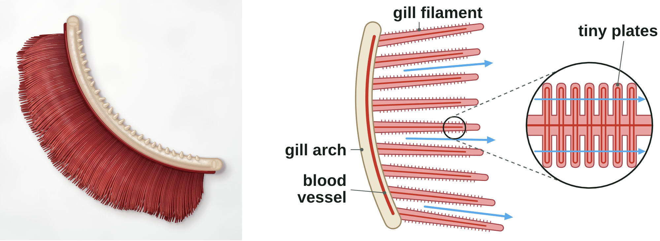
B1 L10 Alternative worksheet: Active transport and exchange surfaces
Page 1 of 2
Name: ______________________________ Class: __________
Key facts
A. Label the gill
[4]
Help: online screens 1 and 2
An exchange surface is a surface specialised for substances to move into or out of an organism. A fish's gills are one.
Each gill has a bony gill arch holding many thin gill filaments. Real gills are deep red: they are full of blood.
Diffusion and osmosis need no energy. Osmosis moves water only.
Active transport moves substances from a lower to a higher concentration (against a concentration gradient). It needs energy from respiration.
Root hair cells take in mineral ions by active transport, and water by osmosis.
Respiration in the mitochondria releases the energy.
A small object has a large surface area to volume ratio. A big object has a small one.
Good exchange surfaces have a large surface area and are thin. In animals they have a good blood supply. Plants have no blood.
Write a name from the box next to each number.
blood vessel
gill arch
gill filament
tiny plates
1
3
2
4
A real gill (left) and a diagram (right).
Tip: the circle shows part of one filament, made bigger.
B1 L10 · Active transport and exchange surfaces · sciencegcse.co.uk · free GCSE science resources

Slide 37
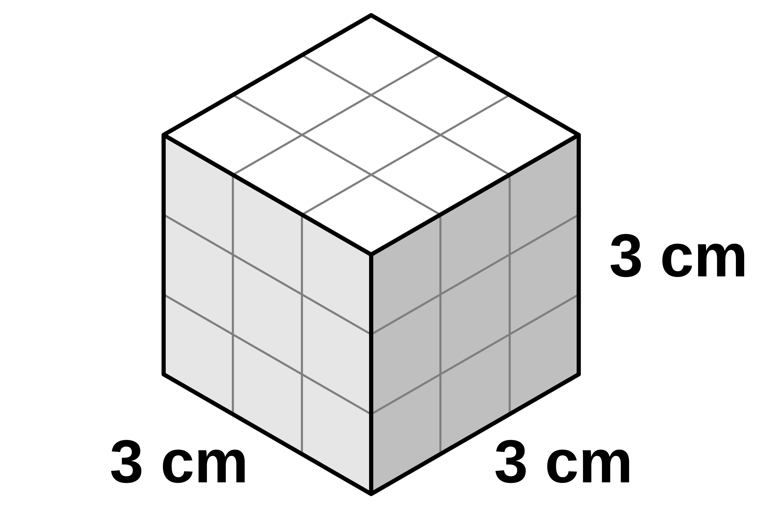
B1 L10 Alternative worksheet: Active transport and exchange surfaces
Page 2 of 2
Name: ______________________________ Class: __________
B. Match up
D. True or false?
[5]
[6]
Help: online screens 1, 3 and 7
Help: online screens 2, 3, 6, 7 and 11
Draw a line from each word to what it means.
Write true or false after each sentence.
gills
the total area of the outside of an object.
1. Real gills are pale pink, like the diagram.
2. Active transport needs energy from respiration.
exchange surface
the organs a fish uses to take in oxygen from water and get rid of carbon dioxide.
3. Diffusion moves particles from a lower to a higher concentration.
surface area
the structures in the cytoplasm where aerobic respiration happens, releasing energy for the cell.
4. Water enters root hair cells by osmosis.
5. A 1 cm cube has a larger surface area to volume ratio than a 3 cm cube.
mineral ions
substances from the soil, such as nitrate, that a plant needs to stay healthy.
6. Leaves have a good blood supply.
mitochondria
a surface specialised for substances to move into or out of an organism, such as the alveoli or the gills.
E. A cube with 3 cm sides
[6]
Help: online screens 7 and 9
Follow the steps. Fill in the gaps, or circle the right answer.
C. Fill in the gaps
[5]
Help: online screens 3, 9, 10 and 11
1. A cube has ________ faces.
Use the words in the box. Use each word once.
blood
energy
mineral ions
small
thin
2. Each face is 3 cm × 3 cm = ________ cm².
3. Surface area = 6 × 9 = ________ cm².
1. Active transport needs ____________ from respiration.
4. Volume = 3 × 3 × 3 = ________ cm³.
2. Root hair cells take in ____________ by active transport.
3. A big animal has a ____________ surface area to volume ratio.
5. The 3 cm cube has a ratio of 2 : 1. A 1 cm cube has a ratio of 6 : 1. Circle the cube with the larger ratio: 1 cm cube / 3 cm cube
4. Gill filaments are ____________, so oxygen only diffuses a short way.
6. Circle the right word: a bigger cube has a larger / smaller surface area to volume ratio.
5. Gills have a good ____________ supply. Plants do not.
B1 L10 · Active transport and exchange surfaces · sciencegcse.co.uk · free GCSE science resources

Slide 38
B1 L10 Alternative worksheet answers - page 1
Answers 1 of 2
Key facts
A. Label the gill
[4]
An exchange surface is a surface specialised for substances to move into or out of an organism. A fish's gills are one.
Each gill has a bony gill arch holding many thin gill filaments. Real gills are deep red: they are full of blood.
Diffusion and osmosis need no energy. Osmosis moves water only.
Active transport moves substances from a lower to a higher concentration (against a concentration gradient). It needs energy from respiration.
Root hair cells take in mineral ions by active transport, and water by osmosis.
Respiration in the mitochondria releases the energy.
A small object has a large surface area to volume ratio. A big object has a small one.
Good exchange surfaces have a large surface area and are thin. In animals they have a good blood supply. Plants have no blood.
Write a name from the box next to each number.
blood vessel
gill arch
gill filament
tiny plates
1
gill arch (1)
3
tiny plates (1)
2
gill filament (1)
4
blood vessel (1)
A real gill (left) and a diagram (right).
Allow small spelling errors if the word is clear.
B1 L10 · Active transport and exchange surfaces · sciencegcse.co.uk · free GCSE science resources

Slide 39
B1 L10 Alternative worksheet answers - page 2
Answers 2 of 2
B. Match up
D. True or false?
[5]
[6]
1 mark for each correct line.
1. Real gills are pale pink, like the diagram. False: real gills are deep red, full of blood. (1)
2. Active transport needs energy from respiration. True. (1)
3. Diffusion moves particles from a lower to a higher concentration. False: diffusion goes from a higher to a lower concentration. (1)
4. Water enters root hair cells by osmosis. True. (1)
5. A 1 cm cube has a larger surface area to volume ratio than a 3 cm cube. True. (1)
6. Leaves have a good blood supply. False: plants have no blood. (1)
gills
the total area of the outside of an object.
exchange surface
the organs a fish uses to take in oxygen from water and get rid of carbon dioxide.
surface area
the structures in the cytoplasm where aerobic respiration happens, releasing energy for the cell.
mineral ions
substances from the soil, such as nitrate, that a plant needs to stay healthy.
mitochondria
a surface specialised for substances to move into or out of an organism, such as the alveoli or the gills.
E. A cube with 3 cm sides
[6]
1 mark for each step.
C. Fill in the gaps
[5]
1. A cube has six (6) (1) faces.
1 mark for each gap.
blood
energy
mineral ions
small
thin
2. Each face is 3 cm × 3 cm = 9 (1) cm².
3. Surface area = 6 × 9 = 54 (1) cm².
1. Active transport needs energy (1) from respiration.
4. Volume = 3 × 3 × 3 = 27 (1) cm³.
2. Root hair cells take in mineral ions (1) by active transport.
3. A big animal has a small (1) surface area to volume ratio.
5. The 3 cm cube has a ratio of 2 : 1. A 1 cm cube has a ratio of 6 : 1. Circle the cube with the larger ratio: 1 cm cube / 3 cm cube (1)
4. Gill filaments are thin (1), so oxygen only diffuses a short way.
6. Circle the right word: a bigger cube has a larger / smaller surface area to volume ratio. (1)
5. Gills have a good blood (1) supply. Plants do not.
B1 L10 · Active transport and exchange surfaces · sciencegcse.co.uk · free GCSE science resources

Slide 40
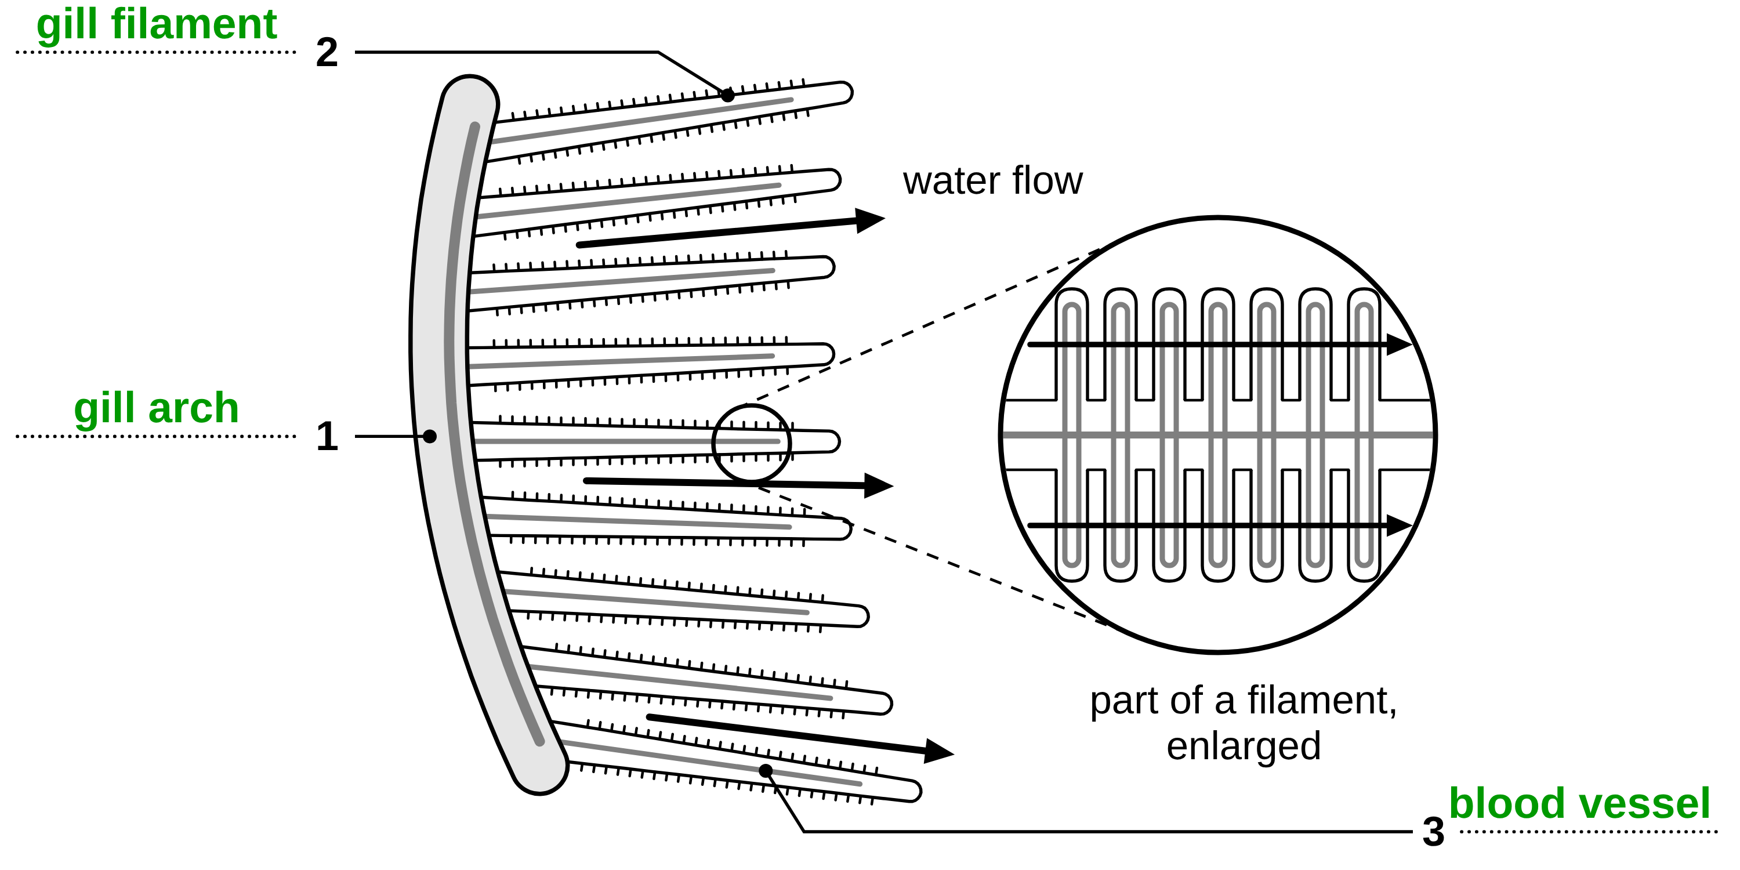
B1 L10 Exam questions worksheet mark scheme - page 1
Answers 1 of 2
01 A fish gill
02 Agar cubes
[4]
[6]
01.1 Complete Figure 1. [3]
1 gill arch (1)
2 gill filament (1)
3 blood vessel (1)
allow capillary for line 3.
More than one word on a line: no mark.
02.1 Calculate the surface area X of the 0.5 cm cube. [2]
6 × 0.5 × 0.5 (1) = 1.5 (cm²) (1)
Correct answer with no working = 2 marks.
02.2 Calculate the surface area to volume ratio Y of the 0.5 cm cube. Give your answer in the form ___ : 1 [1]
12 : 1 (1)
allow their 02.1 answer ÷ 0.125, written as ___ : 1. do not accept 1 : 12.
02.3 Describe the pattern in Table 1. [1]
the bigger the cube, the longer it takes to become colourless (1)
allow “the smaller the surface area to volume ratio, the longer it takes”. “it takes longer” alone = 0: the answer must link size or ratio to time.
02.4 Use Table 1 to suggest why a large organism needs exchange surfaces and a transport system. [2]
a larger cube / organism has a smaller surface area to volume ratio, so it takes much longer for substances to diffuse to its middle (1)
so a large organism needs exchange surfaces (to take in enough) and a transport system (to carry substances to every cell) (1)
allow data used for the first mark, for example “the 2 cm cube took about 4 times as long as the 1 cm cube”.
Model answers:
02.1 6 × 0.5 × 0.5 = 1.5 cm².
02.2 1.5 : 0.125 = 12 : 1.
02.3 The bigger the cube, the longer it takes to become colourless.
02.4 Bigger cubes have a smaller surface area to volume ratio and take much longer for the acid to diffuse to the middle. So a large organism needs exchange surfaces to take in enough, and a transport system to carry substances to every cell.
01.2 Which feature of the gill filaments gives them a large surface area? [1]
They are covered in tiny plates. (1)
If more than one box is ticked, give 0 marks.
03 Nitrate ions
[2]
03 Explain why the root hair cell must use active transport to take in nitrate ions. Use data from Table 2. [2]
the concentration of nitrate ions is higher in the root hair cell (25) than in the soil water (0.5) / 50 times higher (1)
so the ions must move against the concentration gradient, which needs energy from respiration (1)
The first mark needs data or a comparison from Table 2. allow “diffusion would move nitrate ions out of the cell” for the second mark. do not accept “energy is made / produced”.
04 Exchange surfaces
[2]
04 Complete Table 3. Tick the features that each exchange surface has. [2]
villi row: ✓ large surface area, ✓ efficient blood supply, no tick for ventilated (1)
leaf row: ✓ large surface area only (1)
Each row must be fully correct for its mark.
B1 L10 · Active transport and exchange surfaces · sciencegcse.co.uk · free GCSE science resources

Slide 41
B1 L10 Exam questions worksheet mark scheme - page 2
Answers 2 of 2
05 Extended response
[6]
05 Diffusion, osmosis and active transport are three ways that substances move into and out of cells. Compare diffusion, osmosis and active transport. [6]
Level descriptors
Level 3 (5–6 marks): A detailed and coherent comparison of all three processes. What moves, which way it moves (relative to the concentration gradient) and whether energy is needed are given for each, with clear similarities and differences, and examples.
Level 2 (3–4 marks): A comparison of at least two of the processes, with some similarities or differences correctly stated. There may be an omission or one error.
Level 1 (1–2 marks): Simple statements about one or more of the processes, with little or no comparison.
0 marks: No relevant content.
Model answer (Level 3)
All three move substances into or out of cells. In diffusion, particles of a gas or a dissolved substance move from a higher to a lower concentration, for example oxygen into the blood. Osmosis is the diffusion of water only, from a dilute solution to a more concentrated solution through a partially permeable membrane, for example water into a root hair cell. Active transport is different: it moves substances from a lower to a higher concentration, against the concentration gradient, for example mineral ions into a root hair cell. Active transport needs energy from respiration, so cells that do a lot of it have many mitochondria. Diffusion and osmosis need no energy.
Indicative content
all three move substances into or out of cells / across membranes
diffusion: the net movement of particles from a higher to a lower concentration / down a concentration gradient
diffusion happens in gases and in solutions; example: oxygen into the blood / carbon dioxide out of a respiring cell
osmosis: the movement of water only
osmosis: from a dilute solution to a more concentrated solution, through a partially permeable membrane
osmosis is the diffusion of water
in osmosis, water moves; in active transport, a dissolved substance (such as mineral ions or sugar) moves
example of osmosis: water into a root hair cell
active transport: from a more dilute to a more concentrated solution / from a lower to a higher concentration / against a concentration gradient
active transport needs energy from respiration; diffusion and osmosis do not
examples of active transport: mineral ions into root hair cells / sugar from the gut into the blood
cells that do a lot of active transport have many mitochondria
do not accept “energy is made / produced”; for osmosis, “from a high concentration to a low concentration” is credited only if it says “of water”.
B1 L10 · Active transport and exchange surfaces · sciencegcse.co.uk · free GCSE science resources

