Slide 1
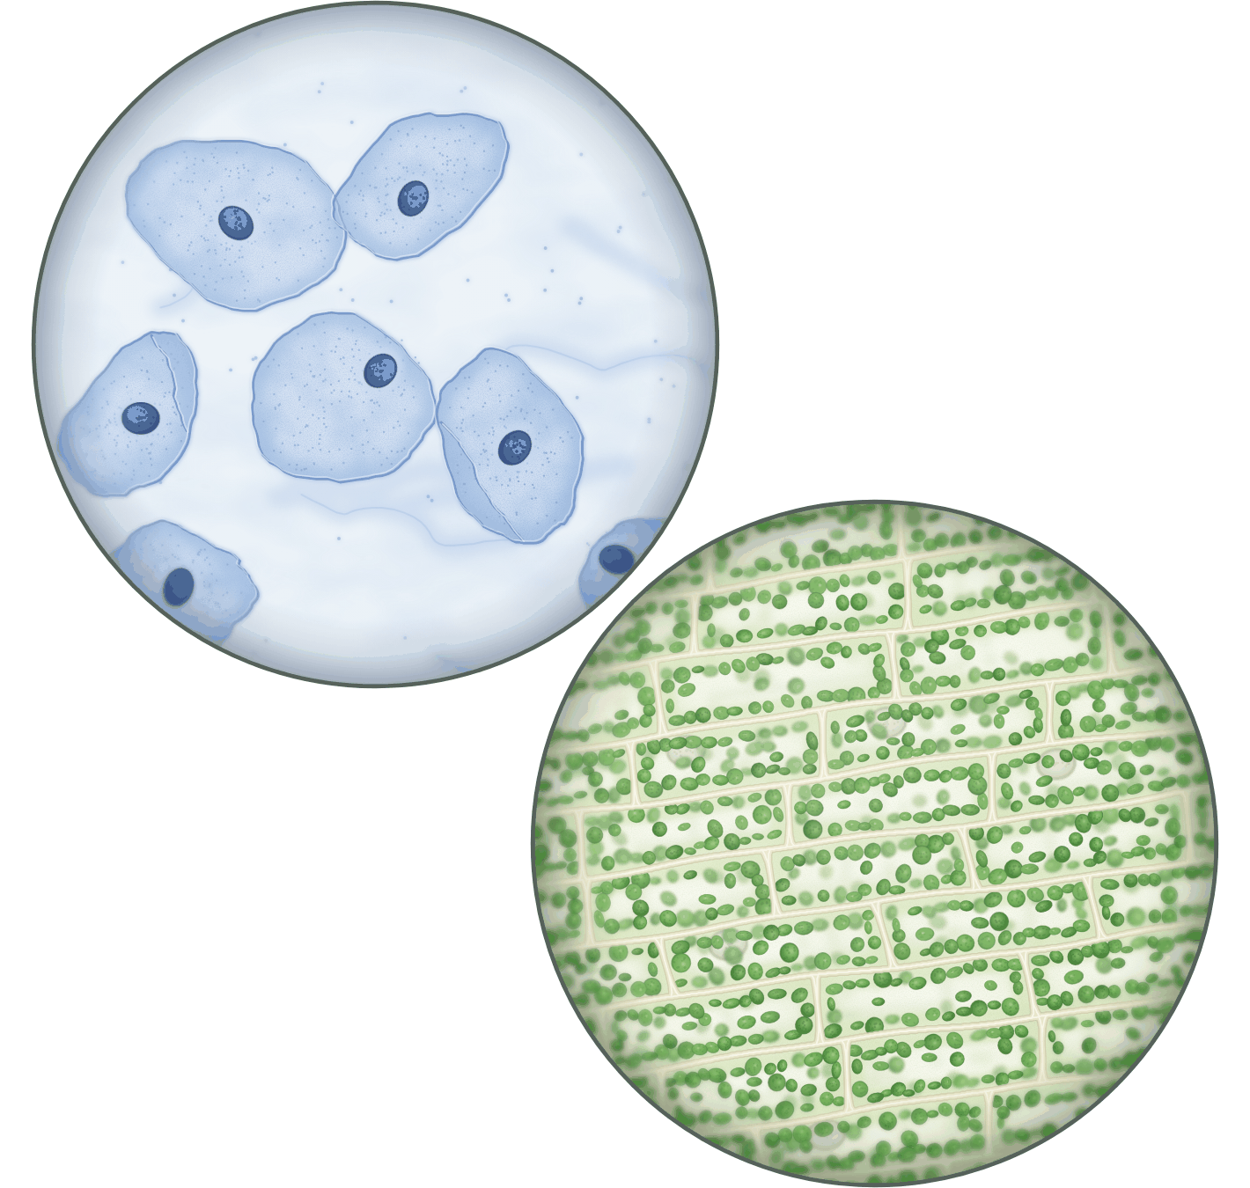
sciencegcse.co.uk · Biology B1 L1
DATE
B1 L1: Animal and plant cells
24/09/2026
DO NOW
KEYWORDS
1. What are all living things made of?
2. Which part of a cell controls what the cell does?
3. What do we use to see cells?
Eukaryotic cell
Nucleus
Mitochondria
Chloroplasts
Cell wall
A painting based on light micrographs. Only the cheek cells are stained.
B1 Cell biology
AQA Combined Science
Notes:
Do now: retrieval from KS3 cells (all three questions). The picture is a painting based on light micrographs: human cheek cells stained with methylene blue, a blue dye (top left) and pondweed leaf cells, not stained (bottom right): their green is real. Ask the class what they can see, and which cells come from a plant. (The pondweed: neat brick shapes in rows, and green chloroplasts.) Q2 leads straight into today: the nucleus contains genetic material, which controls the activities of the cell. Suggested 60 min: slides 1-3 (8 min); slides 4-9 (15 min); slides 10-13 (10 min); slides 14-18 (12 min); Mandatory worksheet started in class (10 min), finished for homework; exit ticket slides 22-23 (5 min). Use slides 19-21 if time allows. Homework: online lesson quiz and the B1 L1 Exam questions worksheet.

Slide 2
sciencegcse.co.uk · Biology B1 L1: Animal and plant cells
Do now answers and lesson focus
Do now answers
In this lesson
1. Cells.
2. The nucleus.
3. A microscope.
• Compare real cells with cell diagrams.
• Name the parts of animal and plant cells and give their jobs.
• Say which parts only plant cells have.
• Estimate the sizes of the parts.
• Explain why plant cells need mitochondria.
Key idea
Animal and plant cells share five parts: nucleus, cytoplasm, cell membrane, mitochondria and ribosomes.
Plant cells also have a cell wall, and often a permanent vacuole and chloroplasts.
2
B1 L1 · sciencegcse.co.uk
Notes:
Go through the answers. Q3: also accept a light microscope or an electron microscope. Then share the lesson focus. The online lesson (sciencegcse.co.uk, B1 L1) follows the same 12 screens as this PowerPoint, so students can go over it at home. There are three checkpoints along the way. At KS3 you met cells, the nucleus and the microscope. Today we go inside the cell: every part and its job. How to use a microscope yourself is B1 L3 Using a microscope.

Slide 3
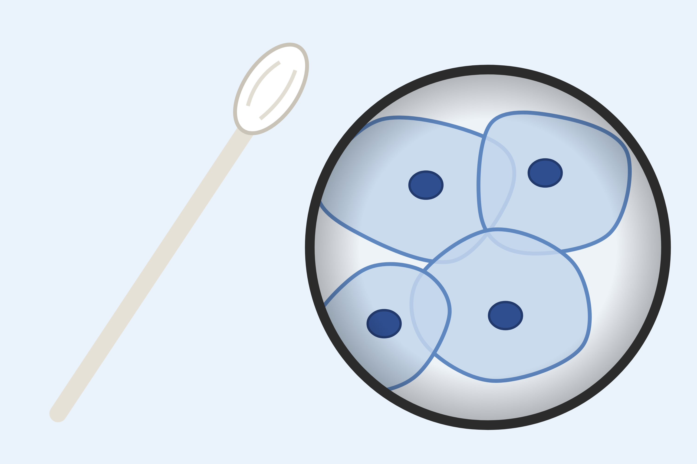

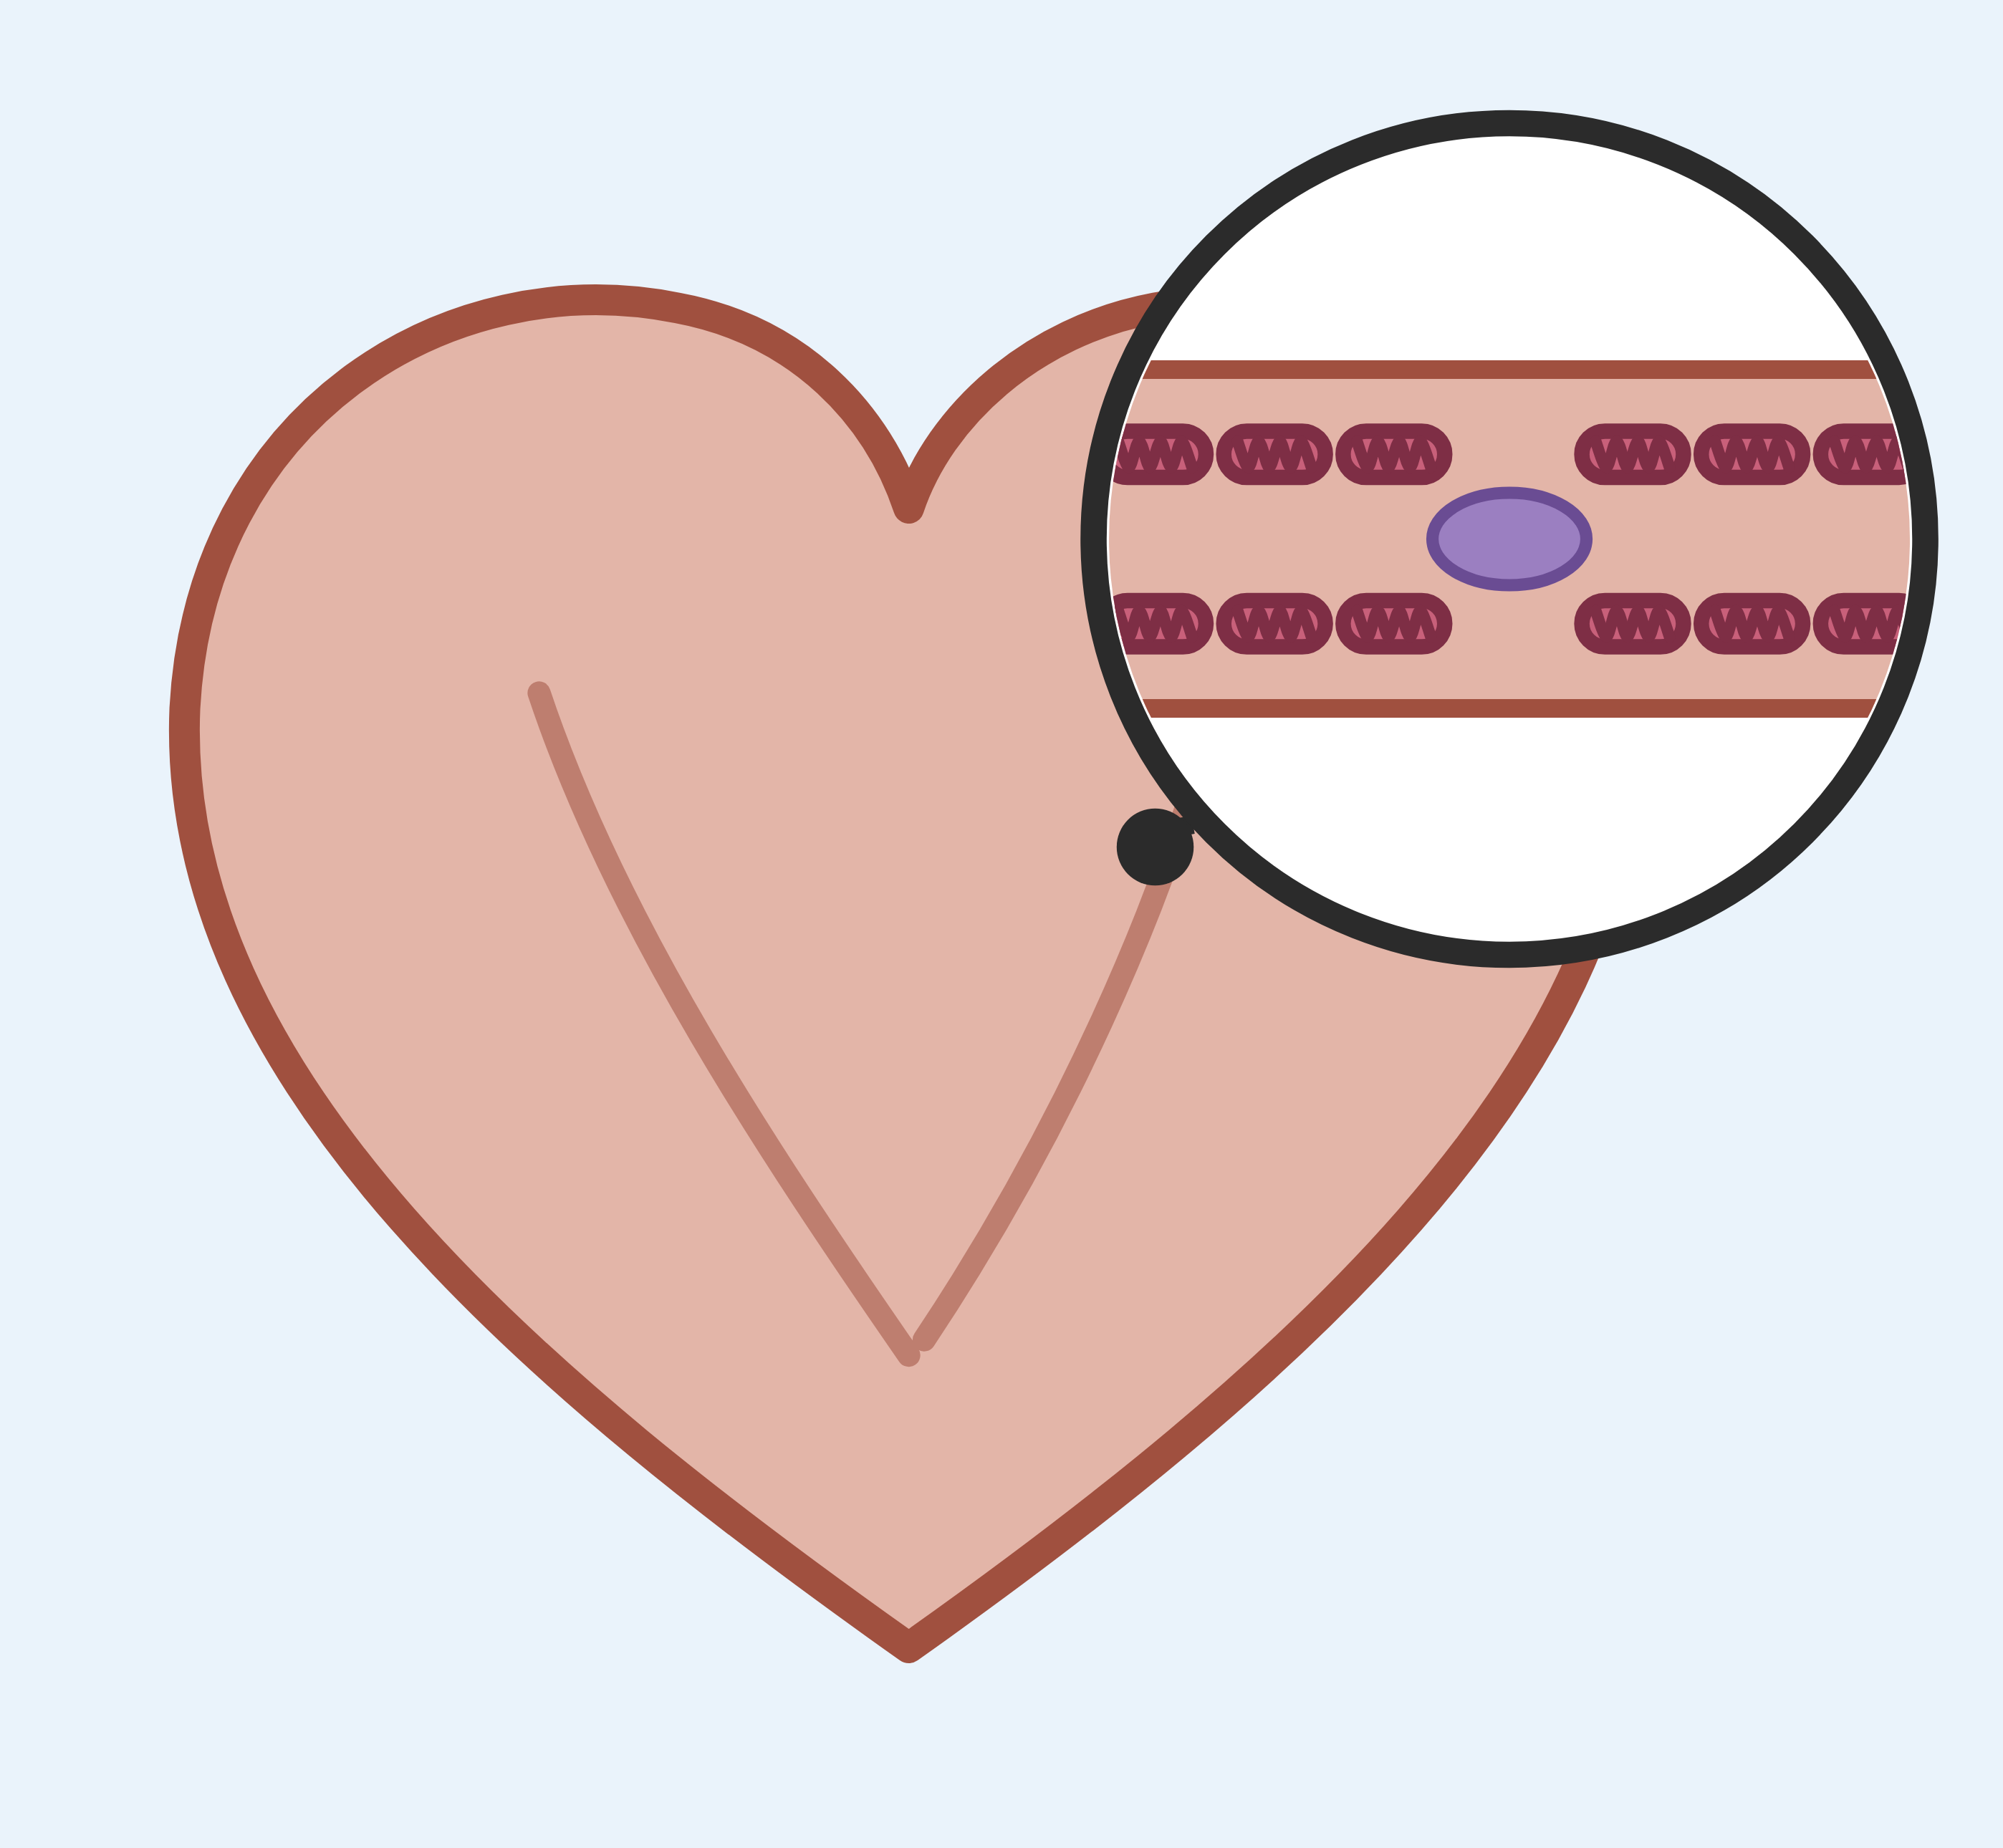
sciencegcse.co.uk · Biology B1 L1: Animal and plant cells
Why this matters in the real world
The parts of your cells matter outside the science lab too.
A cheek swab
Cotton is cell wall
Energy for every heartbeat
about 90%
1000s
of cotton is cellulose
of mitochondria in one heart muscle cell
Doctors and forensic scientists rub a cotton bud inside the cheek to collect cells. The nucleus of each cell holds the person's DNA.
Each cotton fibre is one long plant cell. Its thick cell wall is almost pure cellulose. Paper comes from the cell walls of wood.
Heart muscle never rests. Its cells are packed with mitochondria to release energy by respiration.
Nucleus
Cell wall
Mitochondria
3
B1 L1 · sciencegcse.co.uk
Notes:
Hook. Ask: why do the police or a doctor take a cheek swab, not a scraping of skin or a sample of hair? (Cheek cells come off easily and painlessly, and each one has a nucleus full of DNA.) The cotton in your T-shirt is the cell walls of cotton plant cells: almost pure cellulose. Ask: which organ in your body works non-stop, so its cells need lots of mitochondria? (The heart: its muscle cells release energy every second of your life.) Specialised cells like these are B1 L5 Specialised cells.

Slide 4
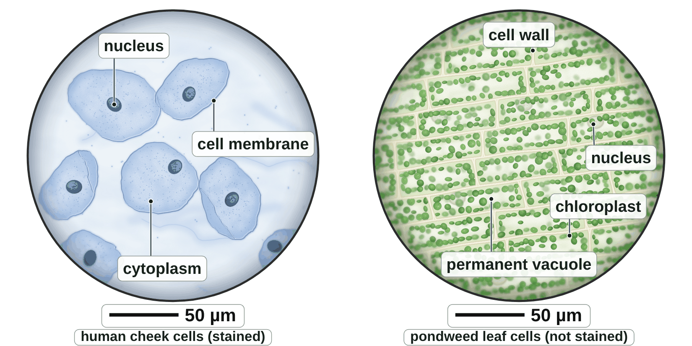
sciencegcse.co.uk · Biology B1 L1: Animal and plant cells
Online lesson: screen 1 of 12
Real cells under a microscope
Cheek cells and pondweed cells
Key facts
All living things are made of cells. A cell is the basic building block of all living things.
Cheek cells are animal cells. A blue stain makes them easier to see.
Pondweed leaf cells are plant cells. Their green chloroplasts are their real colour.
The parts inside a cell are sub-cellular structures. Each one has a job.
Animal and plant cells are eukaryotic: their genetic material is enclosed in a nucleus.
A painting based on light micrographs. Only the cheek cells are stained.
4
B1 L1 · sciencegcse.co.uk
Notes:
This is a painting based on what you see down a light microscope. Left: cells from the inside of a human cheek, collected by gently rubbing a clean cotton bud inside your own cheek. They are stained with a blue dye, methylene blue, because real cheek cells are almost colourless. Right: cells from a pondweed leaf (Elodea). Pondweed leaves are only two cells thick, so light shines through them and they need no stain: the green is real. Ask: which picture shows plant cells, and how can you tell? (The pondweed: neat brick shapes in rows, green chloroplasts.) Ask: what can you see in every cell? (A nucleus in the cheek cells; it is harder to find in the pondweed cells.) 'Eu-' means true: a eukaryotic cell has a true nucleus. Bacterial cells are different (B1 L2 Bacterial cells). How to use a microscope and stain a slide is B1 L3 Using a microscope. For the curious: in living pondweed cells you can often watch the chloroplasts drift slowly round the cell, carried by the moving cytoplasm. One key fact a click.

Slide 5
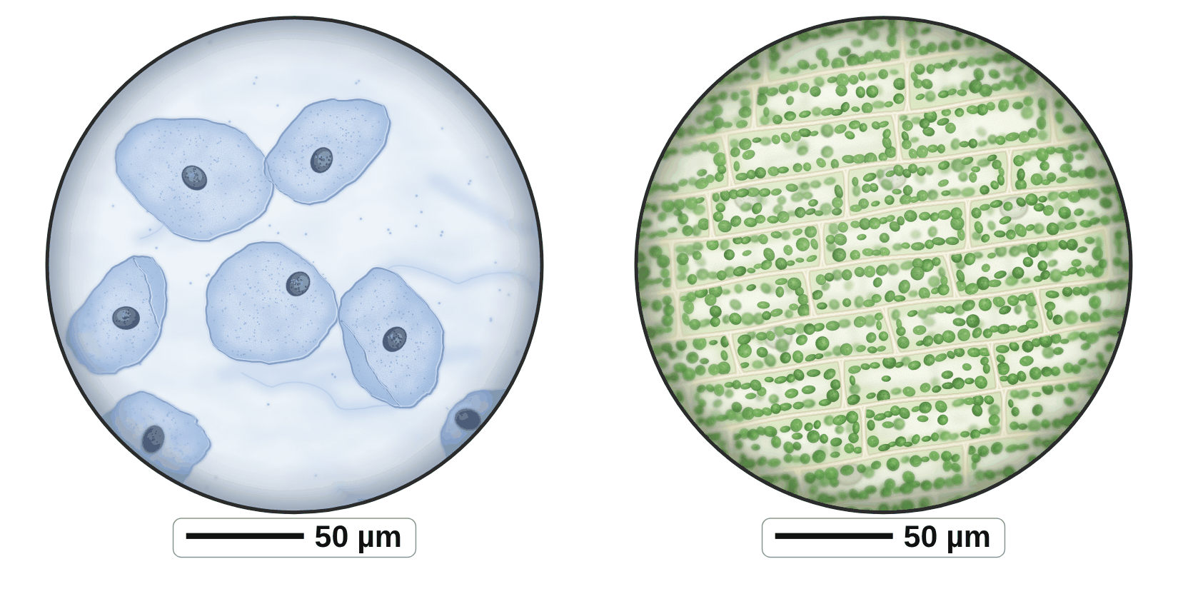
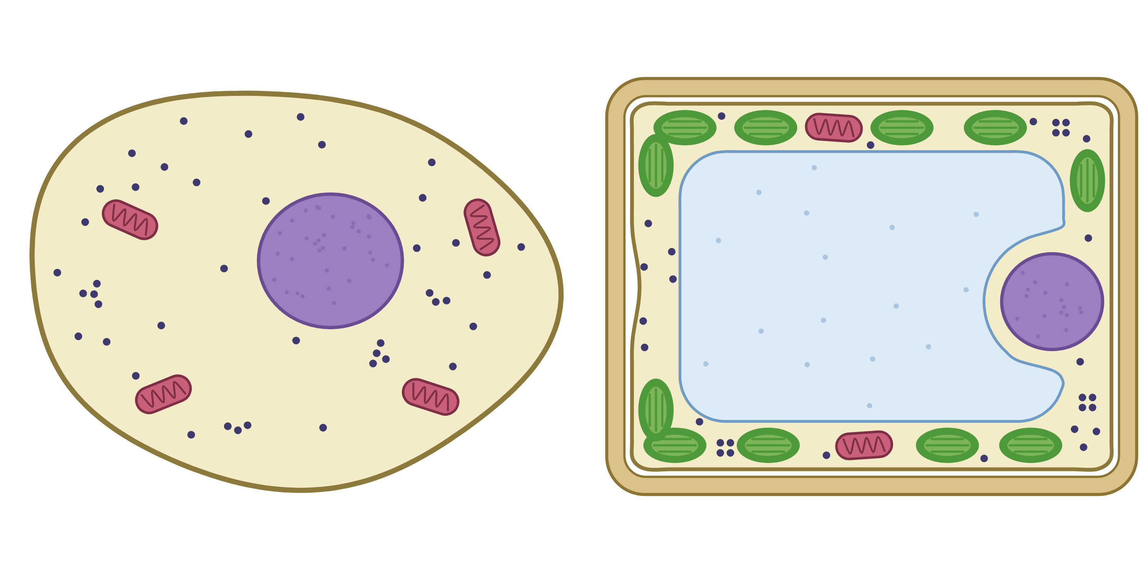
sciencegcse.co.uk · Biology B1 L1: Animal and plant cells
Online lesson: screen 2 of 12
Real cells and cell diagrams
Same thing, two ways
Spot the differences
1
Too small: In a light micrograph like this, mitochondria are too small to see clearly, and ribosomes are far too small to see at all. The diagram draws them so you can learn them.
2
2
Packed: Real plant cells are packed together in rows and share their walls. The diagram shows one neat cell on its own.
3
2
5
3
3
1
4
Permanent vacuole: The permanent vacuole is clear, so it is hard to see in the real cells. The diagram colours it so it stands out.
4
1
5
Real cells (painting)
Cell diagrams
4
Cell membrane: In a real plant cell, the cell membrane is pressed against the cell wall, so you cannot see it on its own. The diagram draws it as a separate line.
animal on the left · plant on the right
animal on the left · plant on the right
5
Nucleus: In the pondweed cells, the nucleus is often hidden behind chloroplasts or pushed to one side. The diagram always shows it clearly.
Stains colour the cells: the blue is a dye. The green chloroplasts are their real colour.
Both show a nucleus, cytoplasm and a cell membrane in the animal cells, and a cell wall and chloroplasts in the plant cells.
5
B1 L1 · sciencegcse.co.uk
Notes:
Cover the right panel and ask: what is different between the real cells and the diagrams? Take ideas, then reveal the five differences (each click shows one difference and its number on both pictures; the last click shows what is the same in both). Key message: exam diagrams are simplified on purpose, so you can learn the parts. Real cells are almost colourless: the cheek cells were stained blue, and only the green of the chloroplasts is a real colour. Mitochondria and ribosomes are there in every one of these cells, but in a light micrograph like this mitochondria are too small to see clearly, and ribosomes cannot be seen at all; ribosomes were first seen with an electron microscope (B1 L3 Using a microscope). In the pondweed, the big clear space in the middle of each cell is the permanent vacuole: you see it as the gap the chloroplasts go round. The cell membrane is pressed tight against the cell wall, so the two look like one line. In the exam, you must recognise the parts in both kinds of picture. The online lesson, screen 2, has the same pictures and differences.

Slide 6
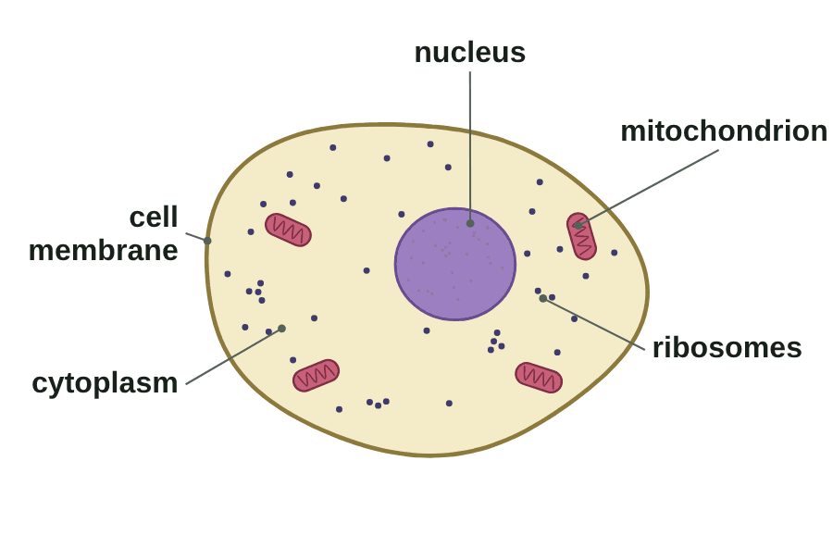
sciencegcse.co.uk · Biology B1 L1: Animal and plant cells
Online lesson: screen 3 of 12
Inside an animal cell
An animal cell
Five parts and their jobs
Nucleus: contains genetic material, which controls the activities of the cell.
Cytoplasm: where most chemical reactions happen, controlled by enzymes.
Cell membrane: controls the movement of substances into and out of the cell.
Mitochondria: where aerobic respiration happens, releasing energy.
Ribosomes: protein synthesis: proteins are made there.
Plant cells have all five of these parts too.
A diagram is simplified. Each part has its own colour so you can tell them apart.
Real cells are almost colourless.
6
B1 L1 · sciencegcse.co.uk
Notes:
Go round the five parts, one a click. The GIF lights each part in turn, like the chips on the online lesson, screen 3 (print and PDF show its first frame, the labelled cell). Ask: which part would you look for first in a micrograph? (The nucleus: it is the biggest part and takes up stain.) Words matter: mitochondria release energy; they never make or produce it. Ribosomes make proteins, such as enzymes (B2 L3 Enzymes and digestion). The genetic material in the nucleus is DNA, which carries the instructions for the cell (B1 L6 Cell division: mitosis). One mitochondrion, two or more mitochondria. On the online lesson, switch the colour off: exam diagrams are often black and white, so learn each part by its shape and position. Common error: 'the cell membrane is the outside wall of the cell'. Animal cells have no cell wall.

Slide 7
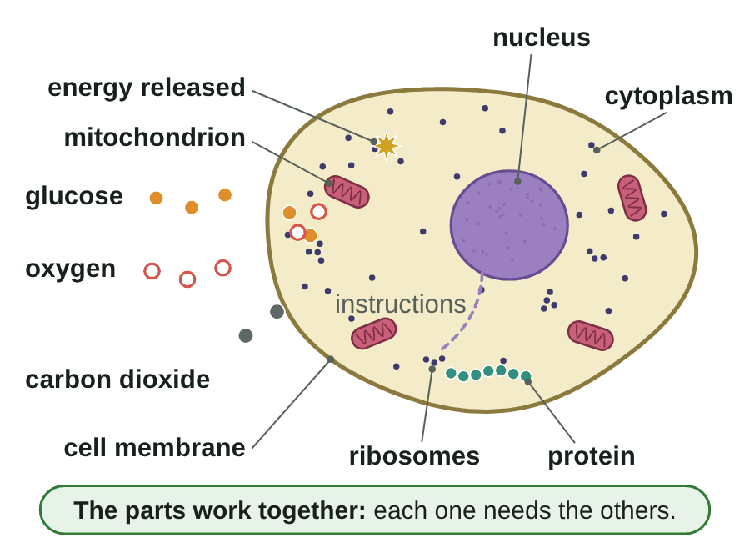
sciencegcse.co.uk · Biology B1 L1: Animal and plant cells
Online lesson: screen 4 of 12
Cell parts working together
Inside a working cell
Step by step
1
Cell membrane: lets glucose and oxygen into the cell.
2
Mitochondria: aerobic respiration releases energy from glucose.
3
Nucleus: its genetic material holds the instructions for making proteins.
4
Ribosomes: use energy to make proteins (protein synthesis).
5
Cytoplasm: most chemical reactions happen here, controlled by enzymes. Waste carbon dioxide passes out through the cell membrane.
The parts work together: each one needs the others.
▶ Online lesson, screen 4: Cell parts working together
● glucose ○ oxygen ✦ energy released.
A diagram is simplified.
7
B1 L1 · sciencegcse.co.uk
Notes:
Run screen 4 of the online lesson with Next step, or let the GIF play (print and PDF show its first frame). One step a click, then the green line. At each step ask: which part is working now, and what is it doing? The big idea: no part works alone. The ribosomes cannot make proteins without energy from the mitochondria; the mitochondria need glucose and oxygen let in by the cell membrane; the nucleus controls it all. How glucose and oxygen get in is B1 L8 Diffusion; respiration in detail is B4 Bioenergetics. Watch out: energy is released by respiration, never made. Ask: what would happen to the cell if its mitochondria stopped working? (No energy released, so no proteins made: the cell would die.)

Slide 8
sciencegcse.co.uk · Biology B1 L1: Animal and plant cells
Online lesson: screen 5 of 12
Checkpoint 1
✓
CHECKPOINT 1 of 3
Quick check on slides 4 to 7 (online screens 1 to 4). Show A, B or C on your whiteboard.
Question 1
Question 2
Question 3
In the painting, the cheek cells are blue. Why are they blue?
Oxygen passes into a cheek cell. Which part of the cell controls this movement?
A muscle cell needs energy to contract. What do its mitochondria do?
A. Cheek cells are naturally blue.
A. The nucleus
A. They release energy by aerobic respiration.
B. A blue stain was added to make them easier to see.
B. The cytoplasm
B. They make energy from glucose.
C. The microscope light makes them look blue.
C. The cell membrane
C. They make proteins for the cell.
✓ Check your answers on the next slide
8
B1 L1 · sciencegcse.co.uk
Notes:
Hinge check. Everyone shows A, B or C at the same time. Q1 A and C test the stain trap (real cells are almost colourless); Q2 A tests nucleus against cell membrane; Q3 B is the 'energy is made' trap and Q3 C mixes up mitochondria and ribosomes. If several get Q1 wrong, go back to slide 5; Q2, slide 6; Q3, slide 7.

Slide 9
sciencegcse.co.uk · Biology B1 L1: Animal and plant cells
Online lesson: screen 5 of 12
Checkpoint 1 answers
✓
CHECKPOINT 1 of 3
Quick check on slides 4 to 7 (online screens 1 to 4). Show A, B or C on your whiteboard.
Question 1
Question 2
Question 3
In the painting, the cheek cells are blue. Why are they blue?
Oxygen passes into a cheek cell. Which part of the cell controls this movement?
A muscle cell needs energy to contract. What do its mitochondria do?
A. Cheek cells are naturally blue.
A. The nucleus
A. They release energy by aerobic respiration.
A. They release energy by aerobic respiration. ✓
B. A blue stain was added to make them easier to see.
B. A blue stain was added to make them easier to see. ✓
B. The cytoplasm
B. They make energy from glucose.
C. The microscope light makes them look blue.
C. The cell membrane
C. The cell membrane ✓
C. They make proteins for the cell.
The stain, methylene blue, is a dye. The nucleus takes up the most stain.
The cell membrane controls the movement of substances into and out of the cell.
Energy is released in the mitochondria. It is never made.
Got one wrong? Look back: Q1 slide 5 · Q2 slide 6 · Q3 slide 7
9
B1 L1 · sciencegcse.co.uk
Notes:
1 B, 2 C, 3 A. Each click shows one answer and why. Ask a student who got each one right to explain why. Follow-up for Q3: where in the cell are proteins made? (At the ribosomes.)

Slide 10
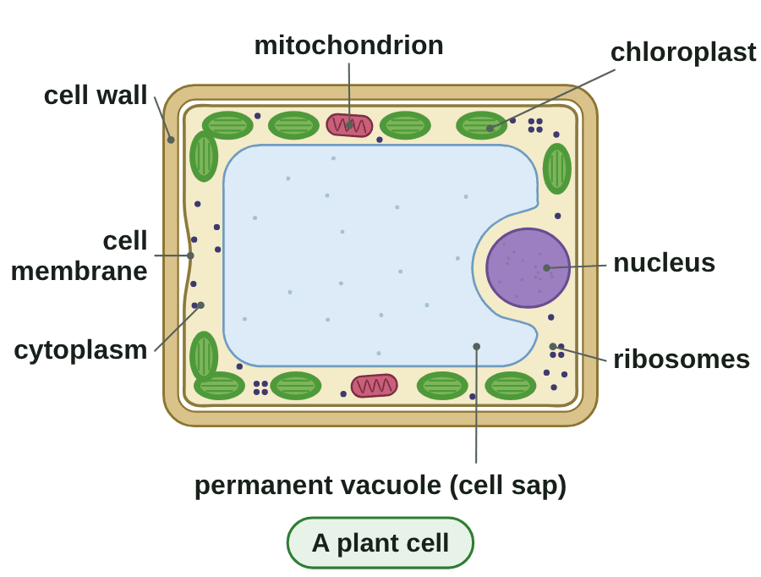
sciencegcse.co.uk · Biology B1 L1: Animal and plant cells
Online lesson: screen 6 of 12
Building a plant cell
From five parts to a plant cell
Step by step
1
Five shared parts: nucleus, cytoplasm, cell membrane, mitochondria, ribosomes.
2
Cell wall: made of cellulose; strengthens the cell.
3
Permanent vacuole: filled with cell sap; helps to keep the cell firm.
4
Chloroplasts: contain green chlorophyll; absorb light to make food by photosynthesis.
Watch out: the cell wall is outside the cell membrane. Plant cells have both.
▶ Online lesson, screen 6: Building a plant cell
A diagram is simplified. Only the chloroplasts' green is a real colour.
10
B1 L1 · sciencegcse.co.uk
Notes:
Build the plant cell with the class: start from the five parts they already know. One step a click, then the Watch out line. Ask before each step: what does a plant cell have that we have not added yet? The cell wall is made of cellulose, the substance in cotton and paper. It strengthens the cell: it does not control what goes in and out (that is the cell membrane, just inside it). Cell sap is a weak solution of sugars and salts. A full vacuole presses the cytoplasm against the wall and keeps the cell firm, which helps a plant stand up; why it fills with water is B1 L9 Osmosis. Chloroplasts contain chlorophyll, the green substance that absorbs light. Algal cells (seaweeds and pond algae) also have a cell wall made of cellulose, and chloroplasts. Common error: writing 'vacuole' without 'permanent', or saying cell sap is just water. The GIF builds the cell as Next step does on the online lesson, screen 6 (print and PDF show its first frame, the finished plant cell).

Slide 11
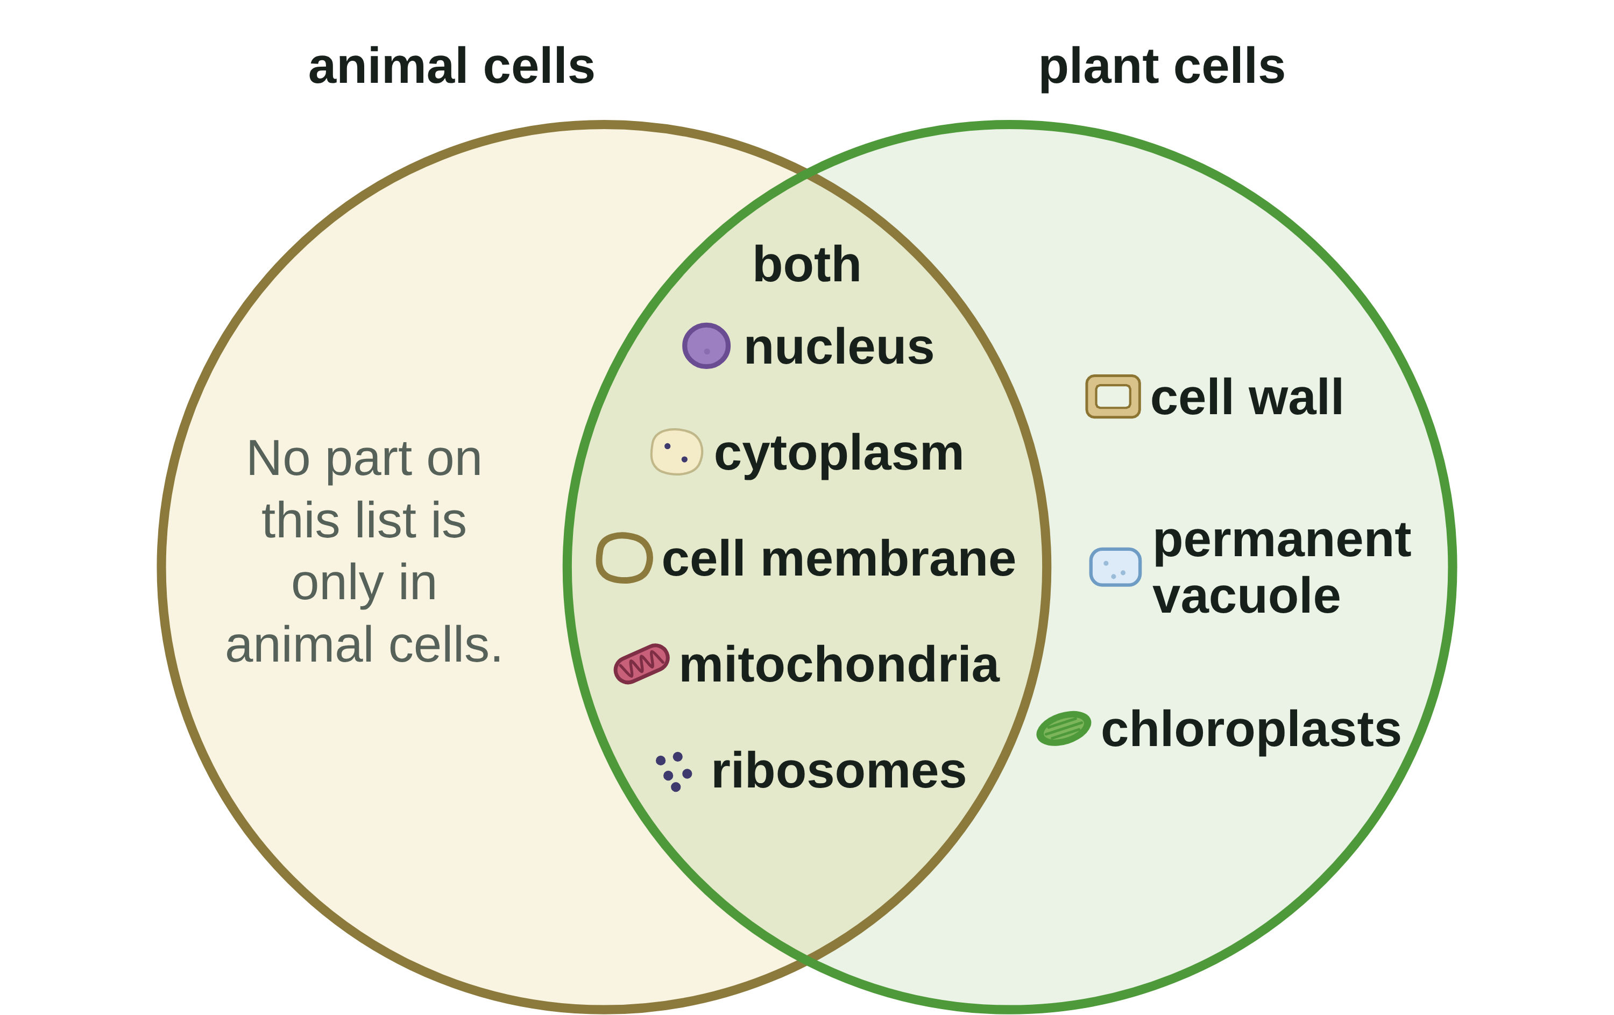
sciencegcse.co.uk · Biology B1 L1: Animal and plant cells
Online lesson: screen 7 of 12
Animal and plant cells compared
Who has what?
Compare the cells
Part
Animal cell
Plant cell
nucleus
yes
yes
cytoplasm
yes
yes
cell membrane
yes
yes
mitochondria
yes
yes
ribosomes
yes
yes
cell wall
no
yes
permanent vacuole
no
often
chloroplasts
no
often
A diagram is simplified.
Watch out: plant cells have mitochondria too. Animal cells have no cell wall and no permanent vacuole.
▶ Online lesson, screen 7: sort the parts yourself
Plant cells have every part that animal cells have, and more.
11
B1 L1 · sciencegcse.co.uk
Notes:
Before you click, ask pairs to sort the eight parts on whiteboards: both, or plant cells only? Then reveal the rows, one a click, then the Watch out line and the green line. The surprise for many students: there is nothing on the AQA list that only animal cells have. The other surprise: plant cells have mitochondria. They make food by photosynthesis, but they still need to release energy from it by respiration, all the time (screen 10). 'Often' for chloroplasts: cells that grow in the dark, such as onion bulb cells and root hair cells, have none (screen 11). The online lesson, screen 7, has the same parts to sort.

Slide 12
sciencegcse.co.uk · Biology B1 L1: Animal and plant cells
Online lesson: screen 8 of 12
Checkpoint 2
✓
CHECKPOINT 2 of 3
Quick check on slides 10 and 11 (online screens 6 and 7). Show A, B or C on your whiteboard.
Question 1
Question 2
Question 3
A plant cell has a cell wall and a cell membrane. What does the cell wall do?
Which of these parts do both animal cells and plant cells have?
A cell has a nucleus, mitochondria, no cell wall and no permanent vacuole. Where is it from?
A. It controls what goes into and out of the cell.
A. Mitochondria
A. A plant, because it has mitochondria
B. It absorbs light for photosynthesis.
B. Chloroplasts
B. An animal, because it has no cell wall
C. It strengthens the cell.
C. A permanent vacuole
C. A plant, because it has a nucleus
✓ Check your answers on the next slide
12
B1 L1 · sciencegcse.co.uk
Notes:
Hinge check: everyone shows A, B or C at the same time. Q1 A is the wall-and-membrane trap; Q2 B and C test which parts are plant only; Q3 A is the 'only plants have mitochondria' trap turned round. If several get Q1 wrong, go back to slide 10; Q2 or Q3, slide 11.

Slide 13
sciencegcse.co.uk · Biology B1 L1: Animal and plant cells
Online lesson: screen 8 of 12
Checkpoint 2 answers
✓
CHECKPOINT 2 of 3
Quick check on slides 10 and 11 (online screens 6 and 7). Show A, B or C on your whiteboard.
Question 1
Question 2
Question 3
A plant cell has a cell wall and a cell membrane. What does the cell wall do?
Which of these parts do both animal cells and plant cells have?
A cell has a nucleus, mitochondria, no cell wall and no permanent vacuole. Where is it from?
A. It controls what goes into and out of the cell.
A. Mitochondria
A. Mitochondria ✓
A. A plant, because it has mitochondria
B. It absorbs light for photosynthesis.
B. Chloroplasts
B. An animal, because it has no cell wall
B. An animal, because it has no cell wall ✓
C. It strengthens the cell.
C. It strengthens the cell. ✓
C. A permanent vacuole
C. A plant, because it has a nucleus
The cell wall is made of cellulose, which strengthens the cell.
Plant cells have mitochondria too, so they can respire.
Animal cells have no cell wall and no permanent vacuole.
Got one wrong? Look back: Q1 slide 10 · Q2 and Q3 slide 11
13
B1 L1 · sciencegcse.co.uk
Notes:
1 C, 2 A, 3 B. Each click shows one answer and why. Follow-up for Q3: name the three parts that would show it was a plant cell. (A cell wall, a permanent vacuole, chloroplasts.)

Slide 14
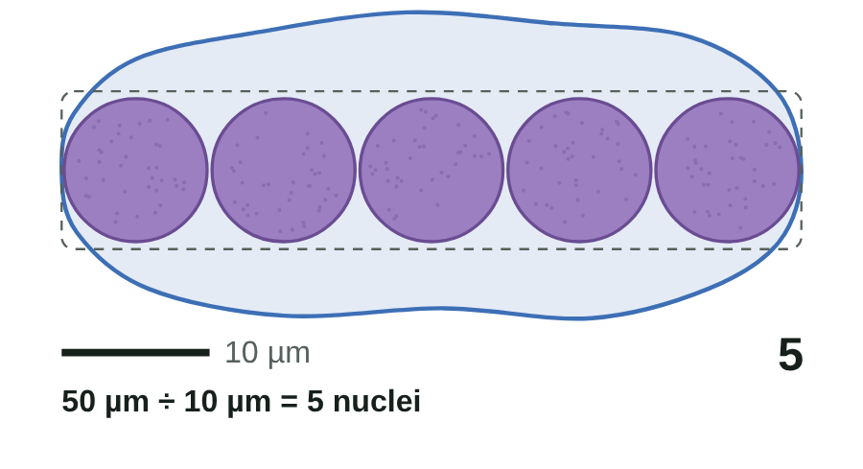
sciencegcse.co.uk · Biology B1 L1: Animal and plant cells
Online lesson: screen 9 of 12
How big are the parts?
Line them up
About how big?
Part
About how big
plant cell
10 to 100 µm
animal cell
10 to 30 µm (a cheek cell is bigger: about 50 µm)
nucleus
5 to 10 µm
chloroplast
about 5 µm
mitochondrion
about 1 µm
ribosome
about 25 nm (0.025 µm)
Estimate
Drawn to scale. A real cell has only one nucleus.
number that fit = width of the cell ÷ width of the part
Example 1: cheek cell 50 µm, nucleus 10 µm: 50 ÷ 10 = 5 nuclei. Check: 5 × 10 µm = 50 µm.
Example 2: plant cell 40 µm, mitochondrion 1 µm: 40 ÷ 1 = 40 mitochondria.
Both sizes must be in the same unit before you divide.
▶ Online lesson, screen 9: How big are the parts?
14
B1 L1 · sciencegcse.co.uk
Notes:
AQA asks you to use estimates to judge the relative sizes of the parts. An estimate is a rough value worked out quickly with simple numbers. Cells vary, so 'about' is the right word. Table rows one a click, then the four lines of Estimate. Go through the equation in words, then example 1: the equation, the numbers, the answer with its unit, then the check. Ask: is the answer sensible? (5 nuclei across: the nucleus is a big part, so yes.) Example 2 the same way. Ask: why can we see nuclei but not ribosomes with a light microscope? (A ribosome is about 25 nm, 400 times narrower than a 10 µm nucleus.) 1 µm = 1000 nm. When to estimate: to check an answer, or to compare sizes quickly. The magnification equation and scale bars are B1 L4 Magnification and cell size. The GIF lines up 5 nuclei, then 50 mitochondria, across a 50 µm cheek cell (print and PDF show its first frame). The online lesson, screen 9, has a 'Try it' box: students can type any two sizes.

Slide 15
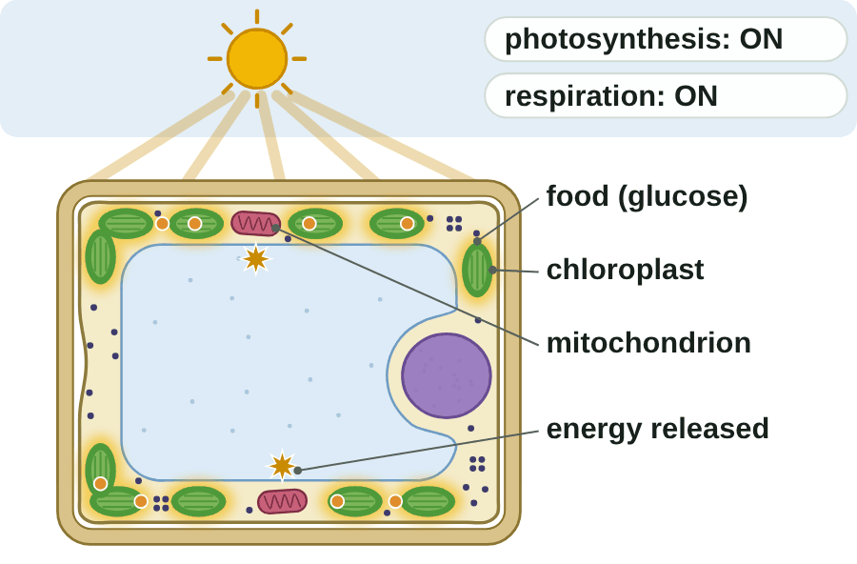
sciencegcse.co.uk · Biology B1 L1: Animal and plant cells
Online lesson: screen 10 of 12
Plant cells respire day and night
A leaf cell, day and night
Key facts
Chloroplasts absorb light to make food by photosynthesis: only in the light.
Mitochondria release energy by aerobic respiration: all the time, day and night.
Plant cells need energy all the time: to make proteins and to grow.
Watch out: plant cells respire as well as photosynthesise.
Chloroplasts do not make energy. Mitochondria release it.
● food (glucose) ✦ energy released. A diagram is simplified.
▶ Online lesson, screen 10: Plant cells respire day and night
15
B1 L1 · sciencegcse.co.uk
Notes:
A very common mistake: 'plants photosynthesise and animals respire', or 'plants respire only at night'. Plant cells respire all the time. In the day they photosynthesise too, and in bright light photosynthesis is faster than respiration; at night only respiration happens. Ask: where does a leaf cell get its food at night? (Food made in the day and stored.) Ask: why does a root cell need mitochondria? (It respires to release energy, and it cannot photosynthesise in the dark soil.) Never say chloroplasts make energy: they absorb light energy and use it to make food (glucose). The equations for photosynthesis and respiration are B4 Bioenergetics. The GIF loops day and night, as the online lesson, screen 10, does (print and PDF show its first frame, the day). One line a click.

Slide 16
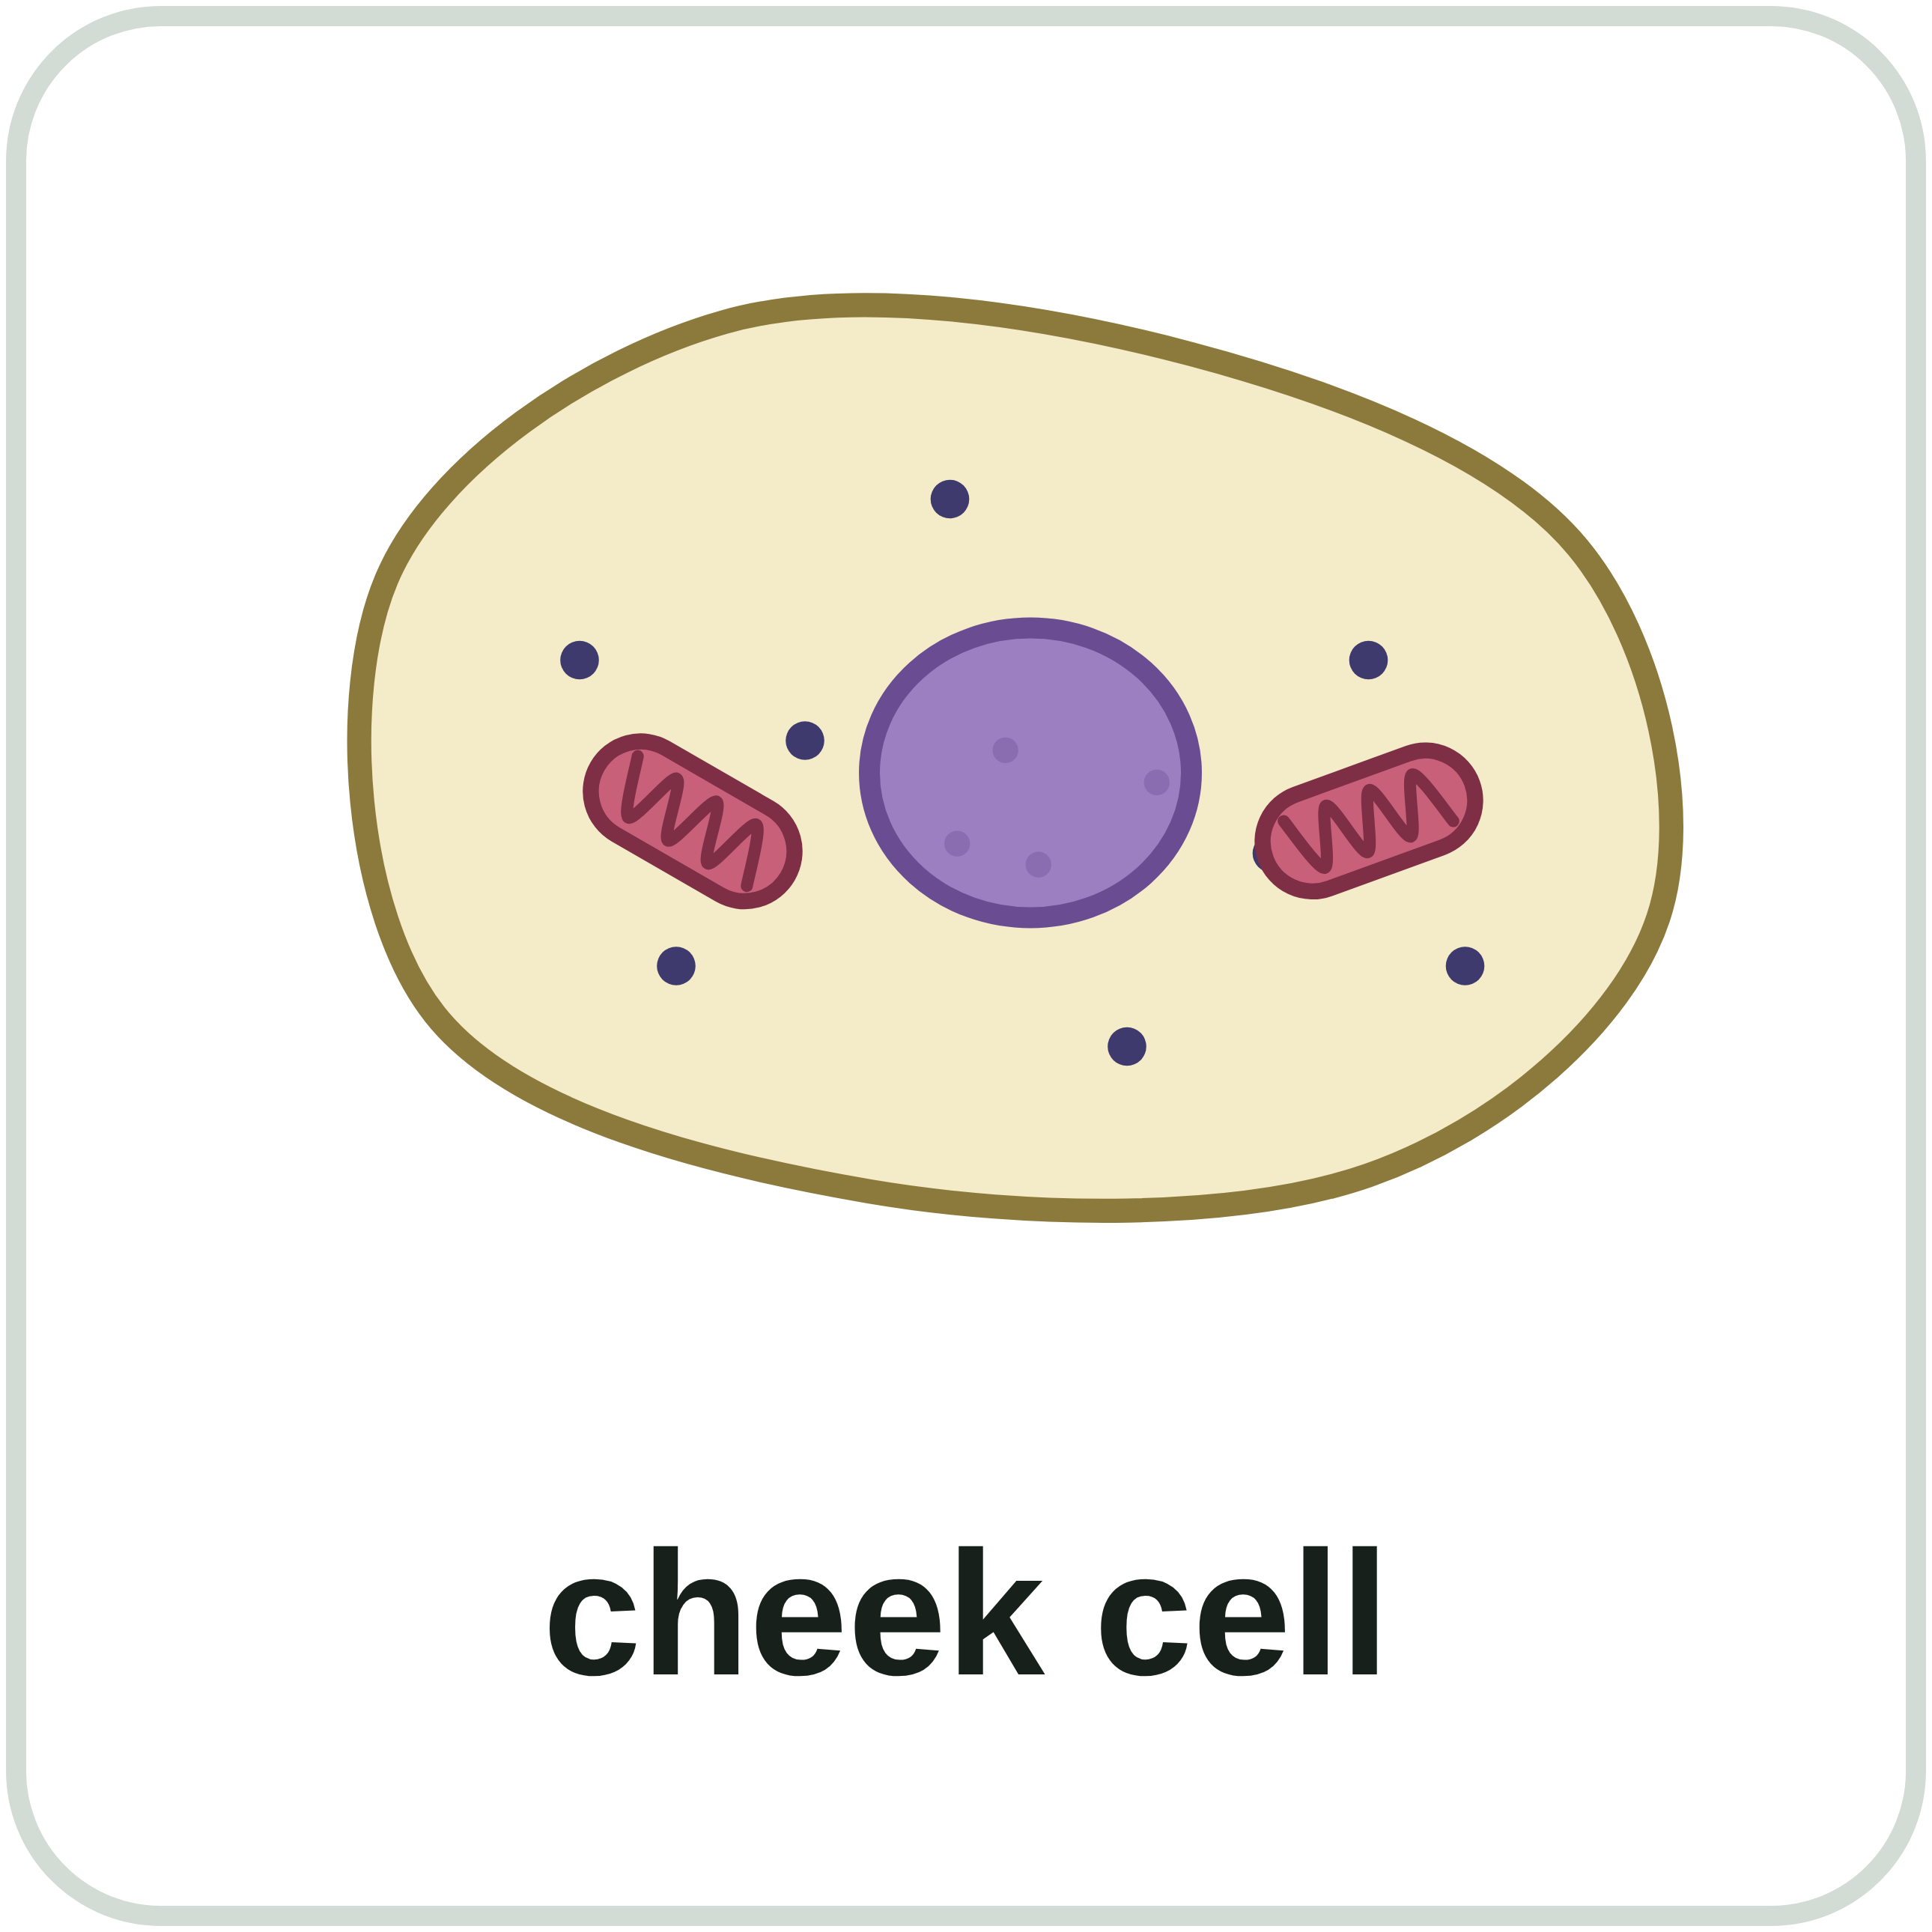
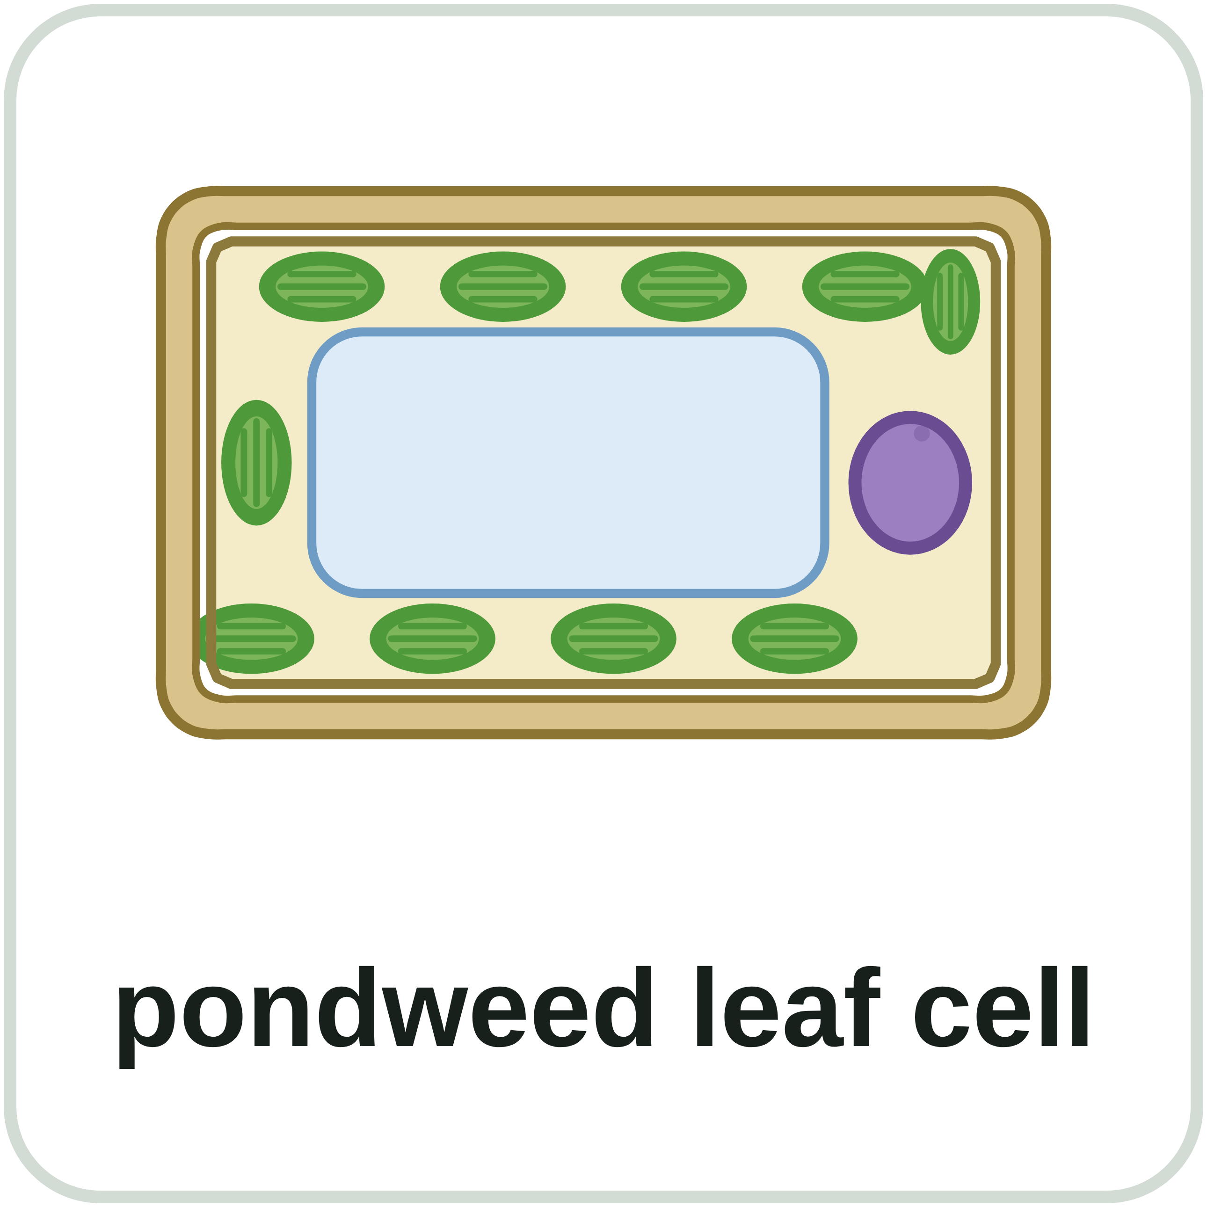
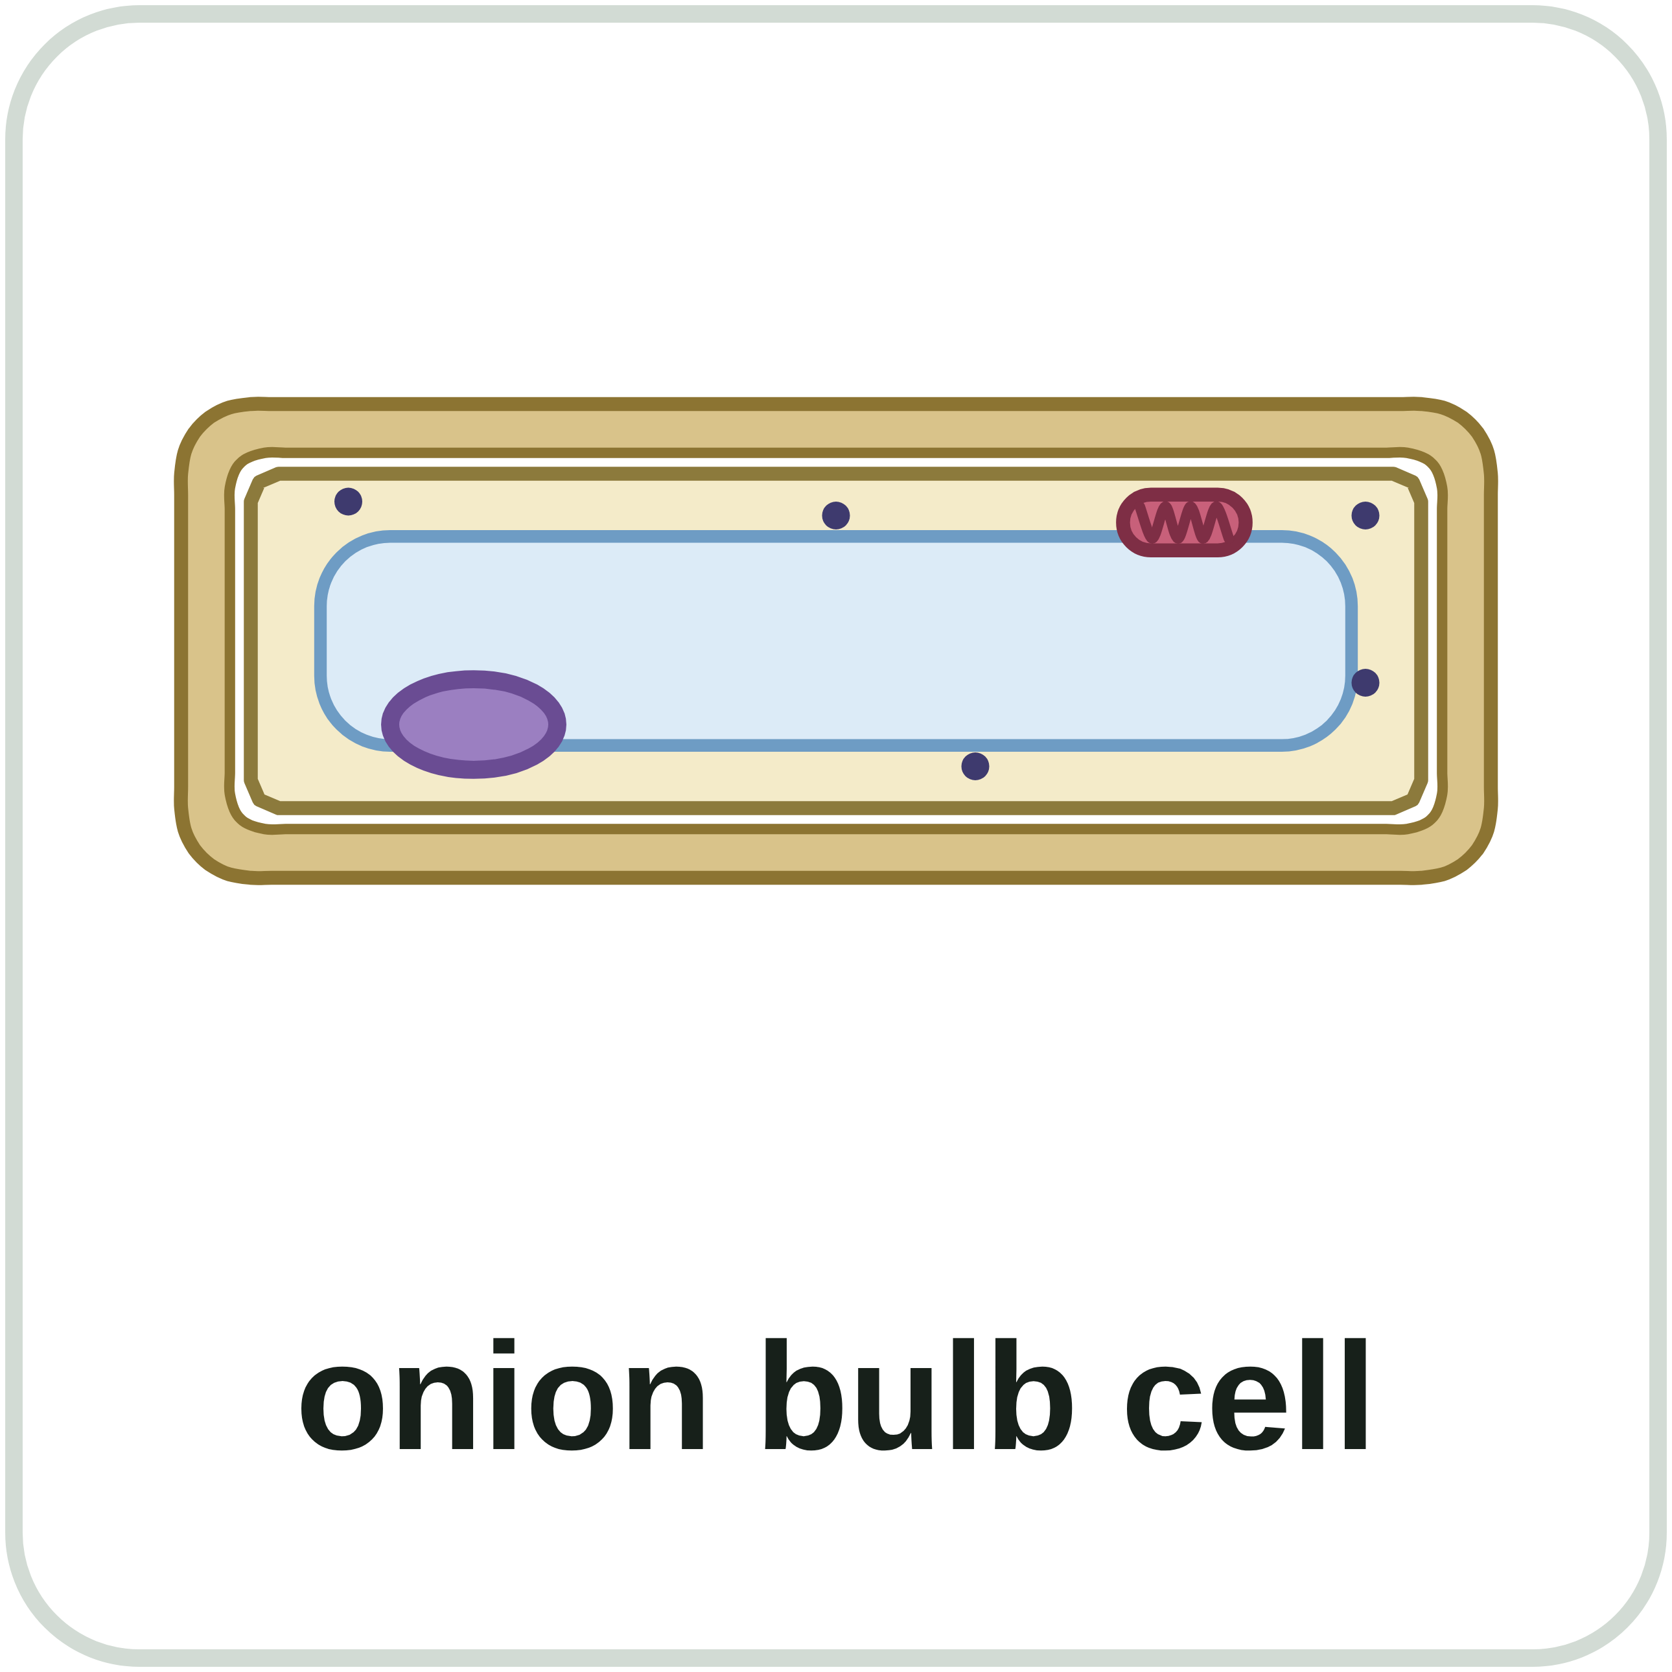
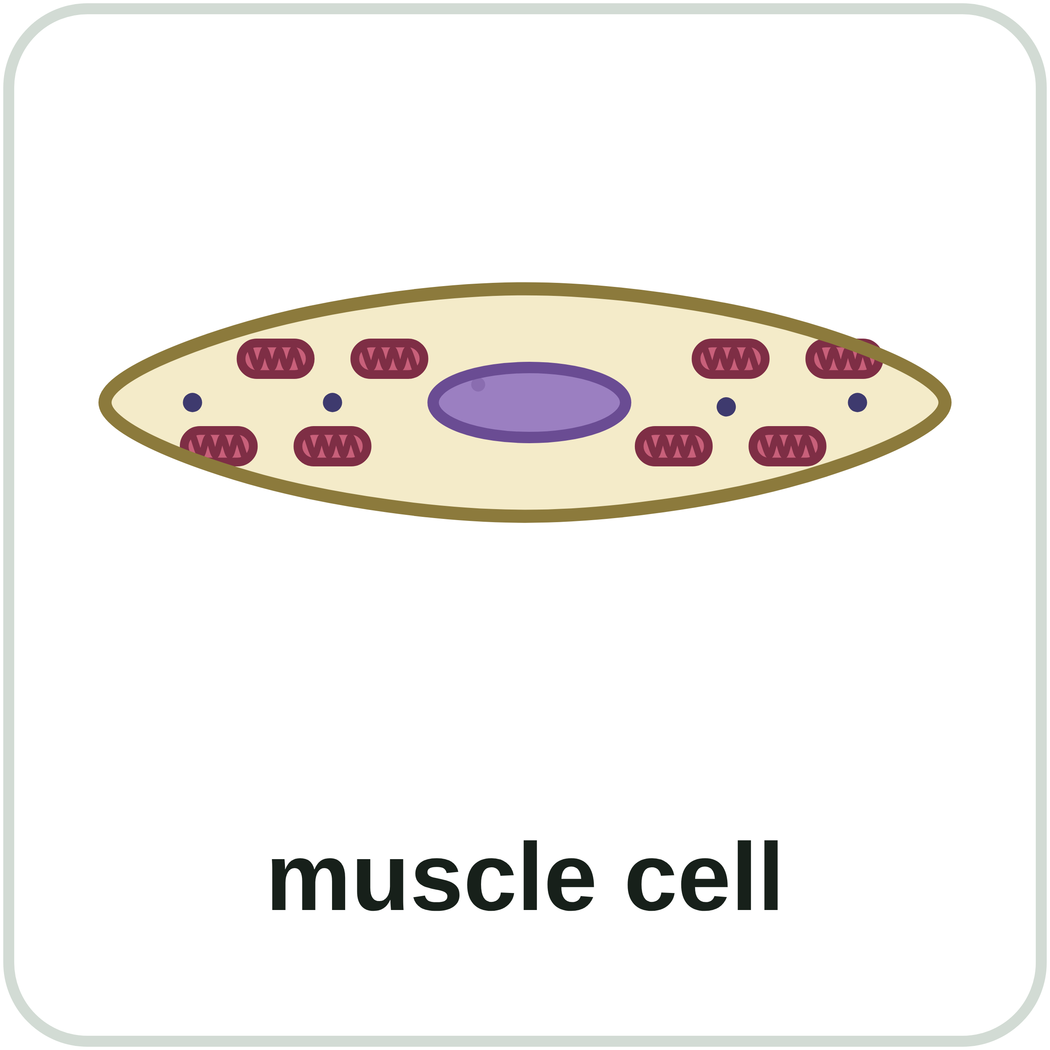
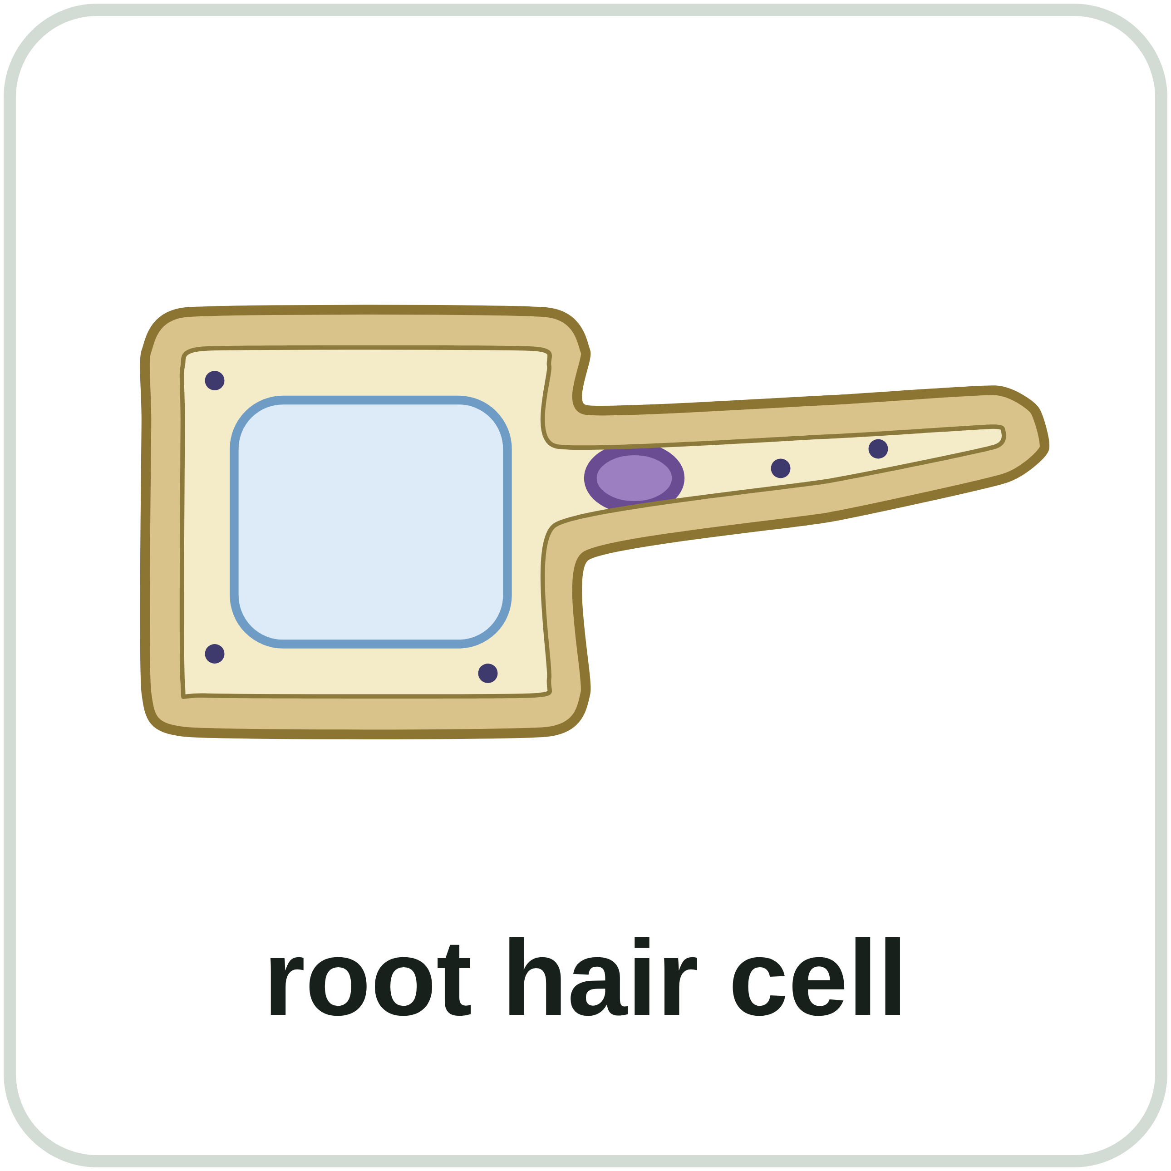
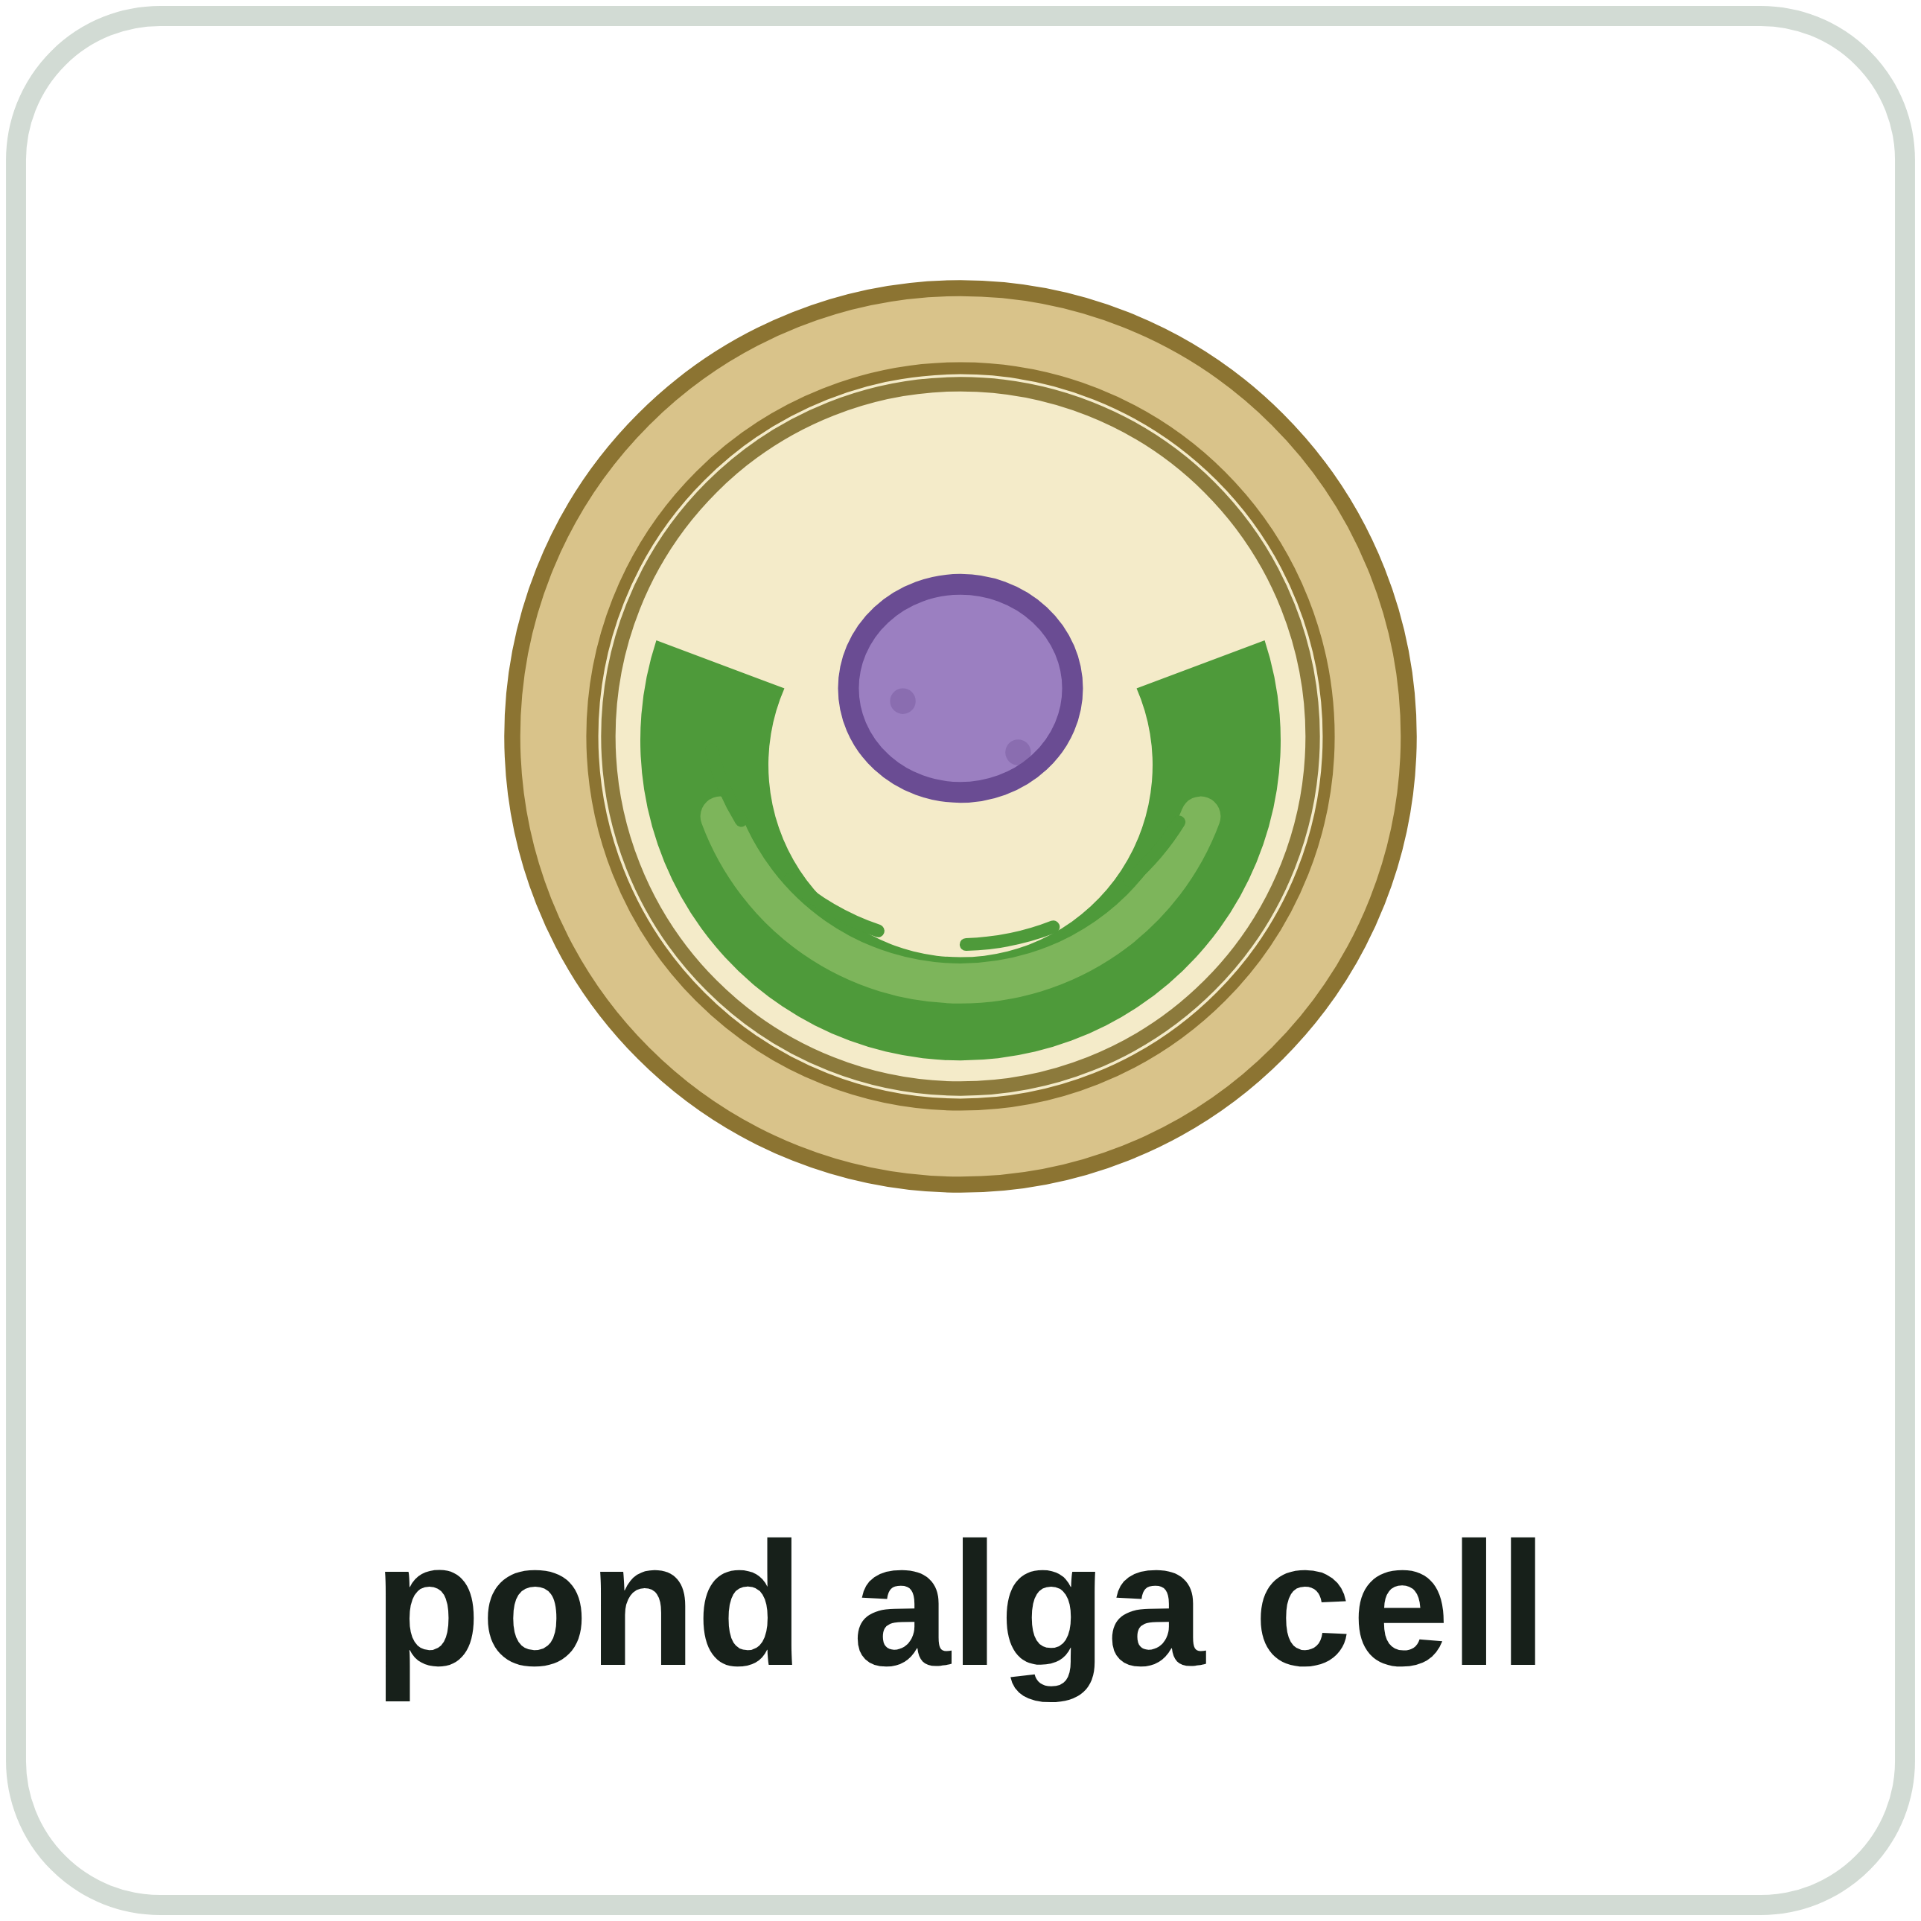
sciencegcse.co.uk · Biology B1 L1: Animal and plant cells
Online lesson: screen 11 of 12
Which cell is it?
Sort the cells
Clues
Animal cell
Plant or algal cell
A cell wall and a permanent vacuole: a plant cell. No cell wall: an animal cell.
Not every plant cell has chloroplasts. Cells that grow in the dark, such as onion bulb cells, have none.
Algal cells also have a cell wall made of cellulose, and chloroplasts.
Look for the cell wall first.
▶ Online lesson, screen 11: sort the cells yourself
16
B1 L1 · sciencegcse.co.uk
Notes:
Before you click, read out the six: a cheek cell, a muscle cell, a pondweed leaf cell, an onion bulb cell, a root hair cell, a cell from a pond alga. Show the six pictures on the online lesson, screen 11, or describe them. Pairs sort them into the two columns (2 minutes). Then click to reveal: each click shows two cards and one clue. The traps: the onion bulb and root hair cells have no chloroplasts, but they are still plant cells: look for the cell wall and the permanent vacuole. The muscle cell has many mitochondria, but so do many hard-working cells; mitochondria never decide the answer. Algae, such as pond algae and seaweeds, are not plants, but their cells have a cell wall made of cellulose and chloroplasts, like plant cells. How root hair cells and muscle cells are adapted for their jobs is B1 L5 Specialised cells.

Slide 17
sciencegcse.co.uk · Biology B1 L1: Animal and plant cells
Online lesson: screen 12 of 12
Checkpoint 3
✓
CHECKPOINT 3 of 3
Quick check on slides 14 to 16 (online screens 9 to 11). Show A, B or C on your whiteboard.
Question 1
Question 2
Question 3
A pondweed cell is about 60 µm long. A chloroplast is about 5 µm long. How many fit along it?
When do the mitochondria in a leaf cell release energy?
Cells from an onion bulb have no chloroplasts. How can you tell they are plant cells?
A. 300
A. All the time, day and night
A. They have a nucleus.
B. 12
B. Only at night
B. They have mitochondria.
C. 55
C. Only in the light
C. They have a cell wall and a permanent vacuole.
✓ Check your answers on the next slide
17
B1 L1 · sciencegcse.co.uk
Notes:
Hinge check: everyone shows A, B or C at the same time. Q1 A (multiplying) and C (subtracting) are the two common slips in estimates; Q2 B and C are the respiration traps; Q3 A and B test whether students know which parts are shared. If several get Q1 wrong, go back to slide 14; Q2, slide 15; Q3, slide 16.

Slide 18
sciencegcse.co.uk · Biology B1 L1: Animal and plant cells
Online lesson: screen 12 of 12
Checkpoint 3 answers
✓
CHECKPOINT 3 of 3
Quick check on slides 14 to 16 (online screens 9 to 11). Show A, B or C on your whiteboard.
Question 1
Question 2
Question 3
A pondweed cell is about 60 µm long. A chloroplast is about 5 µm long. How many fit along it?
When do the mitochondria in a leaf cell release energy?
Cells from an onion bulb have no chloroplasts. How can you tell they are plant cells?
A. 300
A. All the time, day and night
A. All the time, day and night ✓
A. They have a nucleus.
B. 12
B. 12 ✓
B. Only at night
B. They have mitochondria.
C. 55
C. Only in the light
C. They have a cell wall and a permanent vacuole.
C. They have a cell wall and a permanent vacuole. ✓
60 ÷ 5 = 12 chloroplasts.
Plant cells respire all the time. They photosynthesise only in the light.
Not every plant cell has chloroplasts. The inner layers of a bulb get no light.
Got one wrong? Look back: Q1 slide 14 · Q2 slide 15 · Q3 slide 16
18
B1 L1 · sciencegcse.co.uk
Notes:
1 B, 2 A, 3 C. Each click shows one answer and why. Follow-up for Q1: check the answer: 12 × 5 µm = 60 µm. Next: practise spotting the parts on a plant cell.

Slide 19
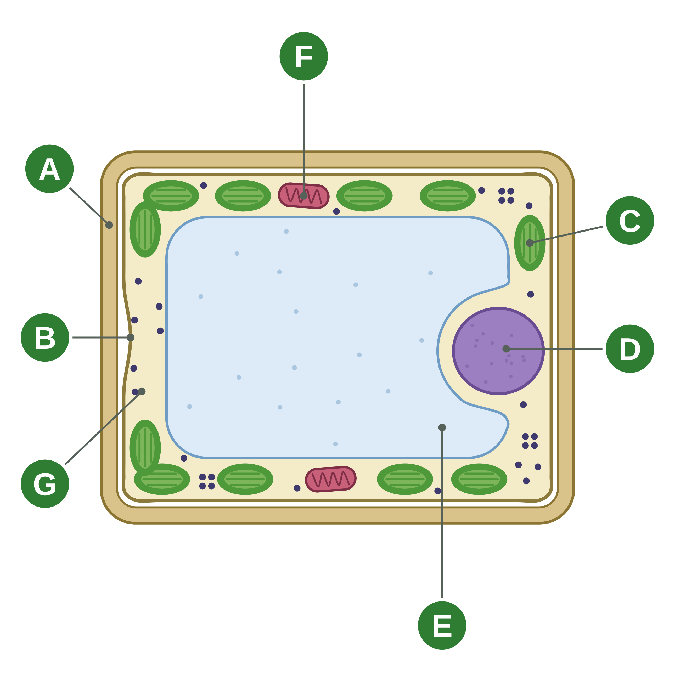
sciencegcse.co.uk · Biology B1 L1: Animal and plant cells
Practice: Spot the parts
A plant cell
Questions
1. Which letter shows the part that strengthens the cell?
______________
2. Which letter shows where aerobic respiration happens?
______________
3. Which letter shows the part filled with cell sap?
______________
4. Which letter shows a part that absorbs light?
______________
5. Which three letters show parts that an animal cell does not have?
______________
6. Name part B and give its job.
______________
A diagram is simplified. Only the chloroplasts' green is a real colour.
19
B1 L1 · sciencegcse.co.uk
Notes:
Pairs, 4 minutes. Cover the key words on the board. Q6 is the trap: B is the cell membrane, just inside the wall.

Slide 20
sciencegcse.co.uk · Biology B1 L1: Animal and plant cells
Spot the parts: answers
A plant cell
Answers
1. Which letter shows the part that strengthens the cell?
A (the cell wall)
2. Which letter shows where aerobic respiration happens?
F (a mitochondrion)
3. Which letter shows the part filled with cell sap?
E (the permanent vacuole)
4. Which letter shows a part that absorbs light?
C (a chloroplast)
5. Which three letters show parts that an animal cell does not have?
A, C and E
6. Name part B and give its job.
The cell membrane: it controls the movement of substances into and out of the cell.
A diagram is simplified. Only the chloroplasts' green is a real colour.
20
B1 L1 · sciencegcse.co.uk
Notes:
A cell wall, B cell membrane, C chloroplast, D nucleus, E permanent vacuole, F mitochondrion, G cytoplasm. Ask: which letter is missing from the questions, and what is it? (G, the cytoplasm: where most chemical reactions happen.) Common error in Q5: including F. Animal cells have mitochondria too.

Slide 21
sciencegcse.co.uk · Biology B1 L1: Animal and plant cells
Exam practice
1. A student writes: 'The cell wall controls what goes into and out of a plant cell.' Explain what is wrong with this sentence. [2]
The cell membrane controls what goes into and out of the cell (1). The cell wall strengthens the cell (1).
2. Cells in a leaf have chloroplasts. Cells in a root have none. Suggest why. [2]
Roots are underground, so they get no light (1). Chloroplasts absorb light for photosynthesis, so they would be no use in a root (1).
21
B1 L1 · sciencegcse.co.uk
Notes:
Model answers with mark points in brackets. Students try each question first, then mark their own work in green. Q1: name the part that does the job, then say what the wall really does. Q2: link the part to light. For more, the B1 L1 Exam questions worksheet (PDF) has 5 questions, 20 marks; its mark scheme is at the end of this PowerPoint. The same questions are in the online lesson, after the quiz.

Slide 22
sciencegcse.co.uk · Biology B1 L1: Animal and plant cells
Exit ticket
Answer on your own
How confident am I?
1. Name one part found in plant cells but not in animal cells. [1]
I can name the parts of cells and give their jobs.
2. What is the job of the ribosomes? [1]
I can say which parts only plant cells have.
3. Animal and plant cells are eukaryotic. What does this tell you about their genetic material? [1]
4. An animal cell is about 21 µm across. Its nucleus is about 7 µm across. Estimate how many nuclei would fit across the cell. Show your working. [2]
I can compare a light micrograph with a diagram.
22
B1 L1 · sciencegcse.co.uk
Notes:
Students answer on their own, then rate their confidence. Q4 checks the estimate from screen 9: the working earns a mark.

Slide 23
sciencegcse.co.uk · Biology B1 L1: Animal and plant cells
Exit ticket answers
Answers
Next lesson
1. A cell wall, a permanent vacuole or chloroplasts.
2. Protein synthesis: proteins are made there.
3. It is enclosed in a nucleus.
4. 21 ÷ 7 (1) = 3 nuclei (1).
Next: B1 L2 Bacterial cells
How bacterial cells differ from animal and plant cells.
Worksheets:
• Mandatory (everyone)
• Alternative (easier, with key notes)
• Challenge (when you finish the Mandatory)
• Exam questions (exam style, 20 marks, homework)
▶ Online lesson: quiz and exam questions
23
B1 L1 · sciencegcse.co.uk
Notes:
Go through the answers. Q1 allows any one of the three. After this slide: the B1 L1 revision notes (4 printable pages), then the worksheets with answers in green: Mandatory (everyone), Challenge (stretch) and Alternative (easier: key notes and very simple tasks). The B1 L1 Exam questions worksheet (exam style, black and white, 20 marks) is a separate PDF for homework; its mark scheme is the last two slides. Homework: the online lesson quiz and the B1 L1 Exam questions worksheet. Next lesson: bacterial cells, which have no nucleus at all.

Slide 24
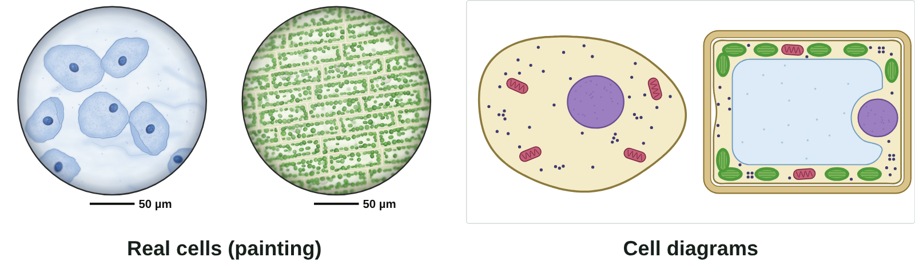
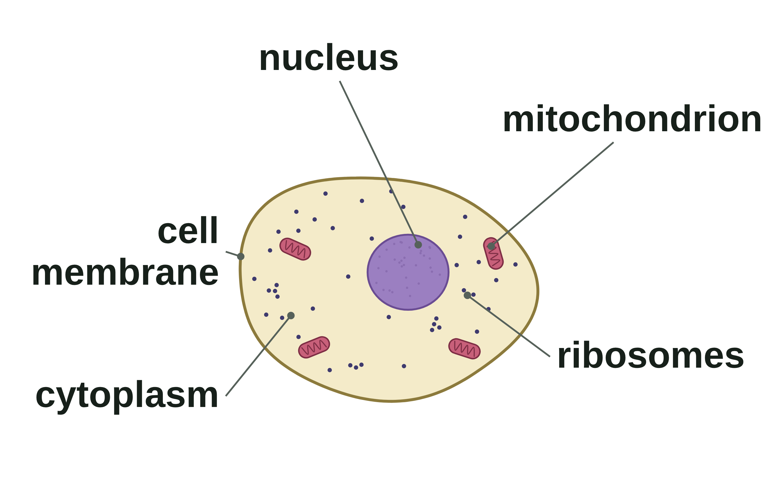
B1 L1 Revision notes 1 of 4
Animal and plant cells
Cells, eukaryotic cells and the animal cell
1. Cells: the building blocks
3. Eukaryotic cells
All living things are made of cells. A cell is the basic building block of all living things.
Most cells are far too small to see without a microscope. A typical animal cell is about 10 to 30 µm across, and a plant cell about 10 to 100 µm (1 mm = 1000 µm).
Inside each cell are smaller parts, called sub-cellular structures. Each one has a particular job. Together they keep the cell alive.
Animal and plant cells are eukaryotic cells. Every eukaryotic cell has:
a cell membrane around the cytoplasm (in plant cells, just inside the cell wall)
cytoplasm inside
genetic material (DNA) enclosed in a nucleus.
"Eu-" means true: a eukaryotic cell has a true nucleus. Bacterial cells are prokaryotic: their genetic material is not in a nucleus (B1 L2 Bacterial cells).
2. Real cells and cell diagrams
4. Inside an animal cell
Most animal cells have five parts. You need to know each one and its job.
Part | Job
nucleus | contains genetic material, which controls the activities of the cell
cytoplasm | a jelly-like substance where most of the chemical reactions in the cell happen; enzymes control the reactions
cell membrane | controls the movement of substances into and out of the cell
mitochondria | where aerobic respiration happens, releasing energy for the cell
ribosomes | protein synthesis: proteins are made there
Stains colour the cells: the blue is a dye. The green chloroplasts are their real colour.
A picture of cells seen through a light microscope is a light micrograph. Real cells are almost colourless, so animal cells such as cheek cells are often stained: a blue dye shows up the nucleus. Pondweed leaf cells need no stain: their chloroplasts are really green.
Exam pictures of cells are usually diagrams. A diagram is simplified on purpose:
It draws mitochondria and ribosomes. In a light micrograph, mitochondria are too small to see clearly, and ribosomes cannot be seen at all.
It shows one neat cell. Real plant cells are packed together in rows and share their walls.
It colours the permanent vacuole. In real cells it is clear and hard to see.
It draws the cell membrane as a separate line. In a real plant cell it is pressed against the cell wall.
It always shows the nucleus clearly. In real plant cells it is often hidden behind chloroplasts.
Notes on the parts:
The genetic material in the nucleus is DNA. It carries the instructions for making the cell's proteins (more in B1 L6 Cell division: mitosis).
One mitochondrion, many mitochondria. Cells that need a lot of energy, such as muscle cells, have a lot of them.
Ribosomes are tiny: about 25 nm across. They make proteins such as enzymes (B2 L3 Enzymes and digestion).
A diagram is simplified.
Watch out: the colours in a diagram are not real. Only the green of the chloroplasts is a real colour. The blue of stained cheek cells is a dye.
Watch out: mitochondria release energy by respiration. Never write that energy is "made" or "produced".
B1 L1 · Animal and plant cells · sciencegcse.co.uk · free GCSE science resources
Notes:
Revision notes page 1 of 4 (or use B1_L1_Revision_notes.pdf). These pages are the textbook for B1 L1: students read them before the worksheets. Page 1: cells, eukaryotic cells, real cells beside diagrams, and the five parts of an animal cell. Ask: why can you not see ribosomes in a light micrograph?

Slide 25
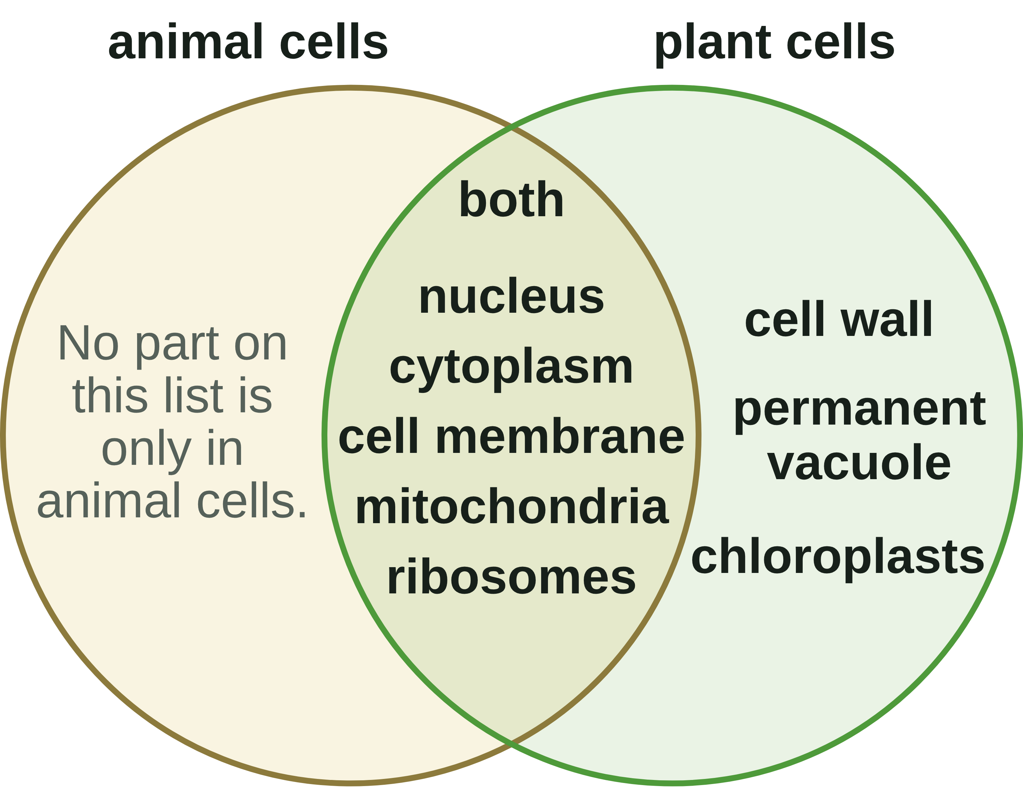
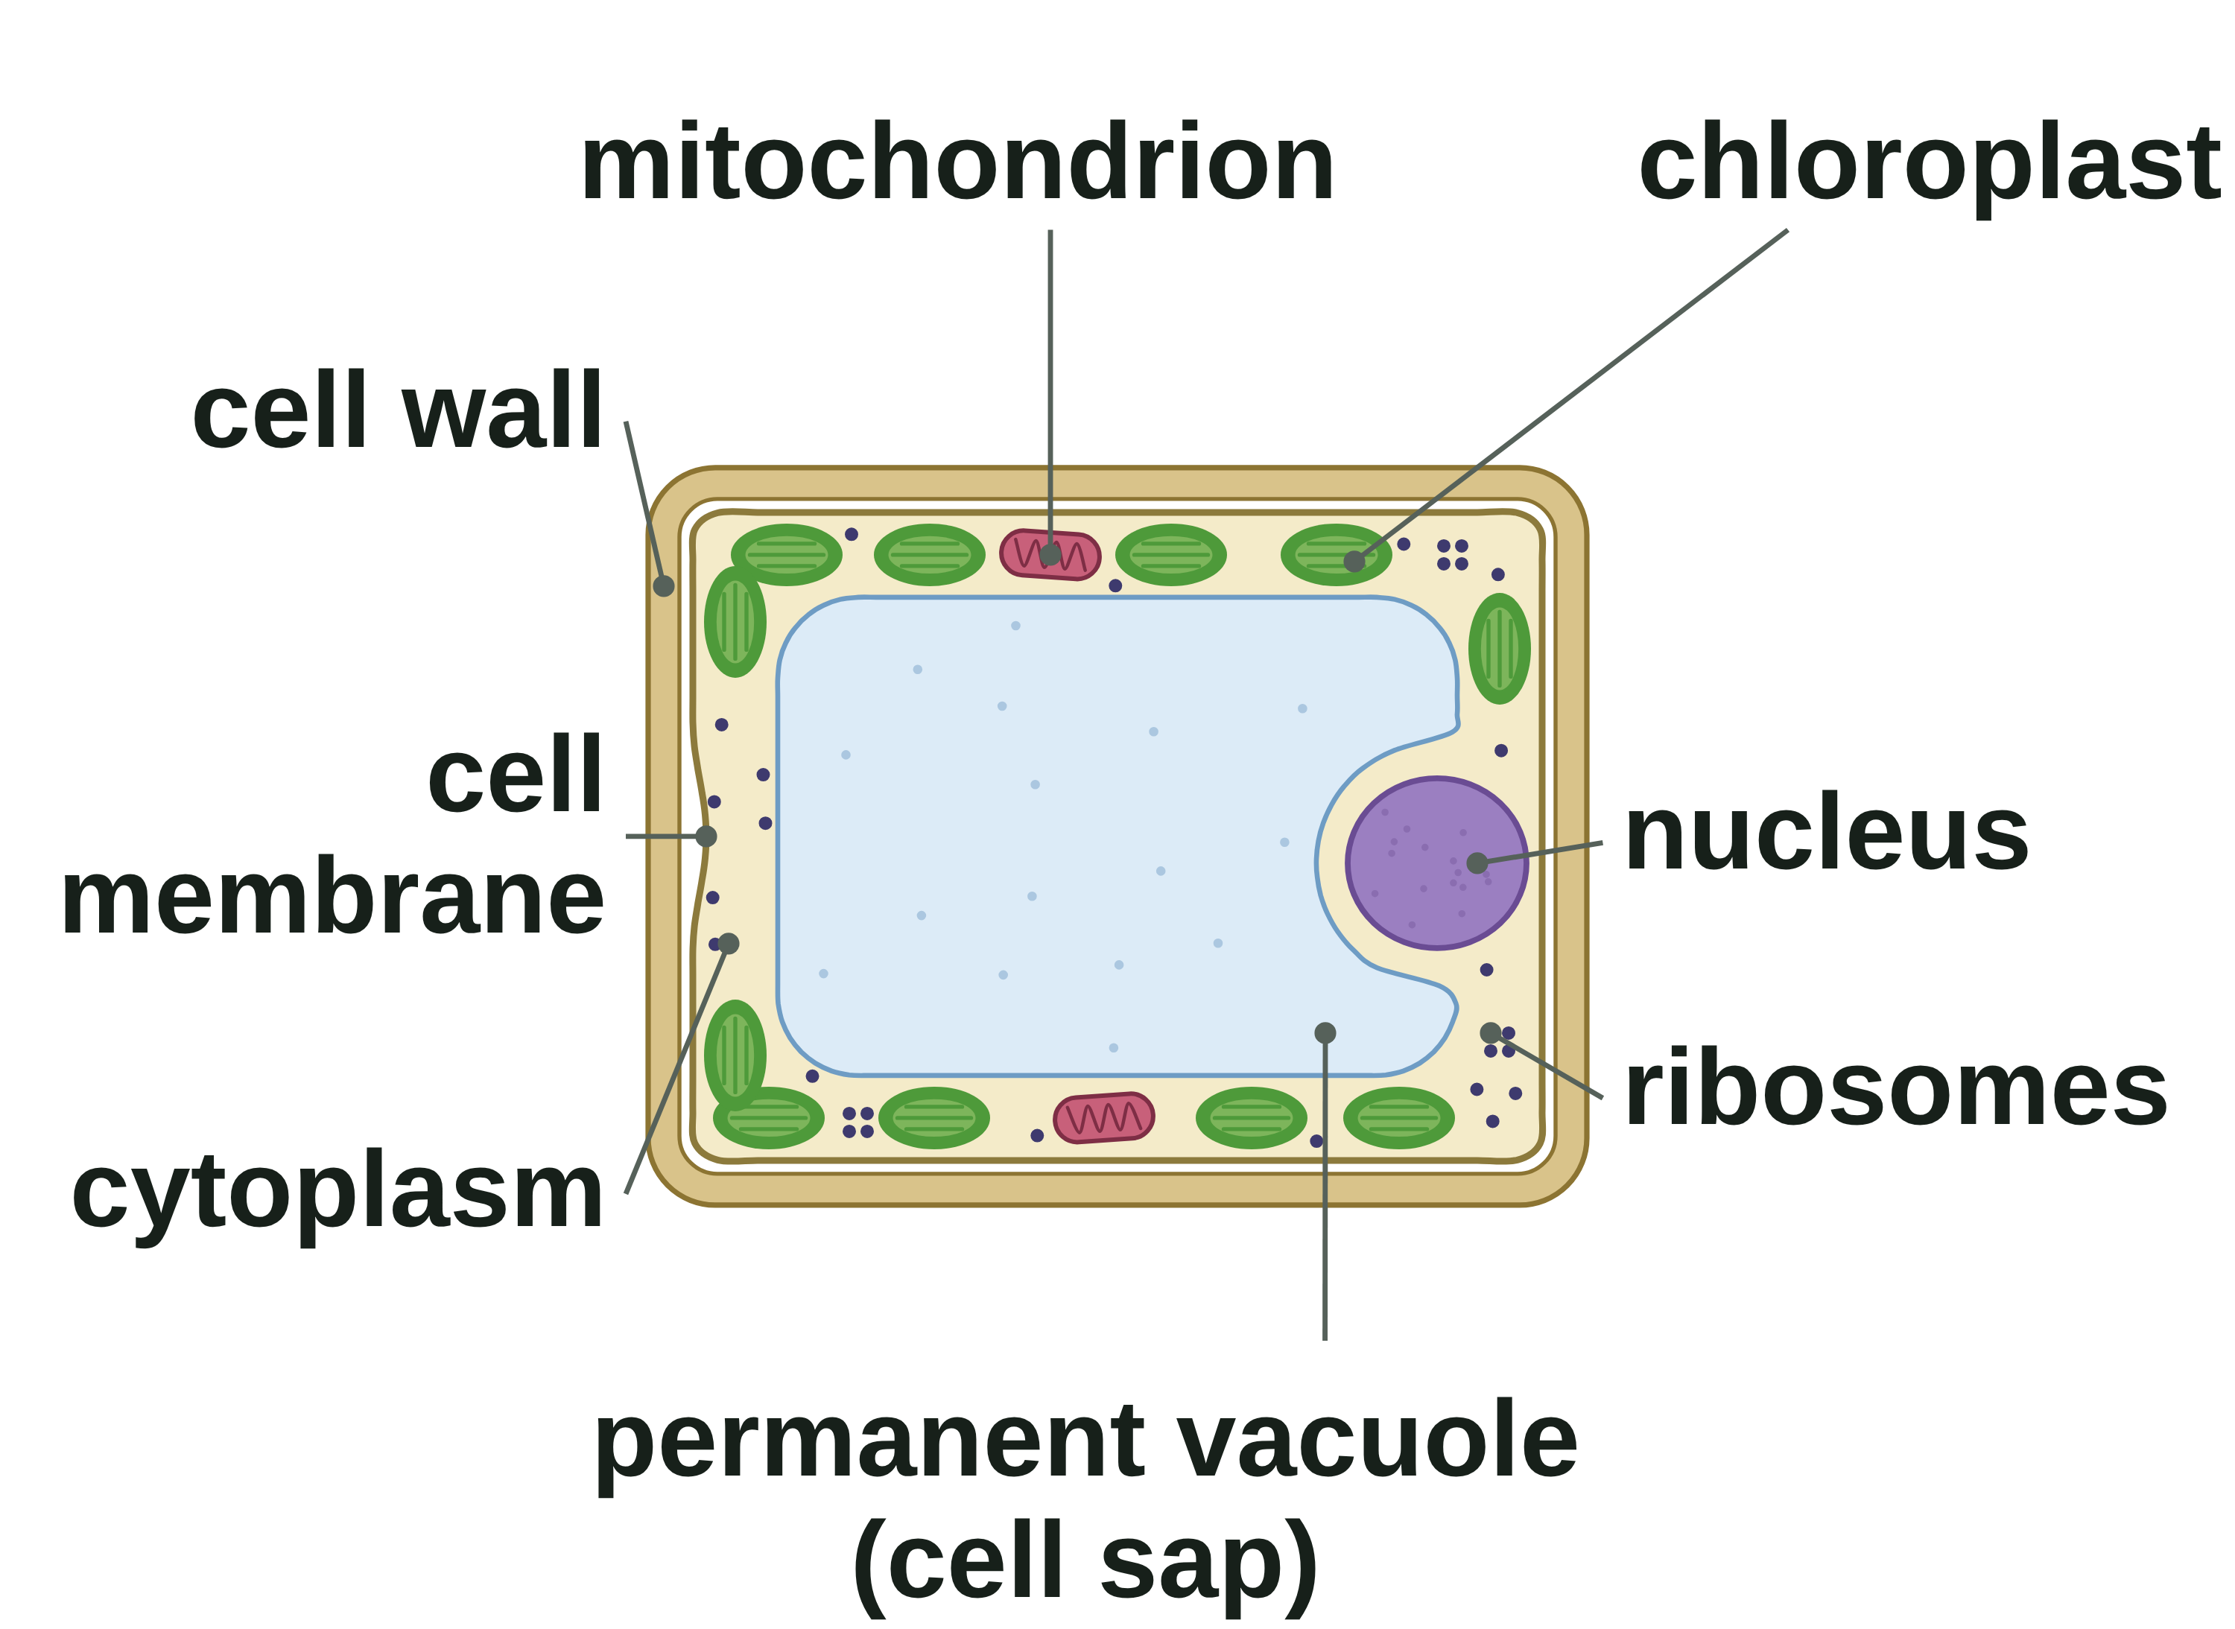
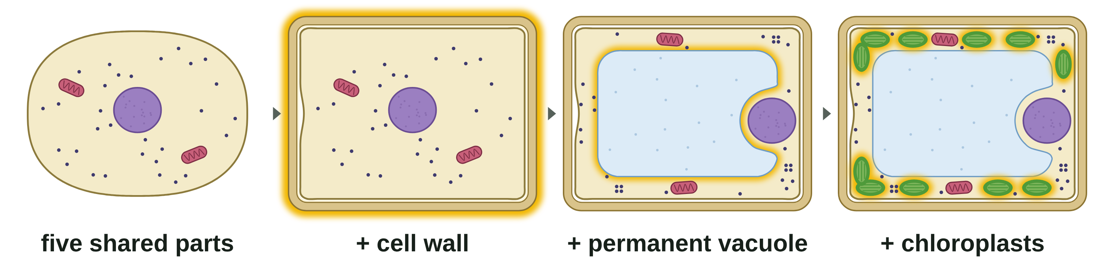
B1 L1 Revision notes 2 of 4
Animal and plant cells
Plant cells, and animal and plant cells compared
5. Inside a plant cell
6. Animal and plant cells compared
Plant cells have the same five parts as animal cells. They often have three more:
Part | Animal | Plant
nucleus | yes | yes
cytoplasm | yes | yes
cell membrane | yes | yes
mitochondria | yes | yes
ribosomes | yes | yes
cell wall | no | yes
permanent vacuole | no | often
chloroplasts | no | often
Part | What it is like | Job
cell wall | made of cellulose; outside the cell membrane | strengthens the cell
permanent vacuole | a space filled with cell sap, a weak solution of sugars and salts | helps to keep the cell firm
chloroplasts | green: they contain chlorophyll | absorb light to make food by photosynthesis
Algal cells, such as the cells of seaweeds and pond algae, also have a cell wall made of cellulose, and chloroplasts.
A full permanent vacuole pushes the cytoplasm out against the cell wall. This keeps the cell firm and helps the plant to stand up (more in B1 L9 Osmosis).
Plant cells have every part that animal cells have, and more. No part on the AQA list is only in animal cells.
Watch out: plant cells have mitochondria too. They respire all the time, day and night (section 9).
Watch out: the cell wall is not the cell membrane. Plant cells have both. The cell wall strengthens the cell. The cell membrane, just inside it, controls what goes in and out.
Watch out: animal cells have no cell wall and no permanent vacuole. The outside layer of an animal cell is the cell membrane.
Watch out: not every plant cell has chloroplasts. Onion bulb cells and root hair cells grow in the dark and have none.
A diagram is simplified. Only the chloroplasts' green is a real colour.
Building a plant cell. Start with the five shared parts. Add a cell wall round the outside, a permanent vacuole in the middle, and chloroplasts in the cytoplasm: that is a plant cell.
7. Which cell is it?
Look for the cell wall first. A cell wall and a permanent vacuole: a plant cell.
No cell wall and no permanent vacuole: an animal cell.
A cell wall made of cellulose and chloroplasts, living on its own in a pond: an algal cell.
No chloroplasts does not mean an animal cell. Lots of mitochondria do not mean a plant cell.
B1 L1 · Animal and plant cells · sciencegcse.co.uk · free GCSE science resources
Notes:
Revision notes page 2 of 4. The plant cell's three extra parts, animal and plant cells compared, and how to tell which cell is which. Ask: name a plant cell with no chloroplasts, and say why.

Slide 26
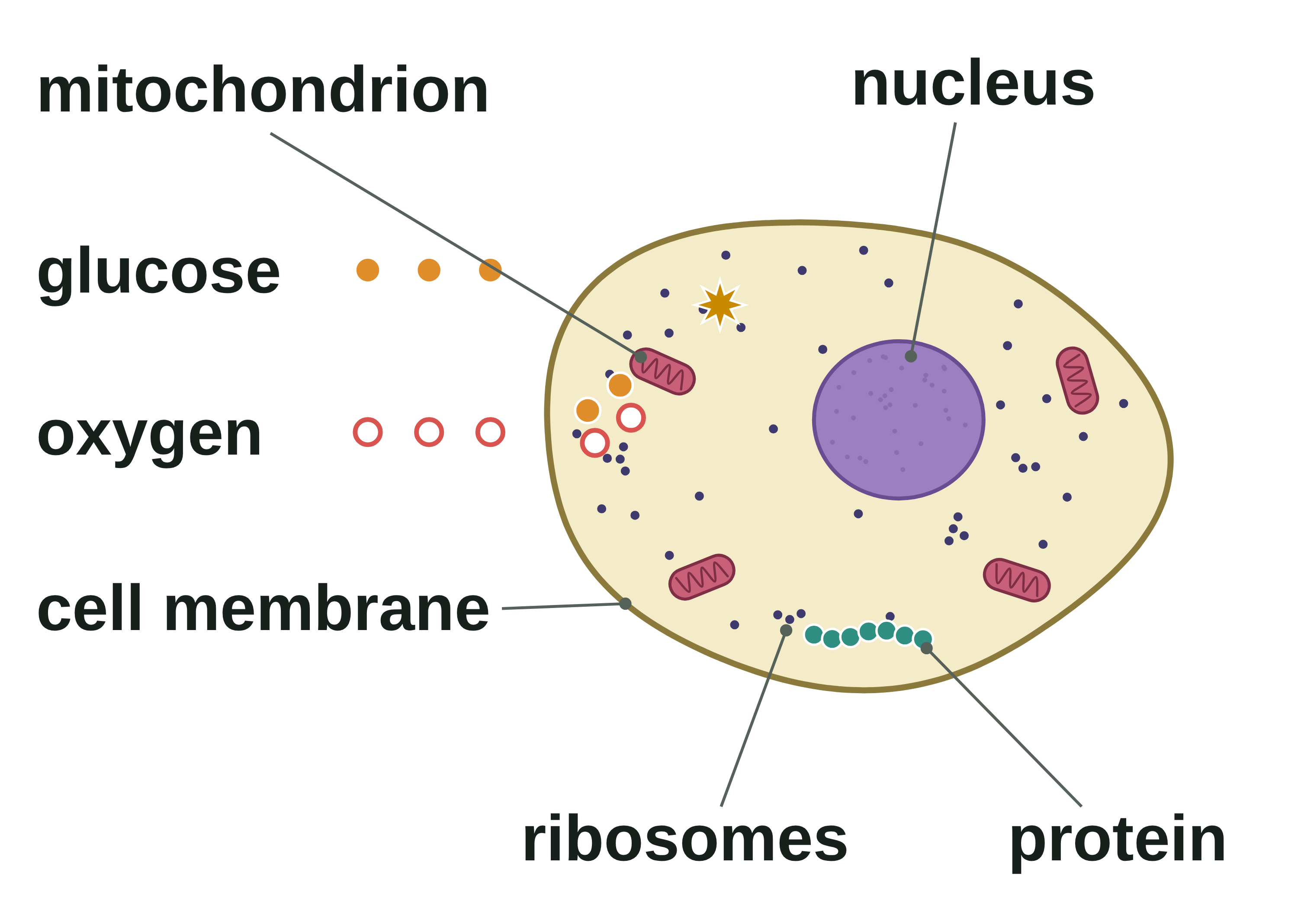
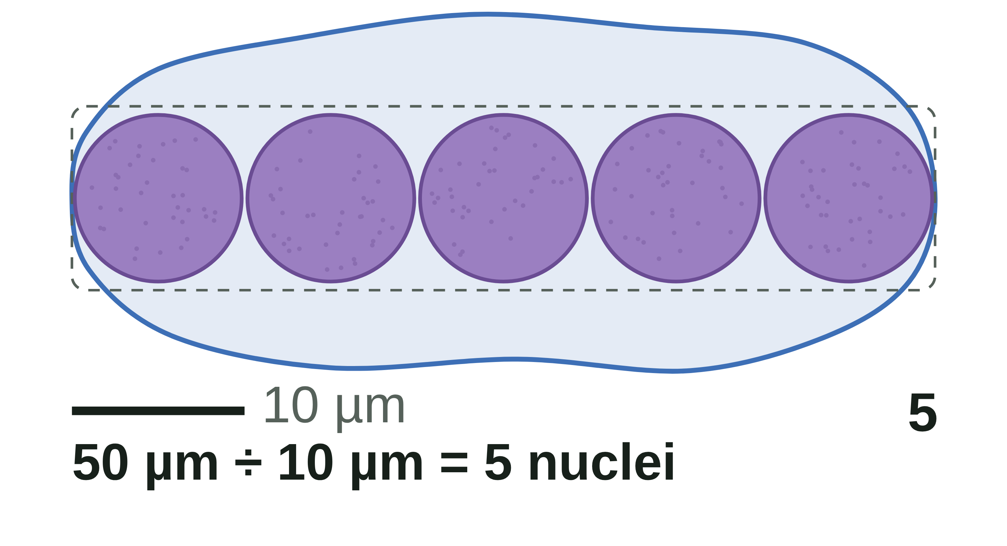
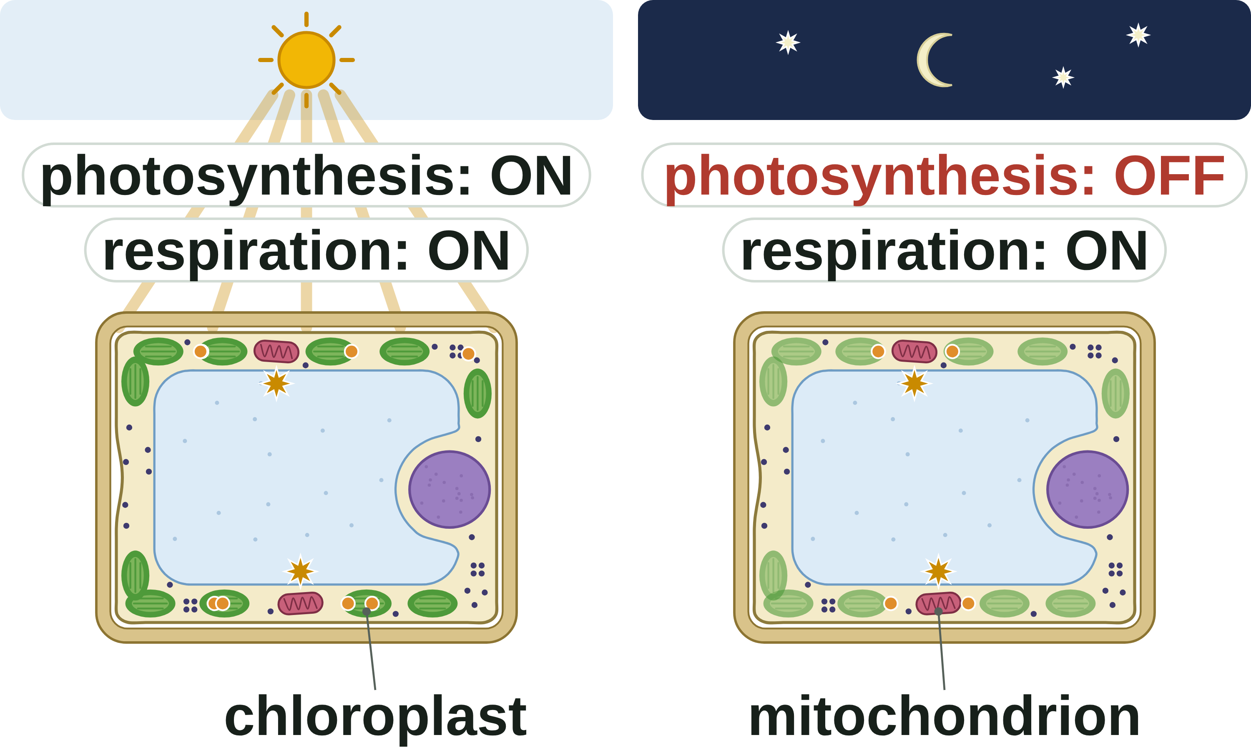
B1 L1 Revision notes 3 of 4
Animal and plant cells
Parts working together, day and night, and sizes
8. The parts work together
10. How big are the parts?
No part of a cell works alone. Follow glucose and oxygen into an animal cell:
The cell membrane lets glucose and oxygen into the cell.
In the mitochondria, aerobic respiration releases energy from glucose.
The nucleus holds the instructions for making proteins.
Part | About how big
plant cell | 10 to 100 µm
animal cell | 10 to 30 µm (a cheek cell about 50 µm)
nucleus | 5 to 10 µm
chloroplast | about 5 µm
mitochondrion | about 1 µm
ribosome | about 25 nm (0.025 µm)
1 mm = 1000 µm
1 µm = 1000 nm
At the ribosomes, proteins are made, using energy from the mitochondria.
Most chemical reactions happen in the cytoplasm, controlled by enzymes. Waste carbon dioxide passes out through the cell membrane.
How substances get into cells is B1 L8 Diffusion.
An estimate is a rough value worked out quickly with simple numbers. Use estimates to compare the sizes of the parts, and to check that an answer is sensible. Cells vary in size, so always say "about".
To estimate how many copies of a part would fit across a cell:
number that fit = width of the cell ÷ width of the part
Worked example: a plant cell is about 80 µm long. Its nucleus is about 10 µm across. Estimate how many nuclei would fit along the cell.
Step 1: check both sizes are in the same unit: 80 µm and 10 µm.
Step 2: divide: 80 ÷ 10 = 8.
Answer: about 8 nuclei. Check: 8 × 10 µm = 80 µm.
A ribosome (about 25 nm) is 400 times narrower than a 10 µm nucleus: far too small to see with a light microscope. Electron microscopes show ribosomes (B1 L3 Using a microscope).
9. Plant cells respire day and night
 | Light | Dark
chloroplasts: photosynthesis | yes | no
mitochondria: aerobic respiration | yes | yes
Chloroplasts absorb light to make food (glucose) by photosynthesis. This can only happen in the light.
Watch out: divide the size of the cell by the size of the part. Change both sizes into the same unit first (more in B1 L4 Magnification and cell size).
Mitochondria release energy by aerobic respiration. Plant cells need energy all the time, so they respire all the time, day and night. At night they use food made in the day.
11. Answering "explain" questions about cells
Name the part, then give its job, then link the job to the question.
Model answer: "A leaf cell has chloroplasts because they absorb light to make food by photosynthesis. A root cell has none because it is underground, in the dark."
"The mitochondria make energy" scores nothing: write "the mitochondria release energy by aerobic respiration".
Watch out: plant cells respire as well as photosynthesise. Chloroplasts do not make energy: they absorb light to make food. Mitochondria release energy from the food.
B1 L1 · Animal and plant cells · sciencegcse.co.uk · free GCSE science resources
Notes:
Revision notes page 3 of 4. The parts working together, plant cells by day and by night, and estimating the sizes of the parts, with a worked example. Go through the worked example on the board.

Slide 27
B1 L1 Revision notes 4 of 4
Animal and plant cells
Key words, exam tips and check yourself
Key words
Check yourself
Cover the answers, then check.
Aerobic respiration: respiration that uses oxygen.
Cell: the basic building block of all living things.
Cell membrane: a thin layer around the cell that controls the movement of substances into and out of the cell.
Cell sap: a weak solution of sugars and salts that fills the permanent vacuole.
Cell wall: a layer outside the cell membrane that strengthens the cell; in plant and algal cells it is made of cellulose.
Cellulose: the tough substance that plant and algal cell walls are made of.
Chlorophyll: the green substance in chloroplasts that absorbs light.
Chloroplasts: green structures in some plant cells that absorb light to make food by photosynthesis.
Cytoplasm: a jelly-like substance where most of the chemical reactions in the cell happen.
Eukaryotic cell: a cell whose genetic material is enclosed in a nucleus, such as an animal or plant cell.
Mitochondria (one mitochondrion): the structures in the cytoplasm where aerobic respiration happens, releasing energy for the cell.
Nucleus: the part of a cell that contains the genetic material, which controls the activities of the cell.
Permanent vacuole: a space in a plant cell, filled with cell sap, that helps to keep the cell firm.
Photosynthesis: the process in which plants and algae use light to make glucose from carbon dioxide and water.
Ribosomes: tiny structures in the cytoplasm where proteins are made.
Sub-cellular structure: a part inside a cell that has a particular job, such as the nucleus or a mitochondrion.
1. Name the five sub-cellular structures found in most animal cells.
2. Name three structures that plant cells often have but animal cells do not.
3. Name the sub-cellular structure where protein synthesis happens.
4. What is a plant cell wall made of, and what does it do?
5. Why do plant cells need mitochondria?
6. Give two reasons why a cell diagram looks different from a light micrograph of the same cells.
7. What does chlorophyll do?
8. A cell is about 45 µm wide. Its nucleus is about 9 µm wide. About how many nuclei would fit across the cell?
Answers
1. Nucleus, cytoplasm, cell membrane, mitochondria and ribosomes.
2. A cell wall, a permanent vacuole and chloroplasts.
3. The ribosomes.
4. Cellulose. It strengthens the cell.
5. To release energy by aerobic respiration, which they do all the time, day and night.
6. Any two: the diagram uses false colours; it draws mitochondria and ribosomes, which are too small to see clearly with a light microscope; it shows one neat cell, not cells packed together; it colours the clear permanent vacuole; it draws the cell membrane apart from the cell wall; it always shows the nucleus clearly.
7. It absorbs light (for photosynthesis).
8. 45 ÷ 9 = about 5 nuclei.
Exam tips
Learn the five parts that animal and plant cells share, and the three extra parts of plant cells.
Learn a job for every part, in the exact words: "controls the activities of the cell", "controls the movement of substances into and out of the cell".
Write "cell membrane" and "cell wall" in full. Write "permanent vacuole", not just "vacuole".
Energy is released by respiration. Never write that energy is "made".
In a light micrograph you cannot see mitochondria clearly, and you cannot see ribosomes at all. Look for the cell wall and the chloroplasts.
In an estimate, show the division and give the unit.
Common mistakes
Wrong: "Plant cells do not have mitochondria." Right: they do, and they respire all the time.
Wrong: "The cell wall controls what goes in and out." Right: the cell membrane does.
Wrong: "Mitochondria make energy." Right: they release energy.
Wrong: "Every plant cell has chloroplasts." Right: cells in the dark have none.
B1 L1 · Animal and plant cells · sciencegcse.co.uk · free GCSE science resources
Notes:
Revision notes page 4 of 4. Key words, exam tips and Check yourself: students cover the answers, try all eight, then check. The common mistakes box sums up the lesson.

Slide 28
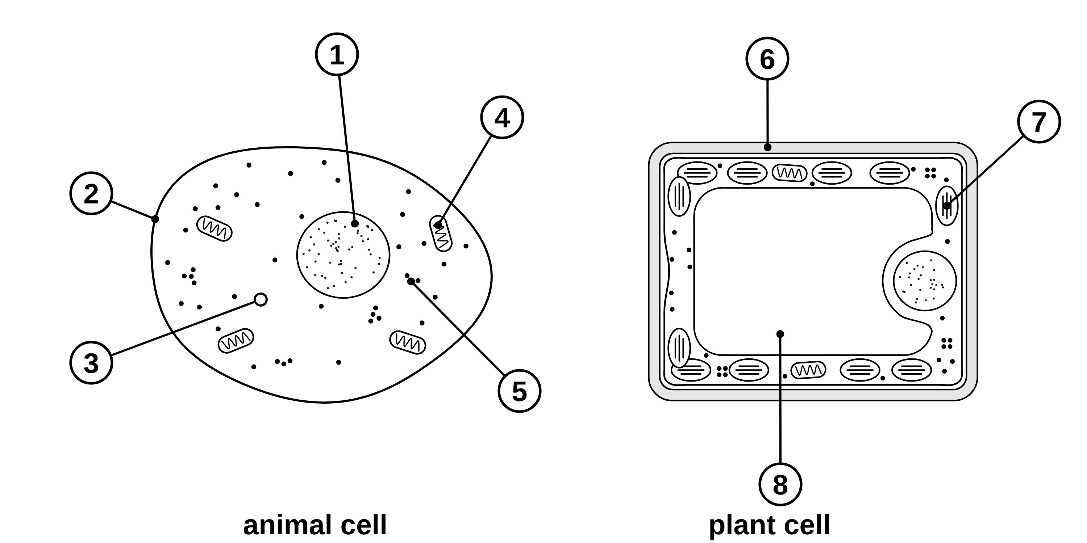
B1 L1 Mandatory worksheet: Animal and plant cells
Page 1 of 2
Name: ______________________________ Class: __________
A. Label the cells
B. Parts and their jobs
[8]
[5]
Help: online screens 3 and 6
Help: online screens 3 and 6
The diagrams show an animal cell and a plant cell. Name the parts labelled 1 to 8.
Complete the table. Write the job of each part.
Part | Job
nucleus
cell membrane
mitochondria
ribosomes
chloroplasts
C. Which cells have it?
[6]
Help: online screen 7
Tick (✓) the cells that have each part. Some parts are in both cells.
Part | Animal cell | Plant cell
1. nucleus
2. cell wall
3. mitochondria
4. chloroplasts
5. permanent vacuole
6. cell membrane
1
5
2
6
3
7
4
8
B1 L1 · Animal and plant cells · sciencegcse.co.uk · free GCSE science resources

Slide 29
B1 L1 Mandatory worksheet: Animal and plant cells
Page 2 of 2
Name: ______________________________ Class: __________
D. Short answers
E. Estimate
[7]
[3]
Help: online screens 1, 2, 6, 10 and 11
Help: online screen 9
1. Animal and plant cells are eukaryotic cells. What does eukaryotic mean? [1]
Use: number that fit = width of the cell ÷ width of the part
(a) An animal cell is about 28 µm across. Its nucleus is about 7 µm across. Estimate how many nuclei would fit side by side across the cell. Show your working. [2]
2. Name the green substance in chloroplasts that absorbs light. [1]
3. What is cell sap? [1]
nuclei
4. Give one way a light micrograph of pondweed leaf cells is different from a diagram of a plant cell. [1]
(b) A mitochondrion is about 1 µm long. About how many mitochondria would fit end to end across the same cell? [1]
mitochondria
F. A cheek cell and a pondweed leaf cell
[4]
5. Onion bulb cells have no chloroplasts. Suggest why. [1]
(a) Give two parts that both cells have. [2]
Help: online screens 6 and 7
1
6. A student says, “Plant cells do not need mitochondria, because they have chloroplasts.” Is the student right? Give a reason for your answer. [2]
2
(b) Give two parts that only the pondweed leaf cell has. [2]
1
2
B1 L1 · Animal and plant cells · sciencegcse.co.uk · free GCSE science resources

Slide 30
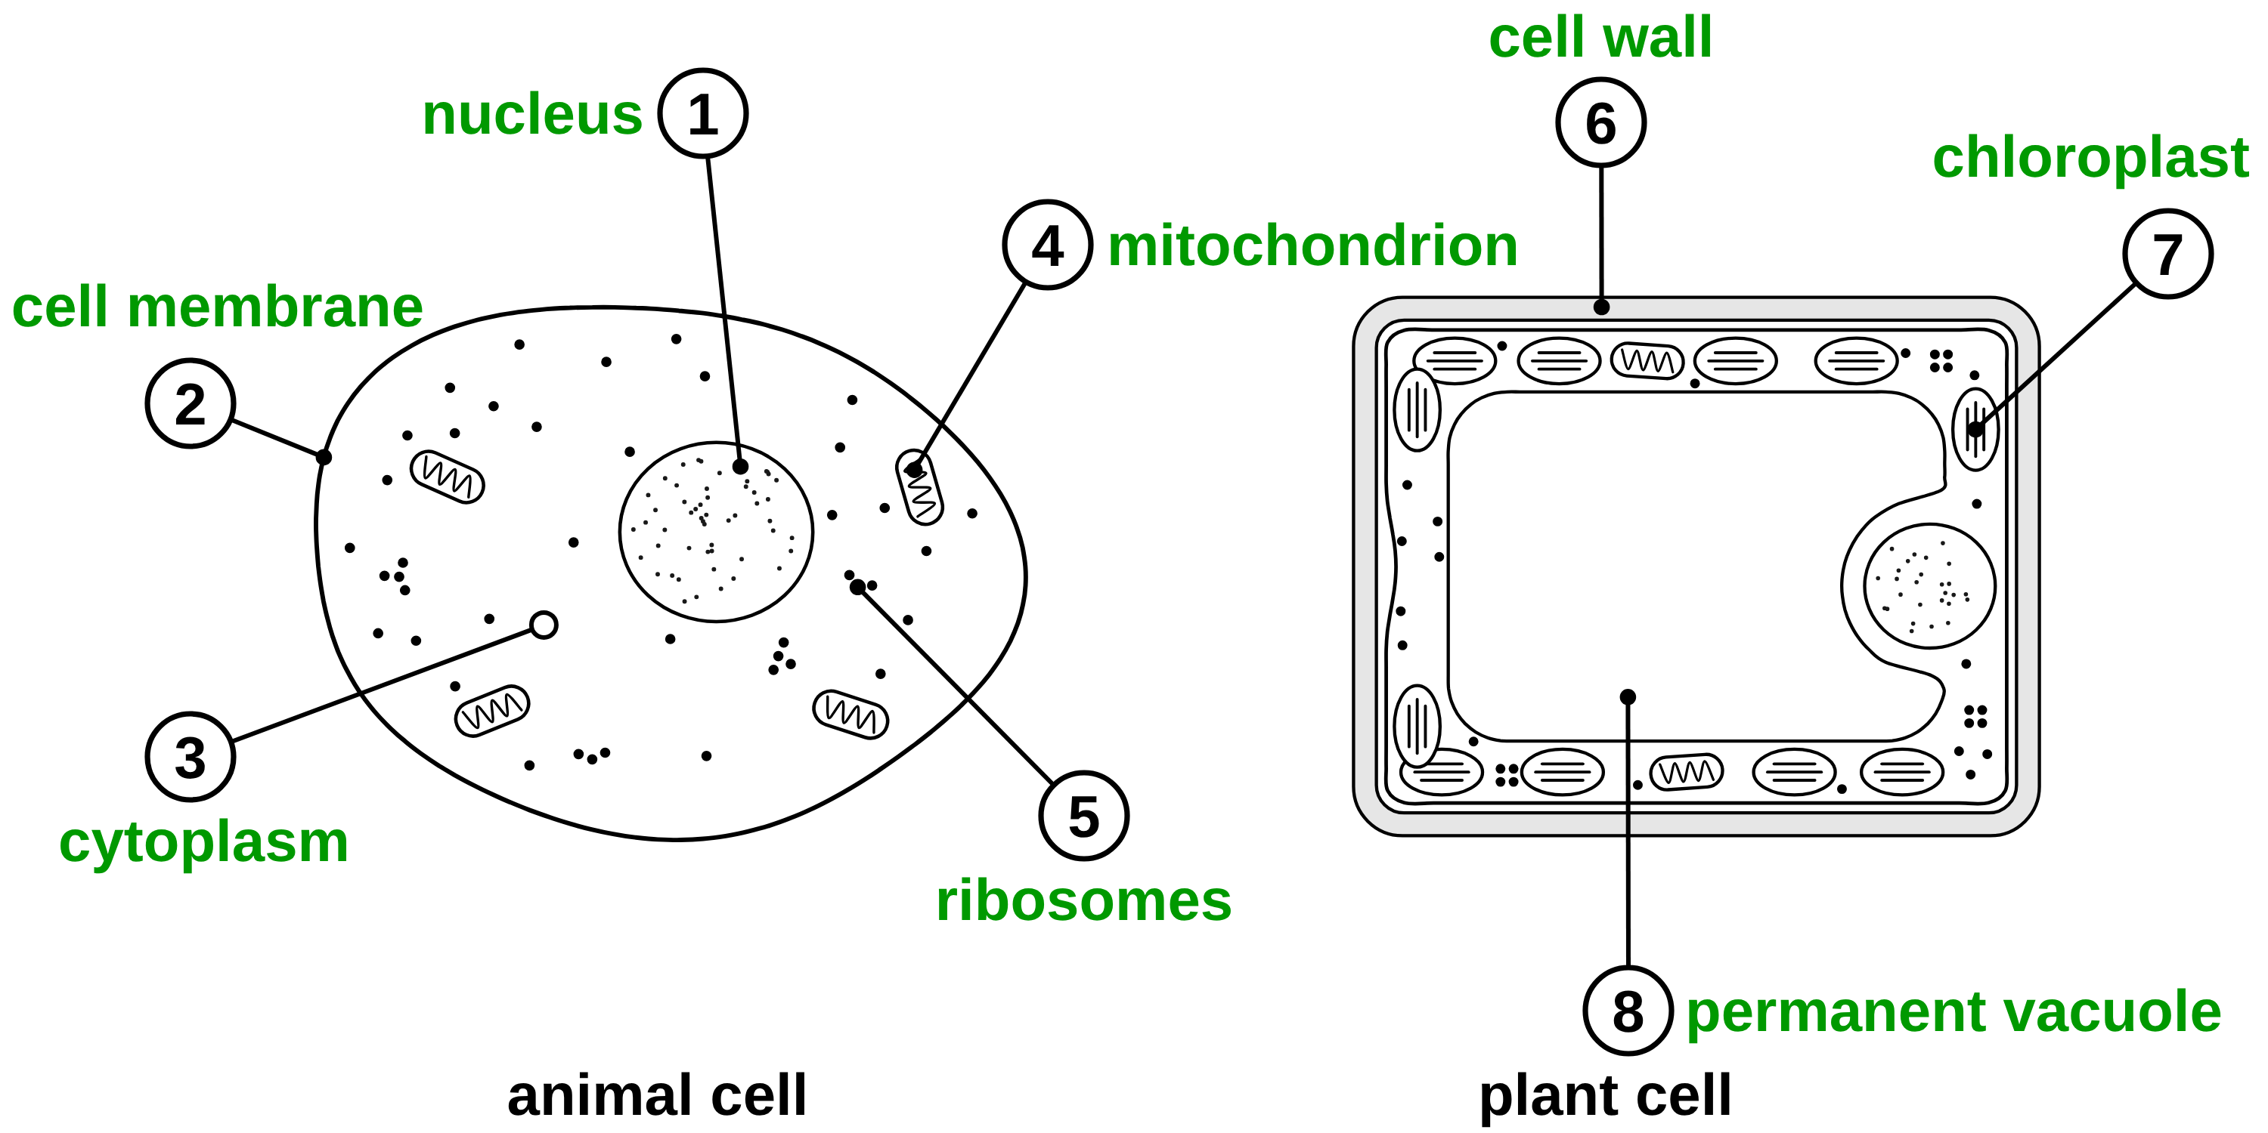
B1 L1 Mandatory worksheet answers - page 1
Answers 1 of 2
A. Label the cells
B. Parts and their jobs
[8]
[5]
The diagrams show an animal cell and a plant cell. Name the parts labelled 1 to 8.
1 mark for each job.
Part | Job
nucleus | contains genetic material, which controls the activities of the cell (1)
cell membrane | controls the movement of substances into and out of the cell (1)
mitochondria | aerobic respiration / release energy (1)
ribosomes | protein synthesis / make proteins (1)
chloroplasts | absorb light to make food / photosynthesis (1)
C. Which cells have it?
[6]
1 mark for each row with both columns right.
1
nucleus (1)
5
ribosomes (1)
Part | Animal cell | Plant cell
1. nucleus | ✓ | ✓
2. cell wall |  | ✓
3. mitochondria | ✓ | ✓
4. chloroplasts |  | ✓
5. permanent vacuole |  | ✓
6. cell membrane | ✓ | ✓
2
cell membrane (1)
6
cell wall (1)
3
cytoplasm (1)
7
chloroplast (1)
4
mitochondrion (1)
8
permanent vacuole (1)
Allow mitochondria for 4, ribosome for 5 and vacuole for 8. Allow small spelling errors if the word is clear.
Do not accept “membrane” alone for 2, or “cell membrane” for 6 (the cell wall is the outside layer of a plant cell).
Row 3 needs both ticks: plant cells have mitochondria too.
B1 L1 · Animal and plant cells · sciencegcse.co.uk · free GCSE science resources

Slide 31
B1 L1 Mandatory worksheet answers - page 2
Answers 2 of 2
D. Short answers
E. Estimate
[7]
[3]
1. Animal and plant cells are eukaryotic cells. What does eukaryotic mean? [1]
Use: number that fit = width of the cell ÷ width of the part
Their genetic material is enclosed in a nucleus (1).
Allow “they have a nucleus”.
(a)
28 ÷ 7 (1) = 4 nuclei (1)
Correct answer with no working scores 2. Do not accept 196 (28 × 7: multiplied) or 21 (28 − 7).
2. Name the green substance in chloroplasts that absorbs light. [1]
Chlorophyll (1).
Allow small spelling errors, such as “chlorophyl”. Do not accept “chloroplast”.
(b)
28 mitochondria (1)
3. What is cell sap? [1]
Model answers
A weak solution of sugars and salts (that fills the permanent vacuole) (1).
Allow “water with sugars and salts dissolved in it”. Do not accept “water” alone.
(a) 28 ÷ 7 = 4 nuclei. Check: 4 × 7 µm = 28 µm.
(b) 28 ÷ 1 = 28 mitochondria.
4. Give one way a light micrograph of pondweed leaf cells is different from a diagram of a plant cell. [1]
Any one (1): you cannot see the mitochondria or ribosomes in the micrograph; the real cells are packed together (sharing walls); the vacuole is clear / hard to see; the cell membrane cannot be seen apart from the cell wall; the nucleus is hidden or pushed to one side; the diagram’s colours are not real (only the chloroplasts’ green is real).
Do not accept “the micrograph is real” or “the diagram is bigger”.
F. A cheek cell and a pondweed leaf cell
[4]
(a)
Any two (1 each): nucleus; cytoplasm; cell membrane; mitochondria; ribosomes.
5. Onion bulb cells have no chloroplasts. Suggest why. [1]
The cells get no light (the bulb is underground / covered / they are inner layers), so they cannot photosynthesise (1).
Do not accept “onion cells are not plant cells”.
(b)
Any two (1 each): cell wall; chloroplasts; permanent vacuole (allow vacuole).
Do not accept mitochondria in (b): both cells have them.
6. A student says, “Plant cells do not need mitochondria, because they have chloroplasts.” Is the student right? Give a reason for your answer. [2]
Model answers
No (1). Plant cells need to release energy by (aerobic) respiration (all the time / day and night); chloroplasts make food, mitochondria release energy from it (1).
The reason scores only with “No”. Do not accept “chloroplasts make energy” or “plants only respire at night”.
(a) A nucleus and a cell membrane.
(b) A cell wall and chloroplasts.
B1 L1 · Animal and plant cells · sciencegcse.co.uk · free GCSE science resources

Slide 32
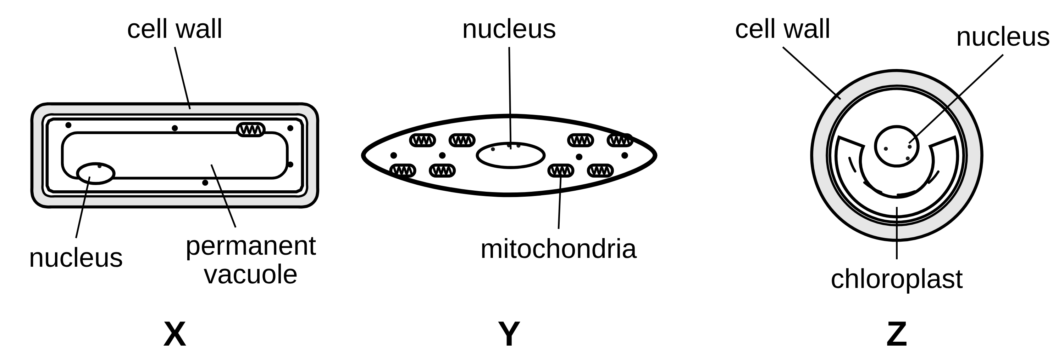
B1 L1 Challenge worksheet: Animal and plant cells
Page 1 of 2
Name: ______________________________ Class: __________
A. Three mystery cells
B. Estimating sizes
[5]
[6]
Help: online screens 3, 7 and 11
Help: online screen 9
Figure 1 shows three cells, X, Y and Z. They are not drawn to the same scale.
(a) An onion epidermis cell is 0.2 mm long (larger than most plant cells). Its nucleus is about 10 µm across. Estimate how many nuclei would fit along the cell. Use 1 mm = 1000 µm. Show your working. [3]
nuclei
Figure 1
(a) Which two cells are plant or algal cells? Give a reason for your answer. [2]
(b) A mitochondrion is about 1 µm long. A ribosome is about 25 nm across. Use 1 µm = 1000 nm. Calculate how many times longer the mitochondrion is than the ribosome. [2]
(b) Cell X comes from a plant root. Suggest why it has no chloroplasts. [1]
times
(c) Cell Y has many more mitochondria than most cells. Suggest what this tells you about cell Y. Explain your answer. [2]
(c) A light microscope cannot show anything smaller than about 200 nm. Explain why a light microscope cannot show ribosomes. [1]
B1 L1 · Animal and plant cells · sciencegcse.co.uk · free GCSE science resources

Slide 33
B1 L1 Challenge worksheet: Animal and plant cells
Page 2 of 2
Name: ______________________________ Class: __________
C. When a part stops working
D. Extended response
[4]
[6]
Help: online screens 3 and 4
Help: online screens 4, 6 and 10
Scientists treat some animal cells with chemicals. Each chemical stops one sub-cellular structure from working.
Explain how the sub-cellular structures in a leaf cell work together to keep the cell alive and growing. [6]
(a) Chemical 1 stops the mitochondria working in a muscle cell. Suggest what would happen to the muscle cell. Explain your answer. [2]
In your answer, name at least five structures and say what each one does.
(b) Chemical 2 damages the cell membrane, so substances leak out of the cell. Suggest why the cell would die. Explain your answer. [2]
B1 L1 · Animal and plant cells · sciencegcse.co.uk · free GCSE science resources

Slide 34
B1 L1 Challenge worksheet answers - page 1
Answers 1 of 2
A. Three mystery cells
B. Estimating sizes
[5]
[6]
(a)
0.2 × 1000 = 200 µm (1)
200 ÷ 10 (1)
= 20 nuclei (1)
Correct answer with no working scores 3. 0.02 (0.2 ÷ 10, units not changed) scores 1 for the division shown.
(b)
1000 ÷ 25 (1)
= 40 times (1)
Correct answer with no working scores 2. Allow 1000 nm ÷ 25 nm.
Figure 1
(a)
X and Z (1); they (both) have a cell wall (1).
The reason must name the cell wall. Do not accept “they have chloroplasts” (X has none) or “Y, because it has mitochondria”.
(c)
Ribosomes are about 25 nm across, which is much smaller than 200 nm (1).
Must use the numbers.
(b)
Roots are underground / in the dark, so there is no light for photosynthesis (1).
Model answers
(c)
It needs / uses a lot of energy (1); mitochondria release energy by aerobic respiration (1).
Do not accept “it makes a lot of energy”.
(a) 0.2 mm = 0.2 × 1000 = 200 µm. 200 ÷ 10 = 20 nuclei.
(b) 1 µm = 1000 nm. 1000 ÷ 25 = 40 times.
(c) A ribosome is about 25 nm across. 200 ÷ 25 = 8, so it is only one eighth of the smallest size a light microscope can show. It is too small to see.
Model answers
(a) X and Z, because they both have a cell wall.
(b) Roots grow in the dark soil, so there is no light for chloroplasts to absorb.
(c) Cell Y uses a lot of energy: its many mitochondria release energy by aerobic respiration.
B1 L1 · Animal and plant cells · sciencegcse.co.uk · free GCSE science resources

Slide 35
B1 L1 Challenge worksheet answers - page 2
Answers 2 of 2
C. When a part stops working
D. Extended response
[4]
[6]
(a)
No (aerobic) respiration, so no energy is released (1);
so the cell could not contract / could not make proteins / would die (1).
Do not accept “no energy is made” (that point scores nothing).
Level 3 (5–6 marks): A detailed and coherent explanation. At least five structures are named with correct jobs, and the links between them are explained (for example, food made in the chloroplasts is used by the mitochondria to release energy, which the ribosomes use to make proteins).
Level 2 (3–4 marks): At least three structures named with correct jobs, with some links between them.
Level 1 (1–2 marks): Simple statements, such as “chloroplasts do photosynthesis”, with little or no link between them.
0 marks: No relevant content.
Indicative content
chloroplasts (containing chlorophyll) absorb light to make food (glucose) by photosynthesis
mitochondria release energy from glucose by aerobic respiration, all the time, day and night
ribosomes make proteins (enzymes) using energy from respiration
the nucleus contains genetic material, which controls the activities of the cell / holds the instructions for the proteins
the cytoplasm is where most chemical reactions happen, controlled by enzymes
the cell membrane controls the movement of substances (such as water, carbon dioxide, oxygen, mineral ions) into and out of the cell
the cell wall (made of cellulose) strengthens the cell
the permanent vacuole, filled with cell sap, keeps the cell firm
new proteins and other substances let the cell grow
Do not accept “energy is made / produced” (that point scores nothing).
The Level 3 model answer is in the box on the left, under task C.
(b)
The cell membrane controls the movement of substances into and out of the cell (1);
so the cell loses substances it needs, such as glucose / cannot keep in what it needs / harmful substances get in (1).
Do not accept “the cell wall would break” (animal cells have no cell wall).
Model answers
(a) The mitochondria could not release energy by aerobic respiration, so the muscle cell would have no energy to contract, and it would die.
(b) The cell membrane controls what goes in and out. If it is damaged, the cell loses the substances it needs, such as glucose, so it dies.
D. Model answer (Level 3)
The chloroplasts contain chlorophyll, which absorbs light. They use it to make food (glucose) by photosynthesis. The mitochondria release energy from the glucose by aerobic respiration, all the time. The ribosomes use this energy to make proteins, such as enzymes, which the cell needs to grow. The nucleus contains genetic material, which controls the activities of the cell, including which proteins are made. Most of the chemical reactions happen in the cytoplasm, controlled by enzymes. The cell membrane controls what goes in and out, such as carbon dioxide and water for photosynthesis. The cell wall strengthens the cell, and the permanent vacuole, full of cell sap, keeps it firm. So every part depends on the others.
B1 L1 · Animal and plant cells · sciencegcse.co.uk · free GCSE science resources

Slide 36
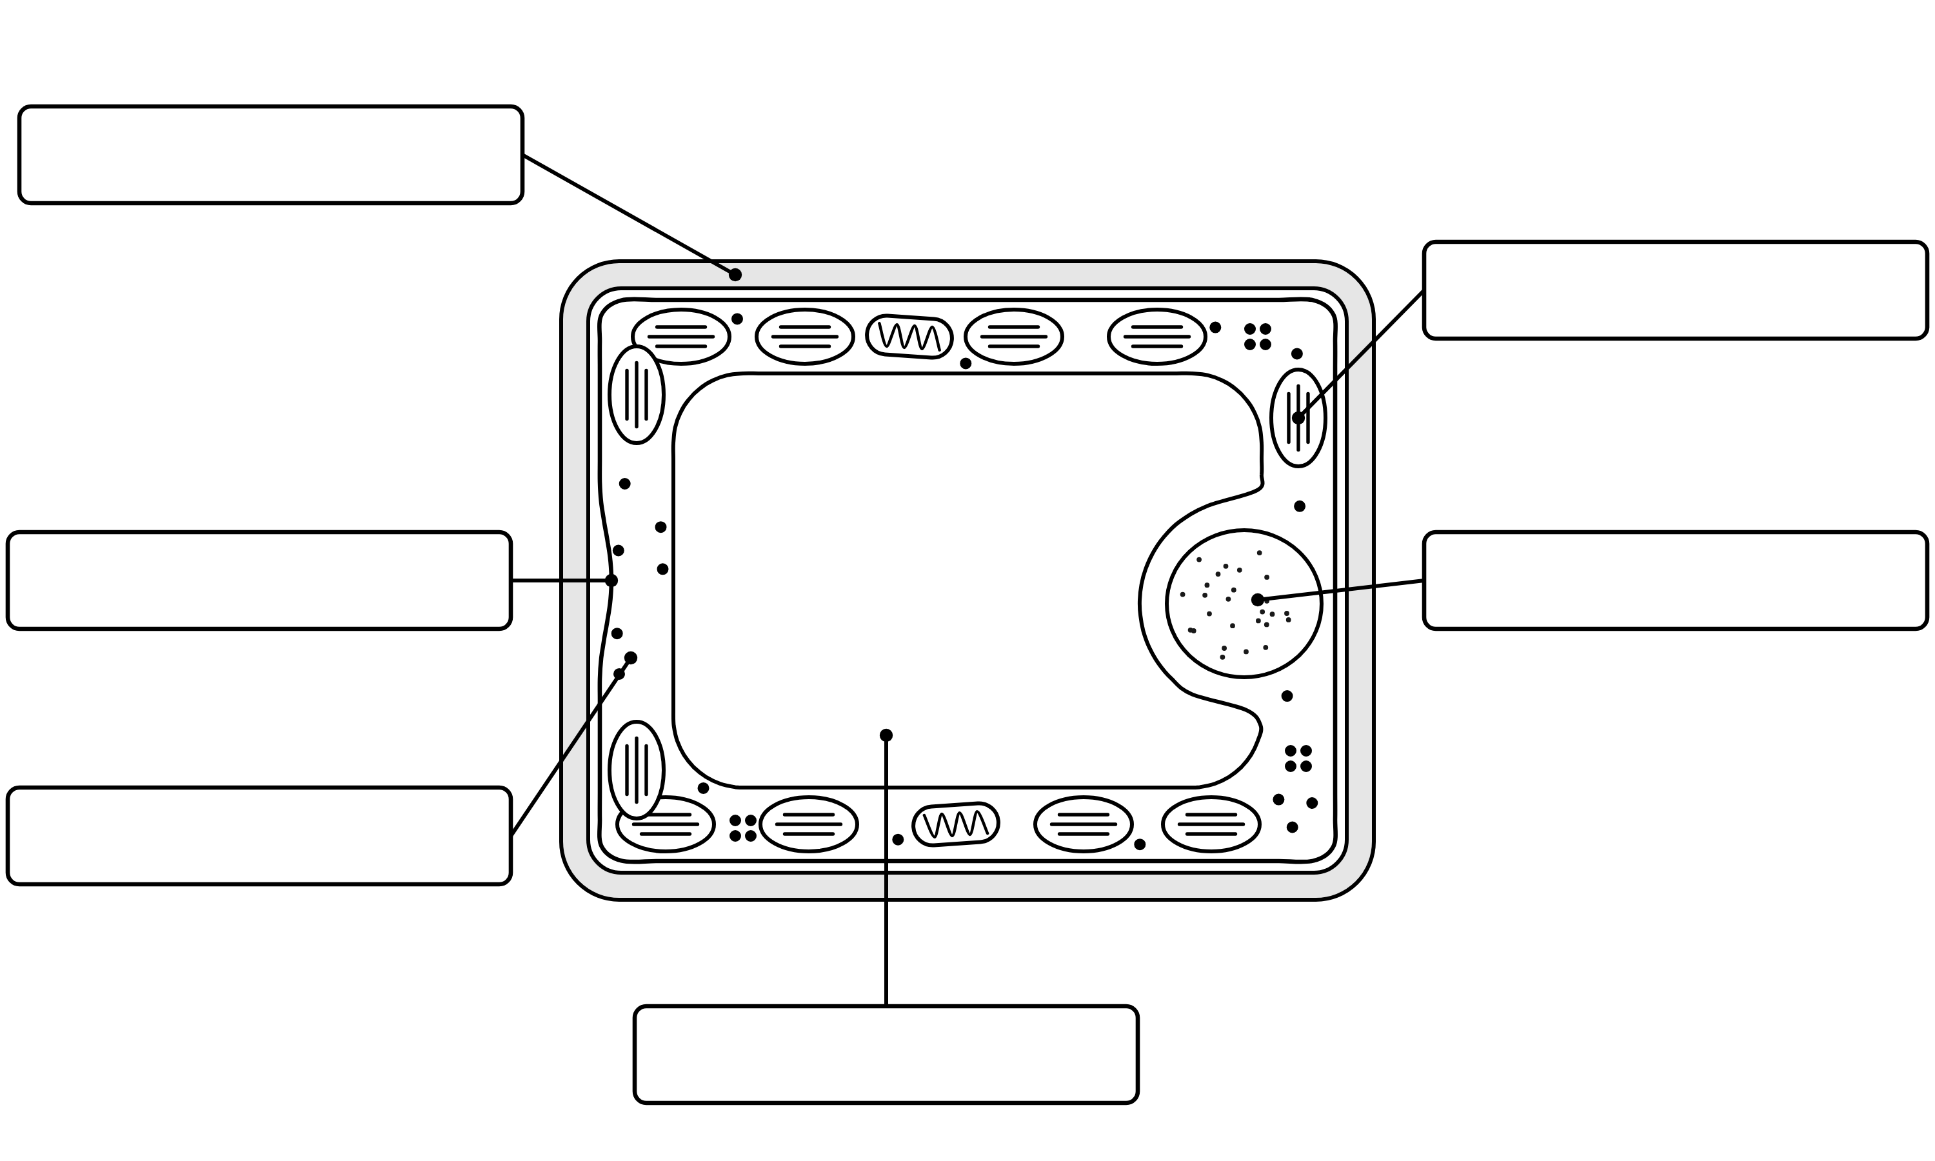
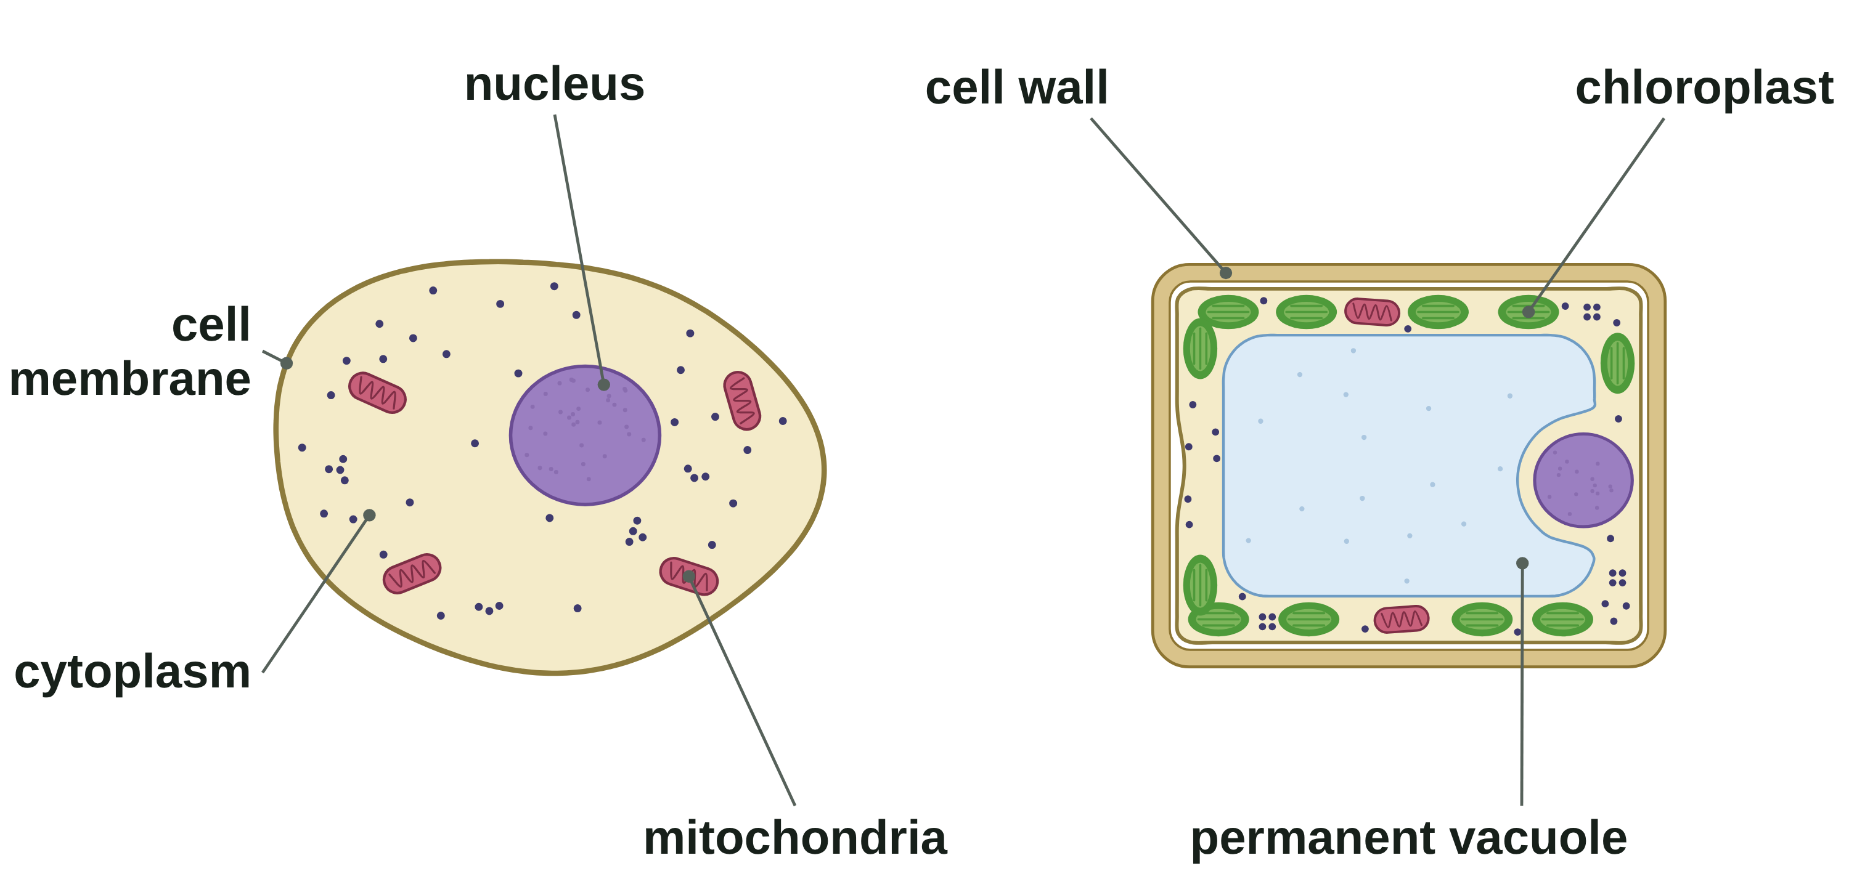
B1 L1 Alternative worksheet: Animal and plant cells
Page 1 of 2
Name: ______________________________ Class: __________
Key facts
A. Label the plant cell
[6]
Help: online screen 6
All living things are made of cells.
Animal and plant cells both have a nucleus, cytoplasm, a cell membrane, mitochondria and ribosomes.
Plant cells also have a cell wall, and often a permanent vacuole and chloroplasts.
The nucleus controls the activities of the cell. The cell membrane controls what goes in and out.
Mitochondria release energy. Ribosomes make proteins.
Chloroplasts absorb light to make food. The cell wall strengthens the cell.
Plant cells have mitochondria too.
Write a word from the box in each label box.
cell membrane
cell wall
chloroplast
cytoplasm
nucleus
permanent vacuole
An animal cell and a plant cell.
A diagram is simplified. Only the green of the chloroplasts is a real colour.
Tip: the cell wall is the outside layer. The cell membrane is just inside it.
B1 L1 · Animal and plant cells · sciencegcse.co.uk · free GCSE science resources

Slide 37
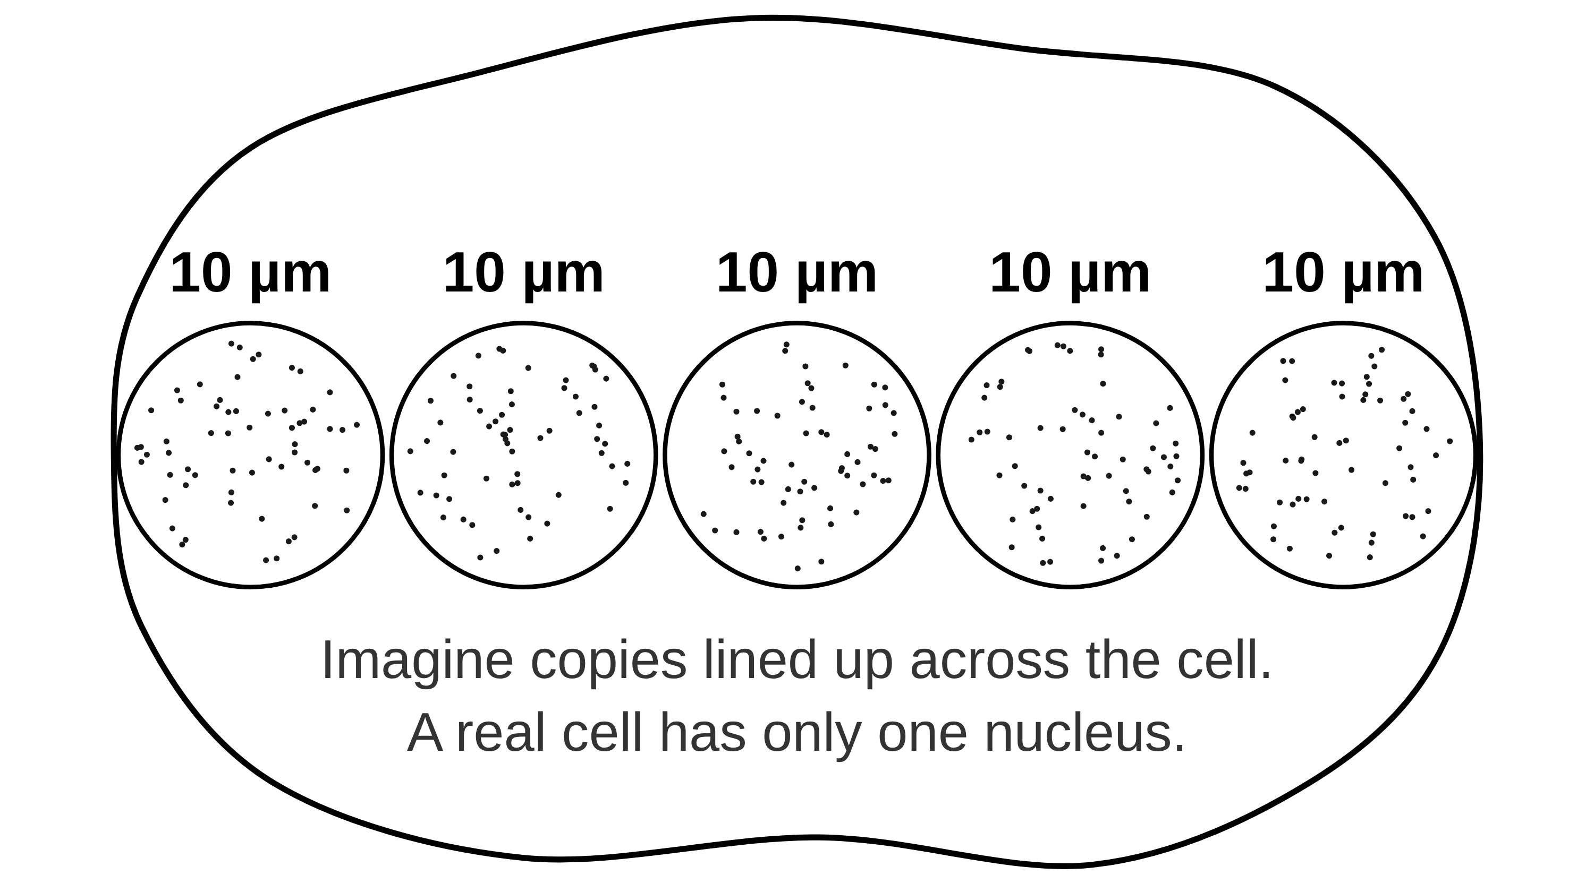
B1 L1 Alternative worksheet: Animal and plant cells
Page 2 of 2
Name: ______________________________ Class: __________
B. Match the part to its job
C. Sort the parts
[5]
[6]
Help: online screens 3 and 6
Help: online screen 7
Draw a line from each part to its job.
Write each part in the correct column.
nucleus
make proteins
cell wall
cell membrane
chloroplasts
cell membrane
absorb light to make food
mitochondria
nucleus
permanent vacuole
mitochondria
controls the activities of the cell
In animal and plant cells | In plant cells only
ribosomes
release energy by respiration
chloroplasts
controls what goes into and out of the cell
D. How big?
[4]
Help: online screen 9
(a) Number these from 1 (smallest) to 4 (largest). [2]
E. True or false?
[6]
Help: online screens 2, 3, 7, 10 and 11
cheek cell
ribosome
nucleus
mitochondrion
Tick (✓) True or False for each sentence.
(b) How many nuclei fit across the cell?
Sentence | True | False
1. Plant cells have mitochondria.
2. Animal cells have a cell wall.
3. Every plant cell has chloroplasts.
4. The cell membrane controls what goes into and out of the cell.
5. Mitochondria make energy.
6. In a micrograph, the blue colour of cheek cells comes from a stain.
[1]
(c) Each nucleus is 10 µm wide. Fill the gap:
5 × 10 =
µm
So the cell is about this wide. [1]
B1 L1 · Animal and plant cells · sciencegcse.co.uk · free GCSE science resources

Slide 38
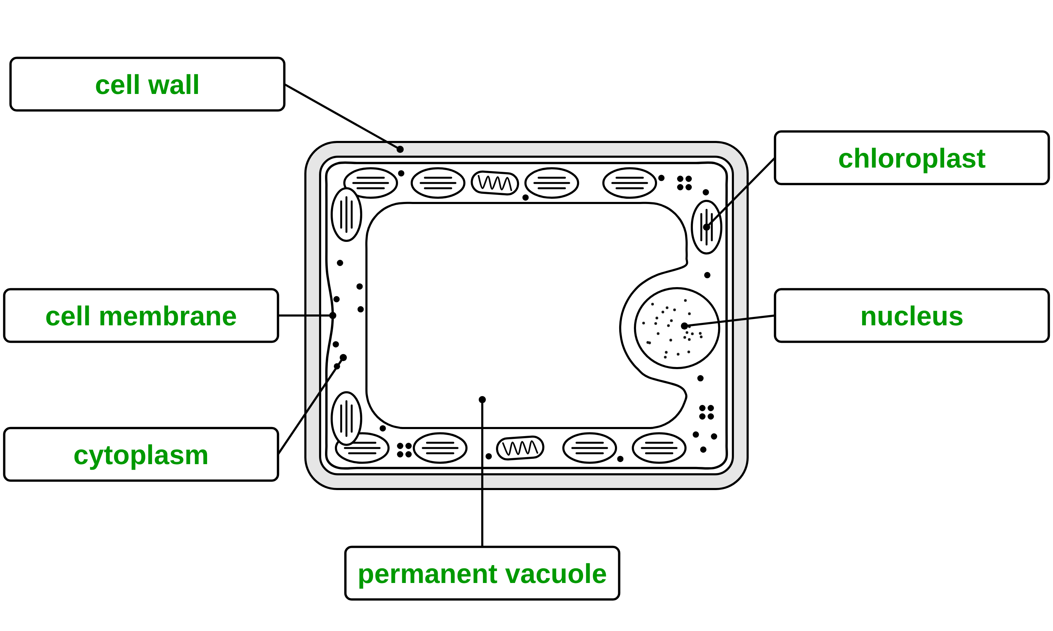
B1 L1 Alternative worksheet answers - page 1
Answers 1 of 2
Key facts
A. Label the plant cell
[6]
All living things are made of cells.
Animal and plant cells both have a nucleus, cytoplasm, a cell membrane, mitochondria and ribosomes.
Plant cells also have a cell wall, and often a permanent vacuole and chloroplasts.
The nucleus controls the activities of the cell. The cell membrane controls what goes in and out.
Mitochondria release energy. Ribosomes make proteins.
Chloroplasts absorb light to make food. The cell wall strengthens the cell.
Plant cells have mitochondria too.
Write a word from the box in each label box.
cell membrane
cell wall
chloroplast
cytoplasm
nucleus
permanent vacuole
1 mark for each correct label box (6): cell wall (top left) (1); cell membrane (left) (1); cytoplasm (bottom left) (1); chloroplast (top right) (1); nucleus (right) (1); permanent vacuole (bottom) (1).
Allow small spelling errors if the word is clear.
An animal cell and a plant cell.
A diagram is simplified. Only the green of the chloroplasts is a real colour.
B1 L1 · Animal and plant cells · sciencegcse.co.uk · free GCSE science resources

Slide 39
B1 L1 Alternative worksheet answers - page 2
Answers 2 of 2
B. Match the part to its job
C. Sort the parts
[5]
[6]
1 mark for each correct line.
1 mark for each part in the correct column (any order).
nucleus
make proteins
cell wall
cell membrane
chloroplasts
cell membrane
absorb light to make food
mitochondria
nucleus
permanent vacuole
mitochondria
controls the activities of the cell
In animal and plant cells | In plant cells only
cell membrane (1) | cell wall (1)
mitochondria (1) | chloroplasts (1)
nucleus (1) | permanent vacuole (1)
ribosomes
release energy by respiration
chloroplasts
controls what goes into and out of the cell
D. How big?
[4]
(a) All four right (2); one pair the wrong way round (1).
4
1
3
2
E. True or false?
[6]
cheek cell
ribosome
nucleus
mitochondrion
1. Plant cells have mitochondria. True. Plant cells respire too. (1)
2. Animal cells have a cell wall. False. Animal cells have no cell wall. (1)
3. Every plant cell has chloroplasts. False. Cells in the dark, such as onion bulb cells, have none. (1)
4. The cell membrane controls what goes into and out of the cell. True. (1)
5. Mitochondria make energy. False. Mitochondria release energy. (1)
6. In a micrograph, the blue colour of cheek cells comes from a stain. True. Real cheek cells are almost colourless: the blue is a dye. (1)
(b) How many nuclei fit across the cell?
5 (1)
(c) Each nucleus is 10 µm wide. Fill the gap:
5 × 10 =
50 (1)
µm
So the cell is about this wide. [1]
B1 L1 · Animal and plant cells · sciencegcse.co.uk · free GCSE science resources

Slide 40
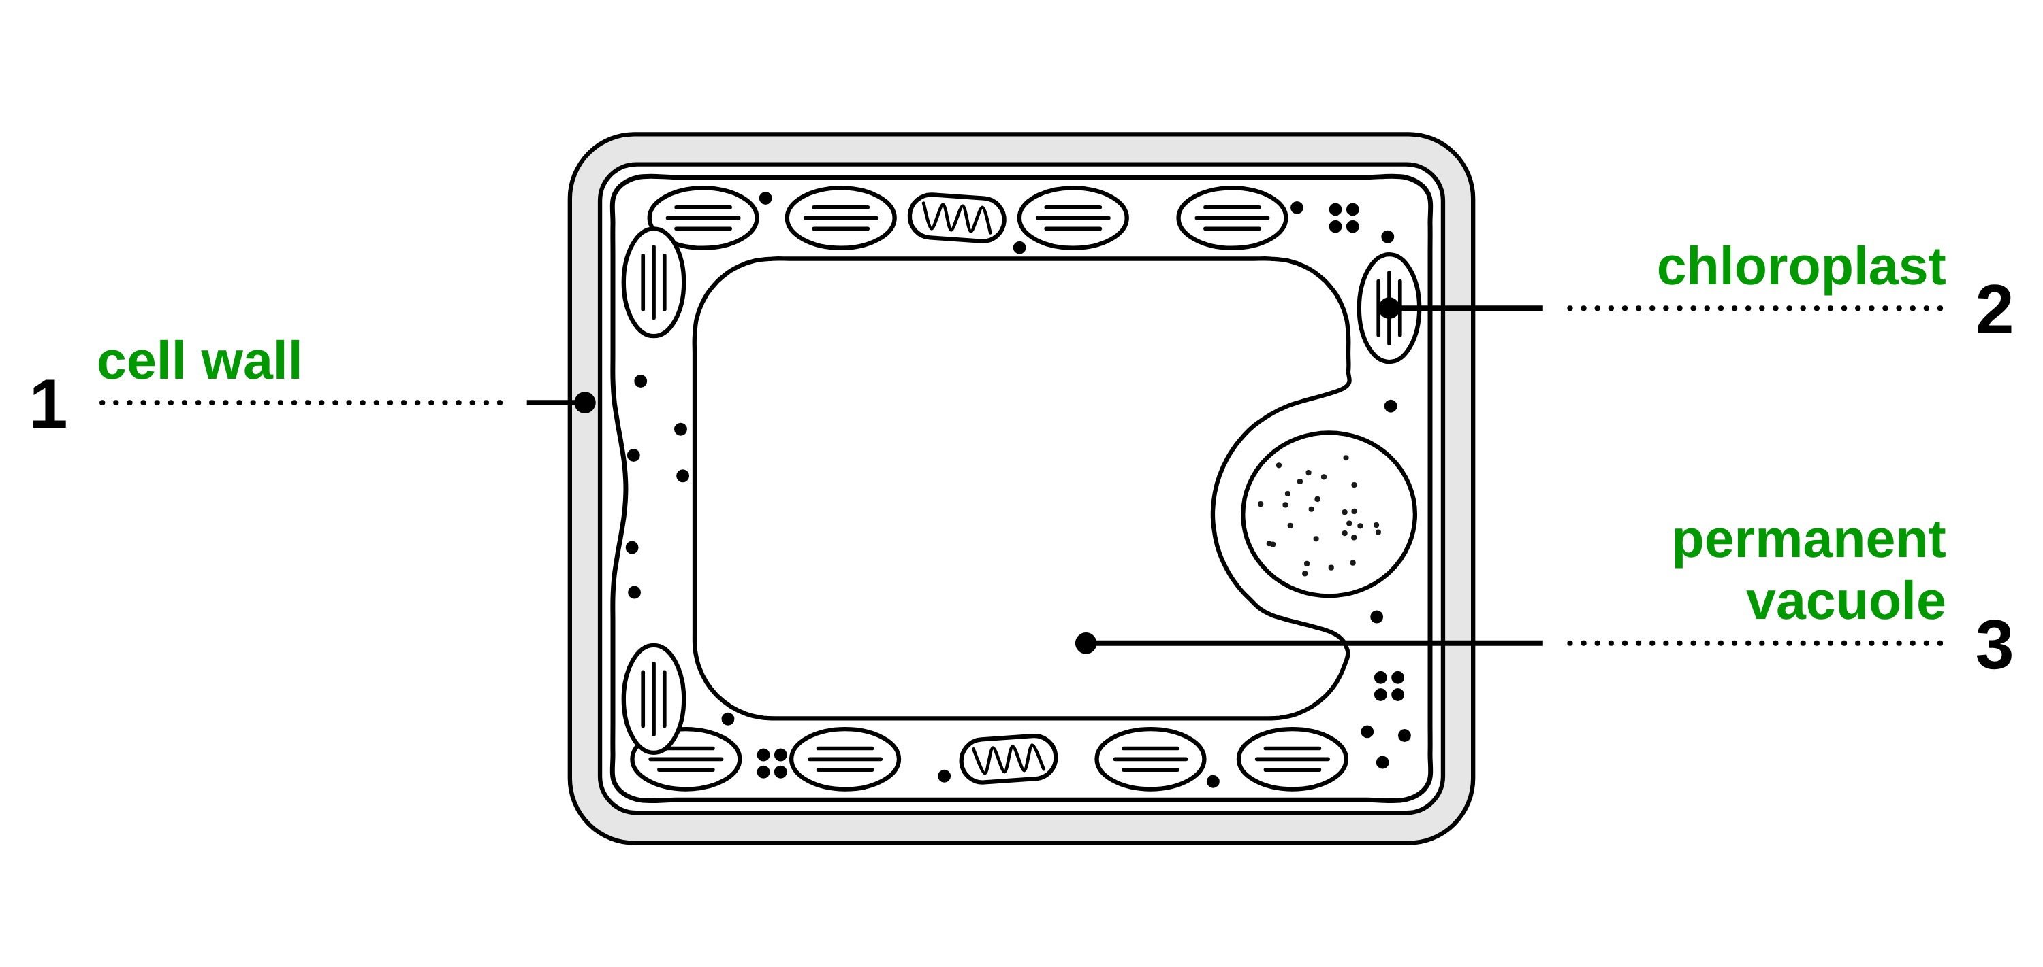
B1 L1 Exam questions worksheet mark scheme - page 1
Answers 1 of 2
01 A plant cell
02 A cheek cell
[5]
[4]
02.1 Give one other way that the cheek cell in Figure 2 is different from the plant cell in Figure 1. [1]
any one from: no chloroplasts / no permanent vacuole / an irregular (uneven) shape (1)
allow the same points written about the plant cell. ignore "no cell wall" (given in the question). do not accept "it has no nucleus" or "it has no mitochondria"
02.2 Estimate the width of the nucleus. [2]
48 ÷ 6 (1) = 8 (µm) (1)
Correct answer with no working = 2 marks. allow 8 µm written anywhere in the space. do not accept 288 (48 × 6) or 42 (48 − 6)
02.3 Suggest why the student could not see any mitochondria or ribosomes. [1]
they are too small (to be seen with a light microscope) (1)
allow "too small to see clearly". allow "the magnification / resolution of a light microscope is not high enough". do not accept "cheek cells have no mitochondria" or "the stain hides them"
03 Structures and functions
[3]
01.1 Complete Figure 1. Choose answers from the box. [3]
1 cell wall (1)
2 chloroplast (1)
3 permanent vacuole (1)
1 mark for each correct label. If more than one word from the box is written on one line, do not give that mark. allow "vacuole" for 3. do not accept "cell membrane" for 1
01.2 What is the function of the cell wall? [1]
It strengthens the cell (1)
If more than one box is ticked, give 0 marks.
01.3 Name the substance that plant cell walls are made of. [1]
cellulose (1)
allow phonetic spellings, such as "celulose". do not accept "cell sap", "chlorophyll" or "cellular"
03 Draw one line from each sub-cellular structure to its function. [3]
Mitochondria → Aerobic respiration (1)
Nucleus → Contains genetic material, which controls the activities of the cell (1)
Ribosomes → Protein synthesis (1)
If more than one line is drawn from a structure, do not give the mark for that structure.
04 The permanent vacuole
[2]
04.1 Name the liquid inside the permanent vacuole. [1]
cell sap (1)
allow "a (weak) solution of sugars and salts". do not accept "water" alone or "cytoplasm"
04.2 Give the function of the permanent vacuole. [1]
(it helps to) keep the cell firm (1)
allow "supports the cell" or "keeps the cell turgid". ignore "stores cell sap". do not accept "strengthens the cell wall" or "makes food"
B1 L1 · Animal and plant cells · sciencegcse.co.uk · free GCSE science resources

Slide 41
B1 L1 Exam questions worksheet mark scheme - page 2
Answers 2 of 2
05 Extended response
[6]
05 A student looked at cheek cells and at leaf cells from pondweed with a light microscope. Compare the structure of a cheek cell with the structure of a pondweed leaf cell. In your answer, give the function of each structure you name. [6]
Level descriptors
Level 3 (5–6 marks): A detailed and coherent comparison. At least three structures are correctly given as found in both cells and at least two as found only in the pondweed leaf cell, with a correct function for most structures named.
Level 2 (3–4 marks): Some structures are correctly given as found in both cells or only in the pondweed leaf cell, with a correct function for some of them. The comparison may be incomplete.
Level 1 (1–2 marks): Simple statements, such as "the plant cell has a cell wall" or "both have a nucleus", with few or no functions.
0 marks: No relevant content.
Model answer (Level 3)
Both cells are eukaryotic, so both have a nucleus, which contains genetic material that controls the activities of the cell. Both have cytoplasm, where most chemical reactions happen, and a cell membrane, which controls the movement of substances into and out of the cell. Both have mitochondria, where aerobic respiration releases energy, and ribosomes, where proteins are made. Only the pondweed cell has a cell wall made of cellulose, which strengthens the cell. Only the pondweed cell has chloroplasts, which absorb light to make food by photosynthesis, and a permanent vacuole filled with cell sap, which keeps the cell firm. The cheek cell has an irregular shape, but the pondweed cell is a regular brick shape.
Indicative content
both cells have a nucleus, which contains genetic material that controls the activities of the cell
both have cytoplasm, where most chemical reactions happen
both have a cell membrane, which controls the movement of substances into and out of the cell
both have mitochondria, where aerobic respiration happens, releasing energy
both have ribosomes, where proteins are made (protein synthesis)
both are eukaryotic: the genetic material is enclosed in a nucleus
only the pondweed cell has a cell wall, made of cellulose, which strengthens the cell
only the pondweed cell has chloroplasts, which absorb light to make food by photosynthesis
only the pondweed cell has a permanent vacuole, filled with cell sap, which keeps the cell firm
the cheek cell has an irregular shape; the pondweed cell has a regular, brick shape
do not accept "mitochondria make / produce energy" (that statement scores nothing; other points can still score)
B1 L1 · Animal and plant cells · sciencegcse.co.uk · free GCSE science resources

