Slide 1
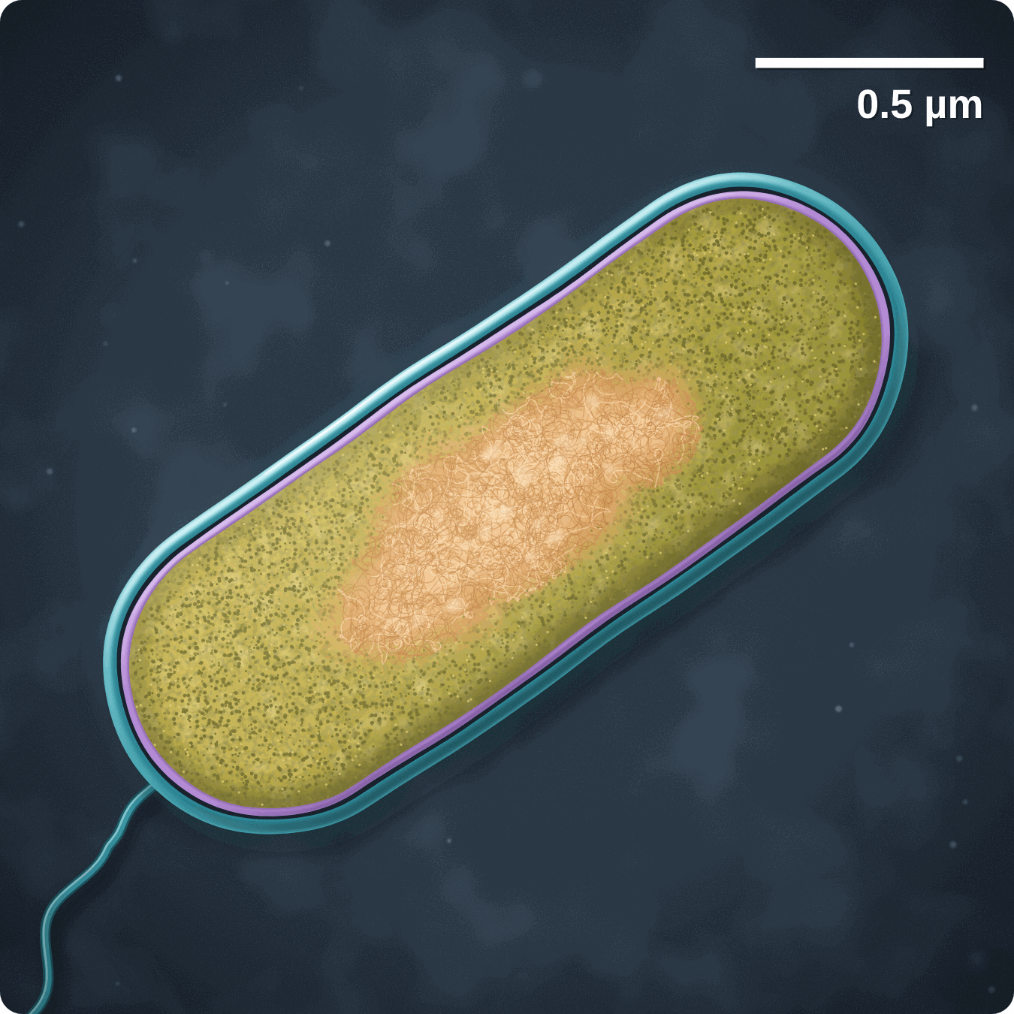
sciencegcse.co.uk · Biology B1 L2
DATE
B1 L2: Bacterial cells
24/09/2026
DO NOW
KEYWORDS
1. Where in a cell does aerobic respiration happen?
2. Where in a cell are proteins made?
3. What is a plant cell wall made of?
Prokaryotic cell
Eukaryotic cell
Bacterium
Plasmids
DNA
A painting based on a coloured electron micrograph. The colours are added.
B1 Cell biology
AQA Combined Science
Notes:
Do now: retrieval from B1 L1 (all three questions). The picture is a painting based on a coloured electron micrograph of one bacterium, cut lengthways and magnified tens of thousands of times; the colours are added. Ask the class what they can see. Is it an animal cell or a plant cell? (Neither: it is a whole living thing, a bacterium.) Can they see a nucleus? (No: that is today's big idea.) The Do now links straight to today: bacteria have ribosomes, but no mitochondria, and their cell wall is not made of cellulose. Suggested 60 min: slides 1-3 (8 min); slides 4-9 (15 min); slides 10-13 (10 min); slides 14-18 (12 min); Mandatory worksheet started in class (10 min), finished for homework; exit ticket slides 22-23 (5 min). Use slides 19-21 if time allows. Homework: online lesson quiz and the B1 L2 Exam questions worksheet. Growing bacteria in the lab (culturing) is separate Biology only.

Slide 2
sciencegcse.co.uk · Biology B1 L2: Bacterial cells
Do now answers and lesson focus
Do now answers
In this lesson
1. In the mitochondria.
2. At the ribosomes.
3. Cellulose.
• Compare a painting of a real bacterium with a diagram.
• Name the parts of a bacterial cell and their jobs.
• Explain why bacterial cells are prokaryotic.
• Describe what plasmids are.
• Compare the sizes of bacteria, animal cells and plant cells.
Key idea
Bacterial cells are prokaryotic: their DNA is not enclosed in a nucleus.
They are much smaller than animal and plant cells.
2
B1 L2 · sciencegcse.co.uk
Notes:
Go through the answers. Then share the lesson focus. The online lesson (sciencegcse.co.uk, B1 L2) follows the same 12 screens as this PowerPoint, so students can go over it at home. There are three checkpoints along the way. All three answers come back today: bacteria have ribosomes, have no mitochondria (but still respire), and have a cell wall that is not made of cellulose.

Slide 3
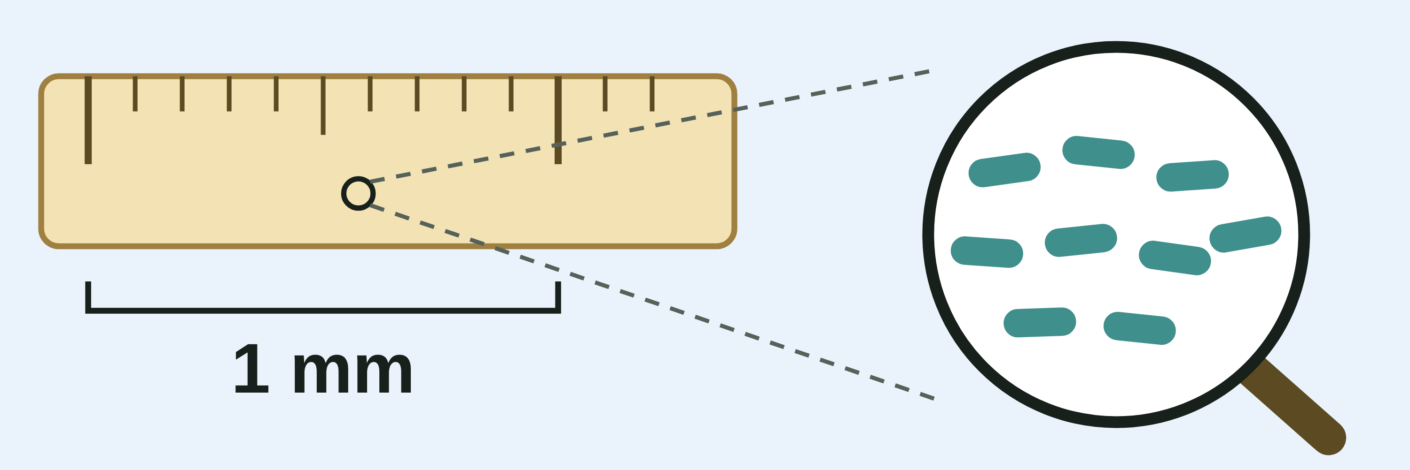
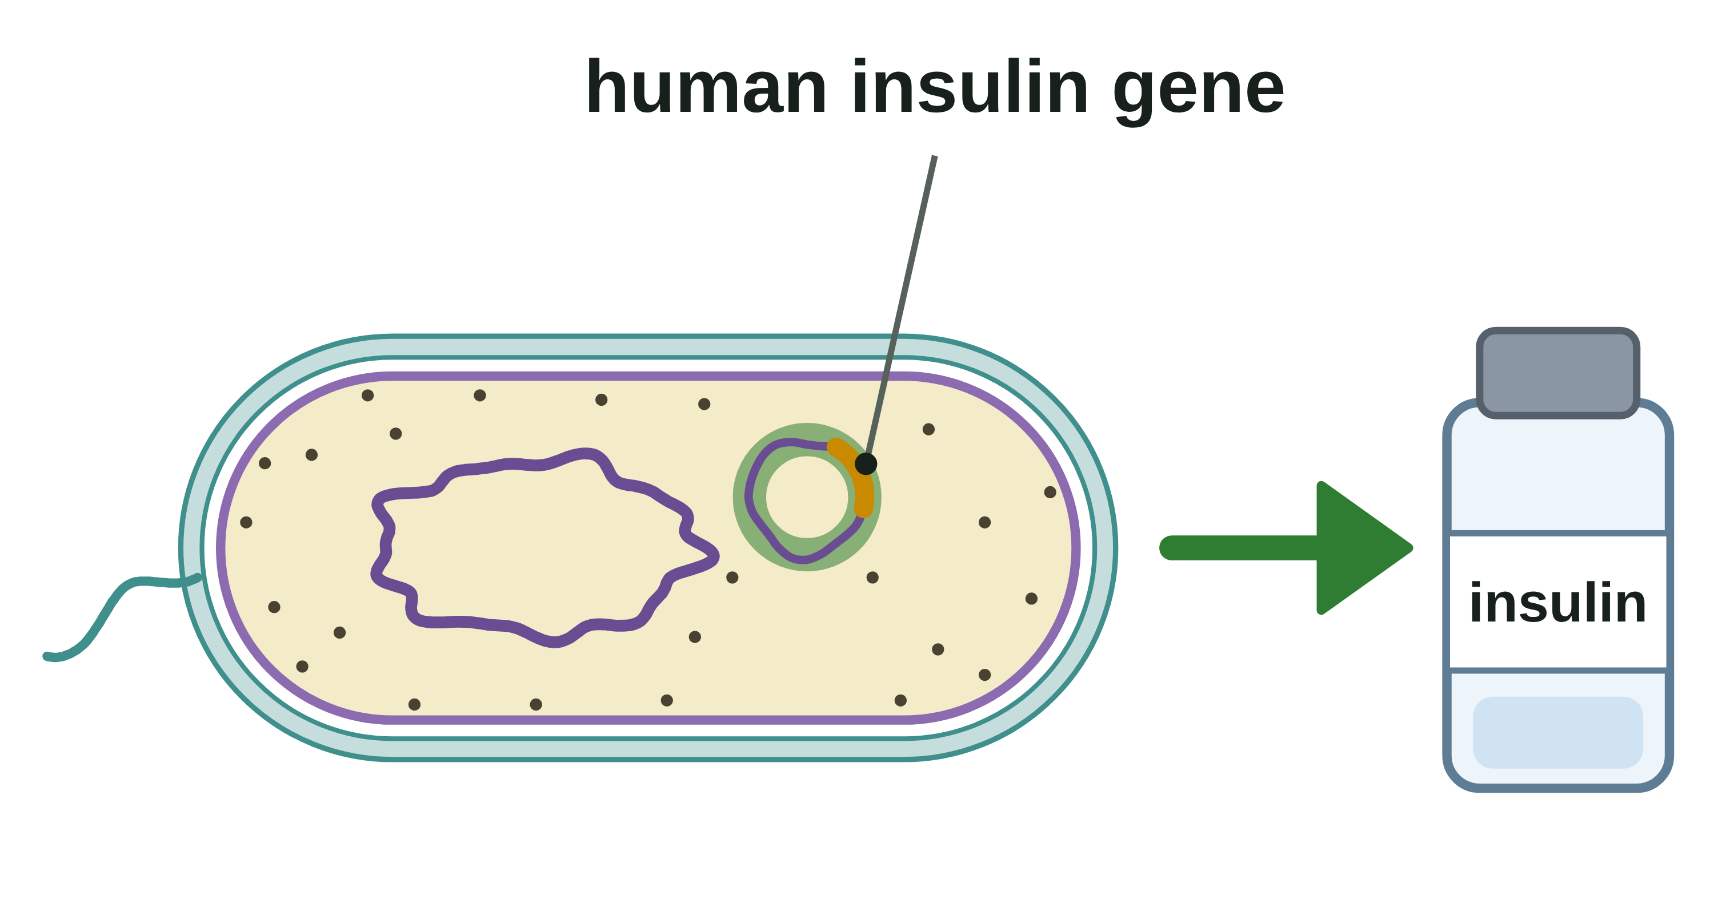
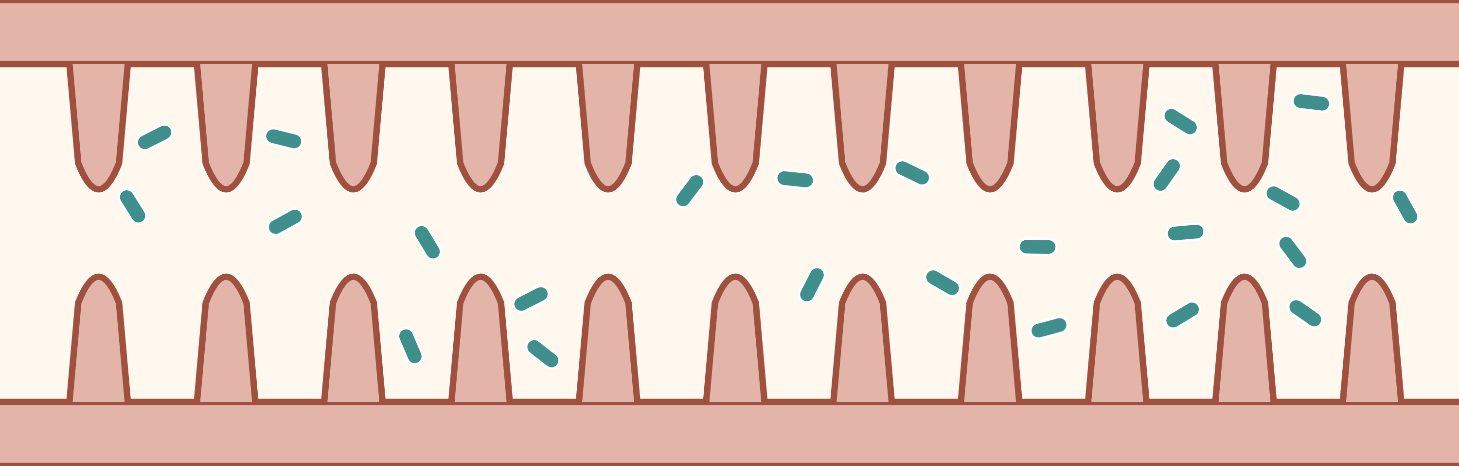
sciencegcse.co.uk · Biology B1 L2: Bacterial cells
Why this matters in the real world
Bacteria are some of the smallest living cells, and they are everywhere: in soil, in water and inside you.
Too small to see
Medicines from bacteria
Bacteria in your gut
2 µm
trillions
a typical bacterium
of bacteria in your gut
A typical bacterium is two thousandths of a millimetre long. You need a microscope to see one.
Scientists put the human insulin gene into bacteria. The bacteria then make insulin for people with diabetes.
Most bacteria are harmless or useful: gut bacteria help to break down some foods. A few are pathogens.
Microorganisms
Plasmids at work
Mostly helpful
3
B1 L2 · sciencegcse.co.uk
Notes:
Hook. Ask: are bacteria good or bad? Take a vote, then show the cards. Most bacteria are harmless or useful: they break down dead material in soil, help to make yoghurt and cheese, and live in your gut, where they help to break down some foods. A few kinds are pathogens that cause disease (B3 Infection and response). Since the 1980s, people with diabetes have used human insulin made by bacteria: scientists put the human insulin gene into a plasmid in the bacteria (more in B6, genetic engineering). Today: what is inside a bacterial cell, and why it is so different from your cells.

Slide 4
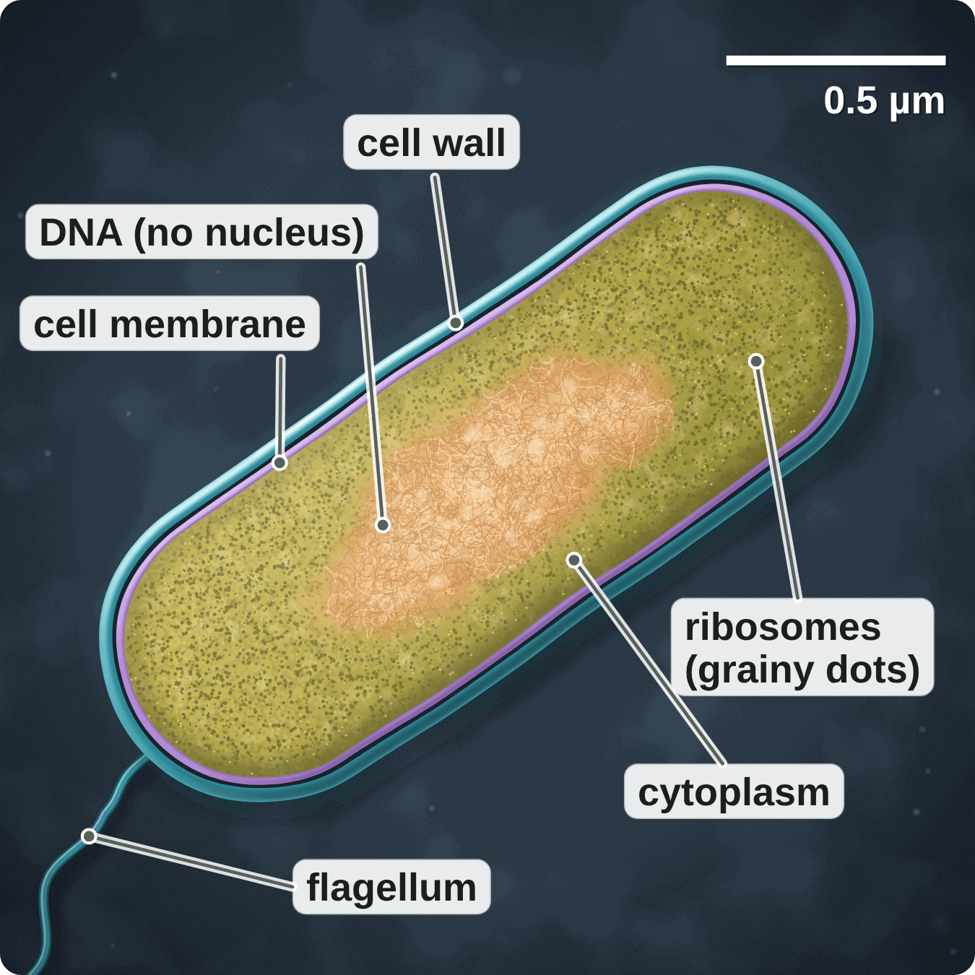
sciencegcse.co.uk · Biology B1 L2: Bacterial cells
Online lesson: screen 1 of 12
A bacterium up close
A bacterium, cut lengthways
Key facts
A bacterium (plural bacteria) is a single-celled organism: its one cell is the whole living thing.
Bacteria are microorganisms: too small to see without a microscope.
Most bacteria are about 1 to 5 µm long. This one is about 2 µm long.
The picture is based on an electron micrograph: a picture taken with an electron microscope.
Bacterial cells are prokaryotic: their DNA is not enclosed in a nucleus.
A bacterium is one cell, with DNA but no nucleus.
A painting based on a coloured electron micrograph.
The colours are added. Real bacteria are almost colourless.
4
B1 L2 · sciencegcse.co.uk
Notes:
This is a painting based on a coloured electron micrograph of one bacterium, sliced lengthways, like cutting a sausage along its length. Ask: what can you see? (A tough outer layer, a grainy inside, a pale tangle in the middle.) Ask: is it an animal cell or a plant cell? (Neither: it is a whole living thing made of one cell.) Use the scale bar: it shows 0.5 µm, and the bacterium is about four of these long, so it is about 2 µm long. A micrometre is a thousandth of a millimetre, so you could line up about 500 of these across one millimetre on your ruler. Electron micrographs are black and white: on the online lesson, screen 1, switch the colours off to see the real picture. The pale tangle in the middle is the DNA; scientists call this area the nucleoid, but you do not need that word: there is no nucleus round it. How electron microscopes work is B1 L3 Using a microscope. One key fact a click.

Slide 5
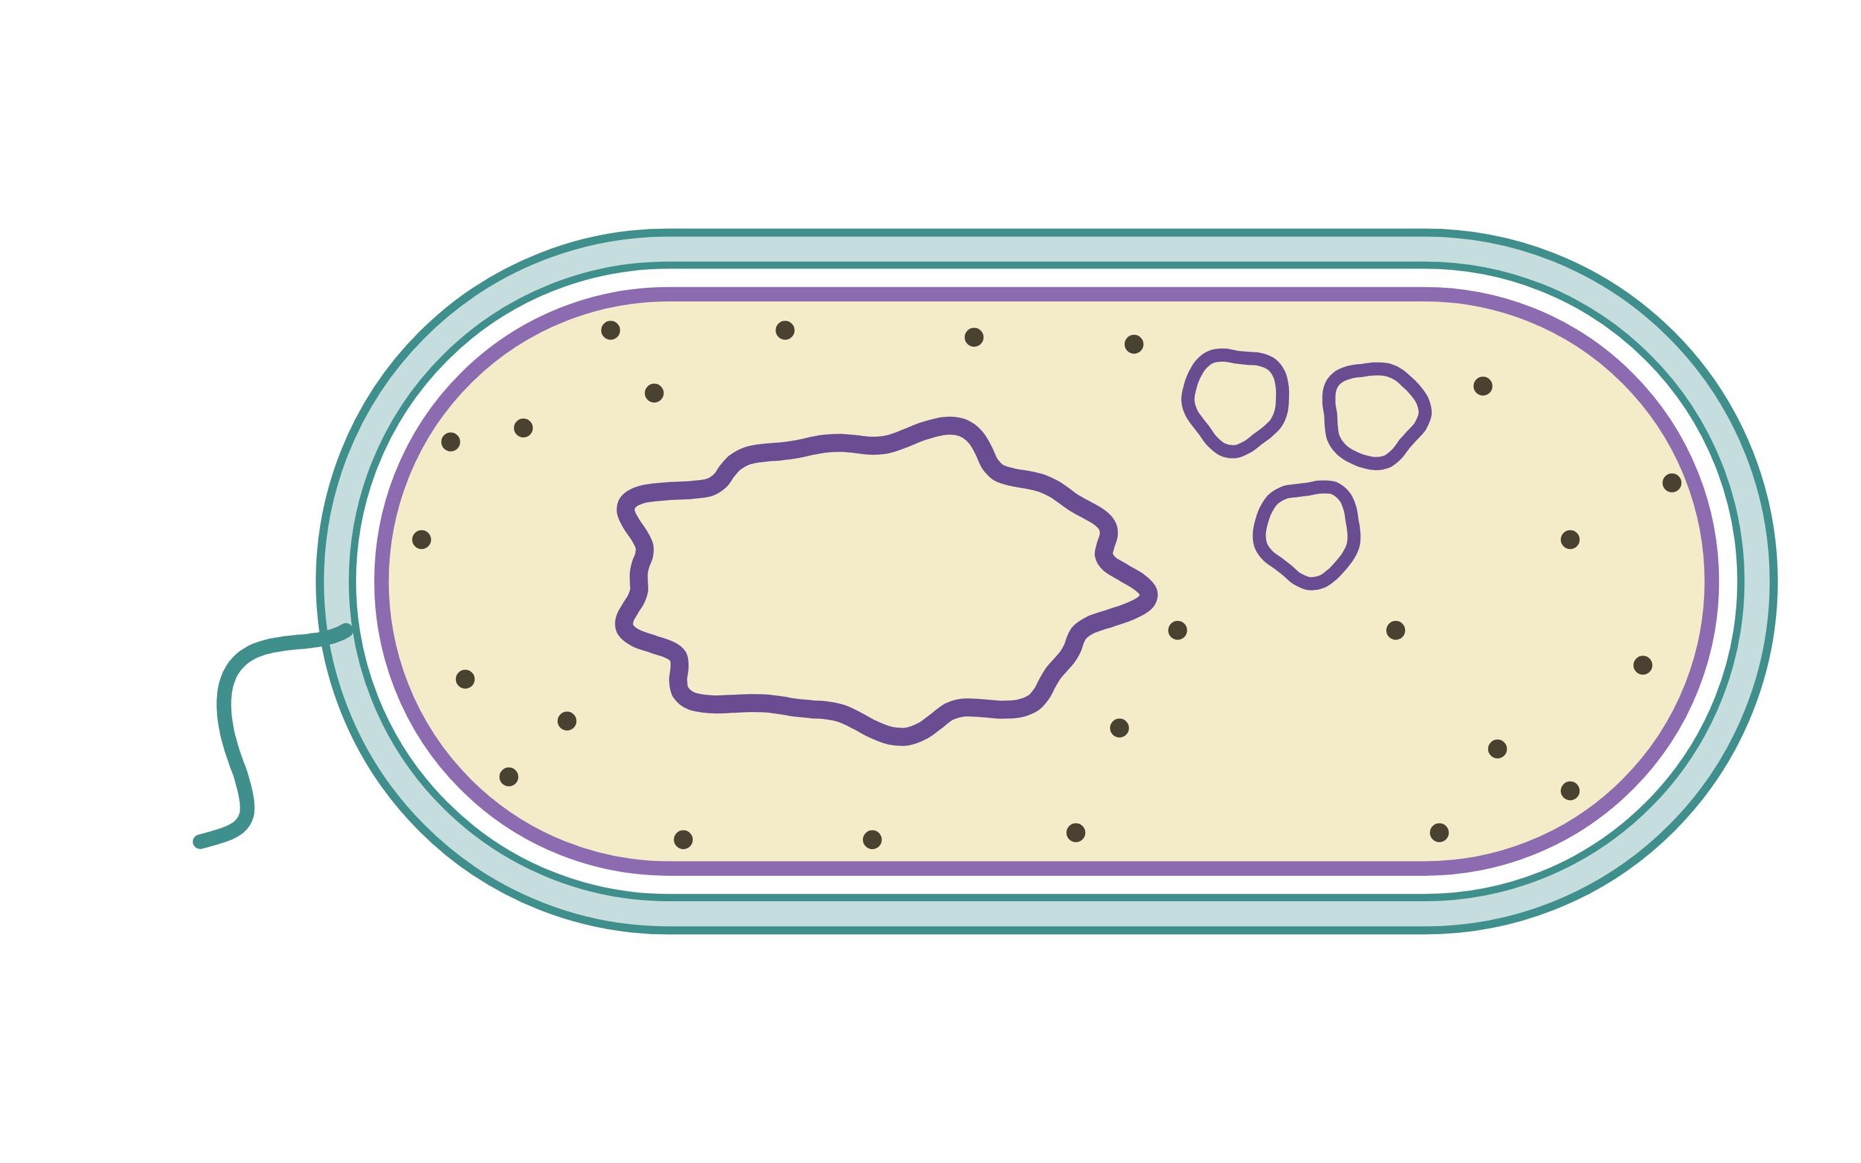
sciencegcse.co.uk · Biology B1 L2: Bacterial cells
Online lesson: screen 2 of 12
A real bacterium and a diagram
Same thing, two ways
Spot the differences
1
DNA: In the micrograph, the DNA is a pale tangle in the middle, with no membrane round it. The diagram draws one neat loop.
5
2
Plasmids: Too small to pick out in the micrograph. The diagram draws them as clear small rings.
2
5
2
1
1
3
Ribosomes: Thousands of tiny dots make the real cytoplasm look grainy. The diagram draws only a few.
3
4
3
4
4
Colour: Electron micrographs are black and white: these colours are added. The diagram uses its own colours.
A real bacterium (painting)
A diagram
5
Wall and membrane: In the micrograph they are two thin layers, pressed close. The diagram draws two clear lines with a gap.
cut lengthways · about 2 µm long
not to scale
Same in both: Both show a cell wall, a cell membrane, cytoplasm and DNA with no nucleus round it.
Electron micrographs are black and white: the colours are added. Real bacteria are almost colourless.
5
B1 L2 · sciencegcse.co.uk
Notes:
Cover the right panel and ask: what is different between the two pictures? Take ideas, then reveal the five differences (each click shows one difference and its number on both pictures; the last click shows what is the same in both). Key message: exam diagrams are simplified on purpose, so that you can see and name every part. The real DNA is very long, about 1.5 mm if it were stretched out, inside a cell only 2 µm long, so it is folded into a tangle; in the diagram it is drawn as one neat loop to show that it is a single loop with no ends. Plasmids and single ribosomes are far too small to pick out at this size. Electron microscopes use a beam of electrons, not light, so the pictures are black and white; scientists add colours on a computer to make the parts easier to see (more in B1 L3 Using a microscope). The bacterial cell wall is not made of cellulose: it is made of a different substance (peptidoglycan; you do not need the name). The online lesson, screen 2, has the same pictures and differences.

Slide 6
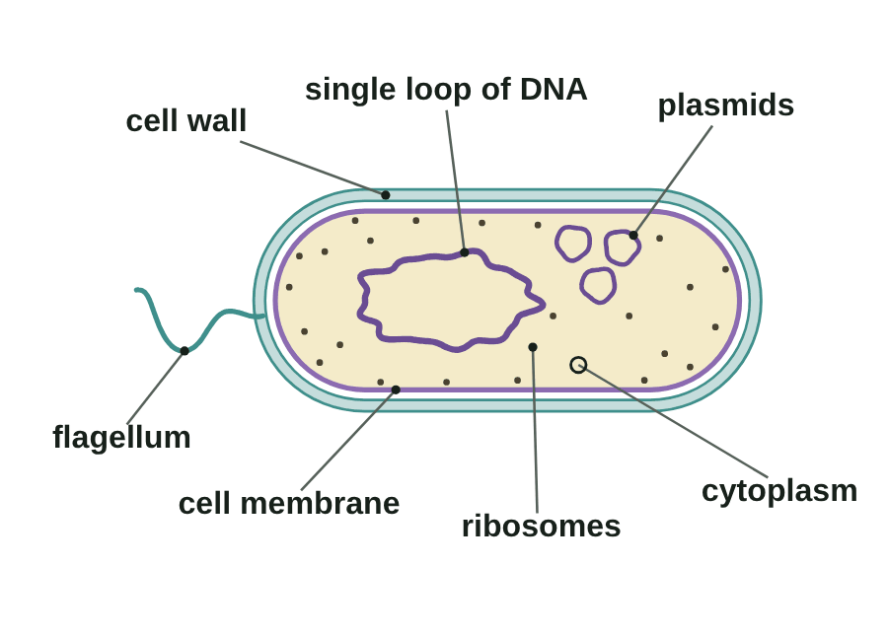
sciencegcse.co.uk · Biology B1 L2: Bacterial cells
Online lesson: screen 3 of 12
Inside a bacterial cell
A bacterial cell
Parts and jobs
Cell wall: strengthens the cell. Not made of cellulose.
Cell membrane: controls what goes in and out.
Cytoplasm: where most chemical reactions happen.
Ribosomes: where proteins are made.
Single loop of DNA: the genetic instructions.
Plasmids: small rings of DNA with a few extra genes.
Flagellum: a tail for moving.
Only some bacteria have plasmids or a flagellum.
A diagram is simplified. The colours help you tell the parts apart.
6
B1 L2 · sciencegcse.co.uk
Notes:
Go round the cell from the outside in. The cell wall is outside the cell membrane, as in a plant cell, but it is not made of cellulose. The membrane controls what goes in and out, as in every cell. Ribosomes make proteins, as in animal and plant cells. Ask: which parts of an animal cell are missing? (The nucleus and the mitochondria.) Which part of a plant cell is missing besides those? (Chloroplasts and the permanent vacuole.) Plasmids and the flagellum are extras: some bacteria have them, some do not. On the online lesson, screen 3, switch on 'Test yourself' to practise the names. Exam diagrams often label a flagellum even though the AQA specification does not list it, so learn it anyway. One line a click, in the same order as the GIF lights the parts (print and PDF show its first frame), then the green line.

Slide 7
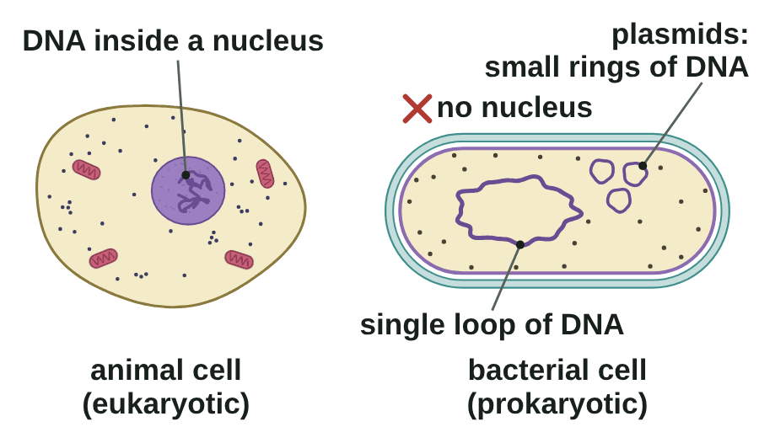
sciencegcse.co.uk · Biology B1 L2: Bacterial cells
Online lesson: screen 4 of 12
DNA, but no nucleus
Where is the DNA?
Step by step
1
Eukaryotic: in animal and plant cells, the DNA is enclosed in a nucleus.
2
No nucleus: a bacterial cell has no nucleus. Its DNA is free in the cytoplasm.
3
One loop: the main DNA is a single loop.
4
Plasmids: many bacteria also have small rings of DNA called plasmids.
No nucleus does not mean no DNA.
A diagram is simplified. Not to scale.
▶ Online lesson, screen 4: DNA, but no nucleus
7
B1 L2 · sciencegcse.co.uk
Notes:
Run screen 4 of the online lesson with Next step, or let the GIF play (print and PDF show its first frame). One step a click, then the green line. 'Pro-' means before and 'karyon' means nucleus: before a nucleus. 'Eu-' means true: eukaryotic cells have a true nucleus. Common error: 'bacteria have no nucleus, so they have no DNA.' Bacteria do have DNA; it is just not wrapped in a nucleus. The main DNA is one loop with no ends; stretched out it would be about 1.5 mm long, about 750 times the length of the cell, so it is folded up. The jobs of the nucleus in animal and plant cells are B1 L1 Animal and plant cells. Bacteria do not divide by mitosis, because they have no nucleus (B1 L6 Cell division: mitosis).

Slide 8
sciencegcse.co.uk · Biology B1 L2: Bacterial cells
Online lesson: screen 5 of 12
Checkpoint 1
✓
CHECKPOINT 1 of 3
Quick check on slides 4 to 7 (online screens 1 to 4). Show A, B or C on your whiteboard.
Question 1
Question 2
Question 3
A coloured electron micrograph shows a golden-yellow bacterium. Where does the colour come from?
Which of these structures is found in a bacterial cell?
A bacterial cell has no nucleus. What is true about its DNA?
A. It is the bacterium's real colour.
A. A nucleus
A. The main DNA is a single loop, free in the cytoplasm.
B. It was added to a black and white picture.
B. Mitochondria
B. It has no DNA at all.
C. The bacterium was stained with iodine.
C. Ribosomes
C. All of its DNA is in plasmids.
✓ Check your answers on the next slide
8
B1 L2 · sciencegcse.co.uk
Notes:
Hinge check. Everyone shows A, B or C at the same time. Q1 A tests 'the colours are real'; Q1 C mixes up light-microscope stains with electron micrographs. Q2 A and B test 'bacteria have a nucleus / mitochondria'. Q3 B is the 'no nucleus, so no DNA' trap and Q3 C the 'plasmids are the main DNA' trap. If several get Q1 wrong, go back to slide 5; Q2, slide 6; Q3, slide 7.

Slide 9
sciencegcse.co.uk · Biology B1 L2: Bacterial cells
Online lesson: screen 5 of 12
Checkpoint 1 answers
✓
CHECKPOINT 1 of 3
Quick check on slides 4 to 7 (online screens 1 to 4). Show A, B or C on your whiteboard.
Question 1
Question 2
Question 3
A coloured electron micrograph shows a golden-yellow bacterium. Where does the colour come from?
Which of these structures is found in a bacterial cell?
A bacterial cell has no nucleus. What is true about its DNA?
A. It is the bacterium's real colour.
A. A nucleus
A. The main DNA is a single loop, free in the cytoplasm.
A. The main DNA is a single loop, free in the cytoplasm. ✓
B. It was added to a black and white picture.
B. It was added to a black and white picture. ✓
B. Mitochondria
B. It has no DNA at all.
C. The bacterium was stained with iodine.
C. Ribosomes
C. Ribosomes ✓
C. All of its DNA is in plasmids.
Electron micrographs are black and white: the colours are added.
Bacteria have ribosomes, so they can make proteins.
Bacteria do have DNA. It is just not enclosed in a nucleus.
Got one wrong? Look back: Q1 slide 5 · Q2 slide 6 · Q3 slide 7
9
B1 L2 · sciencegcse.co.uk
Notes:
1 B, 2 C, 3 A. Each click shows one answer and why. Ask a student who got each one right to explain why. Follow-up for Q2: name two structures that animal cells have but bacterial cells do not. (A nucleus and mitochondria.)

Slide 10
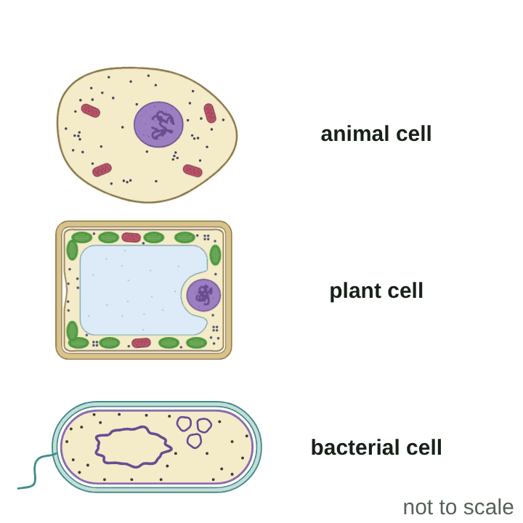
sciencegcse.co.uk · Biology B1 L2: Bacterial cells
Online lesson: screen 6 of 12
Prokaryotic and eukaryotic cells
Three kinds of cell
Which cells have it?
Structure
Animal cell
Plant cell
Bacterial cell
nucleus
✓
✓
✗
DNA
✓ in the nucleus
✓ in the nucleus
✓ a single loop
cell membrane
✓
✓
✓
cytoplasm
✓
✓
✓
ribosomes
✓
✓
✓
mitochondria
✓
✓
✗
chloroplasts
✗
✓ (some)
✗
cell wall
✗
✓ cellulose
✓ not cellulose
plasmids
✗
✗
✓ (some)
Watch out: 'Pro-' = before, 'karyon' = nucleus. 'Eu-' = true.
Prokaryotic: no nucleus. Eukaryotic: the genetic material is enclosed in a nucleus.
A diagram is simplified.
10
B1 L2 · sciencegcse.co.uk
Notes:
Run screen 6 of the online lesson, or let the GIF light each structure in turn (print and PDF show its first frame). One table row a click: ask students to predict the bacterial column before each row appears. All three have a cell membrane, cytoplasm, ribosomes and DNA: these do the basic jobs of being alive. The big difference is the nucleus. Animal and plant cells are eukaryotic: their genetic material is enclosed in a nucleus. Bacterial cells are prokaryotic: no nucleus. Both plant and bacterial cells have a cell wall, but only the plant cell wall is made of cellulose. Not every plant cell has chloroplasts (root hair cells have none: B1 L1). Permanent vacuole: plant cells only; it is in the notes table.

Slide 11
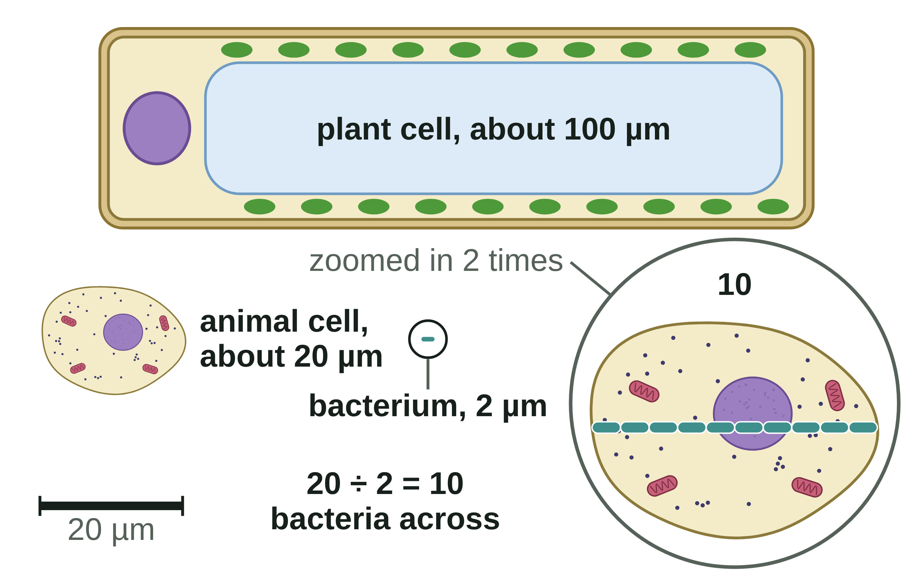
sciencegcse.co.uk · Biology B1 L2: Bacterial cells
Online lesson: screen 7 of 12
How small are bacteria?
Drawn to the same scale
How big are cells?
Cell
Typical size
Times bigger than a bacterium
bacterium
about 2 µm
1
animal cell
about 20 µm
20 ÷ 2 = 10
plant cell
up to about 100 µm
100 ÷ 2 = 50
Watch out!
How many times bigger? Divide the bigger size by the smaller size: 20 ÷ 2 = 10. Do not subtract (20 − 2 = 18).
Both sizes must be in the same unit first. 1 mm = 1000 µm.
A bacterium is about 10 times smaller than an animal cell: about one order of magnitude.
Drawn to the same scale.
Each 10 times bigger is one order of magnitude.
11
B1 L2 · sciencegcse.co.uk
Notes:
Two worked examples on the table, one row a click, then the three Watch out lines. Animal cell: 20 µm ÷ 2 µm = 10, so 10 times bigger: ten bacteria would fit across one animal cell. Plant cell: 100 µm ÷ 2 µm = 50 times bigger. Check: 10 × 2 = 20, and 50 × 2 = 100. Ask: how many bacteria, each 2 µm long, would fit along 1 mm? (1 mm = 1000 µm, so 1000 ÷ 2 = 500.) Common error: subtracting (20 − 2 = 18) instead of dividing. 'Order of magnitude' means a factor of 10: the animal cell is about one order of magnitude bigger than the bacterium. Calculating orders of magnitude, standard form and magnification is B1 L4 Magnification and cell size; on the online lesson, screen 7, press 'Line them up'.

Slide 12
sciencegcse.co.uk · Biology B1 L2: Bacterial cells
Online lesson: screen 8 of 12
Checkpoint 2
✓
CHECKPOINT 2 of 3
Quick check on slides 10 and 11 (online screens 6 and 7). Show A, B or C on your whiteboard.
Question 1
Question 2
Question 3
Which structure do animal cells, plant cells and bacterial cells all have?
A plant cell is 60 µm long. A bacterium is 3 µm long. How many times longer is the plant cell?
Bacterial cells are prokaryotic. What does prokaryotic mean?
A. A nucleus
A. 20 times
A. The cell has a cell wall made of cellulose.
B. A cell wall
B. 57 times
B. The cell's genetic material is not enclosed in a nucleus.
C. A cell membrane
C. 180 times
C. The cell is too small to see.
✓ Check your answers on the next slide
12
B1 L2 · sciencegcse.co.uk
Notes:
Hinge check: everyone shows A, B or C at the same time. Q1 A and B test which cells have a nucleus and a wall. Q2 B (subtracting) and C (multiplying) are the two calculation errors. Q3 A is the cellulose trap and Q3 C confuses prokaryotic with small. If several get Q1 or Q3 wrong, go back to slide 10; Q2, slide 11.

Slide 13
sciencegcse.co.uk · Biology B1 L2: Bacterial cells
Online lesson: screen 8 of 12
Checkpoint 2 answers
✓
CHECKPOINT 2 of 3
Quick check on slides 10 and 11 (online screens 6 and 7). Show A, B or C on your whiteboard.
Question 1
Question 2
Question 3
Which structure do animal cells, plant cells and bacterial cells all have?
A plant cell is 60 µm long. A bacterium is 3 µm long. How many times longer is the plant cell?
Bacterial cells are prokaryotic. What does prokaryotic mean?
A. A nucleus
A. 20 times
A. 20 times ✓
A. The cell has a cell wall made of cellulose.
B. A cell wall
B. 57 times
B. The cell's genetic material is not enclosed in a nucleus.
B. The cell's genetic material is not enclosed in a nucleus. ✓
C. A cell membrane
C. A cell membrane ✓
C. 180 times
C. The cell is too small to see.
All three have a cell membrane, cytoplasm, ribosomes and DNA.
60 ÷ 3 = 20.
"Pro-" means before and "karyon" means nucleus.
Got one wrong? Look back: Q1 slide 10 · Q2 slide 11 · Q3 slide 10
13
B1 L2 · sciencegcse.co.uk
Notes:
1 C, 2 A, 3 B. Each click shows one answer and why. Follow-up for Q2: check by multiplying back: 20 × 3 = 60.

Slide 14
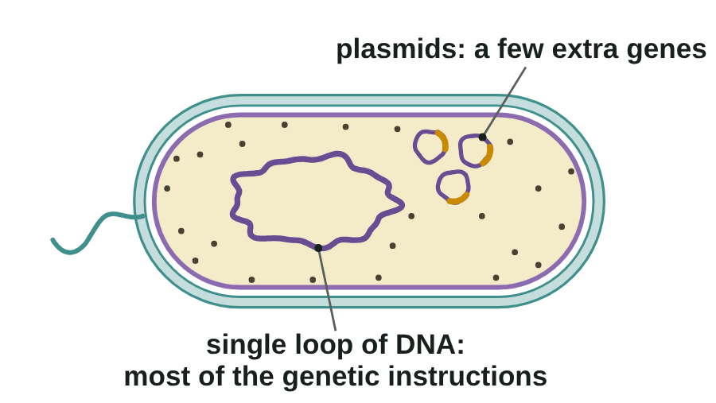
sciencegcse.co.uk · Biology B1 L2: Bacterial cells
Online lesson: screen 9 of 12
Plasmids: extra rings of DNA
Plasmids at work
Plasmids
1. Plasmids are small rings of DNA, separate from the main loop.
2. They carry a few extra genes. The main loop carries most of the genes.
3. Some plasmids carry a gene that helps the bacterium survive an antibiotic.
4. Not every bacterium has plasmids. Some have several.
Plasmids are extras. The main DNA is the single loop.
A diagram is simplified.
▶ Online lesson, screen 9: Plasmids: extra rings of DNA
14
B1 L2 · sciencegcse.co.uk
Notes:
Plasmids are found in bacteria. A bacterium may have none, one or several. The main loop carries the genes the bacterium needs to live; plasmids carry a few extra genes that can help in some places, for example a gene that helps it survive an antibiotic. Ask: why might a doctor be worried about a plasmid like that? (The antibiotic would not work on that bacterium.) How antibiotic resistance spreads is B6 Inheritance, variation and evolution, and antibiotics as medicines are B3 Infection and response. Scientists also put useful genes, such as the human insulin gene, into bacteria, so the bacteria make the protein (B6, genetic engineering). Common error: calling plasmids the main DNA, or saying every bacterium has them. Lines 1 to 4 wipe in one by one, then the green line. The GIF plays in the slide show (print and PDF show its first frame).

Slide 15
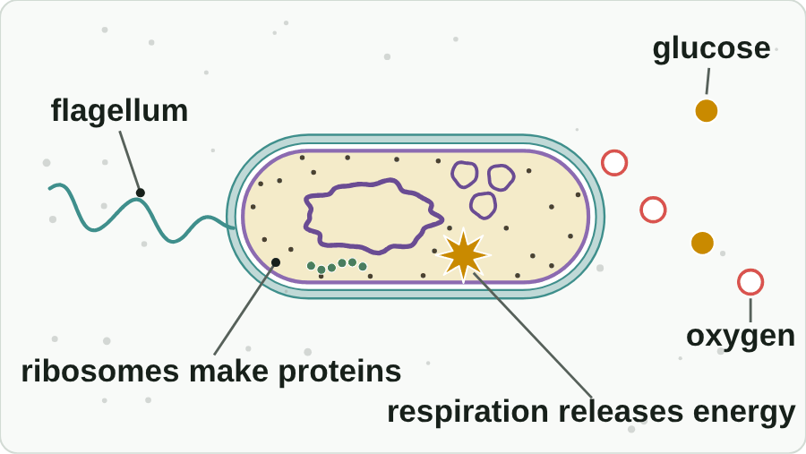
sciencegcse.co.uk · Biology B1 L2: Bacterial cells
Online lesson: screen 10 of 12
One cell, one whole organism
A bacterium at work
A living cell
A bacterium is a single-celled organism and a microorganism.
It takes in substances and makes proteins at its ribosomes. Some bacteria move with a flagellum.
No mitochondria, but bacteria still respire to release energy.
Watch out!
Most bacteria are harmless or useful: bacteria in your gut help to break down some foods. A few are pathogens: microorganisms that cause infectious disease.
Bacteria are not viruses. Viruses are not cells at all (B3 Infection and response).
● glucose ○ oxygen A diagram is simplified.
▶ Online lesson, screen 10: One cell, one whole organism
15
B1 L2 · sciencegcse.co.uk
Notes:
A bacterium is a whole organism in one cell. Compare a muscle cell in your leg: it is one of trillions of cells in an organism, and it cannot live on its own. Ask: if a bacterium has no mitochondria, how does it release energy? (It still respires: the reactions happen in its cytoplasm and on its cell membrane.) Energy is released, never made. Most bacteria are harmless or useful: in soil, in your gut, in yoghurt and cheese making. A few are pathogens. How pathogens cause disease, and viruses, are B3 Infection and response. How bacteria grow and divide is separate Biology only. The three 'A living cell' lines one a click, then the two Watch out lines. The GIF plays in the slide show (print and PDF show its first frame).

Slide 16
sciencegcse.co.uk · Biology B1 L2: Bacterial cells
Online lesson: screen 11 of 12
Which type of cell is it?
Sort the cells
How to decide
Prokaryotic (no nucleus)
Eukaryotic (a nucleus)
1
Prokaryotic or eukaryotic? Sort the eight cells.
Look: for a nucleus.
a cheek cell
a bacterium
a cell 1 µm long with a single loop of DNA
a yeast cell: a single-celled fungus
a cheek cell
a root hair cell
2
No nucleus: prokaryotic (bacteria).
a cell 1 µm long with a single loop of DNA
a pondweed leaf cell
3
A nucleus: eukaryotic (animal and plant cells, and yeast).
a bacterium
a cell with a nucleus and mitochondria
a cell with plasmids and no nucleus
a pondweed leaf cell
4
Watch out: single-celled does not mean prokaryotic.
a cell with plasmids and no nucleus
a yeast cell: a single-celled fungus
a root hair cell
Prokaryotic = no nucleus. Eukaryotic = a nucleus.
Look for a nucleus in each one.
Watch out for the trap!
a cell with a nucleus and mitochondria
16
B1 L2 · sciencegcse.co.uk
Notes:
Before you click, read out the eight cards. Pairs sort them into two columns on a whiteboard (2 minutes). Then click through the four steps of How to decide; click 5 sorts the cards into their columns, and the last click shows the green line. The one decision that matters is the nucleus. Yeast is the trap: it is a single-celled organism, like a bacterium, but it is a fungus with a nucleus, so it is eukaryotic (its card has a green outline). Size and plasmids are clues to a bacterium too: most bacteria are 1 to 5 µm long, and plasmids are found in bacterial cells. The online lesson, screen 11, has the same cards to sort.

Slide 17
sciencegcse.co.uk · Biology B1 L2: Bacterial cells
Online lesson: screen 12 of 12
Checkpoint 3
✓
CHECKPOINT 3 of 3
Quick check on slides 14 to 16 (online screens 9 to 11). Show A, B or C on your whiteboard.
Question 1
Question 2
Question 3
Which statement about plasmids is correct?
Bacteria have no mitochondria. Which statement is true?
A cell is 2 µm long. It has a cell wall and a single loop of DNA, but no nucleus. What is it?
A. They are small rings of DNA, separate from the main loop.
A. Bacteria cannot respire.
A. A plant cell
B. Every bacterium has plasmids.
B. Bacteria still respire to release energy.
B. A yeast cell
C. They hold the main DNA of the cell.
C. Bacteria get their energy from chloroplasts.
C. A bacterial cell
✓ Check your answers on the next slide
17
B1 L2 · sciencegcse.co.uk
Notes:
Hinge check: everyone shows A, B or C at the same time. Q1 B and C are the plasmid traps. Q2 A is 'no mitochondria, so no respiration'. Q3 B is the yeast trap (single-celled but eukaryotic). If several get Q1 wrong, go back to slide 14; Q2, slide 15; Q3, slide 16.

Slide 18
sciencegcse.co.uk · Biology B1 L2: Bacterial cells
Online lesson: screen 12 of 12
Checkpoint 3 answers
✓
CHECKPOINT 3 of 3
Quick check on slides 14 to 16 (online screens 9 to 11). Show A, B or C on your whiteboard.
Question 1
Question 2
Question 3
Which statement about plasmids is correct?
Bacteria have no mitochondria. Which statement is true?
A cell is 2 µm long. It has a cell wall and a single loop of DNA, but no nucleus. What is it?
A. They are small rings of DNA, separate from the main loop.
A. They are small rings of DNA, separate from the main loop. ✓
A. Bacteria cannot respire.
A. A plant cell
B. Every bacterium has plasmids.
B. Bacteria still respire to release energy.
B. Bacteria still respire to release energy. ✓
B. A yeast cell
C. They hold the main DNA of the cell.
C. Bacteria get their energy from chloroplasts.
C. A bacterial cell
C. A bacterial cell ✓
Plasmids carry a few extra genes.
The reactions happen in the cytoplasm and on the cell membrane.
No nucleus and a single loop of DNA: a prokaryotic cell.
Got one wrong? Look back: Q1 slide 14 · Q2 slide 15 · Q3 slide 16
18
B1 L2 · sciencegcse.co.uk
Notes:
1 A, 2 B, 3 C. Each click shows one answer and why. Next: practise naming the parts of a bacterium.

Slide 19
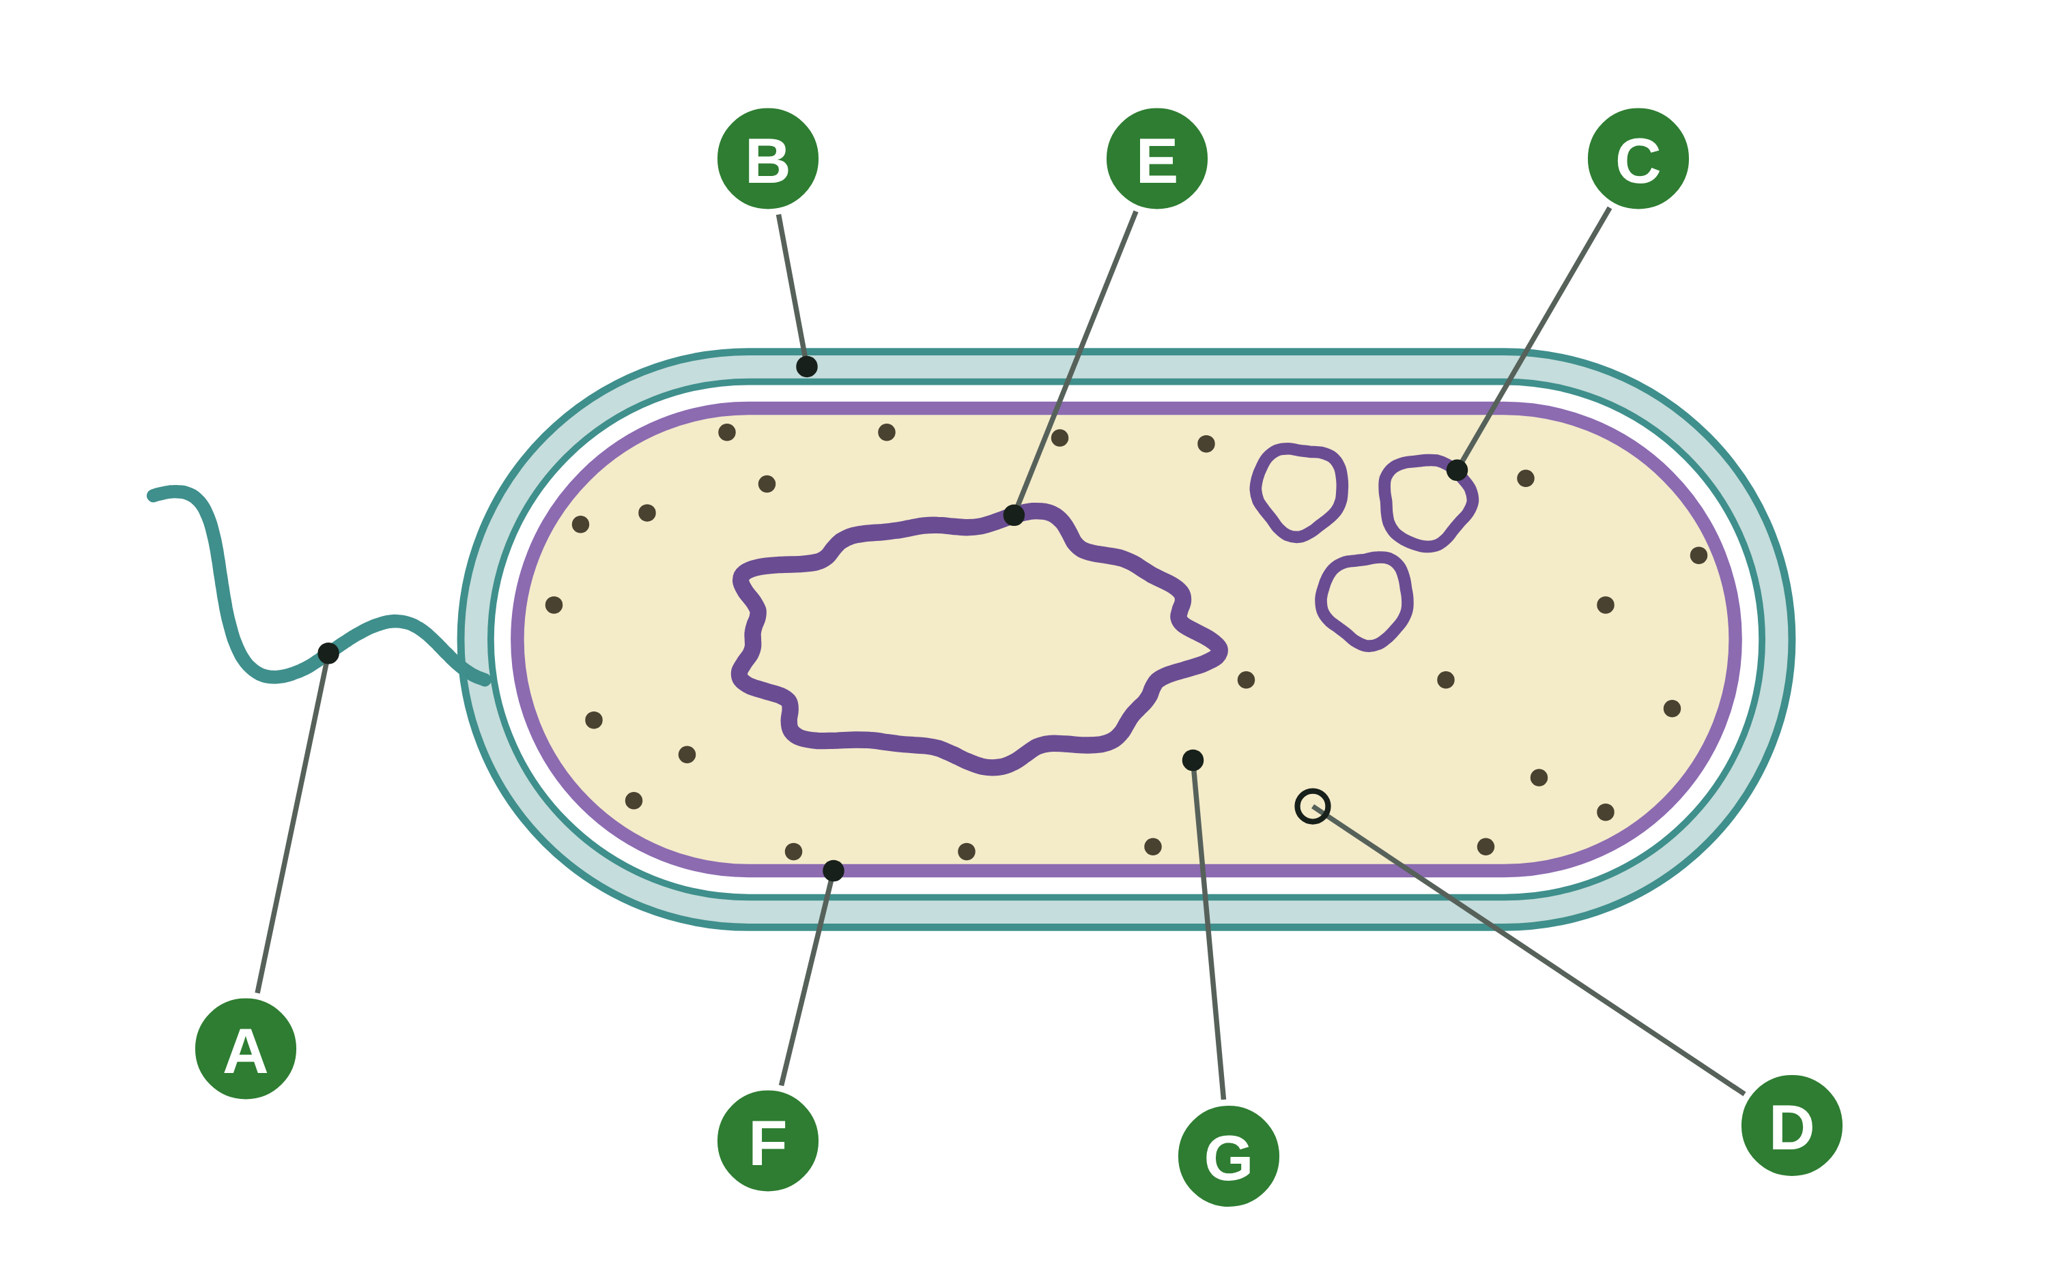
sciencegcse.co.uk · Biology B1 L2: Bacterial cells
Practice: Name the parts of a bacterium
A bacterial cell
Questions
1. Which letter is the cell wall?
______________
2. Which letter is the single loop of DNA?
______________
3. Which letter shows a plasmid?
______________
4. Which letter shows where proteins are made?
______________
5. Which letter shows the part that controls what enters and leaves the cell?
______________
6. Give the letter of a part that only some bacteria have, and name it.
______________
A diagram is simplified. The colours help you tell the parts apart.
19
B1 L2 · sciencegcse.co.uk
Notes:
Pairs, 4 minutes. Name each part first, then answer. The wall (B) and the membrane (F) are the two outlines: the wall is outside.

Slide 20
sciencegcse.co.uk · Biology B1 L2: Bacterial cells
Name the parts of a bacterium: answers
A bacterial cell
Answers
1. Which letter is the cell wall?
B
2. Which letter is the single loop of DNA?
E
3. Which letter shows a plasmid?
C
4. Which letter shows where proteins are made?
G (the ribosomes)
5. Which letter shows the part that controls what enters and leaves the cell?
F (the cell membrane)
6. Give the letter of a part that only some bacteria have, and name it.
A (flagellum) or C (plasmid)
A diagram is simplified. The colours help you tell the parts apart.
20
B1 L2 · sciencegcse.co.uk
Notes:
A flagellum, B cell wall, C plasmid, D cytoplasm, E single loop of DNA, F cell membrane, G ribosomes. Common errors: calling E a nucleus (bacteria have none), and swapping B and F.

Slide 21
sciencegcse.co.uk · Biology B1 L2: Bacterial cells
Exam practice
1. Describe two ways the DNA in a bacterial cell is different from the DNA in an animal cell. [2]
Any two: in a bacterial cell the DNA is not enclosed in a nucleus / it is free in the cytoplasm (1). The main DNA is a single loop (1). A bacterial cell may also have plasmids (small rings of DNA) (1).
2. A plant cell is 0.08 mm long. A bacterium is 5 µm long. 1 mm = 1000 µm. Calculate how many times longer the plant cell is. [3]
0.08 mm × 1000 = 80 µm (1). 80 ÷ 5 (1) = 16 times (1).
21
B1 L2 · sciencegcse.co.uk
Notes:
Model answers with mark points in brackets. Students try each question first, then mark their own work in green. Q2: change both sizes into the same unit first (here, µm), then divide the bigger by the smaller. Check: 16 × 5 = 80. For more, the B1 L2 Exam questions worksheet (PDF) has 5 questions, 20 marks; its mark scheme is at the end of this PowerPoint. The same questions are in the online lesson, after the quiz.

Slide 22
sciencegcse.co.uk · Biology B1 L2: Bacterial cells
Exit ticket
Answer on your own
How confident am I?
1. Name the small rings of DNA found in some bacterial cells. [1]
I can name the parts of a bacterial cell.
2. Give one structure animal cells have but bacterial cells do not. [1]
I can explain prokaryotic and eukaryotic.
3. Name the substance that a plant cell wall is made of, but a bacterial cell wall is not. [1]
4. Explain why a bacterial cell is described as prokaryotic. [2]
I can compare the sizes of cells.
22
B1 L2 · sciencegcse.co.uk
Notes:
Students answer on their own, then rate their confidence. Q3 links back to Do now Q3: plant cell walls are made of cellulose; bacterial cell walls are not.

Slide 23
sciencegcse.co.uk · Biology B1 L2: Bacterial cells
Exit ticket answers
Answers
Next lesson
1. Plasmids.
2. A nucleus (or mitochondria).
3. Cellulose.
4. Its genetic material is not enclosed in a nucleus (1). The DNA is a single loop, free in the cytoplasm (1).
Next: B1 L3 Using a microscope
How to prepare a slide, focus a light microscope and draw what you see.
Worksheets:
• Mandatory (everyone)
• Alternative (easier, with key notes)
• Challenge (when you finish the Mandatory)
• Exam questions (exam style, 20 marks, homework)
▶ Online lesson: quiz and exam questions
23
B1 L2 · sciencegcse.co.uk
Notes:
Go through the answers. After this slide: the B1 L2 revision notes (4 printable pages), then the worksheets with answers in green: Mandatory (everyone), Challenge (stretch) and Alternative (easier: key notes and very simple tasks). The B1 L2 Exam questions worksheet (exam style, black and white, 20 marks) is a separate PDF for homework; its mark scheme is the last two slides. Homework: the online lesson quiz and the B1 L2 Exam questions worksheet. Next lesson we use a light microscope to look at real cells.

Slide 24
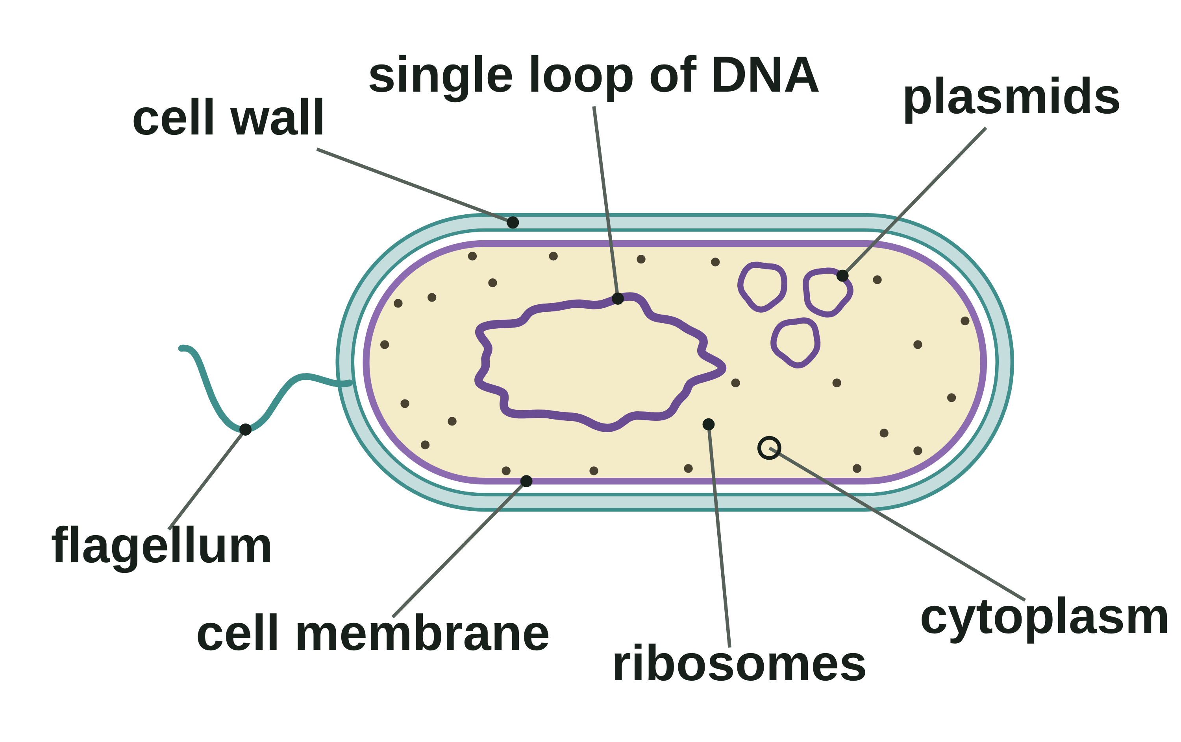
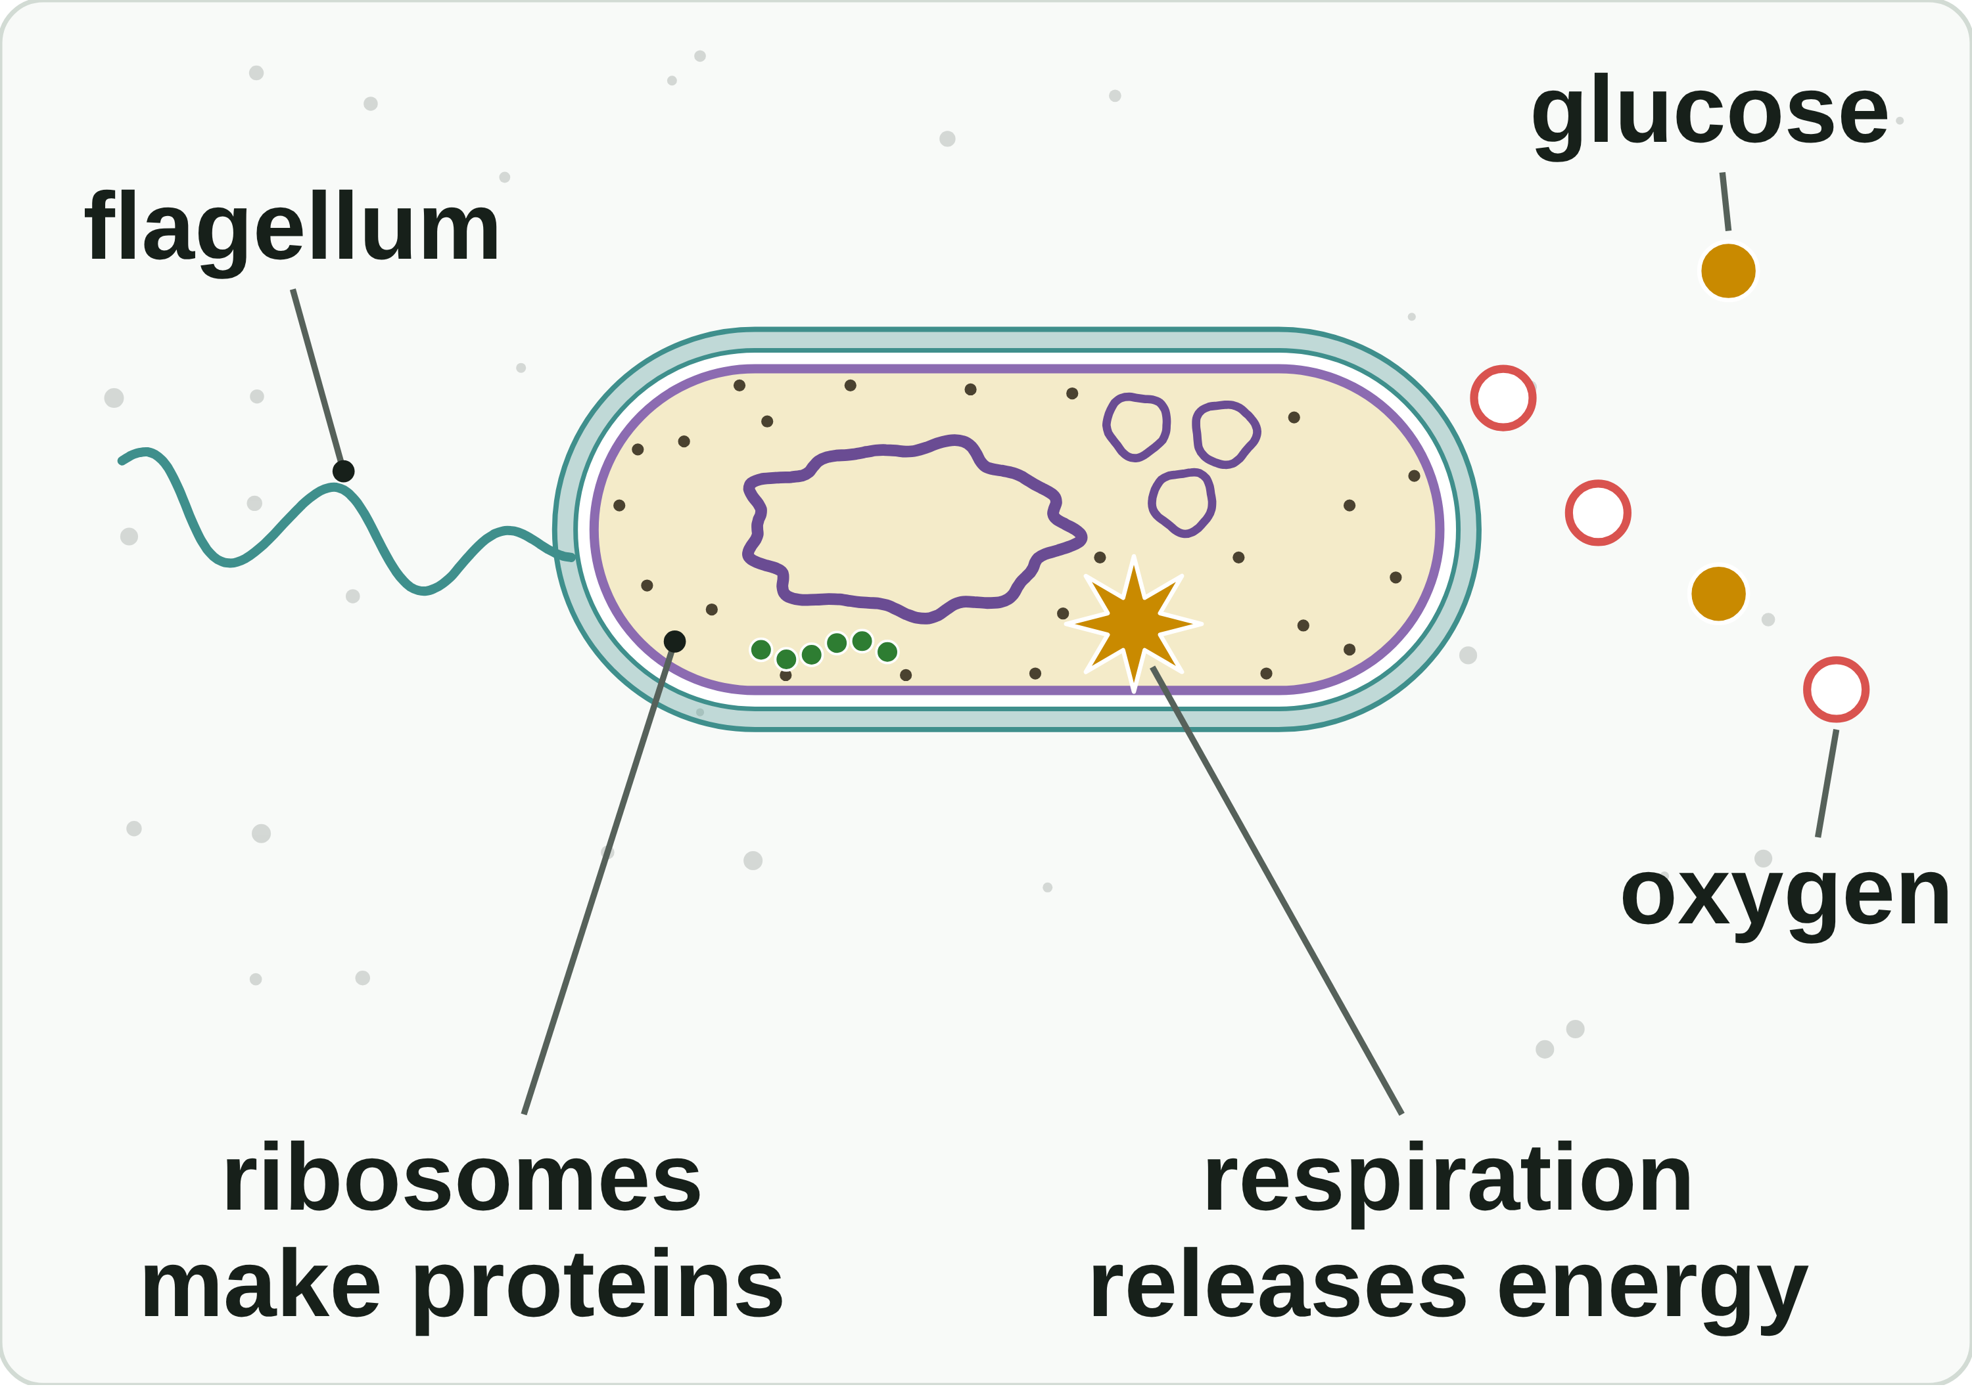
B1 L2 Revision notes 1 of 4
Bacterial cells
Bacteria: one cell, one whole organism, and the parts of a bacterial cell
1. What is a bacterium?
3. The parts of a bacterial cell
A bacterium (plural bacteria) is a single-celled organism with a prokaryotic cell. Its one cell is the whole living thing: it takes in substances, releases energy, makes proteins and, in some bacteria, moves.
Bacteria are microorganisms: living things too small to see without a microscope. Most bacteria are about 1 to 5 µm long (1 mm = 1000 µm). They live almost everywhere: in soil, in water, on your skin and in your gut.
Bacterial cells are prokaryotic: their genetic material is not enclosed in a nucleus. Animal and plant cells are eukaryotic: their genetic material is enclosed in a nucleus (B1 L1 Animal and plant cells).
2. One cell, one whole organism
A bacterium is a single-celled organism: one cell does everything to stay alive.
Taking in: substances such as glucose and oxygen pass through the cell wall and the cell membrane into the cytoplasm.
Releasing energy: bacteria have no mitochondria, but they still respire. The reactions happen in the cytoplasm and on the cell membrane. Respiration releases energy.
A diagram is simplified. The colours help you tell the parts apart.
Part | Its job
cell wall | strengthens the cell and helps it keep its shape; not made of cellulose
cell membrane | controls the movement of substances into and out of the cell
cytoplasm | a jelly-like substance where most of the chemical reactions happen
ribosomes | tiny structures where proteins are made
single loop of DNA | carries the genetic instructions; free in the cytoplasm, not in a nucleus
plasmids (some bacteria) | small rings of DNA that carry a few extra genes
flagellum (some bacteria) | a long, whip-like tail used to move
Making proteins: the ribosomes make the proteins the cell needs.
Moving: some bacteria swim by turning a flagellum.
Most bacteria are harmless or useful: they break down dead material in soil, help to make yoghurt and cheese, and help to break down some foods in your gut. A few are pathogens: microorganisms that cause infectious disease (B3 Infection and response). Bacteria are not viruses: viruses are not cells at all (B3).
Watch out: no mitochondria does not mean no respiration. Energy is released by respiration: never write that energy is "made".
A bacterial cell has no nucleus, no mitochondria and no chloroplasts.
Watch out: the bacterial cell wall is not made of cellulose. Only some bacteria have plasmids or a flagellum.
B1 L2 · Bacterial cells · sciencegcse.co.uk · free GCSE science resources
Notes:
Revision notes page 1 of 4 (or use B1_L2_Revision_notes.pdf). These pages are the textbook for B1 L2: students read them before the worksheets. Page 1: what a bacterium is, how one cell does everything to stay alive, and the parts of a bacterial cell with their jobs. Ask: which two parts do only some bacteria have? (Plasmids and a flagellum.)

Slide 25
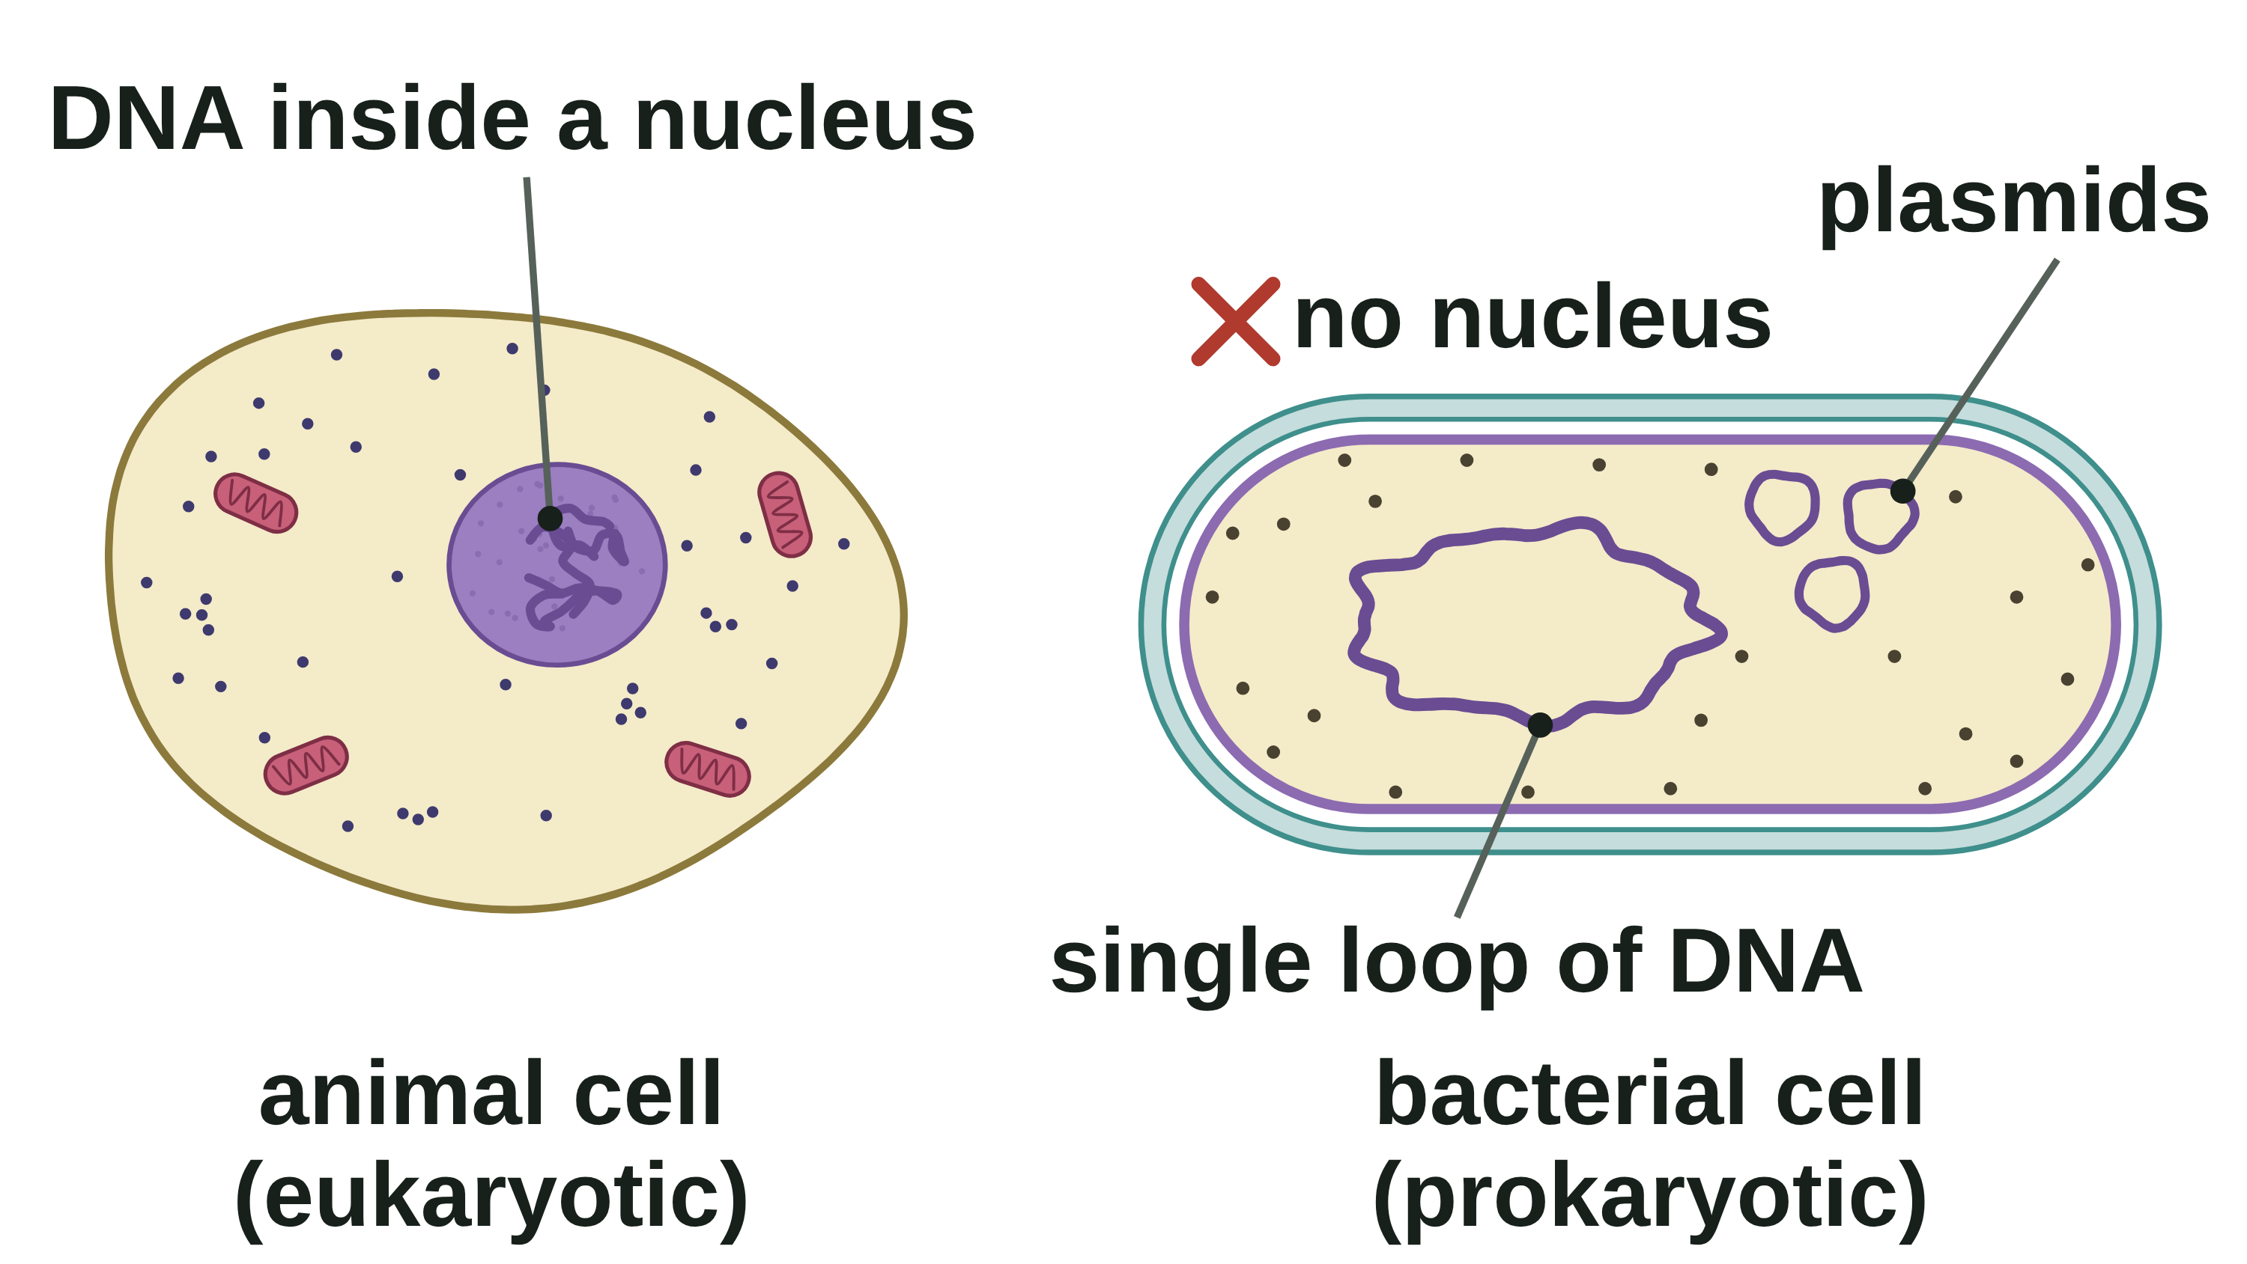
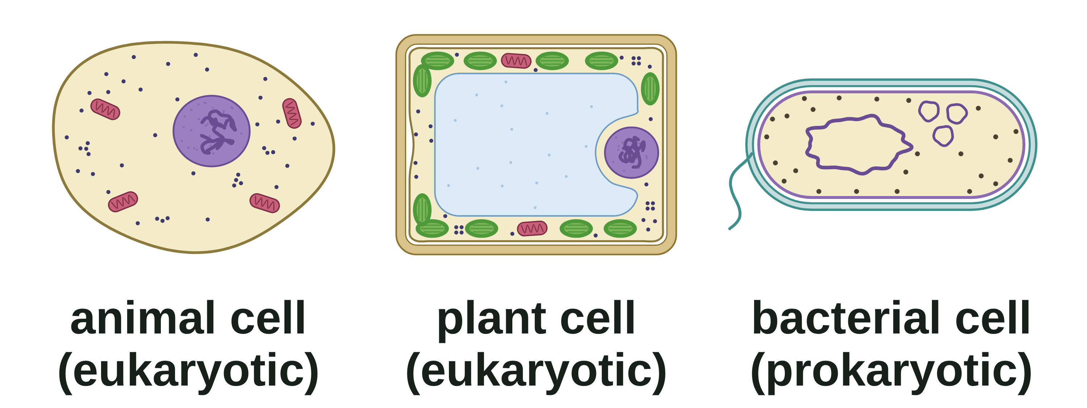
B1 L2 Revision notes 2 of 4
Bacterial cells
DNA with no nucleus, plasmids, and prokaryotic and eukaryotic cells
4. DNA, but no nucleus
6. Prokaryotic and eukaryotic cells
Bacteria, animal cells and plant cells all have DNA: the chemical that carries the genetic instructions for a cell.
In animal and plant cells, the DNA is enclosed in a nucleus.
A bacterial cell has no nucleus. Its main DNA is a single loop, free in the cytoplasm.
Structure | Animal cell | Plant cell | Bacterial cell
nucleus | ✓ | ✓ | ✗
DNA | ✓ in the nucleus | ✓ in the nucleus | ✓ a single loop
cell membrane | ✓ | ✓ | ✓
cytoplasm | ✓ | ✓ | ✓
ribosomes | ✓ | ✓ | ✓
mitochondria | ✓ | ✓ | ✗
chloroplasts | ✗ | ✓ (some) | ✗
permanent vacuole | ✗ | ✓ | ✗
cell wall | ✗ | ✓ cellulose | ✓ not cellulose
plasmids | ✗ | ✗ | ✓ (some)
typical size | about 20 µm | up to about 100 µm | about 1 to 5 µm
A diagram is simplified. Not to scale.
The loop is very long, so it is folded into a tangle. In a micrograph it shows as a pale area in the middle of the cell. Because they have no nucleus, bacteria do not divide by mitosis (B1 L6 Cell division: mitosis).
Watch out: no nucleus does not mean no DNA. Write: "the DNA is a single loop, free in the cytoplasm".
5. Plasmids
Eukaryotic cell: a cell whose genetic material is enclosed in a nucleus, such as an animal or plant cell.
Prokaryotic cell: a cell whose genetic material is not enclosed in a nucleus, such as a bacterial cell.
Plasmids are small rings of DNA found in some bacterial cells, separate from the main loop of DNA.
The main loop carries most of the genes the bacterium needs to live.
A plasmid carries a few extra genes. For example, some plasmids carry a gene that helps the bacterium survive an antibiotic (B6 Inheritance, variation and evolution).
A bacterium may have no plasmids, one or several. It can live without them.
Scientists can put useful genes, such as the human insulin gene, into bacteria, so the bacteria make that protein (B6).
A diagram is simplified. Not to scale.
Word clues: "pro-" means before and "karyon" means nucleus. "Eu-" means true: a true nucleus.
All three kinds of cell have a cell membrane, cytoplasm, ribosomes and DNA.
Watch out: plasmids are extras. The main DNA is the single loop, and not every bacterium has plasmids.
Watch out: single-celled does not mean prokaryotic. Yeast is a single-celled fungus with a nucleus, so its cell is eukaryotic.
B1 L2 · Bacterial cells · sciencegcse.co.uk · free GCSE science resources
Notes:
Revision notes page 2 of 4. DNA with no nucleus, plasmids, and prokaryotic and eukaryotic cells compared in one table. Ask: what does prokaryotic mean, and why is yeast eukaryotic? (The genetic material is not enclosed in a nucleus; yeast is single-celled but its cell has a nucleus.)

Slide 26
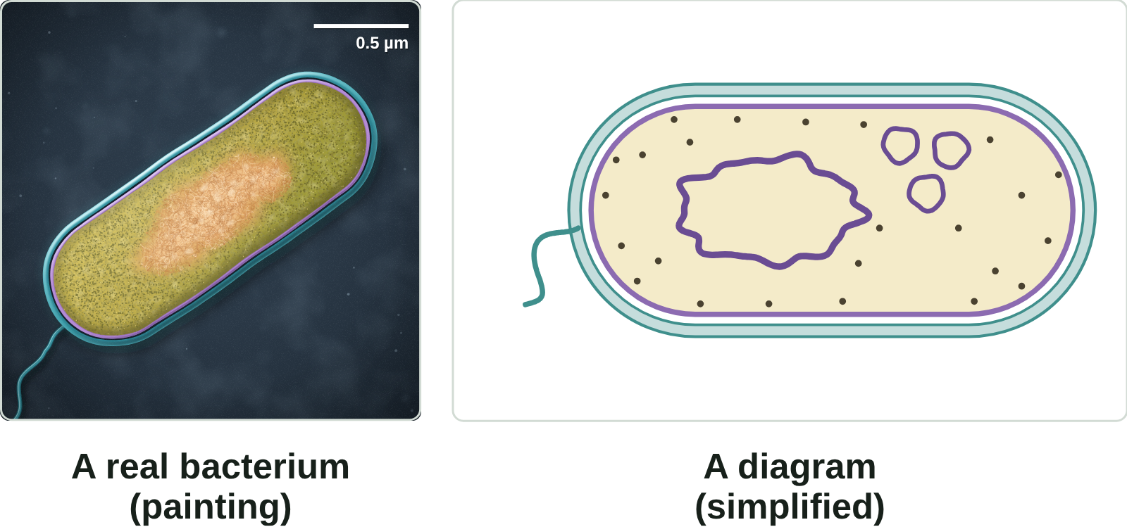
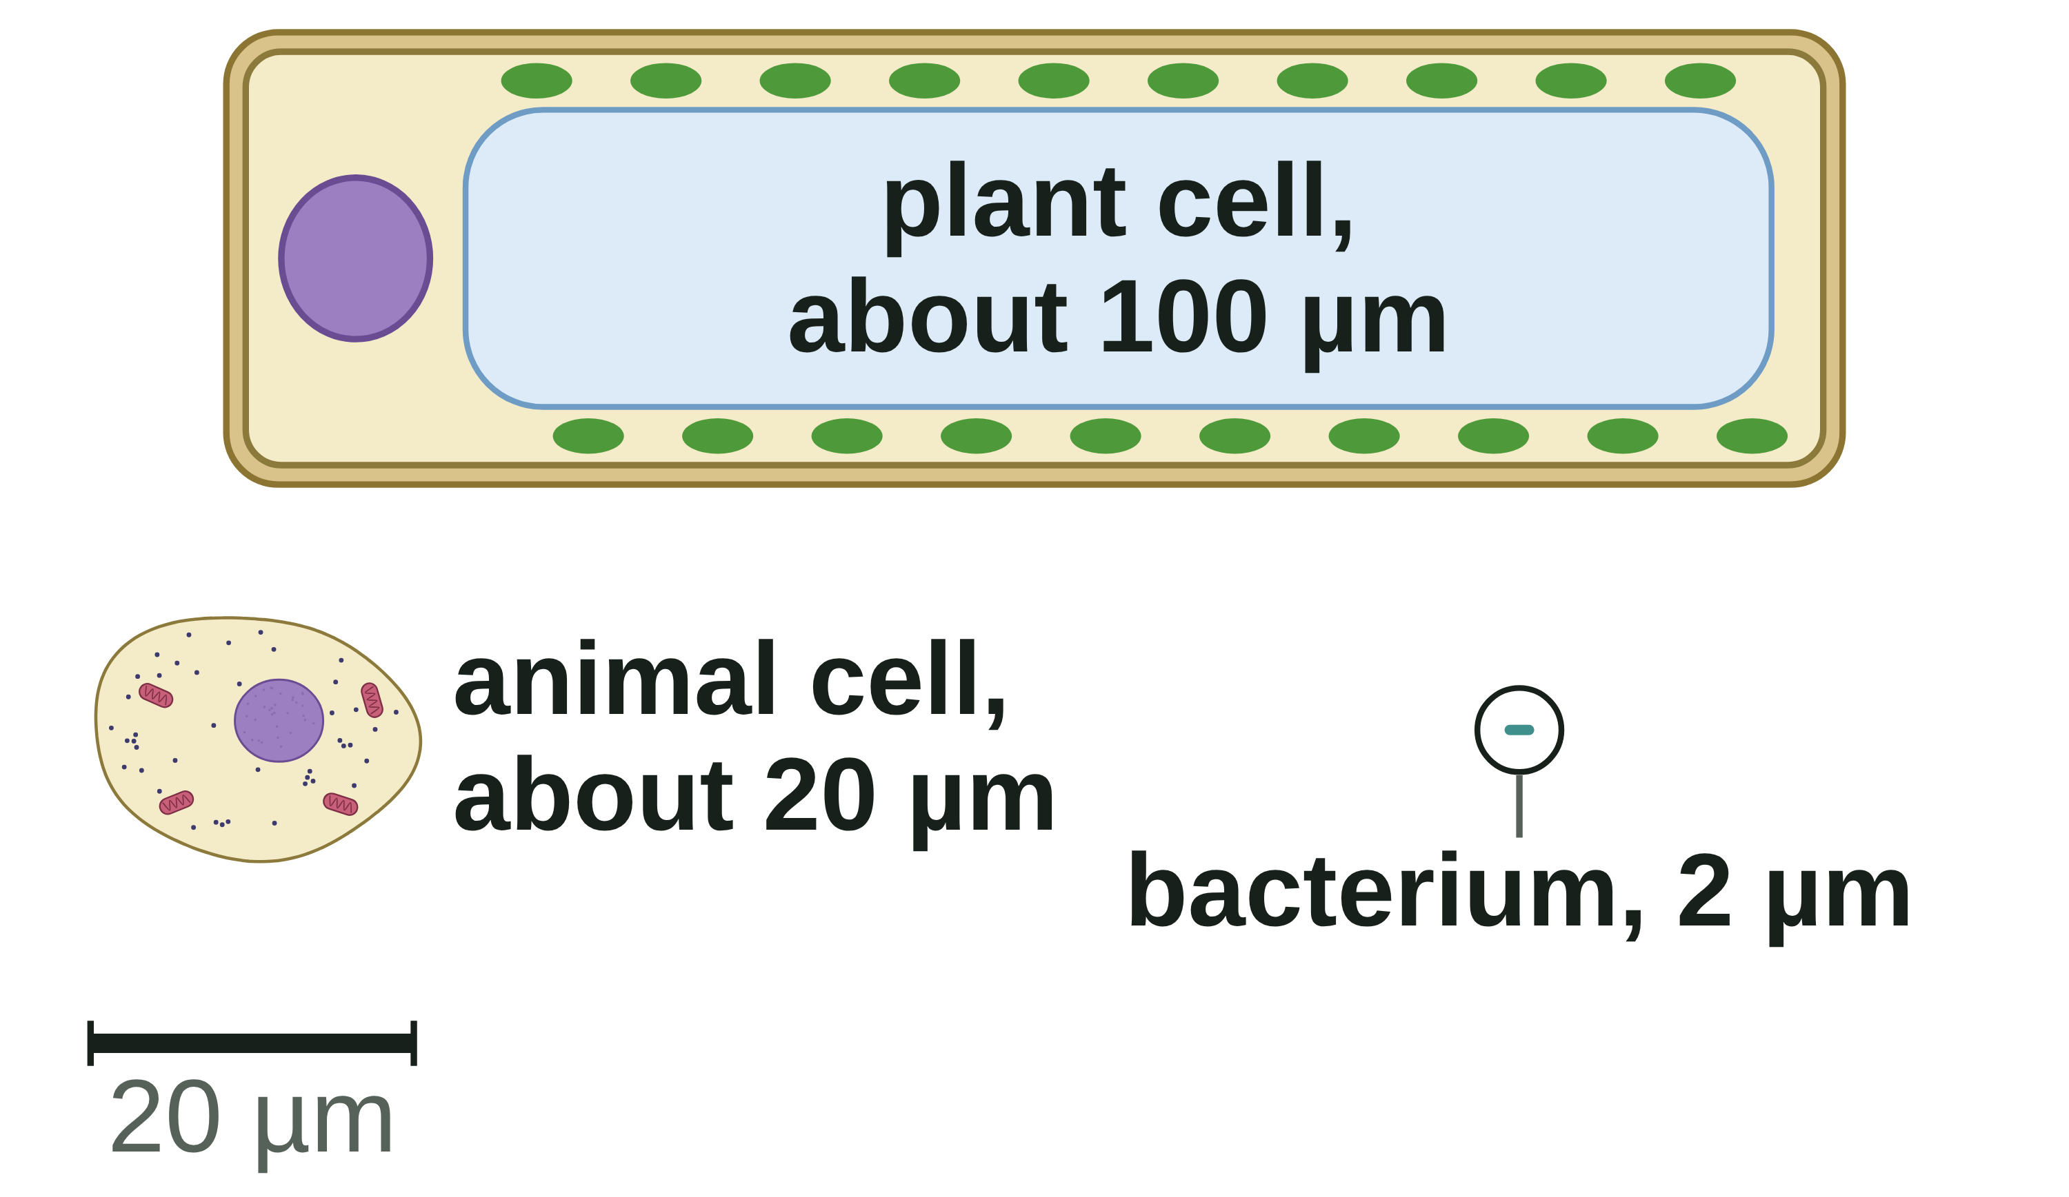
B1 L2 Revision notes 3 of 4
Bacterial cells
A real bacterium and a diagram, how small bacteria are, and answering compare questions
7. A real bacterium and a diagram
8. How small are bacteria?
Cells are measured in micrometres (µm). A micrometre is one thousandth of a millimetre: 1 mm = 1000 µm.
Most bacteria: about 1 to 5 µm long (a typical rod about 2 µm).
An animal cell: about 20 µm across.
A plant cell: up to about 100 µm long (most are 10 to 100 µm).
how many times bigger = bigger size ÷ smaller size (both in the same unit)
Worked example: a cheek cell is 0.05 mm across. A bacterium is 2.5 µm long. How many times bigger is the cheek cell?
Step 1: change mm into µm: 0.05 × 1000 = 50 µm.
Step 2: divide: 50 ÷ 2.5 = 20.
Answer: 20 times bigger. Check: 20 × 2.5 µm = 50 µm.
Electron micrographs are black and white: the colours are added. Real bacteria are almost colourless.
Bacteria are so small that the clearest pictures of them come from an electron microscope (B1 L3 Using a microscope). A picture taken with one is an electron micrograph. The painting is based on a coloured electron micrograph of a bacterium cut lengthways. Exam pictures are usually diagrams, simplified on purpose:
DNA: in the micrograph, the DNA is a pale, tangled mass in the middle, with no membrane round it. The diagram draws one neat loop.
Plasmids: too small to pick out in the micrograph. The diagram draws them as clear small rings.
Ribosomes: thousands of tiny dots make real cytoplasm look grainy. The diagram draws only a few.
Colour: electron micrographs are black and white; the colours are added. Real bacteria are almost colourless.
Wall and membrane: in the micrograph, two thin layers pressed close together. The diagram draws two clear lines with a gap.
Both show a cell wall, a cell membrane, cytoplasm and DNA with no nucleus round it.
An order of magnitude is a factor of 10: one order of magnitude bigger means about 10 times bigger. A bacterium is about one order of magnitude smaller than an animal cell. (Calculations with orders of magnitude and standard form: B1 L4 Magnification and cell size.)
Watch out: to find how many times bigger, divide. Do not subtract: 50 − 2.5 is not the answer. Change both sizes into the same unit first.
9. Answering "compare" questions
A compare question wants similarities and differences, with both cells named in each point. Use "both" for a similarity, and "but" or "whereas" for a difference.
Model answer to "Compare the DNA in a bacterial cell with the DNA in an animal cell": "Both cells have DNA. An animal cell's DNA is enclosed in a nucleus, but a bacterial cell has no nucleus: its main DNA is a single loop, free in the cytoplasm. A bacterial cell may also have plasmids, small rings of DNA, whereas an animal cell has none."
"A bacterium has no nucleus" on its own is only half a comparison: say what the other cell has.
Watch out: the colours in a coloured electron micrograph are not real. They are added to make the parts easier to see.
B1 L2 · Bacterial cells · sciencegcse.co.uk · free GCSE science resources
Notes:
Revision notes page 3 of 4. A real bacterium beside a diagram (what a diagram leaves out), how small bacteria are with a worked example, and how to answer a compare question. Go through the worked example on the board. Ask: why are the colours in the painting not real? (Electron micrographs are black and white: the colours are added.)

Slide 27
B1 L2 Revision notes 4 of 4
Bacterial cells
Key words, exam tips and check yourself
Key words
Check yourself
Cover the answers, then check.
Bacterium (plural bacteria): a single-celled organism with a prokaryotic cell.
Cell membrane: a thin layer around the cell that controls the movement of substances into and out of the cell.
Cell wall: a layer outside the cell membrane that strengthens the cell; in plant and algal cells it is made of cellulose.
Cytoplasm: a jelly-like substance where most of the chemical reactions in the cell happen.
DNA: the chemical that carries the genetic instructions for a cell.
Electron micrograph: a picture of something seen through an electron microscope.
Eukaryotic cell: a cell whose genetic material is enclosed in a nucleus, such as an animal or plant cell.
Flagellum (plural flagella): a long, whip-like tail that some bacteria use to move.
Micrometre (µm): one thousandth of a millimetre (1 mm = 1000 µm).
Microorganism: a living thing that is too small to see without a microscope, such as a bacterium.
Order of magnitude: a factor of 10; one order of magnitude bigger means about 10 times bigger.
Pathogen: a microorganism that causes infectious disease.
Plasmids: small rings of DNA found in some bacterial cells, separate from the main loop of DNA.
Prokaryotic cell: a cell whose genetic material is not enclosed in a nucleus, such as a bacterial cell.
Ribosomes: tiny structures in the cytoplasm where proteins are made.
Single-celled organism: an organism made of only one cell, such as a bacterium.
1. What does prokaryotic mean?
2. Name four structures found in every bacterial cell.
3. Describe the main DNA of a bacterial cell.
4. What are plasmids, and do all bacteria have them?
5. Give two structures that plant cells have but bacterial cells do not.
6. Name two structures that a bacterial cell and a plant cell both have.
7. Why does a coloured electron micrograph not show the real colours of a bacterium?
8. A plant cell is 40 µm long and a bacterium is 5 µm long. How many times longer is the plant cell?
Answers
1. The cell's genetic material is not enclosed in a nucleus.
2. Any four: cell wall, cell membrane, cytoplasm, ribosomes, a single loop of DNA.
3. It is a single loop, free in the cytoplasm (not in a nucleus).
4. Small rings of DNA, separate from the main loop. No: only some bacteria have them.
5. Any two: a nucleus, chloroplasts, mitochondria, a permanent vacuole.
6. Any two: a cell wall, a cell membrane, cytoplasm, ribosomes, DNA.
7. Electron micrographs are black and white: the colours are added. Real bacteria are almost colourless.
8. 40 ÷ 5 = 8 times.
Common mistakes
Exam tips
Wrong: "Bacteria have no DNA." Right: their DNA is a single loop, free in the cytoplasm.
Wrong: "Plasmids are the main DNA." Right: plasmids are small extra rings.
Wrong: "The bacterial cell wall is made of cellulose." Right: it is not made of cellulose.
Wrong: "No mitochondria, so no respiration." Right: bacteria still respire.
Wrong: subtracting to find how many times bigger. Right: divide.
Prokaryotic = no nucleus (bacteria). Eukaryotic = the genetic material is in a nucleus (animal and plant cells).
Never write that bacteria have no DNA. Write "the DNA is a single loop, free in the cytoplasm".
Plasmids are small extra rings of DNA. Do not call them the main DNA.
For bacteria, say "the cell wall is not made of cellulose".
In "how many times bigger" questions, put both sizes in the same unit, divide, and show your working.
In "compare" questions, give similarities and differences, and say which cell has which feature.
B1 L2 · Bacterial cells · sciencegcse.co.uk · free GCSE science resources
Notes:
Revision notes page 4 of 4. Key words, exam tips and Check yourself: students cover the answers, try all eight, then check. The common mistakes box sums up the traps.

Slide 28
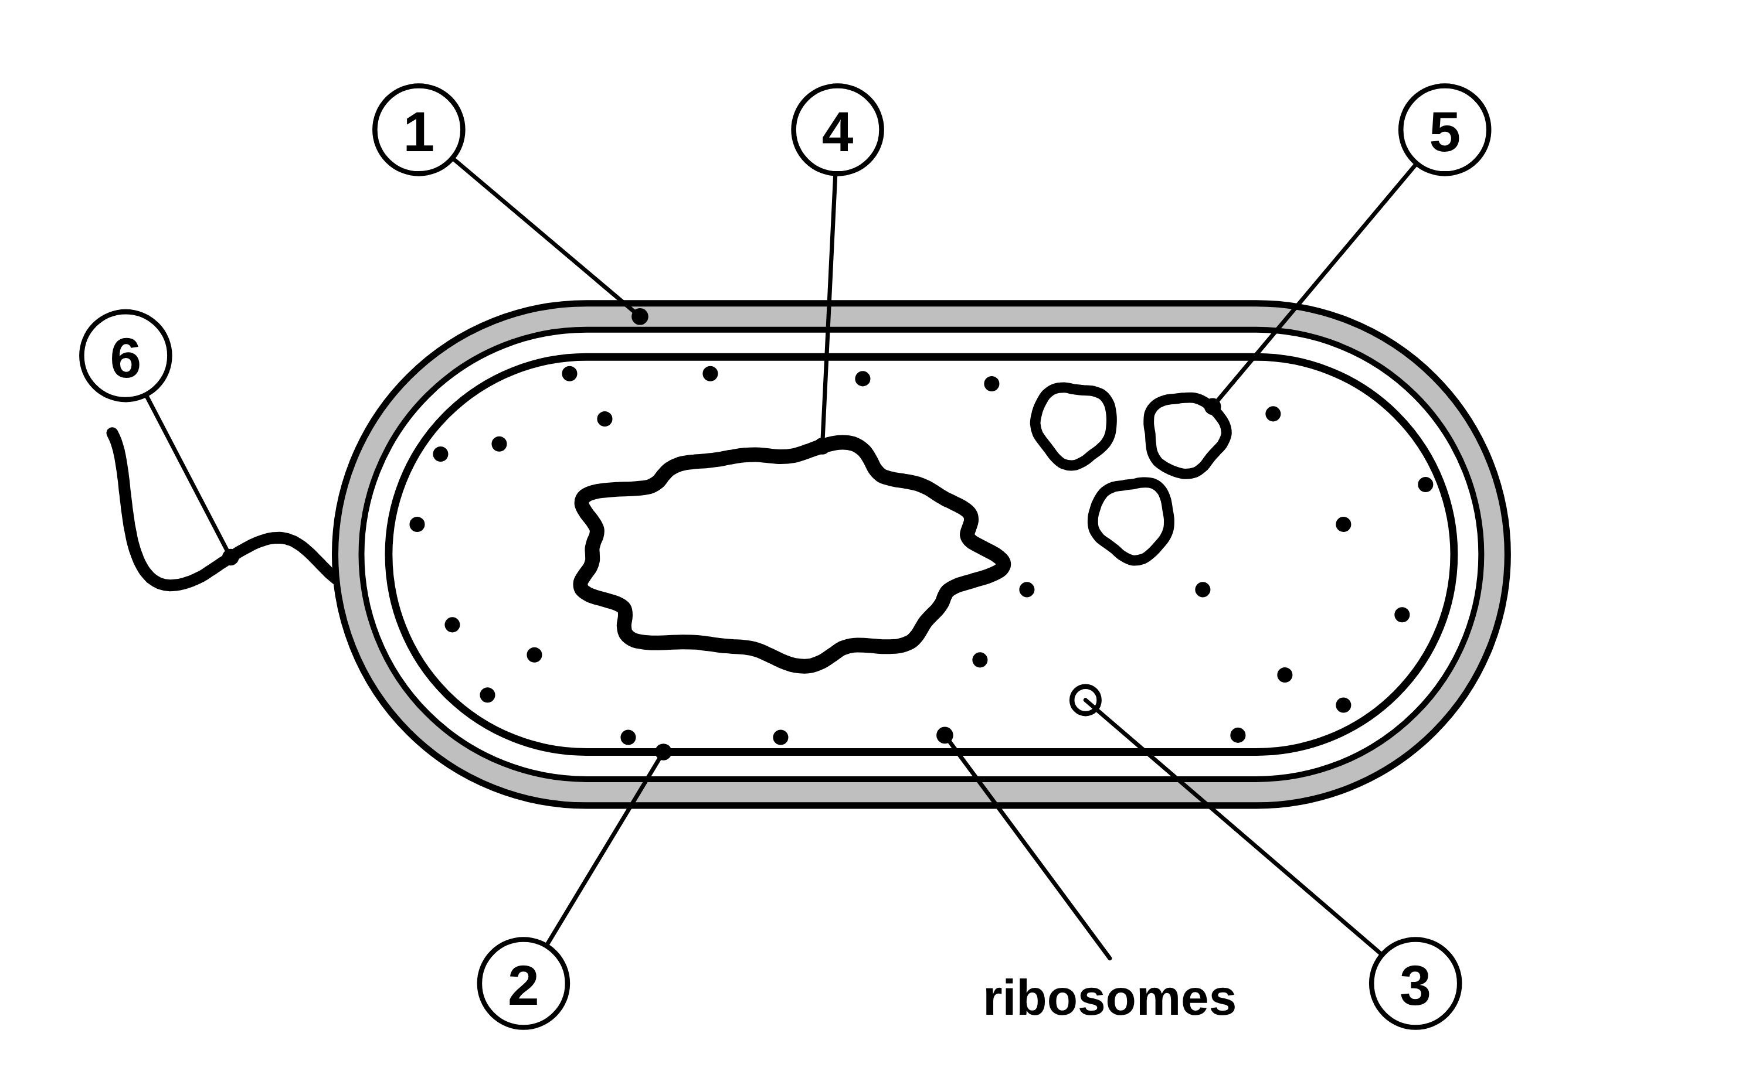
B1 L2 Mandatory worksheet: Bacterial cells
Page 1 of 2
Name: ______________________________ Class: __________
A. Label the bacterial cell
B. Jobs of the parts
[6]
[5]
Help: online screens 1 and 3
Help: online screen 3
The diagram shows a bacterial cell. One part has been labelled for you.
Write the job of each part of a bacterial cell.
Part | Its job
1. cell membrane
2. cell wall
3. ribosomes
4. single loop of DNA
5. flagellum
C. Animal, plant or bacterial?
[8]
Help: online screens 3 and 6
Tick (✓) every cell that has the structure. A row may need more than one tick.
Structure | Animal cell | Plant cell | Bacterial cell
1. nucleus
2. cell membrane
3. cell wall
4. ribosomes
5. mitochondria
6. chloroplasts
7. a single loop of DNA, free in the cytoplasm
8. plasmids
Name the parts labelled 1 to 6. [6]
1
4
2
5
3
6
B1 L2 · Bacterial cells · sciencegcse.co.uk · free GCSE science resources

Slide 29
B1 L2 Mandatory worksheet: Bacterial cells
Page 2 of 2
Name: ______________________________ Class: __________
D. Short answers
E. Calculate
[7]
[4]
Help: online screens 2, 4, 6, 7, 9 and 10
Help: online screen 7
1. Complete the sentence.
In a prokaryotic cell, the genetic material is not enclosed in a ______________. [1]
how many times bigger = bigger size ÷ smaller size (both in the same unit)
(a) A plant cell is 90 µm long. A bacterium is 3 µm long. Calculate how many times longer the plant cell is. [2]
2. Give one way the cell wall of a bacterium is different from the cell wall of a plant cell. [1]
times
(b) A line on a ruler is 1 mm long. 1 mm = 1000 µm. How many bacteria, each 5 µm long, would fit end to end along the line? [2]
3. Describe what plasmids are. [2]
bacteria
4. Give one way a coloured electron micrograph of a bacterium is different from a diagram of one. [1]
F. Compare
[4]
Help: online screens 4 and 6
Give two similarities and two differences between a bacterial cell and an animal cell. [4]
Similarities:
5. Bacteria have no mitochondria. Name the process that releases energy in every living cell, including bacteria. [1]
1
2
Differences:
6. Circle the typical length of a bacterium. [1]
1
2 mm
2 µm
20 µm
200 µm
2
B1 L2 · Bacterial cells · sciencegcse.co.uk · free GCSE science resources

Slide 30
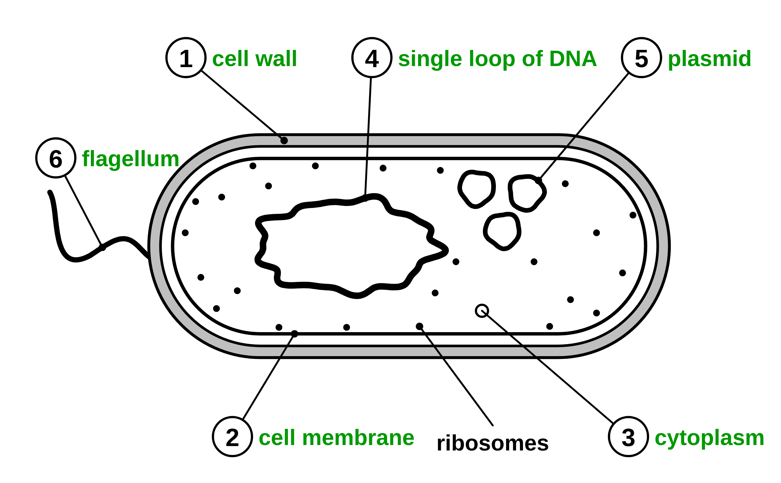
B1 L2 Mandatory worksheet answers - page 1
Answers 1 of 2
A. Label the bacterial cell
B. Jobs of the parts
[6]
[5]
The diagram shows a bacterial cell. One part has been labelled for you.
Part | Its job
1. cell membrane | controls the movement of substances into and out of the cell (1)
2. cell wall | strengthens the cell / helps it keep its shape (1)
3. ribosomes | where proteins are made (1)
4. single loop of DNA | carries the genetic instructions (for the cell) (1)
5. flagellum | used to move / swim (1)
Allow “supports the cell” for 2. Ignore “protects the cell” on its own for 2. Do not accept “lets everything in” for 1, or “makes energy” for 3.
C. Animal, plant or bacterial?
[8]
Structure | Animal cell | Plant cell | Bacterial cell
1. nucleus | ✓ | ✓
2. cell membrane | ✓ | ✓ | ✓
3. cell wall |  | ✓ | ✓
4. ribosomes | ✓ | ✓ | ✓
5. mitochondria | ✓ | ✓
6. chloroplasts |  | ✓
7. a single loop of DNA, free in the cytoplasm |  |  | ✓
8. plasmids |  |  | ✓
1 cell wall (1) 2 cell membrane (1) 3 cytoplasm (1)
4 single loop of DNA (1) 5 plasmid (1) 6 flagellum (1)
Allow “DNA” or “loop of DNA” for 4, “small ring of DNA” for 5, and any clear spelling of flagellum for 6.
Do not accept “ribosomes” for 3, “nucleus” for 4 (a bacterium has no nucleus), or “tail” on its own for 6. If 1 and 2 are swapped (cell membrane for 1, cell wall for 2), give neither mark.
1 mark for each row with all the right ticks and no wrong ones.
Row 3: both have a cell wall, but only the plant cell wall is made of cellulose.
B1 L2 · Bacterial cells · sciencegcse.co.uk · free GCSE science resources

Slide 31
B1 L2 Mandatory worksheet answers - page 2
Answers 2 of 2
D. Short answers
E. Calculate
[7]
[4]
1. Complete the sentence.
In a prokaryotic cell, the genetic material is not enclosed in a ______________. [1]
how many times bigger = bigger size ÷ smaller size (both in the same unit)
nucleus (1)
(a)
90 ÷ 3 (1) = 30 (times) (1)
Correct answer with no working scores 2. Do not accept 87 (subtracted) or 270 (multiplied).
2. Give one way the cell wall of a bacterium is different from the cell wall of a plant cell. [1]
It is not made of cellulose (1).
Allow “the plant cell wall is made of cellulose and the bacterial cell wall is not”. Do not accept “bacteria have no cell wall” or “it is inside the cell membrane”.
(b)
1000 ÷ 5 (1) = 200 (bacteria) (1)
Correct answer with no working scores 2. Allow 1 mark for 0.2 only if 1 ÷ 5 is shown (units not changed).
3. Describe what plasmids are. [2]
Model answers
Small rings of DNA (1); separate from the main loop of DNA / that carry a few extra genes / found only in some bacteria (1).
Do not accept “the main DNA of the cell” or “a type of ribosome”.
(a) 90 ÷ 3 = 30 times. Check: 30 × 3 = 90.
(b) 1 mm = 1000 µm. 1000 ÷ 5 = 200 bacteria.
4. Give one way a coloured electron micrograph of a bacterium is different from a diagram of one. [1]
Any one (1): the colours in the micrograph are added / an electron micrograph is really black and white; the DNA is a tangled mass, not a neat loop; there are thousands of ribosomes (the cytoplasm looks grainy), not a few; plasmids are too small to see in the micrograph; the cell wall and the cell membrane are pressed close together.
Do not accept “the micrograph shows the real colours” or “the micrograph is a photo and the diagram is a drawing” on its own.
F. Compare
[4]
Similarities, any two (1 each): both have a cell membrane; both have cytoplasm; both have ribosomes; both have DNA.
Differences, any two (1 each): an animal cell has a nucleus, but a bacterial cell does not; the bacterial DNA is a single loop, free in the cytoplasm; a bacterial cell has a cell wall, but an animal cell does not; a bacterial cell may have plasmids; an animal cell has mitochondria, but a bacterial cell does not; a bacterial cell is much smaller (about 10 times); some bacteria have a flagellum.
A difference must say which cell has the feature. Allow “a bacterial cell has no nucleus”. Do not accept “bacteria have no DNA” for any mark.
Model answer: Similarities: both have a cell membrane; both have ribosomes. Differences: an animal cell has a nucleus, but a bacterial cell does not (its DNA is a single loop in the cytoplasm); a bacterial cell has a cell wall, but an animal cell does not.
5. Bacteria have no mitochondria. Name the process that releases energy in every living cell, including bacteria. [1]
Respiration (aerobic or anaerobic) (1).
Do not accept “photosynthesis” or “breathing”.
6. Circle the typical length of a bacterium. [1]
2 µm (1)
B1 L2 · Bacterial cells · sciencegcse.co.uk · free GCSE science resources

Slide 32
B1 L2 Challenge worksheet: Bacterial cells
Page 1 of 2
Name: ______________________________ Class: __________
A. A new microorganism
B. Plasmids and an antibiotic
[5]
[4]
Help: online screens 6, 10 and 11
Help: online screens 3, 4 and 9
Scientists found a new microorganism in a hot spring. Table 1 shows what they found out about one of its cells.
A scientist tested an antibiotic on two types of bacteria, X and Y. Type X has a plasmid that carries a gene called P. Type Y has no plasmids. The antibiotic killed type Y, but not type X.
Feature | What they found
nucleus | none
cell membrane | present
cell wall | present (not made of cellulose)
ribosomes | present
mitochondria | none
small rings of DNA | present
length of the cell | 1.5 µm
(a) Suggest what gene P does. [1]
(b) Type Y has no plasmids. Explain how type Y can still make the proteins it needs. [2]
Table 1
(a) Is this cell prokaryotic or eukaryotic? Give two pieces of evidence from Table 1. [3]
(b) A student says: ‘This cell has no mitochondria, so it cannot release energy.’ Explain why the student is wrong. [2]
(c) Gene P is not inside a nucleus. Explain why. [1]
B1 L2 · Bacterial cells · sciencegcse.co.uk · free GCSE science resources

Slide 33
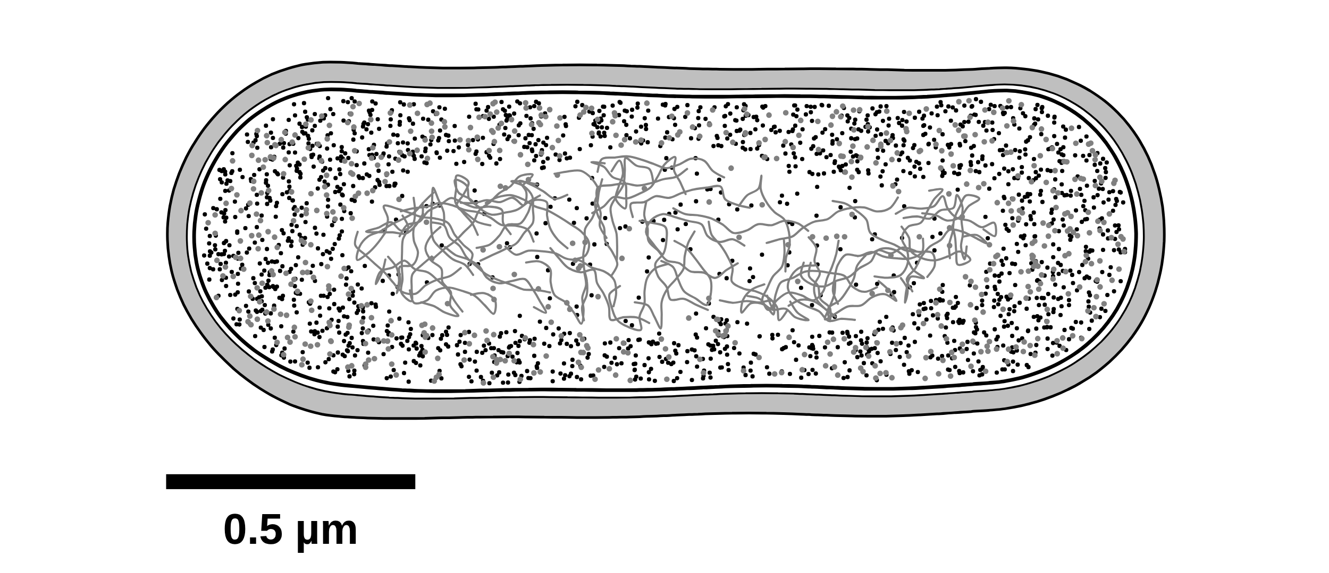
B1 L2 Challenge worksheet: Bacterial cells
Page 2 of 2
Name: ______________________________ Class: __________
C. Sizes and a micrograph
D. Extended response
[6]
[6]
Help: online screens 1, 2 and 7
Help: online screens 3 and 10
Figure 1 is a drawing made from an electron micrograph of a bacterium, cut lengthways.
A bacterium is a single-celled organism. It must take in substances, release energy and make proteins, and some bacteria move. Explain how the structures in a bacterial cell help it to stay alive. [6]
(a) Use the scale bar to estimate the length of the bacterium. [1]
In your answer, name the structures and say what each one does.
µm
Figure 1
(b) A root hair cell is 0.8 mm long. 1 mm = 1000 µm. Calculate how many times longer the root hair cell is than the bacterium. Use your answer to (a). [3]
times
(c) Pictures of bacteria made with an electron microscope are often shown in bright colours. Explain why these are not the real colours of the bacterium. [2]
B1 L2 · Bacterial cells · sciencegcse.co.uk · free GCSE science resources

Slide 34
B1 L2 Challenge worksheet answers - page 1
Answers 1 of 2
A. A new microorganism
B. Plasmids and an antibiotic
[5]
[4]
Feature | What they found
nucleus | none
cell membrane | present
cell wall | present (not made of cellulose)
ribosomes | present
mitochondria | none
small rings of DNA | present
length of the cell | 1.5 µm
(a)
it helps the bacterium survive the antibiotic (1).
Allow “it protects the bacterium from the antibiotic”.
(b)
its main / single loop of DNA carries (most of) the genes / genetic instructions (1);
proteins are made at its ribosomes (1).
Do not accept “it makes proteins in its nucleus”.
(c)
bacterial cells are prokaryotic / have no nucleus, so the plasmid is free in the cytoplasm (1).
Table 1
(a)
prokaryotic (1); there is no nucleus (1); any one more (1): it has small rings of DNA (plasmids) / it is very small (1.5 µm) / it has no mitochondria.
The evidence marks score only with “prokaryotic”. The second mark needs “no nucleus”: size or no mitochondria on their own do not show that a cell is prokaryotic. Ignore “its cell wall is not made of cellulose” (yeast, a eukaryote, has no cellulose wall either). Do not accept “it is made of one cell”: single-celled does not mean prokaryotic (yeast is single-celled and eukaryotic).
Model answers
(a) Gene P helps the bacterium survive the antibiotic.
(b) Its single loop of DNA carries the genes it needs, and its ribosomes use these instructions to make proteins.
(c) Bacteria are prokaryotic: they have no nucleus, so the plasmid is free in the cytoplasm.
(b)
the cell still respires / respiration still releases energy (1); the reactions happen in the cytoplasm / on the cell membrane (1).
Allow “bacteria respire without mitochondria” for the first mark. Do not accept “energy is made” or “it gets energy from chloroplasts”.
Model answers
(a) Prokaryotic. There is no nucleus, and it has small rings of DNA, which are plasmids.
(b) The cell can still respire, and respiration releases energy. In a prokaryotic cell the reactions happen in the cytoplasm and on the cell membrane, so it does not need mitochondria.
B1 L2 · Bacterial cells · sciencegcse.co.uk · free GCSE science resources

Slide 35
B1 L2 Challenge worksheet answers - page 2
Answers 2 of 2
C. Sizes and a micrograph
D. Extended response
[6]
[6]
(a)
2 µm (1)
Allow 1.8 to 2.2 µm.
Level 3 (5–6 marks): A detailed and coherent explanation. At least five structures are named, each with a correct job, linked to keeping the cell alive, including respiration without mitochondria and protein making at the ribosomes.
Level 2 (3–4 marks): At least three structures named with a correct job, with some links to staying alive. Some points may be missing or unclear.
Level 1 (1–2 marks): Simple statements, such as “it has a cell wall” or “the flagellum moves it”, with little or no explanation.
0 marks: No relevant content.
Indicative content
the cell membrane controls the movement of substances into and out of the cell (glucose and oxygen get in)
the cell wall strengthens the cell and helps it keep its shape
the cytoplasm is where most of the chemical reactions happen
there are no mitochondria, but the cell still respires (in the cytoplasm and on the cell membrane)
respiration releases energy for the cell
ribosomes make the proteins the cell needs (such as enzymes)
the single loop of DNA carries the genetic instructions, including those for making proteins
plasmids carry a few extra genes, such as one for surviving an antibiotic
the flagellum is a whip-like tail that some bacteria use to move (for example towards food)
one cell does every job needed to stay alive
Do not accept “energy is made / produced” (that point scores nothing).
Model answer: The cell membrane controls what goes into and out of the cell, so glucose and oxygen can get in. The cell wall strengthens the cell and helps it keep its shape. Most of the chemical reactions happen in the cytoplasm. Bacteria have no mitochondria, but they still respire: the reactions happen in the cytoplasm and on the cell membrane, and they release energy. The ribosomes make the proteins the cell needs. The single loop of DNA carries the genetic instructions, including the instructions for making proteins. Plasmids carry a few extra genes, for example one that helps the bacterium survive an antibiotic. Some bacteria have a flagellum, a whip-like tail that they use to move, for example towards food. So one cell does every job needed to stay alive.
Figure 1
(b)
0.8 × 1000 = 800 µm (1); 800 ÷ 2 (1); = 400 (1)
Allow their answer to (a) used correctly. Correct answer with no working scores 3. Allow 0.4 for 1 mark only if 0.8 ÷ 2 is shown (units not changed).
(c)
an electron microscope makes black and white pictures / uses a beam of electrons, not light (1); the colours are added (on a computer, to make the parts easier to see) (1).
Allow “real bacteria are almost colourless” for 1 mark. Do not accept “the bacterium was stained”.
Model answers
(a) About 2 µm: the bacterium is four scale bars long, and 4 × 0.5 = 2 µm.
(b) 0.8 mm = 800 µm. 800 ÷ 2 = 400 times.
(c) An electron microscope uses a beam of electrons, not light, so the picture is black and white. The colours are added afterwards to make the parts easier to see; real bacteria are almost colourless.
B1 L2 · Bacterial cells · sciencegcse.co.uk · free GCSE science resources

Slide 36
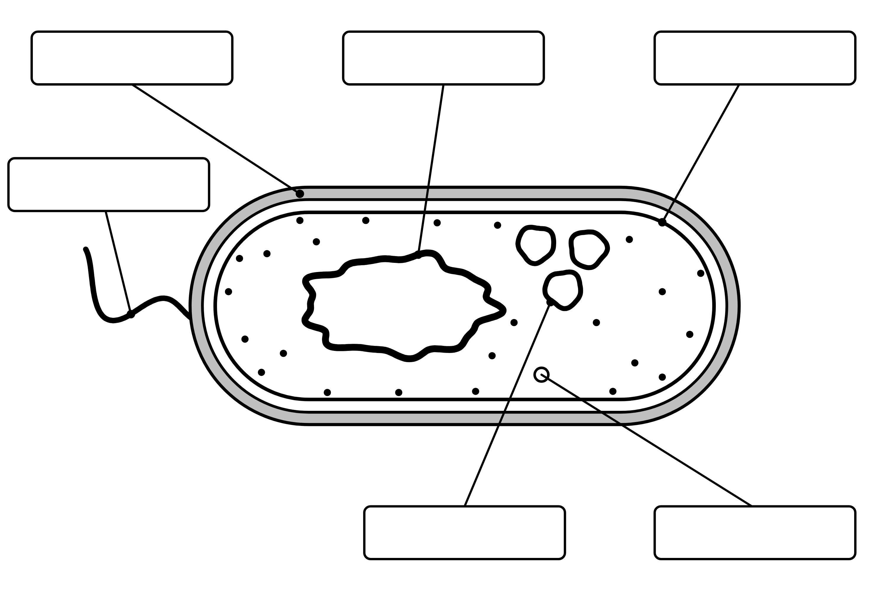
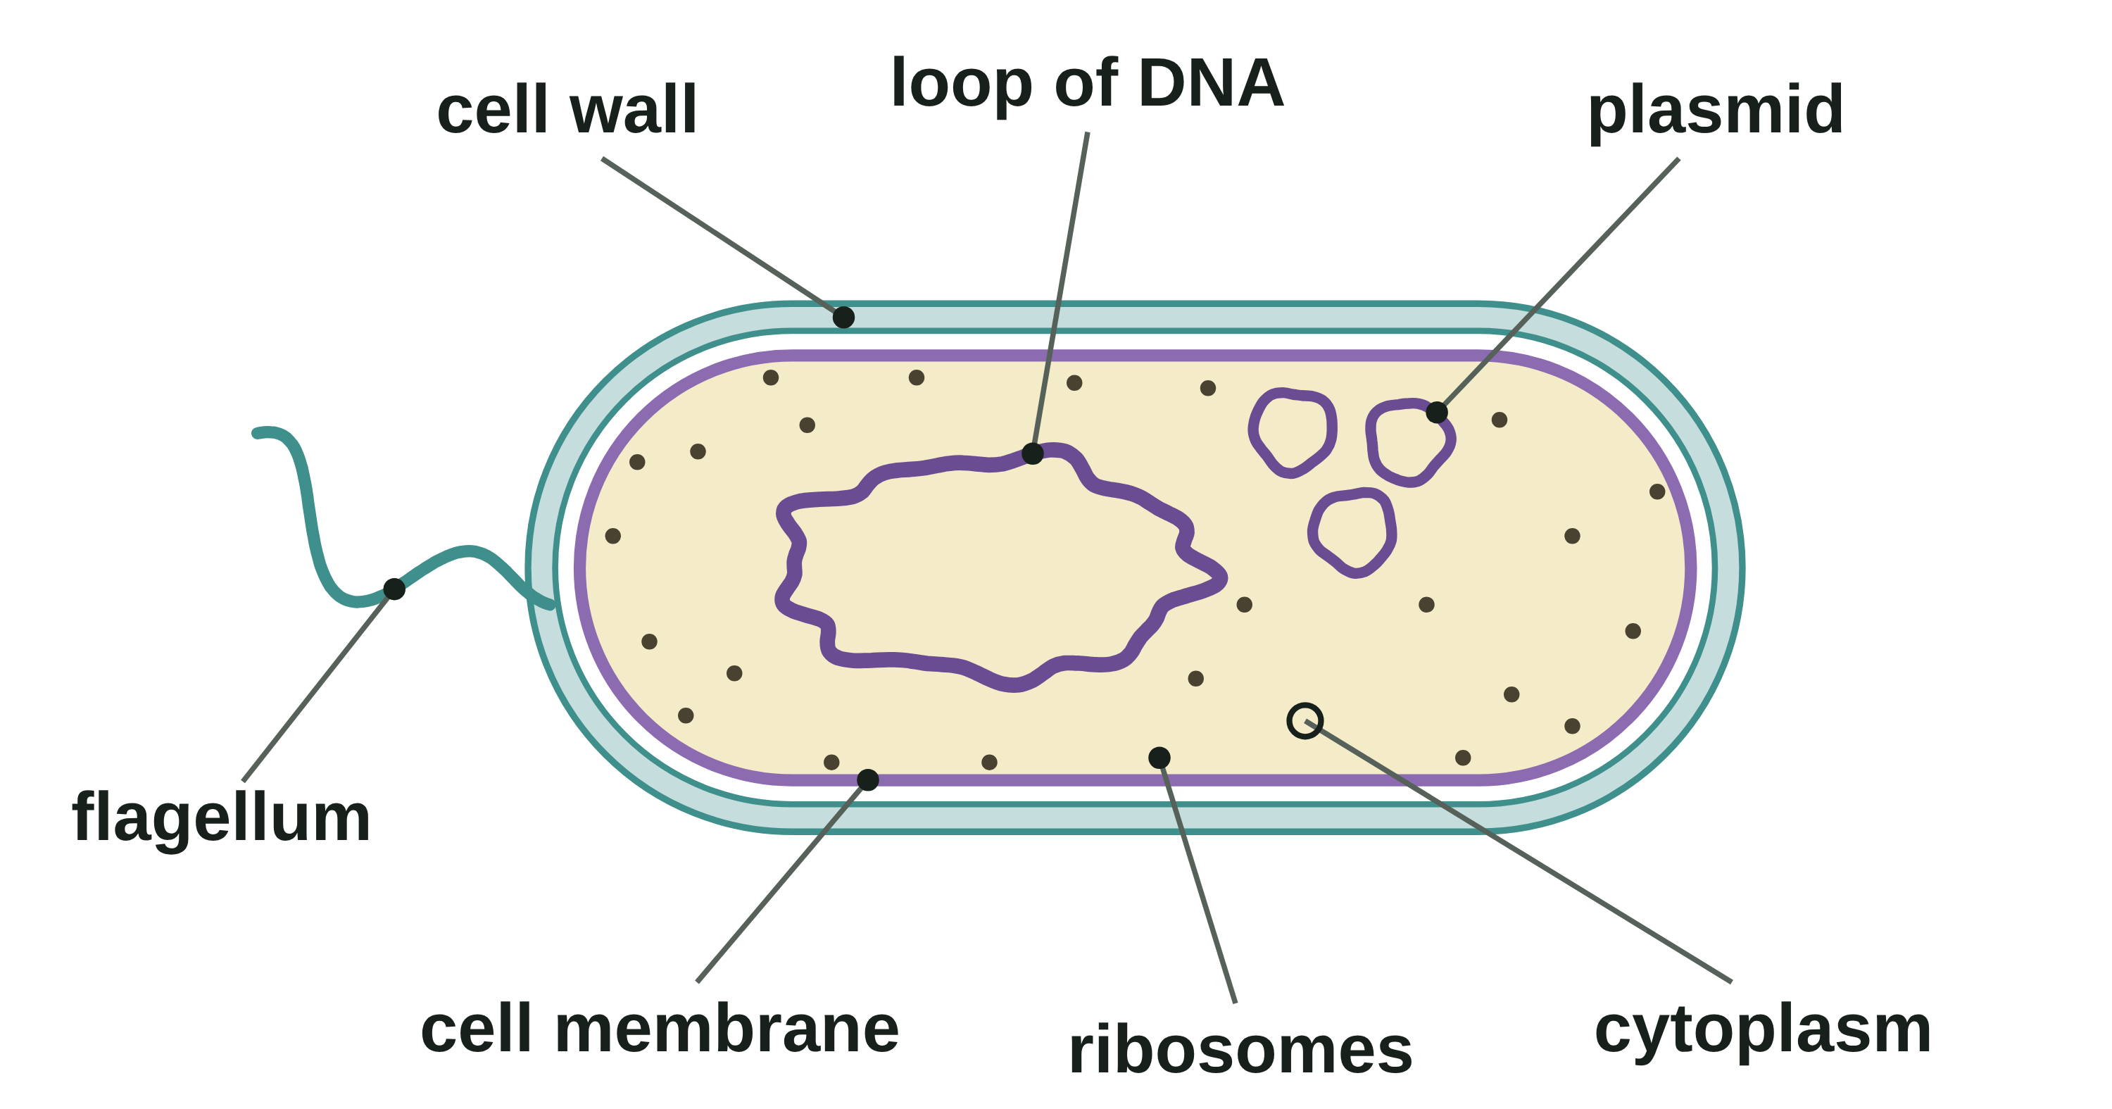
B1 L2 Alternative worksheet: Bacterial cells
Page 1 of 2
Name: ______________________________ Class: __________
Key facts
A. Label the bacterial cell
[6]
Help: online screens 1 and 3
A bacterium is a living thing made of one cell.
Bacteria are tiny: about 2 µm long. An animal cell is about 20 µm, so it is 10 times bigger: divide, 20 ÷ 2 = 10. (1 mm = 1000 µm.)
A bacterial cell has a cell wall, a cell membrane, cytoplasm and ribosomes.
It has no nucleus. Its DNA is a single loop, free in the cytoplasm.
Some bacteria have plasmids: small rings of DNA.
Some bacteria have a flagellum: a tail used to move.
The cell wall is not made of cellulose.
No nucleus: prokaryotic (bacteria). A nucleus: eukaryotic (animal and plant cells).
Most bacteria are harmless or useful. Bacteria are not viruses.
Electron micrographs are black and white: the colours are added.
Write a word from the box in each label box.
cell membrane
cell wall
cytoplasm
flagellum
loop of DNA
plasmid
A bacterial cell (a diagram).
A diagram is simplified. The colours help you tell the parts apart.
Tip: the cell wall is the outside layer. The cell membrane is just inside it.
B1 L2 · Bacterial cells · sciencegcse.co.uk · free GCSE science resources

Slide 37
B1 L2 Alternative worksheet: Bacterial cells
Page 2 of 2
Name: ______________________________ Class: __________
B. Match the word to its meaning
C. Fill the gaps
[5]
[6]
Help: online screens 1, 3, 6 and 9
Help: online screens 3, 4, 6 and 7
Draw a line from each word to its meaning.
Use the words in the box. Use each word once.
bacterium
where proteins are made
cellulose
loop
nucleus
plasmids
ribosomes
smaller
plasmid
a tail used to move
1. A bacterial cell has no ________.
2. Its DNA is a single ________.
flagellum
describes a cell with no nucleus
3. Some bacteria have small rings of DNA called ________.
ribosome
a living thing made of one cell
4. Proteins are made at the ________.
5. The cell wall of a bacterium is not made of ________.
prokaryotic
a small ring of DNA
6. A bacterium is much ________ than an animal cell.
D. Yes or no? Then work it out
[6]
Help: online screens 3, 6 and 7
E. True or false?
[6]
Does a bacterial cell have it? Tick (✓) Yes or No for each part.
Help: online screens 2, 4, 7, 9 and 10
Tick (✓) True or False for each sentence.
Part | Yes | No
1. nucleus
2. cell membrane
3. ribosomes
4. mitochondria
5. cell wall
6. An animal cell is 12 µm across. A bacterium is 3 µm long. How many times bigger is the animal cell?
Sentence | True | False
1. Bacteria have DNA.
2. All bacteria have plasmids.
3. A bacterium is smaller than an animal cell.
4. Bacteria are viruses.
5. The colours in a coloured electron micrograph are real.
6. Most bacteria are harmful.
12 ÷ 3 =
times [1]
B1 L2 · Bacterial cells · sciencegcse.co.uk · free GCSE science resources

Slide 38
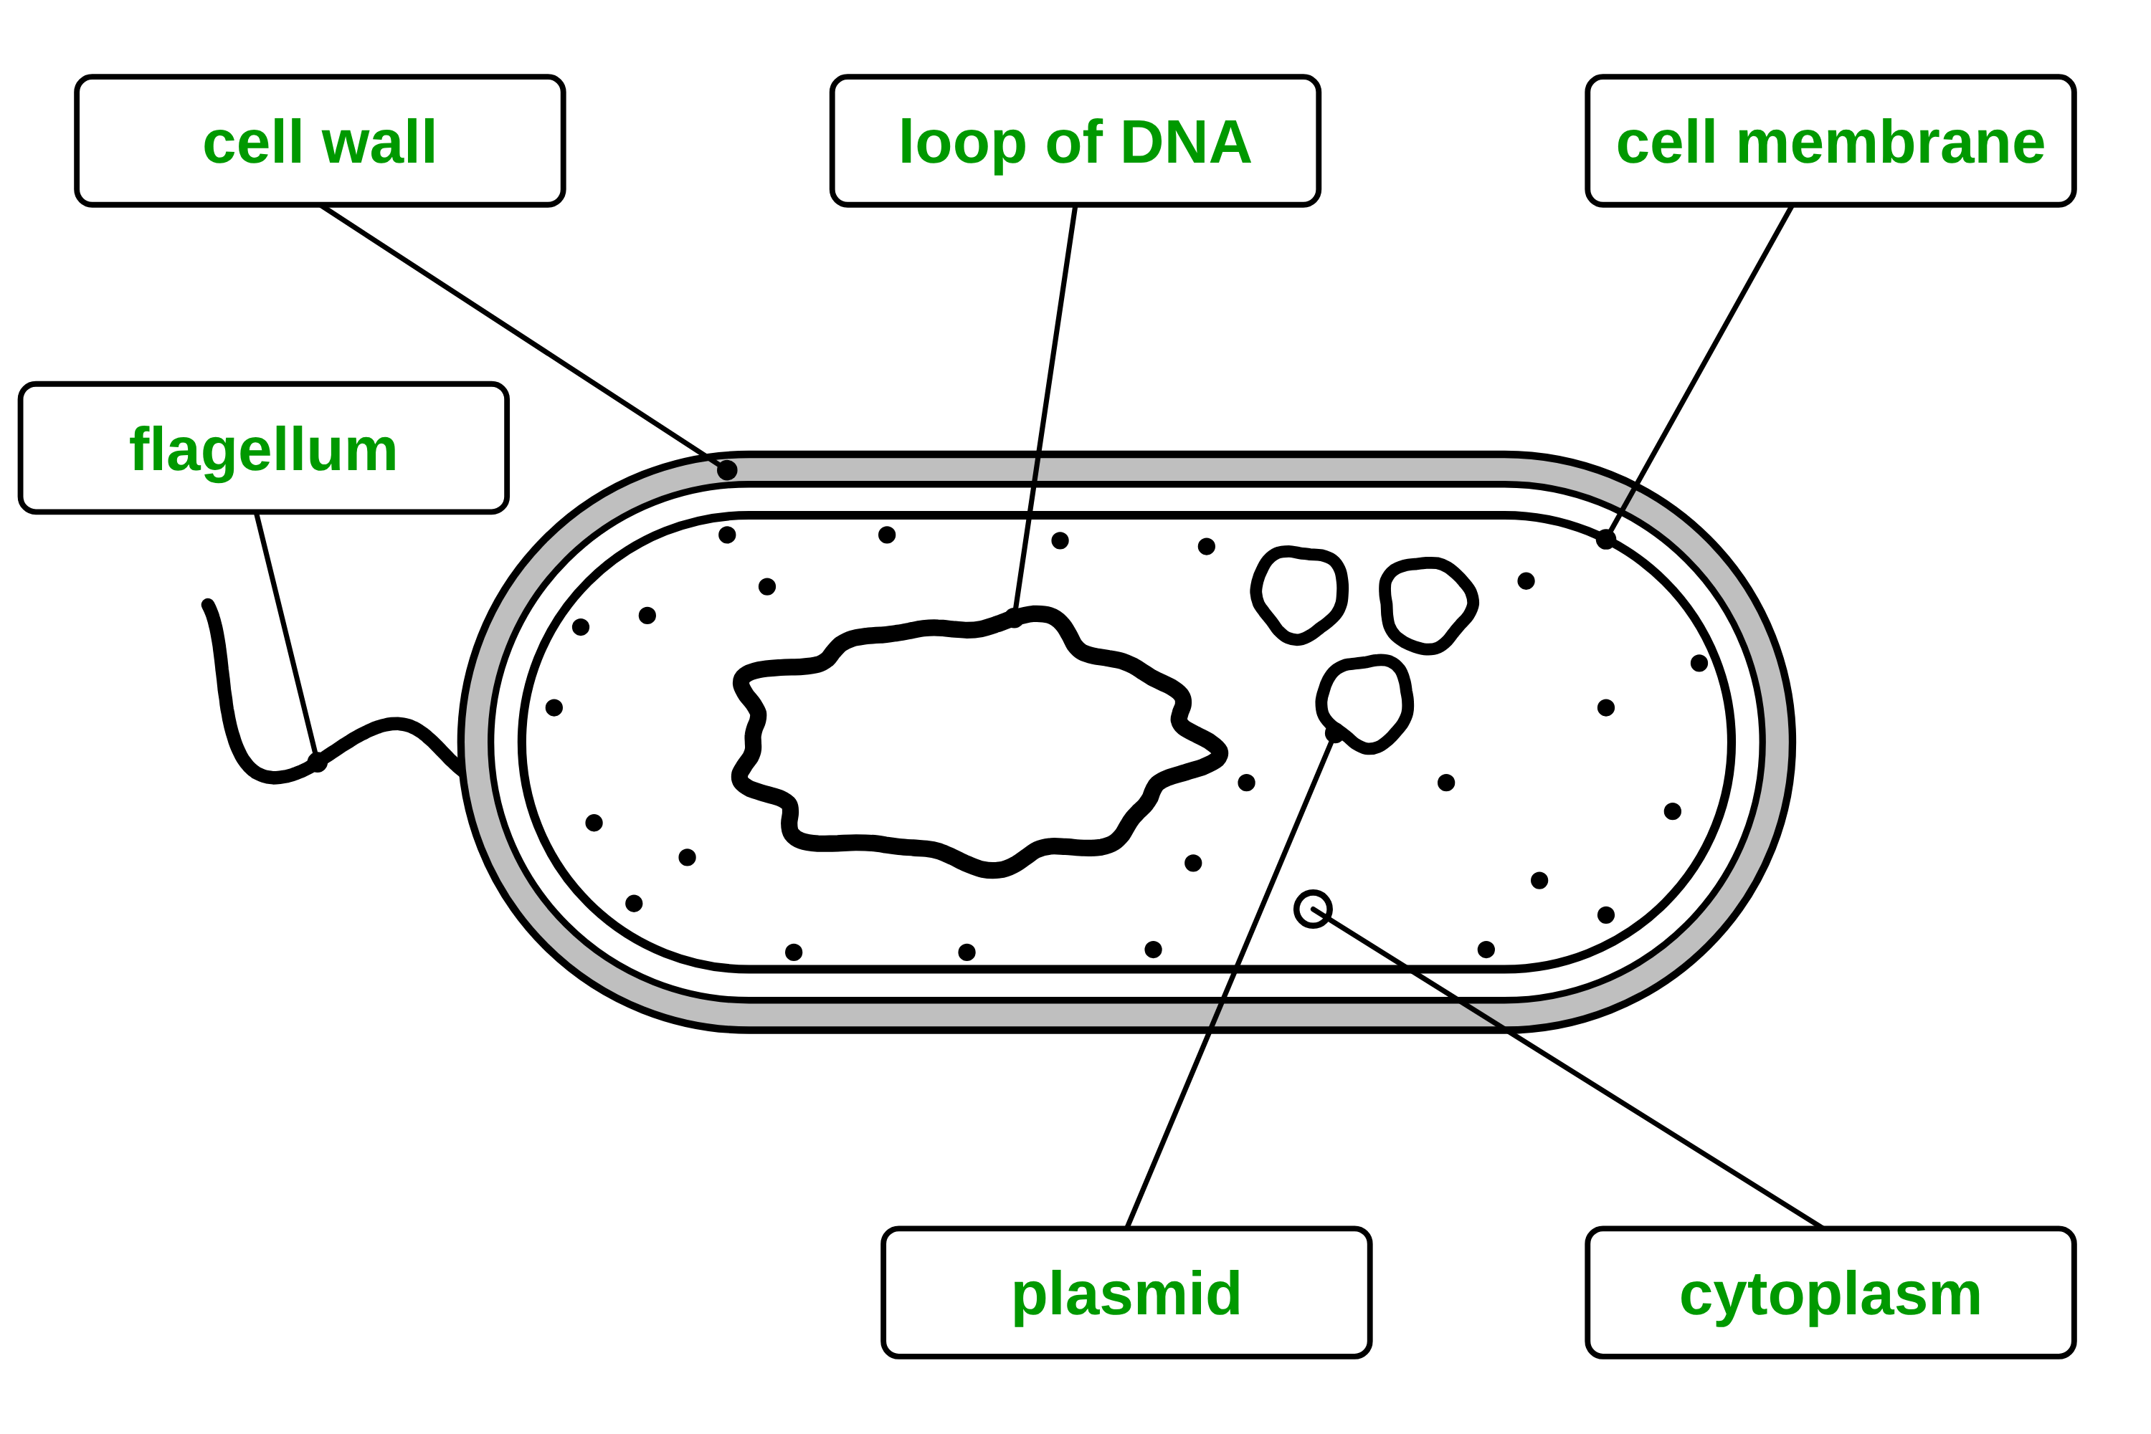
B1 L2 Alternative worksheet answers - page 1
Answers 1 of 2
Key facts
A. Label the bacterial cell
[6]
A bacterium is a living thing made of one cell.
Bacteria are tiny: about 2 µm long. An animal cell is about 20 µm, so it is 10 times bigger: divide, 20 ÷ 2 = 10. (1 mm = 1000 µm.)
A bacterial cell has a cell wall, a cell membrane, cytoplasm and ribosomes.
It has no nucleus. Its DNA is a single loop, free in the cytoplasm.
Some bacteria have plasmids: small rings of DNA.
Some bacteria have a flagellum: a tail used to move.
The cell wall is not made of cellulose.
No nucleus: prokaryotic (bacteria). A nucleus: eukaryotic (animal and plant cells).
Most bacteria are harmless or useful. Bacteria are not viruses.
Electron micrographs are black and white: the colours are added.
Write a word from the box in each label box.
cell membrane
cell wall
cytoplasm
flagellum
loop of DNA
plasmid
1 mark for each correct label box: cell wall (top left) (1); loop of DNA (1); cell membrane (1); flagellum (1); plasmid (1); cytoplasm (1).
Allow small spelling errors if the word is clear. Allow “DNA” for the loop of DNA.
A bacterial cell (a diagram).
A diagram is simplified. The colours help you tell the parts apart.
B1 L2 · Bacterial cells · sciencegcse.co.uk · free GCSE science resources

Slide 39
B1 L2 Alternative worksheet answers - page 2
Answers 2 of 2
B. Match the word to its meaning
C. Fill the gaps
[5]
[6]
Draw a line from each word to its meaning.
Use the words in the box. Use each word once.
1 mark for each correct line.
bacterium
where proteins are made
cellulose
loop
nucleus
plasmids
ribosomes
smaller
plasmid
a tail used to move
1. A bacterial cell has no nucleus. (1)
2. Its DNA is a single loop. (1)
flagellum
describes a cell with no nucleus
3. Some bacteria have small rings of DNA called plasmids. (1)
ribosome
a living thing made of one cell
4. Proteins are made at the ribosomes. (1)
5. The cell wall of a bacterium is not made of cellulose. (1)
prokaryotic
a small ring of DNA
6. A bacterium is much smaller than an animal cell. (1)
D. Yes or no? Then work it out
[6]
E. True or false?
Does a bacterial cell have it? Tick (✓) Yes or No for each part.
[6]
1. Bacteria have DNA. True. The DNA is a loop, free in the cytoplasm. (1)
2. All bacteria have plasmids. False. Only some bacteria have plasmids. (1)
3. A bacterium is smaller than an animal cell. True. (1)
4. Bacteria are viruses. False. Bacteria are cells. Viruses are not cells. (1)
5. The colours in a coloured electron micrograph are real. False. The colours are added. (1)
6. Most bacteria are harmful. False. Most bacteria are harmless or useful. (1)
Part | Yes | No
1. nucleus |  | ✓
2. cell membrane | ✓
3. ribosomes | ✓
4. mitochondria |  | ✓
5. cell wall | ✓
6. An animal cell is 12 µm across. A bacterium is 3 µm long. How many times bigger is the animal cell?
12 ÷ 3 =
4 times (1)
Check: 4 × 3 = 12.
Rows 1 to 5: 1 mark for each correct row.
B1 L2 · Bacterial cells · sciencegcse.co.uk · free GCSE science resources

Slide 40
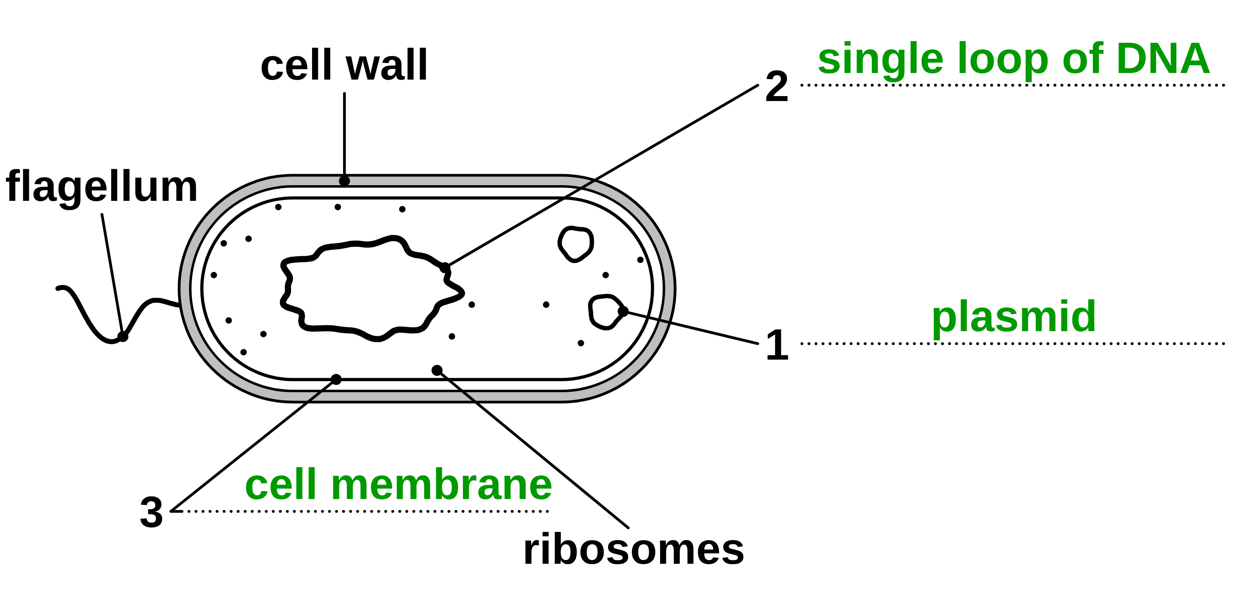
B1 L2 Exam questions worksheet mark scheme - page 1
Answers 1 of 2
01 A bacterial cell
03 Plasmids
[5]
[2]
01.1 Complete Figure 1. Use words from the box. [3]
1 plasmid (1)
2 single loop of DNA (1)
3 cell membrane (1)
allow DNA / loop of DNA for 2. do not accept nucleus
01.2 What is the function of the flagellum? [1]
To move the bacterium (1)
03 Describe two ways plasmids are different from the single loop of DNA. [2]
any two: plasmids are (much) smaller / small rings (1)
a cell may have several plasmids but only one main loop (1)
plasmids carry only a few (extra) genes / the main loop carries most of the genes (1)
not all bacteria have plasmids, but every bacterium has the main loop (1)
plasmids carry genes such as one that helps the bacterium survive an antibiotic (1)
max 2. do not accept "plasmids are not made of DNA" or "plasmids are in a nucleus"
01.3 Name one structure in Figure 1 also found in an animal cell. [1]
cell membrane / cytoplasm / ribosomes (1)
allow DNA. do not accept cell wall, plasmid, flagellum
02 Two cells
04 No nucleus, no DNA?
[4]
[3]
02.1 Which cell in Table 1 is prokaryotic? Give one reason from Table 1. [1]
the bacterium, because it has no nucleus (1)
both the cell and the reason are needed. do not accept size on its own ("it is smaller")
02.2 Calculate the length of the onion epidermis cell in µm. [1]
200 (µm) (1)
02.3 How many times longer is the onion epidermis cell than the bacterium? [2]
200 ÷ 2 (1) = 100 (1)
allow their 02.2 ÷ 2. Correct answer with no working = 2 marks. ignore units. do not accept 198 (subtracted)
04 Explain why the student is wrong. Use the area labelled A in Figure 2. [3]
bacteria / bacterial cells do have DNA (1)
the DNA is (the pale tangled area at) A / in the middle of the cell (1)
the DNA is not enclosed in a nucleus / is free in the cytoplasm / is a single loop (1)
max 3. allow "bacteria may also have DNA in plasmids" for 1 mark. do not accept "A is the nucleus"
B1 L2 · Bacterial cells · sciencegcse.co.uk · free GCSE science resources

Slide 41
B1 L2 Exam questions worksheet mark scheme - page 2
Answers 2 of 2
05 Extended response
[6]
05 Bacterial cells and plant cells both have a cell wall. Compare the structure of a bacterial cell with the structure of a plant cell. [6]
Level descriptors
Level 3 (5-6 marks): A detailed and coherent comparison. At least two similarities and at least three differences are given, each difference saying clearly which cell has which feature (both cells named in each point), including the nucleus or the DNA.
Level 2 (3-4 marks): At least one similarity and at least two differences, with some comparison, but some points describe only one cell.
Level 1 (1-2 marks): Simple statements about one or both cells, such as "bacteria have no nucleus", with little or no comparison.
0 marks: No relevant content.
Model answer (Level 3)
Both cells have a cell membrane, cytoplasm and ribosomes, and both have DNA. Both also have a cell wall, but the plant cell wall is made of cellulose, whereas the bacterial cell wall is not. The plant cell's DNA is enclosed in a nucleus, so it is eukaryotic, but the bacterial cell has no nucleus: its DNA is a single loop, free in the cytoplasm, so it is prokaryotic. A bacterial cell may also have plasmids, small rings of DNA, which a plant cell does not have. A plant cell has mitochondria, a permanent vacuole and, in some cells, chloroplasts, but a bacterial cell has none of these. A bacterial cell is also much smaller: about 2 µm long, compared with up to about 100 µm.
Indicative content
Similarities: both have a cell membrane; both have cytoplasm; both have ribosomes; both have DNA; both have a cell wall
the plant cell wall is made of cellulose, but the bacterial cell wall is not
a plant cell has a nucleus, but a bacterial cell does not
the bacterial DNA is a single loop, free in the cytoplasm; the plant cell's DNA is enclosed in a nucleus
a plant cell is eukaryotic; a bacterial cell is prokaryotic
a bacterial cell may have plasmids (small rings of DNA); a plant cell does not
a plant cell has mitochondria; a bacterial cell does not
some plant cells have chloroplasts; a bacterial cell does not
a plant cell has a permanent vacuole; a bacterial cell does not
some bacteria have a flagellum; a plant cell does not
a bacterial cell is much smaller (about 1 to 5 µm, against up to about 100 µm for a plant cell)
B1 L2 · Bacterial cells · sciencegcse.co.uk · free GCSE science resources

