Slide 1
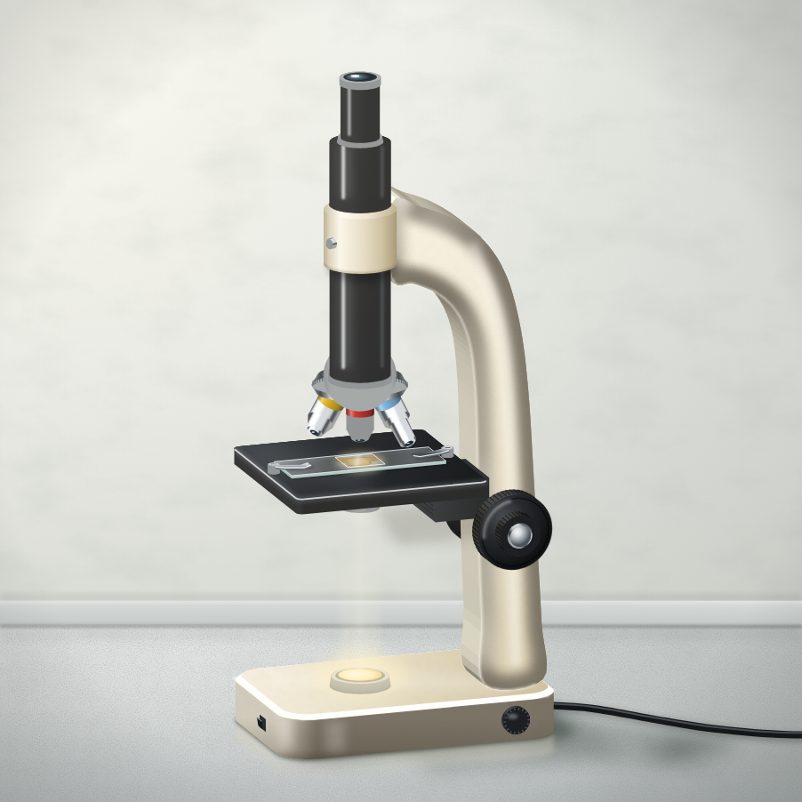
sciencegcse.co.uk · Biology B1 L3
DATE
B1 L3: Using a microscope
24/09/2026
Required practical 1 (Combined Science and Biology)
DO NOW
KEYWORDS
1. Is a bacterial cell prokaryotic or eukaryotic?
2. What are plasmids?
3. Which part of a plant cell absorbs light for photosynthesis?
Light microscope
Magnification
Resolution
Stain
Electron microscope
A painting of a school light microscope.
B1 Cell biology
AQA Combined Science
Notes:
Do now: retrieval from B1 L2 (Q1, Q2) and B1 L1 (Q3). The picture is a painting of a school light microscope, not a photograph. A slide of onion cells, stained yellow-brown with iodine solution, is clipped on the stage, and the lamp is on. Ask: which parts can you already name? What do you think the three lenses at the bottom are for? Link: bacteria (Q1, Q2) are so small that you need an electron microscope to see inside them; chloroplasts (Q3) are big enough to see with a light microscope. Today is Required practical 1 (Combined Science and Biology). Suggested 60 min with the practical: slides 1-3 (6 min); slides 4-9 (12 min); slides 10-12 as the method, then the practical in pairs: make an onion slide, focus on low and high power, and draw what you see (25 min); slides 13-19 (12 min); exit ticket slides 23-24 (5 min). Without the practical (or with the virtual lab): slides 1-3 (6 min); slides 4-9 (12 min); slides 10-14 (12 min); slides 15-19 (12 min); Mandatory worksheet started in class (12 min), finished for homework; exit ticket slides 23-24 (6 min). Use slides 20-22 if time allows. Homework: online lesson quiz and the B1 L3 Exam questions worksheet. Technician list (per pair): a light microscope with a lamp; a quarter of an onion on a white tile; forceps; microscope slides and coverslips; a mounted needle; a dropping pipette and a small beaker of water; iodine solution in a dropper bottle; paper towels; eye protection. Optional: methylene blue, clean cotton buds and a pot of disinfectant, or prepared slides of cheek cells.

Slide 2
sciencegcse.co.uk · Biology B1 L3: Using a microscope
Do now answers and lesson focus
Do now answers
In this lesson
1. Prokaryotic.
2. Small rings of DNA.
3. The chloroplasts.
• Name the parts of a light microscope and their jobs.
• Work out the total magnification.
• Prepare a slide and focus on the cells.
• Draw and label what you see.
• Compare light and electron microscopes.
Key idea
Two lenses magnify: multiply their magnifications to get the total magnification.
Start on low power. Coarse focusing knob first, then the fine focusing knob.
2
B1 L3 · sciencegcse.co.uk
Notes:
Go through the answers. Then share the lesson focus. The online lesson (sciencegcse.co.uk, B1 L3) follows the same 13 screens as this PowerPoint, so students can go over it at home. There are three checkpoints along the way. Answer 1: a prokaryotic cell has no nucleus; its DNA is a single loop (B1 L2). Answer 3: chloroplasts absorb light to make food by photosynthesis (B1 L1).

Slide 3
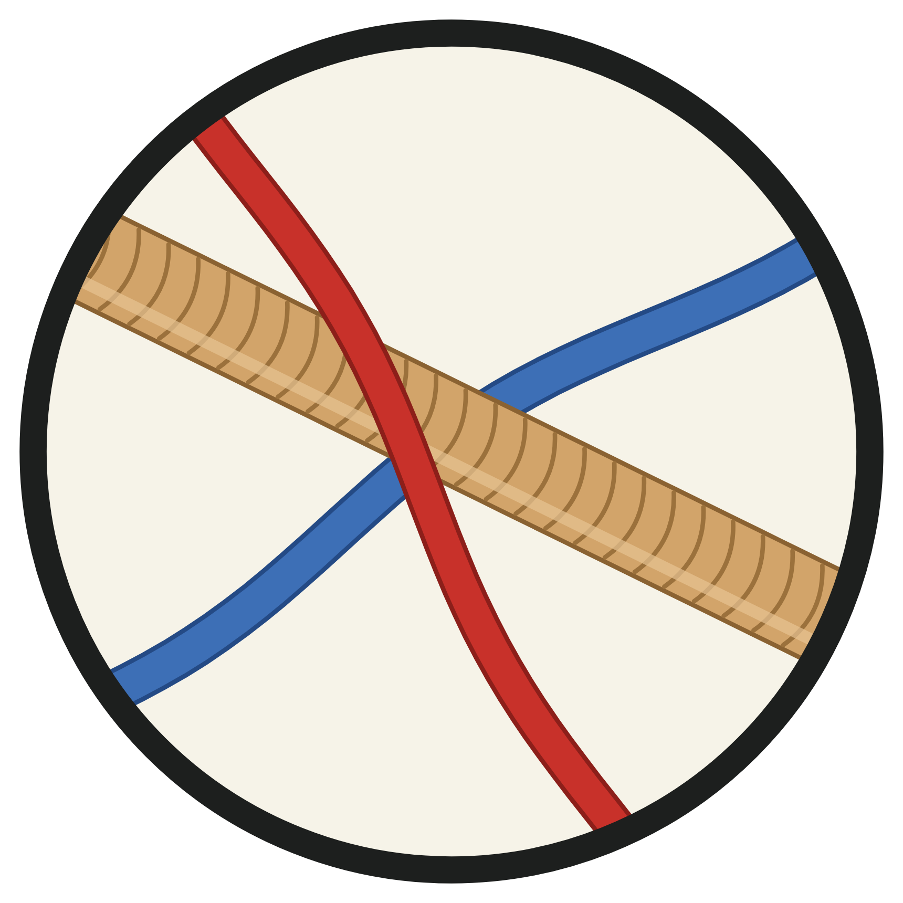
sciencegcse.co.uk · Biology B1 L3: Using a microscope
Why this matters in the real world
Microscopes let us see a world that is too small for our eyes.
Discovering cells
Solving crimes
Seeing more
1665
× 2 000 000
the year cells were named
an electron microscope
Robert Hooke looked at a thin slice of cork. The tiny boxes reminded him of small rooms, so he called them cells.
Forensic scientists compare hairs and fibres from a crime scene under a microscope.
Electron microscopes magnify up to about 2 million times. They show parts of cells that a light microscope cannot.
History of science
Forensic science
Modern science
3
B1 L3 · sciencegcse.co.uk
Notes:
Hook. Ask: how could a single fibre on a jumper link someone to a crime scene? (Under a microscope its colour, thickness and pattern can be matched.) The middle picture is a round magnified view of a hair and two crossing fibres, one blue and one red. Hooke's 'cells' in cork were the empty cell walls of dead plant cells. Ask: what is the smallest thing you think a microscope could show? We find out on screen 12.

Slide 4
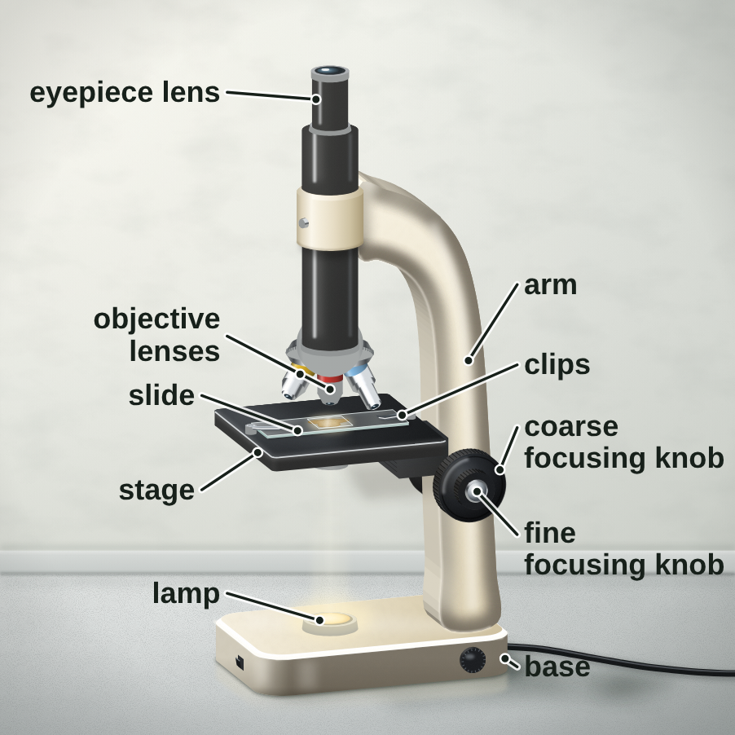
sciencegcse.co.uk · Biology B1 L3: Using a microscope
Online lesson: screen 1 of 13
The light microscope
A school light microscope
Key facts
A light microscope uses light and lenses to make a magnified image.
The lamp shines light up through the specimen on the stage.
The objective lens and the eyepiece lens both magnify the image.
You look through the eyepiece lens at the top.
The specimen must be thin, so light can pass through it.
A painting of a school light microscope. The slide holds onion cells stained with iodine solution.
4
B1 L3 · sciencegcse.co.uk
Notes:
This lesson is Required practical 1 (Combined Science and Biology). The picture is a painting of a school microscope, not a photograph. Ask: which parts can you already name? (Most students met the eyepiece and the stage in Year 7.) Ask: why must the specimen be thin? (Light comes from below and must pass through it. A thick piece blocks the light, so you see a dark shadow.) Point out the three objective lenses on the turning nosepiece: screen 4 uses them. The onion cells on the slide are plant cells: their parts and jobs were B1 L1 Animal and plant cells. One fact a click; the green line is the reason the specimen must be thin.

Slide 5
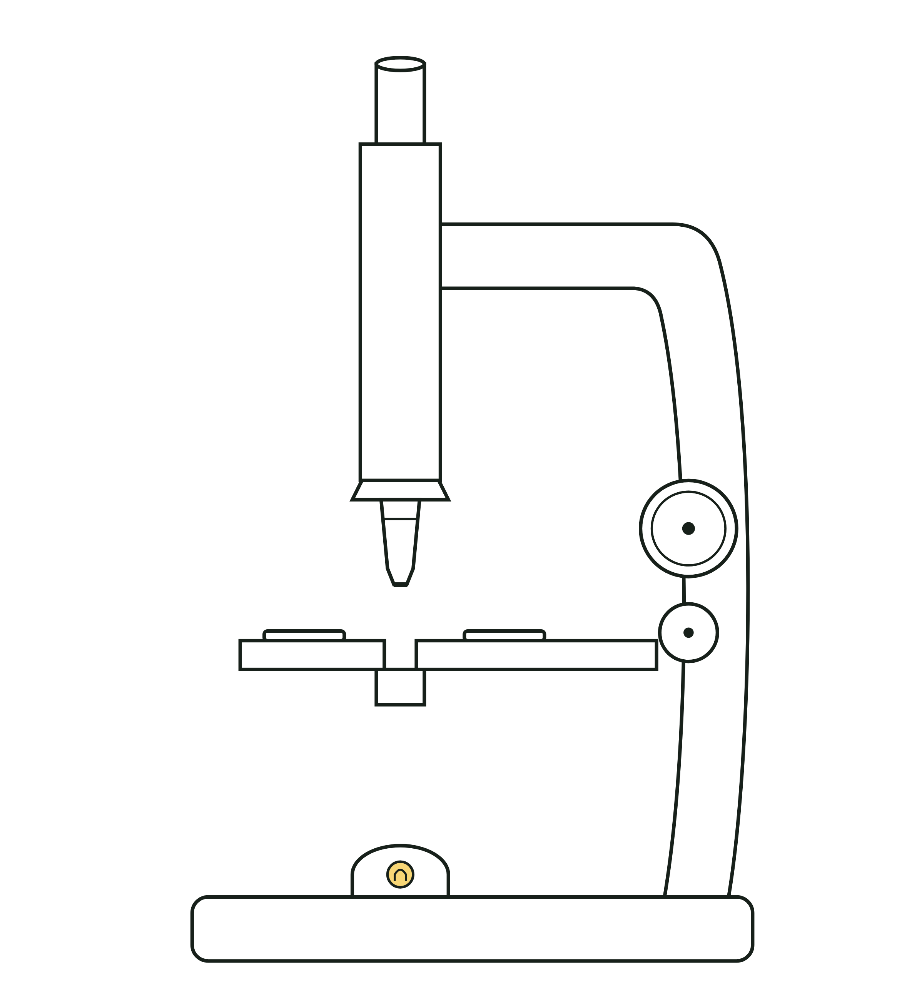
sciencegcse.co.uk · Biology B1 L3: Using a microscope
Online lesson: screen 2 of 13
A real microscope and a diagram
Same thing, two ways
Spot the differences
1
Objective lenses: The real microscope has three objective lenses on a turning nosepiece. The diagram shows only one.
2
Focusing knobs: On the real microscope, the small fine knob sits inside the big coarse knob, on both sides. The diagram draws two separate knobs.
1
1
3
Slide: On the real microscope, two clips hold a glass slide of stained onion cells on the stage. The diagram shows the clips on an empty stage.
2
3
2
3
4
4
4
Arm and base: The real arm and base are heavy metal, so the microscope stays steady. The diagram draws them as thin outlines.
A real microscope
An exam diagram
A diagram is simplified: it shows only the parts you need to name.
Both have an eyepiece lens at the top, an objective lens above the stage, a lamp below the stage, and focusing knobs on the arm.
5
B1 L3 · sciencegcse.co.uk
Notes:
Cover the right panel. Ask: what is different between the painting and the diagram? Take ideas, then reveal the four differences: each click shows one difference and puts its number on both pictures; the last click shows what is the same in both. Key message: an exam diagram leaves out detail, but the parts are always in the same places, so you can name them on any microscope. On most school microscopes the fine knob sits inside the coarse knob, and there is a pair on each side so you can use either hand. Some older microscopes have a mirror instead of a lamp: it reflects light up through the slide (never point it at the Sun). Carry a microscope with one hand on the arm and the other under the base. The online lesson, screen 2, has the same pictures and differences.

Slide 6
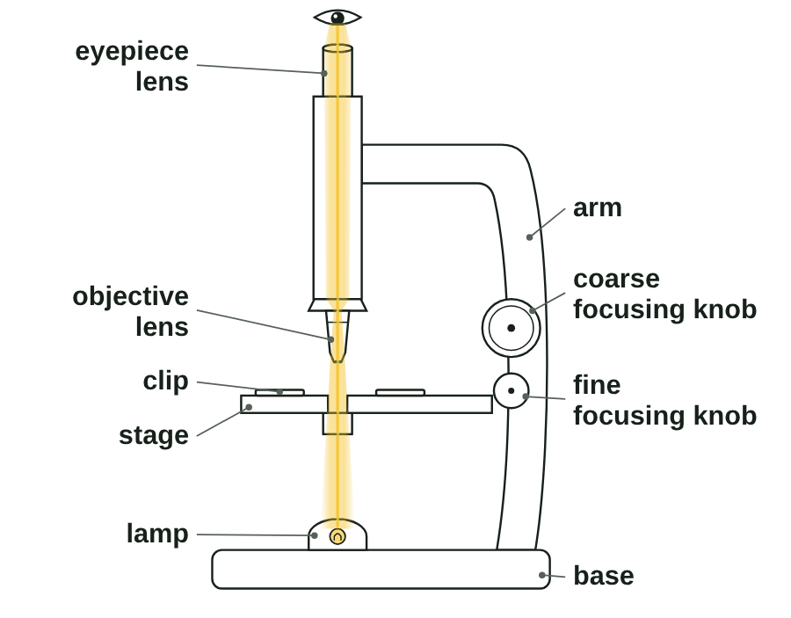
sciencegcse.co.uk · Biology B1 L3: Using a microscope
Online lesson: screen 3 of 13
Parts and their jobs
Parts of a light microscope
Parts and jobs
Eyepiece lens: you look through it. It magnifies.
Objective lens: magnifies. There are usually three to choose from.
Stage and clips: hold the slide still.
Lamp: shines light up through the specimen.
Coarse focusing knob: moves the lens a long way, to find the image.
Fine focusing knob: moves it a tiny distance, to make the image sharp.
Arm and base: hold the microscope steady.
The yellow beam shows the path of the light. A diagram is simplified.
▶ Online lesson, screen 3: tap a part
6
B1 L3 · sciencegcse.co.uk
Notes:
The animated GIF lights each part in turn, then follows the light from the lamp to the eye, as the chips do on screen 3 of the online lesson (print and PDF show its first frame, the labelled diagram). One part a click. Ask: which two parts magnify? (The eyepiece lens and the objective lens.) Which knob makes the image sharp? (The fine focusing knob.) Use the exam names: 'eyepiece lens', not 'eye lens'; 'stage', not 'table'. The light must pass through the specimen, so it has to be thin. On some microscopes the knobs move the stage and on others they move the lens; either way they change the gap between the lens and the slide.

Slide 7
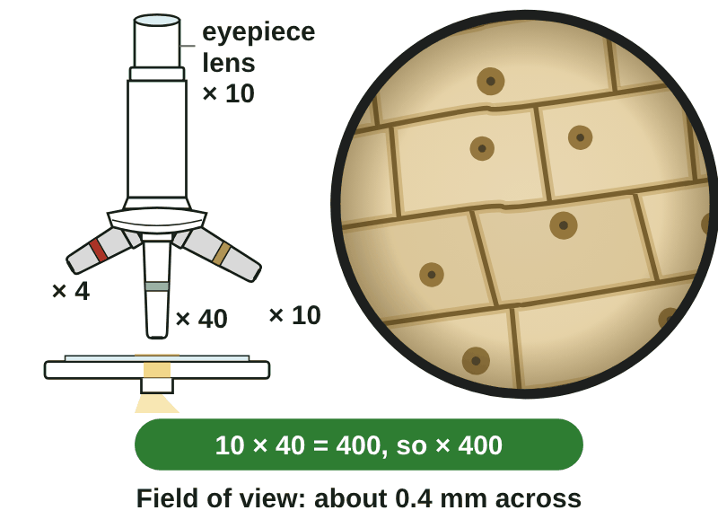
sciencegcse.co.uk · Biology B1 L3: Using a microscope
Online lesson: screen 4 of 13
Total magnification
Turn the nosepiece
Work it out
total magnification = eyepiece lens magnification × objective lens magnification
Example 1: eyepiece × 10, objective × 40. 10 × 40 = 400, so × 400.
Example 2: eyepiece × 15, objective × 4. 15 × 4 = 60, so × 60.
Check: the total is bigger than either lens on its own. Multiply, never add.
Field of view
Objective lens
Total magnification
Field of view (onion cells across)
× 4
× 40
about 4.0 mm (about 20 cells)
× 10
× 100
about 1.6 mm (about 8 cells)
Onion cells stained with iodine solution: yellow-brown.
× 40
× 400
about 0.4 mm (about 2 cells)
▶ Online lesson, screen 4: change the lens
The higher the magnification, the smaller the field of view.
7
B1 L3 · sciencegcse.co.uk
Notes:
Total magnification is the eyepiece lens magnification multiplied by the objective lens magnification. Model both examples: the equation in words, the numbers in, the answer with the × sign. Magnification has no unit. Check: the total must be bigger than either lens. A common error is adding: 10 + 40 = 50 is wrong. The animated GIF turns the nosepiece through × 4, × 10 and × 40, as the chips do on screen 4 of the online lesson (print and PDF show the × 400 view). The table is the result of the virtual lab: the same onion slide at three magnifications. Ask: why do you see fewer cells at × 400? (Each cell looks bigger, so fewer fit in the circle.) Working out the size of one cell from the field of view, and the equation magnification = size of image ÷ size of real object, are next lesson, B1 L4 Magnification and cell size.

Slide 8
sciencegcse.co.uk · Biology B1 L3: Using a microscope
Online lesson: screen 5 of 13
Checkpoint 1
✓
CHECKPOINT 1 of 3
Quick check on slides 4 to 7 (online screens 1 to 4). Show A, B or C on your whiteboard.
Question 1
Question 2
Question 3
Why must the specimen on a microscope slide be thin?
Which part moves the lens and the slide a tiny distance, to make the image sharp?
The eyepiece lens is × 10 and the objective lens is × 40. What is the total magnification?
A. So that it fits under the clips.
A. The coarse focusing knob
A. × 400
B. So that light can pass through it.
B. The stage
B. × 50
C. So that it is magnified more.
C. The fine focusing knob
C. × 4
✓ Check your answers on the next slide
8
B1 L3 · sciencegcse.co.uk
Notes:
Hinge check. Everyone shows A, B or C at the same time. Q1 tests why the specimen is thin; Q2 the job of the fine knob; Q3 the most common error, adding instead of multiplying. If several get Q1 wrong, go back to slide 4; Q2, slide 6; Q3, slide 7. Wrong options to listen for: Q1 C (thin does not change the magnification: only the lenses do); Q2 A (the coarse knob moves the lens a long way); Q3 B (× 50 adds 10 + 40) and Q3 C (× 4 divides 40 by 10).

Slide 9
sciencegcse.co.uk · Biology B1 L3: Using a microscope
Online lesson: screen 5 of 13
Checkpoint 1 answers
✓
CHECKPOINT 1 of 3
Quick check on slides 4 to 7 (online screens 1 to 4). Show A, B or C on your whiteboard.
Question 1
Question 2
Question 3
Why must the specimen on a microscope slide be thin?
Which part moves the lens and the slide a tiny distance, to make the image sharp?
The eyepiece lens is × 10 and the objective lens is × 40. What is the total magnification?
A. So that it fits under the clips.
A. The coarse focusing knob
A. × 400
A. × 400 ✓
B. So that light can pass through it.
B. So that light can pass through it. ✓
B. The stage
B. × 50
C. So that it is magnified more.
C. The fine focusing knob
C. The fine focusing knob ✓
C. × 4
Light from the lamp must pass up through the specimen. A thick piece blocks the light.
The fine focusing knob makes tiny movements, to make the image sharp.
Total magnification = eyepiece × objective = 10 × 40 = 400.
Got one wrong? Look back: Q1 slide 4 · Q2 slide 6 · Q3 slide 7
9
B1 L3 · sciencegcse.co.uk
Notes:
1 B, 2 C, 3 A. Each click shows one answer and why. Follow-up: what would the total magnification be with the × 4 objective lens? (10 × 4 = 40, so × 40.)

Slide 10
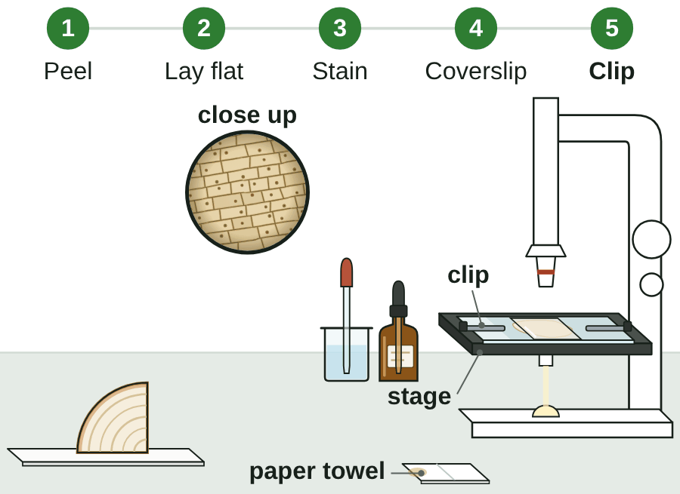
sciencegcse.co.uk · Biology B1 L3: Using a microscope
Online lesson: screen 6 of 13
Preparing a slide
Making the slide
Method
1
Peel: Peel a thin layer of onion epidermis with forceps.
2
Lay flat: Lay it flat in a drop of water on a clean slide.
3
Stain: Add a drop of iodine solution.
4
Coverslip: Lower a coverslip at an angle with a mounted needle.
5
Clip: Blot off extra liquid. Clip the slide onto the stage.
Safety
Iodine solution stains the onion cells yellow-brown.
Wear eye protection: iodine solution is an irritant and stains skin.
Mounted needles and glass are sharp. Tell your teacher about any broken glass.
▶ Virtual lab: try the practical online
10
B1 L3 · sciencegcse.co.uk
Notes:
This is the method for Required practical 1 (Combined Science and Biology). The animated GIF shows the five steps, as Next step does on screen 6 of the online lesson (print and PDF show the finished slide on the stage). One step a click, then the safety lines. How to run it in class: pairs, eye protection on before the iodine solution is opened; each pair makes one onion slide. What goes wrong: the layer is too thick or folded (dark, overlapping cells); too much iodine solution (everything dark brown); the coverslip is dropped flat (air bubbles); liquid on top of the coverslip (blot it). Ask: why stain the cells? (To make the cells, and parts such as the nucleus, easier to see. Onion cells are almost colourless, and a stain does not make them bigger.) Animal cells: some classes look at their own cheek cells: wipe the inside of your own cheek gently with a clean cotton bud, smear it on a slide, add methylene blue and a coverslip; used cotton buds go straight into disinfectant. Many schools use a prepared slide of cheek cells instead, which works just as well. The virtual lab (link under the animation) runs the whole practical online.

Slide 11
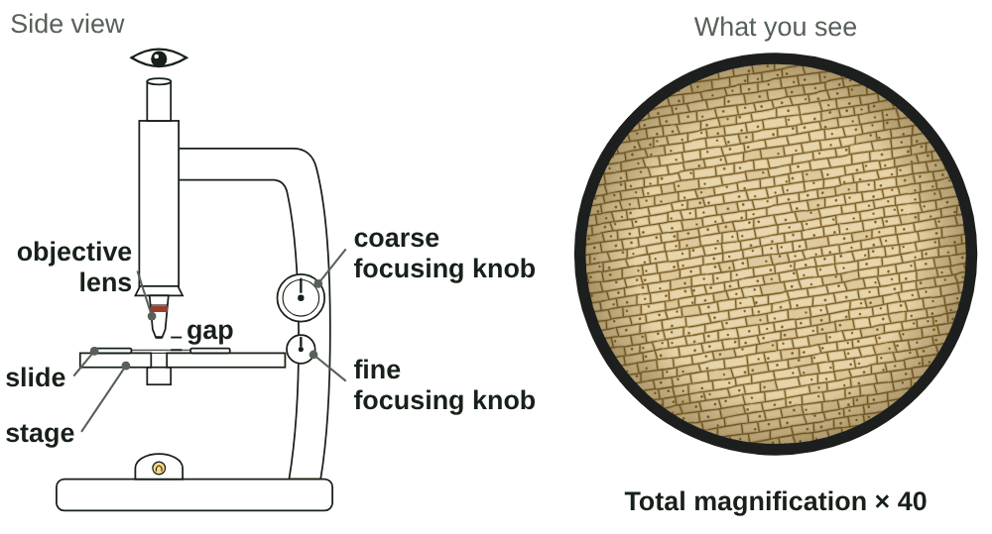
sciencegcse.co.uk · Biology B1 L3: Using a microscope
Online lesson: screen 7 of 13
Focusing step by step
Side view and what you see
Step by step
1
Low power: Start with the lowest-power objective lens.
2
From the side: Turn the coarse focusing knob to bring the lens close to the slide, without touching it.
3
Coarse: Look through the eyepiece. Move the lens and the slide apart until the cells appear.
4
Fine: Make the image sharp with the fine knob. Focusing changes the sharpness, not the size.
5
Higher power: Turn the nosepiece. Fine knob only.
Drawn as seen down a light microscope. Iodine solution stains the cells yellow-brown.
Never use the coarse knob at high power: the lens could crack the slide.
▶ Online lesson, screen 7: step through focusing
11
B1 L3 · sciencegcse.co.uk
Notes:
The animated GIF shows the side view beside what you see, as the five steps on screen 7 of the online lesson does (print and PDF show the sharp × 40 view). One step a click, then the green rule. Why start on low power? It has the widest field of view, so the cells are easy to find, and the lowest-power objective lens is the shortest, so it is furthest from the slide. Why watch from the side? So you can stop before the lens touches the slide. Then you only ever move the lens and the slide apart while you look through the eyepiece, so they cannot crash. Focusing changes how sharp the image is, not how big it is: only the lenses change the size. At high power the lens is very close to the slide, so the coarse knob could push it into the slide and crack it: use the fine knob only. If you see only a bright circle: check the specimen is over the hole, and refocus on low power. Next lesson, B1 L4 Magnification and cell size, asks: which objective lens should you start with?

Slide 12
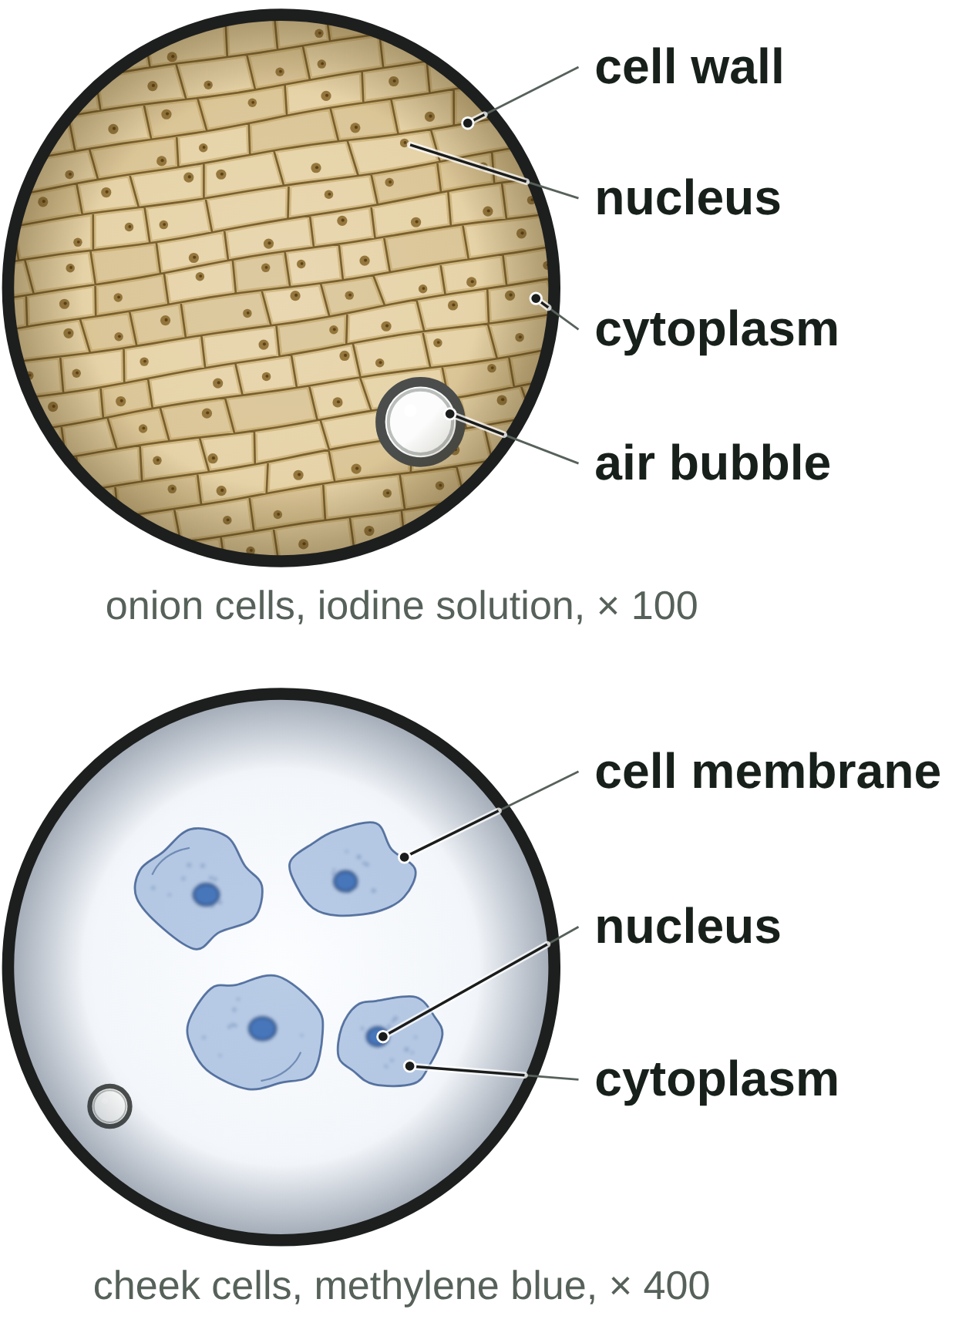
sciencegcse.co.uk · Biology B1 L3: Using a microscope
Online lesson: screen 8 of 13
Onion and cheek cells
Under the microscope
Results
Cells
Stain
What you can see
Onion epidermis
iodine solution (yellow-brown)
cell wall, cytoplasm, nucleus; no chloroplasts
Cheek cells
methylene blue (blue)
cell membrane, cytoplasm, dark blue nucleus; no cell wall
Both
mitochondria: too small to see clearly; ribosomes: too small to see at all
Variables
This practical is a skill: there is no independent or dependent variable.
To compare magnifications: change the objective lens (independent variable); measure the diameter of the field of view (dependent variable); keep the same slide (control variable).
Drawn as seen down a light microscope. Stains colour the cells.
12
B1 L3 · sciencegcse.co.uk
Notes:
These are the results of the practical. Onion cells: about 0.2 mm long, brick-shaped, in rows. You can see the cell wall, the cytoplasm and a nucleus. The cell membrane is pressed against the wall, so you cannot see it on its own. An onion bulb grows underground, so its cells have no chloroplasts. Cheek cells: about 50 µm across, flat and uneven, with a dark blue nucleus and no cell wall: they are animal cells. Ask: a student sees a round shape with a thick black edge. Is it a cell? (No: an air bubble.) You cannot see mitochondria clearly with a school light microscope, and ribosomes are far too small to see at all. This practical has no independent or dependent variable, because it is a technique, but the variables panel shows how to use the words if you compare magnifications. One row a click, then the two variables lines. The parts of the cells and their jobs were B1 L1 Animal and plant cells. Screen 8 of the online lesson has a switch between the two views and the virtual-lab link.

Slide 13
sciencegcse.co.uk · Biology B1 L3: Using a microscope
Online lesson: screen 9 of 13
Checkpoint 2
✓
CHECKPOINT 2 of 3
Quick check on slides 10 to 12 (online screens 6 to 8). Show A, B or C on your whiteboard.
Question 1
Question 2
Question 3
Why is the coverslip lowered at an angle?
A student has found the cells with the × 10 objective lens. She turns to the × 40 objective lens. Which knob should she use now?
Among the onion cells, a student sees a round shape with a thick, dark edge. What is it?
A. To stop air bubbles being trapped.
A. The coarse focusing knob
A. A large nucleus
B. To push the stain into the nucleus.
B. The fine focusing knob
B. A cheek cell
C. To make the cells look bigger.
C. Either knob
C. An air bubble
✓ Check your answers on the next slide
13
B1 L3 · sciencegcse.co.uk
Notes:
Mini whiteboards: A, B or C. Listen for 'coarse' in Q2: at high power it must be the fine knob, because the lens is very close to the slide and the coarse knob could crack it. Q1 C is the 'bigger' misconception: only the lenses magnify. Q3 B: there are no cheek cells on an onion slide. If several get Q1 wrong, go back to slide 10; Q2, slide 11; Q3, slide 12.

Slide 14
sciencegcse.co.uk · Biology B1 L3: Using a microscope
Online lesson: screen 9 of 13
Checkpoint 2 answers
✓
CHECKPOINT 2 of 3
Quick check on slides 10 to 12 (online screens 6 to 8). Show A, B or C on your whiteboard.
Question 1
Question 2
Question 3
Why is the coverslip lowered at an angle?
A student has found the cells with the × 10 objective lens. She turns to the × 40 objective lens. Which knob should she use now?
Among the onion cells, a student sees a round shape with a thick, dark edge. What is it?
A. To stop air bubbles being trapped.
A. To stop air bubbles being trapped. ✓
A. The coarse focusing knob
A. A large nucleus
B. To push the stain into the nucleus.
B. The fine focusing knob
B. A cheek cell
B. The fine focusing knob ✓
C. To make the cells look bigger.
C. An air bubble
C. Either knob
C. An air bubble ✓
Lowering it slowly at an angle pushes the air out to the side.
At high power, use only the fine focusing knob. It moves the lens a tiny distance.
Air bubbles are round, with thick dark edges. They are not cells.
Got one wrong? Look back: Q1 slide 10 · Q2 slide 11 · Q3 slide 12
14
B1 L3 · sciencegcse.co.uk
Notes:
1 A, 2 B, 3 C. Each click shows one answer and why. Follow-up: which stain shows up the nucleus of a cheek cell? (Methylene blue.)

Slide 15
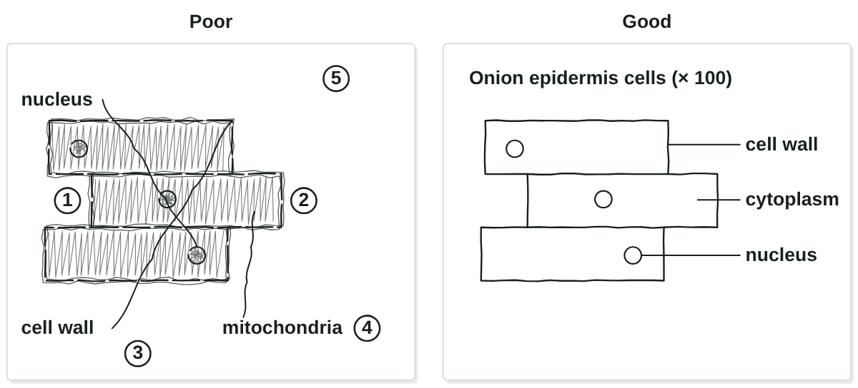
sciencegcse.co.uk · Biology B1 L3: Using a microscope
Online lesson: screen 10 of 13
Drawing what you see
Fix the drawing
Drawing rules
Use a sharp pencil and clear, single lines.
No shading.
Draw large, and keep the sizes of the parts in proportion.
Draw label lines with a ruler. They touch the part and never cross.
Label only what you can see.
Add a title and the magnification, such as "× 100", or a scale bar.
Draw what you see, not what a textbook shows.
▶ Online lesson, screen 10: fix the drawing
15
B1 L3 · sciencegcse.co.uk
Notes:
The animated GIF draws the good drawing again rule by rule, and each numbered mistake on the poor drawing pulses as its rule is drawn, as 'Fix the drawing' does on screen 10 of the online lesson (print and PDF show both drawings). One rule a click. AQA asks for a drawing 'with a magnification scale': write the magnification under the title (the eyepiece lens × the objective lens you used), or draw a scale bar; scale bars are next lesson, B1 L4 Magnification and cell size. Draw two or three cells large, at least half the box, not the whole field of view. Draw what you see, not a textbook cell: if you cannot see mitochondria, do not label them. Put labels to one side, in a column, with ruled lines. Ask: what is wrong with shading? (It hides detail and can look like a structure.)

Slide 16
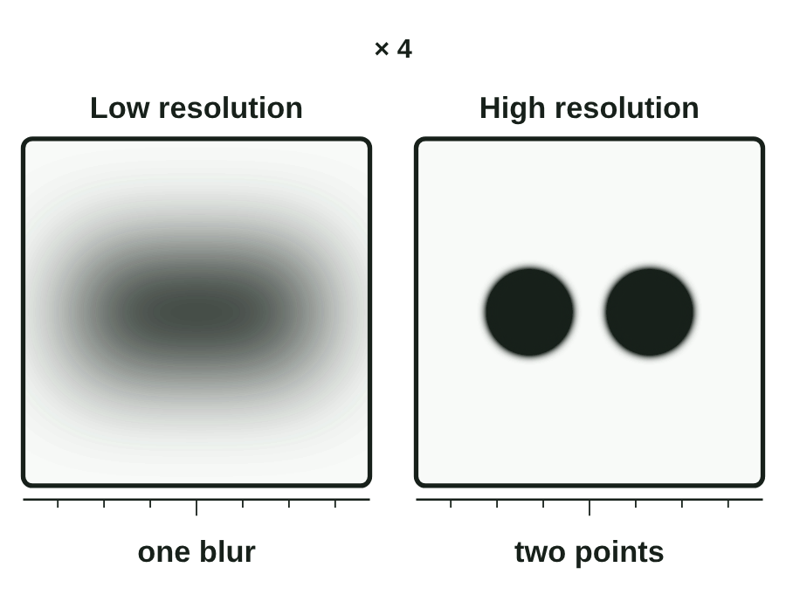
sciencegcse.co.uk · Biology B1 L3: Using a microscope
Online lesson: screen 11 of 13
Magnification and resolution
Bigger is not clearer
Two different ideas
Magnification: how many times bigger the image is than the real object.
Resolution (resolving power): the ability to see two points that are close together as two separate points.
Higher resolution = more detail.
Watch out!
Magnifying a blurry image only gives a bigger blur.
To see more detail, you need a higher resolution.
Two points that are close together, seen at low and high resolution.
▶ Online lesson, screen 11: magnify the blur
16
B1 L3 · sciencegcse.co.uk
Notes:
Magnification and resolution are different. The animated GIF magnifies two close points × 1, × 2 and × 4 at low and at high resolution, as the chips and the switch do on screen 11 of the online lesson (print and PDF show both squares at × 4). A light microscope can resolve two points about 200 nm (0.2 µm) apart. Two points closer than that blur into one, however much you magnify. That is why ribosomes, about 25 nm across, cannot be seen with a light microscope. Analogy: zoom right in on a small photo on a phone; it gets bigger, but blurry or blocky, and no new detail appears. Ask: what would you need to see the two points as two? (A higher resolution: an electron microscope, screen 12.)

Slide 17
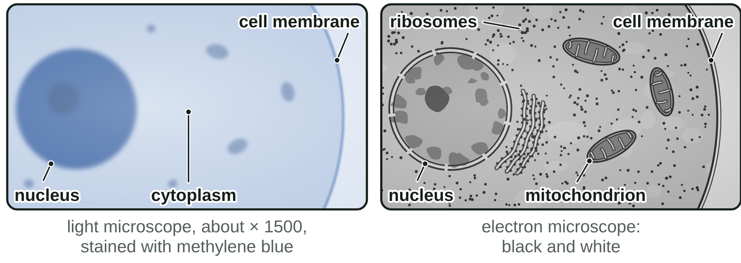
sciencegcse.co.uk · Biology B1 L3: Using a microscope
Online lesson: screen 12 of 13
Light and electron microscopes
Same cell, two microscopes
Light and electron microscopes
Light microscope
Electron microscope
Uses
light
a beam of electrons
Magnification
up to about × 1500
up to about × 2 000 000
Resolution
about 200 nm
about 0.2 nm
Shows
cells, nuclei, chloroplasts
ribosomes, the inside of mitochondria
Electron micrographs are black and white. Any colour is added.
How microscopes developed
1665: Robert Hooke looks at cork and names cells.
1930s: the first electron microscopes are built.
1950s: ribosomes are seen for the first time.
Better microscopes let biologists see more sub-cellular structures.
17
B1 L3 · sciencegcse.co.uk
Notes:
An electron microscope uses a beam of electrons instead of light. It has a much higher magnification and a much higher resolution, so biologists can study cells in much finer detail. This let them see and understand many more sub-cellular structures: ribosomes were first seen with one in the 1950s, and the folded inside of a mitochondrion. For stretch: electrons behave like waves with a much shorter wavelength than light, which is why they can resolve smaller details. Electron micrographs are black and white; coloured ones have had colour added (B1 L2 Bacterial cells shows a coloured one). School labs use light microscopes: they are cheap, small and easy to use, and show real colours and stains. One table row a click, then the timeline. Screen 12 of the online lesson switches between the two views of the same cell.

Slide 18
sciencegcse.co.uk · Biology B1 L3: Using a microscope
Online lesson: screen 13 of 13
Checkpoint 3
✓
CHECKPOINT 3 of 3
Quick check on slides 15 to 17 (online screens 10 to 12). Show A, B or C on your whiteboard.
Question 1
Question 2
Question 3
Which of these is a rule for a biological drawing?
A student makes a blurry picture bigger on a screen. Why does she see no more detail?
Why can an electron microscope show ribosomes when a light microscope cannot?
A. Shade the nucleus so that it stands out.
A. Magnification does not improve resolution.
A. It uses coloured stains.
B. Draw the label lines with a ruler, and do not let them cross.
B. The picture is not bright enough.
B. It uses a brighter lamp.
C. Label every part a cell has, even if you cannot see it.
C. The magnification is too low.
C. It has a much higher resolution.
✓ Check your answers on the next slide
18
B1 L3 · sciencegcse.co.uk
Notes:
Mini whiteboards: A, B or C. Q1 A and C are the two drawing traps: shading, and labelling what you cannot see. Q2 C is the 'bigger is clearer' misconception. Q3 A: electron micrographs are black and white, so colour is not the reason. If several get Q1 wrong, go back to slide 15; Q2, slide 16; Q3, slide 17.

Slide 19
sciencegcse.co.uk · Biology B1 L3: Using a microscope
Online lesson: screen 13 of 13
Checkpoint 3 answers
✓
CHECKPOINT 3 of 3
Quick check on slides 15 to 17 (online screens 10 to 12). Show A, B or C on your whiteboard.
Question 1
Question 2
Question 3
Which of these is a rule for a biological drawing?
A student makes a blurry picture bigger on a screen. Why does she see no more detail?
Why can an electron microscope show ribosomes when a light microscope cannot?
A. Shade the nucleus so that it stands out.
A. Magnification does not improve resolution.
A. Magnification does not improve resolution. ✓
A. It uses coloured stains.
B. Draw the label lines with a ruler, and do not let them cross.
B. Draw the label lines with a ruler, and do not let them cross. ✓
B. The picture is not bright enough.
B. It uses a brighter lamp.
C. Label every part a cell has, even if you cannot see it.
C. The magnification is too low.
C. It has a much higher resolution.
C. It has a much higher resolution. ✓
Ruled label lines touch their part and never cross another line.
Making a blurry image bigger only gives a bigger blur. More detail needs a higher resolution.
Its resolution is about 0.2 nm, so it can show tiny structures such as ribosomes.
Got one wrong? Look back: Q1 slide 15 · Q2 slide 16 · Q3 slide 17
19
B1 L3 · sciencegcse.co.uk
Notes:
1 B, 2 A, 3 C. Each click shows one answer and why. Next: practise naming the parts and working out the magnification.

Slide 20
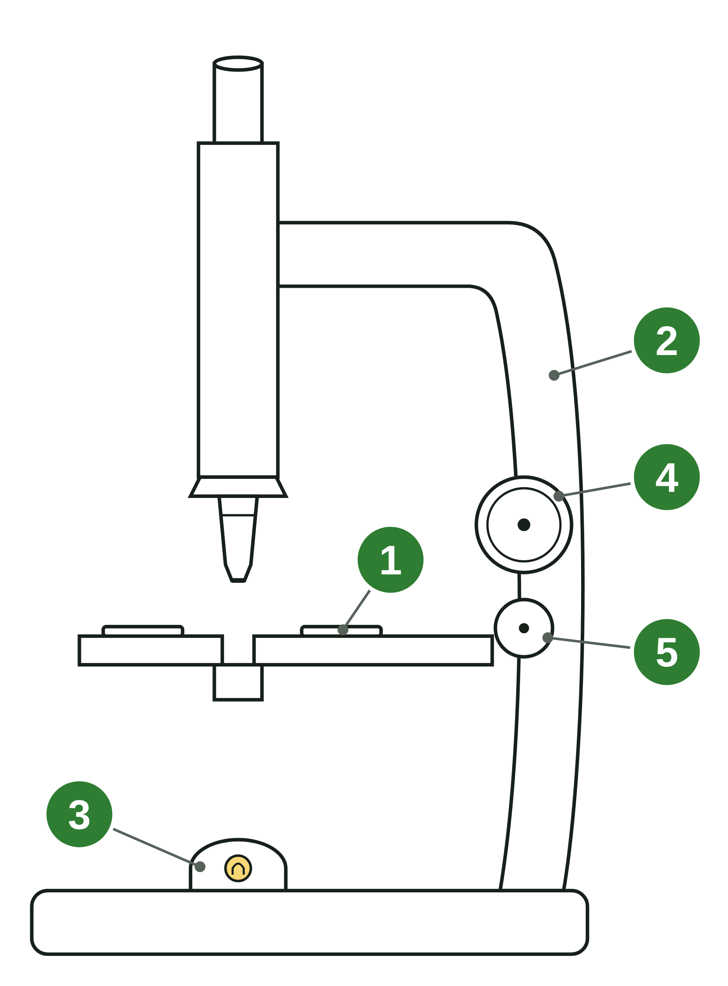
sciencegcse.co.uk · Biology B1 L3: Using a microscope
Practice: parts and total magnification
A light microscope
Questions
1. Name part 1 and give its job.
______________
2. Name parts 4 and 5.
______________
3. Which part, 4 or 5, must you not use with the × 40 objective lens? Why?
______________
4. You carry a microscope by the base and by part 2. Name part 2.
______________
5. The eyepiece lens is × 5 and the objective lens is × 40. Calculate the total magnification.
______________
20
B1 L3 · sciencegcse.co.uk
Notes:
Pairs, 4 minutes. Use the exam names. For question 5, write the equation, the numbers, then the answer with the × sign. The diagram is the exam-style microscope with five numbered parts and no words.

Slide 21
sciencegcse.co.uk · Biology B1 L3: Using a microscope
Parts and total magnification: answers
A light microscope
Answers
1. Name part 1 and give its job.
A clip: it holds the slide still on the stage.
2. Name parts 4 and 5.
4: the coarse focusing knob. 5: the fine focusing knob.
3. Which part, 4 or 5, must you not use with the × 40 objective lens? Why?
Part 4: the coarse knob moves the lens a long way, so it could crack the slide.
4. You carry a microscope by the base and by part 2. Name part 2.
The arm.
5. The eyepiece lens is × 5 and the objective lens is × 40. Calculate the total magnification.
5 × 40 = 200, so × 200.
21
B1 L3 · sciencegcse.co.uk
Notes:
Common errors: mixing up the coarse and fine knobs (the coarse knob is the bigger one); adding in question 5 (5 + 40 = 45 is wrong). Remind students: carry a microscope with one hand on the arm and one under the base.

Slide 22
sciencegcse.co.uk · Biology B1 L3: Using a microscope
Exam practice
1. Explain why you should start with the lowest-power objective lens when you focus a light microscope. [2]
It has the widest field of view, so the cells are easier to find (1). It is the shortest lens, so it is furthest from the slide and less likely to hit it (1).
2. Compare a light microscope with an electron microscope. [3]
A light microscope uses light; an electron microscope uses a beam of electrons (1). An electron microscope has a much higher magnification: up to about × 2 000 000, not about × 1500 (1). An electron microscope has a much higher resolution, so it shows more detail, such as ribosomes (1).
22
B1 L3 · sciencegcse.co.uk
Notes:
Model answers with mark points in brackets. Students try each question first, then mark their own work in green. Each click shows one model answer. In a 'compare' question, say what each microscope does: 'an electron microscope has a higher resolution than a light microscope', not just 'it is better'. For more, the B1 L3 Exam questions worksheet (PDF) has five questions, 20 marks; its mark scheme is at the end of this PowerPoint. The same questions are in the online lesson, after the quiz.

Slide 23
sciencegcse.co.uk · Biology B1 L3: Using a microscope
Exit ticket
Answer on your own
How confident am I?
1. Name the lens that you look through. [1]
I can name the parts of a light microscope and give their jobs.
2. An eyepiece lens is × 10 and an objective lens is × 4. What is the total magnification? [1]
I can prepare a slide, focus on the cells and draw them.
3. Which focusing knob should you use with the highest-power objective lens? [1]
4. Give two rules for a biological drawing. [2]
I can explain the difference between magnification and resolution.
23
B1 L3 · sciencegcse.co.uk
Notes:
Students answer on their own, then rate their confidence. Look for multiplying in question 2 and 'fine' in question 3.

Slide 24
sciencegcse.co.uk · Biology B1 L3: Using a microscope
Exit ticket answers
Answers
Next lesson
1. The eyepiece lens.
2. × 40 (10 × 4 = 40).
3. The fine focusing knob.
4. Any two (1 each): a sharp pencil; clear, single lines; no shading; label lines drawn with a ruler that do not cross; label only what you can see; a title; the magnification or a scale bar.
Next: B1 L4 Magnification and cell size
How to calculate magnification and real size, and compare the sizes of cells.
Worksheets:
• Mandatory (everyone)
• Alternative (easier, with key notes)
• Challenge (when you finish the Mandatory)
• Exam questions (exam style, 20 marks, homework)
▶ Online lesson: quiz and exam questions
24
B1 L3 · sciencegcse.co.uk
Notes:
Go through the answers. Next lesson, B1 L4 Magnification and cell size, uses the microscope to work out how big cells really are: magnification = size of image ÷ size of real object. After this slide: the B1 L3 revision notes (4 printable pages), then the worksheets with answers in green: the Mandatory worksheet (everyone), the Challenge worksheet (stretch) and the Alternative worksheet (easier: key notes and very simple tasks). The B1 L3 Exam questions worksheet (exam style, black and white, 20 marks) is a separate PDF for homework; its mark scheme is the last two slides.

Slide 25
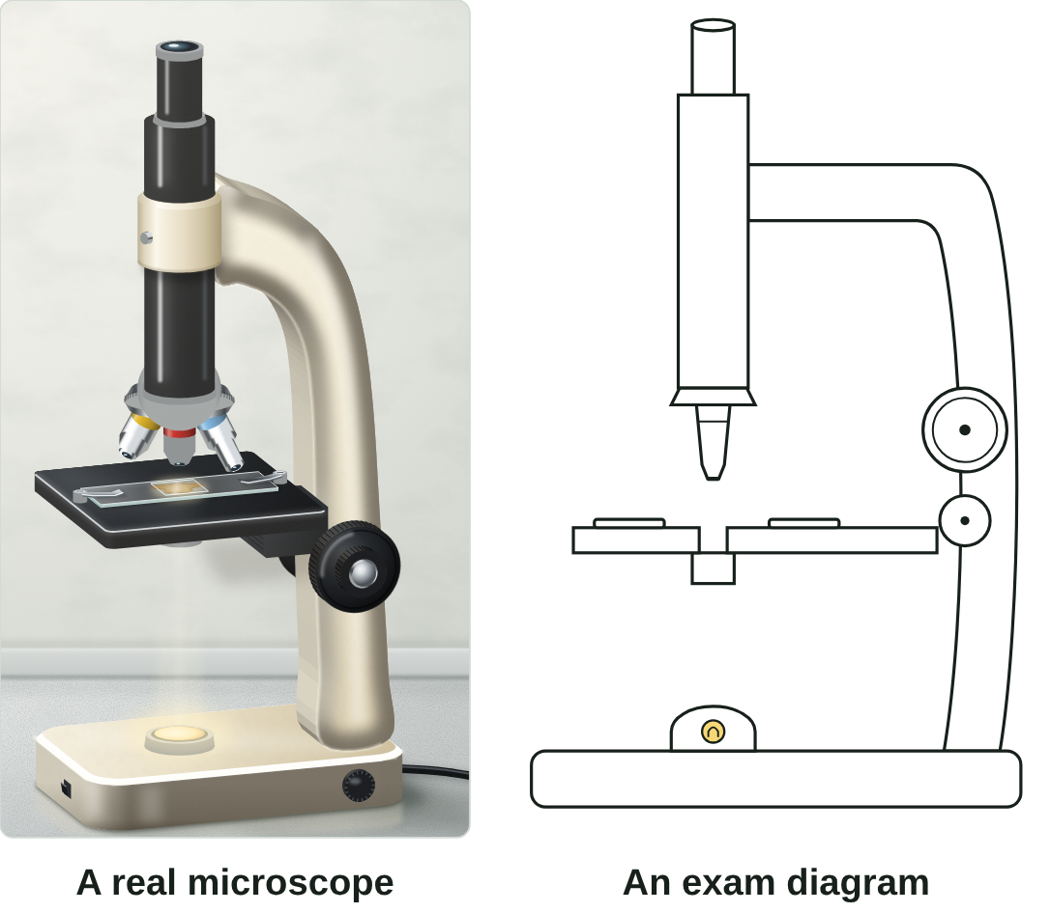
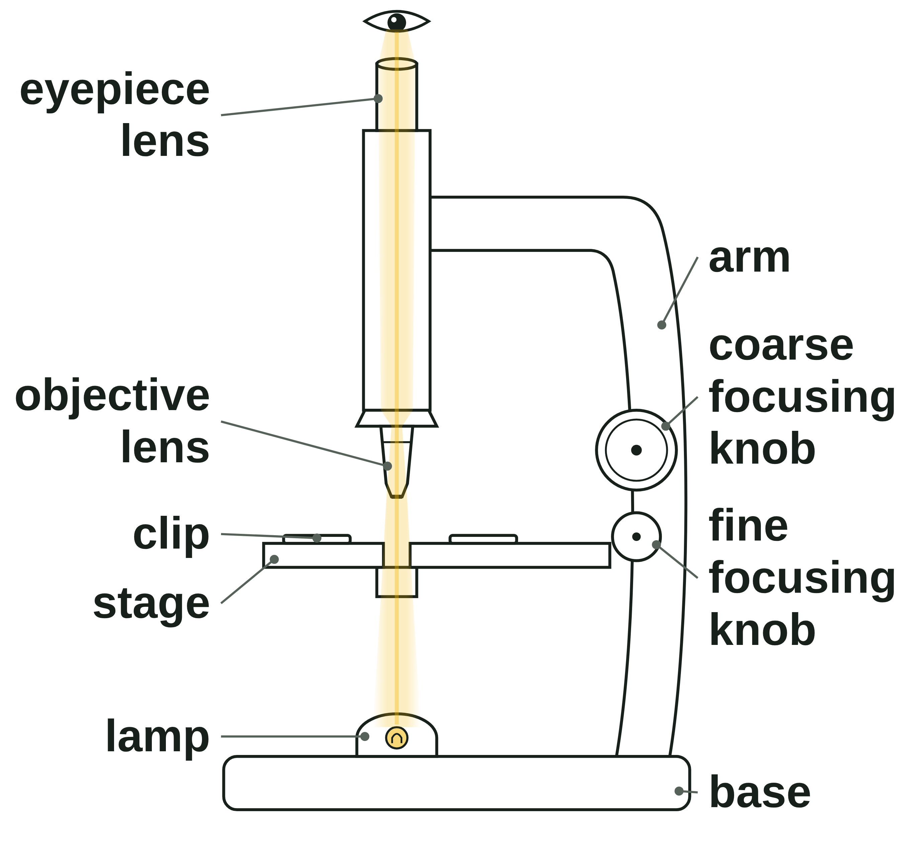
B1 L3 Revision notes 1 of 4
Using a microscope
The light microscope: its parts, a real microscope and a diagram, total magnification
1. What a light microscope does
3. A real microscope and a diagram
A light microscope uses light and lenses to make a magnified image. Light from the lamp shines up through the specimen, the thing you are looking at. Then two lenses magnify it: the objective lens and the eyepiece lens.
The specimen sits on a microscope slide, a thin, flat piece of glass.
The specimen must be thin, so that light can pass through it. A thick piece blocks the light.
A picture of something seen through a light microscope is a light micrograph.
A real school microscope has three objective lenses on a turning nosepiece. A diagram usually shows one.
On a real microscope the fine knob often sits inside the coarse knob, on both sides. A diagram draws two separate knobs.
The parts are always in the same places, so you can name them on any microscope.
A diagram is simplified: it shows only the parts you need to name.
2. The parts and their jobs
Part | Job
Eyepiece lens | the lens you look through; it magnifies the image (often × 10)
Objective lens | magnifies the image; there are usually three (such as × 4, × 10 and × 40) on a turning nosepiece
Stage and clips | the stage holds the slide; the clips keep it still
Lamp | shines light up through the specimen (older microscopes use a mirror)
Coarse focusing knob | the larger knob: moves the lens and the slide a long way, to find the image
Fine focusing knob | the smaller knob: moves them a tiny distance, to make the image sharp
Arm and base | hold the microscope steady; carry it by the arm, with a hand under the base
4. Total magnification
total magnification = eyepiece lens magnification × objective lens magnification
Worked example: the eyepiece lens is × 10 and the objective lens is × 40.
Numbers in: 10 × 40 = 400, so the total magnification is × 400. It has no unit.
Check: the answer is bigger than either lens on its own.
The higher the magnification, the smaller the field of view. With a × 10 eyepiece lens:
Objective lens | Total magnification | Field of view | Onion cells across
× 4 | × 40 | about 4.0 mm | about 20
× 10 | × 100 | about 1.6 mm | about 8
× 40 | × 400 | about 0.4 mm | about 2
Watch out: multiply, never add. × 10 and × 40 give × 400, not × 50.
B1 L3 · Using a microscope · sciencegcse.co.uk · free GCSE science resources
Notes:
Revision notes page 1 of 4 (or use B1_L3_Revision_notes.pdf). These pages are the textbook for B1 L3: students read them before the lesson, use them to catch up, or revise from them. Page 1: what a light microscope does, its parts and their jobs, a real microscope beside an exam diagram, and total magnification.

Slide 26
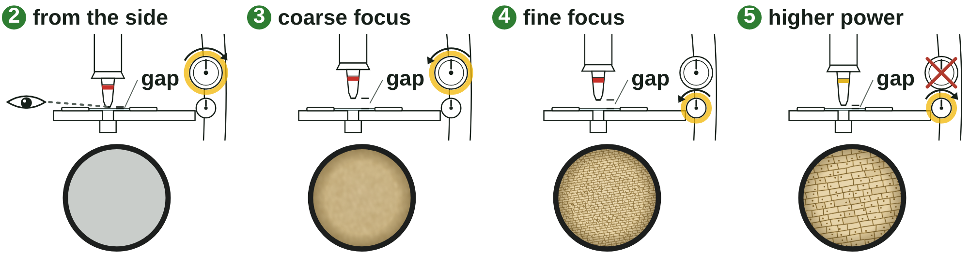
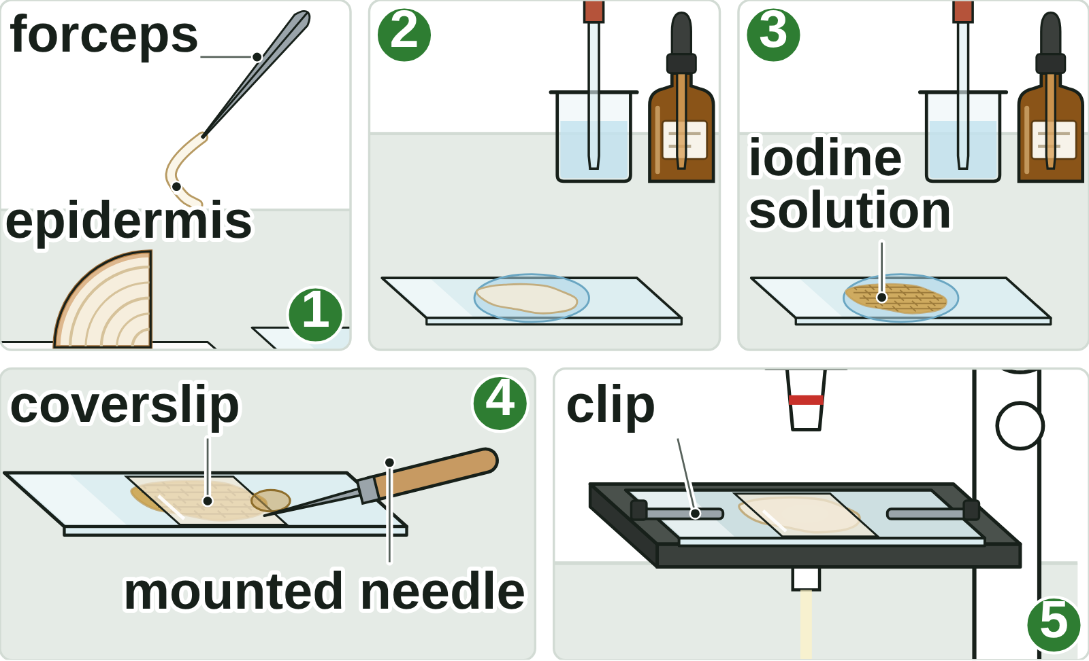
B1 L3 Revision notes 2 of 4
Using a microscope
Required practical 1 (Combined Science and Biology): preparing a slide, focusing and working safely
5. Required practical 1 (Combined Science and Biology)
8. Focusing step by step
Aim: to use a light microscope to observe, draw and label plant and animal cells, with a magnification scale.
Apparatus: a light microscope, microscope slides, coverslips, an onion, forceps, a dropping pipette, water, iodine solution, a mounted needle, a paper towel, eye protection (and, for cheek cells, a clean cotton bud and methylene blue).
This practical is a skill, so it has no independent or dependent variable. To compare magnifications, you could change the objective lens (independent variable) and measure the diameter of the field of view (dependent variable), using the same slide (control variable).
6. Preparing a slide of onion cells
1. Start with the lowest-power objective lens. Its wide field of view makes the cells easy to find.
2. Watching from the side, turn the coarse focusing knob to bring the lens close to the slide, without touching it.
3. Look through the eyepiece lens. Turn the coarse knob to move the lens and the slide apart until the cells appear.
4. Turn the fine focusing knob until the image is sharp.
5. For a higher magnification, turn the nosepiece to a higher-power objective lens and refocus with the fine knob only.
1. Peel a thin layer of epidermis (skin) from the inside of an onion layer, using forceps.
2. Put a drop of water on a clean microscope slide. Lay the epidermis flat in it, with no folds.
3. Add a drop of iodine solution. It is a stain that makes the cells, and parts such as the nucleus, easier to see. It stains the cells yellow-brown.
4. Lower a coverslip at an angle with a mounted needle, so no air bubbles are trapped. The coverslip keeps the specimen flat and stops it drying out.
5. Blot off any extra liquid with a paper towel. Clip the slide onto the stage, with the specimen over the hole.
Watch out: never use the coarse knob at high power: the lens could crack the slide.
Watch out: focusing changes the sharpness, not the size.
9. Safety
Hazard | Risk | Precaution
Iodine solution, methylene blue | irritate the eyes; stain skin and clothes | wear eye protection; use a dropper; wipe up spills
Mounted needle, glass slides and coverslips | cuts | handle with care; tell the teacher about broken glass
Cheek cells | spreading infection | use only your own cheek and a clean cotton bud; used buds into disinfectant
The microscope | dropping it; a mirror pointed at the Sun can damage your eyes | carry it with one hand on the arm and the other under the base; never point a mirror at the Sun
Watch out: a stain makes cells easier to see. It does not make them bigger: only the lenses magnify.
7. Animal cells: cheek cells
Gently wipe the inside of your own cheek with a clean cotton bud. Smear it on a slide, add a drop of methylene blue and lower a coverslip. Methylene blue stains the cells blue and the nucleus dark blue. Put used cotton buds straight into disinfectant. Many schools use a prepared slide of cheek cells instead.
B1 L3 · Using a microscope · sciencegcse.co.uk · free GCSE science resources
Notes:
Revision notes page 2 of 4: Required practical 1 (Combined Science and Biology): the method for onion and cheek cells, focusing step by step, and safety. The traps: start on low power, never use the coarse knob at high power, and a stain does not make cells bigger.

Slide 27
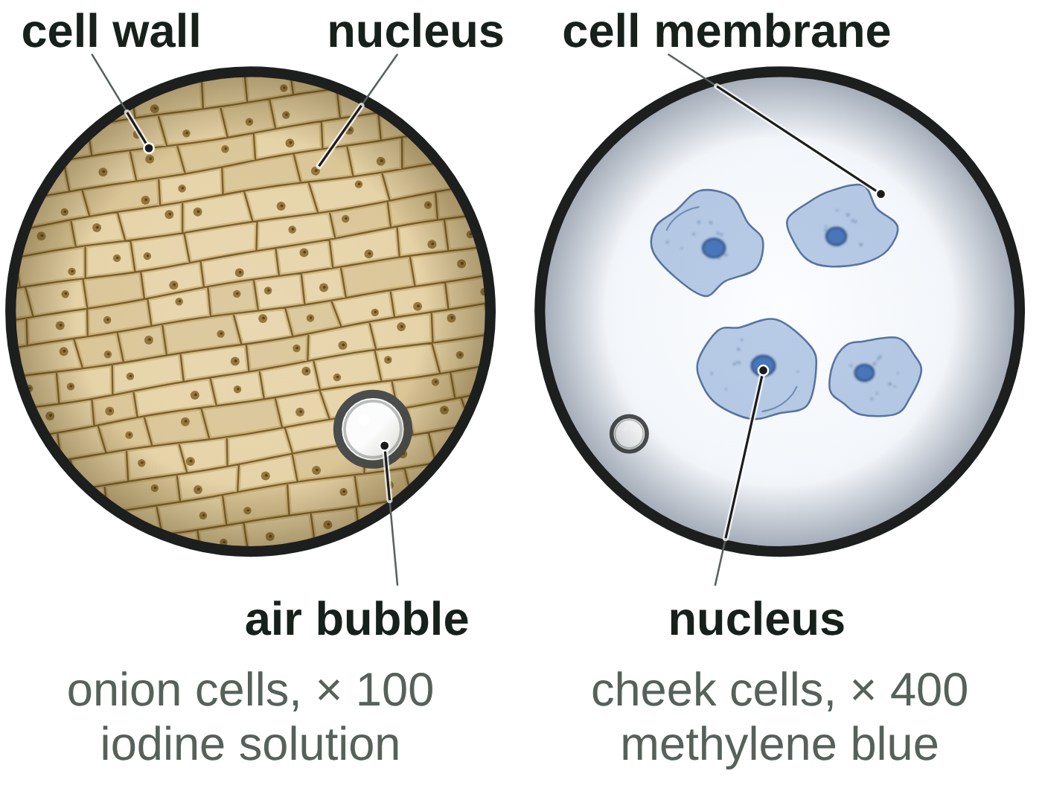
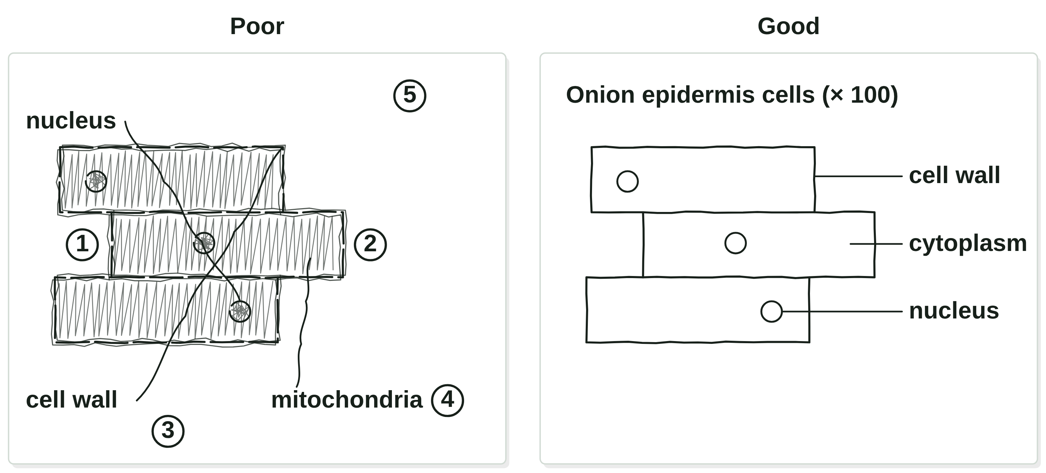
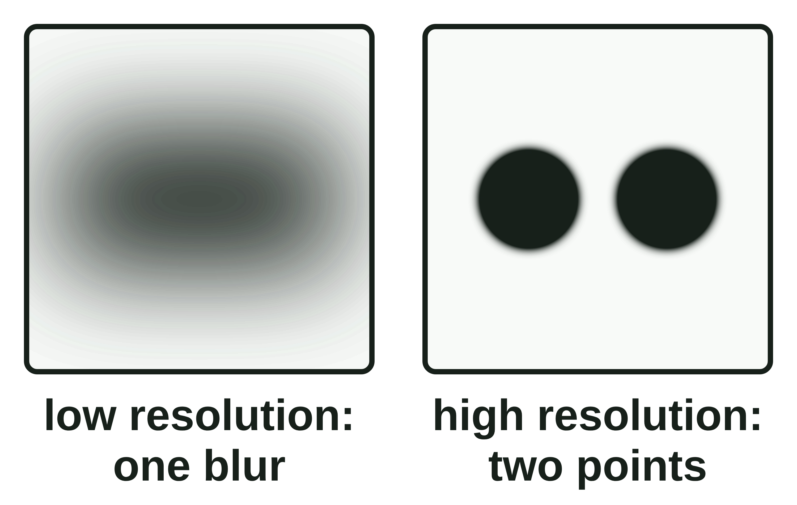
B1 L3 Revision notes 3 of 4
Using a microscope
Results, biological drawings, magnification and resolution, what can go wrong
10. What you see
12. A biological drawing
Onion cells (iodine solution): brick-shaped cells in rows, about 0.2 mm long. You can see the cell wall, the cytoplasm and a nucleus. The cell membrane is pressed against the wall, so you cannot see it on its own. There are no chloroplasts: an onion bulb grows underground.
Cheek cells (methylene blue): flat, uneven cells, about 50 µm across, with a dark blue nucleus, a cell membrane and no cell wall.
You cannot see mitochondria clearly with a school light microscope. Ribosomes are far too small to see at all.
Watch out: an air bubble is round, with a thick dark edge. It is not a cell. Do not draw it.
11. Magnification and resolution
Draw large: two or three cells, not the whole field of view. Keep the sizes of the parts in proportion. The numbers match the mistakes in the poor drawing.
1. Use a sharp pencil and clear, single lines.
2. No shading.
3. Draw label lines with a ruler. Each line touches its part, and no two lines cross.
4. Label only what you can see.
5. Add a title and the magnification (eyepiece × objective, such as “× 100”), or a scale bar.
Magnification: how many times bigger the image is than the real object.
Resolution (resolving power): the ability to see two points that are close together as two separate points.
A light microscope can resolve points about 200 nm (0.2 µm) apart. Points closer than that blur into one, however much you magnify them.
Watch out: draw what you see, not a textbook cell: no mitochondria if you cannot see them.
13. What can go wrong
Watch out: magnifying a blurry image only gives a bigger blur. More detail needs a higher resolution.
Problem | Likely cause | Fix
Dark image, cells on top of each other | the layer is too thick or folded | peel a thinner layer; lay it flat
Everything dark brown | too much iodine solution | add one drop only
Only a bright circle | out of focus, or the specimen is not over the hole | move the slide; refocus on low power
B1 L3 · Using a microscope · sciencegcse.co.uk · free GCSE science resources
Notes:
Revision notes page 3 of 4: what you see, the difference between magnification and resolution, how to draw what you see, and what goes wrong in the practical. Light and electron microscopes, with how microscopy developed, are on page 4 under the answers. B1 L4 Magnification and cell size builds on this.

Slide 28
B1 L3 Revision notes 4 of 4
Using a microscope
Key words, exam tips and check yourself
Key words
Check yourself
Cover the answers, then check.
Coarse focusing knob: the larger knob, which moves the lens and the slide a long way apart or together to find the image.
Coverslip: a very thin square of glass laid over the specimen to keep it flat and stop it drying out.
Electron microscope: a microscope that uses a beam of electrons instead of light, giving a much higher magnification and resolution.
Eyepiece lens: the lens at the top of a microscope that you look through.
Field of view: the circle you can see when you look down a microscope.
Fine focusing knob: the smaller knob, which moves the lens and the slide a tiny distance to make the image sharp.
Light microscope: a microscope that uses light and lenses to make a magnified image.
Magnification: how many times bigger the image is than the real object.
Methylene blue: a blue stain used to make the nuclei of animal cells, such as cheek cells, easier to see.
Objective lens: a lens just above the specimen; a microscope has several, each with a different magnification.
Resolution (resolving power): the ability to see two points that are close together as two separate points.
Specimen: the thing you look at under a microscope.
Stage: the flat platform that holds the microscope slide.
Stain: a dye that colours cells, or parts of cells, so they are easier to see.
Total magnification: the magnification of the eyepiece lens multiplied by the magnification of the objective lens.
1. What two things does a light microscope use to make a magnified image?
2. What is the job of the stage?
3. An eyepiece lens of × 5 is used with an objective lens of × 10. What is the total magnification?
4. Why is iodine solution added to onion cells on a slide?
5. Which focusing knob do you use first, to find the image?
6. On your slide you see a round shape with a thick, dark edge. What is it?
7. What is meant by resolution?
8. Name one structure you can see with an electron microscope but not with a light microscope.
Answers
1. Light and lenses.
2. It holds the microscope slide.
3. × 50 (5 × 10 = 50).
4. To make the cells, and parts such as the nucleus, easier to see. It is a stain.
5. The coarse focusing knob.
6. An air bubble, not a cell.
7. The ability to see two points that are close together as two separate points.
8. Ribosomes (allow the inside of a mitochondrion).
14. Light and electron microscopes
Exam tips
 | Light microscope | Electron microscope
Uses | light | a beam of electrons
Magnification | up to about × 1500 | up to about × 2 000 000
Resolution | about 200 nm | about 0.2 nm
You can see | cells, nuclei, chloroplasts | ribosomes, the inside of mitochondria
Use the exam names: eyepiece lens, objective lens, stage, coarse focusing knob, fine focusing knob.
Total magnification: multiply, never add. Write it as “× 400”. It has no unit.
Focusing: lowest power first; coarse knob, then fine knob; fine knob only at high power.
A stain makes cells easier to see. It does not make them bigger.
Drawings: sharp pencil, single lines, no shading, ruled label lines, a title and the magnification.
Magnification makes the image bigger. Resolution decides how much detail you can see.
An electron microscope has a much higher magnification and resolution, so biologists can see many more sub-cellular structures. 1665: Robert Hooke names cells. 1930s: the first electron microscopes. 1950s: ribosomes are seen for the first time.
B1 L3 · Using a microscope · sciencegcse.co.uk · free GCSE science resources
Notes:
Revision notes page 4 of 4: the key words for B1 L3 in alphabetical order, exam tips, and 8 check-yourself questions with short answers. Students cover the answers box, answer the questions, then check and correct in a different colour. Under the answers, section 14: light and electron microscopes, and how microscopy developed (1665, 1930s, 1950s). B1 L4 Magnification and cell size builds on this.

Slide 29
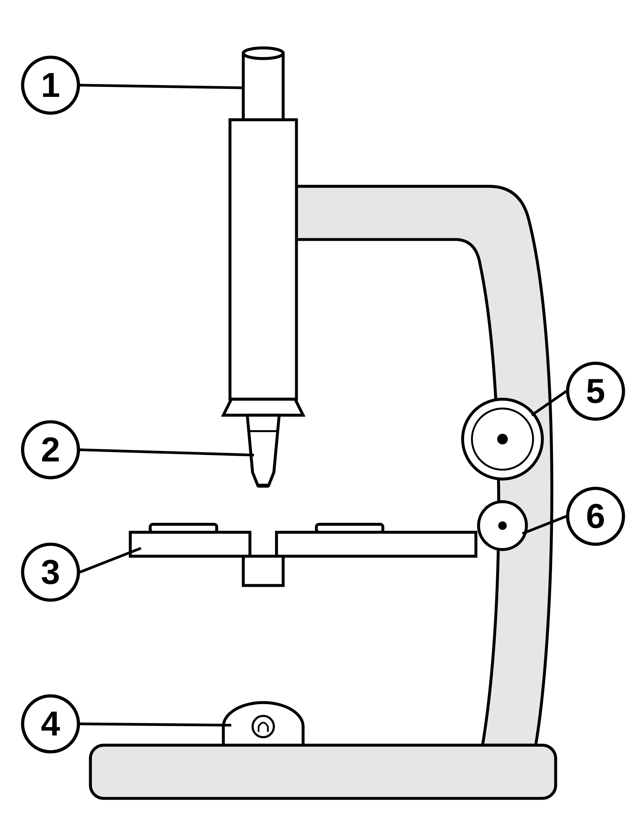
B1 L3 Mandatory worksheet: Using a microscope
Page 1 of 2
Name: ______________________________ Class: __________
A. Label the light microscope
C. Focus the microscope
[6]
[4]
Help: online screens 1 and 3
Help: online screen 7
Name the parts labelled 1 to 6.
Put the steps in order. Step 1 has been done for you. Write the letters in the boxes.
1
P
Turn the fine focusing knob until the image is sharp.
Step 1
Q
2
Q
Clip the slide onto the stage.
Step 2
3
R
Turn the nosepiece to the lowest-power objective lens.
Step 3
S
Watching from the side, turn the coarse focusing knob to bring the lens close to the slide, without touching it.
4
Step 4
5
T
Look through the eyepiece lens and turn the coarse focusing knob until the cells appear.
Step 5
6
D. Preparing a slide
[6]
Help: online screen 6
B. Total magnification
1. Why must the layer of onion epidermis be thin? [1]
[5]
Help: online screen 4
(a) Use the equation to complete the table. The first row is done for you. [4]
total magnification = eyepiece lens magnification × objective lens magnification
2. Which stain is added to the onion cells? [1]
Eyepiece lens | Objective lens | Total magnification
× 10 | × 4 | × 40
× 10 | × 10
× 10 | × 40
× 5 | × 4
× 15 | × 40
(b) Which total magnification in the table gives the smallest field of view? [1]
3. Give one reason for adding a stain. [1]
4. Name the piece of equipment used to lower the coverslip. [1]
5. Explain why the coverslip is lowered slowly, at an angle. [2]
B1 L3 · Using a microscope · sciencegcse.co.uk · free GCSE science resources

Slide 30
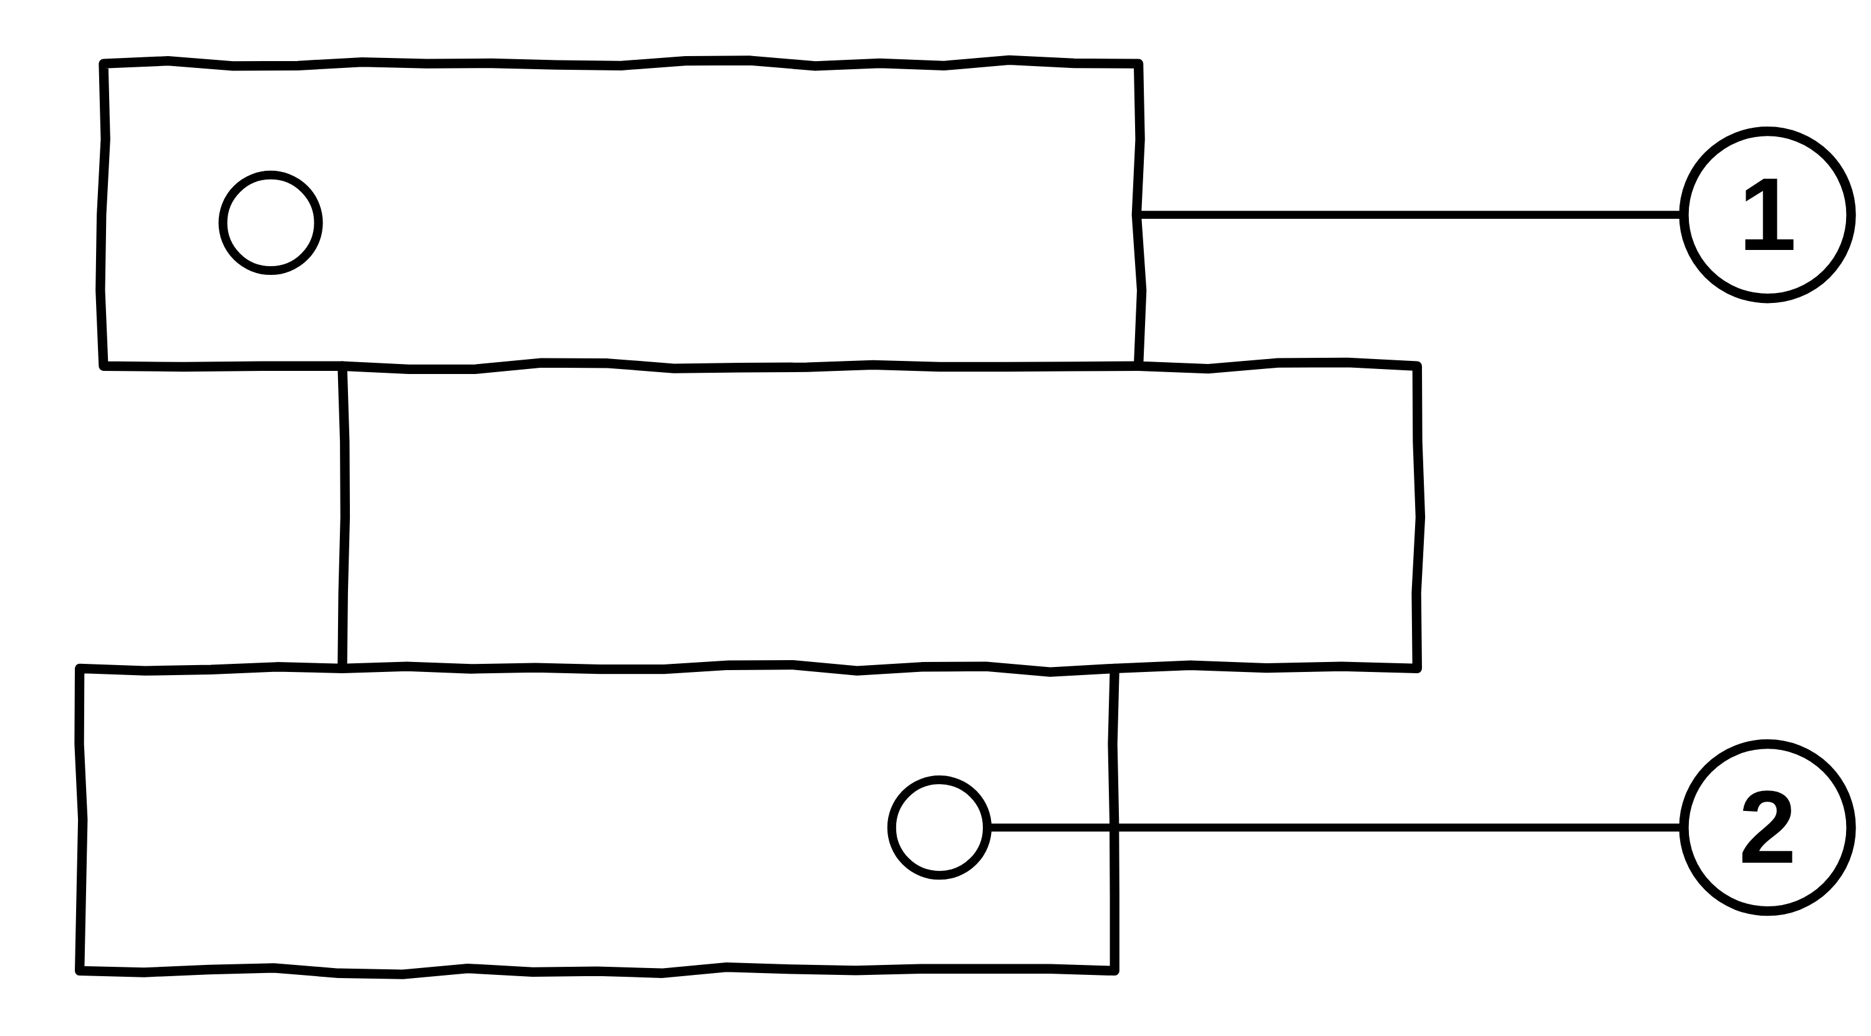
B1 L3 Mandatory worksheet: Using a microscope
Page 2 of 2
Name: ______________________________ Class: __________
E. Light or electron microscope?
F. Drawing what you see
[6]
[6]
Help: online screens 11 and 12
Help: online screens 4, 8 and 10
(a) Tick (✓) one box in each row. [5]
A student drew some onion cells she saw with a light microscope.
Statement | Light microscope | Electron microscope
1. It uses a beam of electrons.
2. It is used in school labs to look at onion cells.
3. It can show ribosomes.
4. It has a magnification of up to about × 1500.
5. It has the higher resolution.
(a) Name the parts labelled 1 and 2. [2]
1
2
(b) Give three rules for making a good biological drawing. [3]
(c) She used a × 10 eyepiece lens and a × 10 objective lens. What magnification should she write under her drawing? [1]
(b) Complete the sentence. [1]
Resolution is the ability to see two points that are close together as ______________________ .
B1 L3 · Using a microscope · sciencegcse.co.uk · free GCSE science resources

Slide 31
B1 L3 Mandatory worksheet answers - page 1
Answers 1 of 2
A. Label the light microscope
C. Focus the microscope
[6]
[4]
Name the parts labelled 1 to 6.
Q, R, S, T, P. 1 mark for each correct letter in boxes 2 to 5 (R, S, T, P). At high power, use the fine focusing knob only: the coarse knob could crack the slide.
1
eyepiece lens (1)
2
objective lens (1)
P
Turn the fine focusing knob until the image is sharp.
Step 1
Q
3
stage (1)
Q
Clip the slide onto the stage.
Step 2
R
4
lamp (1)
R
Turn the nosepiece to the lowest-power objective lens.
5
coarse focusing knob (1)
Step 3
S
6
fine focusing knob (1)
S
Watching from the side, turn the coarse focusing knob to bring the lens close to the slide, without touching it.
Step 4
T
Allow “eyepiece” for 1, “objective” for 2, “light” for 4, “coarse focus” and “fine focus” for 5 and 6. Allow small spelling errors if the word is clear. Do not accept “eye lens”, or “focusing knob” with no coarse or fine.
T
Look through the eyepiece lens and turn the coarse focusing knob until the cells appear.
Step 5
P
D. Preparing a slide
[6]
B. Total magnification
1.
So that light can pass through it (1). Allow: so you see a single layer of cells. Do not accept “so it fits on the slide”.
[5]
(a) Use the equation to complete the table. The first row is done for you. [4]
total magnification = eyepiece lens magnification × objective lens magnification
2.
Iodine solution (1). Allow iodine. Do not accept methylene blue (that is for cheek cells).
Eyepiece lens | Objective lens | Total magnification
× 10 | × 4 | × 40
× 10 | × 10 | × 100 (1)
× 10 | × 40 | × 400 (1)
× 5 | × 4 | × 20 (1)
× 15 | × 40 | × 600 (1)
(b) Which total magnification in the table gives the smallest field of view? [1]
3.
To make the cells, and parts such as the nucleus, easier to see (1). Do not accept “to make the cells bigger”.
4.
A mounted needle (1). Allow needle. Do not accept forceps.
5.
It pushes the air out (1), so no air bubbles are trapped (1). Allow “air bubbles could be mistaken for cells / hide the cells” for the second mark.
Model answer: Lowering the coverslip at an angle pushes the air out from under it, so no air bubbles are trapped.
× 600 (1)
Allow the numbers without the × sign. Do not accept a total made by adding (row 2: × 20; row 3: × 50; row 4: × 9; row 5: × 55).
B1 L3 · Using a microscope · sciencegcse.co.uk · free GCSE science resources

Slide 32
B1 L3 Mandatory worksheet answers - page 2
Answers 2 of 2
E. Light or electron microscope?
F. Drawing what you see
[6]
[6]
(a) Tick (✓) one box in each row. [5]
A student drew some onion cells she saw with a light microscope.
Statement | Light microscope | Electron microscope
1. It uses a beam of electrons. |  | ✓
2. It is used in school labs to look at onion cells. | ✓
3. It can show ribosomes. |  | ✓
4. It has a magnification of up to about × 1500. | ✓
5. It has the higher resolution. |  | ✓
(a)
1 cell wall (1)
2 nucleus (1)
Do not accept “cell membrane” for 1.
(b)
Any three (1 each): use a sharp pencil; clear, single lines; no shading; draw it large / in proportion; label lines drawn with a ruler; label lines do not cross / touch the part; label only what you can see; add a title; add the magnification or a scale bar.
(c)
× 100 (1). Allow 100.
Model answer
(b) Use a sharp pencil and clear, single lines. Do not shade. Draw label lines with a ruler, and do not let them cross.
1 mark for each row. If both boxes in a row are ticked, no mark for that row.
(b) Complete the sentence. [1]
Resolution is the ability to see two points that are close together as two separate points. (1)
Do not accept “how big it is” (that is magnification).
Electron micrographs are black and white. Any colour is added.
B1 L3 · Using a microscope · sciencegcse.co.uk · free GCSE science resources

Slide 33
B1 L3 Challenge worksheet: Using a microscope
Page 1 of 2
Name: ______________________________ Class: __________
A. Changing the objective lens
B. Seeing small things
[6]
[6]
Help: online screens 4 and 8
Help: online screens 11 and 12
A student used a × 10 eyepiece lens. She looked at the same onion slide with three objective lenses. Each time she measured the diameter of the field of view. Table 1 shows her results.
Table 2 gives the resolution of two microscopes and the sizes of three sub-cellular structures. 1 µm = 1000 nm.
Table 2
Microscope or structure | Resolution or size
light microscope | 0.2 µm
electron microscope | 0.2 nm
nucleus | about 6 µm across
mitochondrion | about 1 µm long
ribosome | about 25 nm across
Table 1
Objective lens | Total magnification | Field of view (mm)
× 4 |  | 4.0
× 10 | × 100 | 1.6
× 40 |  | 0.4
(a) Convert the resolution of the light microscope into nanometres (nm). [1]
nm
(b) The resolution of the electron microscope is 0.2 nm. How many times smaller is this than the resolution of the light microscope? Use your answer to (a). Show your working. [2]
(a) Complete Table 1. [2]
(b) Name the independent variable and the dependent variable in her investigation. [2]
times
Independent:
(c) Use Table 2 to explain why ribosomes can be seen with an electron microscope but not with a light microscope. [2]
Dependent:
(c) Describe the pattern in her results. [1]
(d) Can a light microscope show a nucleus? Use Table 2 to give a reason. [1]
(d) Give one variable she kept the same. [1]
B1 L3 · Using a microscope · sciencegcse.co.uk · free GCSE science resources

Slide 34
B1 L3 Challenge worksheet: Using a microscope
Page 2 of 2
Name: ______________________________ Class: __________
C. Looking at a pondweed leaf
D. Extended response
[4]
[6]
Help: online screens 1, 6 and 12
Help: online screens 6, 7 and 8
A student puts a pondweed leaf in a drop of water on a slide. She adds a coverslip but no stain. The leaf is only two cells thick. She sees green chloroplasts moving round the edges of brick-shaped cells.
A student looked at a slide of onion cells. He wrote: ‘The image was dark. In some places the cells were on top of each other. I could see lots of round shapes with thick black edges. When I turned to the × 40 objective lens and turned the big knob, I heard a crack.’
(a) Suggest why she does not need to add a stain. [1]
Explain what the student did wrong, and how he should improve his method. [6]
(b) Explain why the leaf can be looked at without peeling a thinner layer. [1]
(c) She wants to see the inside of a chloroplast. Suggest what she should use, and explain why. [2]
B1 L3 · Using a microscope · sciencegcse.co.uk · free GCSE science resources

Slide 35
B1 L3 Challenge worksheet answers - page 1
Answers 1 of 2
A. Changing the objective lens
B. Seeing small things
[6]
[6]
A student used a × 10 eyepiece lens. She looked at the same onion slide with three objective lenses. Each time she measured the diameter of the field of view. Table 1 shows her results.
Table 2 gives the resolution of two microscopes and the sizes of three sub-cellular structures. 1 µm = 1000 nm.
Table 2
Microscope or structure | Resolution or size
light microscope | 0.2 µm
electron microscope | 0.2 nm
nucleus | about 6 µm across
mitochondrion | about 1 µm long
ribosome | about 25 nm across
Table 1
Objective lens | Total magnification | Field of view (mm)
× 4 | × 40 (1) | 4.0
× 10 | × 100 | 1.6
× 40 | × 400 (1) | 0.4
(a)
200 (nm) (1)
(b)
200 ÷ 0.2 (1) = 1000 (times) (1)
Correct answer with no working scores 2. Allow ECF from (a).
(a)
× 40 (1); × 400 (1)
(c)
A ribosome (25 nm) is smaller than the resolution of the light microscope (200 nm / 0.2 µm) (1); but bigger than the resolution of the electron microscope (0.2 nm) (1).
Do not accept “the electron microscope magnifies more” on its own: the question is about resolution.
(b)
Independent: the objective lens / the (total) magnification (1).
Dependent: the (diameter of the) field of view (1).
Allow “the number of cells across the field of view” for the dependent variable.
(c)
The higher the magnification, the smaller the field of view (1). Allow “as the magnification goes up, the field of view goes down”.
(d)
Yes, because the nucleus (6 µm) is much bigger than 0.2 µm (1). “Yes” alone scores 0.
(d)
Any one (1): the same slide; the same eyepiece lens; the same microscope. Do not accept “the same objective lens” (that is the independent variable).
Model answer
Model answer
(c) A ribosome is about 25 nm across. That is smaller than 200 nm, the resolution of a light microscope, so it cannot be seen. It is bigger than 0.2 nm, the resolution of an electron microscope, so an electron microscope can show it.
(c) As the total magnification goes up, the field of view gets smaller: from 4.0 mm at × 40 to 0.4 mm at × 400.
B1 L4 Magnification and cell size uses the field of view to estimate the size of a cell.
B1 L3 · Using a microscope · sciencegcse.co.uk · free GCSE science resources

Slide 36
B1 L3 Challenge worksheet answers - page 2
Answers 2 of 2
C. Looking at a pondweed leaf
D. Extended response
[4]
[6]
A student puts a pondweed leaf in a drop of water on a slide. She adds a coverslip but no stain. The leaf is only two cells thick. She sees green chloroplasts moving round the edges of brick-shaped cells.
Level 3 (5–6 marks): A clear explanation of at least three of the problems, each linked to its cause and to a correct improvement, in a logical order.
Level 2 (3–4 marks): At least two problems linked to a cause or to an improvement, with some explanation.
Level 1 (1–2 marks): Simple statements, such as “use a thin piece” or “do not use the big knob”, with no link to the problem.
0 marks: No relevant content.
Indicative content
dark image and cells on top of each other: the onion layer was too thick or folded, so light could not pass through
peel a thin layer of epidermis and lay it flat in the water
round shapes with thick black edges: air bubbles; the coverslip was dropped flat
lower it slowly at an angle with a mounted needle
the crack: he used the coarse focusing knob at high power and the lens hit the slide
at high power use the fine focusing knob only
start on the lowest-power objective lens
watch from the side while bringing the lens close to the slide, and only move the lens and slide apart while looking through the eyepiece
dark image: check the lamp is on and the specimen is over the hole
do not use too much iodine solution
Model answer: The cells were on top of each other and the image was dark because the onion layer was too thick, or folded, so not enough light passed through it. He should peel a thin layer of epidermis and lay it flat in the drop of water. The round shapes with thick black edges were air bubbles, because the coverslip was dropped flat. He should lower it slowly at an angle with a mounted needle, so the air is pushed out. The crack happened because he used the coarse focusing knob at high power, so the lens hit the slide. At high power he should use only the fine focusing knob, and always start on the lowest-power objective lens.
(a)
The chloroplasts are green / the cells already have colour, so they can be seen (1).
(b)
It is thin enough for light to pass through (1).
Allow: it is only two cells thick, so light gets through.
(c)
An electron microscope (1); it has a much higher resolution, so it shows finer detail (1).
Allow “higher magnification and resolution” for the second mark; do not accept “higher magnification” on its own.
Model answer
(c) She should use an electron microscope. It has a much higher resolution, so it can show the detail inside a chloroplast.
B1 L3 · Using a microscope · sciencegcse.co.uk · free GCSE science resources

Slide 37
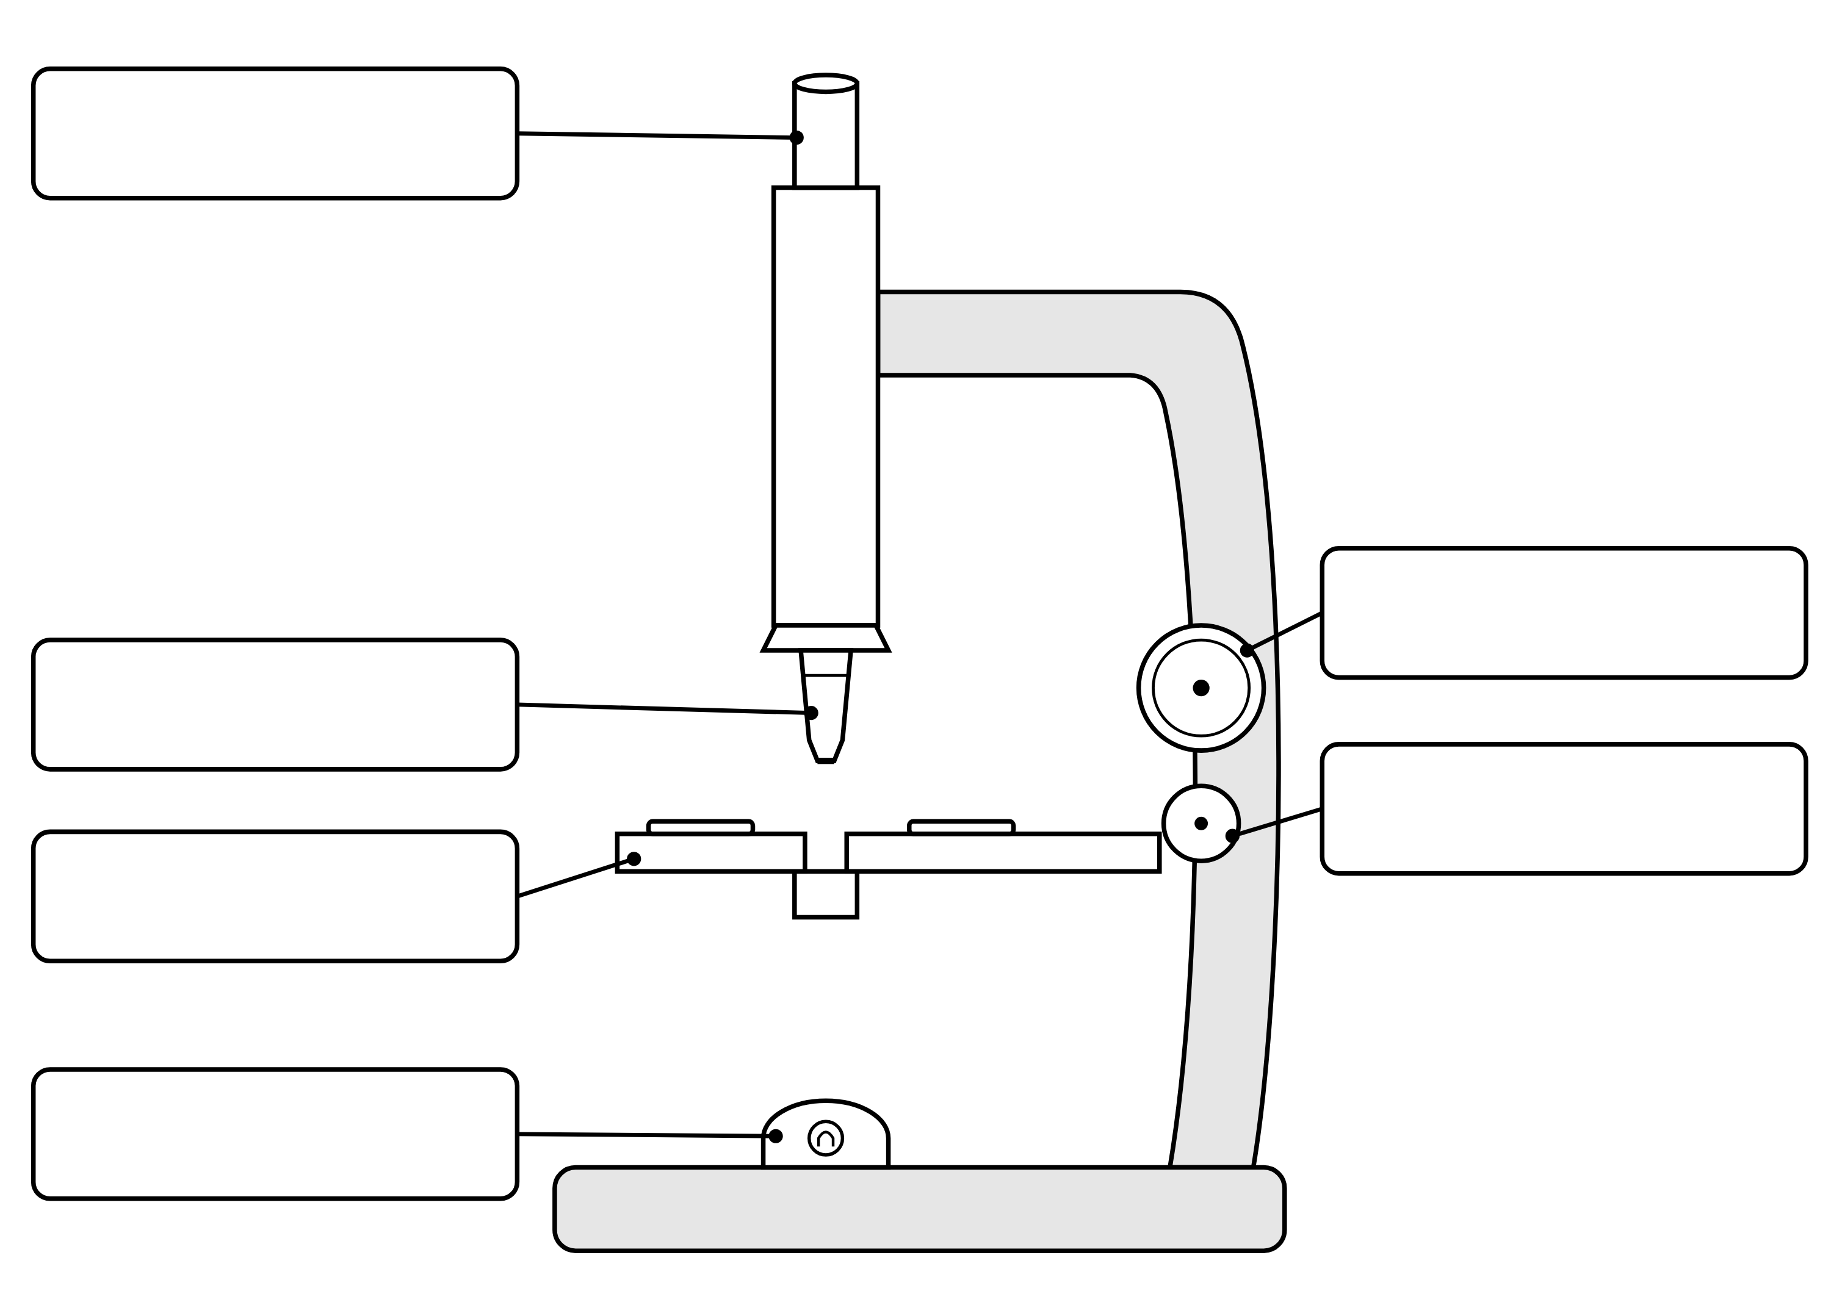
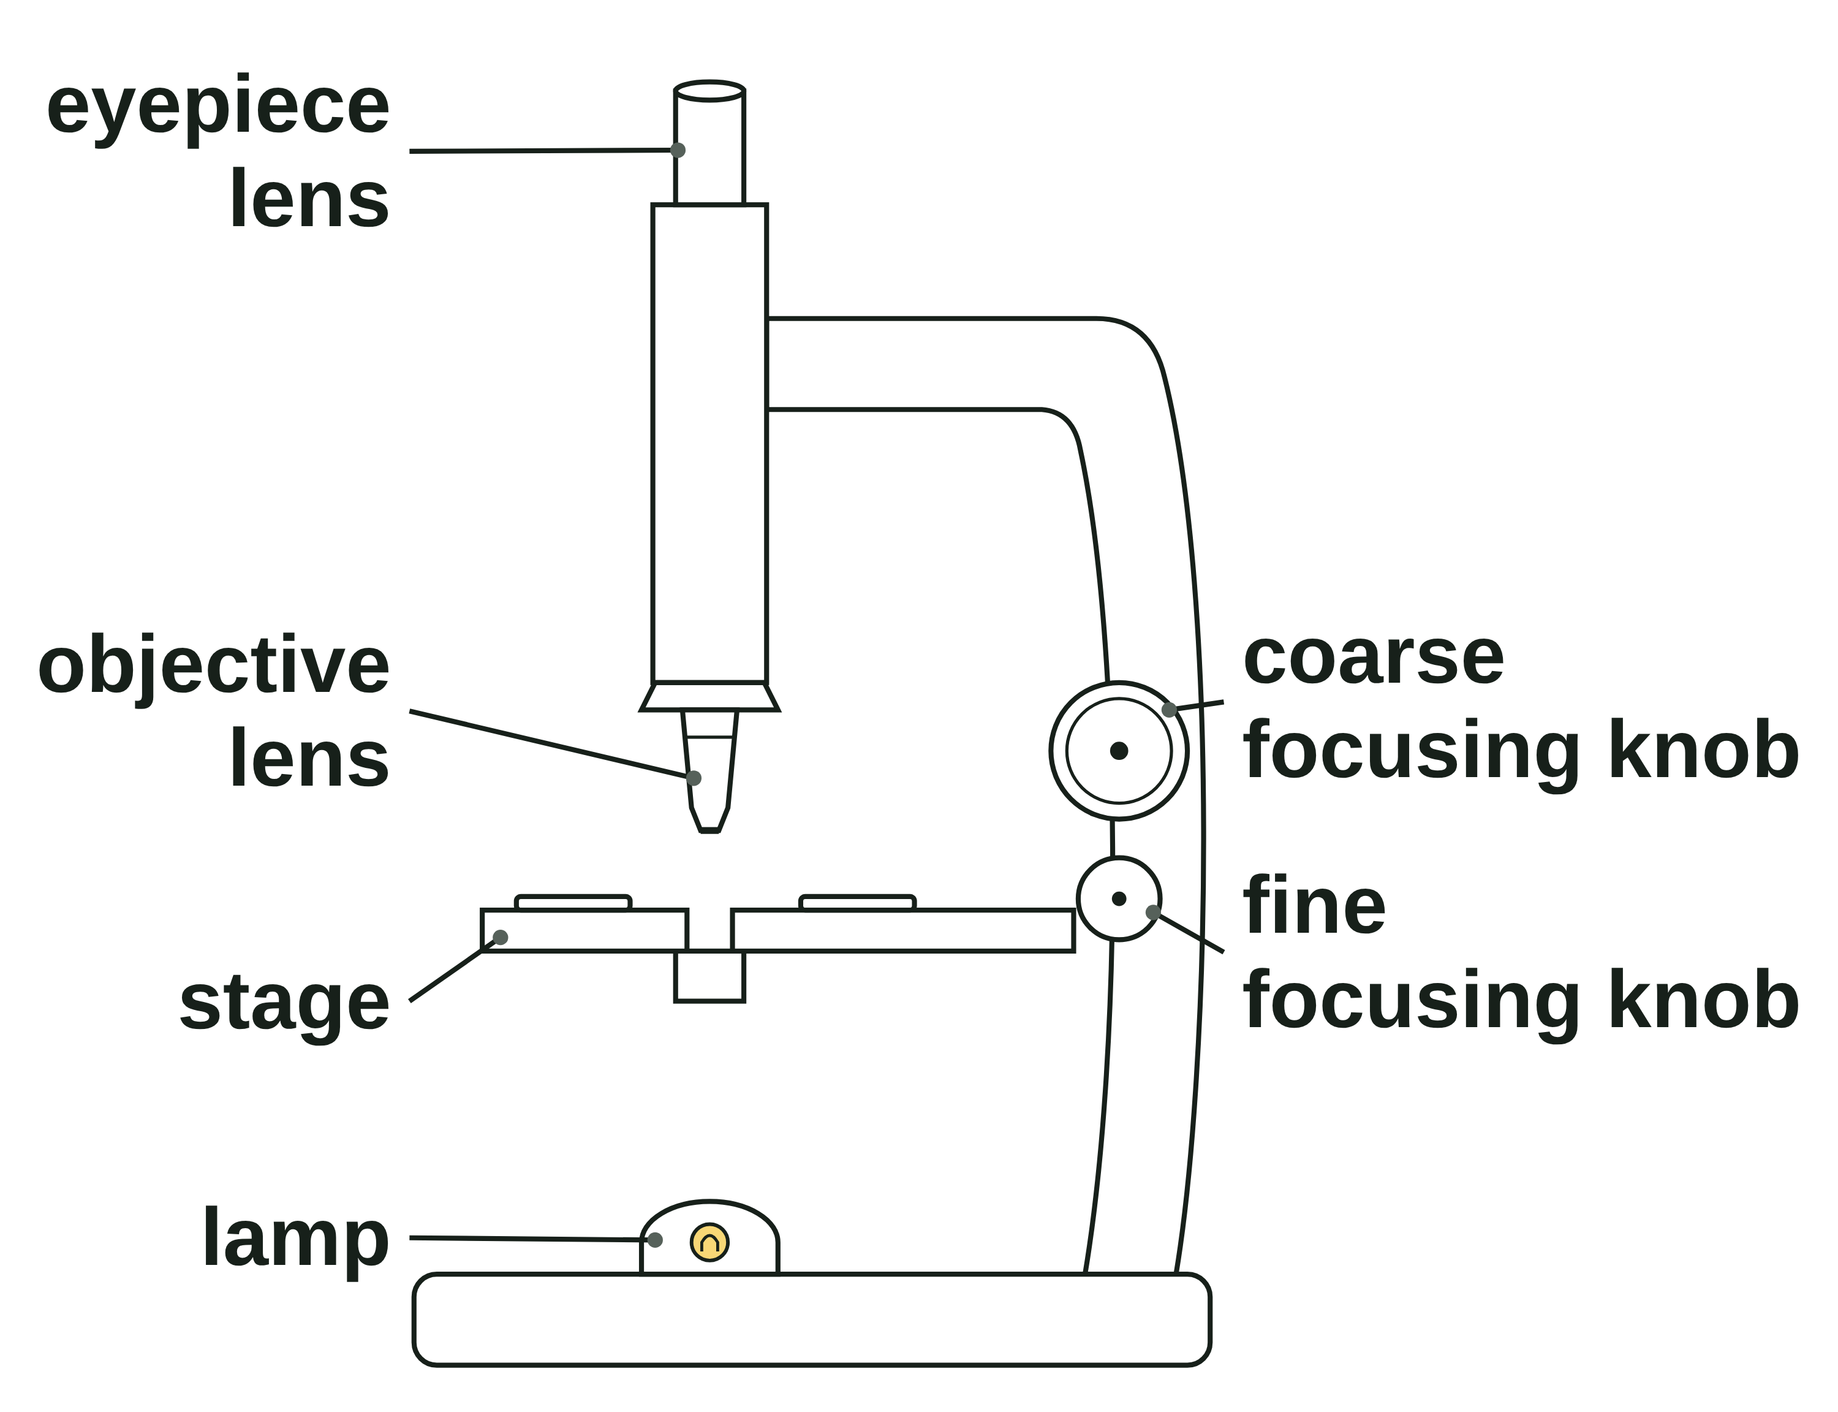
B1 L3 Alternative worksheet: Using a microscope
Page 1 of 2
Name: ______________________________ Class: __________
Key facts
A. Label the microscope
[6]
Help: online screens 1 and 3
A light microscope uses light and lenses to make things look bigger.
You look through the eyepiece lens. The objective lens is just above the slide.
The stage holds the slide. The lamp shines light up through it.
Total magnification = eyepiece × objective. × 10 and × 40 make × 400.
To make a slide: a thin layer of onion, a drop of iodine solution (a stain), then a coverslip.
Start on low power. Find the cells with the coarse focusing knob. Make them sharp with the fine focusing knob.
Draw with a sharp pencil. Do not shade.
An electron microscope shows much more detail than a light microscope.
Write a word from the box in each label box.
eyepiece lens
objective lens
stage
lamp
coarse focusing knob
fine focusing knob
Look through the eyepiece lens. The lamp shines light up through the slide.
B1 L3 · Using a microscope · sciencegcse.co.uk · free GCSE science resources

Slide 38
B1 L3 Alternative worksheet: Using a microscope
Page 2 of 2
Name: ______________________________ Class: __________
B. Match the part to its job
D. True or false?
[4]
[6]
Help: online screen 3
Help: online screens 6, 7, 8, 10 and 12
Draw a line from each part to its job.
Write true or false after each sentence.
Eyepiece lens
makes the image sharp
1. Focusing makes the cells look bigger.
2. A stain makes the cells easier to see.
Stage
shines light up through the slide
3. An air bubble is a kind of cell.
4. You should shade your drawing.
Lamp
you look through it
5. An electron microscope shows more detail than a light microscope.
Fine focusing knob
holds the slide
6. Robert Hooke named cells in 1665.
C. Fill the gaps
E. Multiply the numbers
[6]
[4]
Help: online screens 6, 7 and 10
Help: online screen 4
Use the words in the box. Use each word once.
Total magnification = eyepiece × objective. Fill in the totals.
thin
iodine
coverslip
lowest
fine
pencil
Eyepiece | Objective | Total
× 10 | × 4
× 10 | × 10
× 10 | × 40
1. The layer of onion must be __________ so that light can pass through it.
2. Add a drop of __________ solution to stain the cells.
3. Lower the __________ slowly, at an angle.
4. Start with the __________ -power objective lens.
5. Make the image sharp with the __________ focusing knob.
Which total makes the cells look biggest? [1]
6. Draw what you see with a sharp __________ .
B1 L3 · Using a microscope · sciencegcse.co.uk · free GCSE science resources

Slide 39
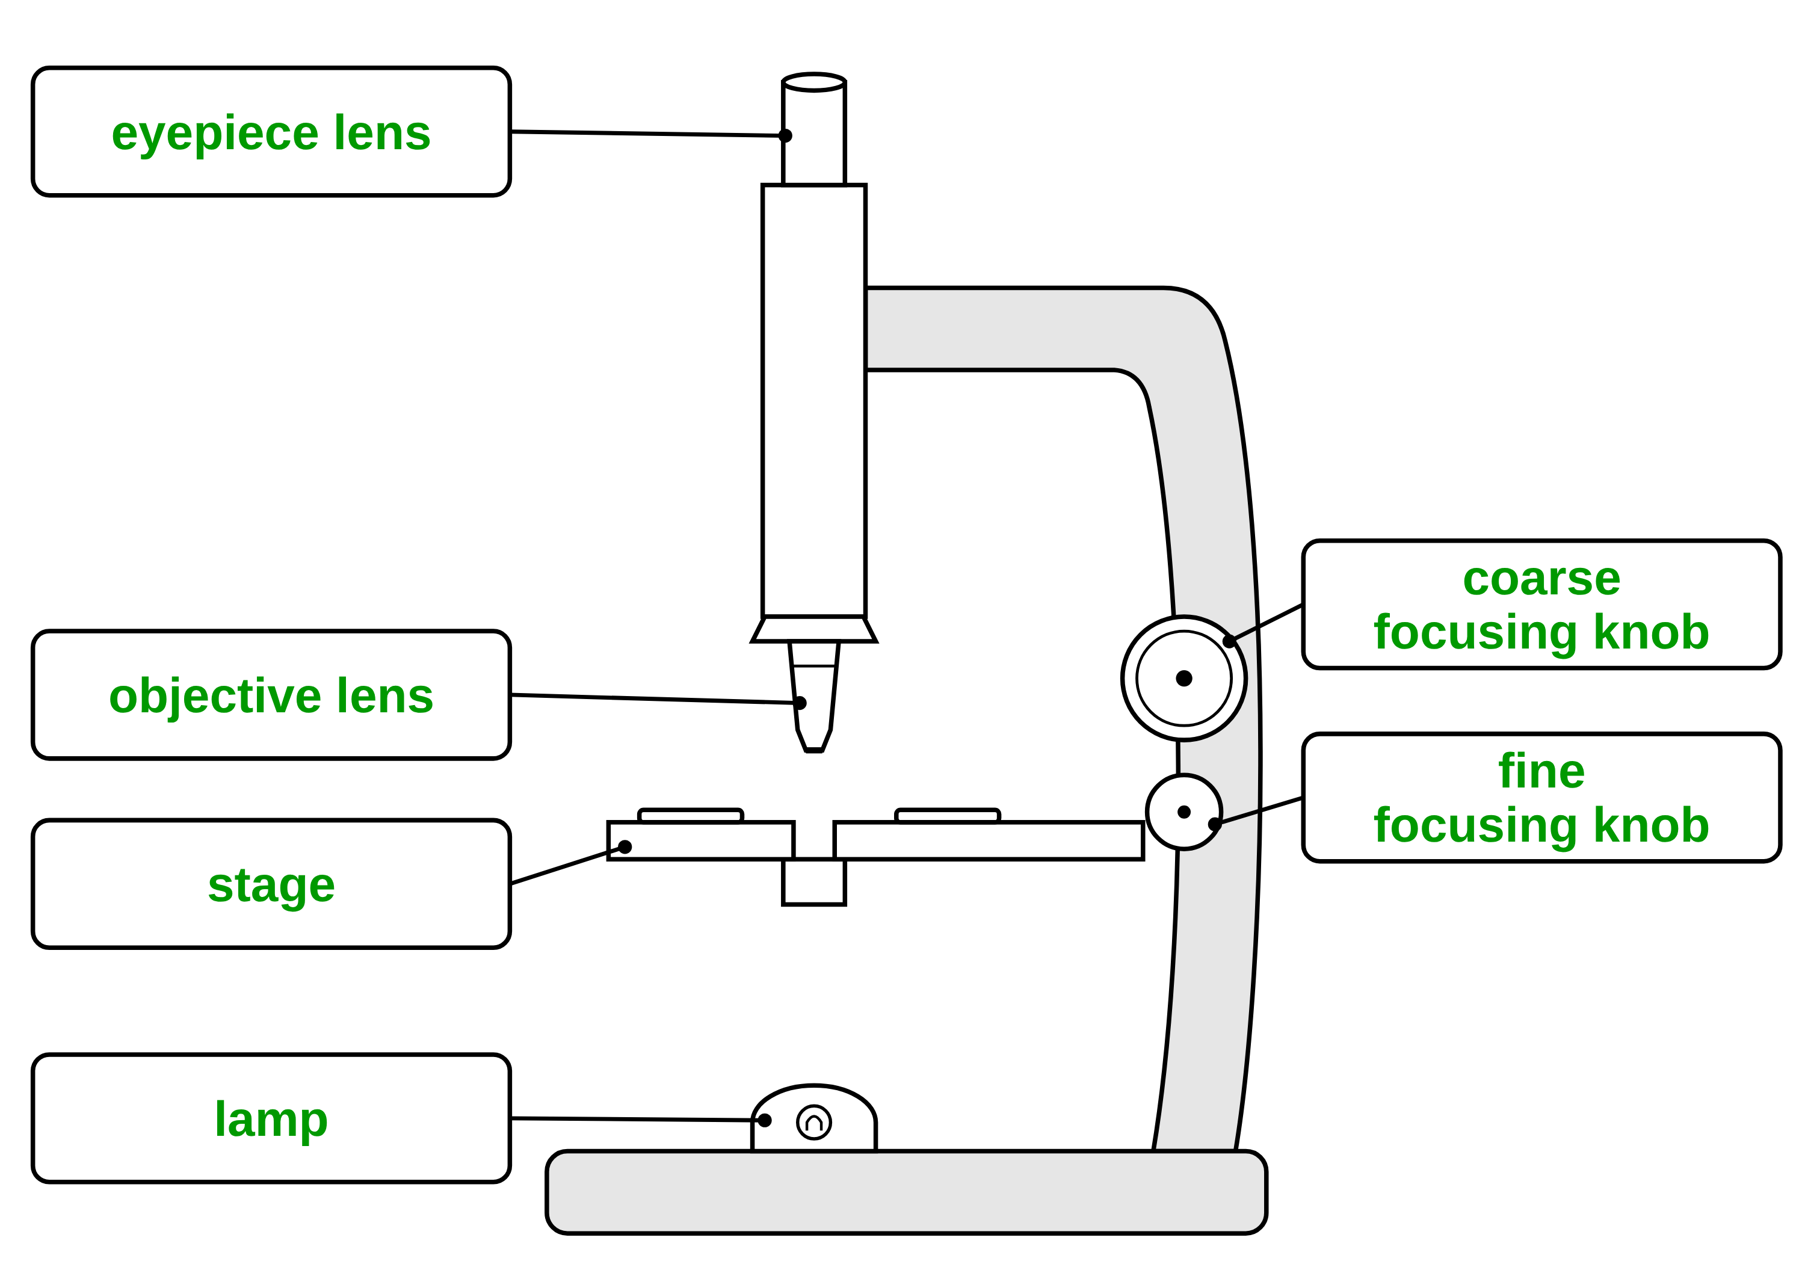
B1 L3 Alternative worksheet answers - page 1
Answers 1 of 2
Key facts
A. Label the microscope
[6]
A light microscope uses light and lenses to make things look bigger.
You look through the eyepiece lens. The objective lens is just above the slide.
The stage holds the slide. The lamp shines light up through it.
Total magnification = eyepiece × objective. × 10 and × 40 make × 400.
To make a slide: a thin layer of onion, a drop of iodine solution (a stain), then a coverslip.
Start on low power. Find the cells with the coarse focusing knob. Make them sharp with the fine focusing knob.
Draw with a sharp pencil. Do not shade.
An electron microscope shows much more detail than a light microscope.
Write a word from the box in each label box.
eyepiece lens
objective lens
stage
lamp
coarse focusing knob
fine focusing knob
1 mark for each box (the words are in the boxes above).
Allow small spelling errors if the word is clear.
Look through the eyepiece lens. The lamp shines light up through the slide.
B1 L3 · Using a microscope · sciencegcse.co.uk · free GCSE science resources

Slide 40
B1 L3 Alternative worksheet answers - page 2
Answers 2 of 2
B. Match the part to its job
D. True or false?
[4]
[6]
Draw a line from each part to its job.
Write true or false after each sentence.
1 mark for each correct line.
Eyepiece lens
makes the image sharp
1. Focusing makes the cells look bigger. False: focusing makes the cells sharper, not bigger. (1)
2. A stain makes the cells easier to see. True. (1)
3. An air bubble is a kind of cell. False: an air bubble is not a cell. (1)
4. You should shade your drawing. False: never shade. (1)
5. An electron microscope shows more detail than a light microscope. True. (1)
6. Robert Hooke named cells in 1665. True. (1)
Stage
shines light up through the slide
Lamp
you look through it
Fine focusing knob
holds the slide
C. Fill the gaps
E. Multiply the numbers
[6]
[4]
Use the words in the box. Use each word once.
Total magnification = eyepiece × objective. Fill in the totals.
thin
iodine
coverslip
lowest
fine
pencil
Eyepiece | Objective | Total
× 10 | × 4 | × 40 (1)
× 10 | × 10 | × 100 (1)
× 10 | × 40 | × 400 (1)
1. The layer of onion must be thin so that light can pass through it. (1)
2. Add a drop of iodine solution to stain the cells. (1)
3. Lower the coverslip slowly, at an angle. (1)
4. Start with the lowest-power objective lens. (1)
5. Make the image sharp with the fine focusing knob. (1)
Which total makes the cells look biggest? [1]
× 400 (1)
Allow the numbers without the × sign.
6. Draw what you see with a sharp pencil. (1)
B1 L3 · Using a microscope · sciencegcse.co.uk · free GCSE science resources

Slide 41
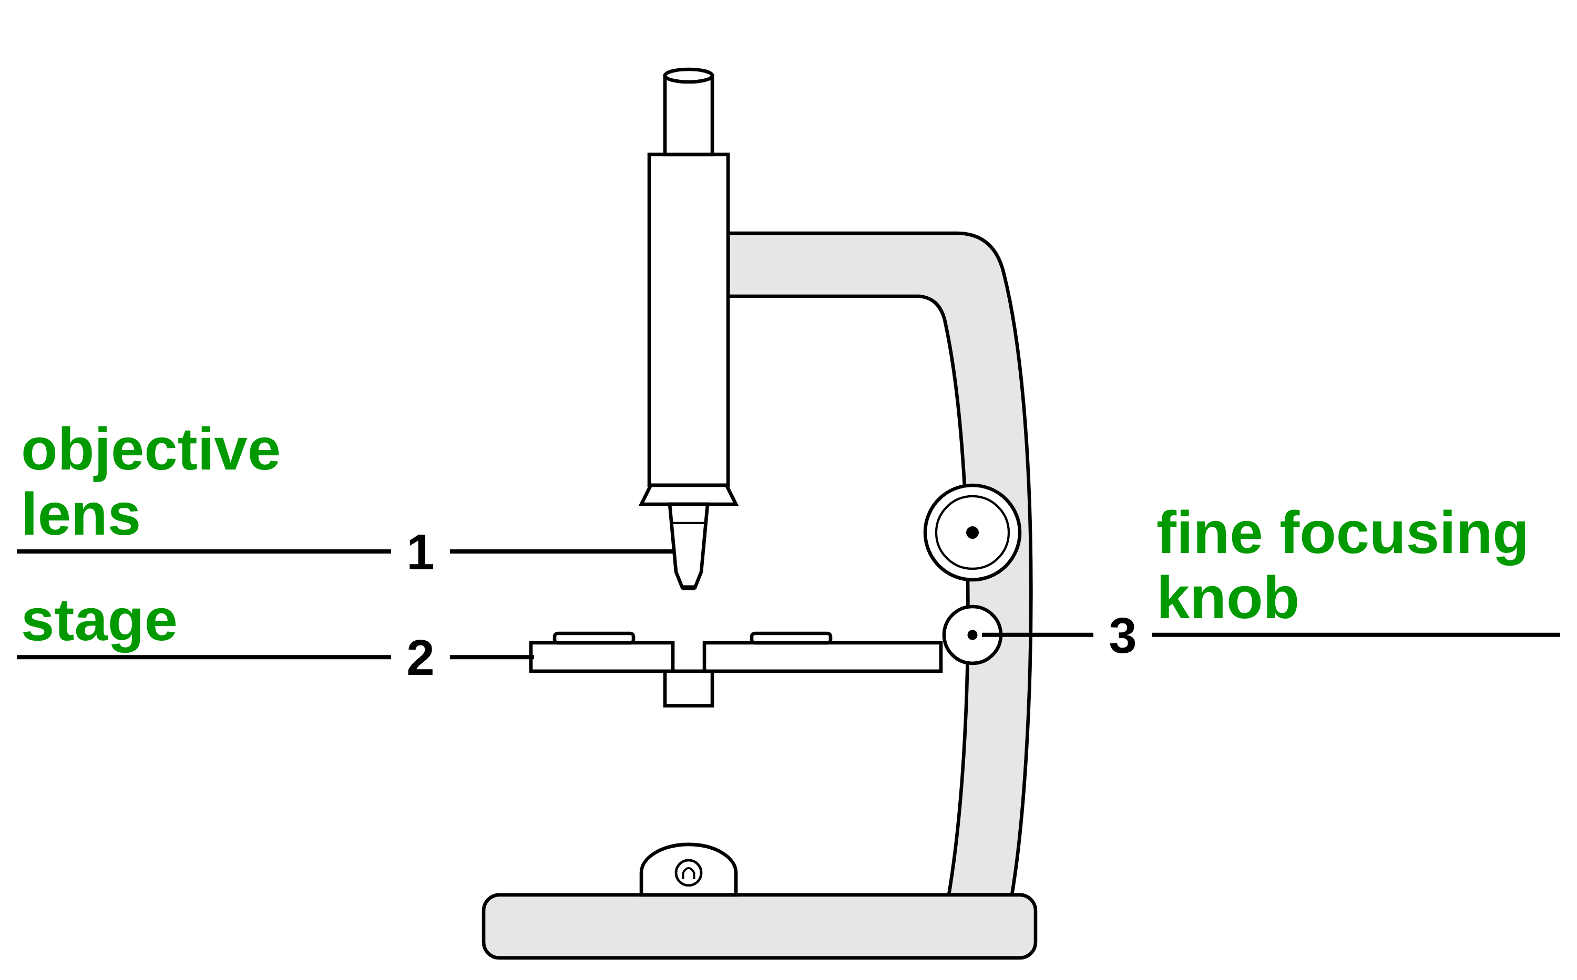
B1 L3 Exam questions worksheet mark scheme - page 1
Answers 1 of 2
01 A light microscope
03 A student's drawing
[5]
[3]
01.1 Complete Figure 1. [3]
1 objective lens (1)
2 stage (1)
3 fine focusing knob (1)
1 mark for each correct label. If more than one word from the box is written on one line, do not give that mark.
01.2 Calculate the total magnification. [2]
15 × 10 (1)
= (×) 150 (1)
Correct answer with no working = 2 marks. allow 150 without the × sign. do not accept 25 (the magnifications added): 0 marks. ignore a unit.
03.1 Give two ways the student could improve the drawing. [2]
any two from: do not shade (1); clear, single lines (1); label lines drawn with a ruler (1); label lines do not cross (1); add a title (1); add the magnification / a scale bar (1)
Max 2. ignore “remove the cell wall label” (tested in 03.2); “draw it bigger”.
03.2 Give one reason why the cell wall label is wrong. [1]
cheek cells are animal cells, which do not have a cell wall / the outline is the cell membrane (1)
allow “animal cells have no cell wall”. allow “only plant (and algal) cells have a cell wall”. do not accept “you cannot see the cell wall” on its own.
02 Preparing a slide
04 Light and electron microscopes
[3]
[3]
02.1 Write the letters P, Q, R and S in the correct order. [2]
P, R, S, Q (2)
All four in the correct order = 2 marks. At least two letters in the correct place = 1 mark.
02.2 Give one safety precaution when using iodine solution. [1]
wear eye protection / safety glasses / goggles (1)
allow wear gloves (it stains skin); wash splashes off (the skin) with (plenty of) water. ignore “be careful”; lab coat.
04.1 Which structure can be seen with an electron microscope but not with a light microscope? [1]
Ribosome (1)
If more than one box is ticked, give 0 marks.
04.2 Explain how electron microscopes have helped biologists. Use Table 1. [2]
(much) higher resolution / resolving power (1)
so sub-cellular structures can be seen / cells studied in finer detail (1)
allow “higher magnification and resolution” for the first mark; “higher magnification” alone does not score the first mark. allow a named example for the second mark, such as ribosomes / the inside of a mitochondrion. allow use of data, such as 0.2 nm compared with 200 nm, for the first mark.
B1 L3 · Using a microscope · sciencegcse.co.uk · free GCSE science resources

Slide 42
B1 L3 Exam questions worksheet mark scheme - page 2
Answers 2 of 2
05 Extended response
[6]
05 A student has a prepared slide of onion cells. Describe how the student should use a light microscope to see the cells clearly at high power, and then make a labelled drawing of what they see. [6]
Level descriptors
Level 3 (5–6 marks): A detailed, logical description of how to focus at low power then at high power, in a sensible order (lowest-power objective first; coarse focusing knob, then fine; fine knob only at high power) and of a good drawing, including at least two drawing rules and the magnification or a scale bar.
Level 2 (3–4 marks): A description with some detail of focusing and of drawing. The order may not be fully clear, or the drawing is described with only one rule.
Level 1 (1–2 marks): Simple statements, for example “focus it” or “draw the cells”, with little detail.
0 marks: No relevant content.
Model answer (Level 3)
Clip the slide onto the stage with the cells over the hole, and switch on the lamp. Start with the lowest-power objective lens. Watching from the side, turn the coarse focusing knob to bring the lens close to the slide without touching it. Then look through the eyepiece lens and turn the coarse knob to move the lens and the slide apart until the cells appear. Make the image sharp with the fine focusing knob. Turn the nosepiece to a higher-power objective lens and refocus using only the fine focusing knob. Draw the cells with a sharp pencil, using clear, single lines and no shading. Label the cell wall, the cytoplasm and the nucleus with ruled lines that do not cross. Add a title and the magnification, such as × 400.
Indicative content
clip the slide onto the stage, with the specimen over the hole; switch on the lamp
start with the lowest-power objective lens
watch from the side and turn the coarse focusing knob to bring the lens close to the slide (without touching it)
look through the eyepiece lens and turn the coarse focusing knob to move the lens and the slide apart until the cells appear
turn the fine focusing knob until the image is sharp
turn the nosepiece to a higher-power objective lens
refocus with the fine focusing knob only (the coarse knob could crack the slide)
draw with a sharp pencil, using clear, single lines and no shading
draw label lines with a ruler; they do not cross
label only what can be seen, such as the cell wall, the cytoplasm and the nucleus
add a title and the magnification (eyepiece × objective, such as × 400) or a scale bar
do not accept “use the coarse focusing knob at high power” (that point scores nothing; others still score).
B1 L3 · Using a microscope · sciencegcse.co.uk · free GCSE science resources

