Slide 1
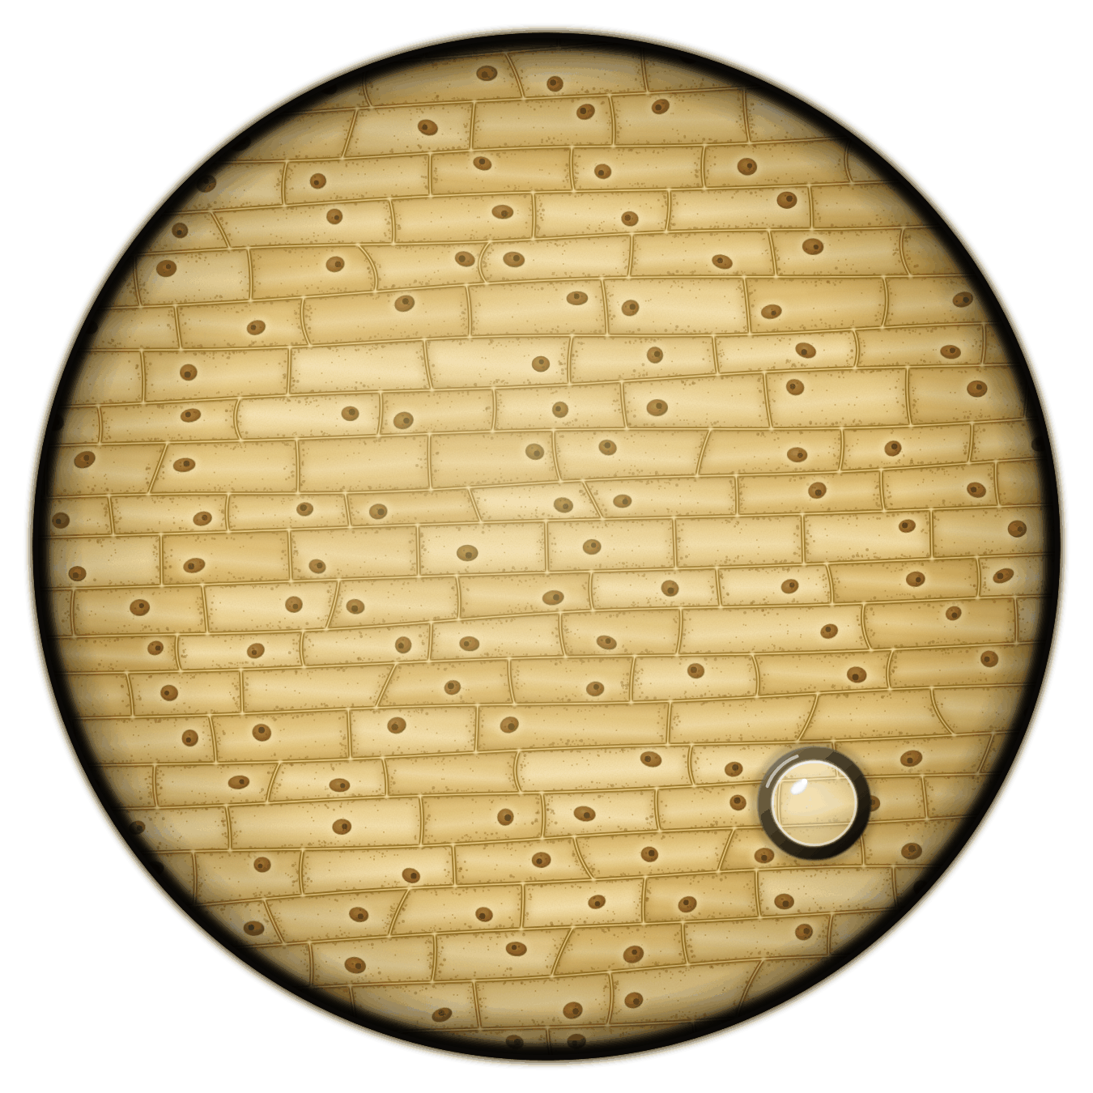
sciencegcse.co.uk · Biology B1 L4
DATE
B1 L4: Magnification and cell size
24/09/2026
DO NOW
KEYWORDS
1. Which objective lens should you start with?
2. Which type of microscope has the higher resolution?
3. Where is the main DNA in a bacterial cell?
Magnification
Image size
Real size
Micrometre
Standard form
A painting based on a light micrograph. Stains colour the cells.
B1 Cell biology
AQA Combined Science
Notes:
Do now: retrieval from B1 L3 (Q1, Q2) and B1 L2 (Q3). The picture is a painting of the view down a light microscope at × 100: onion epidermis cells stained yellow-brown with iodine solution, as in the B1 L3 practical. Ask: roughly how many cells fit across the circle? (About 8.) Keep the answer: we use it on slide 15 to work out how long one cell is. Suggested 60 min: slides 1-3 (8 min); slides 4-9 (15 min); slides 10-13 (12 min); slides 14-18 (12 min); Mandatory worksheet started in class (8 min), finished for homework; exit ticket slides 22-23 (5 min). Use slides 19-21 if time allows. Students need a ruler and a calculator. Homework: online lesson quiz and the B1 L4 Exam questions worksheet.

Slide 2
sciencegcse.co.uk · Biology B1 L4: Magnification and cell size
Do now answers and lesson focus
Do now answers
In this lesson
1. The lowest-power one.
2. The electron microscope.
3. In a single loop, free in the cytoplasm.
• Compare the view down a microscope with a biological drawing.
• Convert between mm, µm and nm.
• Calculate magnification, real size and image size.
• Use a scale bar and the field of view to find real sizes.
• Use standard form and orders of magnitude.
Key idea
magnification = size of image ÷ size of real object
Put both sizes in the same unit before you divide.
2
B1 L4 · sciencegcse.co.uk
Notes:
Go through the answers. Then share the lesson focus. The online lesson (sciencegcse.co.uk, B1 L4) follows the same 12 screens as this PowerPoint, so students can go over it at home. There are three checkpoints along the way. Q2 links to today: an electron microscope also magnifies far more than a light microscope, which is why some micrographs are at × 10 000 or more.

Slide 3
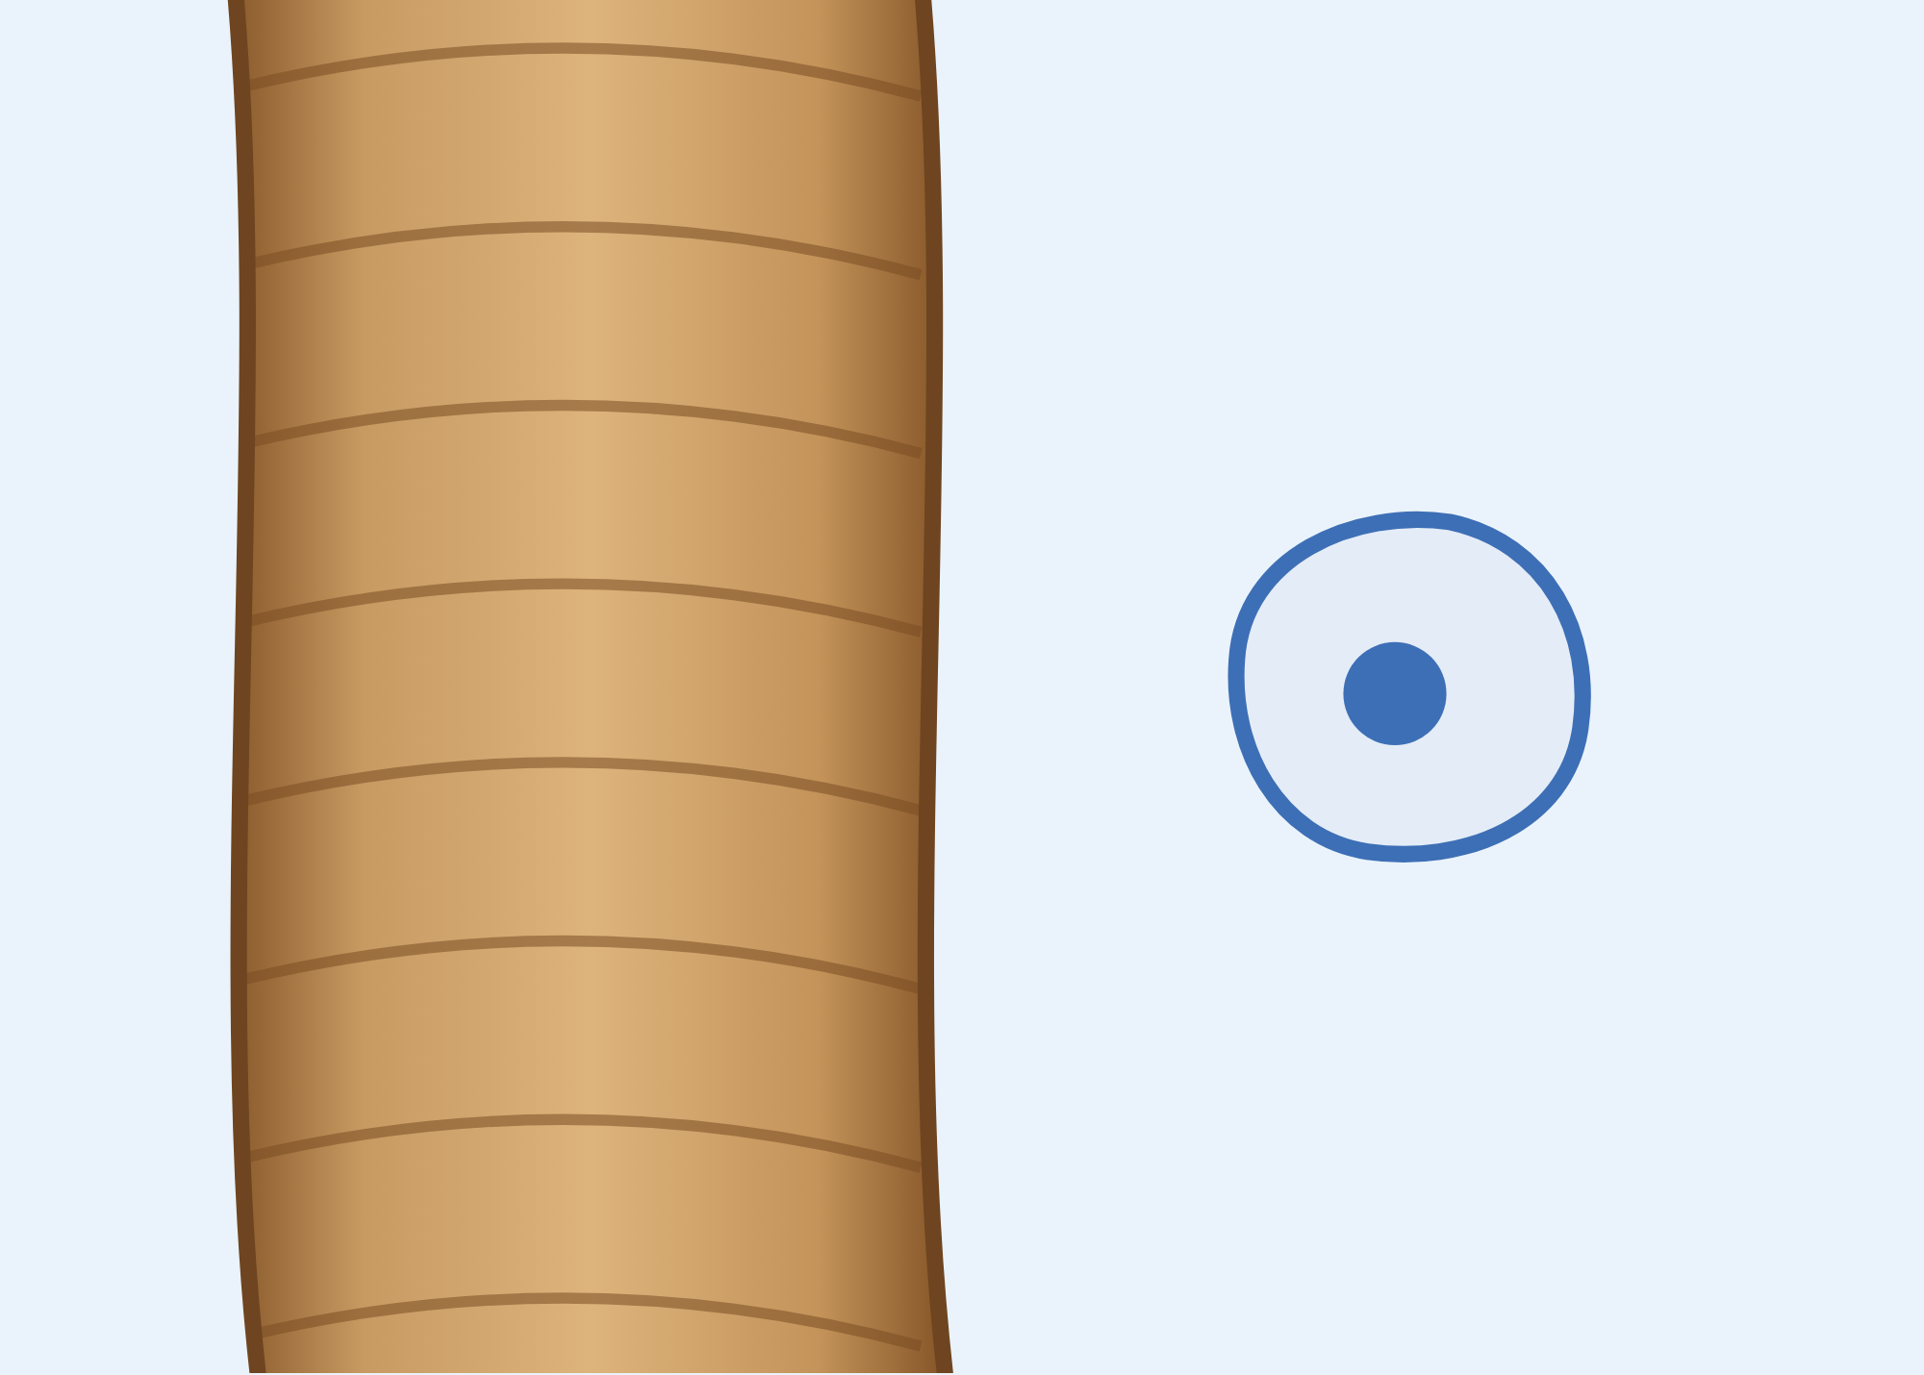
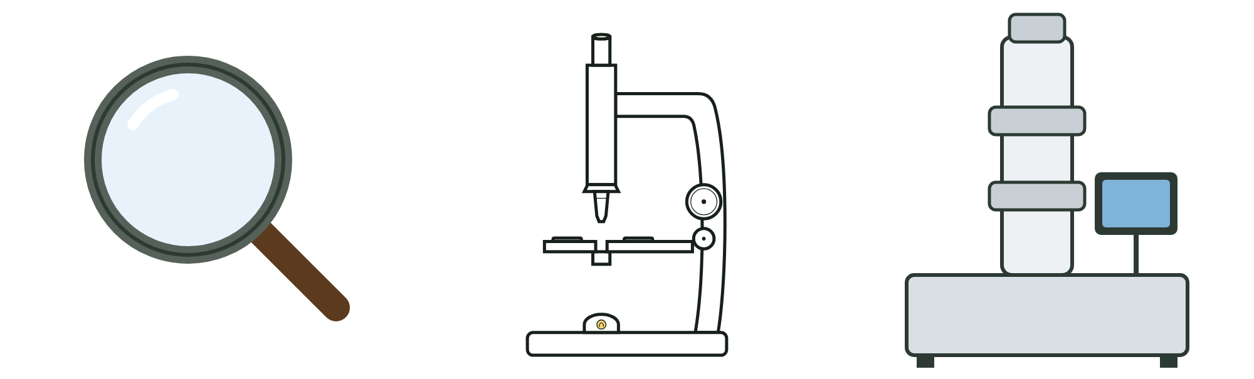
sciencegcse.co.uk · Biology B1 L4: Magnification and cell size
Why this matters in the real world
Cells are far too small to see. To measure them, we need tiny units and a bit of maths.
Thinner than a hair
How many times bigger?
Smaller still
100 nm
0.1 mm
hand
lens
× 10
light
microscope
up to
× 1500
electron
microscope
up to
× 2 000 000
a typical virus
the width of a hair
Most cells are narrower than a human hair. A cheek cell is about half as wide as a hair.
A hand lens, a light microscope and an electron microscope magnify by very different amounts.
Many viruses are about 100 nm across: 20 times smaller than a bacterium. Only an electron microscope shows them.
Too small to see
Magnification
Nanometres
3
B1 L4 · sciencegcse.co.uk
Notes:
Hook. Ask: why can you not see a cell without a microscope? (Most cells are smaller than about 0.1 mm, the smallest thing your eye can see clearly. Even a large onion cell, about 0.2 mm long, is only a tiny speck.) The picture on the first card shows a hair beside a cheek cell at the same scale: a cheek cell is about 50 µm, half the width of a hair. A light microscope magnifies up to about × 1500; an electron microscope up to about × 2 000 000 (B1 L3 Using a microscope). A bacterium is about 2 µm, which is 2000 nm, so a 100 nm virus is 20 times smaller. Viruses as pathogens: B3 Infection and response.

Slide 4
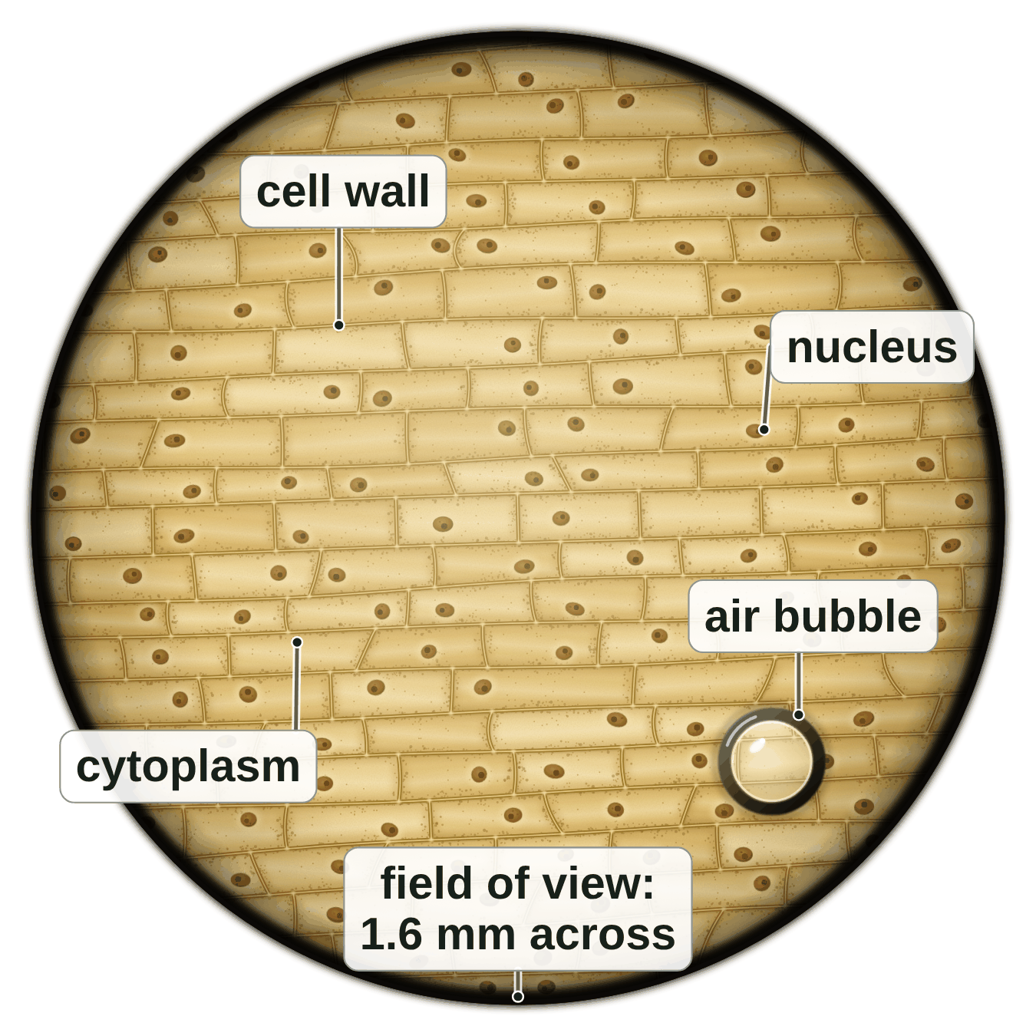
sciencegcse.co.uk · Biology B1 L4: Magnification and cell size
Online lesson: screen 1 of 12
Onion cells at × 100
The view at × 100
Key facts
This is the view down a light microscope at × 100: a × 10 eyepiece lens and a × 10 objective lens (B1 L3).
The cells come from a thin layer of onion epidermis (skin).
Iodine solution stains them yellow-brown, so the cell walls and nuclei are easier to see.
The circle is the field of view. At × 100 it is about 1.6 mm across.
The round shape with a thick dark edge is an air bubble, not a cell.
Cells are tiny. Today: how to work out their real size.
A painting based on a light micrograph. Stains colour the cells.
4
B1 L4 · sciencegcse.co.uk
Notes:
This is the view students saw in the B1 L3 practical with the × 10 objective lens: 10 × 10 = 100, so × 100. The picture is a painting based on a light micrograph: real onion epidermis cells are almost colourless; the yellow-brown comes from the iodine stain. Ask: how long do you think one of these cells really is? Take guesses in millimetres and write two or three on the board. Students find out on screen 10 (slide 15): about 0.2 mm. Ask: what is the round shape with the thick dark edge? (An air bubble trapped under the coverslip. It is not a cell.) One key fact a click. The picture is the same as screen 1 of the online lesson, where the labels switch on and off.

Slide 5
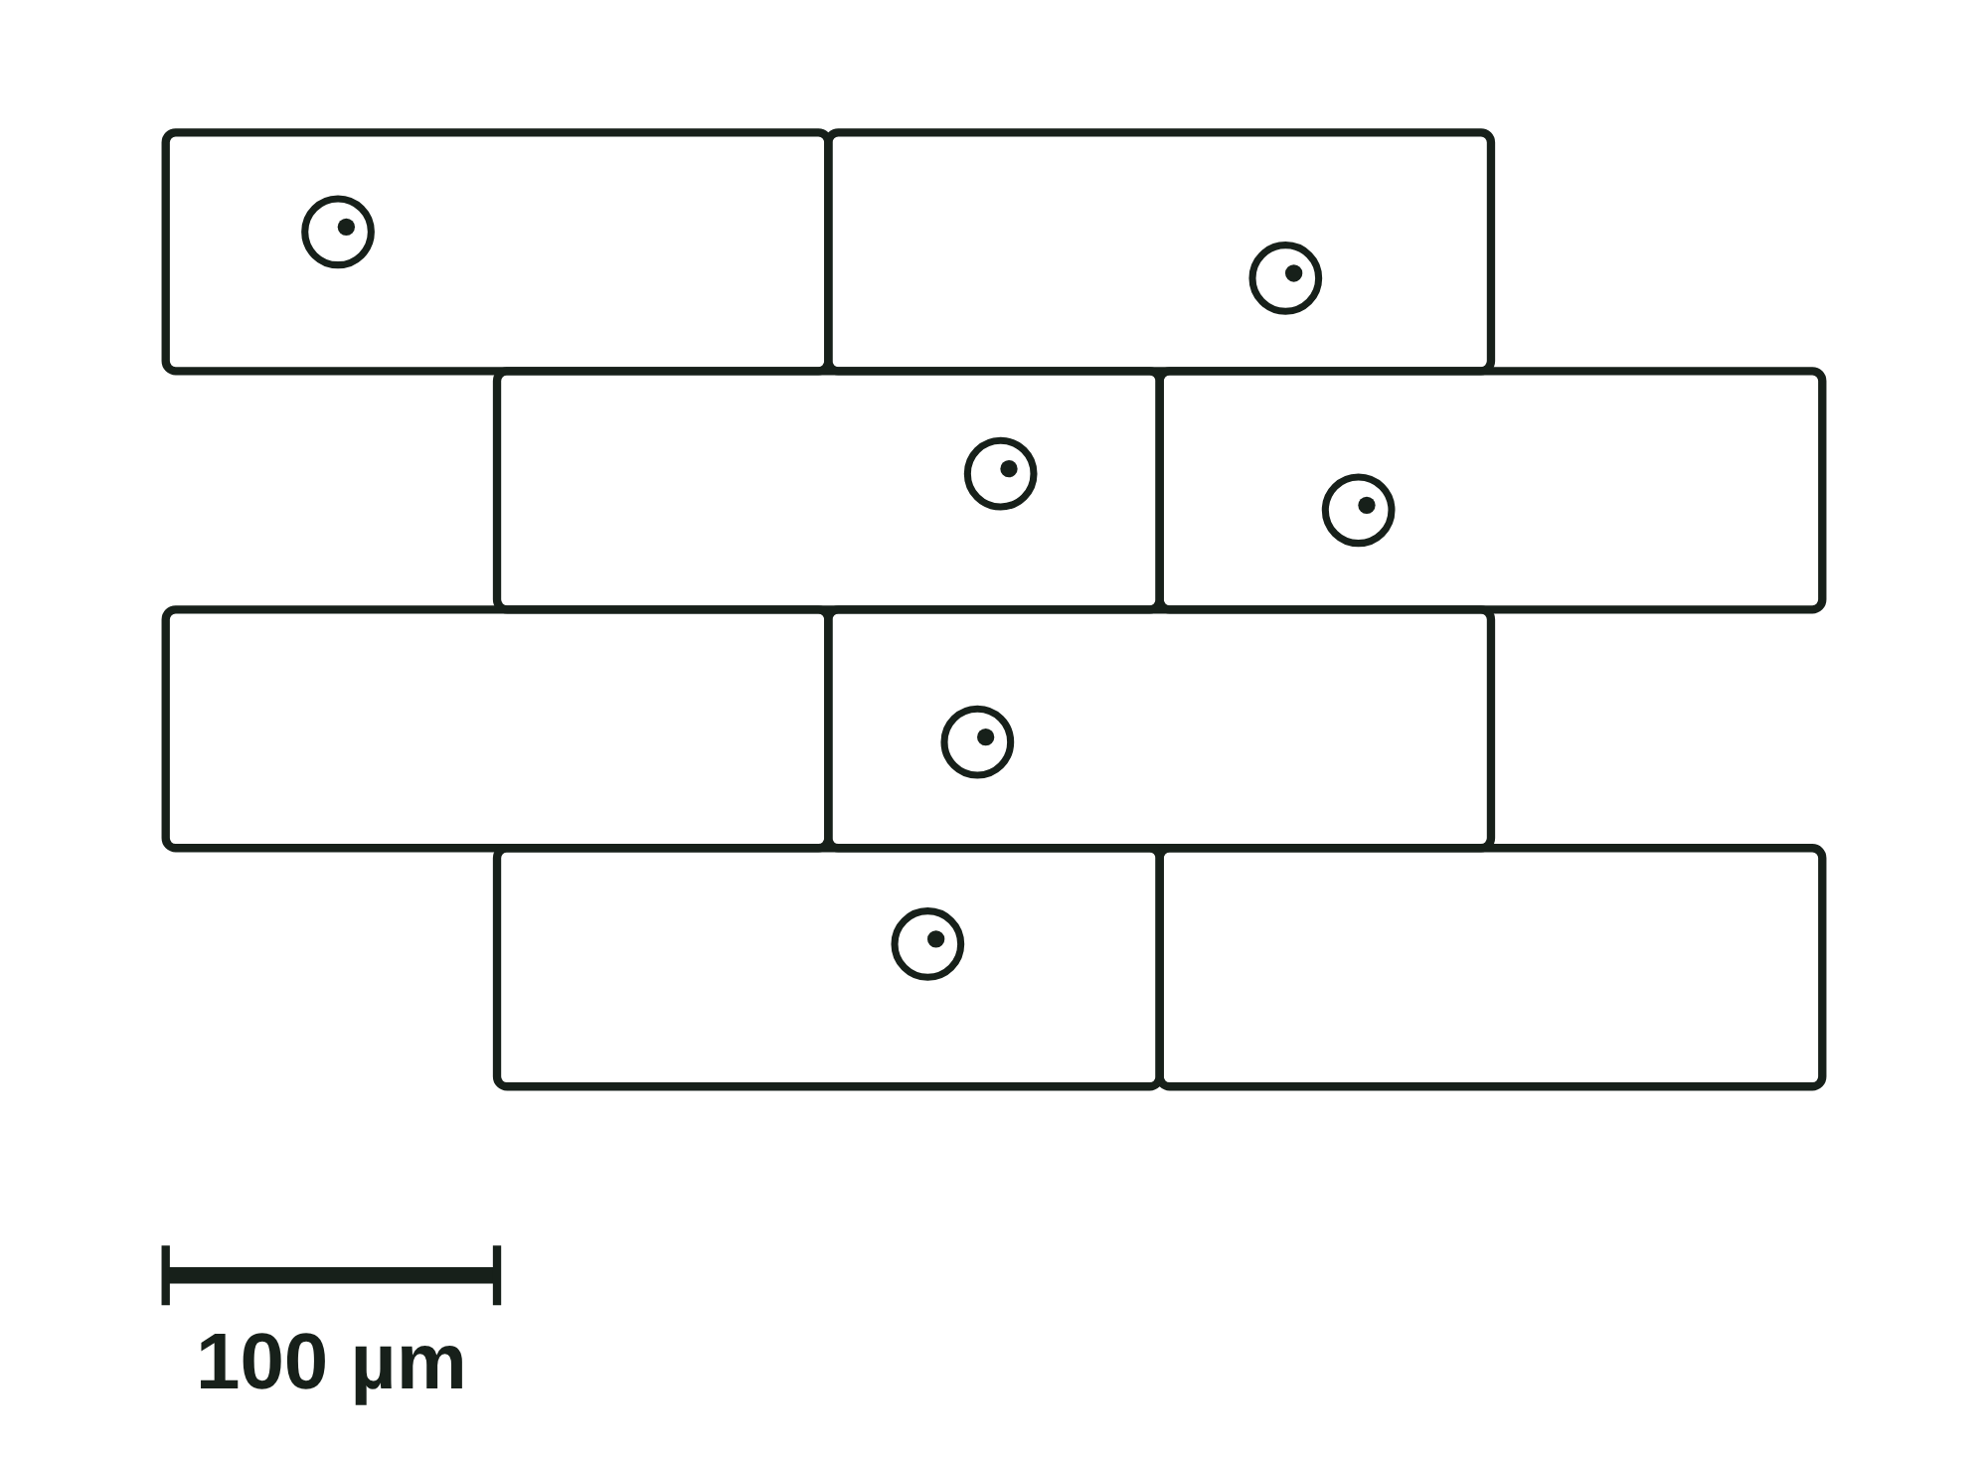
sciencegcse.co.uk · Biology B1 L4: Magnification and cell size
Online lesson: screen 2 of 12
A real view and a drawing
Same thing, two ways
Spot the differences
1
Scale bar: The drawing has a scale bar, so you can work out real sizes. The view down the microscope has none: you use the width of the field of view instead.
2
3
2
Edges: Down the microscope, cells are cut off by the round edge of the field of view. The drawing shows only whole cells.
3
2
5
3
Shapes: Real cells vary in size and shape, and their walls are not quite straight. The drawing tidies them into neat bricks.
5
4
4
4
Air bubble: The round shape with a thick dark edge is an air bubble trapped under the coverslip. It is not a cell, so it is left out of the drawing.
1
1
The view at × 100
A drawing
5
Colour: Iodine stains the real cells yellow-brown. The drawing uses clear pencil lines, with no colour and no shading.
Iodine stains the cells yellow-brown. The drawing adds a scale bar, so you can work out real sizes.
Both show rows of brick-shaped cells with cell walls, and a nucleus in most cells.
5
B1 L4 · sciencegcse.co.uk
Notes:
Cover the right panel and ask: what is different between the two pictures? Take ideas, then reveal the five differences: each click shows one difference and puts its number on both pictures; the last click shows what is the same in both. A biological drawing (B1 L3 Using a microscope) uses clear single pencil lines, no shading and no colour, shows only whole cells, and leaves out air bubbles. Exam pictures of cells are usually drawings like this. Ask: which picture could you use to find the real length of one cell? (The drawing: it has a scale bar, screen 9. For the view down the microscope, you use the width of the field of view, screen 10.) The online lesson, screen 2, has the same pictures and differences.

Slide 6
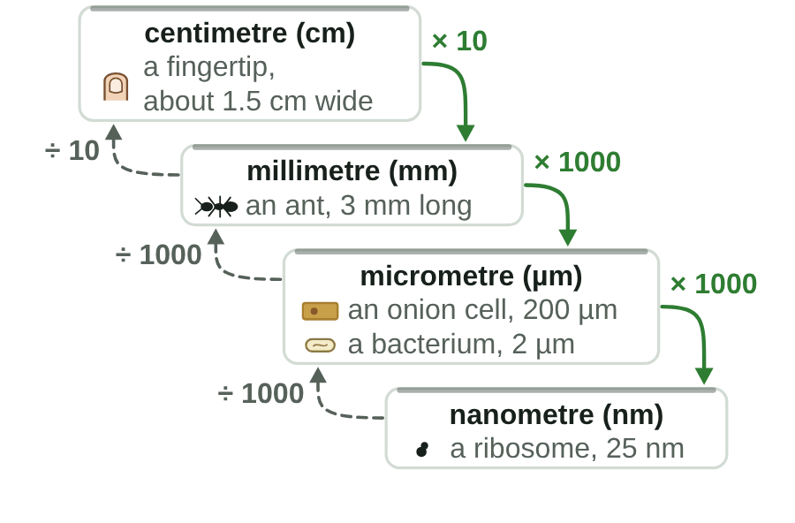
sciencegcse.co.uk · Biology B1 L4: Magnification and cell size
Online lesson: screen 3 of 12
Units for tiny things
Down and up the staircase
Changing units
1 cm = 10 mm
1 mm = 1000 µm
1 µm = 1000 nm
To a smaller unit (down the steps): multiply.
To a bigger unit (up the steps): divide.
Example 1: an onion cell is 0.2 mm long. 0.2 × 1000 = 200 µm. 200 × 1000 = 200 000 nm.
Example 2: a ribosome is 25 nm across. 25 ÷ 1000 = 0.025 µm.
Watch out: µm → mm: divide by 1000. The number of mm is always smaller.
Smaller unit, bigger number.
▶ Online lesson, screen 3: step down the staircase
6
B1 L4 · sciencegcse.co.uk
Notes:
The prefixes tell you the size: centi means a hundredth, milli a thousandth, micro a millionth and nano a billionth of a metre. The smallest marks on a ruler are millimetres: 1000 micrometres fit in one of them. Run screen 3 of the online lesson, or let the GIF play: the 0.2 mm token steps down to µm and nm, then a 25 nm ribosome climbs up to µm. One line a click. Ask: a cheek cell is 50 µm across. How many mm? (50 ÷ 1000 = 0.05 mm.) Common error: multiplying when changing µm into mm. Check: going up the staircase to a bigger unit, the number must get smaller. The picture is an animated GIF: it runs when the slide show runs (print and PDF show its first frame).

Slide 7
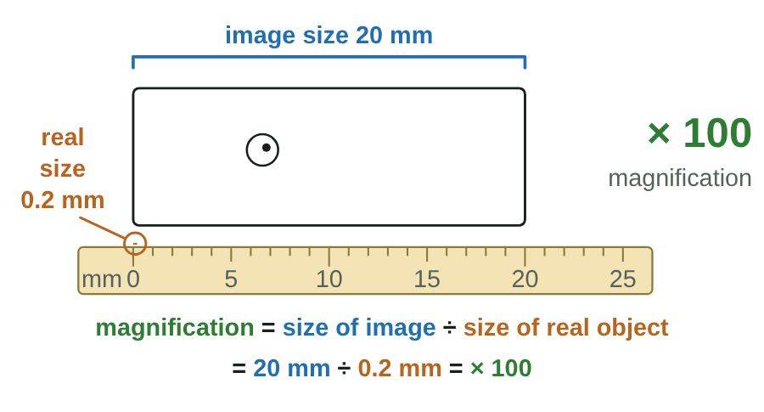
sciencegcse.co.uk · Biology B1 L4: Magnification and cell size
Online lesson: screen 4 of 12
How many times bigger?
Magnify, measure, calculate
Step by step
1
Real size: the actual size of the object. An onion cell is 0.2 mm long.
2
Magnify: a microscope makes a bigger image of it.
3
Image size: measure the image with a ruler, in mm: 20 mm.
4
Calculate: magnification = size of image ÷ size of real object = 20 ÷ 0.2 = × 100
Magnification has no unit: write × 100.
Brown = real size. Blue = image size. Green = magnification.
▶ Online lesson, screen 4: How many times bigger?
7
B1 L4 · sciencegcse.co.uk
Notes:
magnification = size of image ÷ size of real object is the AQA equation: learn it word for word (next lesson's Do now asks for it). Both sizes must be in the same unit; here both are in mm. The units cancel, so magnification has no unit. Link to B1 L3: the total magnification of a light microscope is the eyepiece lens magnification × the objective lens magnification. This equation works for any image: a micrograph, a drawing or a picture on a screen. Ask: an image is 30 mm long and the real object is 3 mm long. What is the magnification? (× 10.) Check that the image is always bigger than the real object. One step a click, then the green line. The online lesson, screen 4, has the same steps with Next step. The picture is an animated GIF: it runs when the slide show runs (print and PDF show its first frame).

Slide 8
sciencegcse.co.uk · Biology B1 L4: Magnification and cell size
Online lesson: screen 5 of 12
Checkpoint 1
✓
CHECKPOINT 1 of 3
Quick check on slides 4 to 7 (online screens 1 to 4). Show A, B or C on your whiteboard.
Question 1
Question 2
Question 3
Down the microscope there is a round shape with a thick dark edge. Why is it left out of the biological drawing?
A human egg cell is about 0.1 mm across. How wide is it in micrometres (µm)? (1 mm = 1000 µm)
A drawing of a cell is 30 mm long. The real cell is 0.06 mm long. What is the magnification?
A. It is a nucleus, and nuclei are never drawn.
A. 0.0001 µm
A. × 500
B. It is an air bubble, not a cell.
B. 10 µm
B. × 0.002
C. It is too big to fit in the drawing.
C. 100 µm
C. 500 mm
✓ Check your answers on the next slide
8
B1 L4 · sciencegcse.co.uk
Notes:
Checkpoint 1. Hinge check. Everyone shows A, B or C at the same time. Q1 tests the air bubble; Q2 A tests dividing instead of multiplying; Q3 B tests the equation upside down and Q3 C the 'magnification has a unit' trap. If several get Q1 wrong, go back to slide 5; Q2, slide 6; Q3, slide 7.

Slide 9
sciencegcse.co.uk · Biology B1 L4: Magnification and cell size
Online lesson: screen 5 of 12
Checkpoint 1 answers
✓
CHECKPOINT 1 of 3
Quick check on slides 4 to 7 (online screens 1 to 4). Show A, B or C on your whiteboard.
Question 1
Question 2
Question 3
Down the microscope there is a round shape with a thick dark edge. Why is it left out of the biological drawing?
A human egg cell is about 0.1 mm across. How wide is it in micrometres (µm)? (1 mm = 1000 µm)
A drawing of a cell is 30 mm long. The real cell is 0.06 mm long. What is the magnification?
A. It is a nucleus, and nuclei are never drawn.
A. 0.0001 µm
A. × 500
A. × 500 ✓
B. It is an air bubble, not a cell.
B. It is an air bubble, not a cell. ✓
B. 10 µm
B. × 0.002
C. It is too big to fit in the drawing.
C. 100 µm
C. 100 µm ✓
C. 500 mm
It is air trapped under the coverslip. It is not part of the specimen, so it is left out.
0.1 × 1000 = 100 µm. Smaller unit, bigger number.
magnification = size of image ÷ size of real object = 30 ÷ 0.06 = 500.
Got one wrong? Look back: Q1 slide 5 · Q2 slide 6 · Q3 slide 7
9
B1 L4 · sciencegcse.co.uk
Notes:
1 B, 2 C, 3 A. Each click shows one answer and why. Ask a student who got each one right to explain why. Follow-up for Q3: how could you check? (0.06 mm × 500 = 30 mm, the size of the drawing.)

Slide 10
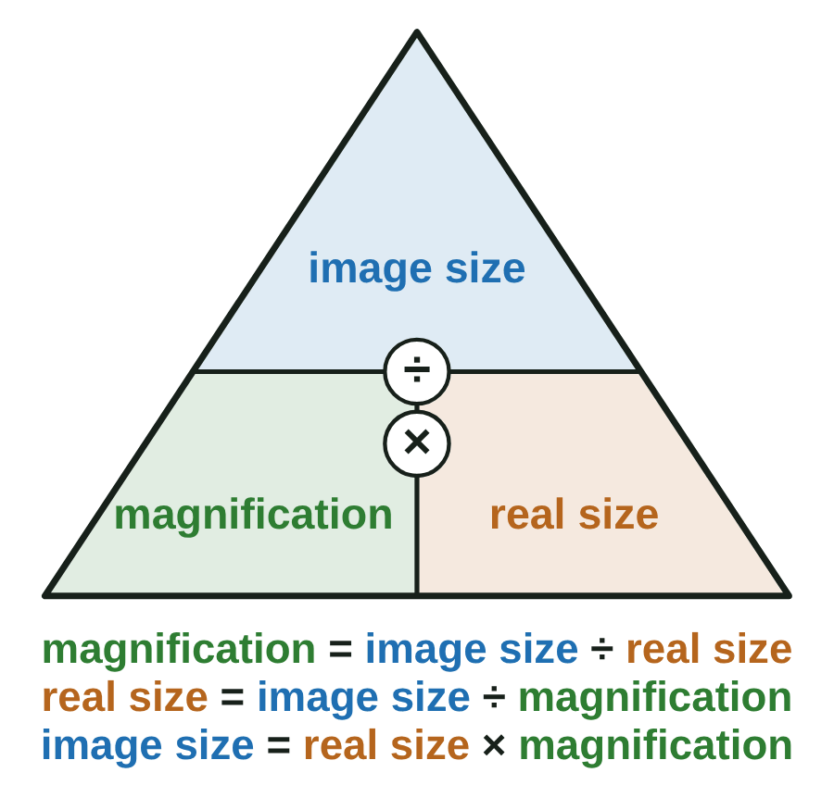
sciencegcse.co.uk · Biology B1 L4: Magnification and cell size
Online lesson: screen 6 of 12
Finding the real size
Cover to find
Worked example
real size = image size ÷ magnification
A drawing of a cheek cell is 25 mm wide. The magnification is × 500. Find its real width.
Step 1: real size = 25 ÷ 500
Step 2: = 0.05 mm
Step 3: in µm: 0.05 × 1000 = 50 µm
Check: 50 µm × 500 = 25 000 µm = 25 mm, the size of the drawing.
Watch out: the real size must be smaller than the image. If yours is bigger, you multiplied: divide instead.
Divide to find the real size. Multiply to find the image size.
Brown = real size. Blue = image size. Green = magnification.
10
B1 L4 · sciencegcse.co.uk
Notes:
Model the worked example on the board, saying each step. Image size means the size of the image; real size means the size of the real object. The triangle is a memory aid: cover what you want to find, and what is left tells you the sum. The AQA equation is still magnification = size of image ÷ size of real object. A real cheek cell is about 50 µm across (B1 L1), so the answer is sensible: always ask 'does my answer make sense?'. Ask: a picture of a cell is 40 mm wide at × 800. How wide is the real cell? (40 ÷ 800 = 0.05 mm = 50 µm.) One line a click. On screen 6 of the online lesson students tap what they want to find and the card covers it. The picture is an animated GIF: it runs when the slide show runs (print and PDF show its first frame).

Slide 11
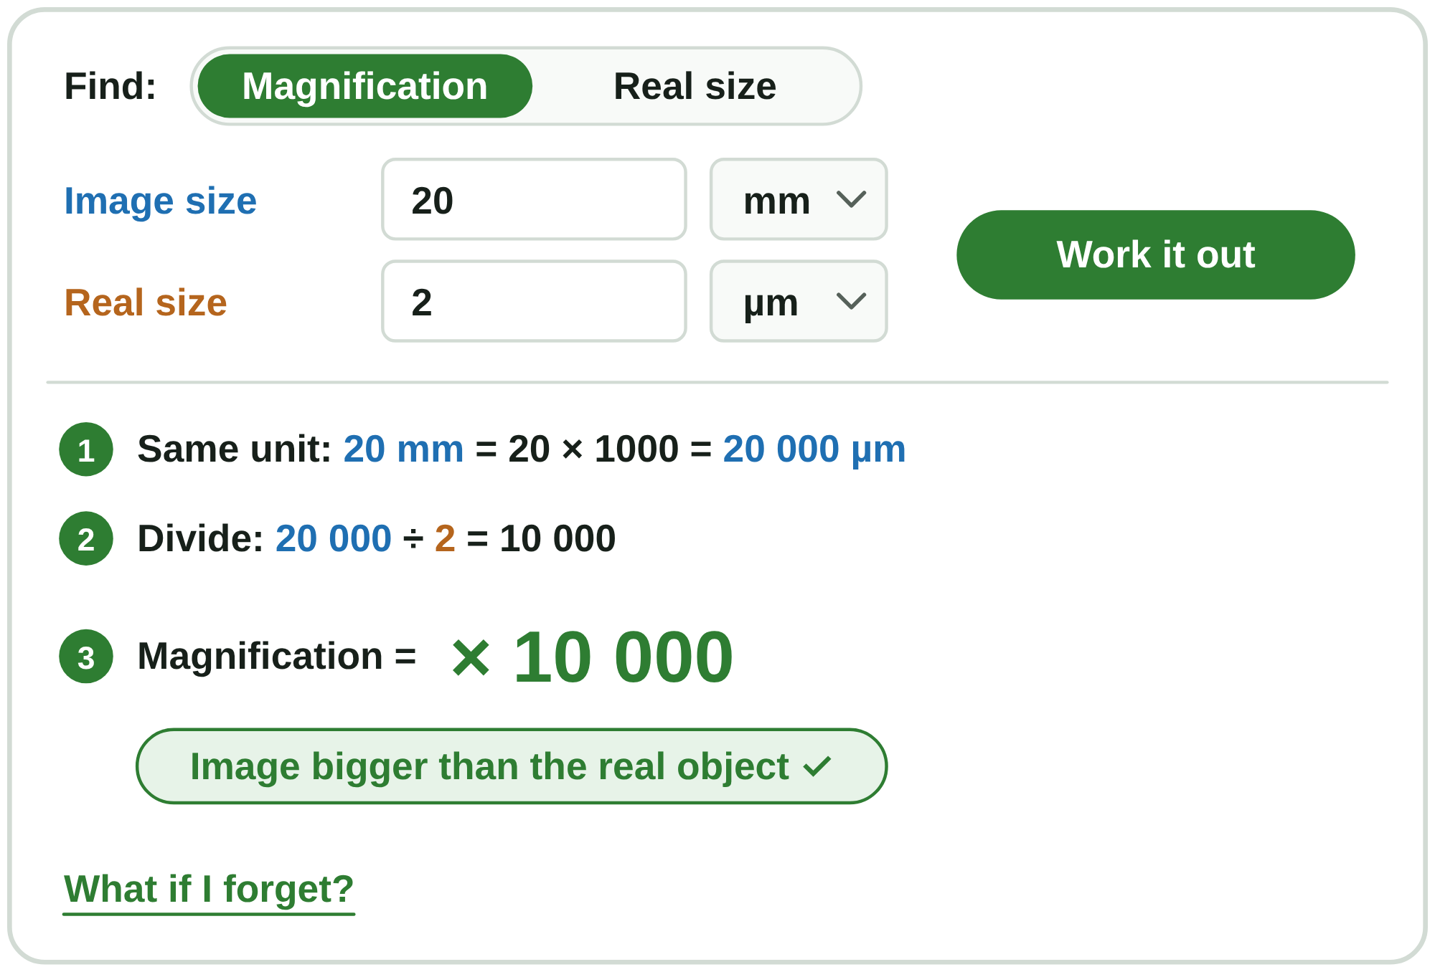
sciencegcse.co.uk · Biology B1 L4: Magnification and cell size
Online lesson: screen 7 of 12
Same units first
Try it
Worked example
A bacterium is 2 µm long. In a micrograph, its image is 20 mm long. Calculate the magnification.
Step 1: same unit: 20 mm = 20 × 1000 = 20 000 µm
Step 2: 20 000 ÷ 2 = 10 000
Step 3: magnification = × 10 000
Check: 2 µm × 10 000 = 20 000 µm = 20 mm, the size of the image.
Watch out: 20 ÷ 2 = × 10 is wrong. It mixes mm and µm.
Calculator: type 20000 ÷ 2. Never type the × sign.
Same unit first, then divide.
▶ Online lesson, screen 7: Try the calculator
11
B1 L4 · sciencegcse.co.uk
Notes:
Both sizes must be in the same unit before you divide, or the answer is 1000 times too small (or too big). Usually change the image size from mm into µm, because the real object is small. Model the example, one line a click. Then open screen 7 of the online lesson and let students try the presets, and press 'What if I forget?' to see the mistake. A light microscope can only magnify up to about × 1500, so a × 10 000 image of a bacterium was most likely taken with an electron microscope (B1 L3). On a calculator, type only the numbers: the × in × 500 is not a times sign to type. For standard form, use the EXP or × 10ˣ key. The picture shows the online calculator with the Bacterium example worked out.

Slide 12
sciencegcse.co.uk · Biology B1 L4: Magnification and cell size
Online lesson: screen 8 of 12
Checkpoint 2
✓
CHECKPOINT 2 of 3
Quick check on slides 10 and 11 (online screens 6 and 7). Show A, B or C on your whiteboard.
Question 1
Question 2
Question 3
Which equation gives the real size of an object?
A drawing of a cell is 18 mm long. The magnification is × 600. What is the real length of the cell?
A bacterium is 4 µm long. Its image in a micrograph is 12 mm long. What is the magnification?
A. real size = image size × magnification
A. 0.03 mm
A. × 3
B. real size = magnification ÷ image size
B. 10 800 mm
B. × 3000
C. real size = image size ÷ magnification
C. 33.3 mm
C. × 48 000
✓ Check your answers on the next slide
12
B1 L4 · sciencegcse.co.uk
Notes:
Checkpoint 2. Mini whiteboards: A, B or C. Q1 A and B test the triangle; Q2 B tests multiplying instead of dividing; Q3 A tests the 'same units' trap, the most common mistake in exams. If several get Q1 or Q2 wrong, go back to slide 10; Q3, slide 11.

Slide 13
sciencegcse.co.uk · Biology B1 L4: Magnification and cell size
Online lesson: screen 8 of 12
Checkpoint 2 answers
✓
CHECKPOINT 2 of 3
Quick check on slides 10 and 11 (online screens 6 and 7). Show A, B or C on your whiteboard.
Question 1
Question 2
Question 3
Which equation gives the real size of an object?
A drawing of a cell is 18 mm long. The magnification is × 600. What is the real length of the cell?
A bacterium is 4 µm long. Its image in a micrograph is 12 mm long. What is the magnification?
A. real size = image size × magnification
A. 0.03 mm
A. 0.03 mm ✓
A. × 3
B. real size = magnification ÷ image size
B. 10 800 mm
B. × 3000
B. × 3000 ✓
C. real size = image size ÷ magnification
C. real size = image size ÷ magnification ✓
C. 33.3 mm
C. × 48 000
Cover "real size" in the triangle: image size ÷ magnification.
real size = 18 ÷ 600 = 0.03 mm, which is 30 µm.
12 mm = 12 000 µm, and 12 000 ÷ 4 = 3000.
Got one wrong? Look back: Q1 and Q2 slide 10 · Q3 slide 11
13
B1 L4 · sciencegcse.co.uk
Notes:
1 C, 2 A, 3 B. Each click shows one answer and why. Follow-up for Q3: is the answer sensible? (× 3000 is higher than a light microscope can manage, so this micrograph was most likely taken with an electron microscope.)

Slide 14
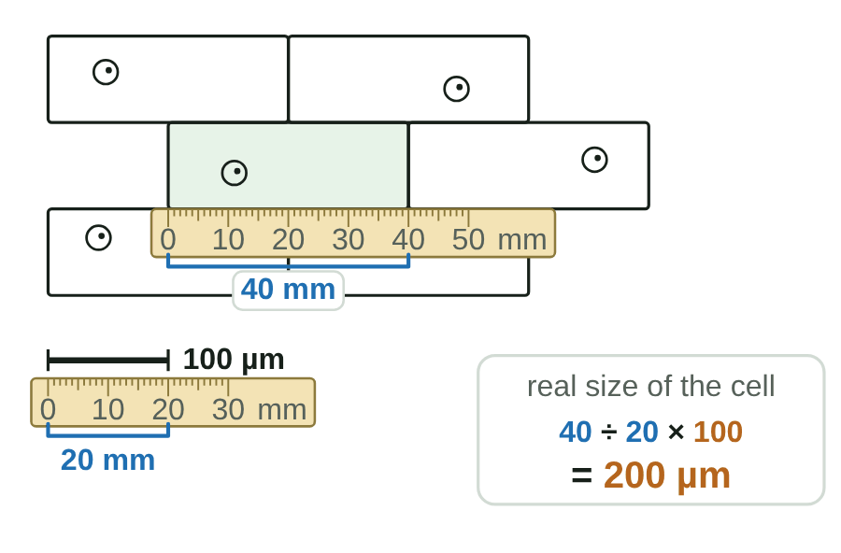
sciencegcse.co.uk · Biology B1 L4: Magnification and cell size
Online lesson: screen 9 of 12
Using a scale bar
Measure, then calculate
Using a scale bar
A scale bar shows a real length on the picture.
1. Measure the scale bar in mm: 20 mm. It stands for 100 µm.
2. Measure the cell in mm: 40 mm.
3. real size = size on the picture ÷ length of the scale bar × value of the scale bar
= 40 ÷ 20 × 100 = 200 µm
Watch out: measure the bar with a ruler. Never use its label (100 µm) as its length.
You can also find the magnification: 20 mm = 20 000 µm, and 20 000 ÷ 100 = × 200.
A scale bar still works when the picture is printed bigger or smaller.
▶ Online lesson, screen 9: print it smaller or bigger
14
B1 L4 · sciencegcse.co.uk
Notes:
Most exam micrographs have a scale bar instead of a magnification. Model it with a real ruler on a printed copy if you can. One line a click. Common error: using the label, 100 µm, as if it were the bar's length. The scale bar is printed as part of the picture, so it shrinks or grows with the picture; a written magnification is only right at the original size (the GIF shows the drawing printed at half size: the bar is 10 mm, the cell 20 mm, and the answer is still 200 µm; online screen 9: try Smaller and Bigger). You can also find the magnification from a scale bar: 20 mm = 20 000 µm, and 20 000 ÷ 100 = × 200, so this drawing is at × 200. The picture is an animated GIF: it runs when the slide show runs (print and PDF show its first frame).

Slide 15
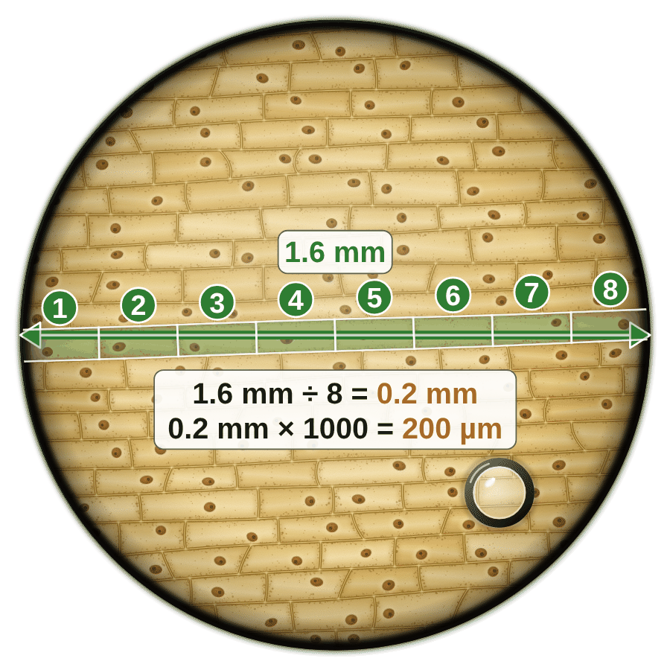
sciencegcse.co.uk · Biology B1 L4: Magnification and cell size
Online lesson: screen 10 of 12
Cell size from the field of view
Count across the field
Field of view (× 10 eyepiece lens)
Magnification
Width of the field of view
× 40
about 4.0 mm
× 100
about 1.6 mm
× 400
about 0.4 mm
Estimate the size
size of one cell ≈ width of the field of view ÷ number of cells across
Example 1: × 100, field 1.6 mm, 8 onion cells across: 1.6 ÷ 8 = 0.2 mm = 200 µm.
Example 2: × 400, field 0.4 mm, 8 cheek cells across: 0.4 ÷ 8 = 0.05 mm = 50 µm.
It is an estimate: cells vary, and cells at the edge are cut off.
15
B1 L4 · sciencegcse.co.uk
Notes:
The widths of the field of view come from the B1 L3 practical (they depend on the microscope; these are typical for a school microscope with a × 10 eyepiece lens). Go back to the guesses from slide 4: who was closest to 0.2 mm? The two examples give the sizes we use all lesson: an onion cell about 200 µm long, a cheek cell about 50 µm across. The table rows wipe in one a click, then the four lines. Ask: why is it an estimate? (Cells are not all the same size, and they do not fit exactly.) Ask: at × 400 the field is 0.4 mm. How many 200 µm onion cells fit across? (400 ÷ 200 = 2.) The picture is an animated GIF: it runs when the slide show runs (print and PDF show its first frame).

Slide 16
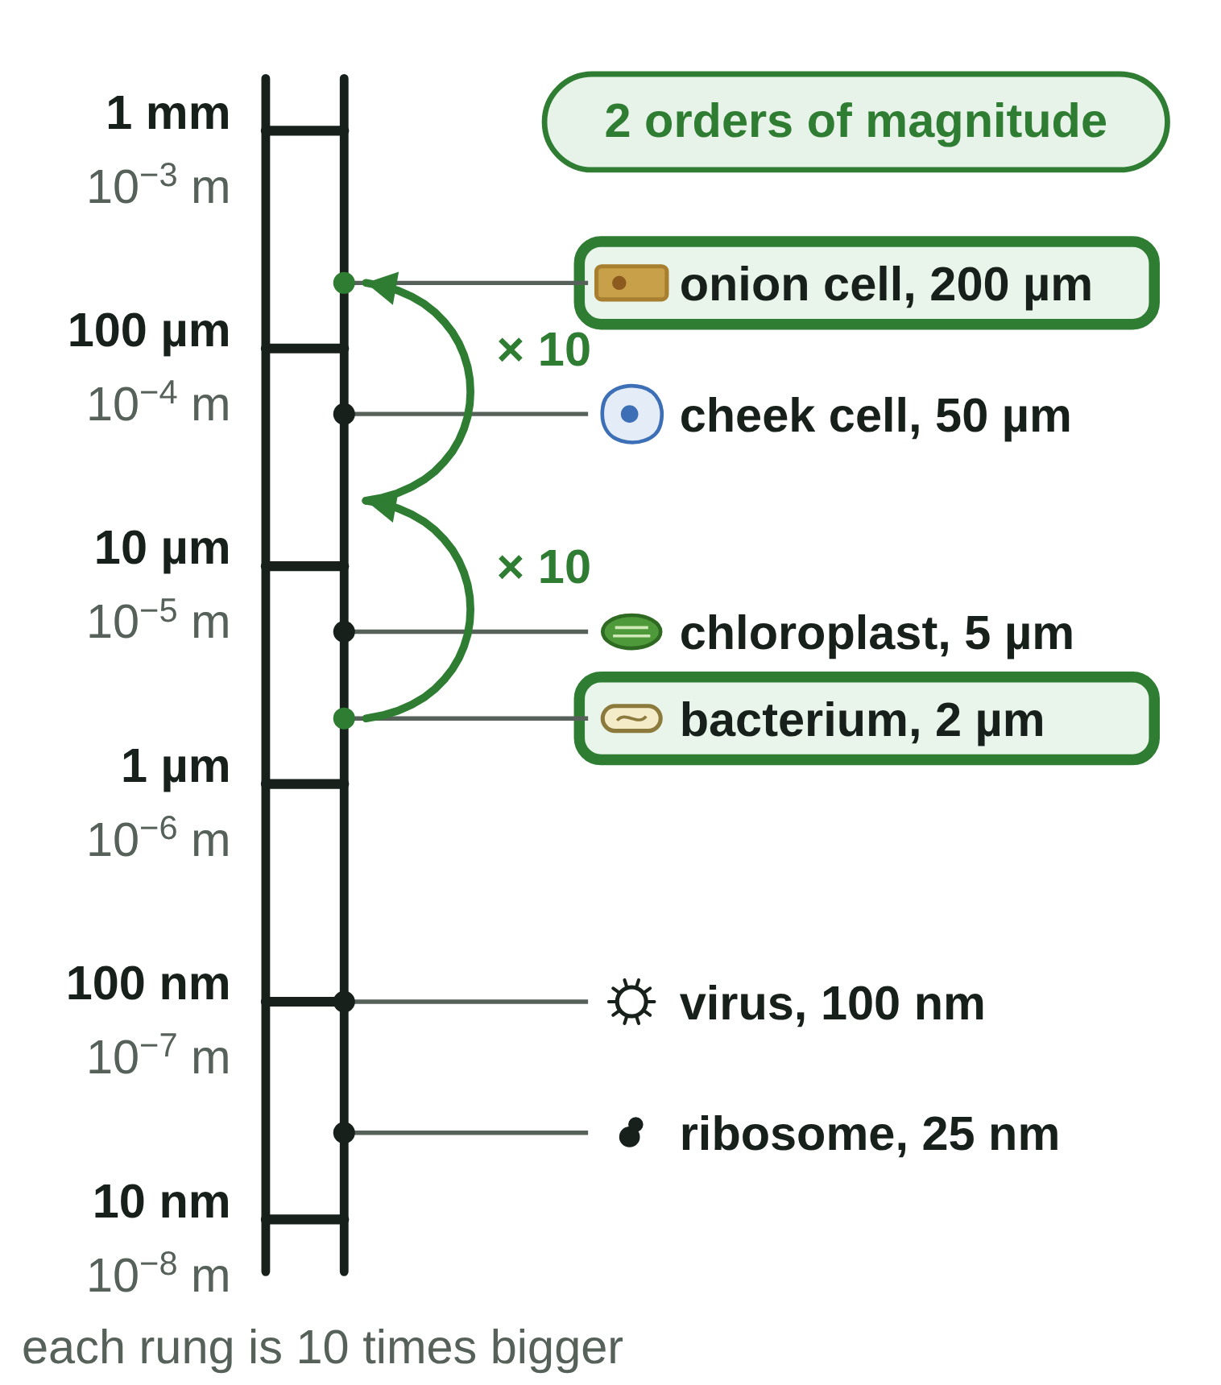
sciencegcse.co.uk · Biology B1 L4: Magnification and cell size
Online lesson: screen 11 of 12
Standard form and orders of magnitude
The size ladder
Standard form
a number between 1 and 10, multiplied by a power of 10
2000 = 2 × 10³ · 0.000 002 m = 2 × 10⁻⁶ m (a bacterium)
Small numbers have negative powers: count how many places the point moves.
Watch out: 25 × 10⁻⁶ m is not standard form. Write 2.5 × 10⁻⁵ m.
Orders of magnitude
One order of magnitude = 10 times. Two = 10 × 10 = 100 times.
Onion cell 200 µm ÷ bacterium 2 µm = 100 = 10²: 2 orders of magnitude.
Watch out: two orders of magnitude is 100 times, not 20 times.
Use orders of magnitude to check that an answer is sensible.
16
B1 L4 · sciencegcse.co.uk
Notes:
Standard form: the first number is between 1 and 10 (it can be 1, but not 10); the power says how many places the decimal point moves; for a number less than 1 the power is negative. Practise: 0.000 002 m, move the point 6 places to get 2, so 2 × 10⁻⁶ m. On a calculator, type 2 EXP −6 (or 2 × 10ˣ −6). Orders of magnitude: divide the bigger size by the smaller (same units), then write the answer as a power of 10. The power is the number of orders of magnitude. Use orders of magnitude to check answers: a plant cell about 100 µm is about 2 orders of magnitude bigger than a 1 µm bacterium. The four 'Standard form' lines one a click, then the four 'Orders of magnitude' lines. Online screen 11: tap the compare chips to see the hops.

Slide 17
sciencegcse.co.uk · Biology B1 L4: Magnification and cell size
Online lesson: screen 12 of 12
Checkpoint 3
✓
CHECKPOINT 3 of 3
Quick check on slides 14 to 16 (online screens 9 to 11). Show A, B or C on your whiteboard.
Question 1
Question 2
Question 3
On a drawing, a 50 µm scale bar is 10 mm long. A cell on the drawing is 30 mm long. What is the real length of the cell?
A field of view is 1.2 mm across. About 4 cells fit across it. About how long is one cell?
How is 0.000 005 m written in standard form?
A. 4.8 mm
A. 5 × 10⁻⁶ m
A. 50 µm
B. 150 µm
B. 3.3 mm
B. 5 × 10⁶ m
C. 300 µm
C. 0.3 mm
C. 0.5 × 10⁻⁵ m
✓ Check your answers on the next slide
17
B1 L4 · sciencegcse.co.uk
Notes:
Checkpoint 3. Mini whiteboards: A, B or C. Q1 A is the 'scale bar label' trap; Q2 A and B test the division; Q3 B tests the sign of the power and Q3 C the 'between 1 and 10' rule. If several get Q1 wrong, go back to slide 14; Q2, slide 15; Q3, slide 16.

Slide 18
sciencegcse.co.uk · Biology B1 L4: Magnification and cell size
Online lesson: screen 12 of 12
Checkpoint 3 answers
✓
CHECKPOINT 3 of 3
Quick check on slides 14 to 16 (online screens 9 to 11). Show A, B or C on your whiteboard.
Question 1
Question 2
Question 3
On a drawing, a 50 µm scale bar is 10 mm long. A cell on the drawing is 30 mm long. What is the real length of the cell?
A field of view is 1.2 mm across. About 4 cells fit across it. About how long is one cell?
How is 0.000 005 m written in standard form?
A. 4.8 mm
A. 5 × 10⁻⁶ m
A. 5 × 10⁻⁶ m ✓
A. 50 µm
B. 150 µm
B. 3.3 mm
B. 5 × 10⁶ m
B. 150 µm ✓
C. 0.3 mm
C. 300 µm
C. 0.3 mm ✓
C. 0.5 × 10⁻⁵ m
30 ÷ 10 = 3, and 3 × 50 µm = 150 µm.
1.2 ÷ 4 = 0.3 mm, which is 300 µm.
The point moves 6 places, and a small number has a negative power.
Got one wrong? Look back: Q1 slide 14 · Q2 slide 15 · Q3 slide 16
18
B1 L4 · sciencegcse.co.uk
Notes:
1 B, 2 C, 3 A. Each click shows one answer and why. Next: practise with three drawings, then the quiz in the online lesson.

Slide 19
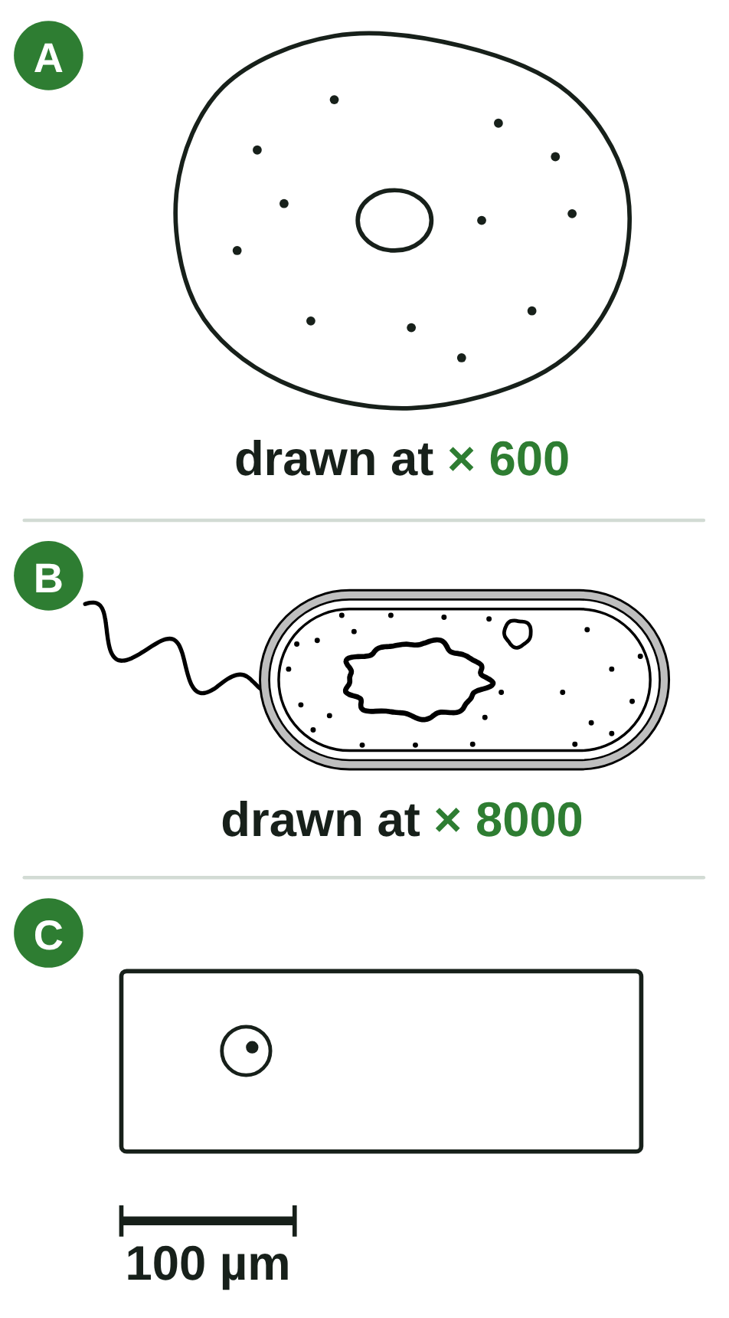
sciencegcse.co.uk · Biology B1 L4: Magnification and cell size
Practice: Sizes of three cells
Three drawings
Questions
1. The image of A is 36 mm wide. Calculate its real width in mm.
______________
2. Write your answer to question 1 in µm.
______________
3. The image of B is 24 mm long. Calculate its real length in µm.
______________
4. Write the real length of B in metres, in standard form.
______________
5. In drawing C, the scale bar is 15 mm long and the cell is 45 mm long. Calculate the real length of C.
______________
6. How many times longer is C than B? How many orders of magnitude is that?
______________
Not to scale with each other.
19
B1 L4 · sciencegcse.co.uk
Notes:
Pairs, 5 minutes, with calculators. The lengths are given, so nobody needs to measure the screen. Remind students: write the equation, change to the same unit, show the working, give the unit.

Slide 20
sciencegcse.co.uk · Biology B1 L4: Magnification and cell size
Sizes of three cells: answers
Three drawings
Answers
1. The image of A is 36 mm wide. Calculate its real width in mm.
36 ÷ 600 = 0.06 mm
2. Write your answer to question 1 in µm.
0.06 × 1000 = 60 µm
3. The image of B is 24 mm long. Calculate its real length in µm.
24 ÷ 8000 = 0.003 mm = 3 µm
4. Write the real length of B in metres, in standard form.
3 × 10⁻⁶ m
5. In drawing C, the scale bar is 15 mm long and the cell is 45 mm long. Calculate the real length of C.
45 ÷ 15 × 100 = 300 µm
6. How many times longer is C than B? How many orders of magnitude is that?
300 ÷ 3 = 100 times: 2 orders of magnitude
Not to scale with each other.
20
B1 L4 · sciencegcse.co.uk
Notes:
Q1: real size = image size ÷ magnification. Q3: 0.003 mm × 1000 = 3 µm; a sensible size for a bacterium. Q4: 3 µm = 0.000 003 m. Q5 is the common trap: 100 µm is the bar's label, not its length. Q6: change to the same unit first (both in µm), then 100 = 10², so 2 orders of magnitude.

Slide 21
sciencegcse.co.uk · Biology B1 L4: Magnification and cell size
Exam practice
1. An image of a nucleus is 16 mm across. The magnification is × 2000. Calculate the real diameter of the nucleus in µm. [3]
real size = image size ÷ magnification = 16 ÷ 2000 (1) = 0.008 mm (1) = 0.008 × 1000 = 8 µm (1).
2. A micrograph has a scale bar. It may be printed bigger or smaller in another book. Explain why a scale bar is more useful than writing the magnification under the picture. [2]
The scale bar is part of the picture, so it changes size by the same amount as the picture (1). So measuring with it always gives the right real size, but a written magnification is wrong once the picture is printed at a different size (1).
21
B1 L4 · sciencegcse.co.uk
Notes:
Model answers with mark points in brackets. Students try each question first, then mark their own work in green. Q1: an answer in mm (0.008 mm) without changing to µm scores 2 of the 3 marks. For more, the B1 L4 Exam questions worksheet (PDF) has 5 questions, 20 marks; its mark scheme is at the end of this PowerPoint. The same questions are in the online lesson, after the quiz.

Slide 22
sciencegcse.co.uk · Biology B1 L4: Magnification and cell size
Exit ticket
Answer on your own
How confident am I?
1. Write 3.5 mm in micrometres (µm). [1]
I can convert between mm, µm and nm.
2. A cell's image is 14 mm long. The magnification is × 200. Calculate its real length in mm. [1]
I can calculate magnification and real size.
3. Write 0.000 08 m in standard form. [1]
4. A bacterium is 1.5 µm long. In a micrograph it is 18 mm long. Calculate the magnification. [2]
I can use a scale bar and standard form.
22
B1 L4 · sciencegcse.co.uk
Notes:
Students answer on their own, with a calculator, then rate their confidence. Q4 needs the same units first: the most common exam mistake.

Slide 23
sciencegcse.co.uk · Biology B1 L4: Magnification and cell size
Exit ticket answers
Answers
Next lesson
1. 3.5 × 1000 = 3500 µm.
2. 14 ÷ 200 = 0.07 mm.
3. 8 × 10⁻⁵ m.
4. 18 mm = 18 000 µm (1). 18 000 ÷ 1.5 = × 12 000 (1).
Next: B1 L5 Specialised cells
How specialised cells are adapted for their jobs, and how cells become specialised.
Worksheets:
• Mandatory (everyone)
• Alternative (easier, with key notes)
• Challenge (when you finish the Mandatory)
• Exam questions (exam style, 20 marks, homework)
▶ Online lesson: quiz and exam questions
23
B1 L4 · sciencegcse.co.uk
Notes:
Go through the answers. Q4: 18 ÷ 1.5 = × 12 scores 0: the units were not changed. After this slide: the B1 L4 revision notes (4 printable pages), then the worksheets with answers in green: Mandatory (everyone), Challenge (stretch) and Alternative (easier: key notes and very simple tasks). The B1 L4 Exam questions worksheet (exam style, black and white, 20 marks) is a separate PDF for homework; its mark scheme is the last two slides. Homework: the online lesson quiz and the B1 L4 Exam questions worksheet.

Slide 24
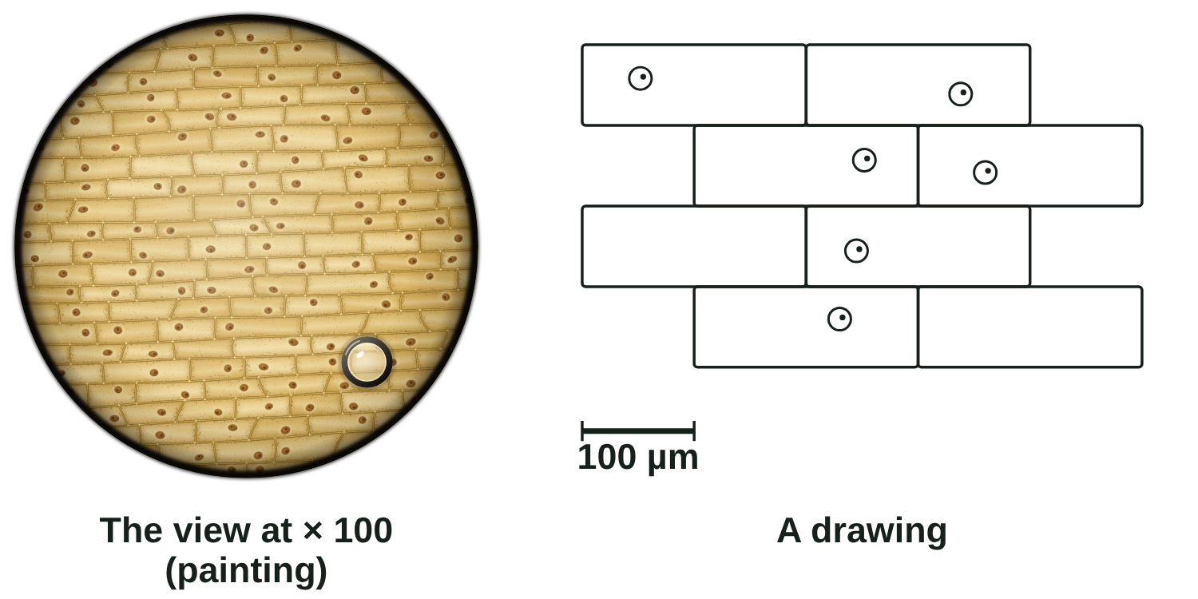
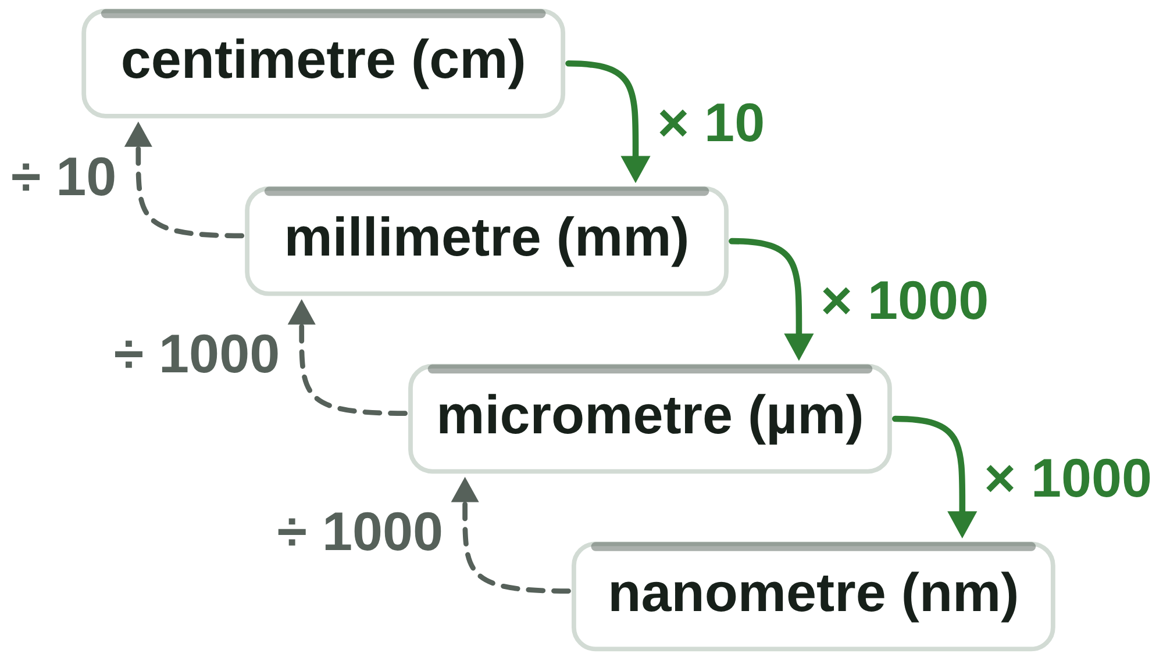
B1 L4 Revision notes 1 of 4
Magnification and cell size
How small cells are, units, and the view down a microscope
1. How small are cells?
3. The view down a microscope
Most cells are far too small to see with your eyes alone. You need a microscope to see them, and very small units to measure them. Sizes vary, so these are typical values:
At × 100 (a × 10 eyepiece lens and a × 10 objective lens: B1 L3 Using a microscope) you see a round field of view, about 1.6 mm across. A slide of a thin layer of onion epidermis (skin), stained with iodine solution, shows:
rows of brick-shaped cells, stained yellow-brown;
a cell wall round each cell;
a darker nucleus in most cells;
sometimes an air bubble: a round shape with a thick dark edge. It is air trapped under the coverslip, not a cell.
Thing | About how big
the width of a human hair | 0.1 mm (100 µm)
an onion epidermis cell | 0.2 mm (200 µm) long
a cheek cell | 50 µm across
a chloroplast | 5 µm
a bacterium | 2 µm long
a mitochondrion | 1 µm
a virus | 100 nm
a ribosome | 25 nm
4. A real view and a biological drawing
Both show rows of brick-shaped cells with cell walls, and a nucleus in most cells.
Iodine stains the cells yellow-brown. The drawing adds a scale bar, so you can work out real sizes.
2. Units for tiny things
1 cm = 10 mm
1 mm = 1000 µm (micrometres)
1 µm = 1000 nm (nanometres)
The prefix tells you the size: centi means one hundredth, milli one thousandth, micro one millionth and nano one billionth of a metre.
Exam pictures of cells are usually biological drawings. A drawing is simplified on purpose:
It has a scale bar, so you can work out real sizes. The view down the microscope has none.
It shows only whole cells. Down the microscope, cells are cut off at the edge of the field of view.
It tidies the cells into neat bricks. Real cells vary in size and shape.
It leaves out air bubbles: they are not cells.
It uses clear pencil lines, with no colour and no shading. The real cells are stained yellow-brown.
To change to a smaller unit (down the staircase), multiply: 0.2 mm × 1000 = 200 µm.
To change to a bigger unit (up the staircase), divide: 25 nm ÷ 1000 = 0.025 µm.
Watch out: to change µm into mm, divide by 1000. The number of mm is always smaller than the number of µm.
Watch out: an air bubble is not a cell. Leave air bubbles out of a biological drawing.
B1 L4 · Magnification and cell size · sciencegcse.co.uk · free GCSE science resources
Notes:
Revision notes page 1 of 4 (or use B1_L4_Revision_notes.pdf). These pages are the textbook for B1 L4: students read them before the worksheets. Page 1: how small cells are, the units mm, µm and nm, and the view down a microscope beside a biological drawing. Ask: which way do you go on the units staircase to change µm into mm, and do you multiply or divide?

Slide 25
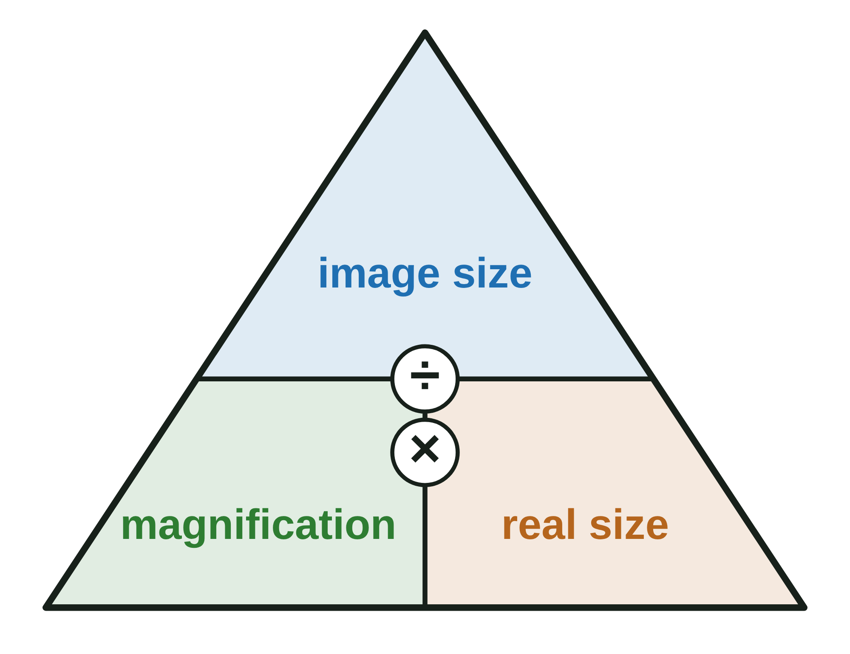
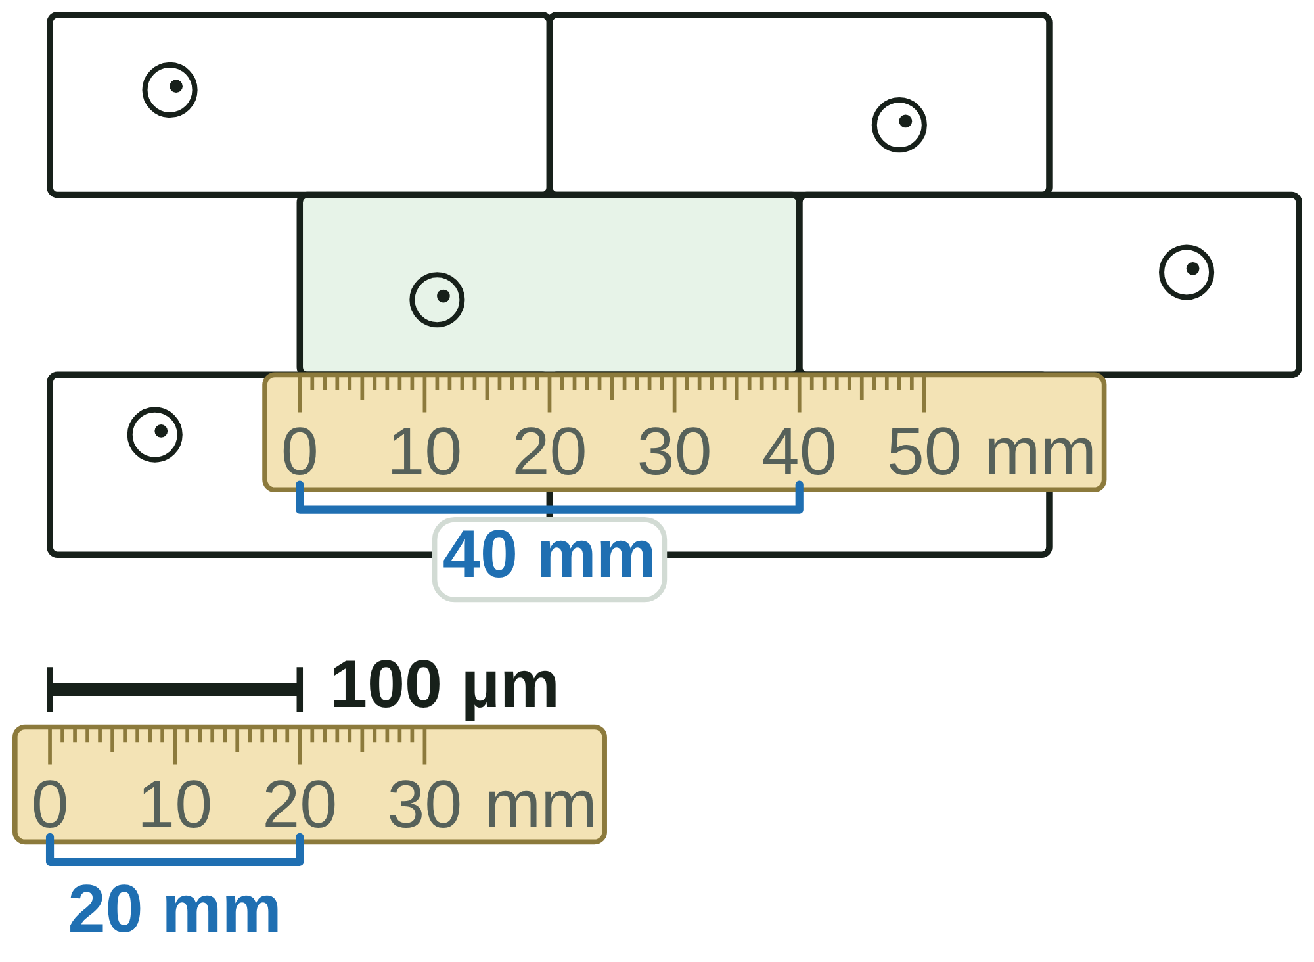
B1 L4 Revision notes 2 of 4
Magnification and cell size
Magnification, the magnification equation and scale bars
5. What magnification means
7. Worked examples
Magnification is how many times bigger the image is than the real object. "× 400" means the image is 400 times bigger than the real object.
Magnification has no unit. Write it with a times sign: × 400.
A light microscope magnifies up to about × 1500. An electron microscope magnifies up to about × 2 000 000 (B1 L3).
The total magnification of a light microscope is the eyepiece lens magnification × the objective lens magnification (B1 L3).
The equation below works for any image: a micrograph, a drawing, or a picture on a screen.
Example 1: finding the magnification. An electron micrograph shows a mitochondrion. Its image is 30 mm long. The real mitochondrion is 1.5 µm long. Calculate the magnification.
Step 1: same unit: 30 mm = 30 × 1000 = 30 000 µm.
Step 2: magnification = size of image ÷ size of real object = 30 000 ÷ 1.5 = 20 000.
Answer: × 20 000. (Too high for a light microscope, as you would expect for an electron micrograph.)
Example 2: finding the real size. A drawing of a pollen grain is 45 mm wide. The magnification is × 1500. Calculate the real width in µm.
Step 1: real size = image size ÷ magnification = 45 ÷ 1500 = 0.03 mm.
Step 2: in µm: 0.03 × 1000 = 30 µm.
Check: 30 µm × 1500 = 45 000 µm = 45 mm, the size of the drawing.
Watch out: magnification has no unit. Never write 400 mm or 400 µm for a magnification.
6. The magnification equation
magnification = size of image ÷ size of real object
8. Using a scale bar
Rearranged:
real size = image size ÷ magnification
image size = real size × magnification
Image size means the size of the image (measured with a ruler). Real size means the size of the real object.
A scale bar is a line on a picture that shows a real length, such as 10 µm.
1. Measure the scale bar with a ruler, in mm.
2. Measure the object, in mm.
3. real size = size on the picture ÷ length of the scale bar × value of the scale bar.
Example: in a drawing of onion cells, the 100 µm scale bar is 20 mm long and a cell is 40 mm long. 40 ÷ 20 × 100 = 200 µm.
How to answer a calculation:
1. Write the equation you need.
2. Put both sizes in the same unit (usually µm).
3. Put the numbers in and work it out. Type only the numbers into the calculator.
4. Give a unit (mm, µm or nm) for a size. Give no unit for a magnification.
5. Check: the real size must be smaller than the image.
A scale bar is printed as part of the picture, so it stays right when the picture is printed bigger or smaller. A written magnification, such as × 200, is only right at the original size.
You can also find the magnification from a scale bar: 20 mm = 20 000 µm, and 20 000 ÷ 100 = × 200.
Watch out: measure the scale bar with a ruler. Do not use its label (100 µm) as its length.
B1 L4 · Magnification and cell size · sciencegcse.co.uk · free GCSE science resources
Notes:
Revision notes page 2 of 4. What magnification means, the equation and its rearranged forms, how to answer a calculation, two worked examples, and using a scale bar. Go through worked example 1 on the board: it needs the same units first. Ask: why does a scale bar still work when a picture is printed bigger?

Slide 26
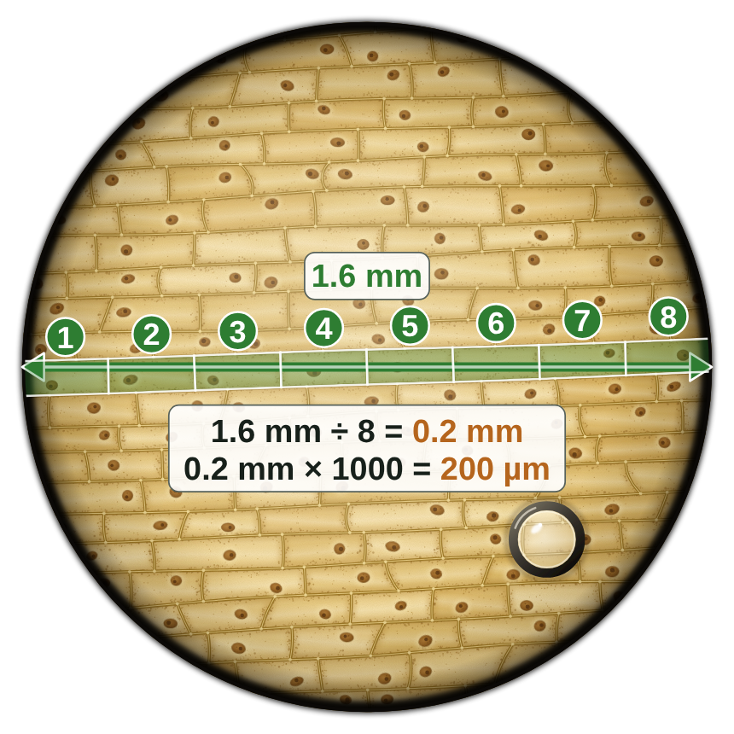
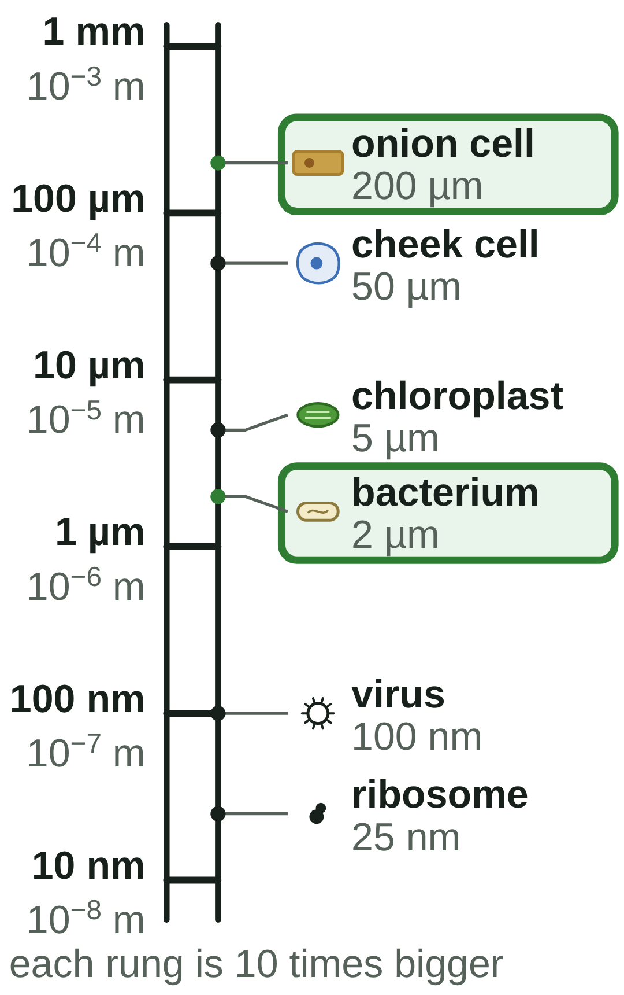
B1 L4 Revision notes 3 of 4
Magnification and cell size
Getting it right, the field of view, standard form and orders of magnitude
9. Getting it right
11. Standard form
Watch out: change both sizes into the same unit before you divide. mm → µm: multiply by 1000. If you forget, your answer is 1000 times too small or too big.
Standard form writes a very large or very small number as a number between 1 and 10 multiplied by a power of 10.
Watch out: the real size is smaller than the image. If your answer is bigger, the equation is upside down: divide, do not multiply.
Length | In metres | Standard form
1 mm | 0.001 m | 1 × 10⁻³ m
1 µm | 0.000 001 m | 1 × 10⁻⁶ m
1 nm | 0.000 000 001 m | 1 × 10⁻⁹ m
an onion cell, 200 µm | 0.0002 m | 2 × 10⁻⁴ m
a bacterium, 2 µm | 0.000 002 m | 2 × 10⁻⁶ m
Watch out: do not type the × sign into your calculator. For × 1500, type 1500.
10. Estimating size from the field of view
With a × 10 eyepiece lens:
Magnification | Width of the field of view
× 40 | about 4.0 mm
× 100 | about 1.6 mm
× 400 | about 0.4 mm
Count how many places the decimal point moves to give a number between 1 and 10. That is the power.
Small numbers (less than 1) have negative powers. Big numbers have positive powers: 2000 = 2 × 10³.
size of one cell ≈ width of the field of view ÷ number of cells across
Watch out: the first number must be between 1 and 10. 25 × 10⁻⁶ m is not standard form: write 2.5 × 10⁻⁵ m.
Example: at × 40, about 20 onion cells fit across the 4.0 mm field of view. 4.0 ÷ 20 = 0.2 mm = 200 µm.
This is an estimate: cells vary in size, and cells at the edge are cut off. Use estimates to check that a calculated answer is sensible.
12. Orders of magnitude
An order of magnitude is a factor of 10. To compare two sizes:
1. Put them in the same unit.
2. Divide the bigger by the smaller.
3. Write the answer as a power of 10. The power is the number of orders of magnitude.
Example: a plant cell about 100 µm across and a bacterium about 1 µm long. 100 ÷ 1 = 100 = 10², so the plant cell is 2 orders of magnitude bigger.
Which method? Three ways to find a real size
The magnification is given: real size = image size ÷ magnification.
The picture has a scale bar: real size = size on the picture ÷ length of the scale bar × value of the scale bar.
You can see the whole field of view: size of one cell ≈ width of the field of view ÷ number of cells across. This is only an estimate.
Watch out: two orders of magnitude is 10 × 10 = 100 times, not 20 times.
B1 L4 · Magnification and cell size · sciencegcse.co.uk · free GCSE science resources
Notes:
Revision notes page 3 of 4. The three mistakes to avoid in a calculation, estimating size from the field of view, standard form and orders of magnitude. Ask: why is the size from the field of view only an estimate?

Slide 27
B1 L4 Revision notes 4 of 4
Magnification and cell size
Key words, exam tips and check yourself
Key words
Check yourself
Cover the answers, then check.
Estimate: a rough value worked out quickly, using simple numbers.
Field of view: the circle you can see when you look down a microscope.
Image size: the size of an object in a picture or drawing, measured with a ruler.
Light micrograph: a picture of something seen through a light microscope.
Magnification: how many times bigger the image is than the real object.
Micrometre (µm): one thousandth of a millimetre (1 mm = 1000 µm).
Nanometre (nm): one thousandth of a micrometre (1 µm = 1000 nm).
Order of magnitude: a factor of 10; one order of magnitude bigger means about 10 times bigger.
Real size: the actual size of the object, before it was magnified.
Scale bar: a line on a picture that shows a real length, such as 10 µm.
Stain: a dye that colours cells, or parts of cells, so they are easier to see.
Standard form: a way of writing a very large or very small number as a number between 1 and 10 multiplied by a power of 10, such as 2 × 10⁻⁶.
1. Change 2.5 mm into µm.
2. Change 750 nm into µm.
3. What does a magnification of × 250 mean?
4. Write the equation for the real size of an object.
5. An image is 18 mm long. The real object is 0.09 mm long. Calculate the magnification.
6. A 5 µm scale bar is 10 mm long. A chloroplast in the same picture is 12 mm long. How long is the real chloroplast?
7. Write 0.0003 m in standard form.
8. One object is 10 000 times bigger than another. How many orders of magnitude bigger is it?
Answers
1. 2.5 × 1000 = 2500 µm.
2. 750 ÷ 1000 = 0.75 µm.
3. The image is 250 times bigger than the real object.
4. real size = image size ÷ magnification.
5. 18 ÷ 0.09 = × 200.
6. 12 ÷ 10 × 5 = 6 µm.
7. 3 × 10⁻⁴ m.
8. 10 000 = 10⁴, so 4 orders of magnitude.
Exam tips
Learn the equation word for word: magnification = size of image ÷ size of real object.
Put both sizes in the same unit before you divide, and show your working.
Magnification has no unit: write × 400. A size always needs a unit: mm, µm or nm.
Check your answer: the real size is smaller than the image, and a cell is usually 1 to 200 µm.
With a scale bar, measure the bar and the object with a ruler, in mm.
In standard form, the first number is between 1 and 10, and a small number has a negative power.
A worked answer: set out every step
A drawing of a cheek cell is 25 mm wide. The magnification is × 500. Find its real width.
1. real size = image size ÷ magnification
2. = 25 ÷ 500 = 0.05 mm
3. 0.05 mm × 1000 = 50 µm
Check: 50 µm × 500 = 25 000 µm = 25 mm, the size of the drawing.
Common mistakes
Wrong: 20 mm ÷ 2 µm, with two different units. Right: change both into µm first: 20 000 ÷ 2.
Wrong: real size = image size × magnification. Right: real size = image size ÷ magnification.
Wrong: using the label (100 µm) as the length of the scale bar. Right: measure the bar with a ruler.
Wrong: 25 × 10⁻⁶ m. Right: 2.5 × 10⁻⁵ m: the first number is between 1 and 10.
Wrong: two orders of magnitude is 20 times. Right: it is 10 × 10 = 100 times.
In the exam, each step can earn a mark, so write every step and give the unit.
B1 L4 · Magnification and cell size · sciencegcse.co.uk · free GCSE science resources
Notes:
Revision notes page 4 of 4. Key words, exam tips and Check yourself: students cover the answers, try all eight, then check. The common mistakes and the worked answer sum up the lesson: ask students to set out every calculation like the worked answer.

Slide 28
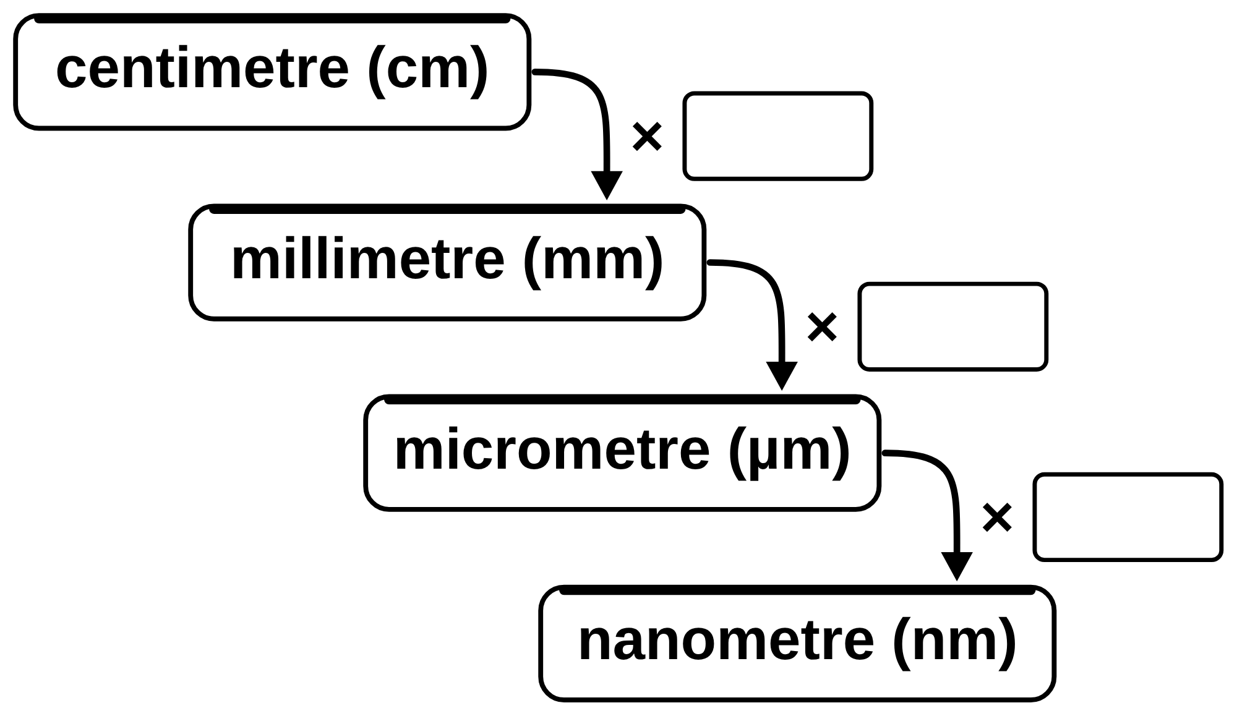
B1 L4 Mandatory worksheet: Magnification and cell size
Page 1 of 2
Name: ______________________________ Class: __________
A. Units for tiny things
B. Fill in the gaps
[8]
[4]
Help: online screen 3
Help: online screens 4 and 6
(a) Complete the units staircase. Write the missing number in each box. [3]
Use words from the box. Use each word once. Two words are not needed.
bigger
ruler
same
scale bar
smaller
unit
1.
Magnification tells you how many times ____________ the image is than the real object.
2.
You measure the size of an image with a ____________.
3.
Magnification has no ____________.
4.
The real size of a cell is ____________ than its image.
C. Which is bigger?
[6]
Help: online screen 3
Tick (✓) the bigger length in each row. Change them into the same unit first.
(b) Convert these lengths. [5]
 | Length A | Length B | A is bigger | B is bigger
1 | 1 mm | 100 µm
2 | 500 nm | 1 µm
3 | 0.5 mm | 600 µm
4 | 2000 nm | 3 µm
5 | 0.01 mm | 5 µm
6 | 1.2 µm | 900 nm
1.
6 mm =
µm
2.
80 µm =
mm
3.
3 µm =
nm
4.
4000 nm =
µm
5.
1.5 cm =
mm
B1 L4 · Magnification and cell size · sciencegcse.co.uk · free GCSE science resources

Slide 29
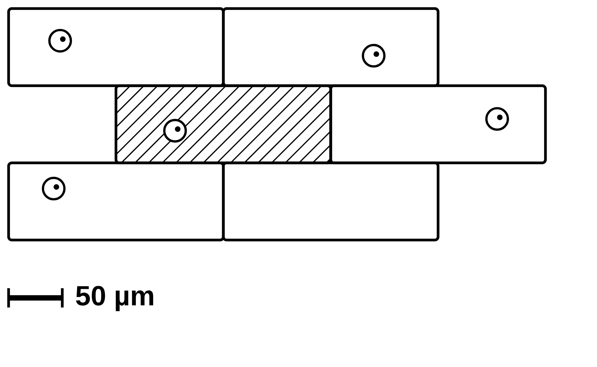
B1 L4 Mandatory worksheet: Magnification and cell size
Page 2 of 2
Name: ______________________________ Class: __________
D. Short answers
E. Calculate
[8]
[3]
Help: online screens 1, 2, 4, 6, 9, 10 and 11
Help: online screens 6 and 7
1. A micrograph is labelled × 1000. What does × 1000 tell you? [1]
Use:
real size = image size ÷ magnification
1 mm = 1000 µm
A drawing of a yeast cell is 21 mm long. The magnification is × 3000. Calculate the real length of the yeast cell in µm. Show your working. [3]
2. Complete the equation.
real size = ______________ ÷ ______________ [1]
3. Why are air bubbles left out of a biological drawing of cells? [1]
µm
4. Give one way a biological drawing is different from the view down the microscope. [1]
F. Use a scale bar
[4]
Help: online screens 4 and 9
The drawing shows onion cells. A student measured the drawing with a ruler. The 50 µm scale bar was 12 mm long. The shaded cell was 48 mm long.
5. What is the field of view? [1]
(a) Calculate the real length of the shaded cell in µm. Use: real size = size on the picture ÷ length of the scale bar × value of the scale bar. [2]
6. A picture has a scale bar labelled 20 µm. What does the scale bar show? [1]
7. Write 1 µm in metres, in standard form. [1]
µm
1 µm =
m
(b) Change your answer to (a) into mm. [1]
mm
8. A plant cell is two orders of magnitude bigger than a bacterium. How many times bigger is it? [1]
(c) The scale bar is 12 mm long and stands for 50 µm. Calculate the magnification of the drawing. Use: 12 mm = 12 000 µm. [1]
times
magnification = ×
B1 L4 · Magnification and cell size · sciencegcse.co.uk · free GCSE science resources

Slide 30
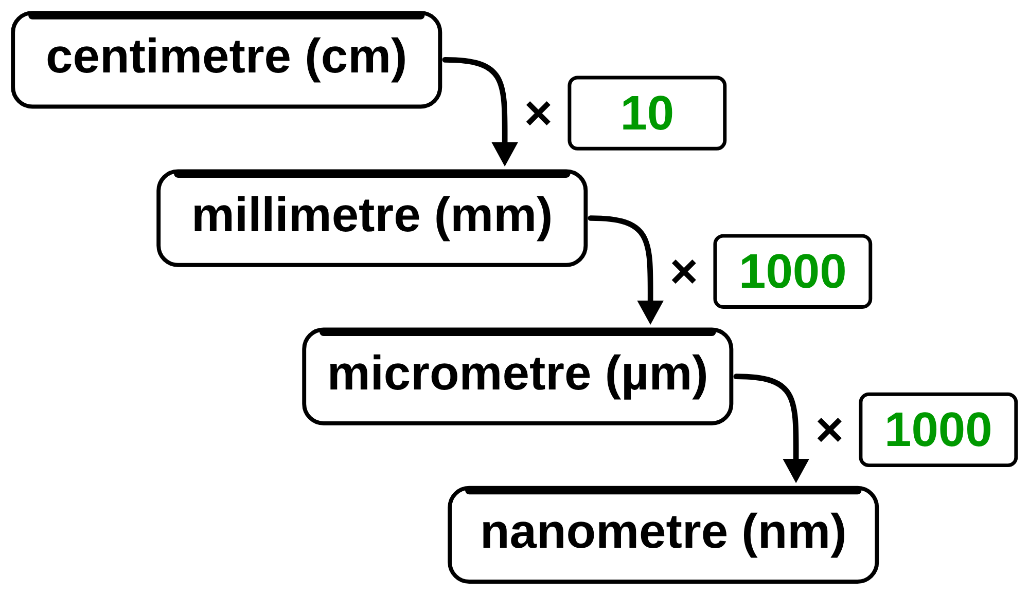
B1 L4 Mandatory worksheet answers - page 1
Answers 1 of 2
A. Units for tiny things
B. Fill in the gaps
[8]
[4]
(a) Complete the units staircase. Write the missing number in each box. [3]
Use words from the box. Use each word once. Not needed: same, scale bar.
bigger
ruler
same
scale bar
smaller
unit
1.
Magnification tells you how many times bigger the image is than the real object. (1)
2.
You measure the size of an image with a ruler. (1)
3.
Magnification has no unit. (1)
4.
The real size of a cell is smaller than its image. (1)
C. Which is bigger?
[6]
Tick (✓) the bigger length in each row. Change them into the same unit first.
1 mark for each box: × 10 (1); × 1000 (1); × 1000 (1).
 | Length A | Length B | A is bigger | B is bigger
1 | 1 mm | 100 µm | ✓
2 | 500 nm | 1 µm |  | ✓
3 | 0.5 mm | 600 µm |  | ✓
4 | 2000 nm | 3 µm |  | ✓
5 | 0.01 mm | 5 µm | ✓
6 | 1.2 µm | 900 nm | ✓
(b) Convert these lengths. [5]
1.
6 mm =
6000
µm (1)
2.
80 µm =
0.08
mm (1)
3.
3 µm =
3000
nm (1)
4.
4000 nm =
4
µm (1)
5.
1.5 cm =
15
mm (1)
Do not accept 80 000 for 2 (multiplied: to change µm into mm, divide by 1000). Do not accept 0.004 for 4.
In the same unit: 1) 1 mm = 1000 µm; 2) 1 µm = 1000 nm; 3) 0.5 mm = 500 µm; 4) 3 µm = 3000 nm; 5) 0.01 mm = 10 µm; 6) 1.2 µm = 1200 nm. 1 mark for each row. Do not give the mark if both boxes in a row are ticked.
B1 L4 · Magnification and cell size · sciencegcse.co.uk · free GCSE science resources

Slide 31
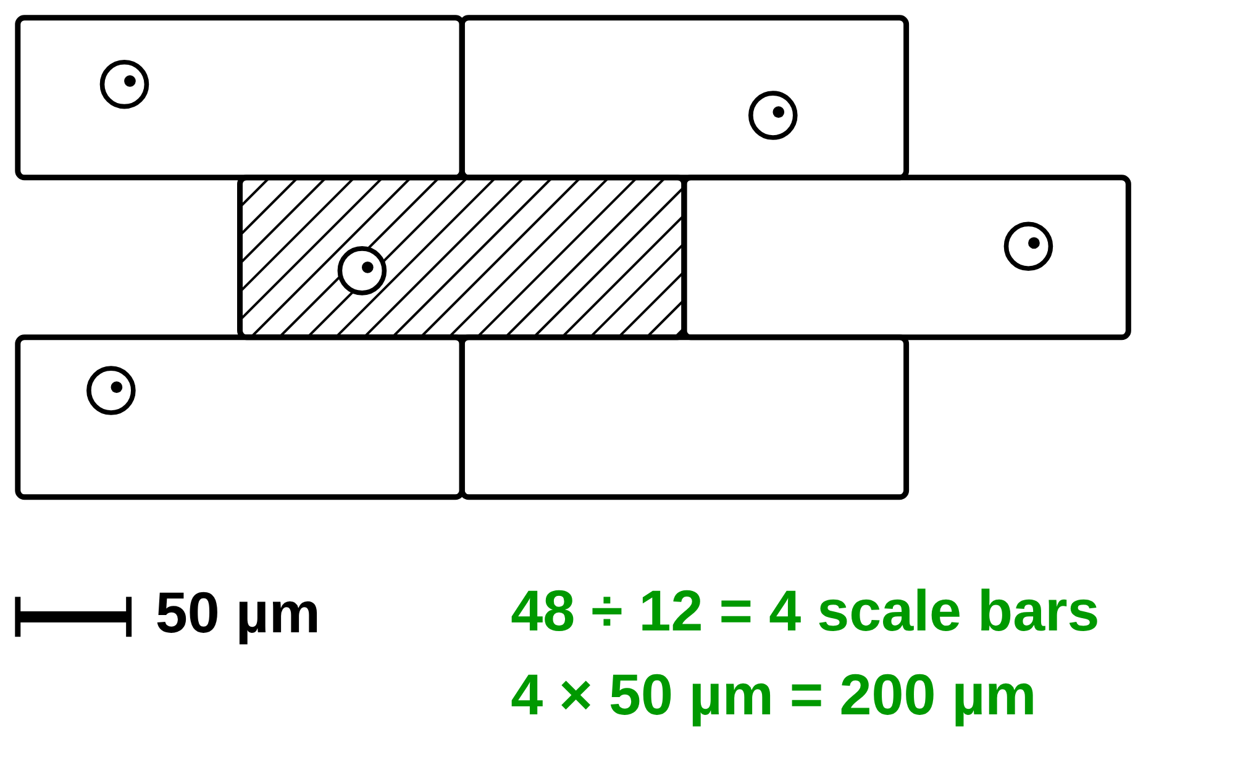
B1 L4 Mandatory worksheet answers - page 2
Answers 2 of 2
D. Short answers
E. Calculate
[8]
[3]
1. A micrograph is labelled × 1000. What does × 1000 tell you? [1]
Use:
real size = image size ÷ magnification
1 mm = 1000 µm
The image is 1000 times bigger than the real object (1). Allow “the cell looks 1000 times bigger than it really is”. Do not accept “it is 1000 mm” or “1000 µm” (magnification has no unit).
21 ÷ 3000 (1) = 0.007 (mm) (1)
0.007 × 1000 = 7 (µm) (1)
Correct answer with no working scores 3. An answer of 0.007 mm scores 2. Do not accept 63 000 (21 × 3000: multiplied, so bigger than the image).
Model answer: real size = 21 ÷ 3000 = 0.007 mm. 0.007 × 1000 = 7 µm.
2. Complete the equation.
real size = ______________ ÷ ______________ [1]
image size ÷ magnification (1). Allow “size of image ÷ magnification”. Both needed, in this order. Do not accept magnification ÷ image size.
3. Why are air bubbles left out of a biological drawing of cells? [1]
An air bubble is not a cell / not part of the specimen (it is air trapped under the coverslip) (1). Do not accept “it is too big” or “it is too dark”.
F. Use a scale bar
4. Give one way a biological drawing is different from the view down the microscope. [1]
[4]
Any one (1): the drawing has a scale bar; the drawing shows only whole cells / cells are not cut off at the edge; the drawing makes the cells neat / the same shape; the drawing leaves out air bubbles; the drawing has no colour / uses pencil lines / no shading. Do not accept “the drawing is smaller” or “the drawing is not real”.
(a)
48 ÷ 12 = 4 (1); 4 × 50 = 200 (µm) (1)
Do not accept 50 µm (the scale bar’s label) or 2400 (48 × 50).
5. What is the field of view? [1]
The circle you can see when you look down a microscope (1). Allow “what you can see down the microscope”.
6. A picture has a scale bar labelled 20 µm. What does the scale bar show? [1]
(b)
0.2 mm (1)
Allow their (a) ÷ 1000.
The length of the bar stands for 20 µm in real life / a real length of 20 µm (1). Do not accept “the cell is 20 µm long” or “the bar is 20 µm long on the page”.
(c)
12 000 ÷ 50 = × 240 (1)
Allow 240 without the × sign. Do not accept “240 mm”.
7. Write 1 µm in metres, in standard form. [1]
1 × 10⁻⁶ m (1). Do not accept 1 × 10⁶ m or 0.000 001 m (not standard form).
Model answers
8. A plant cell is two orders of magnitude bigger than a bacterium. How many times bigger is it? [1]
(a) 48 ÷ 12 = 4 scale bars long. 4 × 50 µm = 200 µm.
(b) 200 ÷ 1000 = 0.2 mm.
(c) 12 000 µm ÷ 50 µm = × 240.
100 times (1). Do not accept 20 (two orders of magnitude is 10 × 10, not 2 × 10).
B1 L4 · Magnification and cell size · sciencegcse.co.uk · free GCSE science resources

Slide 32
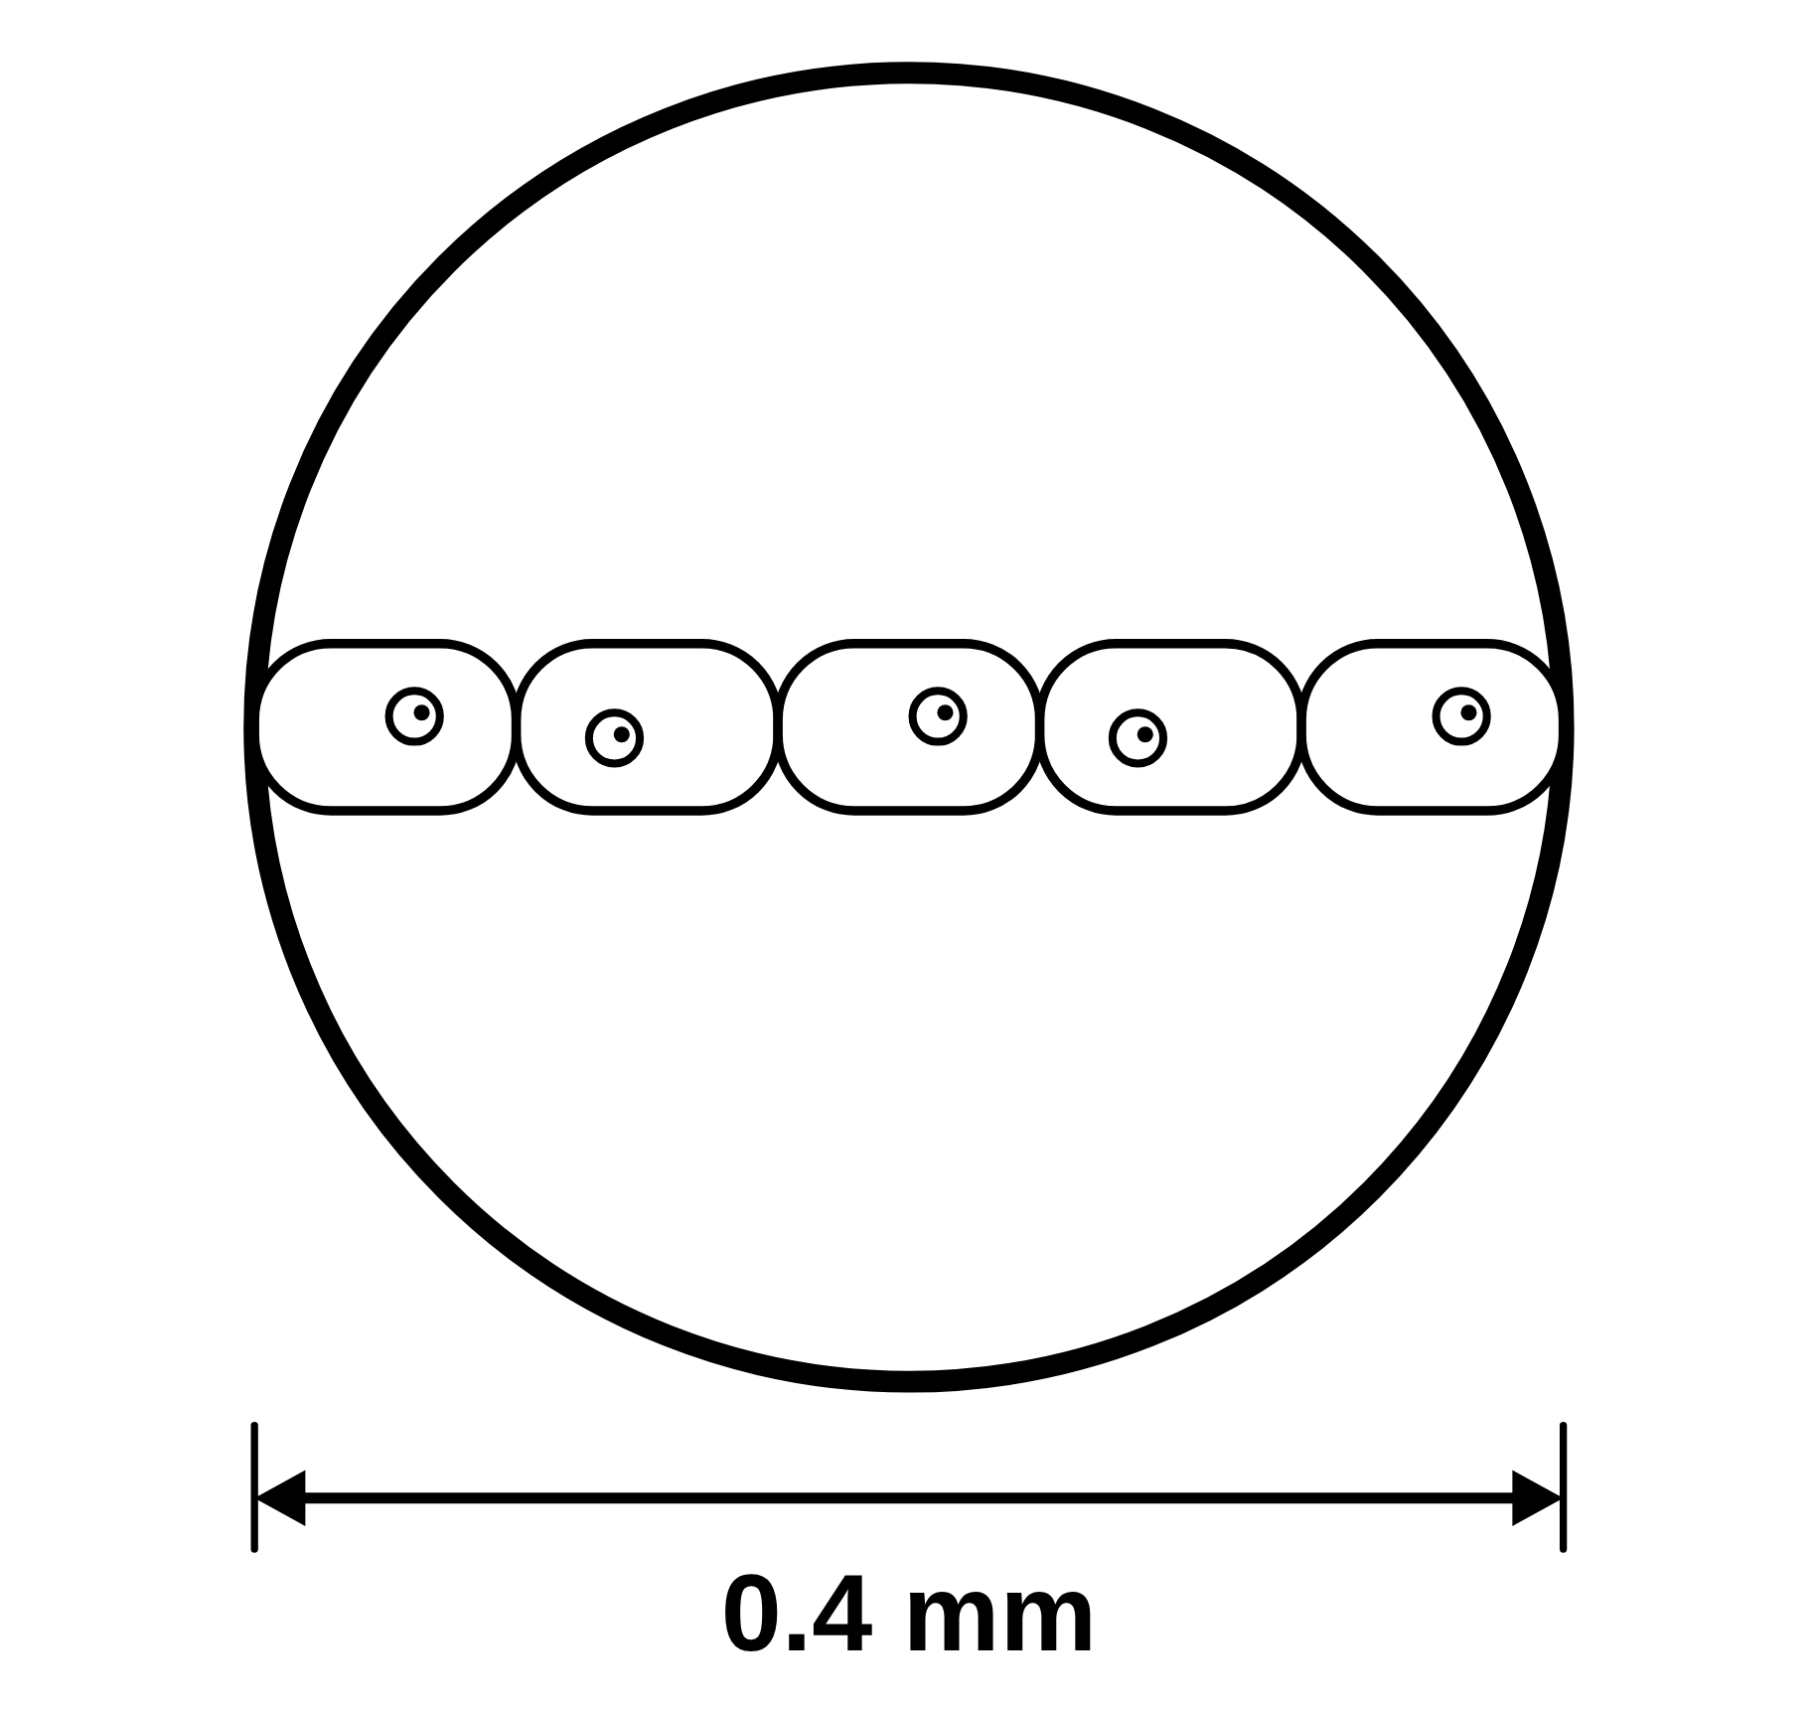
B1 L4 Challenge worksheet: Magnification and cell size
Page 1 of 2
Name: ______________________________ Class: __________
A. A ribosome in an electron micrograph
B. Estimating from the field of view
[5]
[5]
Help: online screens 3 and 10
An electron micrograph shows a ribosome.
At × 400, the field of view of a microscope is 0.4 mm across.
Help: online screens 3, 6, 7 and 11
Its image is 5 mm across. The magnification is × 200 000.
A student sees a chain of 5 algal cells that just reaches across the field of view.
(a) Calculate the real width of the ribosome in nanometres (nm). 1 mm = 1000 µm and 1 µm = 1000 nm. [3]
(a) Estimate the length of one algal cell in µm. [2]
µm
nm
(b) At × 100, the field of view is 1.6 mm across. Estimate how many of these algal cells would fit across it. [2]
(b) Write the real width of the ribosome in metres, in standard form. [2]
cells
(c) Suggest why your answer to (a) is an estimate, not an exact size. [1]
m
B1 L4 · Magnification and cell size · sciencegcse.co.uk · free GCSE science resources

Slide 33
B1 L4 Challenge worksheet: Magnification and cell size
Page 2 of 2
Name: ______________________________ Class: __________
C. Comparing sizes
D. Extended response
[5]
[6]
Help: online screens 3 and 11
Help: online screens 4, 6, 7 and 9
The table shows the sizes of four structures.
A student has a printed micrograph of cheek cells. It has a scale bar labelled 20 µm, but no magnification is given. Describe how the student can find the real width of one cheek cell and the magnification of the micrograph. [6]
Structure | Size
plant cell | 0.1 mm
nucleus | 10 µm
mitochondrion | 1 × 10⁻⁶ m
virus | 100 nm
In your answer, say what to measure, which calculations to do and which units to use.
(a) Write the four structures in order of size. Start with the largest. [2]
largest
smallest
(b) How many orders of magnitude bigger is the plant cell than the mitochondrion? [1]
(c) A student says: ‘The plant cell is 1000 times bigger than the virus.’ Is the student right? Show your working. [2]
B1 L4 · Magnification and cell size · sciencegcse.co.uk · free GCSE science resources

Slide 34
B1 L4 Challenge worksheet answers - page 1
Answers 1 of 2
A. A ribosome in an electron micrograph
B. Estimating from the field of view
[5]
[5]
An electron micrograph shows a ribosome.
At × 400, the field of view of a microscope is 0.4 mm across.
Its image is 5 mm across. The magnification is × 200 000.
A student sees a chain of 5 algal cells that just reaches across the field of view.
(a)
5 ÷ 200 000 = 0.000 025 mm (1); × 1000 = 0.025 µm (1); × 1000 = 25 nm (1)
Correct answer with no working scores 3. Allow changing units first: 5 mm = 5 000 000 nm (1); 5 000 000 ÷ 200 000 (1) = 25 nm (1).
(a)
0.4 mm = 400 µm (1); 400 ÷ 5 = 80 µm (1)
Allow 0.4 ÷ 5 = 0.08 mm, then 80 µm.
(b)
25 nm = 0.000 000 025 m (1); = 2.5 × 10⁻⁸ m (1)
Allow their (a) correctly converted. Do not accept 25 × 10⁻⁹ m for the second mark (the first number must be between 1 and 10).
Model answers
(a) 5 ÷ 200 000 = 0.000 025 mm = 0.025 µm = 25 nm.
(b) 25 nm = 0.000 000 025 m = 2.5 × 10⁻⁸ m.
(b)
1.6 mm = 1600 µm (1); 1600 ÷ 80 = 20 (cells) (1)
Allow their (a) used correctly.
(c)
Any one (1): cells are not all the same size; the cells may not fit exactly across / there may be gaps or overlaps; the width of the field of view is only approximate.
Model answers
(a) 0.4 mm = 400 µm. 400 ÷ 5 = 80 µm.
(b) 1.6 mm = 1600 µm. 1600 ÷ 80 = 20 cells.
(c) The algal cells are not all exactly the same length.
B1 L4 · Magnification and cell size · sciencegcse.co.uk · free GCSE science resources

Slide 35
B1 L4 Challenge worksheet answers - page 2
Answers 2 of 2
C. Comparing sizes
D. Extended response
[5]
[6]
The table shows the sizes of four structures.
Level 3 (5–6 marks): A clear, logical method for both parts. The scale bar and the cell are measured with a ruler in mm; the real width is calculated from the scale bar with the right steps and units; the magnification is found by changing the bar’s length into µm and dividing by 20 µm (or image size ÷ real size, in the same unit). The steps are in a logical order. (A way to improve the result, such as measuring several cells, is credit-worthy but not needed for Level 3.)
Level 2 (3–4 marks): A method for the real width using the scale bar, with some correct steps. The magnification is missing or incomplete, or the units are not handled correctly.
Level 1 (1–2 marks): Simple statements, such as “measure the cell” or “use the scale bar”, with no clear method.
0 marks: No relevant content.
Indicative content
measure the length of the scale bar with a ruler, in mm
measure the width of one cell across its widest part, in mm
do not use the label (20 µm) as the bar’s length
divide the cell’s width by the bar’s length to find how many bars wide the cell is
multiply by 20 µm to get the real width in µm
to find the magnification, change the bar’s length into µm (× 1000)
magnification = size of image ÷ size of real object = the bar’s length in µm ÷ 20 µm (or the cell’s image width in µm ÷ its real width)
magnification has no unit
measure several cells and find the mean
check the answer is sensible (a cheek cell is about 50 µm across)
Model answer: Use a ruler to measure the length of the scale bar in mm, for example 8 mm. Then measure the width of one cheek cell across its widest part, for example 20 mm. Divide the cell’s width by the bar’s length to find how many bars wide the cell is: 20 ÷ 8 = 2.5. Multiply by the value of the bar: 2.5 × 20 µm = 50 µm. This is the real width. To find the magnification, change the bar’s length into µm: 8 mm = 8000 µm. Then magnification = size of image ÷ size of real object = 8000 ÷ 20 = × 400. To get a better answer, measure several cells and work out the mean width.
Structure | Size
plant cell | 0.1 mm
nucleus | 10 µm
mitochondrion | 1 × 10⁻⁶ m
virus | 100 nm
(a) Write the four structures in order of size. Start with the largest. [2]
plant cell
nucleus
mitochondrion
virus
largest
smallest
(a)
plant cell, nucleus, mitochondrion, virus (2). One pair the wrong way round (1). (In µm: 100, 10, 1, 0.1.)
(b)
2 (1): 100 µm ÷ 1 µm = 100 = 10². Do not accept 20 or 100.
(c)
0.1 mm = 100 µm = 100 000 nm (or virus 100 nm = 0.1 µm) (1); 100 000 ÷ 100 = 1000, so yes, the student is right (1).
“Yes” with no working scores 0.
Model answers
(a) plant cell, nucleus, mitochondrion, virus.
(b) 100 µm ÷ 1 µm = 100 = 10², so 2 orders of magnitude.
(c) 0.1 mm = 100 000 nm. 100 000 ÷ 100 = 1000, so the student is right.
B1 L4 · Magnification and cell size · sciencegcse.co.uk · free GCSE science resources

Slide 36
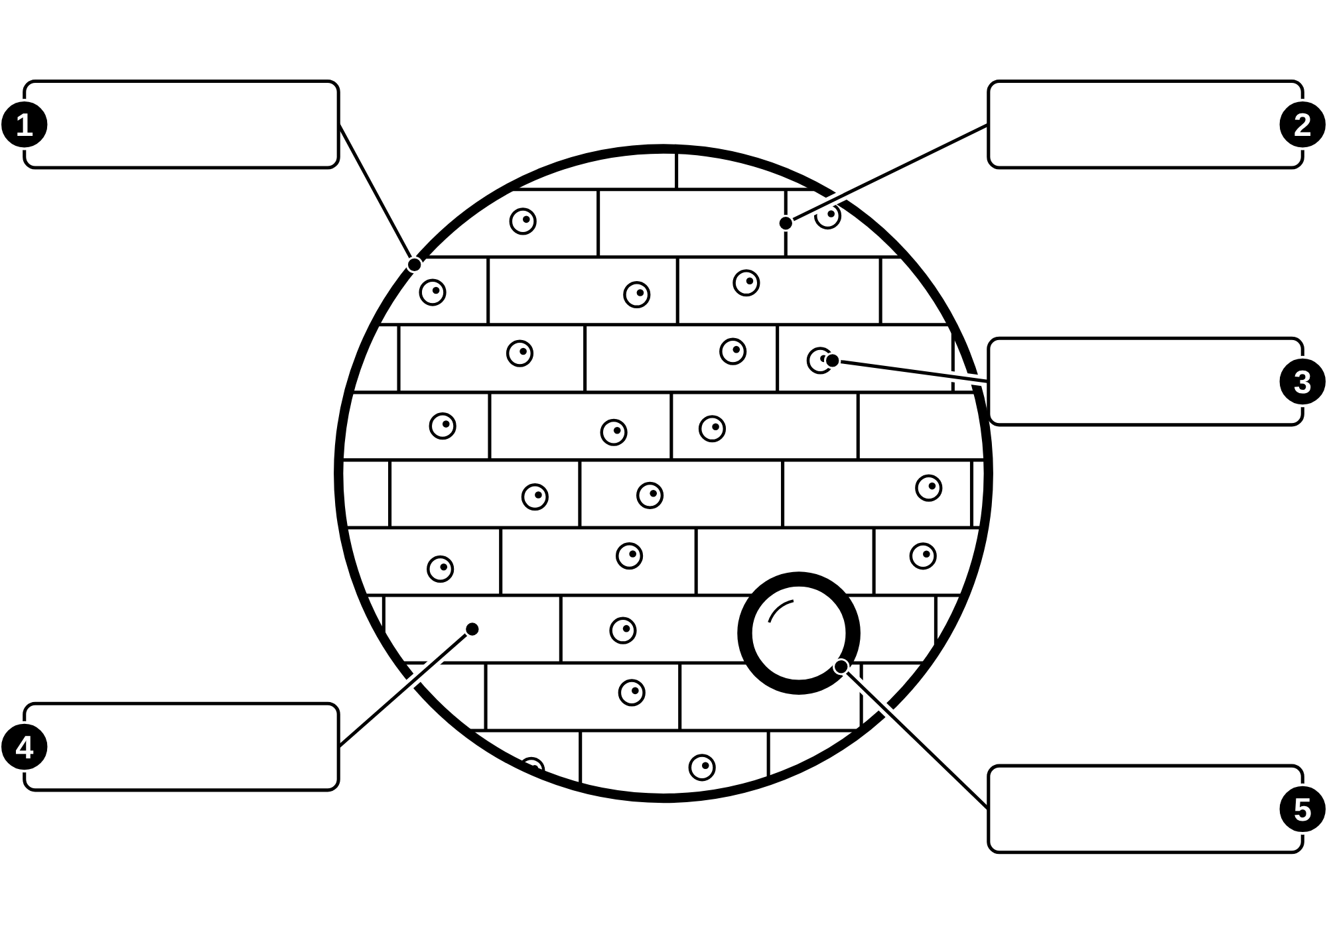
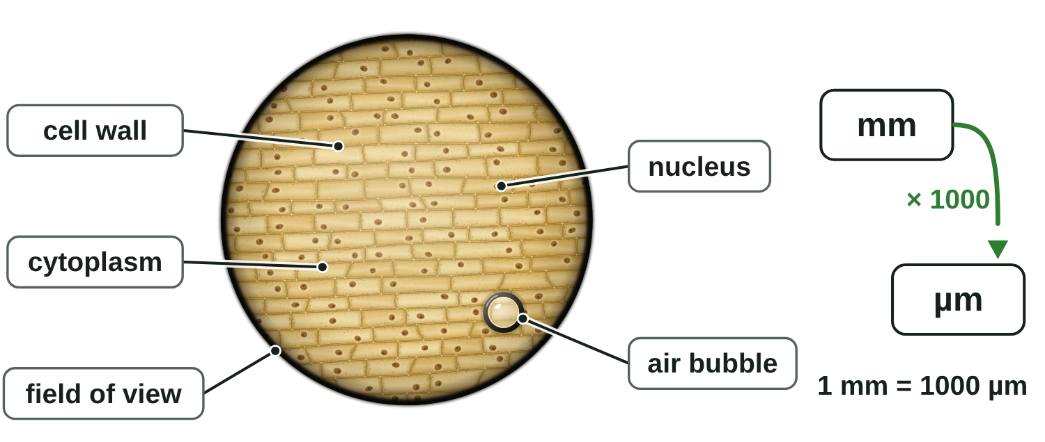
B1 L4 Alternative worksheet: Magnification and cell size
Page 1 of 2
Name: ______________________________ Class: __________
Key facts
A. Label the view down the microscope
[5]
Cells are tiny. We measure them in micrometres (µm).
1 mm = 1000 µm. 1 µm = 1000 nm.
Magnification is how many times bigger the image is than the real object.
magnification = size of image ÷ size of real object
Magnification has no unit. We write it like this: × 100.
The real size is smaller than the image.
A scale bar is a line on a picture that shows a real length.
The field of view is the circle you can see when you look down a microscope.
Write a word from the box in each label box.
Help: online screens 1 and 2
air bubble
cell wall
cytoplasm
field of view
nucleus
The view at × 100, and the units staircase.
Tip: the air bubble is not a cell.
B1 L4 · Magnification and cell size · sciencegcse.co.uk · free GCSE science resources

Slide 37
B1 L4 Alternative worksheet: Magnification and cell size
Page 2 of 2
Name: ______________________________ Class: __________
B. Match the word to its meaning
C. Fill the gaps
[5]
[6]
Help: online screens 3, 4, 9 and 10
Help: online screens 3, 4 and 6
Draw a line from each word to its meaning.
Use the words in the box. Use each word once.
micrometre (µm)
a line on a picture that shows a real length
1000
bigger
divide
multiply
smaller
unit
nanometre (nm)
one thousandth of a millimetre
1. One millimetre is the same as __________ micrometres.
magnification
how many times bigger the image is than the real object
2. To change mm into µm, you __________ by 1000.
3. To change µm into mm, you __________ by 1000.
scale bar
the circle you can see when you look down a microscope
4. Magnification has no __________.
field of view
one thousandth of a micrometre
5. The image is __________ than the real object.
6. The real cell is __________ than its image.
D. True or false?
[6]
Help: online screens 2, 3, 4 and 9
E. Work it out
[5]
Tick (✓) True or False for each sentence.
Help: online screens 3, 4 and 6
Sentence | True | False
1. 1 mm is bigger than 1 µm.
2. Magnification is measured in mm.
3. × 100 means the image is 100 times bigger than the real object.
4. A biological drawing should include the air bubbles.
5. A scale bar shows a real length.
6. 1 µm is the same as 100 nm.
1 mm = 1000 µm. Fill in each answer.
1. 7 mm = __________ µm
2. 5000 µm = __________ mm
3. A drawing of a cell is 20 mm long. The magnification is × 100.
Real size = 20 ÷ 100 = __________ mm
4. Change your answer to question 3 into µm: __________ µm
5. An image is 30 mm long. The real object is 3 mm long.
Magnification = 30 ÷ 3 = × __________
B1 L4 · Magnification and cell size · sciencegcse.co.uk · free GCSE science resources

Slide 38
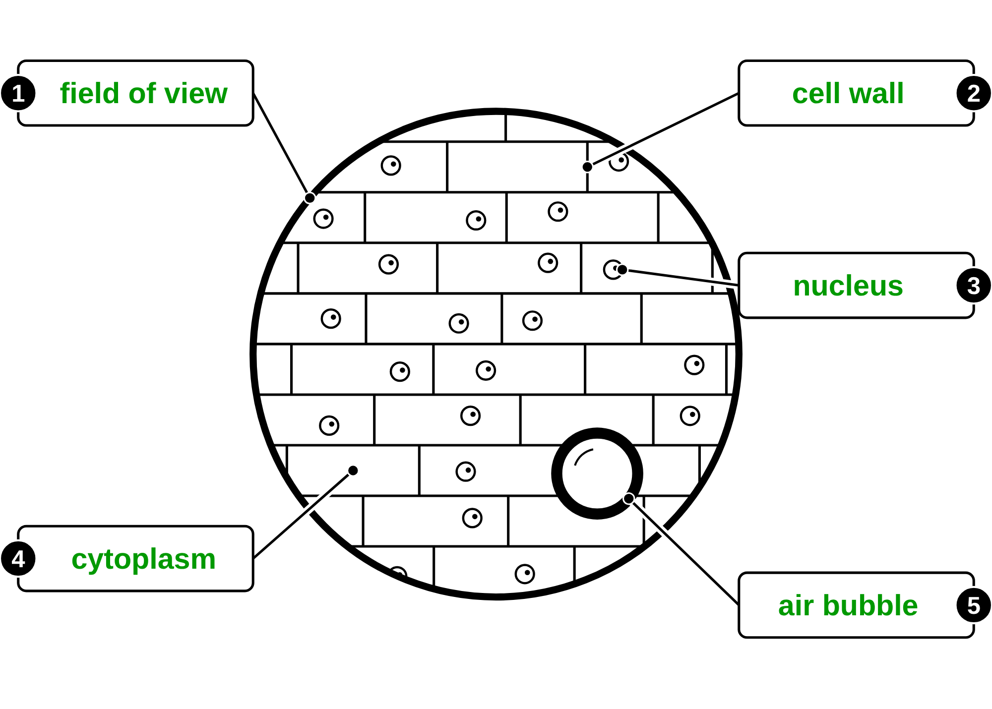
B1 L4 Alternative worksheet answers - page 1
Answers 1 of 2
Key facts
A. Label the view down the microscope
[5]
Cells are tiny. We measure them in micrometres (µm).
1 mm = 1000 µm. 1 µm = 1000 nm.
Magnification is how many times bigger the image is than the real object.
magnification = size of image ÷ size of real object
Magnification has no unit. We write it like this: × 100.
The real size is smaller than the image.
A scale bar is a line on a picture that shows a real length.
The field of view is the circle you can see when you look down a microscope.
Write a word from the box in each label box.
air bubble
cell wall
cytoplasm
field of view
nucleus
1 field of view (1); 2 cell wall (1); 3 nucleus (1);
4 cytoplasm (1); 5 air bubble (1).
Allow small spelling errors if the word is clear.
The view at × 100, and the units staircase.
B1 L4 · Magnification and cell size · sciencegcse.co.uk · free GCSE science resources

Slide 39
B1 L4 Alternative worksheet answers - page 2
Answers 2 of 2
B. Match the word to its meaning
C. Fill the gaps
[5]
[6]
Draw a line from each word to its meaning.
Use the words in the box. Use each word once.
1 mark for each correct line.
micrometre (µm)
a line on a picture that shows a real length
1000
bigger
divide
multiply
smaller
unit
nanometre (nm)
one thousandth of a millimetre
1. One millimetre is the same as 1000 micrometres. (1)
magnification
how many times bigger the image is than the real object
2. To change mm into µm, you multiply by 1000. (1)
3. To change µm into mm, you divide by 1000. (1)
scale bar
the circle you can see when you look down a microscope
4. Magnification has no unit. (1)
field of view
one thousandth of a micrometre
5. The image is bigger than the real object. (1)
6. The real cell is smaller than its image. (1)
D. True or false?
[6]
E. Work it out
1. 1 mm is bigger than 1 µm. True. (1)
2. Magnification is measured in mm. False. Magnification has no unit. (1)
3. × 100 means the image is 100 times bigger than the real object. True. (1)
4. A biological drawing should include the air bubbles. False. An air bubble is not a cell, so it is left out of the drawing. (1)
5. A scale bar shows a real length. True. (1)
6. 1 µm is the same as 100 nm. False. 1 µm = 1000 nm. (1)
[5]
1 mm = 1000 µm. Fill in each answer.
1. 7 mm = 7000 µm (1)
2. 5000 µm = 5 mm (1)
3. A drawing of a cell is 20 mm long. The magnification is × 100.
Real size = 20 ÷ 100 = 0.2 mm (1)
4. Change your answer to question 3 into µm: 200 µm (1)
5. An image is 30 mm long. The real object is 3 mm long.
Magnification = 30 ÷ 3 = × 10 (1)
B1 L4 · Magnification and cell size · sciencegcse.co.uk · free GCSE science resources

Slide 40
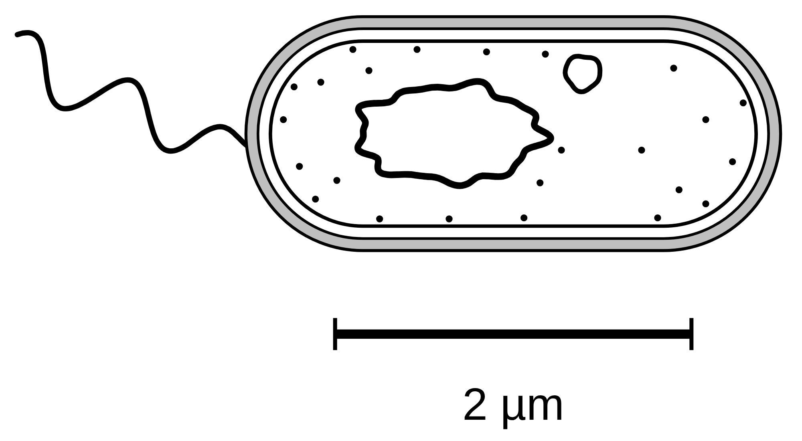
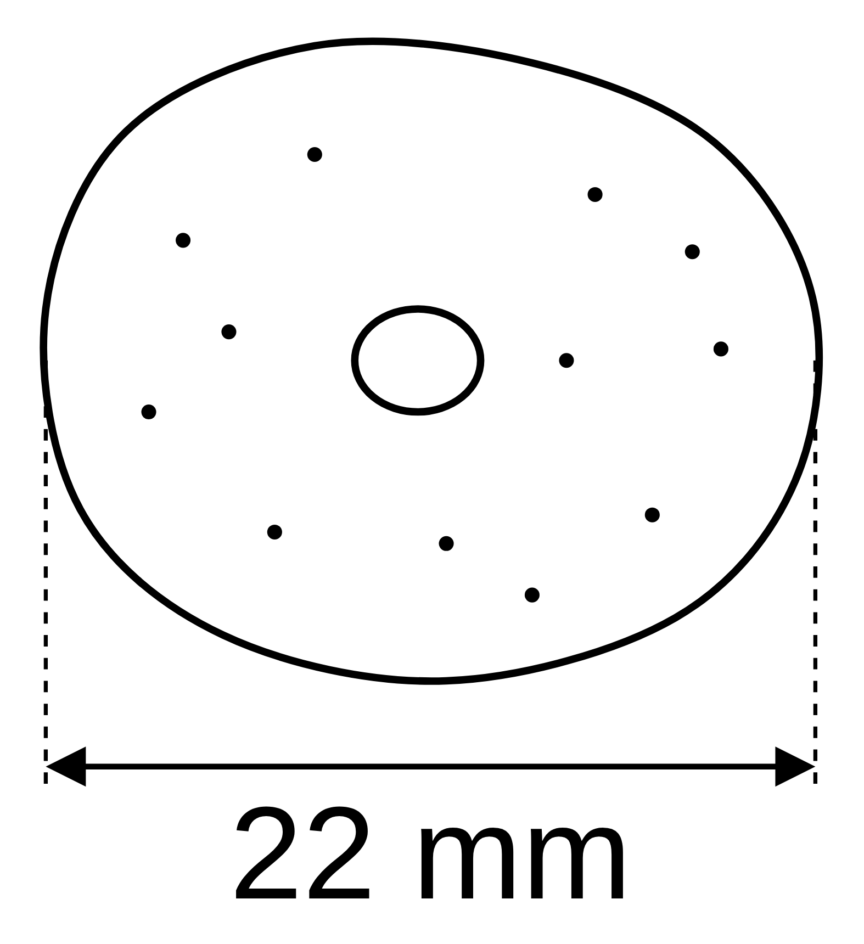
B1 L4 Exam questions worksheet mark scheme - page 1
Answers 1 of 2
01 Units
03 A scale bar
[3]
[2]
01.1 Draw one line from each unit to the length it is equal to. [2]
1 cm → 10 mm; 1 mm → 1000 µm; 1 µm → 1000 nm
3 correct = 2 marks; 1 or 2 correct = 1 mark. If more than one line is drawn from a unit, none of its lines scores.
01.2 Which structure is the smallest? [1]
a ribosome, 25 nm wide (1)
If more than one box is ticked, give 0 marks.
03 Calculate the real length of the bacterium. [2]
45 ÷ 30 = 1.5 (1)
1.5 × 2 = 3 µm (1)
do not accept 2 µm (the label)
Correct answer with no working = 2 marks. allow 45 ÷ 15 = 3 µm (15 mm stands for 1 µm). ignore units.
real length 3 µm
02 A cheek cell
04 The field of view
[5]
[4]
02.1 Calculate the real width of the cheek cell in µm. [3]
22 ÷ 400 (1) = 0.055 mm (1) = 55 µm (1)
allow 22 000 µm ÷ 400 = 55 µm for 3 marks. 0.055 mm = 2 marks; 0.055 with the unit µm = 2 marks. do not accept 8800 (multiplied).
04.1 Estimate the length of one moss leaf cell in µm. [2]
1.8 ÷ 30 = 0.06 mm (1) = 60 µm (1)
Correct answer with no working = 2 marks. allow 1800 µm ÷ 30 = 60 µm. 0.06 mm = 1 mark. do not accept 54 (1.8 × 30).
04.2 Explain why the student sees fewer cells at × 400. [2]
the field of view is smaller (1)
each cell looks bigger, so fewer fit across (1)
allow ‘the field of view is only about a quarter as wide (about 0.45 mm)’ for the first mark. allow ‘only about 7 or 8 cells fit across’ for the second mark.
do not accept the cells get bigger
real width 55 µm
02.2 What does × 400 mean for the drawing? [1]
The drawing is 400 times bigger than the real cell (1)
02.3 Write your answer to 02.1 in metres, in standard form. [1]
5.5 × 10⁻⁵ m (1)
allow their 02.1. do not accept 55 × 10⁻⁶
B1 L4 · Magnification and cell size · sciencegcse.co.uk · free GCSE science resources

Slide 41
B1 L4 Exam questions worksheet mark scheme - page 2
Answers 2 of 2
05 Extended response
[6]
05 A student has two micrographs. Micrograph A shows plant cells at a magnification of × 200. Micrograph B shows bacteria at a magnification of × 20 000. The student wants to find out how many times bigger a plant cell is than a bacterium. Describe how the student could use the two micrographs to find this out. [6]
Level descriptors
Level 3 (5–6 marks): A clear, logical method. Both cells are measured with a ruler, both real sizes are calculated with real size = image size ÷ magnification (or magnification = size of image ÷ size of real object, rearranged), both are put in the same unit, and the plant cell’s size is divided by the bacterium’s size. The steps are in a logical order. (A way to improve the result or to check it is sensible is credit-worthy but not needed for Level 3.)
Level 2 (3–4 marks): Measuring and using the magnification for at least one micrograph, with an idea of comparing the two sizes. One step, such as changing to the same unit, may be missing or unclear.
Level 1 (1–2 marks): Simple statements, such as ‘measure the cells’ or ‘the plant cell is bigger’, with no clear method.
0 marks: No relevant content.
Indicative content
measure the length of a plant cell in micrograph A with a ruler (in mm)
measure the length of a bacterium in micrograph B with a ruler (in mm)
real size = image size ÷ magnification
plant cell: divide its image length by 200
bacterium: divide its image length by 20 000
change both real sizes into the same unit (such as µm: × 1000)
divide the real size of the plant cell by the real size of the bacterium
the answer is how many times bigger the plant cell is
measure several cells of each and use the mean
measure the same dimension each time (such as the longest length)
give the answer as an order of magnitude (for example, about 100 times = 2 orders of magnitude)
check the answer is sensible: a plant cell is about 10 to 100 µm, a bacterium about 1 to 5 µm
Model answer (Level 3)
Use a ruler to measure the length of one plant cell in micrograph A, in mm. Work out its real length: real size = image size ÷ magnification, so divide the image length by 200. Do the same for one bacterium in micrograph B, dividing its image length by 20 000. Change both real lengths into µm by multiplying by 1000, so they are in the same unit. Then divide the real length of the plant cell by the real length of the bacterium. This tells you how many times bigger the plant cell is. For example, a plant cell image 20 mm long gives 20 ÷ 200 = 0.1 mm = 100 µm, and a bacterium image 40 mm long gives 40 ÷ 20 000 = 0.002 mm = 2 µm, so the plant cell is 100 ÷ 2 = 50 times longer. To make the answer more reliable, measure several cells of each type and use the mean. Check it is sensible: a plant cell should be about one to two orders of magnitude bigger than a bacterium.
B1 L4 · Magnification and cell size · sciencegcse.co.uk · free GCSE science resources

