Slide 1
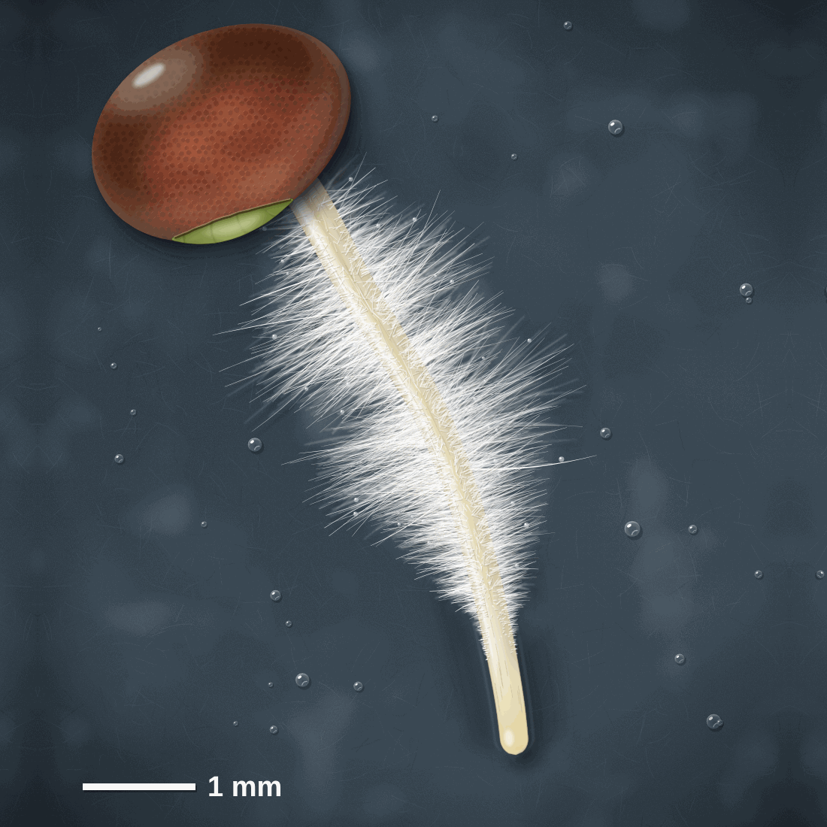
sciencegcse.co.uk · Biology B1 L5
DATE
B1 L5: Specialised cells
24/09/2026
DO NOW
KEYWORDS
1. Complete: 1 mm = ___ µm.
2. Complete: magnification = size of image ÷ ___.
3. Name the stain used on onion cells in the microscope practical.
Specialised cell
Differentiation
Adaptation
Root hair cell
Sperm cell
A painting of a young seedling root, seen through a hand lens.
B1 Cell biology
AQA Combined Science
Notes:
Do now: retrieval from B1 L4 (Q1, Q2) and B1 L3 (Q3). The picture is a painting of a radish seedling's root seen through a hand lens, about ten times bigger than real life. Ask: what can you see? (A seed, a root, a white fuzz of tiny hairs, and a smooth tip with no hairs.) Each white hair is part of one cell, a root hair cell. Today: how cells like this are built for their jobs, and how they get that way. Suggested 60 min: slides 1-3 (8 min); slides 4-9 (15 min); slides 10-13 (10 min); slides 14-18 (12 min); Mandatory worksheet started in class (10 min), finished for homework; exit ticket slides 22-23 (5 min). Use slides 19-21 if time allows. Homework: online lesson quiz and the B1 L5 Exam questions worksheet.

Slide 2
sciencegcse.co.uk · Biology B1 L5: Specialised cells
Do now answers and lesson focus
Do now answers
In this lesson
1. 1000.
2. Size of real object.
3. Iodine solution.
• Compare a real seedling root with a diagram of a root hair cell.
• Explain how six specialised cells are adapted to their jobs.
• Compare the sizes of cells, changing the units first.
• Describe how cells become specialised.
• Explain how a cell you have not met is adapted.
Key idea
A specialised cell has a structure that suits it to one job.
Cells become specialised by differentiation.
2
B1 L5 · sciencegcse.co.uk
Notes:
Go through the answers. Then share the lesson focus. The online lesson (sciencegcse.co.uk, B1 L5) follows the same 12 screens as this PowerPoint, so students can go over it at home. There are three checkpoints along the way. Q1 and Q2 come back today: on slide 11 we change mm into µm to compare cell sizes, and the exam practice uses the magnification equation. Q3: iodine solution stains onion cells yellow-brown so the cells, and parts such as the nucleus, are easier to see; the seedling root on slide 1 is not stained.

Slide 3
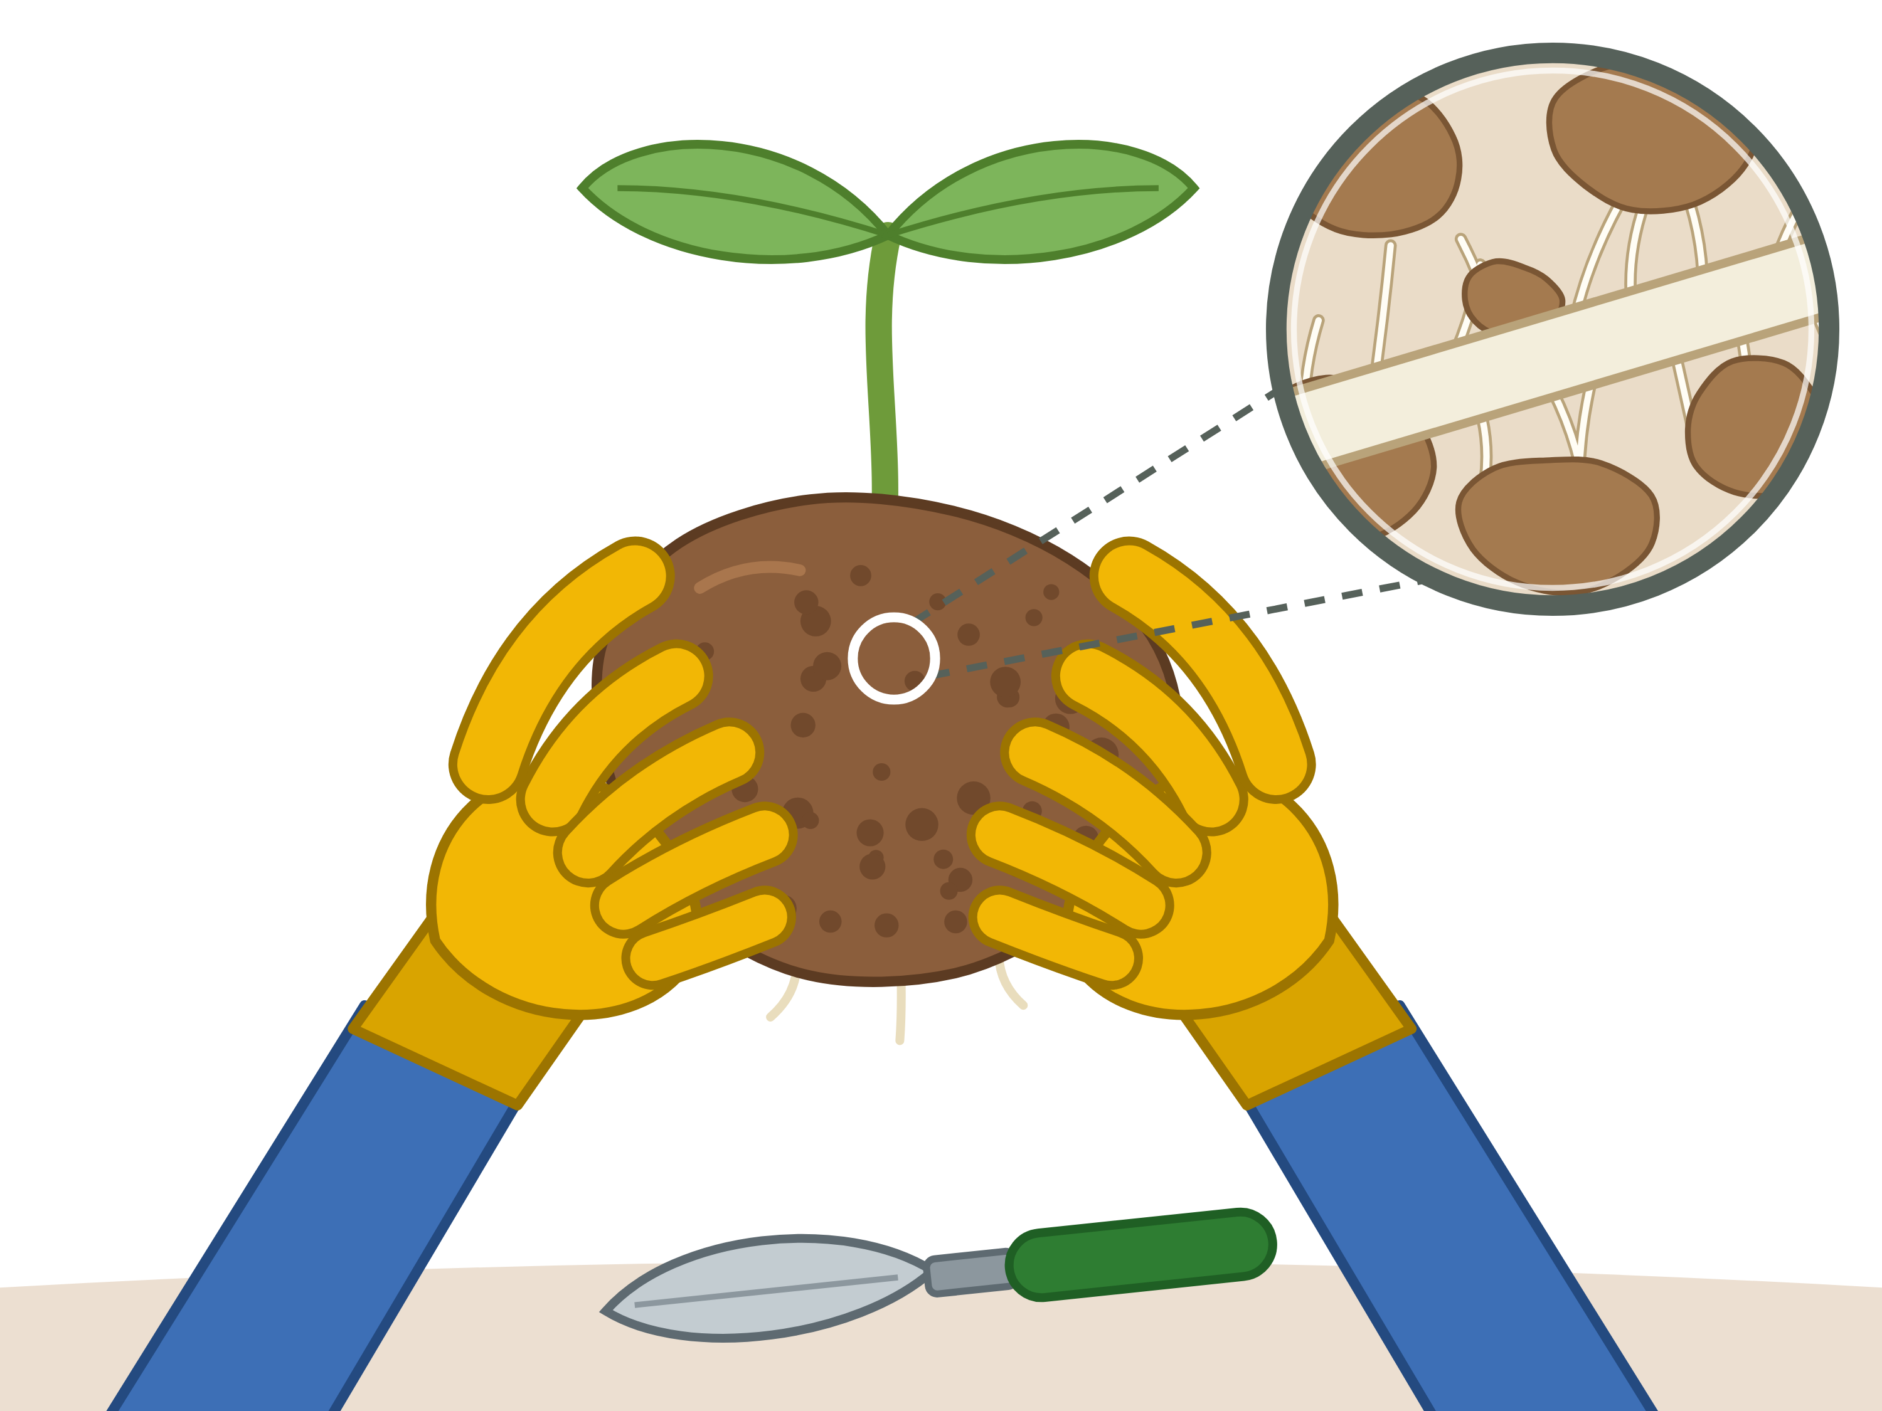
sciencegcse.co.uk · Biology B1 L5: Specialised cells
Why this matters in the real world
Your body, and every plant, depends on cells that are built for one job.
Over 200 types
Moving seedlings
The longest cells
200+
1 m
types of cell in your body
the longest nerve cells
Your body has more than 200 types of specialised cell. They all come from one cell, by division and differentiation.
Gardeners lift seedlings with soil round their roots. This stops the tiny root hairs being torn off, so the plant can still take in water.
Some nerve cells run from the bottom of your spine to your toes. Being long lets them carry impulses a long way.
Differentiation
Root hair cells
Nerve cells
3
B1 L5 · sciencegcse.co.uk
Notes:
Hook. Ask: why does a gardener keep a ball of soil round the roots when moving a seedling? (Pulling the roots out of the soil tears off most of the root hairs, so the plant cannot take in enough water and it wilts until new root hairs grow.) Ask: a nerve cell can be 1 m long, but a sperm cell is about 50 µm. Why are they so different? (Each cell's size and shape suit its job.) The figure of more than 200 cell types is the usual estimate for humans. The middle picture is a drawing: gloved hands lift a seedling with its ball of soil, and the circle shows the root hairs among the soil particles.

Slide 4
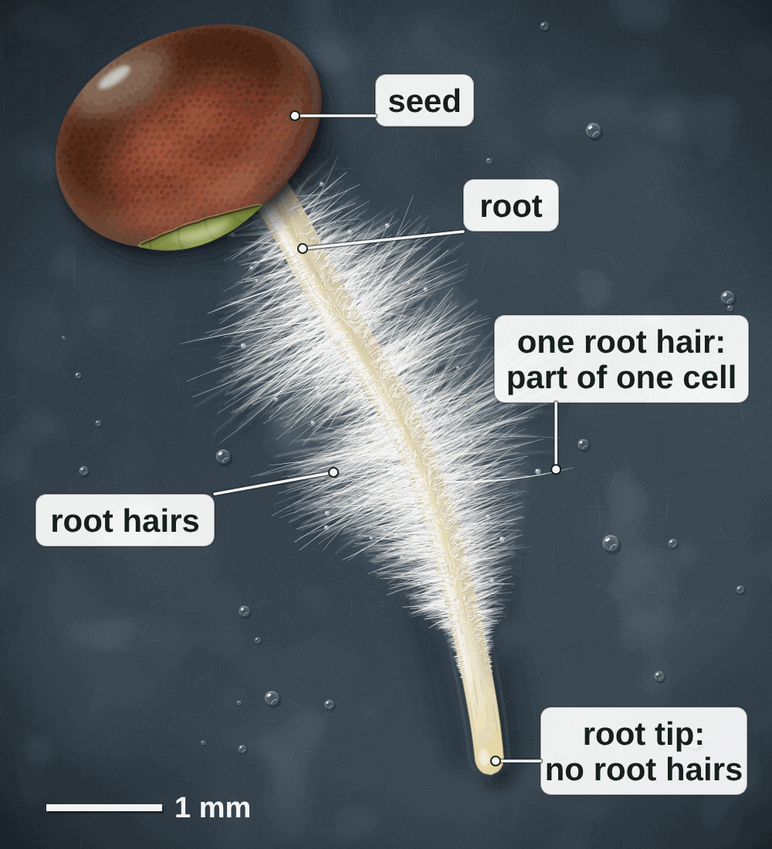
sciencegcse.co.uk · Biology B1 L5: Specialised cells
Online lesson: screen 1 of 12
A seedling root up close
A painting of a seedling root
Key facts
A specialised cell has a structure that suits it to one job.
The white fuzz on the root is thousands of root hairs.
Each root hair is part of one root hair cell: its long, thin extension.
Root hair cells take in water and mineral ions from the soil.
Near the root tip there are no root hairs yet: the new cells there have not yet become root hair cells.
Root hair cells have no chloroplasts, so the hairs are white.
A painting of a young seedling root, seen through a hand lens.
4
B1 L5 · sciencegcse.co.uk
Notes:
This is a painting of a radish seedling grown on damp paper for two or three days, seen through a hand lens, so it looks about ten times bigger than real life (the scale bar is 1 mm). Ask: what can you see? (A seed, a root, a white fuzz and a smooth tip.) Each white hair is not a separate hair: it is the long, thin extension of one cell, a root hair cell. Each one is up to about 1 mm long and much thinner than a hair on your head. Ask: why are they white, not green? (They grow underground where there is no light, so they have no chloroplasts.) Point to the bare tip: the cells there are new and have not yet become root hair cells. That is differentiation, which we come back to on slide 15. If you can, grow cress or radish seeds on damp paper in a dish a few days before the lesson and pass a hand lens round. One key fact a click. The picture is the same painting as screen 1 of the online lesson (labels on).

Slide 5
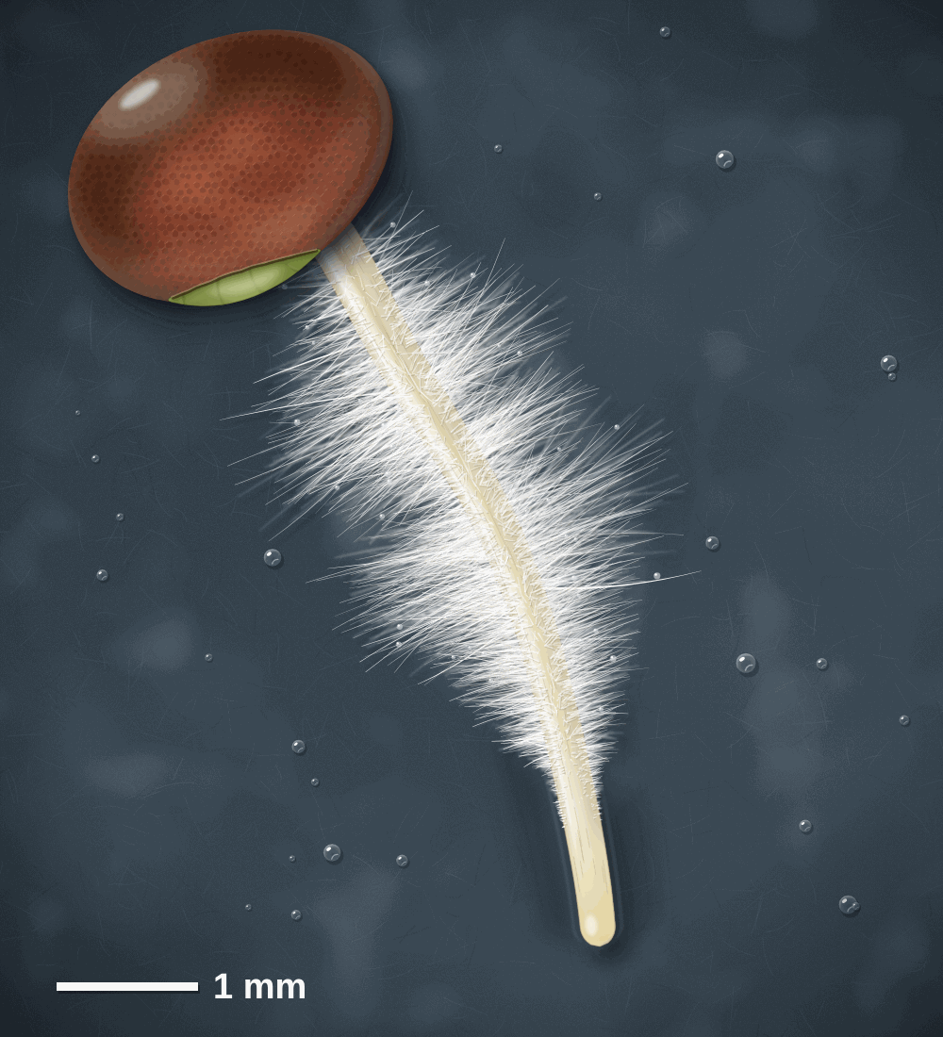
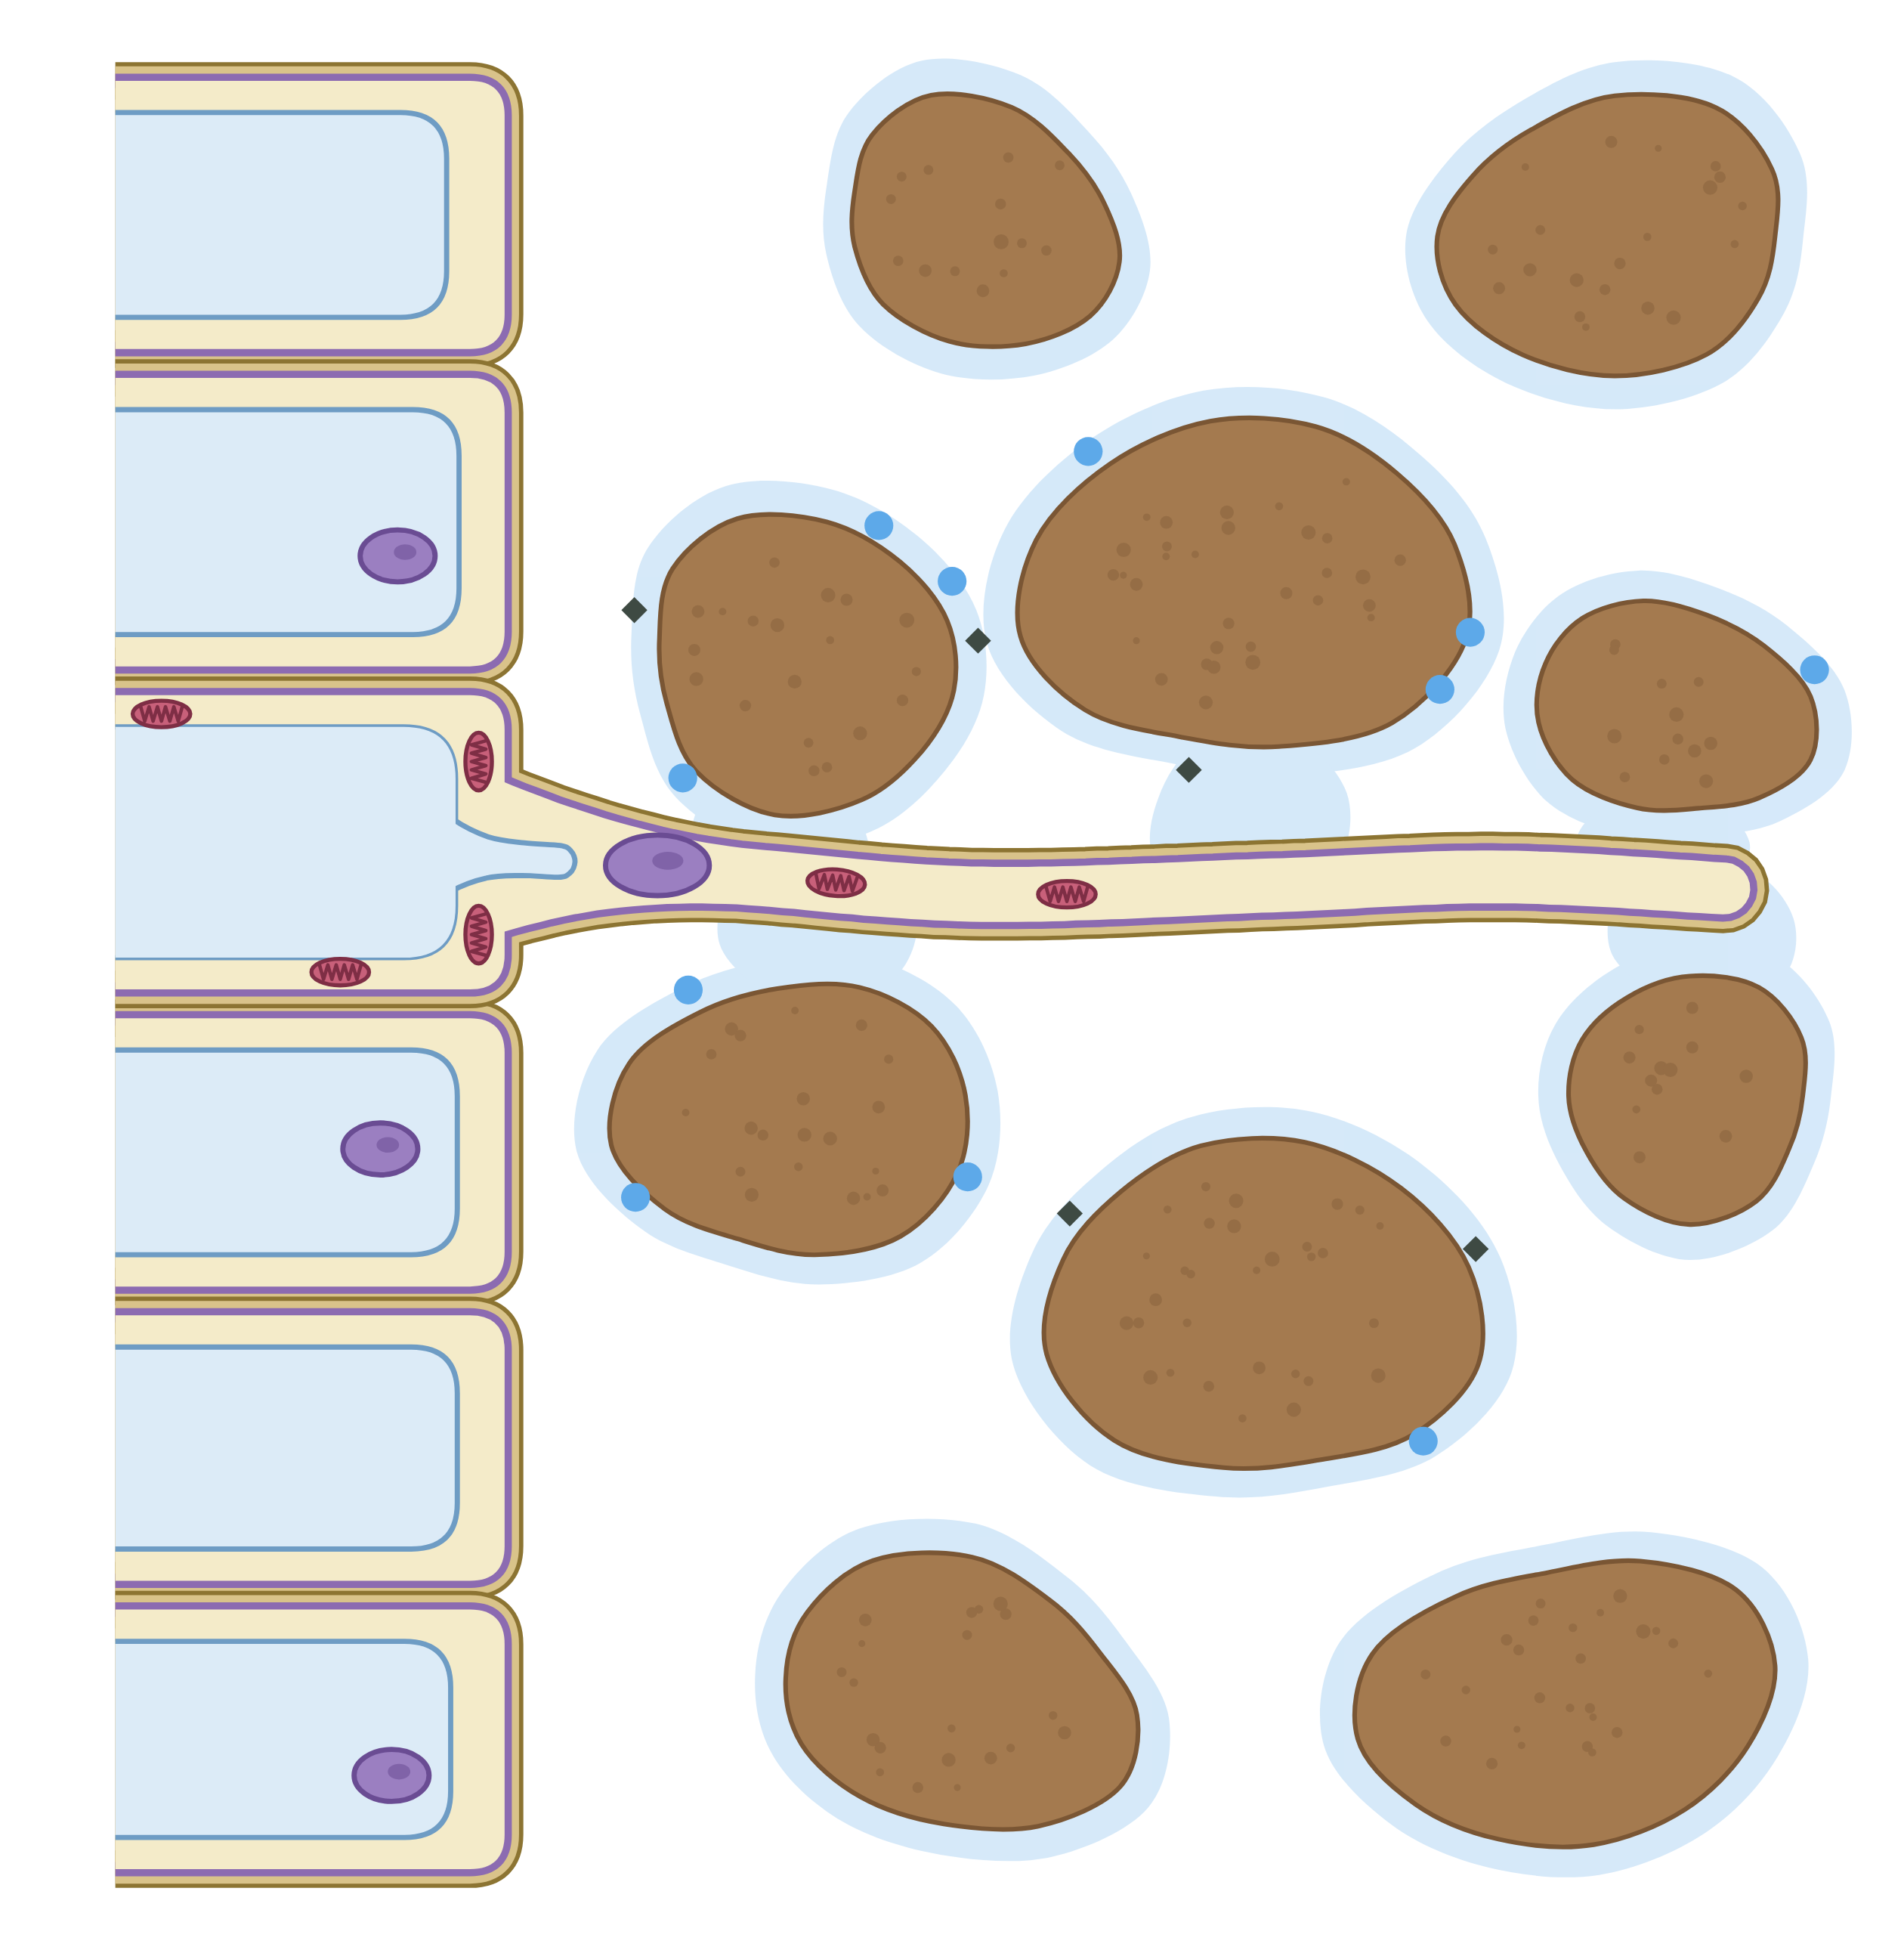
sciencegcse.co.uk · Biology B1 L5: Specialised cells
Online lesson: screen 2 of 12
A real root and a diagram
Same thing, two ways
Spot the differences
1
How many: The real root has thousands of root hairs. The diagram shows just one root hair cell.
5
2
Part of a cell: Each white hair is only part of one cell: its long, thin extension. The diagram shows the whole cell, with its nucleus and vacuole.
3
3
3
Colour: Real root hairs are white because they have no chloroplasts. The diagram adds colours so you can tell the parts apart.
2
1
4
1
2
4
Size: Each real hair is tiny: up to about 1 mm long, and far thinner than a hair on your head. The diagram draws the cell much bigger than real life.
5
5
Where it grows: This seedling grew on damp paper, so its hairs are easy to see. In soil, each hair grows out between the soil particles, as the diagram shows.
4
A real root (painting)
A diagram
Each white hair is part of one root hair cell. Root hair cells have no chloroplasts.
Both show the long, thin extension that gives a root hair cell a large surface area for taking in water and mineral ions.
5
B1 L5 · sciencegcse.co.uk
Notes:
Cover the right panel and ask: what is different between the two pictures? Take ideas, then reveal the five differences: each click shows one difference and puts its number on both pictures; the last click shows what is the same in both. Key message: an exam diagram is simplified on purpose. It shows one root hair cell, drawn big and coloured, so you can see its parts: the cell wall, the cell membrane, the cytoplasm, the nucleus and the permanent vacuole. In the real root you see thousands of hairs, and each hair is just the long, thin extension of one of those cells. The real cells are colourless and have no chloroplasts. The seedling in the painting grew on damp paper; in soil, each hair pushes out between the soil particles, into the thin film of water around them. Both pictures show the one feature that matters most: the long, thin extension that gives a large surface area. The online lesson, screen 2, has the same pictures and differences.

Slide 6
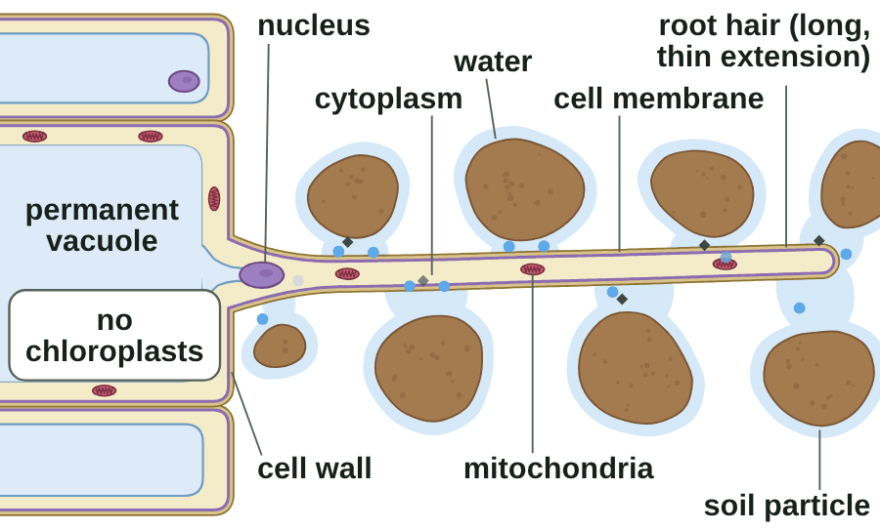
sciencegcse.co.uk · Biology B1 L5: Specialised cells
Online lesson: screen 3 of 12
Root hair cells: built to take in water
A root hair cell in the soil
Feature → how it helps
Long, thin extension: a large surface area, so more water and mineral ions are taken in.
No chloroplasts: it is underground, where there is no light for photosynthesis.
Many mitochondria: release energy to take in mineral ions by active transport (B1 L10 Active transport and exchange surfaces).
Water in: water enters by osmosis (B1 L9 Osmosis).
Always link the feature, how it helps and the job.
Blue dots = water. Grey diamonds = mineral ions.
A diagram is simplified.
6
B1 L5 · sciencegcse.co.uk
Notes:
Model the sentence on the board: 'A root hair cell has a long, thin extension (feature), which gives it a large surface area (how it helps), so it can take in more water and mineral ions from the soil (job).' Ask students to say it to a partner. On the online lesson, screen 3, switch the root hair off: the same cell without its hair takes in water much more slowly, because less of its surface touches the soil water. Ask: why would chloroplasts be wasted in this cell? (No light reaches it underground.) Mitochondria release energy; never say they make it. How water gets in (osmosis) is B1 L9, and how mineral ions get in (active transport) is B1 L10: today we only need to know that they do. The surface area idea comes back in B1 L10. One feature a click: the picture is an animated GIF in which the same parts light up in the same order, as the chips do on the online lesson (print and PDF show its first frame).

Slide 7
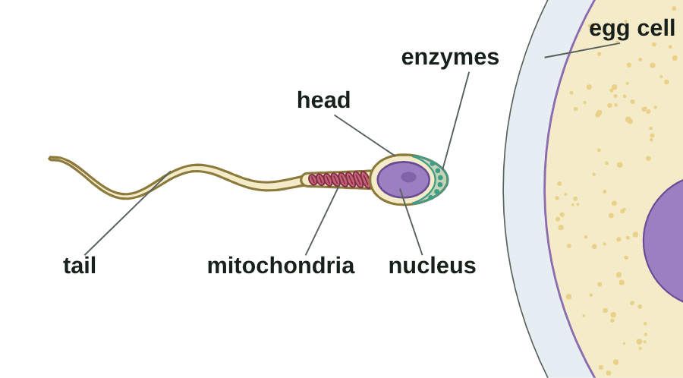
sciencegcse.co.uk · Biology B1 L5: Specialised cells
Online lesson: screen 4 of 12
Sperm cells: built to swim
A sperm cell at work
Step by step
1
Tail: lashes from side to side, so the sperm cell can swim to the egg cell.
2
Mitochondria: many of them release energy for swimming.
3
Enzymes: in the head, they digest a way into the egg cell.
4
Nucleus: carries half the genetic material; it joins with the egg cell's nucleus.
Job: to reach an egg cell and fertilise it.
A diagram is simplified. A sperm cell is about 50 µm long.
▶ Online lesson, screen 4: Sperm cells: built to swim
7
B1 L5 · sciencegcse.co.uk
Notes:
Keep this matter-of-fact: it is a cell, adapted for a job. Run screen 4 of the online lesson with Next step, or let the GIF play (print and PDF show its first frame). One step a click. At each step ask: what is this feature for? The mitochondria release energy for swimming (never 'make energy'). The enzymes are at the very front of the head, so they meet the egg first. The nucleus has half the genetic material of a body cell, so when it joins the egg cell's nucleus the new cell has the full amount: that is B6. The names acrosome and midpiece are not needed for AQA. A sperm cell is about 50 µm long; the egg cell is about 0.1 mm across: about twice the length of a sperm cell (slide 11).

Slide 8
sciencegcse.co.uk · Biology B1 L5: Specialised cells
Online lesson: screen 5 of 12
Checkpoint 1
✓
CHECKPOINT 1 of 3
Quick check on slides 4 to 7 (online screens 1 to 4). Show A, B or C on your whiteboard.
Question 1
Question 2
Question 3
In the painting of the seedling root, what is each white hair?
How does the long, thin extension help a root hair cell?
What do the enzymes in the head of a sperm cell do?
A. A whole root
A. It gives a large surface area, so more water and mineral ions are taken in.
A. They release energy for swimming.
B. A separate hair stuck onto the root
B. It releases energy for the cell.
B. They digest a way through the outer layer of the egg cell.
C. A long, thin part of one root hair cell
C. It carries water up to the leaves.
C. They carry the genetic material.
✓ Check your answers on the next slide
8
B1 L5 · sciencegcse.co.uk
Notes:
Checkpoint 1. Hinge check. Everyone shows A, B or C at the same time. Q1 A and B test the 'a root hair is a separate hair or a whole root' trap. Q2 B tests mixing up the jobs of parts (mitochondria); Q2 C mixes up root hair cells and xylem. Q3 A tests enzymes against mitochondria. If several get Q1 wrong, go back to slide 5; Q2, slide 6; Q3, slide 7.

Slide 9
sciencegcse.co.uk · Biology B1 L5: Specialised cells
Online lesson: screen 5 of 12
Checkpoint 1 answers
✓
CHECKPOINT 1 of 3
Quick check on slides 4 to 7 (online screens 1 to 4). Show A, B or C on your whiteboard.
Question 1
Question 2
Question 3
In the painting of the seedling root, what is each white hair?
How does the long, thin extension help a root hair cell?
What do the enzymes in the head of a sperm cell do?
A. A whole root
A. It gives a large surface area, so more water and mineral ions are taken in.
A. It gives a large surface area, so more water and mineral ions are taken in. ✓
A. They release energy for swimming.
B. A separate hair stuck onto the root
B. It releases energy for the cell.
B. They digest a way through the outer layer of the egg cell.
B. They digest a way through the outer layer of the egg cell. ✓
C. A long, thin part of one root hair cell
C. A long, thin part of one root hair cell ✓
C. It carries water up to the leaves.
C. They carry the genetic material.
Each white hair is the long, thin extension of one root hair cell.
Feature, how it helps, job: a large surface area means more is taken in from the soil.
The enzymes let the sperm cell get into the egg cell.
Got one wrong? Look back: Q1 slide 5 · Q2 slide 6 · Q3 slide 7
9
B1 L5 · sciencegcse.co.uk
Notes:
1 C, 2 A, 3 B. Each click shows one answer and why. Ask a student who got each one right to say the full chain for Q2: feature, how it helps, job. Follow-up for Q3: which part releases the energy for swimming? (The mitochondria.)

Slide 10
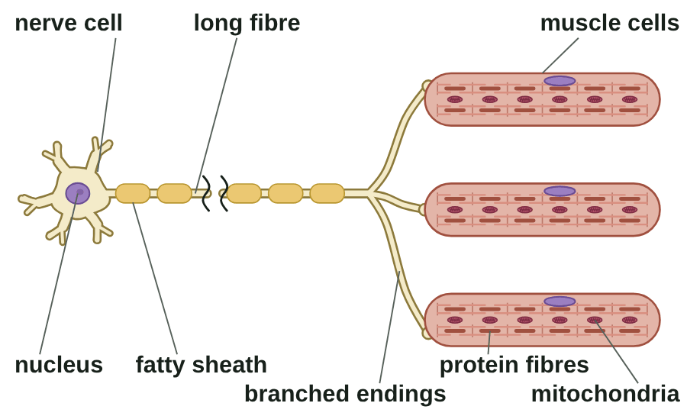
sciencegcse.co.uk · Biology B1 L5: Specialised cells
Online lesson: screen 6 of 12
Nerve cells and muscle cells
An impulse makes muscles contract
How they are adapted
Nerve cell: carries electrical impulses
Long: carries impulses a long way.
Branched endings: connect with many other cells.
Fatty sheath: insulates it, so impulses travel quickly.
Muscle cell: contracts to cause movement
Protein fibres: slide over each other, so the cell gets shorter.
Many mitochondria: release the energy needed to contract.
Watch out: nerve cells carry electrical impulses, not blood. Mitochondria release energy; they never make it.
A diagram is simplified. More about nerve impulses: B5 Homeostasis and response.
▶ Online lesson, screen 6: Nerve cells and muscle cells
10
B1 L5 · sciencegcse.co.uk
Notes:
Follow one impulse: from the cell body, along the long fibre, through the branched endings, into the muscle cells, which contract. Ask: why is it useful for a nerve cell to have branched endings? (One nerve cell can pass impulses to many muscle cells, so they contract together.) Ask: what would happen if the fatty sheath were damaged? (Impulses would travel more slowly, or not at all.) Muscle cells in a muscle work together as muscular tissue (B2 L1 Cells, tissues and organs). Nerve cells are also called neurones; the nervous system is B5. The names axon, dendrite and myelin are not needed for AQA. Common errors: 'nerve cells carry blood' and 'mitochondria make energy'. Each line wipes in on a click: the nerve cell first, then the muscle cell, then the Watch out line. The picture is an animated GIF of the online lesson's screen 6 loop (print and PDF show its first frame).

Slide 11
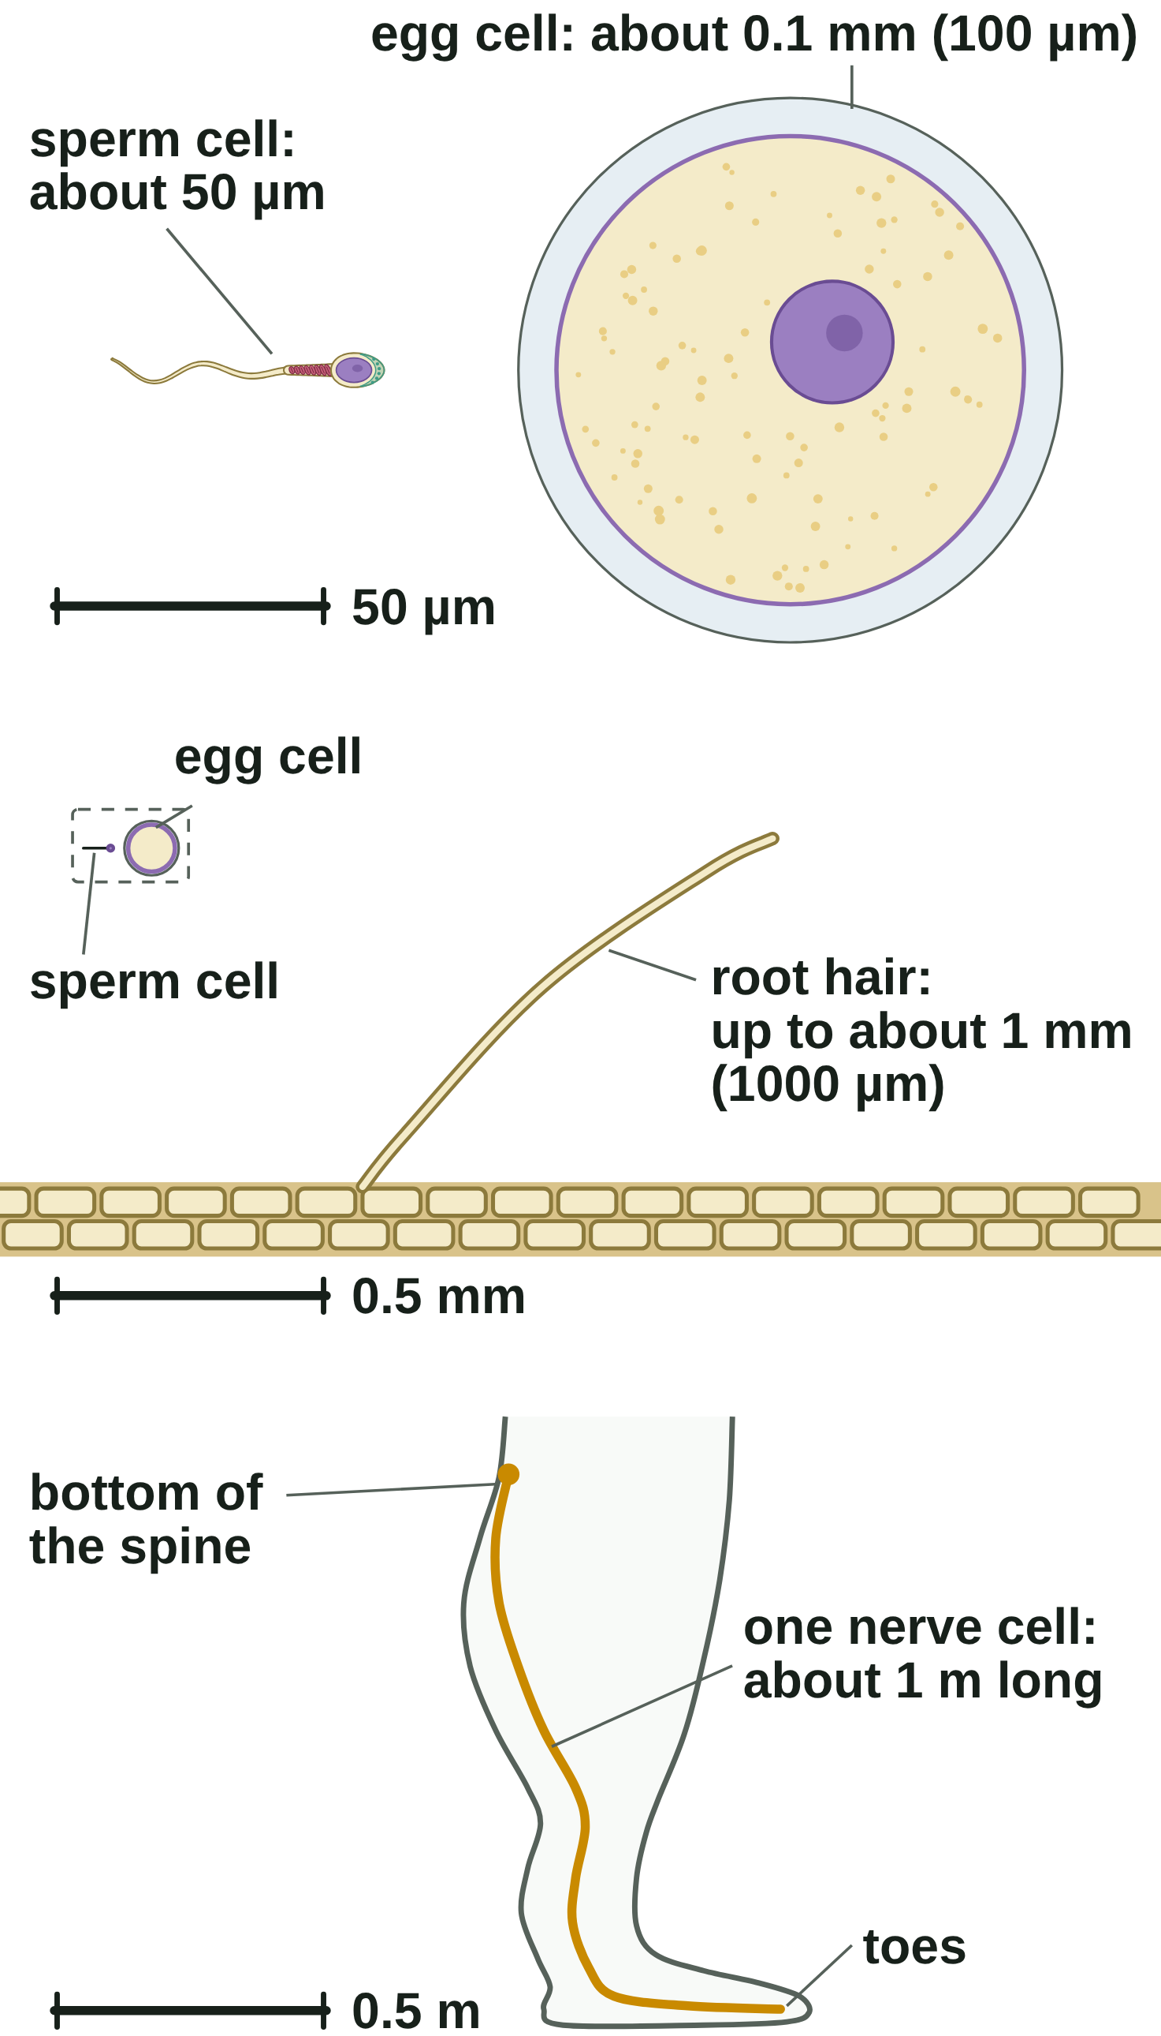
sciencegcse.co.uk · Biology B1 L5: Specialised cells
Online lesson: screen 7 of 12
Comparing the sizes of cells
Drawn to scale: zoom out
zoom out
zoom out
× 10
× 1000
Each picture is drawn to scale. Look at the scale bar: it changes at each step.
How big are specialised cells?
Same unit first
Cell
About how big
How many times bigger = bigger size ÷ smaller size, both in µm (1 mm = 1000 µm).
Example 1: egg cell 0.1 mm = 0.1 × 1000 = 100 µm. 100 ÷ 50 = 2: the egg cell is about 2 times as wide as a sperm cell is long. Check: 2 × 50 µm = 100 µm.
Example 2: root hair 1 mm = 1 × 1000 = 1000 µm. 1000 ÷ 50 = 20 times as long. Check: 20 × 50 µm = 1000 µm.
Change into the same unit before you divide.
sperm cell
50 µm long
egg cell
0.1 mm (100 µm) across
root hair
up to 1 mm (1000 µm) long
nerve cell (the longest)
1 m long, from the bottom of the spine to the toes
11
B1 L5 · sciencegcse.co.uk
Notes:
This uses the unit skills from B1 L4 Magnification and cell size (Do now Q1). Clicks: the four table rows (the root hair row brings in the second picture, the nerve cell row the third), then the four lines of 'Same unit first'. Work example 1 on the board, then let pairs try example 2 before you reveal it. Ask: what goes wrong if you divide 1 by 50? (You get 0.02, which says the root hair is smaller than the sperm: the units were not the same.) Challenge: how many sperm cells would fit along the longest nerve cell? (1 m = 1 000 000 µm; 1 000 000 ÷ 50 = 20 000.) Sizes vary, so say 'about'. Common errors: dividing instead of multiplying when changing mm into µm, and dividing two sizes that are in different units. Check that the answer is sensible: a root hair is easy to see with a hand lens, a sperm cell is not. The pictures are the three steps of the online lesson's screen 7 zoom, each drawn to scale with its own scale bar: the scale bar changes at each step, so compare the numbers, not the drawings.

Slide 12
sciencegcse.co.uk · Biology B1 L5: Specialised cells
Online lesson: screen 8 of 12
Checkpoint 2
✓
CHECKPOINT 2 of 3
Quick check on slides 10 and 11 (online screens 6 and 7). Show A, B or C on your whiteboard.
Question 1
Question 2
Question 3
What is the job of a nerve cell?
How does a muscle cell get shorter when it contracts?
A root hair is 0.7 mm long. A sperm cell is 50 µm long. How many times longer is the root hair? (1 mm = 1000 µm)
A. To carry blood around the body
A. Its nucleus shrinks.
A. 14
B. To carry electrical impulses from one part of the body to another
B. Its cell wall pulls it in.
B. 0.014
C. To contract to cause movement
C. Protein fibres inside it slide over each other.
C. 35 000
✓ Check your answers on the next slide
12
B1 L5 · sciencegcse.co.uk
Notes:
Checkpoint 2. Mini whiteboards: A, B or C. Q1 A is the 'nerve cells carry blood' trap; Q1 C mixes up nerve and muscle cells. Q2 B tests 'animal cells have no cell wall'. Q3 B tests dividing without changing the units; Q3 C tests multiplying. If several get Q1 or Q2 wrong, go back to slide 10; Q3, slide 11.

Slide 13
sciencegcse.co.uk · Biology B1 L5: Specialised cells
Online lesson: screen 8 of 12
Checkpoint 2 answers
✓
CHECKPOINT 2 of 3
Quick check on slides 10 and 11 (online screens 6 and 7). Show A, B or C on your whiteboard.
Question 1
Question 2
Question 3
What is the job of a nerve cell?
How does a muscle cell get shorter when it contracts?
A root hair is 0.7 mm long. A sperm cell is 50 µm long. How many times longer is the root hair? (1 mm = 1000 µm)
A. To carry blood around the body
A. Its nucleus shrinks.
A. 14
A. 14 ✓
B. To carry electrical impulses from one part of the body to another
B. To carry electrical impulses from one part of the body to another ✓
B. Its cell wall pulls it in.
B. 0.014
C. To contract to cause movement
C. Protein fibres inside it slide over each other.
C. Protein fibres inside it slide over each other. ✓
C. 35 000
Its long fibre, branched endings and fatty sheath help it do this.
As the fibres slide, the cell gets shorter. Mitochondria release the energy needed.
0.7 mm = 700 µm, and 700 ÷ 50 = 14.
Got one wrong? Look back: Q1 and Q2 slide 10 · Q3 slide 11
13
B1 L5 · sciencegcse.co.uk
Notes:
1 B, 2 C, 3 A. Each click shows one answer and why. Follow-up for Q3: check the answer. (14 × 50 µm = 700 µm = 0.7 mm.)

Slide 14
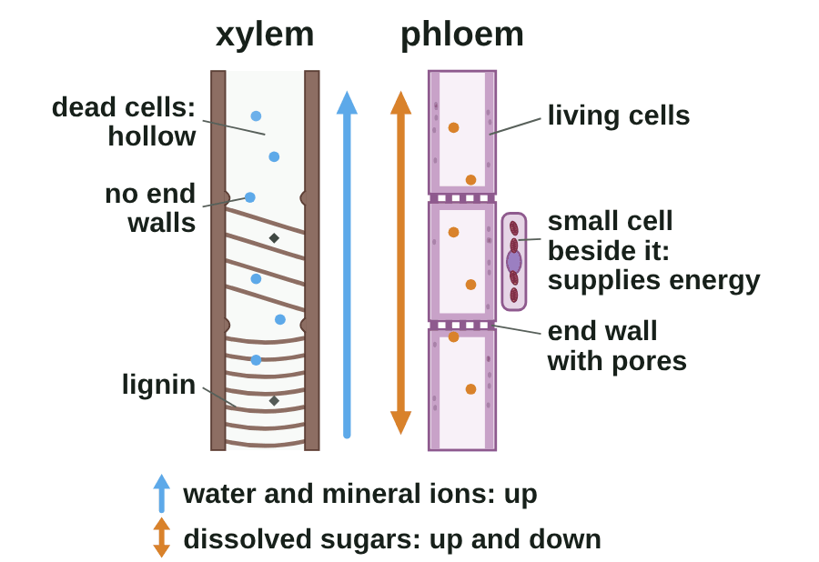
sciencegcse.co.uk · Biology B1 L5: Specialised cells
Online lesson: screen 9 of 12
Xylem and phloem cells
From living cells to a hollow tube
Adapted to carry
Xylem cells: dead cells joined end to end with no end walls, so they form hollow tubes.
Lignin: strengthens the walls and supports the plant.
Xylem carries water and mineral ions up from the roots.
Phloem cells: living cells; pores in their end walls let cell sap move from cell to cell.
Phloem carries dissolved sugars up and down the plant.
Watch out: xylem cells are dead and hollow; phloem cells are living.
In the diagram, brown = xylem and purple = phloem. Real xylem and phloem are pale.
Blue dots = water. Orange dots = dissolved sugars.
14
B1 L5 · sciencegcse.co.uk
Notes:
This is differentiation in action: a young xylem cell gains lignin in its walls, then dies, and its contents and end walls break down. The result is a long tube, like a drinking straw, with nothing in the way of the water. Ask: why would a column of living cells with end walls be a poor way to carry water a long way? (The contents and end walls would block the flow.) Phloem cells must stay alive. They have few sub-cellular structures, so the cell sap flows easily, and small cells beside them supply the energy they need. AQA calls the liquid in the phloem 'cell sap': it is not the same as the cell sap in a vacuole (B1 L1 Animal and plant cells). The names sieve tube, sieve plate and companion cell are not needed for AQA, so avoid them. The whole-plant story (the transpiration stream and translocation) is B2 L13 Plant transport: xylem and phloem. One line a click: the GIF shows the same order as the online lesson's five steps (print and PDF show its first frame, the finished tube).

Slide 15
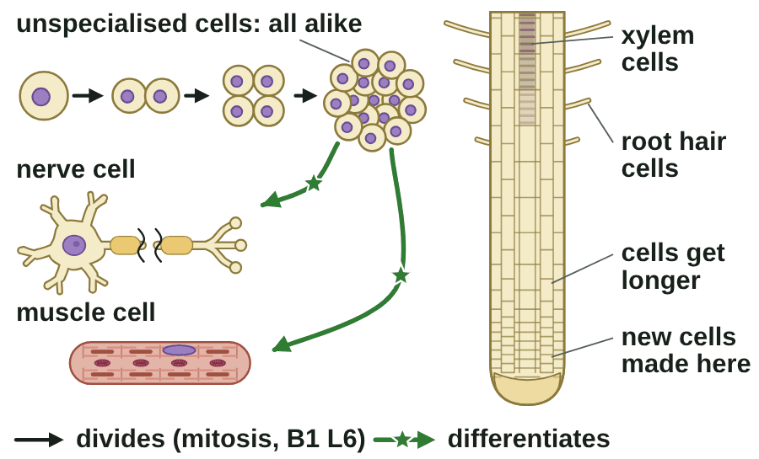
sciencegcse.co.uk · Biology B1 L5: Specialised cells
Online lesson: screen 10 of 12
How cells become specialised
Cells differentiate
Differentiation
1
Unspecialised cells: an early embryo is a ball of cells that all look alike.
2
Differentiate: each cell gains the sub-cellular structures it needs for its job.
3
Animals: most animal cells differentiate at an early stage. In adults, cell division is mainly for repair and replacement.
4
Plants: many plant cells can differentiate throughout life, so plants keep growing new roots, shoots and leaves.
Watch out: differentiation is not division. A cell divides by mitosis and becomes specialised by differentiating.
A diagram is simplified.
Stem cells and meristems: B1 L7 Stem cells.
▶ Online lesson, screen 10: How cells become specialised
15
B1 L5 · sciencegcse.co.uk
Notes:
Use the root from the painting: the bare tip has new cells that have not yet differentiated; further back they have become root hair cells. Ask: why does a multicellular organism like you need differentiation? (It needs many types of cell to do different jobs; one type could not do them all.) Specialised cells then group into tissues (B2 L1 Cells, tissues and organs). Common error: 'differentiation is when a cell divides'. Division makes more cells; differentiation changes what a cell is like. Cells that have not differentiated, stem cells, and the plant tissues that keep making new cells (meristems), are B1 L7 Stem cells. This is why a tree cut to a stump can grow new shoots, but most animals cannot grow a new leg. One step a click (Wipe), then the green line. The picture is an animated GIF of the online lesson's screen 10 steps (print and PDF show its first frame).

Slide 16
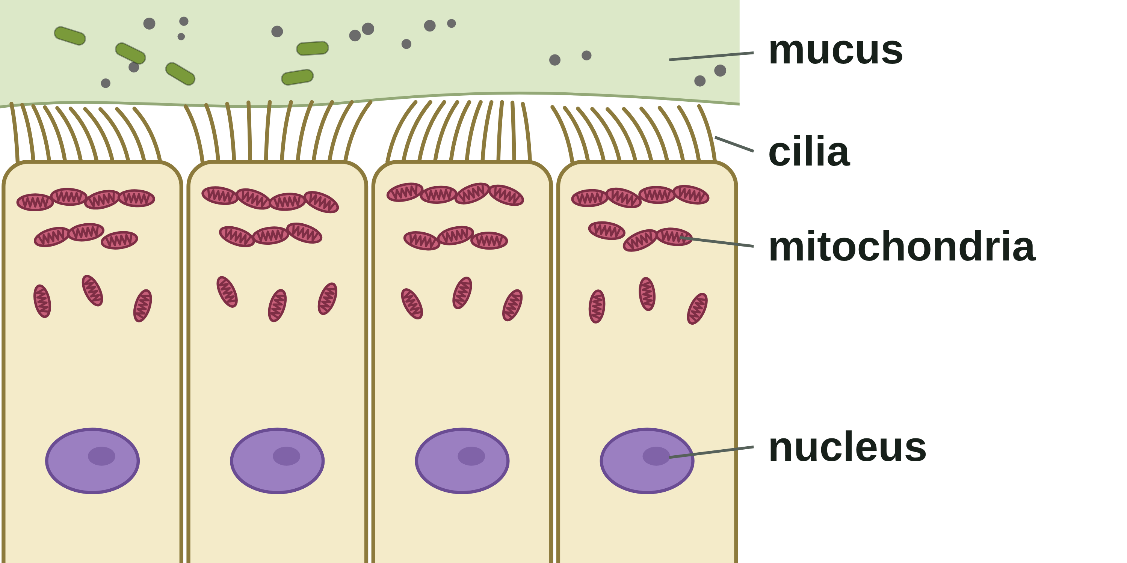
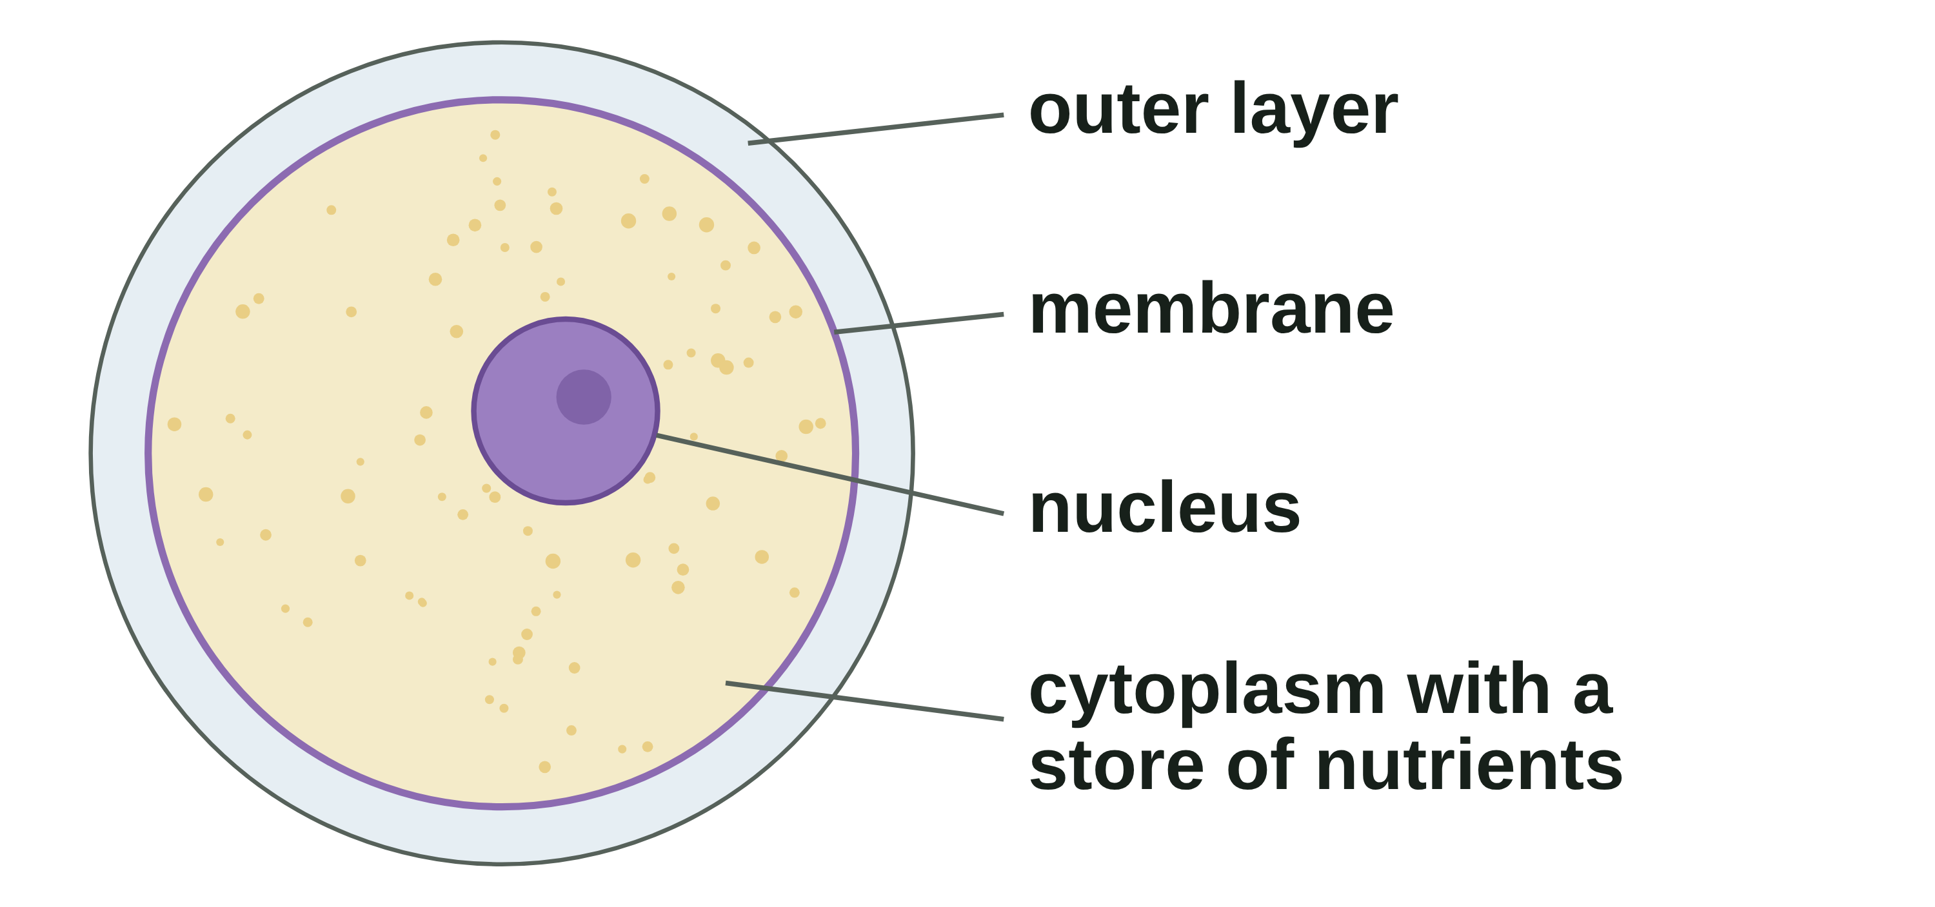
sciencegcse.co.uk · Biology B1 L5: Specialised cells
Online lesson: screen 11 of 12
Apply it: cells you have not met
Two cells you have not met
Build the explanation
Feature
How it helps
Job
Ciliated cell
cilia (tiny hairs)
beat together to sweep mucus along
moves mucus away from the lungs
many mitochondria
release energy for the cilia to beat
keeps the mucus moving away from the lungs
A ciliated cell (lines the airways)
Egg cell
cytoplasm with a store of nutrients
feeds the new cells after fertilisation
the new cells can grow and divide
membrane changes after one sperm cell gets in
stops more sperm cells getting in
only one sperm cell fertilises the egg cell
Use the information you are given: link each feature to how it helps and to the job.
An egg cell
16
B1 L5 · sciencegcse.co.uk
Notes:
AQA asks you to explain how a cell is adapted 'when provided with appropriate information', so expect cells you have not met. The method: read the job first; find each feature in the picture or the text; for each one, say how it helps the cell do that job. The first click shows the four features: students suggest how each helps, and the job, on whiteboards. Each later click fills in one row. Let pairs try the ciliated cell first, then the egg cell. Mitochondria always means energy is released for something: say what (here, for the cilia to beat). Ciliated cells and mucus come back in B3 Infection and response; egg cells and fertilisation in B6. The online lesson, screen 11, lets students build each chain.

Slide 17
sciencegcse.co.uk · Biology B1 L5: Specialised cells
Online lesson: screen 12 of 12
Checkpoint 3
✓
CHECKPOINT 3 of 3
Quick check on slides 14 to 16 (online screens 9 to 11). Show A, B or C on your whiteboard.
Question 1
Question 2
Question 3
Xylem cells are dead when they carry water. How does this help?
What is differentiation?
Airway cells have tiny hairs called cilia that beat to move mucus. Why do they have many mitochondria?
A. Dead cells release more energy to pump the water up.
A. When a cell becomes specialised, gaining the sub-cellular structures it needs for its job
A. To make energy for the cilia
B. With no contents and no end walls, the cells form hollow tubes, so water flows through easily.
B. When a cell divides to make two new cells
B. To trap dust in the mucus
C. Dead cells can carry dissolved sugars up and down the plant.
C. When a cell dies and is replaced
C. To release energy for the cilia to keep beating
✓ Check your answers on the next slide
17
B1 L5 · sciencegcse.co.uk
Notes:
Checkpoint 3. Mini whiteboards: A, B or C. Q1 A tests 'plants pump water' and 'dead cells respire'; Q1 C mixes up xylem and phloem. Q2 B is the 'differentiation is division' trap. Q3 A is the 'mitochondria make energy' trap. If several get Q1 wrong, go back to slide 14; Q2, slide 15; Q3, slide 16.

Slide 18
sciencegcse.co.uk · Biology B1 L5: Specialised cells
Online lesson: screen 12 of 12
Checkpoint 3 answers
✓
CHECKPOINT 3 of 3
Quick check on slides 14 to 16 (online screens 9 to 11). Show A, B or C on your whiteboard.
Question 1
Question 2
Question 3
Xylem cells are dead when they carry water. How does this help?
What is differentiation?
Airway cells have tiny hairs called cilia that beat to move mucus. Why do they have many mitochondria?
A. Dead cells release more energy to pump the water up.
A. When a cell becomes specialised, gaining the sub-cellular structures it needs for its job
A. When a cell becomes specialised, gaining the sub-cellular structures it needs for its job ✓
A. To make energy for the cilia
B. With no contents and no end walls, the cells form hollow tubes, so water flows through easily.
B. With no contents and no end walls, the cells form hollow tubes, so water flows through easily. ✓
B. When a cell divides to make two new cells
B. To trap dust in the mucus
C. Dead cells can carry dissolved sugars up and down the plant.
C. When a cell dies and is replaced
C. To release energy for the cilia to keep beating
C. To release energy for the cilia to keep beating ✓
Nothing in the tube gets in the way of the water and mineral ions.
For example, a young xylem cell gains lignin in its walls.
Feature, how it helps, job: the energy keeps the cilia beating, so mucus is moved away from the lungs.
Got one wrong? Look back: Q1 slide 14 · Q2 slide 15 · Q3 slide 16
18
B1 L5 · sciencegcse.co.uk
Notes:
1 B, 2 A, 3 C. Each click shows one answer and why. Next: practise naming each cell and its adaptations.

Slide 19
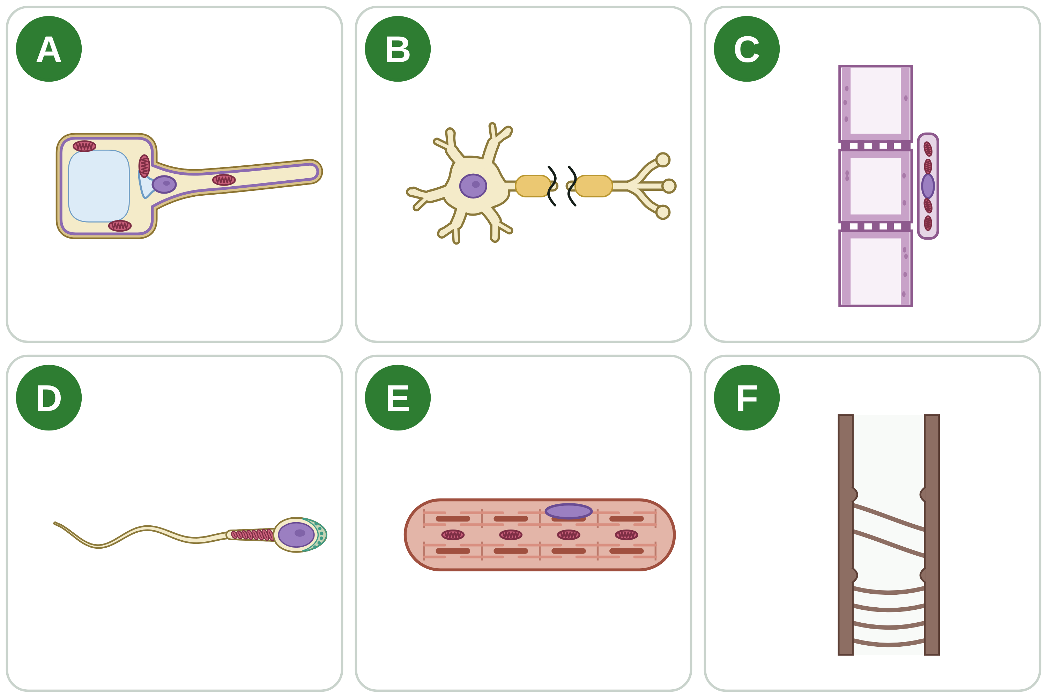
sciencegcse.co.uk · Biology B1 L5: Specialised cells
Practice: Name the cell
Six specialised cells
Questions
1. Which letter shows the cell that fertilises an egg cell?
______________
2. Which two letters show cells that transport substances in a plant?
______________
3. Which letter shows a cell that takes in water from the soil?
______________
4. Cell B carries electrical impulses. Give one way it is adapted to its job.
______________
5. Which letter shows dead cells with no end walls?
______________
6. Cell E has many mitochondria. Explain why.
______________
A diagram is simplified. The cells are not drawn to the same scale.
19
B1 L5 · sciencegcse.co.uk
Notes:
Pairs, 4 minutes. Name each cell first (A root hair cell, B nerve cell, C phloem cells, D sperm cell, E muscle cell, F xylem cells), then answer. For Q4 and Q6, use feature → how it helps → job.

Slide 20
sciencegcse.co.uk · Biology B1 L5: Specialised cells
Name the cell: answers
Six specialised cells
Answers
1. Which letter shows the cell that fertilises an egg cell?
D
2. Which two letters show cells that transport substances in a plant?
C and F
3. Which letter shows a cell that takes in water from the soil?
A
4. Cell B carries electrical impulses. Give one way it is adapted to its job.
Any one: it is long, to carry impulses a long way; branched endings connect with many cells; a fatty sheath insulates it, so impulses travel quickly.
5. Which letter shows dead cells with no end walls?
F
6. Cell E has many mitochondria. Explain why.
Mitochondria release energy, which the muscle cell needs to contract.
A diagram is simplified. The cells are not drawn to the same scale.
20
B1 L5 · sciencegcse.co.uk
Notes:
A root hair cell, B nerve cell, C phloem cells, D sperm cell, E muscle cell, F xylem cells. Q2: xylem carries water and mineral ions; phloem carries dissolved sugars. Q5: xylem cells are dead and hollow; phloem cells (C) are living, with pores in their end walls. Q6: 'release energy', never 'make energy'.

Slide 21
sciencegcse.co.uk · Biology B1 L5: Specialised cells
Exam practice
1. A young xylem cell is a living cell with a nucleus, cytoplasm and end walls. Describe how it changes as it becomes part of a xylem tube. [2]
Lignin builds up in its walls (1). The cell dies, and its cytoplasm, nucleus and end walls break down, leaving a hollow tube (1).
2. In a textbook, a root hair cell is drawn 60 mm long. The real cell is 0.3 mm long. Calculate the magnification of the drawing. Use: magnification = size of image ÷ size of real object. [2]
Magnification = 60 ÷ 0.3 (1) = × 200 (1). Both sizes are already in mm.
21
B1 L5 · sciencegcse.co.uk
Notes:
Model answers with mark points in brackets. Students try each question first, then mark their own work in green. Q1 links to slides 14 and 15: a young xylem cell differentiating is a clear example of a cell gaining what it needs for its job (allow 'the cell dies and becomes hollow' for the second mark). Q2 uses the magnification equation from B1 L4 (Do now Q2): check that both sizes are in the same unit before dividing. For more, the B1 L5 Exam questions worksheet (PDF) has 5 questions, 20 marks; its mark scheme is at the end of this PowerPoint. The same questions are in the online lesson, after the quiz.

Slide 22
sciencegcse.co.uk · Biology B1 L5: Specialised cells
Exit ticket
Answer on your own
How confident am I?
1. Name the specialised cell that carries electrical impulses. [1]
I can explain an adaptation: feature, how it helps, job.
2. Which plant cells are dead and form hollow tubes? [1]
I can describe how the six specialised cells are adapted.
3. Name the sub-cellular structure that releases energy for a sperm cell to swim. [1]
4. A root hair cell has a long, thin extension. Explain how this helps the cell to do its job. [2]
I can explain what differentiation is.
22
B1 L5 · sciencegcse.co.uk
Notes:
Students answer on their own, then rate their confidence. Q4 needs both halves of the chain for 2 marks: how it helps (a large surface area) and the job (taking in more water and mineral ions).

Slide 23
sciencegcse.co.uk · Biology B1 L5: Specialised cells
Exit ticket answers
Answers
Next lesson
1. A nerve cell.
2. Xylem cells.
3. Mitochondria.
4. It gives a large surface area (1), so more water and mineral ions are taken in from the soil (1).
Next: B1 L6 Cell division: mitosis
How chromosomes are copied and shared out when a cell divides by mitosis.
Worksheets:
• Mandatory (everyone)
• Alternative (easier, with key notes)
• Challenge (when you finish the Mandatory)
• Exam questions (exam style, 20 marks, homework)
▶ Online lesson: quiz and exam questions
23
B1 L5 · sciencegcse.co.uk
Notes:
Go through the answers. After this slide: the B1 L5 revision notes (4 printable pages), then the worksheets with answers in green: Mandatory (everyone), Challenge (stretch) and Alternative (easier: key notes and very simple tasks). The B1 L5 Exam questions worksheet (exam style, black and white, 20 marks) is a separate PDF for homework; its mark scheme is the last two slides. Homework: the online lesson quiz and the B1 L5 Exam questions worksheet. Next lesson: how cells divide by mitosis, which makes the new cells that then differentiate.

Slide 24
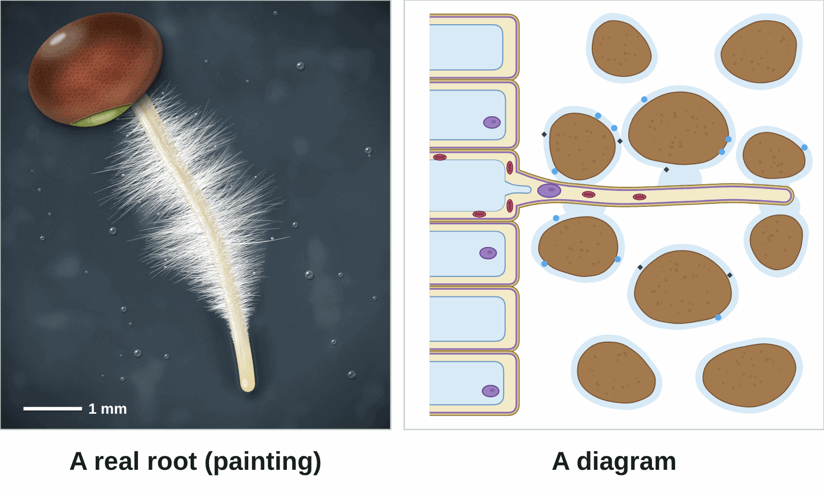
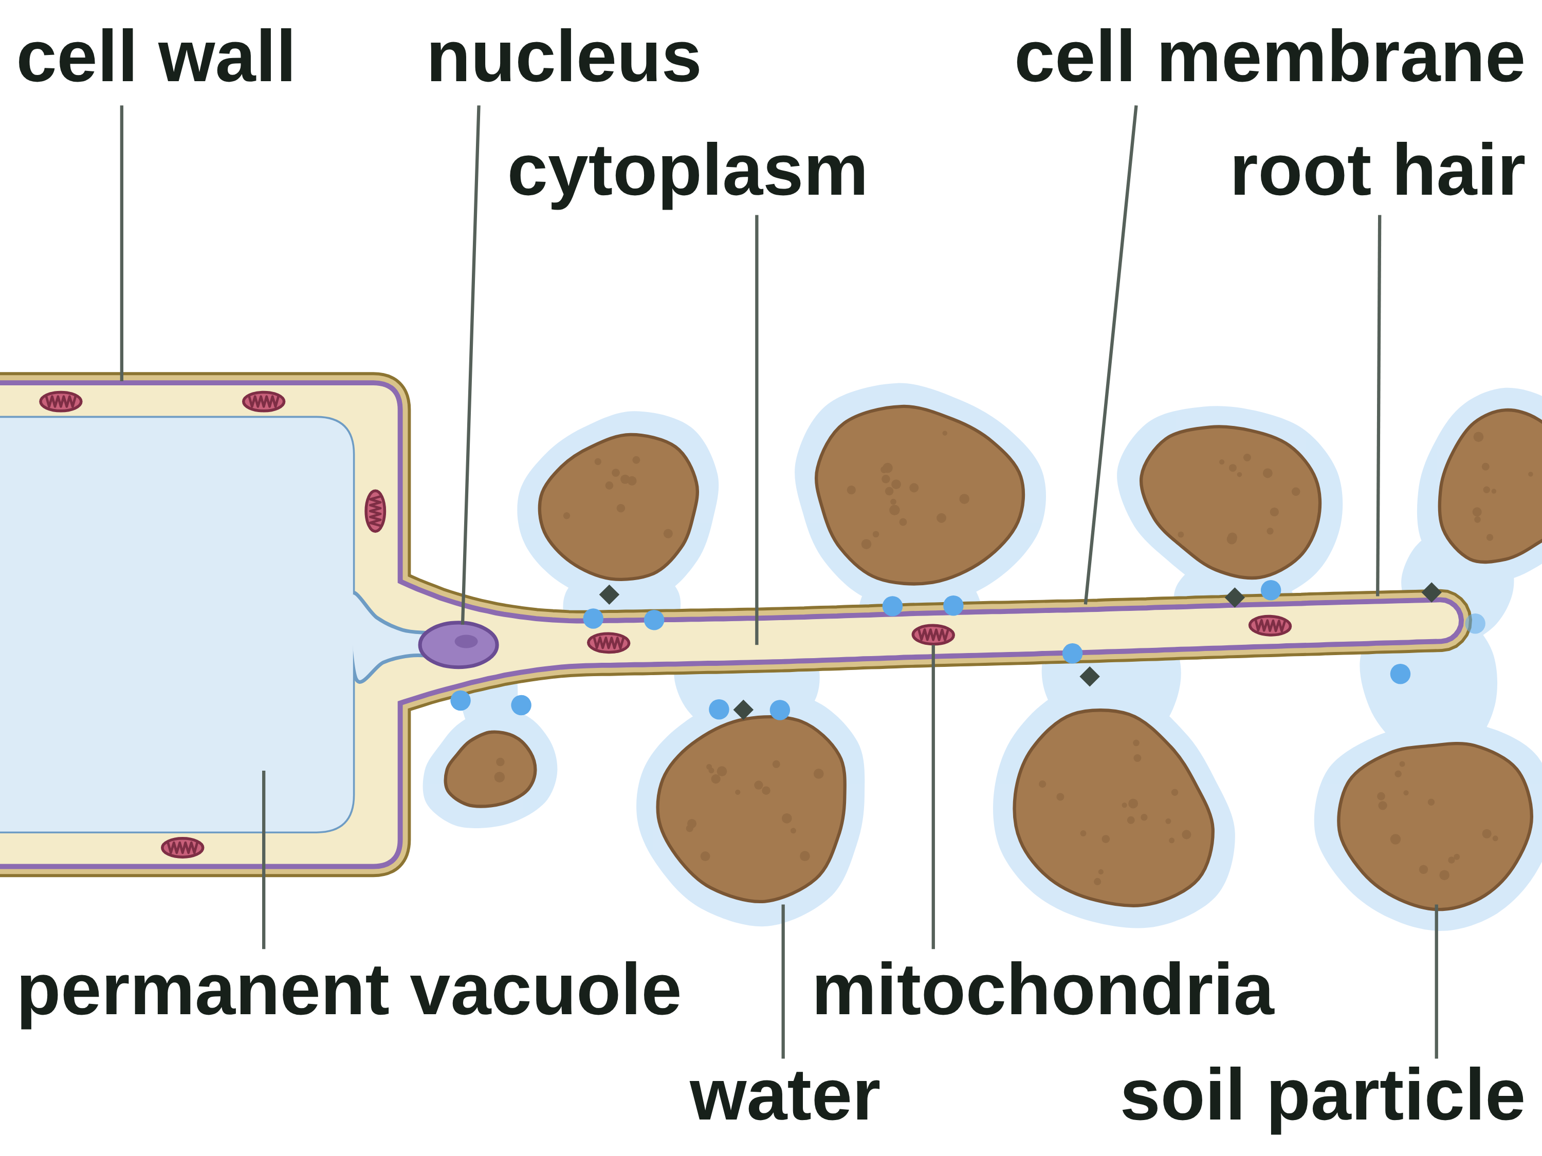
B1 L5 Revision notes 1 of 4
Specialised cells
Specialised cells and root hair cells
1. What is a specialised cell?
3. A real root and a diagram
A large organism, such as you or an oak tree, is made of many cells. The cells do not all do the same job. A specialised cell is a cell with a structure that suits it to one job. Its shape, and the sub-cellular structures inside it, help it to do that job. A feature that suits a cell to its job is an adaptation.
To explain an adaptation, use three parts:
feature → how it helps → job
Example: a root hair cell has a long, thin extension (feature), which gives it a large surface area (how it helps), so it can take in more water and mineral ions from the soil (job).
The six specialised cells you need to know, and their jobs, are in the table on page 2 (section 4).
Watch out: a list of features scores few marks. For each feature, say how it helps the cell do its job.
2. Root hair cells
A root hair cell is a cell on the surface of a root. Its job is to take in water and mineral ions from the soil.
A long, thin extension (the root hair) reaches out between the soil particles. It gives the cell a large surface area touching the water in the soil, so it takes in more water and mineral ions.
It has no chloroplasts. It grows underground, where there is no light, so it cannot photosynthesise.
It has many mitochondria. They release energy, which the cell uses to take in mineral ions by active transport (B1 L10 Active transport and exchange surfaces).
Water moves into the root hair cell by osmosis (B1 L9 Osmosis).
Each white hair is part of one root hair cell. Root hair cells have no chloroplasts.
If you look at the root of a young seedling through a hand lens, you see a white fuzz. The fuzz is thousands of root hairs. Each root hair is the long, thin extension of one root hair cell. Near the root tip there are no root hairs yet: the new cells there have not become root hair cells.
Exam pictures of a root hair cell are usually diagrams. A diagram is simplified on purpose:
It shows one root hair cell. A real root has thousands of root hairs.
It shows the whole cell, with its nucleus and vacuole. In the real root, each white hair is only part of one cell.
It adds colours to show the parts. Real root hairs are white because they have no chloroplasts.
It draws the cell much bigger than real life. A real root hair is up to about 1 mm long and far thinner than a hair on your head.
It shows the hair between soil particles. The painted seedling grew on damp paper, so its hairs are easy to see.
Both show the long, thin extension that gives a large surface area for taking in water and mineral ions.
Blue dots = water. Grey diamonds = mineral ions. A diagram is simplified.
Watch out: not every plant cell is green. Root hair cells have no chloroplasts.
Watch out: a root hair is not a separate hair, and not a whole root. It is part of one root hair cell.
B1 L5 · Specialised cells · sciencegcse.co.uk · free GCSE science resources
Notes:
Revision notes page 1 of 4 (or use B1_L5_Revision_notes.pdf). These pages are the textbook for B1 L5: students read them before the worksheets. Page 1: what a specialised cell is, how to explain an adaptation, the root hair cell, and the real root beside a diagram. Ask: what are the three parts of a good explanation of an adaptation?

Slide 25
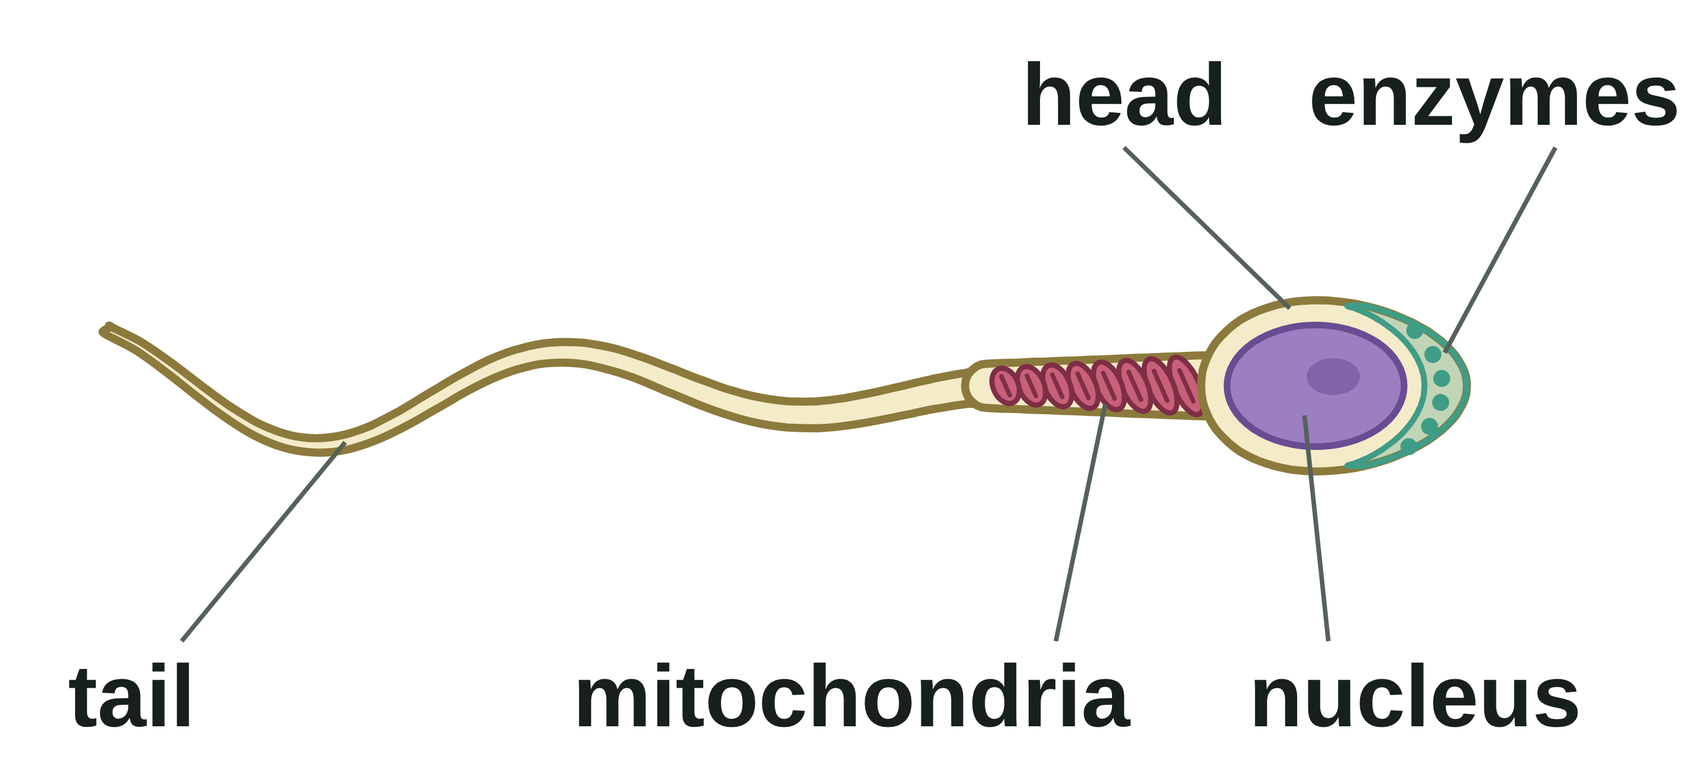
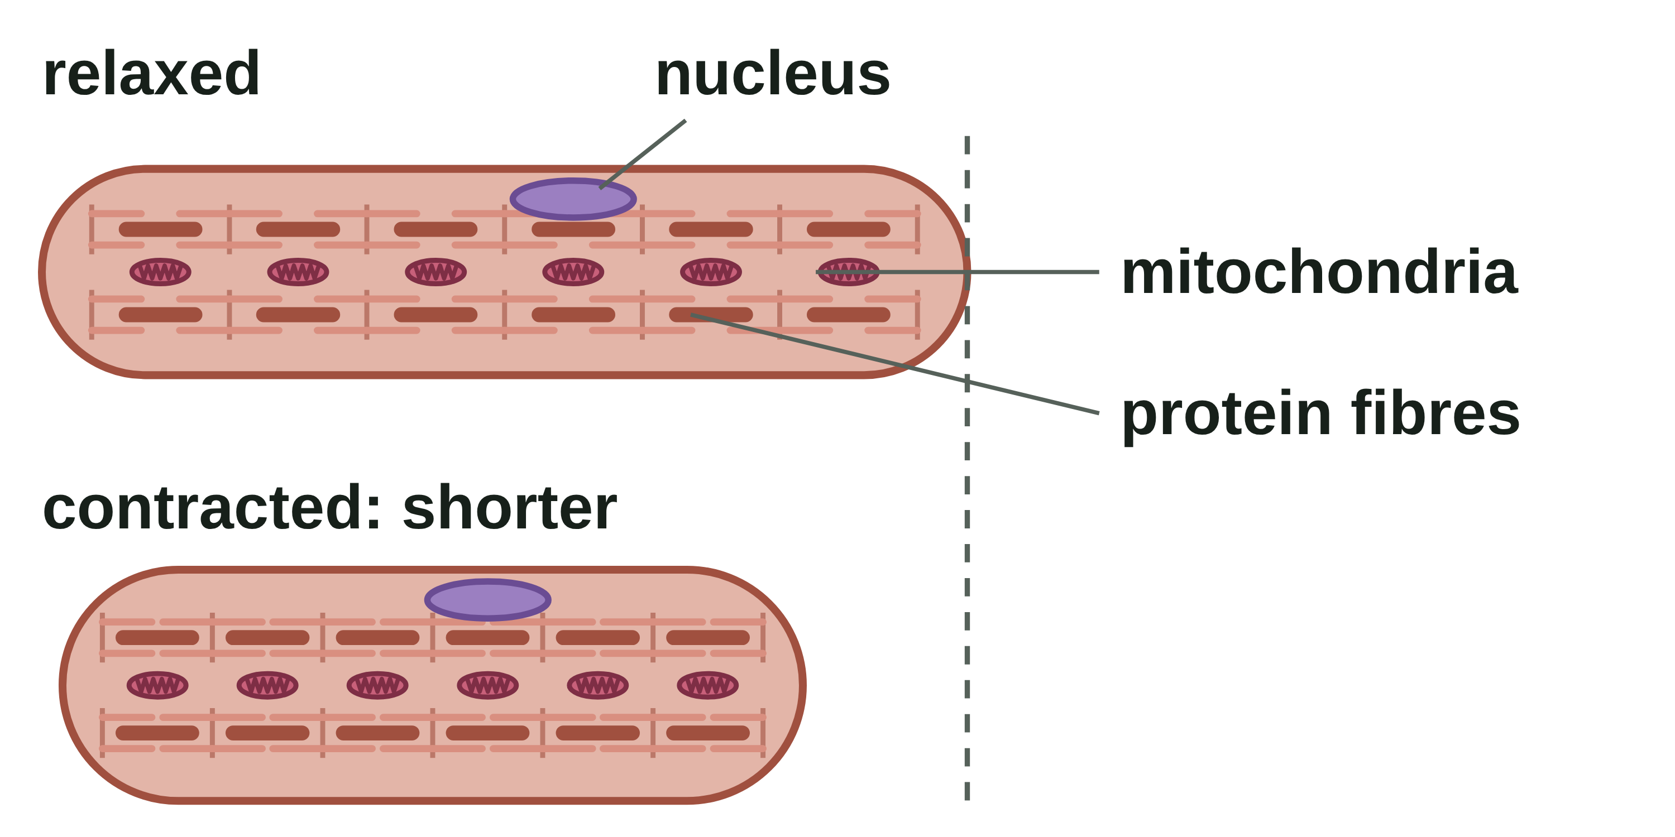
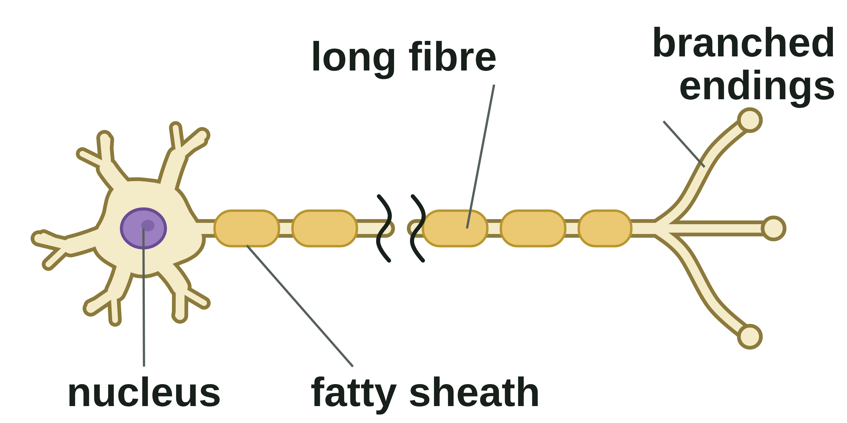
B1 L5 Revision notes 2 of 4
Specialised cells
Sperm, nerve and muscle cells, and the sizes of cells
4. The six specialised cells you need to know
Animal cell | Job
sperm cell | swims to an egg cell and fertilises it
nerve cell | carries electrical impulses from one part of the body to another
muscle cell | contracts (gets shorter) to cause movement
Plant cell | Job
root hair cell | takes in water and mineral ions from the soil
xylem cells | carry water and mineral ions up the plant
phloem cells | carry dissolved sugars up and down the plant
5. Sperm cells
7. Muscle cells
A sperm cell is the male sex cell. Its job is to swim to an egg cell and fertilise it.
A long tail lashes from side to side, so the sperm cell can swim to the egg cell.
Many mitochondria, packed just behind the head, release energy for swimming.
Enzymes in the head digest a way through the outer layer of the egg cell.
The nucleus carries half the genetic material of a body cell. It joins with the egg cell's nucleus at fertilisation (B6).
A muscle cell is a cell that can contract (get shorter) to cause movement.
It contains protein fibres that slide over each other, so the cell gets shorter.
It has many mitochondria, which release the energy needed to contract.
Many muscle cells working together make muscular tissue (B2 L1 Cells, tissues and organs).
Watch out: mitochondria release energy. Never write that they make or produce energy.
8. Comparing the sizes of cells
6. Nerve cells
Cell | About how big
sperm cell | 50 µm long
egg cell | 0.1 mm (100 µm) across
root hair | up to 1 mm (1000 µm) long
nerve cell (the longest) | 1 m long, from the bottom of the spine to the toes
A nerve cell is a long cell that carries electrical impulses from one part of the body to another.
It is long, so it can carry impulses a long way.
Branched endings connect with many other cells, so impulses can pass to them.
A fatty sheath insulates the long fibre, so impulses travel quickly.
To compare two sizes, change them into the same unit first: 1 mm = 1000 µm.
Worked example: how many times longer is a root hair 0.5 mm long than a sperm cell 50 µm long?
Step 1: change mm into µm: 0.5 × 1000 = 500 µm.
Step 2: divide: 500 ÷ 50 = 10.
Answer: 10 times longer. Check: 10 × 50 µm = 500 µm = 0.5 mm.
Nerve cells are also called neurones. How impulses control the body is B5 Homeostasis and response.
Watch out: nerve cells carry electrical impulses, not blood.
Watch out: change both sizes into the same unit before you divide. mm → µm: multiply by 1000.
B1 L5 · Specialised cells · sciencegcse.co.uk · free GCSE science resources
Notes:
Revision notes page 2 of 4. Sperm cells, nerve cells and muscle cells, and comparing the sizes of cells with a worked example. Ask: which two of these cells have many mitochondria, and why?

Slide 26
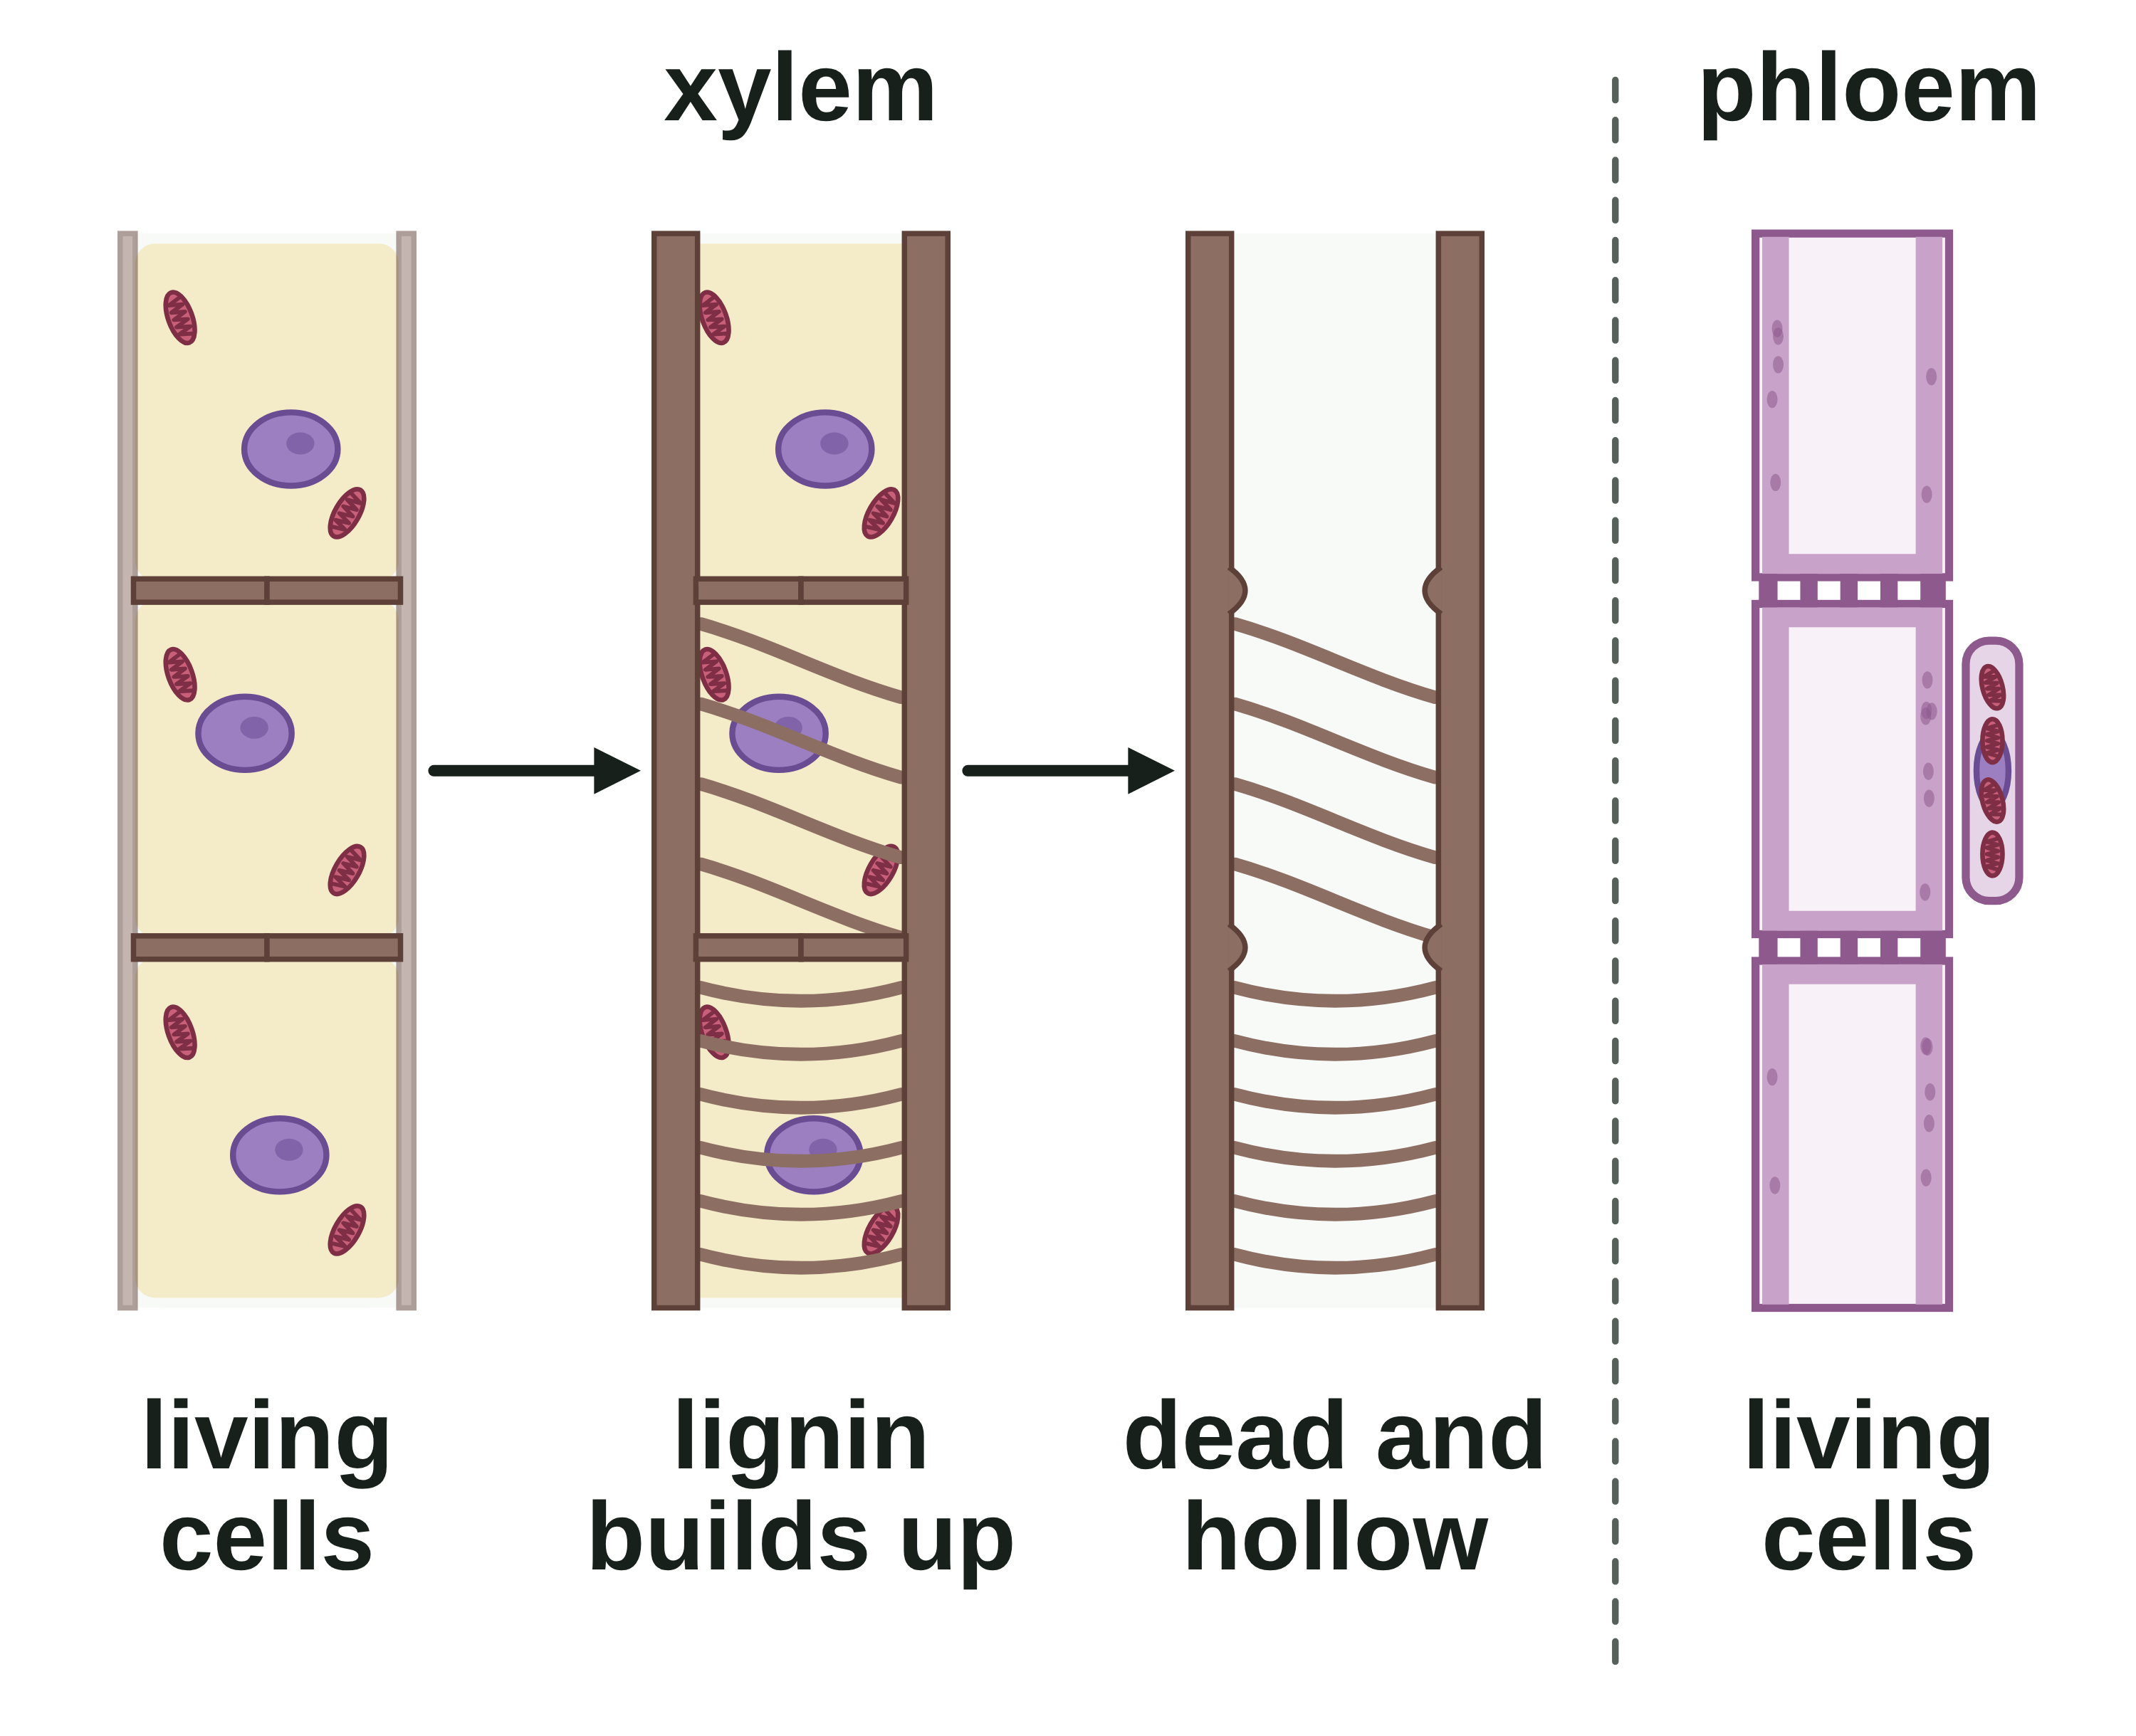
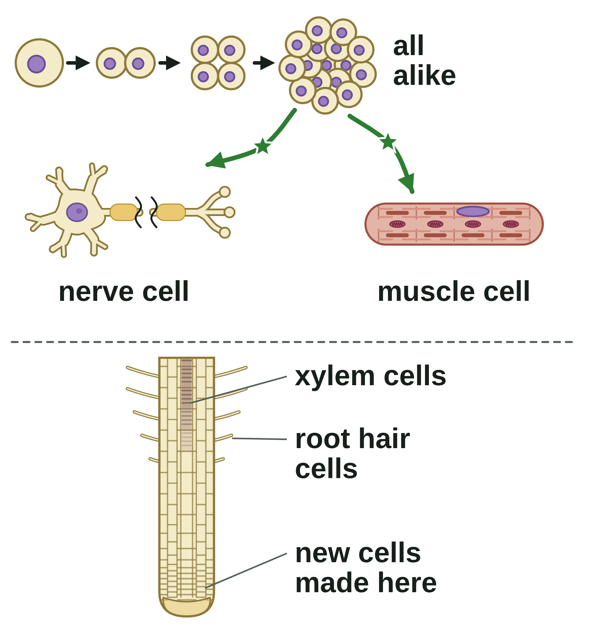
B1 L5 Revision notes 3 of 4
Specialised cells
Xylem and phloem cells, differentiation, and cells you have not met
9. Xylem cells
11. Differentiation
Xylem carries water and mineral ions from the roots up to the stem and leaves.
Young xylem cells are living cells joined end to end.
Lignin builds up in their walls, in rings and spirals. It strengthens the walls and helps to support the plant.
Then the cells die. Their cytoplasm, nucleus and end walls break down.
This leaves long, hollow tubes with no end walls, so water and mineral ions flow through with nothing in the way.
Differentiation is the process by which a cell becomes specialised, gaining the sub-cellular structures it needs for its job.
As an organism develops, its cells differentiate into different types of cell.
Most animal cells differentiate at an early stage.
In adult animals, cell division is mainly for repair and replacement, such as replacing skin cells.
Many plant cells keep the ability to differentiate throughout life. That is why a plant can keep growing new roots, shoots and leaves.
In the diagram, brown = xylem and purple = phloem. Real xylem and phloem are pale.
10. Phloem cells
Why it matters: a multicellular organism needs many types of cell to do different jobs. Specialised cells then work together in tissues (B2 L1 Cells, tissues and organs). Stem cells: B1 L7 Stem cells.
Phloem carries dissolved sugars from the leaves to the rest of the plant, up and down.
Phloem cells are living cells joined end to end in tubes.
Pores in the end walls let cell sap, carrying dissolved sugars, move from one cell to the next.
They have few sub-cellular structures. Small cells beside them supply the energy they need.
Watch out: differentiation is not division. A cell divides by mitosis (B1 L6 Cell division: mitosis) and becomes specialised by differentiating.
 | Xylem cells | Phloem cells
living or dead? | dead | living
end walls | none: hollow tubes | end walls with pores
walls | strengthened with lignin | thin
carry | water and mineral ions | dissolved sugars
which way | up | up and down
12. Answering "Explain how this cell is adapted"
In the exam you may meet a cell you have not studied. You will be given information about it.
Step 1: read the cell's job.
Step 2: find each feature in the picture or the text.
Step 3: for each feature, write feature → how it helps → job.
Model answer (a ciliated cell, which moves mucus away from the lungs): "The cell has tiny hairs called cilia, which beat together to sweep the mucus along, so it is moved away from the lungs. The cell has many mitochondria, which release energy for the cilia to keep beating."
Watch out: the 'cell sap' in phloem is not a vacuole's cell sap (B1 L1 Animal and plant cells).
How the whole plant transports water and sugars is B2 L13 Plant transport: xylem and phloem.
B1 L5 · Specialised cells · sciencegcse.co.uk · free GCSE science resources
Notes:
Revision notes page 3 of 4. Xylem and phloem cells, differentiation in animals and plants, and how to answer a question about a cell you have not met. Go through the model answer for the ciliated cell.

Slide 27
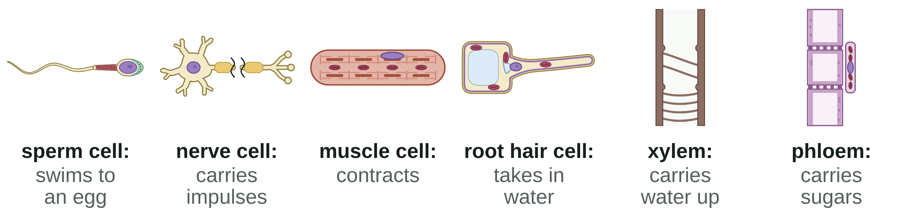
B1 L5 Revision notes 4 of 4
Specialised cells
Key words, exam tips and check yourself
Key words
Check yourself
Cover the answers, then check.
Adaptation: a feature that suits a cell or an organism to its job or to where it lives.
Differentiation: the process by which a cell becomes specialised, gaining the sub-cellular structures it needs for its job.
Lignin: a tough substance that strengthens the walls of xylem tubes.
Micrometre (µm): one thousandth of a millimetre (1 mm = 1000 µm).
Mineral ions: substances from the soil, such as nitrate, that a plant needs to stay healthy.
Mitochondria (one mitochondrion): the structures in the cytoplasm where aerobic respiration happens, releasing energy for the cell.
Muscle cell: a cell that can contract (get shorter) to cause movement.
Nerve cell: a long cell that carries electrical impulses from one part of the body to another.
Phloem: a plant tissue of tubes of elongated living cells that carries dissolved sugars from the leaves to the rest of the plant.
Root hair cell: a cell on the surface of a root, with a long, thin extension that gives a large surface area for taking in water and mineral ions.
Specialised cell: a cell with a structure that suits it to one job.
Sperm cell: the male sex cell, which swims to an egg cell and fertilises it.
Xylem: a plant tissue of hollow tubes strengthened by lignin that carries water and mineral ions from the roots to the stem and leaves.
1. Give the job of a phloem cell.
2. How is a root hair cell adapted to take in water?
3. Name three ways a sperm cell is adapted to its job.
4. How does a fatty sheath help a nerve cell?
5. Why do muscle cells need many mitochondria?
6. Why are xylem cells hollow?
7. Describe what happens to a cell when it differentiates.
8. A root hair is 0.5 mm long. How long is it in micrometres?
Answers
1. It carries dissolved sugars up and down the plant.
2. It has a long, thin extension, which gives a large surface area, so it takes in more water.
3. A tail to swim; many mitochondria to release energy for swimming; enzymes in the head to digest a way into the egg cell.
4. It insulates the cell, so impulses travel quickly.
5. To release the energy the cell needs to contract.
6. The cells are dead, and their cytoplasm, nucleus and end walls have broken down, so water and mineral ions flow through with nothing in the way.
7. It becomes specialised: it gains the sub-cellular structures it needs for its job.
8. 0.5 × 1000 = 500 µm.
Common mistakes
Wrong: "Root hairs are tiny hairs on a root." Right: each root hair is part of one root hair cell.
Wrong: "Mitochondria make energy." Right: they release energy.
Wrong: "Xylem carries sugars." Right: xylem carries water and mineral ions; phloem carries dissolved sugars.
Wrong: "Differentiation is when a cell divides." Right: it is when a cell becomes specialised.
Exam tips
Learn the job of each of the six cells and two or three features of each.
For "explain how this cell is adapted", write feature → how it helps → job for each feature.
With a cell you have not met, use the information given. Many mitochondria means energy is released for something: say what.
Energy is released by respiration in mitochondria. Never write that energy is "made".
Xylem: dead, hollow, lignin, water and mineral ions. Phloem: living, pores in end walls, dissolved sugars.
In size questions, change both sizes into the same unit first, show your working and give the unit.
The six cells at a glance
B1 L5 · Specialised cells · sciencegcse.co.uk · free GCSE science resources
Notes:
Revision notes page 4 of 4. Key words, exam tips and Check yourself: students cover the answers, try all eight, then check. The six cells at a glance and the common mistakes sum up the lesson.

Slide 28
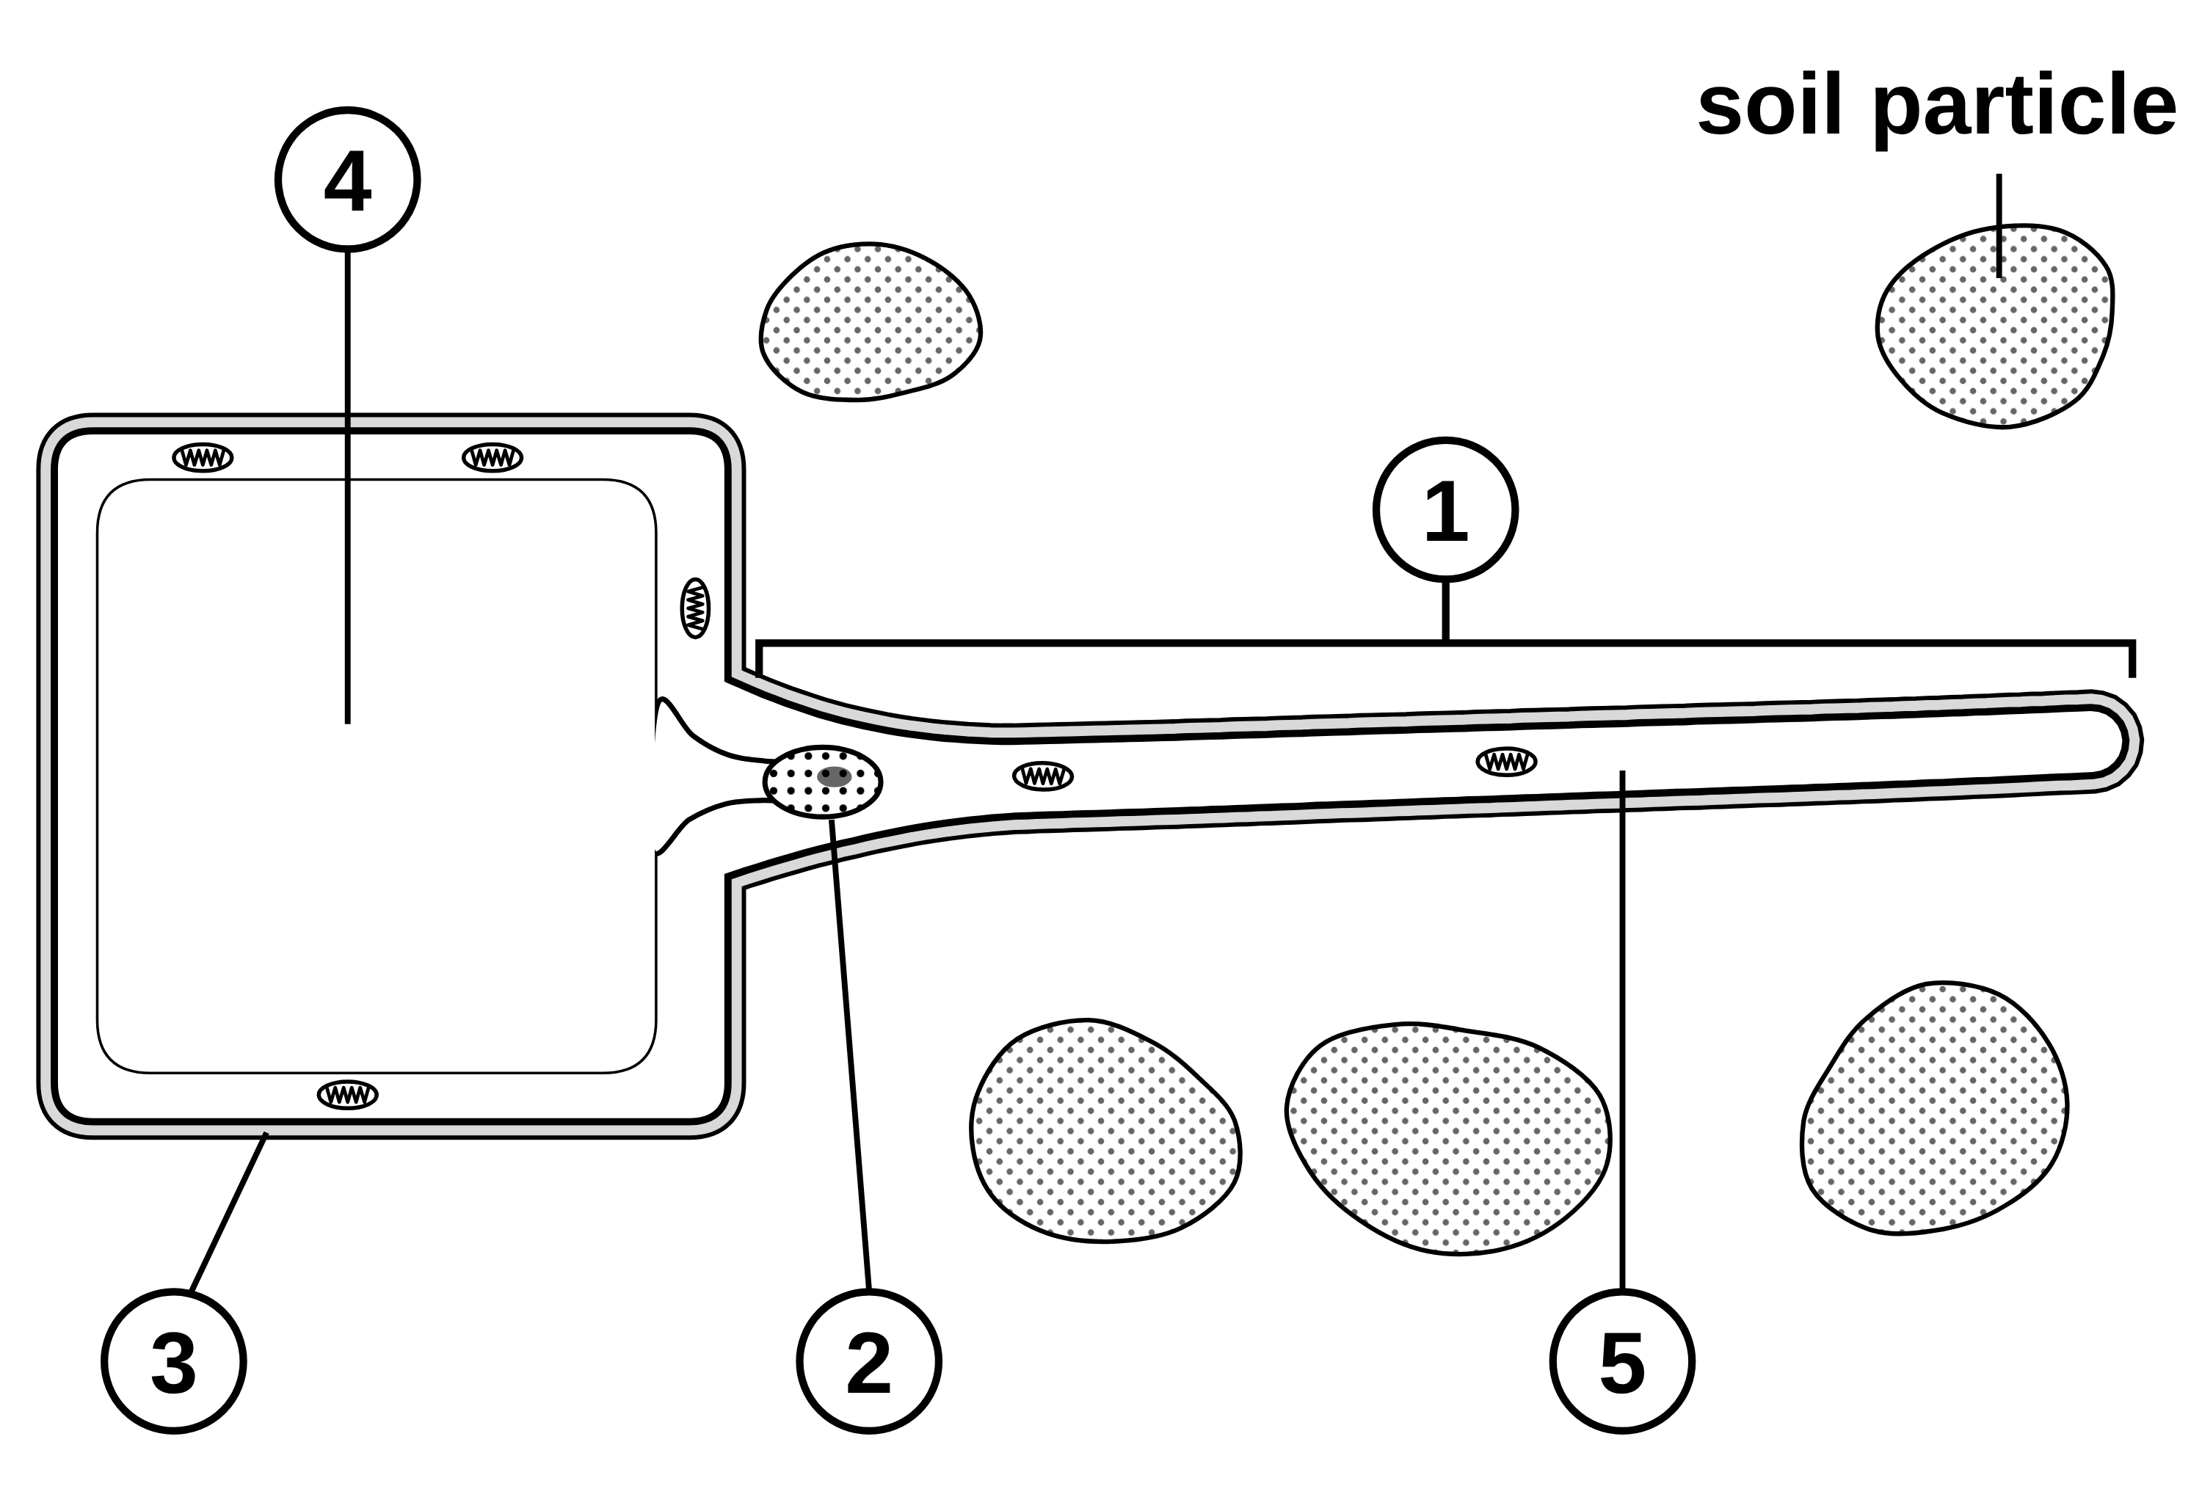
B1 L5 Mandatory worksheet: Specialised cells
Page 1 of 2
Name: ______________________________ Class: __________
A. The root hair cell
B. Fill in the gaps
[6]
[5]
Help: online screens 2 and 3
Help: online screens 1 and 10
The diagram shows a root hair cell in the soil.
Use words from the box. Use each word once. Two words are not needed.
differentiation
early
late
mitosis
plant
repair
structure
1. A specialised cell has a ____________ that suits it to one job.
2. Cells become specialised by a process called ____________.
3. Most animal cells differentiate at an ____________ stage.
4. Many ____________ cells can differentiate throughout their lives.
5. In adult animals, cell division is mainly for ____________ and replacement.
C. Which cell has this feature?
[6]
Help: online screens 3, 4 and 6
(a) Name the parts labelled 1 to 5. [5]
Tick (✓) one box in each row.
Feature | Sperm cell | Nerve cell | Muscle cell | Root hair cell
1. a long tail
2. branched endings
3. protein fibres that slide over each other
4. a long, thin extension
5. enzymes in its head
6. a fatty sheath
1
4
2
5
3
(b) Most leaf cells have chloroplasts. Root hair cells do not. Give the reason. [1]
B1 L5 · Specialised cells · sciencegcse.co.uk · free GCSE science resources

Slide 29
B1 L5 Mandatory worksheet: Specialised cells
Page 2 of 2
Name: ______________________________ Class: __________
D. Short answers
E. Calculate
[8]
[3]
Help: online screens 1, 2, 6, 9 and 10
Help: online screens 4 and 7
1. Give the meaning of the term “specialised cell”. [1]
A student draws a sperm cell 75 mm long. The real sperm cell is 50 µm long. Calculate the magnification of the drawing. Use: magnification = size of image ÷ size of real object, and 1 mm = 1000 µm. Show your working. [3]
2. Give one way the painting of a real root is different from the diagram of a root hair cell. [1]
Magnification = ×
3. Nerve cells have a fatty sheath. How does it help the nerve cell? [1]
4. Xylem cell walls contain lignin. Give one job of the lignin. [1]
F. Explain
[4]
Help: online screen 4
A sperm cell’s job is to reach an egg cell and fertilise it. Explain how a sperm cell is adapted to do this job. [4]
5. Name the plant cells that carry dissolved sugars. [1]
6. Phloem cells have pores in their end walls. What moves through the pores? [1]
7. What is cell division mainly used for in adult animals? [1]
8. Are xylem cells living or dead when they carry water? [1]
B1 L5 · Specialised cells · sciencegcse.co.uk · free GCSE science resources

Slide 30
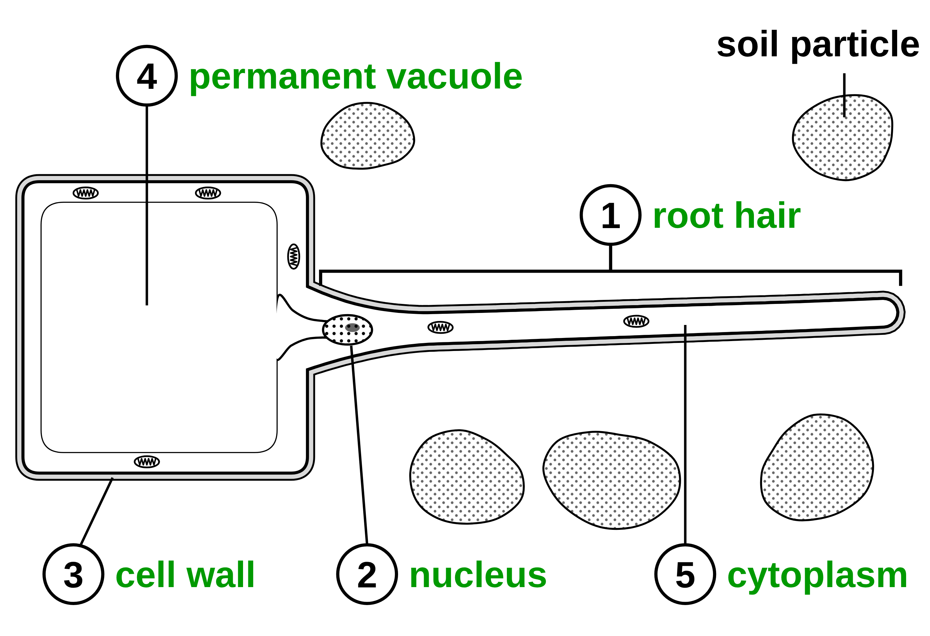
B1 L5 Mandatory worksheet answers - page 1
Answers 1 of 2
A. The root hair cell
B. Fill in the gaps
[6]
[5]
The diagram shows a root hair cell in the soil.
Use words from the box. Use each word once. Two words are not needed.
differentiation
early
late
mitosis
plant
repair
structure
1. A specialised cell has a structure that suits it to one job. (1)
2. Cells become specialised by a process called differentiation. (1)
3. Most animal cells differentiate at an early stage. (1)
4. Many plant cells can differentiate throughout their lives. (1)
5. In adult animals, cell division is mainly for repair and replacement. (1)
C. Which cell has this feature?
[6]
(a)
1 root hair / long, thin extension (1) 2 nucleus (1)
3 cell wall (1) 4 permanent vacuole / vacuole (1) 5 cytoplasm (1)
Allow “hair” for 1. Do not accept “root” for 1 (a root has thousands of root hair cells). Do not accept “cell membrane” for 3 (the membrane is just inside the wall).
1 mark for each correct row.
Feature | Sperm cell | Nerve cell | Muscle cell | Root hair cell
1. a long tail | ✓
2. branched endings |  | ✓
3. protein fibres that slide over each other |  |  | ✓
4. a long, thin extension |  |  |  | ✓
5. enzymes in its head | ✓
6. a fatty sheath |  | ✓
(b)
They are underground / no light reaches them, so they cannot photosynthesise (1).
Do not accept “because they are white” (that is what you see, not the reason).
Do not give the mark if more than one box in a row is ticked.
B1 L5 · Specialised cells · sciencegcse.co.uk · free GCSE science resources

Slide 31
B1 L5 Mandatory worksheet answers - page 2
Answers 2 of 2
D. Short answers
E. Calculate
[8]
[3]
1. Give the meaning of the term “specialised cell”. [1]
75 mm = 75 000 µm (1)
75 000 ÷ 50 (1)
= × 1500 (1)
Correct answer with no working scores 3. Allow 1.5 for 1 mark only if 75 ÷ 50 is shown (units not changed). Allow 50 µm = 0.05 mm and 75 ÷ 0.05 = 1500 (full marks). Do not accept 3 750 000 (75 000 × 50: multiplied instead of divided).
Model answer: 75 mm = 75 × 1000 = 75 000 µm. Magnification = 75 000 ÷ 50 = × 1500.
A cell with a structure that suits it to one job (1).
Allow “a cell adapted to do one job”.
2. Give one way the painting of a real root is different from the diagram of a root hair cell. [1]
Any one (1): the real root has thousands of root hairs / the diagram shows one cell; each real hair is only part of a cell / the diagram shows the whole cell; real root hairs are white / the diagram is coloured; real hairs are tiny / the diagram is drawn much bigger; the painted seedling grew on damp paper / the diagram shows soil.
Do not accept “the painting is real” or “the diagram is smaller”.
3. Nerve cells have a fatty sheath. How does it help the nerve cell? [1]
It insulates the cell, so impulses travel quickly (1).
Allow “it insulates the cell” or “impulses travel faster” on its own.
F. Explain
4. Xylem cell walls contain lignin. Give one job of the lignin. [1]
[4]
It strengthens the walls / it supports the plant (1).
It has a (long) tail, so it can swim to the egg cell (1).
It has many mitochondria (1),
which release energy for swimming / for the tail to move (1).
It has enzymes in its head, which digest a way into the egg cell (1).
Max 4. Allow: its nucleus has half the genetic material of a body cell (which joins the egg cell’s nucleus) for 1 mark in place of a missing point. “Many mitochondria” scores 1 mark on its own; the tail and enzymes marks need the feature and what it does. Do not accept “mitochondria make / produce energy” (the energy point scores 0).
Model answer: A sperm cell has a long tail, so it can swim to the egg cell. It has many mitochondria, which release energy for swimming. It has enzymes in its head, which digest a way through the outer layer of the egg cell. Its nucleus carries half the genetic material, which joins with the egg cell’s nucleus.
5. Name the plant cells that carry dissolved sugars. [1]
Phloem cells (1).
Do not accept “xylem”.
6. Phloem cells have pores in their end walls. What moves through the pores? [1]
Cell sap containing dissolved sugars (1).
Allow “dissolved sugars” or “sugar solution”. Do not accept “water and mineral ions” (that is xylem). This cell sap is the liquid in the phloem, not the cell sap in a vacuole.
7. What is cell division mainly used for in adult animals? [1]
Repair and replacement (of cells) (1).
Allow either word.
8. Are xylem cells living or dead when they carry water? [1]
Dead (1).
B1 L5 · Specialised cells · sciencegcse.co.uk · free GCSE science resources

Slide 32
B1 L5 Challenge worksheet: Specialised cells
Page 1 of 2
Name: ______________________________ Class: __________
A. Mitochondria in cells
B. Sizes and magnification
[6]
[5]
Help: online screens 4 and 6
Help: online screen 7
A scientist counted the mitochondria in four types of animal cell. Table 1 shows the results.
(a) A nerve cell runs from the bottom of the spine to a toe. It is 0.9 m long. Its cell body is 90 µm across. Calculate how many times longer the nerve cell is than the width of its cell body. Give your answer in standard form. Use 1 m = 1000 mm and 1 mm = 1000 µm. [3]
Table 1
Cell | What the cell does | Mean number of mitochondria in one cell
A | contracts all day and night to pump blood | 5000
B | carries out many chemical reactions | 1500
C | swims to an egg cell | 70
D | stores fat | 30
(a) Which cell, A, B, C or D, is likely to release the most energy? Give a reason for your answer. [2]
times
(b) In a textbook, the cell body is drawn 27 mm across. Calculate the magnification of the drawing. Use: magnification = size of image ÷ size of real object. [2]
(b) Calculate how many times more mitochondria cell B has than cell D. [2]
times
(c) Cell C is a sperm cell. Its mitochondria are packed into a short section just behind the head, where the tail starts. Suggest why. [2]
Magnification = ×
B1 L5 · Specialised cells · sciencegcse.co.uk · free GCSE science resources

Slide 33
B1 L5 Challenge worksheet: Specialised cells
Page 2 of 2
Name: ______________________________ Class: __________
C. Apply what you know
D. Extended response
[4]
[6]
Help: online screens 10 and 11
Help: online screens 2, 3 and 9
(a) Gland cells in the pancreas make enzymes. Enzymes are proteins. Use what you learnt about ribosomes in B1 L1 Animal and plant cells. Suggest why these gland cells have many ribosomes. [2]
Water moves from the soil into root hair cells, then up the plant in the xylem to the leaves. Explain how root hair cells and xylem cells are adapted to do their jobs. [6]
In your answer, describe the structure of each type of cell and explain how it helps the cell to do its job.
(b) A tree is cut down to a stump. A few weeks later, new shoots with leaves grow from the stump. Explain what this shows about plant cells. [2]
B1 L5 · Specialised cells · sciencegcse.co.uk · free GCSE science resources

Slide 34
B1 L5 Challenge worksheet answers - page 1
Answers 1 of 2
A. Mitochondria in cells
B. Sizes and magnification
[6]
[5]
A scientist counted the mitochondria in four types of animal cell. Table 1 shows the results.
(a)
0.9 m = 900 000 µm (allow 900 mm and 0.09 mm) (1)
900 000 ÷ 90 = 10 000 (allow 900 ÷ 0.09) (1)
= 1 × 10⁴ (1)
Correct answer in standard form with no working scores 3. 10 000 not in standard form scores 2. Do not accept 10 × 10³ for the third mark (the number before × must be between 1 and 10).
Table 1
Cell | What the cell does | Mean number of mitochondria in one cell
A | contracts all day and night to pump blood | 5000
B | carries out many chemical reactions | 1500
C | swims to an egg cell | 70
D | stores fat | 30
(b)
27 mm = 27 000 µm (or 90 µm = 0.09 mm) and 27 000 ÷ 90 (1)
= × 300 (1)
Correct answer with no working scores 2.
(a)
A (1); it has the most mitochondria, and mitochondria release energy (by respiration) (1).
Do not accept “mitochondria make energy” for the second mark.
Model answers
(a) 0.9 m = 900 mm = 900 000 µm. 900 000 ÷ 90 = 10 000 = 1 × 10⁴ times.
(b) 27 mm = 27 000 µm. 27 000 ÷ 90 = × 300.
(b)
1500 ÷ 30 (1) = 50 (times) (1)
Correct answer with no working scores 2.
(c)
The mitochondria are close to the tail (1);
so the energy is released where it is needed, for the tail to move / for swimming (1).
Model answers
(a) Cell A. It has the most mitochondria, and mitochondria release energy by respiration.
(b) 1500 ÷ 30 = 50 times.
(c) The mitochondria are next to the tail, so the energy they release is right where the tail needs it to swim.
B1 L5 · Specialised cells · sciencegcse.co.uk · free GCSE science resources

Slide 35
B1 L5 Challenge worksheet answers - page 2
Answers 2 of 2
C. Apply what you know
D. Extended response
[4]
[6]
(a)
Ribosomes are where proteins are made / protein synthesis happens (1);
the cells make a lot of enzymes (proteins), so they need many ribosomes (1).
Level 3 (5–6 marks): A detailed and coherent explanation. Both types of cell are described, with at least two features of each, and each feature is linked to how it helps the cell do its job. The answer follows the water from the soil to the leaves in a logical order.
Level 2 (3–4 marks): Features of both types of cell, with some links to their jobs; or one type of cell explained in detail.
Level 1 (1–2 marks): Simple statements, such as “root hair cells take in water” or “xylem is a tube”, with little or no explanation.
0 marks: No relevant content.
Indicative content
root hair cell: a long, thin extension (root hair) gives a large surface area
so more water (and mineral ions) is taken in from the soil
the hair grows between soil particles into the soil water; water enters by osmosis
no chloroplasts, as there is no light underground
many mitochondria release energy to take in mineral ions by active transport
xylem cells: dead cells joined end to end; no end walls, no cytoplasm or nucleus
they form long, hollow tubes, so water flows through easily with nothing in the way
lignin strengthens the walls so the tubes do not collapse; lignin supports the plant
xylem carries water and mineral ions up from the roots to the stem and leaves
together: root hair cells take water in; xylem carries it up to the leaves
Do not accept “mitochondria make energy” (that point scores nothing). Ignore “sieve plate”, “vessel element” and other names not needed for AQA.
The Level 3 model answer is in the box on the left, under task C.
(b)
Many plant cells keep the ability to differentiate throughout life (1);
cells in the stump differentiate into the specialised cells of new shoots, such as leaf, xylem and phloem cells (1).
Allow “cells divide to make new cells, which then differentiate into ...” for the second mark. Do not accept “the cells divide” alone for either mark (division is not differentiation).
Model answers
(a) Ribosomes are where proteins are made. These cells make large amounts of enzymes, which are proteins, so they need many ribosomes.
(b) Many plant cells keep the ability to differentiate all their lives. Cells in the old stump can still differentiate into new specialised cells, such as leaf, xylem and phloem cells, so new shoots grow.
D. Model answer (Level 3)
Root hair cells have a long, thin extension that reaches out between the soil particles. This gives a large surface area, so more water is taken in from the soil, by osmosis. Root hair cells have no chloroplasts, because no light reaches them underground, and they have many mitochondria, which release energy to take in mineral ions. The water then moves across the root into the xylem. Xylem cells are dead and have no end walls, no cytoplasm and no nucleus, so they form long, hollow tubes. Water and mineral ions flow up these tubes easily, with nothing in the way. Lignin strengthens the walls, so the tubes do not collapse, and it helps to support the plant. So root hair cells take the water in, and xylem carries it up to the leaves.
B1 L5 · Specialised cells · sciencegcse.co.uk · free GCSE science resources

Slide 36
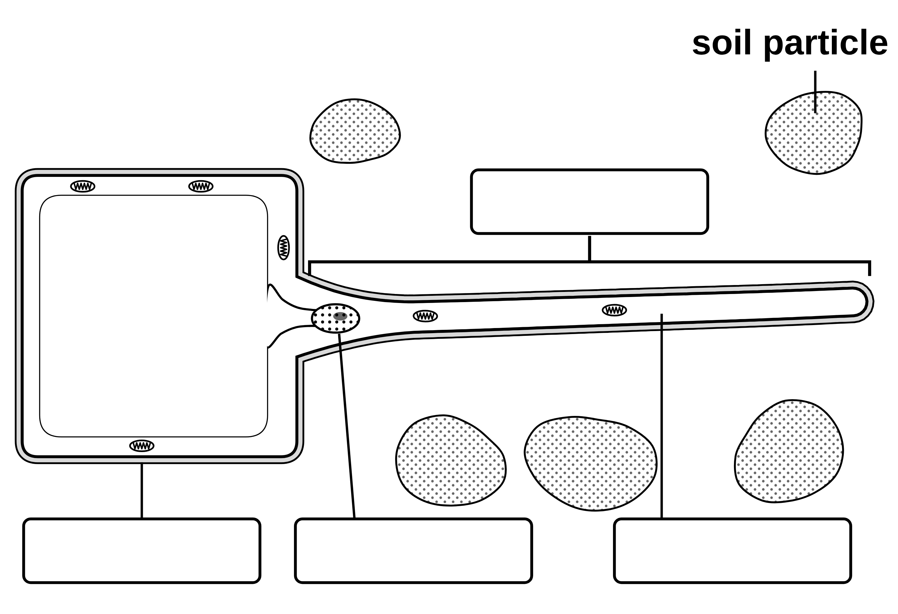
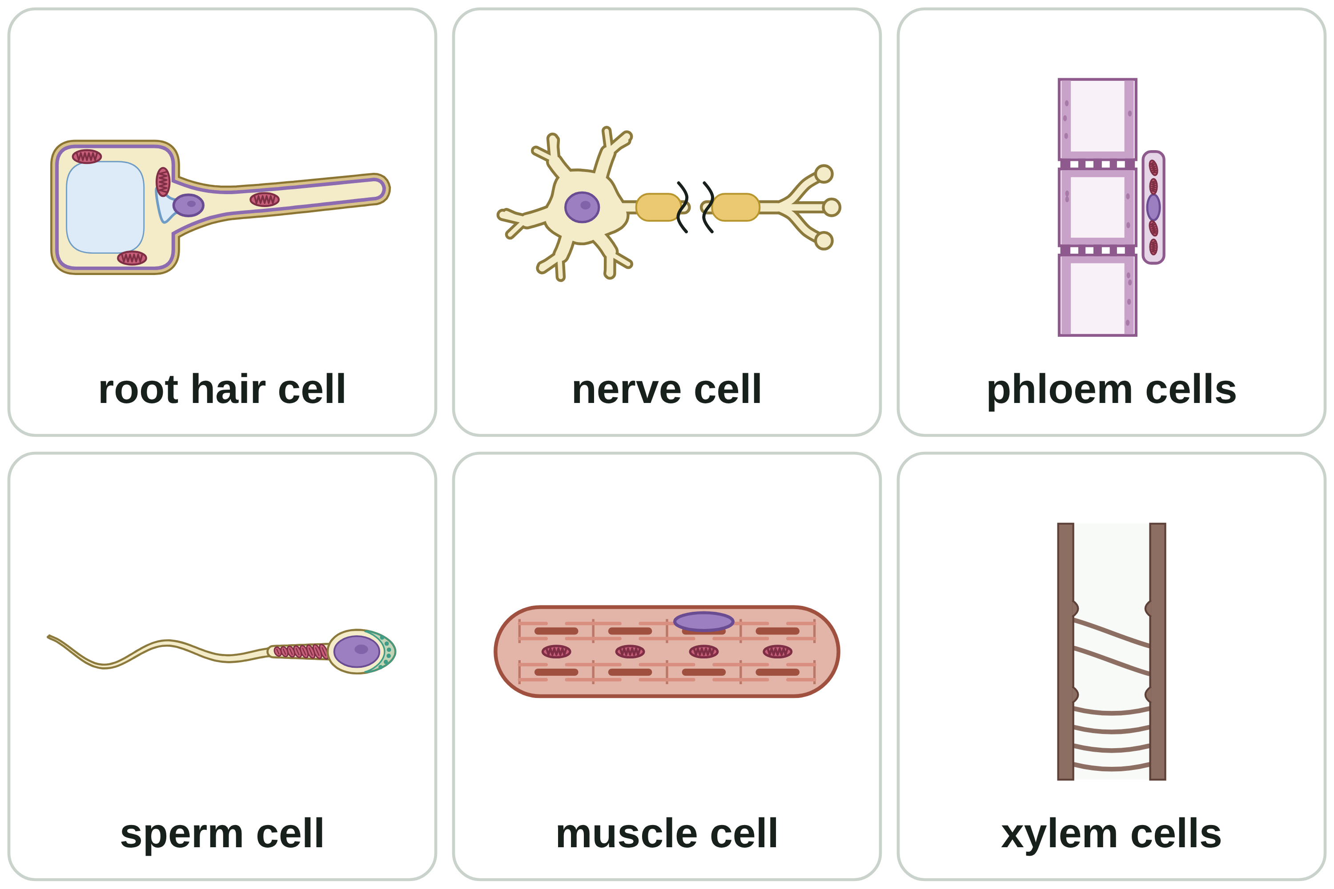
B1 L5 Alternative worksheet: Specialised cells
Page 1 of 2
Name: ______________________________ Class: __________
Key facts
A. Label the root hair cell
[4]
Help: online screens 2 and 3
A specialised cell has a structure that suits it to one job.
Sperm cell: swims to an egg cell and fertilises it. It has a tail.
Nerve cell: carries electrical impulses.
Muscle cell: contracts (gets shorter) to cause movement.
Root hair cell: takes in water and mineral ions from the soil. It has no chloroplasts.
Xylem cells: dead, hollow tubes that carry water and mineral ions.
Phloem cells: living cells that carry dissolved sugars.
Mitochondria release energy.
Cells become specialised by differentiation.
Write a word from the box in each label box.
cytoplasm
nucleus
root hair
cell wall
Six specialised cells.
A diagram is simplified. Cells are drawn much bigger than real life, and the colours only show the parts.
Tip: the root hair is the long, thin part that reaches into the soil.
B1 L5 · Specialised cells · sciencegcse.co.uk · free GCSE science resources

Slide 37
B1 L5 Alternative worksheet: Specialised cells
Page 2 of 2
Name: ______________________________ Class: __________
B. Match the cell to its job
C. Fill the gaps
[6]
[6]
Help: online screens 3, 4, 6 and 9
Help: online screens 3, 4, 6 and 9
Draw a line from each cell to its job.
Use the words in the box. Use each word once.
sperm cell
carry dissolved sugars
contract
impulses
mitochondria
sugars
tail
water
nerve cell
contracts to cause movement
1. A sperm cell swims with its __________.
muscle cell
takes in water from the soil
2. Many __________ release energy for swimming.
root hair cell
swims to an egg cell
3. Nerve cells carry electrical __________.
4. Muscle cells __________ to cause movement.
xylem cells
carry water up the plant
5. Root hair cells take in __________ from the soil.
phloem cells
carries electrical impulses
6. Phloem cells carry dissolved __________.
D. True or false?
E. How many times longer?
[6]
[3]
Help: online screens 1, 3, 4, 6 and 9
Help: online screen 7
Tick (✓) True or False for each sentence.
Fill in the gaps. Do one step at a time.
1 mm = 1000 µm
Sentence | True | False
1. A root hair is a separate hair stuck onto a root.
2. Root hair cells have chloroplasts.
3. A sperm cell uses its tail to swim.
4. Nerve cells carry blood.
5. Xylem cells are dead and hollow.
6. Mitochondria release energy.
A root hair is 0.4 mm long. A sperm cell is 50 µm long. How many times longer is the root hair?
1. Change mm into µm: 0.4 × 1000 = ________ µm
2. Divide by the length of the sperm cell: ________ ÷ 50 = ________
3. Check: your answer × 50 = ________ µm
The root hair is ________ times longer than the sperm cell.
Tip: change both sizes into µm before you divide.
B1 L5 · Specialised cells · sciencegcse.co.uk · free GCSE science resources

Slide 38
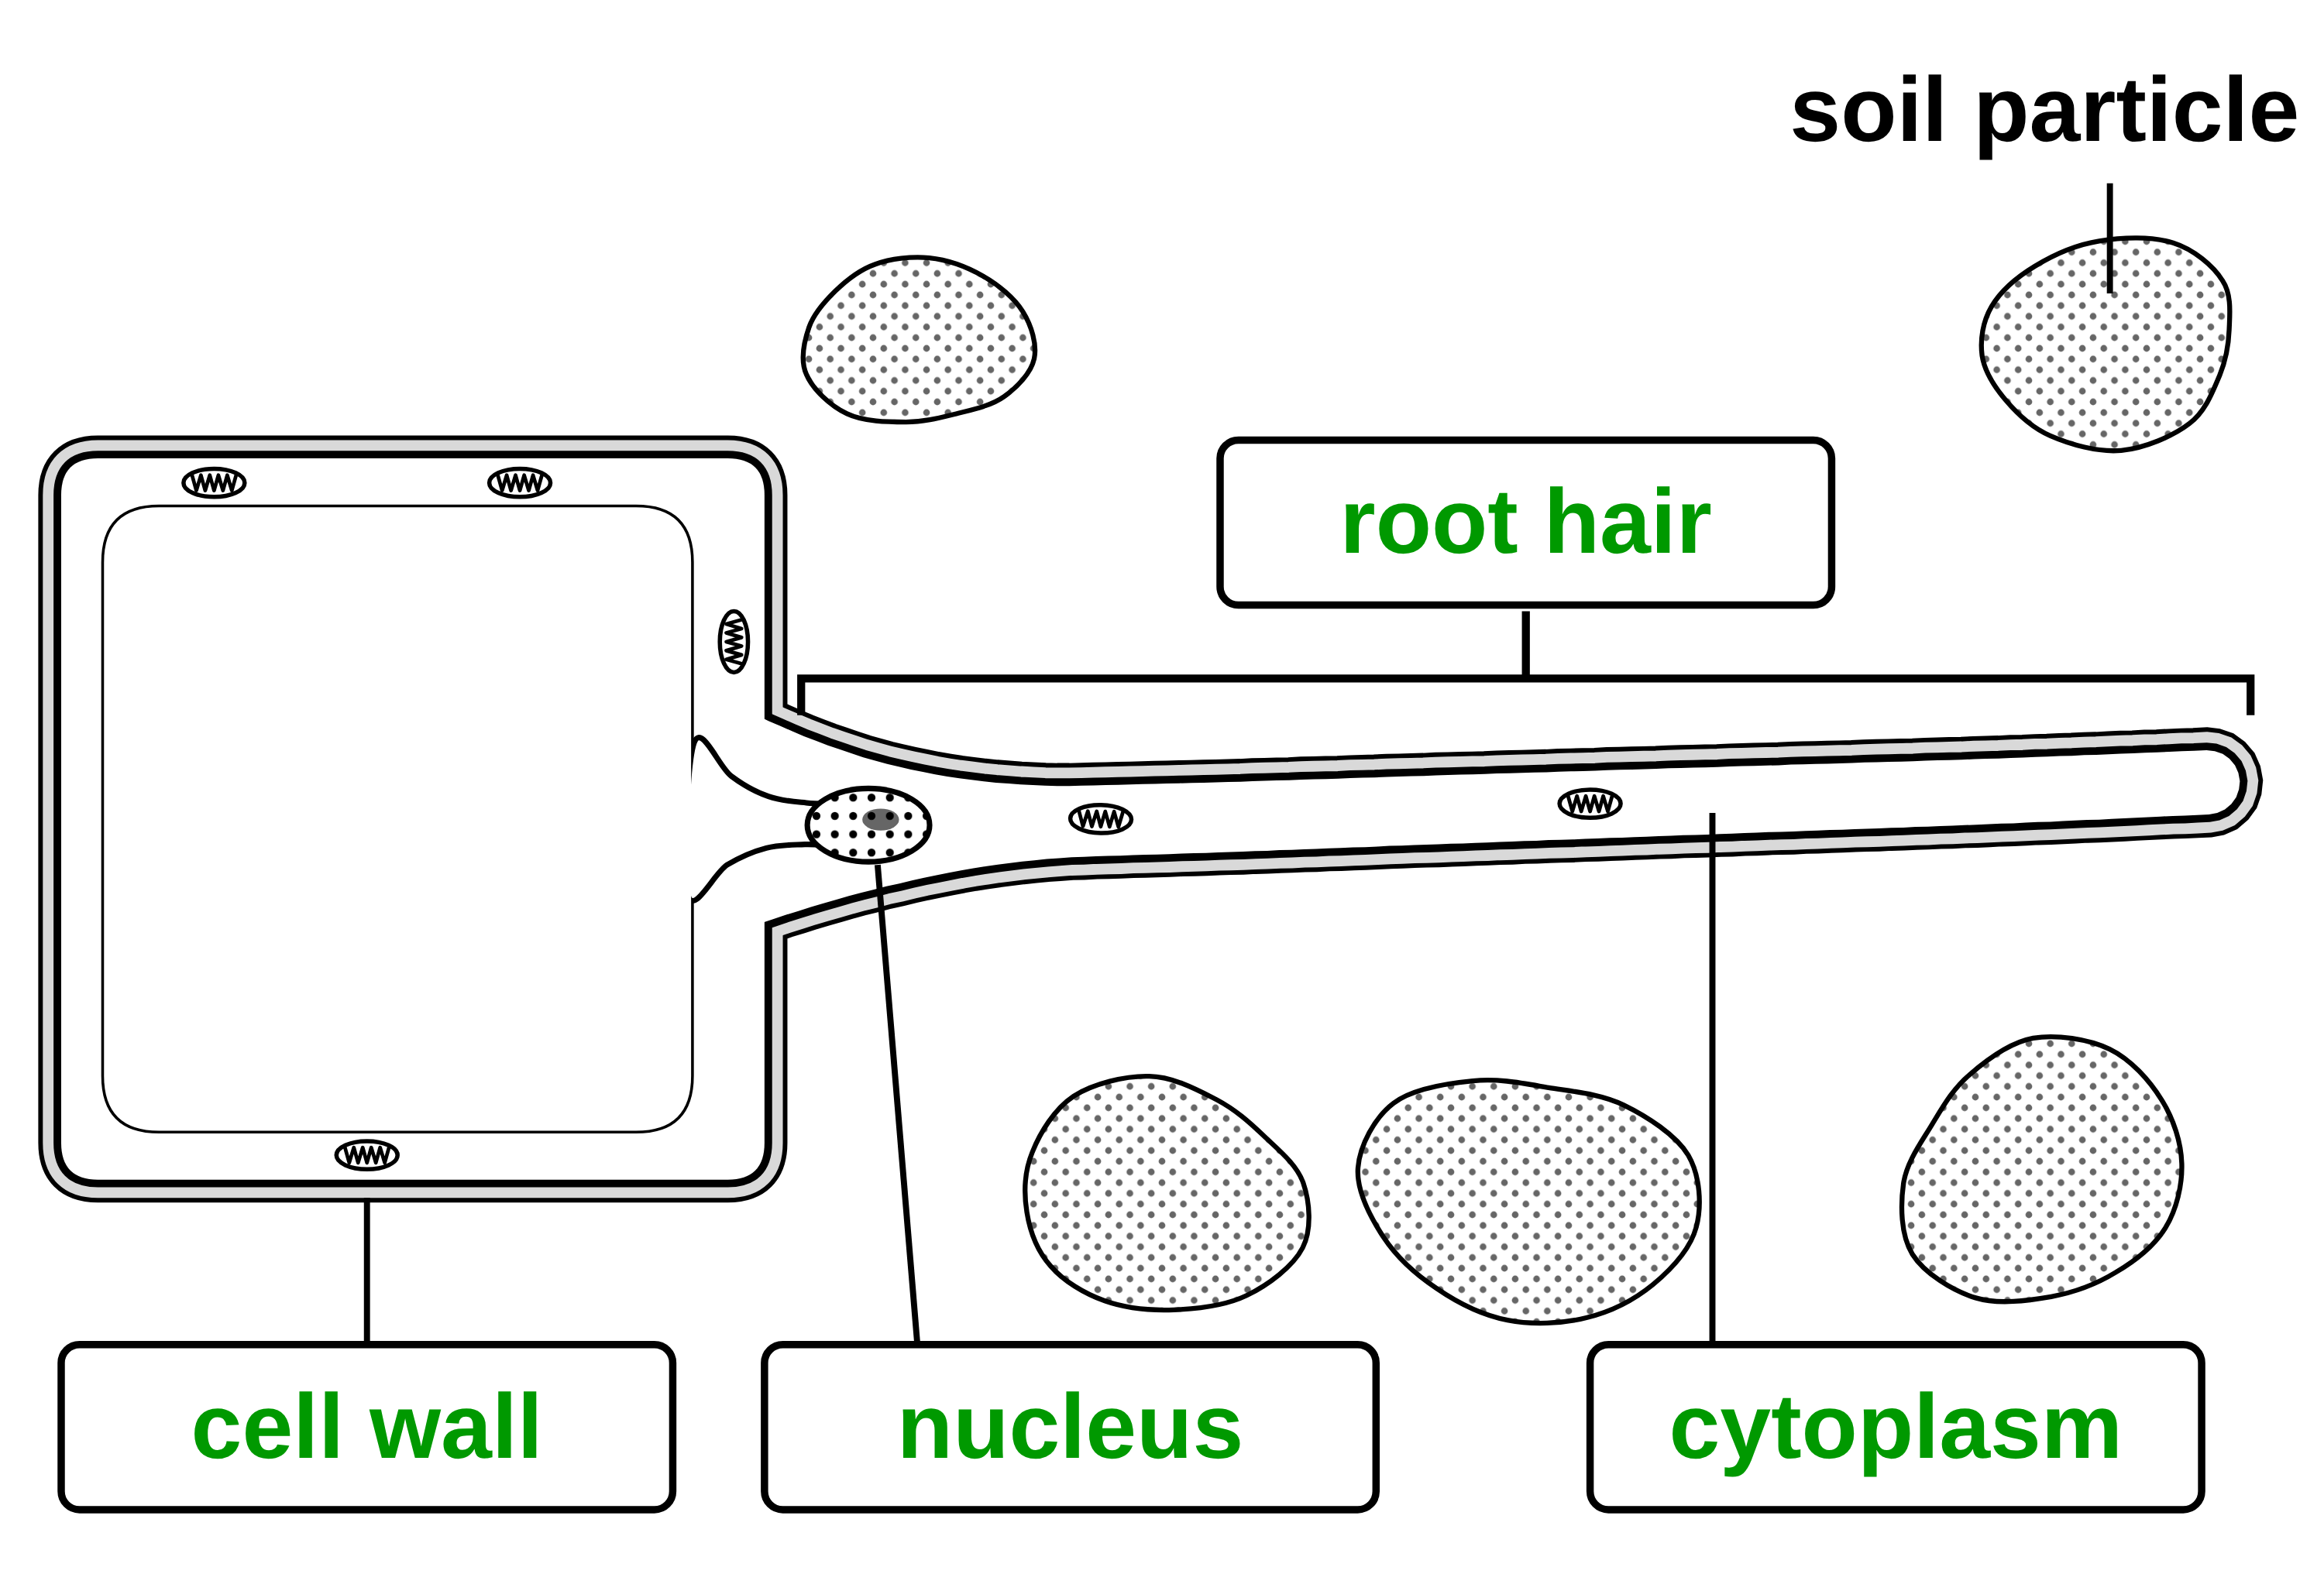
B1 L5 Alternative worksheet answers - page 1
Answers 1 of 2
Key facts
A. Label the root hair cell
[4]
A specialised cell has a structure that suits it to one job.
Sperm cell: swims to an egg cell and fertilises it. It has a tail.
Nerve cell: carries electrical impulses.
Muscle cell: contracts (gets shorter) to cause movement.
Root hair cell: takes in water and mineral ions from the soil. It has no chloroplasts.
Xylem cells: dead, hollow tubes that carry water and mineral ions.
Phloem cells: living cells that carry dissolved sugars.
Mitochondria release energy.
Cells become specialised by differentiation.
Write a word from the box in each label box.
cytoplasm
nucleus
root hair
cell wall
1 mark for each correct label box (4):
root hair (top) (1); cell wall (bottom left) (1); nucleus (bottom middle) (1); cytoplasm (bottom right) (1).
Allow small spelling errors if the word is clear.
Six specialised cells.
A diagram is simplified. Cells are drawn much bigger than real life, and the colours only show the parts.
B1 L5 · Specialised cells · sciencegcse.co.uk · free GCSE science resources

Slide 39
B1 L5 Alternative worksheet answers - page 2
Answers 2 of 2
B. Match the cell to its job
C. Fill the gaps
[6]
[6]
1 mark for each correct line.
Use the words in the box. Use each word once.
sperm cell
carry dissolved sugars
contract
impulses
mitochondria
sugars
tail
water
nerve cell
contracts to cause movement
1. A sperm cell swims with its tail. (1)
muscle cell
takes in water from the soil
2. Many mitochondria release energy for swimming. (1)
root hair cell
swims to an egg cell
3. Nerve cells carry electrical impulses. (1)
4. Muscle cells contract to cause movement. (1)
xylem cells
carry water up the plant
5. Root hair cells take in water from the soil. (1)
phloem cells
carries electrical impulses
6. Phloem cells carry dissolved sugars. (1)
D. True or false?
E. How many times longer?
[6]
[3]
1. A root hair is a separate hair stuck onto a root. False. A root hair is part of one root hair cell. (1)
2. Root hair cells have chloroplasts. False. They are underground, so they have no chloroplasts. (1)
3. A sperm cell uses its tail to swim. True. (1)
4. Nerve cells carry blood. False. Nerve cells carry electrical impulses. (1)
5. Xylem cells are dead and hollow. True. (1)
6. Mitochondria release energy. True. (1)
Fill in the gaps. Do one step at a time.
1 mm = 1000 µm
A root hair is 0.4 mm long. A sperm cell is 50 µm long. How many times longer is the root hair?
1. Change mm into µm: 0.4 × 1000 = 400 µm (1)
2. Divide by the length of the sperm cell: 400 ÷ 50 = 8 (1)
3. Check: your answer × 50 = 400 µm (1)
The root hair is 8 times longer than the sperm cell.
Allow their step 1 answer ÷ 50, and their step 2 answer × 50, if done correctly.
B1 L5 · Specialised cells · sciencegcse.co.uk · free GCSE science resources

Slide 40
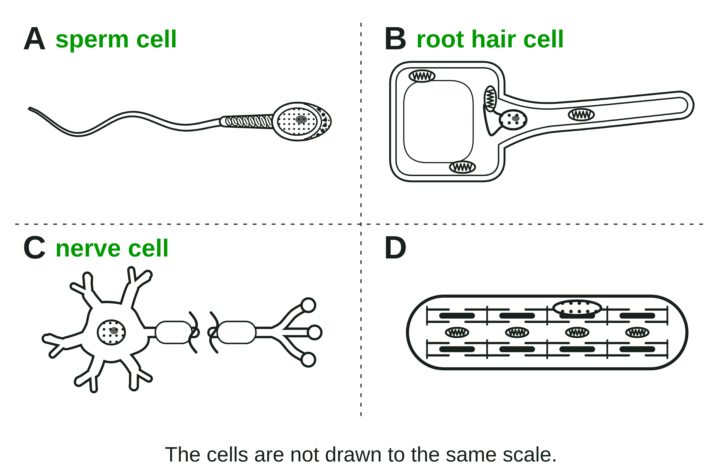
B1 L5 Exam questions worksheet mark scheme - page 1
Answers 1 of 2
01 Four specialised cells
03 A cell in the small intestine
[4]
[4]
01.1 Name cells A, B and C. Use words from the box. [3]
A sperm cell (1)
B root hair cell (1)
C nerve cell (1)
allow sperm for A. do not accept xylem cell for B
03.1 Explain how the folds help the cell to do its job. [2]
the folds give a large(r) surface area (1)
so more (digested food) molecules / glucose can be absorbed (more quickly) (1)
allow "more surface" / "bigger surface" for the first mark. do not accept "more space"
03.2 The cell has many mitochondria. Explain why. [2]
mitochondria release energy (by respiration) (1)
(the energy is needed) for active transport (of glucose / food molecules into the cell) (1)
do not accept "mitochondria make / produce energy": that point scores 0, the second point can still score
01.2 What is the job of cell D? [1]
To contract to cause movement (1)
If more than one box is ticked, give 0 marks.
02 Root hairs
04 Differentiation
[4]
[2]
02.1 What is the length of the root hair in micrometres (µm)? [1]
600 (µm) (1)
02.2 Calculate how many times longer the root hair is than it is wide. [2]
600 ÷ 12 (1) = 50 (times) (1)
allow their 02.1 answer ÷ 12 correctly worked for 2 marks; allow 0.6 ÷ 0.012 for the first mark. Correct answer with no working = 2 marks. ignore units
02.3 Root hair cells have no chloroplasts. Suggest why. [1]
they are underground / no light reaches them, so they cannot photosynthesise (1)
allow "they do not photosynthesise". do not accept "because they are white" or "because they are not green"
04 Describe how cell differentiation in animals is different from cell differentiation in plants. [2]
most animal cells differentiate at an early stage (1)
many plant cells keep the ability to differentiate throughout life (1)
allow "animal cells lose the ability to differentiate early" for the first mark; allow "in adult animals, cell division is mainly for repair and replacement" for the first mark if the plant point is also made. do not accept "plant cells divide and animal cells do not"
B1 L5 · Specialised cells · sciencegcse.co.uk · free GCSE science resources

Slide 41
B1 L5 Exam questions worksheet mark scheme - page 2
Answers 2 of 2
05 Extended response
[6]
05 When you decide to move your arm, nerve cells carry electrical impulses to the muscle cells in your arm. The muscle cells contract. Explain how nerve cells and muscle cells are adapted to do their jobs. [6]
Level descriptors
Level 3 (5-6 marks): A detailed and coherent explanation of both cells. At least two features of the nerve cell and two of the muscle cell are given, and each is linked to how it helps the cell do its job.
Level 2 (3-4 marks): Features of both cells are given, with some linked to their jobs; or one cell is explained in detail.
Level 1 (1-2 marks): Simple statements of features or jobs, such as "nerve cells are long" or "muscles contract", with little or no explanation.
0 marks: No relevant content.
Model answer (Level 3)
Nerve cells carry electrical impulses to the muscle cells. A nerve cell is long, so it can carry impulses a long way down the arm. Its branched endings connect with many muscle cells, so one impulse can reach many of them. A fatty sheath insulates the nerve cell, so the impulses travel quickly. Muscle cells contract to move the arm. They contain protein fibres that slide over each other, so the cell gets shorter. They have many mitochondria, which release the energy needed for contraction. Many muscle cells contract together, so the arm moves.
Indicative content
nerve cells carry electrical impulses (from the brain or spinal cord to the muscles)
a nerve cell is long, so it can carry impulses a long way (for example, down the arm)
branched endings connect with many other cells / pass impulses to many muscle cells
a fatty sheath insulates the nerve cell, so impulses travel quickly
muscle cells contract (get shorter) to cause movement
muscle cells contain protein fibres that slide over each other, so the cell gets shorter
muscle cells have many mitochondria, which release energy (by respiration) for contraction
many muscle cells contract together (in muscular tissue), so the arm moves
allow "axon", "myelin (sheath)", "nerve endings" or "dendrites" when used correctly; do not accept "nerve cells carry blood" or "mitochondria make / produce energy"
B1 L5 · Specialised cells · sciencegcse.co.uk · free GCSE science resources

