Slide 1
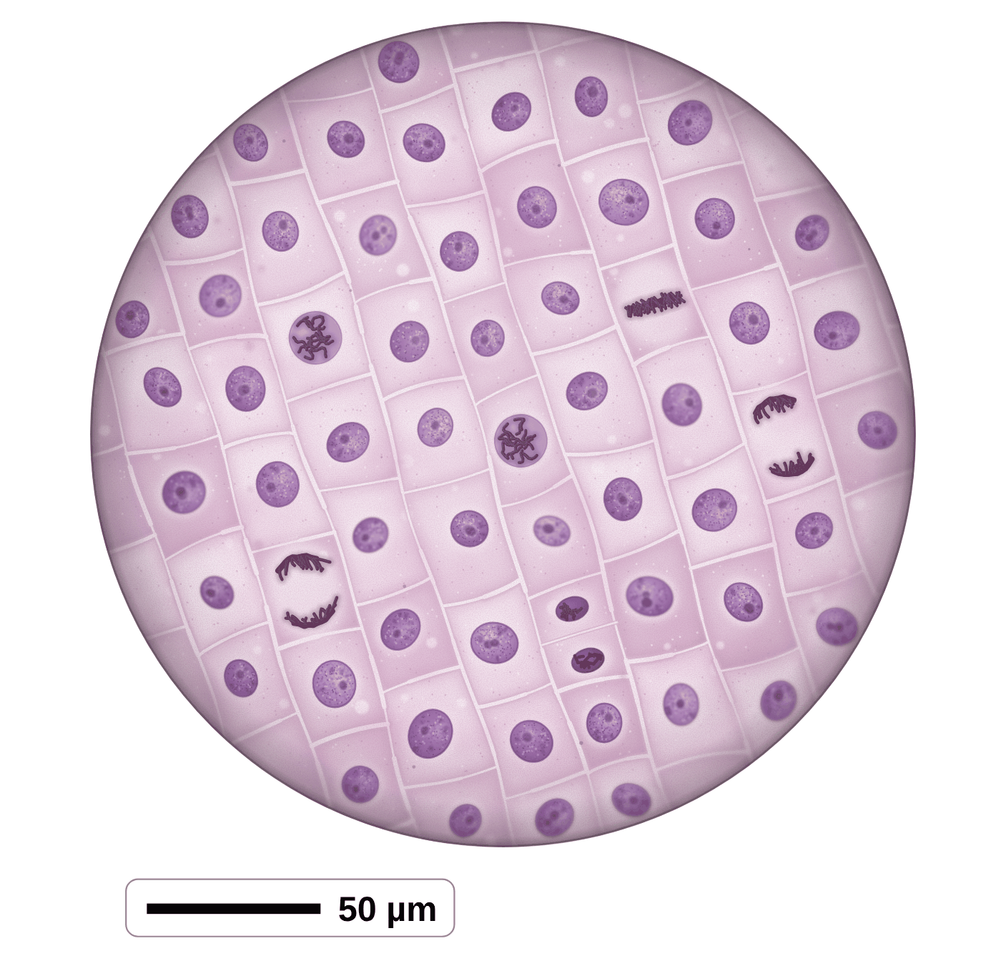
sciencegcse.co.uk · Biology B1 L6
DATE
B1 L6 Cell division: mitosis
24/09/2026
DO NOW
KEYWORDS
1. Name one specialised plant cell.
2. Why does a sperm cell have many mitochondria?
3. Which part of a cell contains the genetic material?
Chromosome
Gene
Cell cycle
Mitosis
Genetically identical
A painting based on a light micrograph. Stains colour the chromosomes.
B1 Cell biology
AQA Combined Science
Notes:
Do now: retrieval from B1 L5 (Q1, Q2) and B1 L1 (Q3). The picture is a painting of the tip of an onion root, squashed thin, stained and seen through a light microscope. Ask the class what they can see. (Rows of cells, most with one round nucleus; a few with dark threads.) By the end of the lesson they will know what the dark threads are and why only a few cells have them. Suggested 60 min: slides 1-3 (8 min); slides 4-9 (15 min); slides 10-13 (10 min); slides 14-18 (12 min); Mandatory worksheet started in class (10 min), finished for homework; exit ticket slides 22-23 (5 min). Use slides 19-21 if time allows. Homework: online lesson quiz and the B1 L6 Exam questions worksheet.

Slide 2
sciencegcse.co.uk · Biology B1 L6 Cell division: mitosis
Do now answers and lesson focus
Do now answers
In this lesson
1. A root hair cell.
2. To release energy for swimming.
3. The nucleus.
• Compare a painting of a real root tip with a cell cycle diagram.
• Describe chromosomes, DNA and genes.
• Describe the three stages of the cell cycle.
• Explain why mitosis makes two identical cells.
• Describe where mitosis happens (growth, repair and replacement), and calculate with cell counts.
Key idea
The cell copies its DNA, then mitosis shares the chromosomes out equally.
So the two daughter cells are genetically identical.
2
B1 L6 · sciencegcse.co.uk
Notes:
Go through the answers. Q1: also accept a xylem cell or a phloem cell. Then share the lesson focus. The online lesson (sciencegcse.co.uk, B1 L6) follows the same 12 screens as this PowerPoint, so students can go over it at home. There are three checkpoints along the way. Q2 and Q3 link to today: before a cell divides it makes more mitochondria, and the nucleus holds the chromosomes that are copied and shared out.

Slide 3
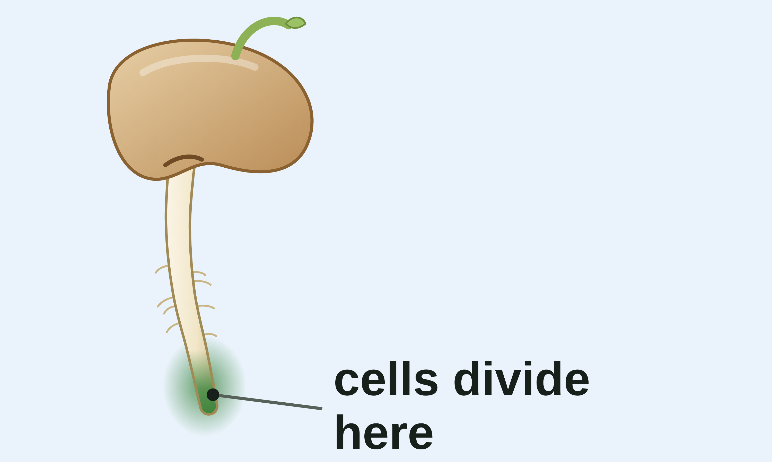
sciencegcse.co.uk · Biology B1 L6 Cell division: mitosis
Why this matters in the real world
Every day, your body makes billions of new cells by mitosis.
New cells every day
Growing roots
Healing a cut
330 billion
1 to 2
new cells a day
weeks for a small cut to heal
Scientists estimate that your body makes about 330 billion new cells every day, mostly blood cells and cells lining the gut.
Roots grow at their tips. Cells there divide by mitosis again and again, so the root gets longer.
Cells beside a cut divide by mitosis to fill the gap. A small cut heals in about 1 to 2 weeks.
Replacement
Growth
Repair
3
B1 L6 · sciencegcse.co.uk
Notes:
Hook. Ask: you started as one cell. How did you end up with trillions of cells? (Cells divided again and again by mitosis.) The 330 billion is an estimate by scientists who worked out how fast each type of cell is replaced: most are blood cells and cells lining the gut. The three cards are the three jobs of mitosis: growth, repair and replacement.

Slide 4
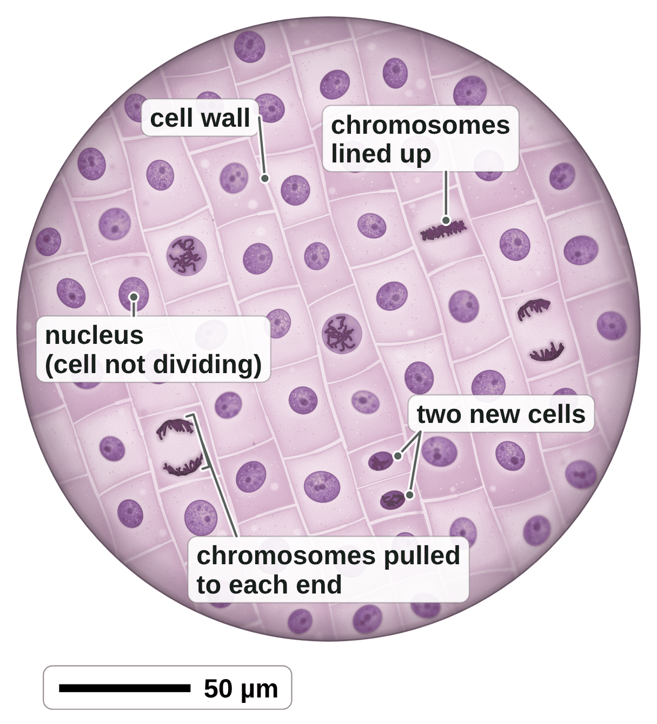
sciencegcse.co.uk · Biology B1 L6 Cell division: mitosis
Online lesson: screen 1 of 12
Inside a growing root tip
A painting of a root tip
Key facts
Roots grow at their tips. Cells there divide to make new cells.
A thin piece of root tip is squashed on a slide and stained, so the chromosomes show up.
Most cells have one round nucleus. They are not dividing.
In a few cells, the chromosomes show as dark threads. These cells are dividing.
New body cells are made by mitosis.
A painting based on a light micrograph. Stains colour the chromosomes.
4
B1 L6 · sciencegcse.co.uk
Notes:
This is a painting of what you would see if you squashed the tip of a growing onion root on a slide, stained it, and looked through a light microscope. Ask: what do you notice? (Most cells look the same, with one round nucleus. A few look different, with dark threads.) The dark threads are chromosomes: they show up only when a cell is dividing. Count with the class: in this view 6 of the 60 cells are dividing (screen 1 of the online lesson, Dividing cells: Show). The purple comes from a stain: real chromosomes are colourless (B1 L3 Using a microscope: stains). Why a root tip? Roots grow at their tips, so this is where cells divide most. Today: how one cell becomes two identical cells. One key fact a click.

Slide 5
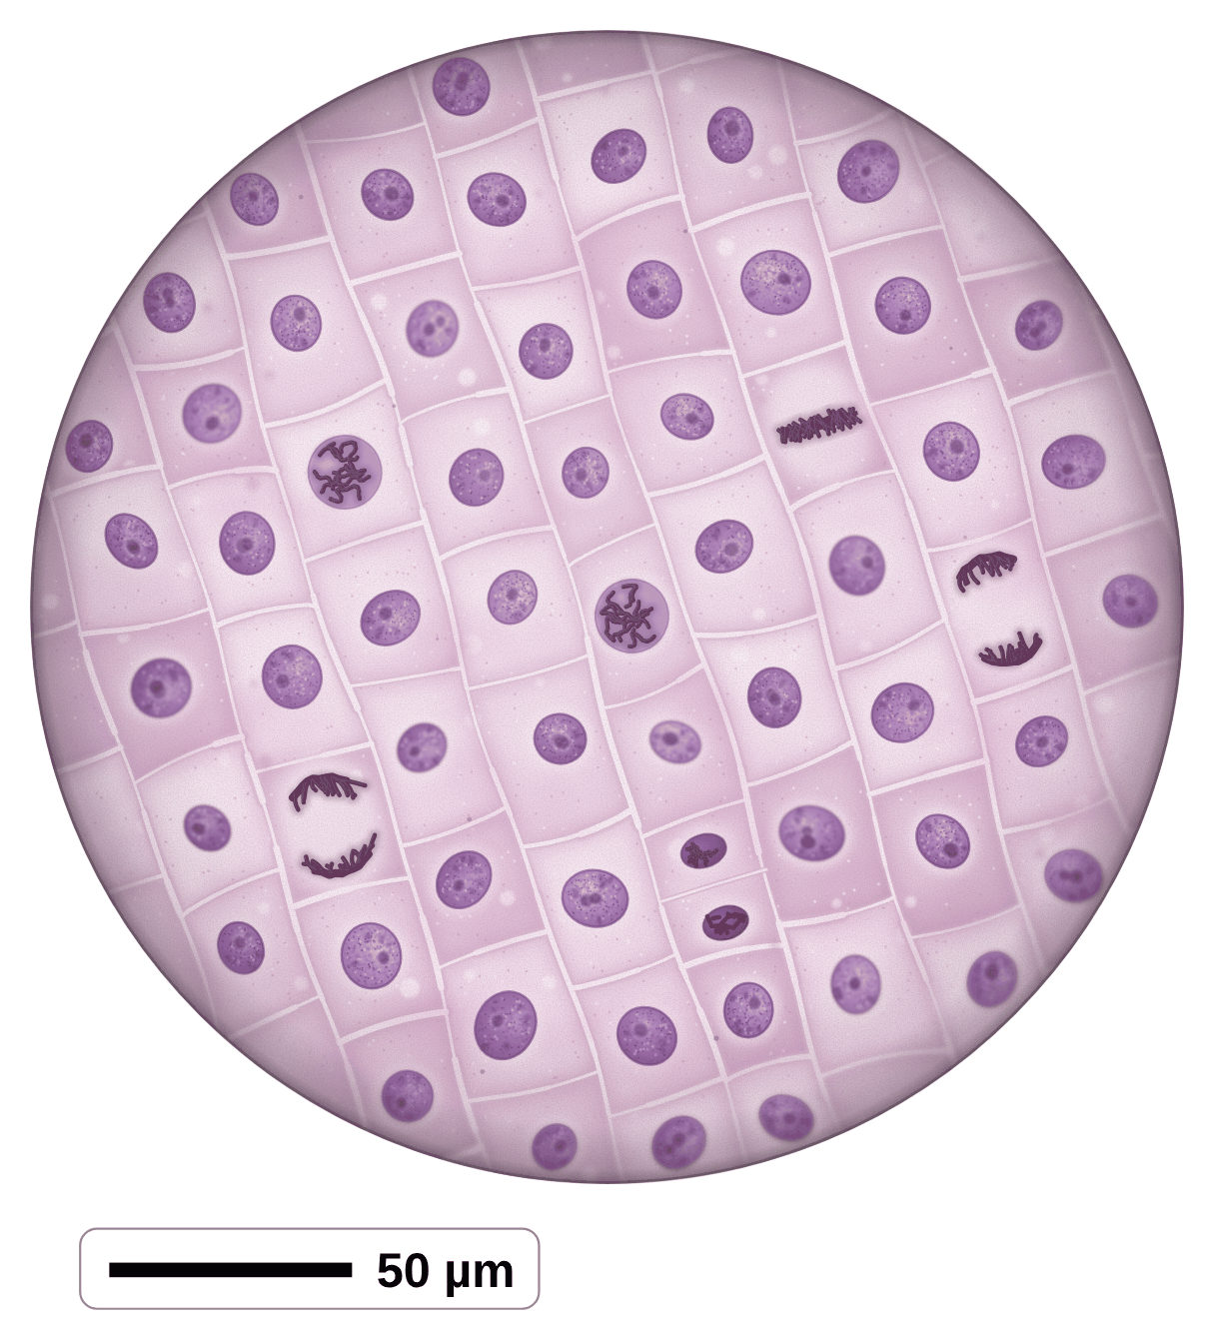
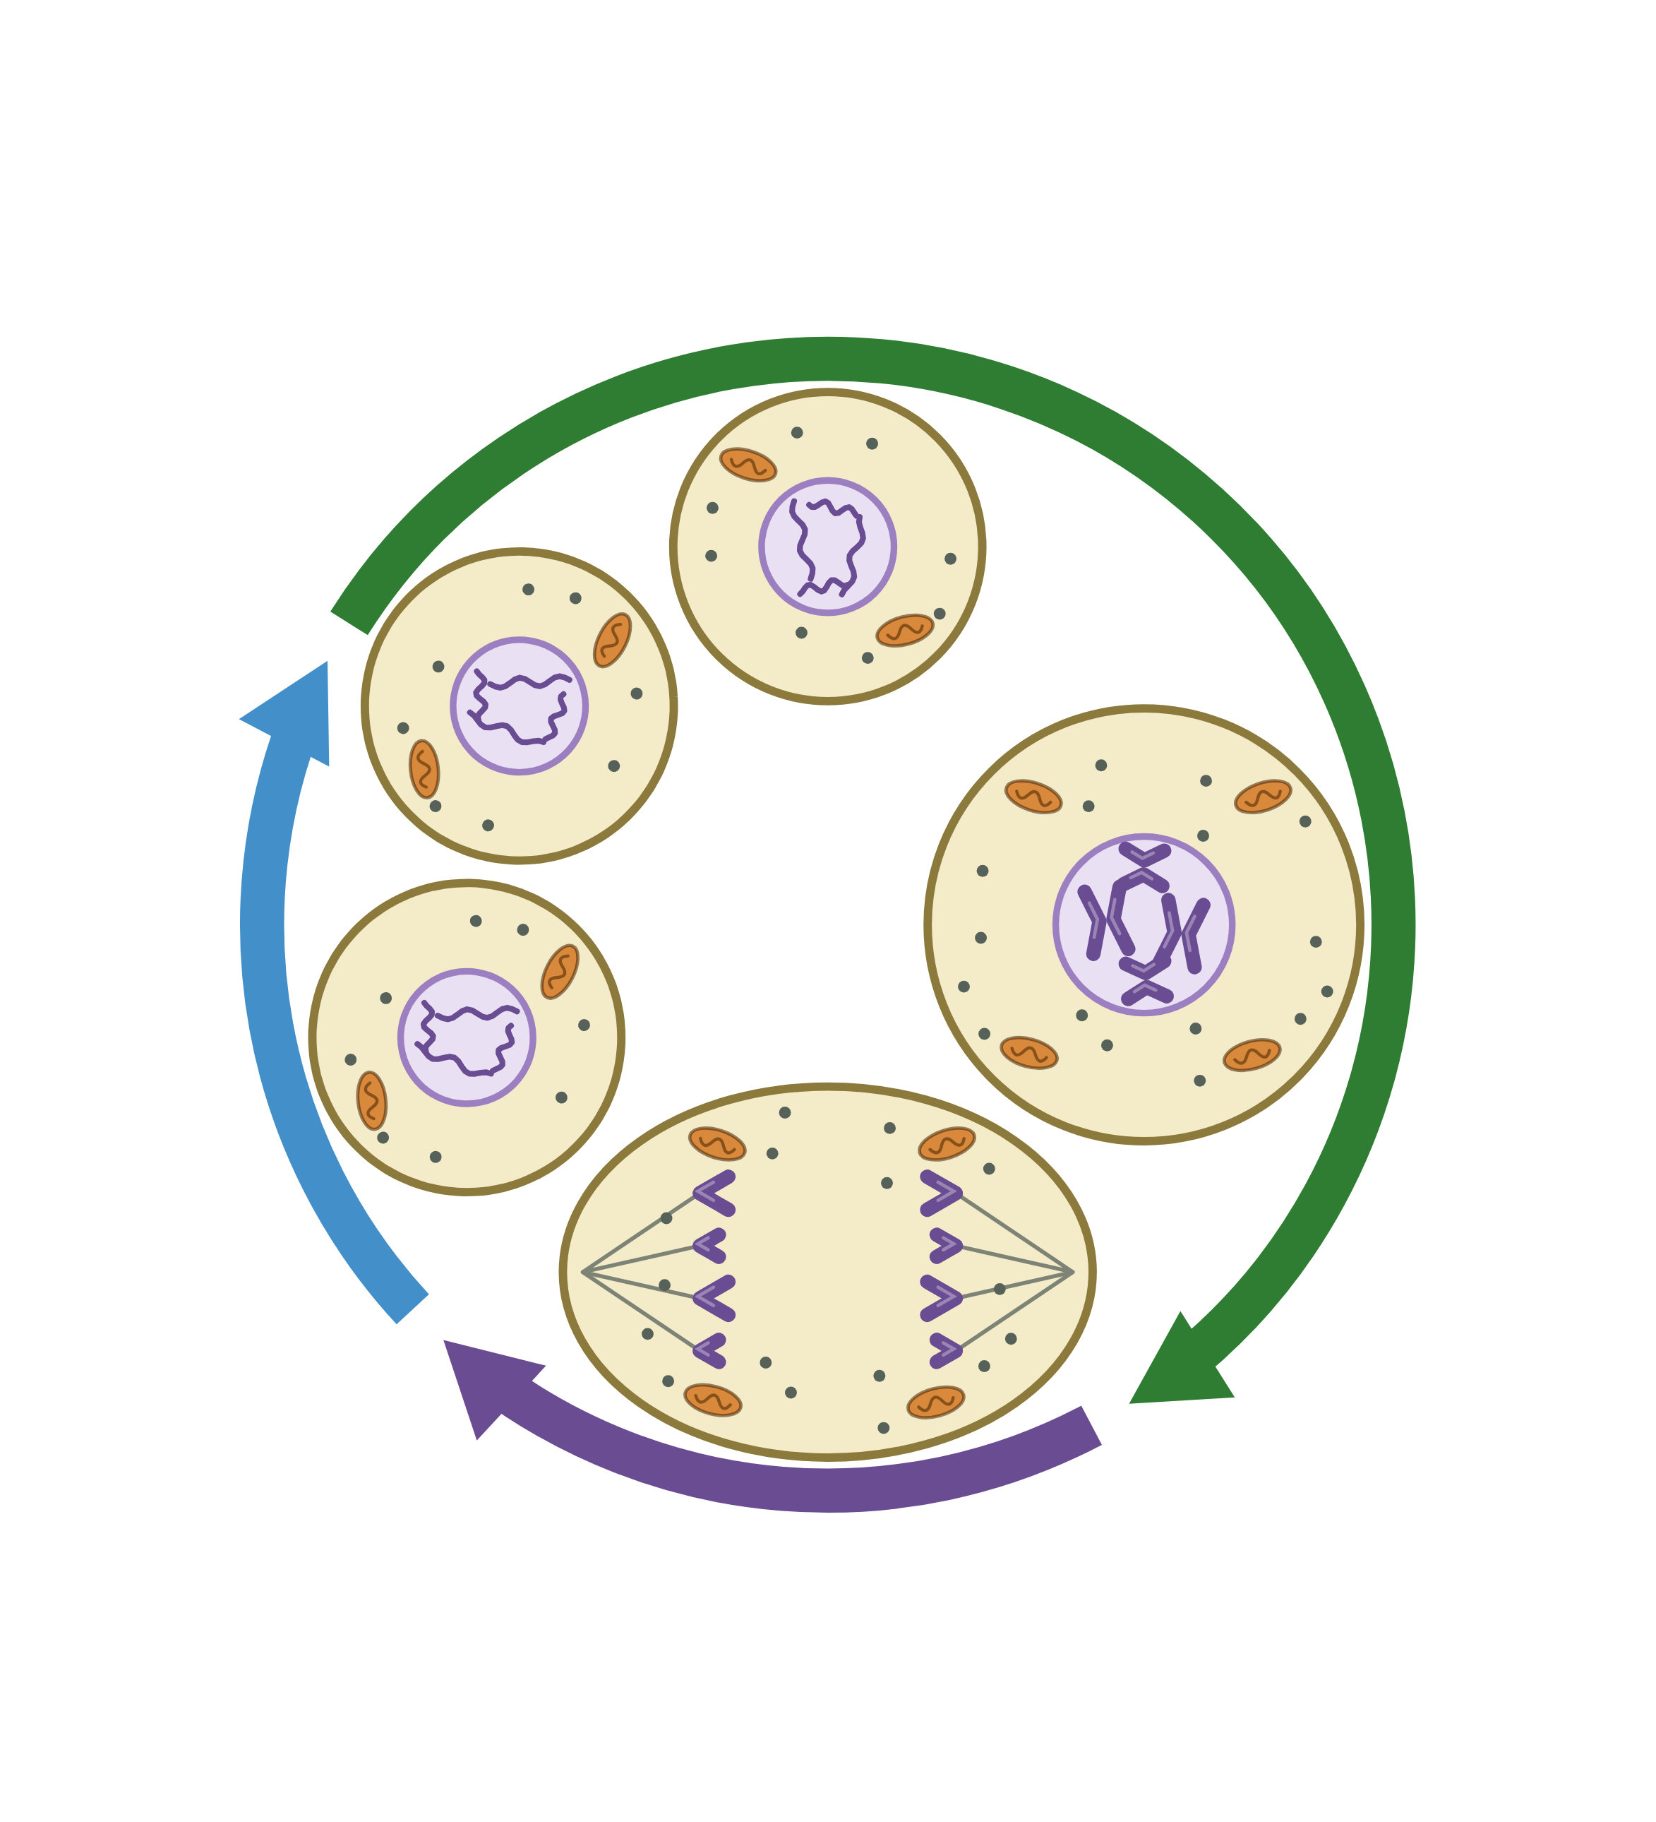
sciencegcse.co.uk · Biology B1 L6 Cell division: mitosis
Online lesson: screen 2 of 12
A real root tip and a diagram
Same thing, two ways
Spot the differences
1
Not dividing: Most of the real cells are not dividing. Many are growing and copying their DNA, ready to divide. The diagram gives every stage its own picture.
1
3
1
2
Chromosomes: In the real cells, chromosomes show as separate threads only when a cell divides. The diagram draws them in every cell, so you can follow them.
2
2
5
3
Number: A real onion cell has 16 chromosomes. The diagram cell has only 4 (2 pairs), so they are easy to count.
4
3
5
4
4
Colour: The purple in the painting is a stain. Real chromosomes are colourless. The diagram colours them so you can see them.
5
Cells: The real cells are packed together in rows, sharing their walls. The diagram draws one cell on its own, with space round it.
A real root tip
A diagram
A painting based on a light micrograph. Stains colour the chromosomes; most cells are not dividing. In the diagram, the chromosomes are coloured; real ones are colourless.
Same in both: Both show cells with one round nucleus, and dividing cells with one set of chromosomes pulled to each end.
5
B1 L6 · sciencegcse.co.uk
Notes:
Cover the right panel and ask: what is different between the two pictures? Take ideas, then reveal the five differences (each click shows one difference and its number on both pictures; the last click shows what is the same in both). Key message: exam diagrams are simplified on purpose. A real root tip has thousands of cells, and at any moment most of them are not dividing: a cell spends most of its cycle growing and copying its DNA. The chromosomes are in every nucleus all the time, but between divisions they are long, thin threads, too thin to see one by one; when a cell divides they coil up, short and thick, and the stain shows them. The diagram follows one model cell with only 4 chromosomes; a real onion cell has 16 and a human body cell 46. In plant cells a new cell wall also forms between the two new cells; you do not need this. Both pictures show the same thing: dividing cells pull one set of chromosomes to each end. The online lesson, screen 2, has the same pictures and differences.

Slide 6
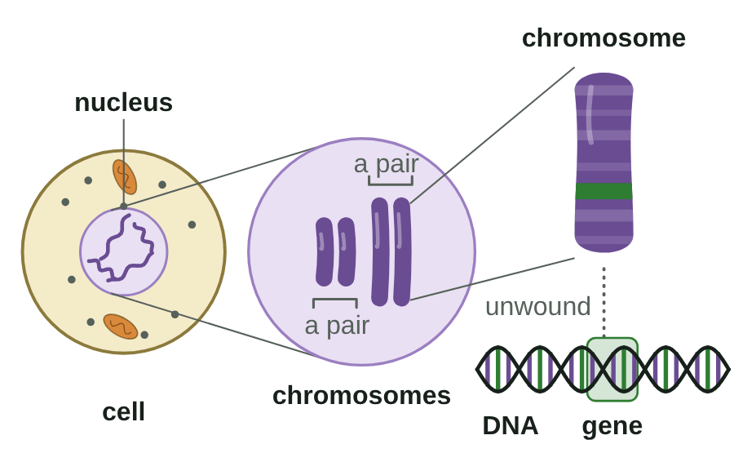
sciencegcse.co.uk · Biology B1 L6 Cell division: mitosis
Online lesson: screen 3 of 12
Chromosomes, DNA and genes
From cell to gene
Key facts
The nucleus contains chromosomes.
A chromosome is made of DNA: one very long, coiled molecule.
A gene is a small section of DNA on a chromosome. Each chromosome carries a large number of genes.
In body cells, chromosomes are normally in pairs: 46 in a human body cell (23 pairs).
Genes are on chromosomes, chromosomes are made of DNA, and all of them are in the nucleus.
A diagram is simplified: this model cell has only 4 chromosomes. A human body cell has 46.
6
B1 L6 · sciencegcse.co.uk
Notes:
A model: the nucleus is a library. Each chromosome is a book, the DNA is the writing, and a gene is one recipe in a book: a small section. A human body cell has 46 books in 23 pairs; you get one of each pair from each parent (B6 Inheritance, variation and evolution). Ask: which is bigger, a gene or a chromosome? (A chromosome: it carries a large number of genes.) Common errors: saying a gene is a chromosome, or that a chromosome is made of genes and DNA is something else. A chromosome is made of DNA, and a gene is a small section of that DNA. Different organisms have different numbers: an onion cell has 16. Sex cells are different again (B6). Link to the Do now: the nucleus contains the genetic material: the chromosomes. The picture is an animated GIF: it zooms from the cell to a gene, as the chips do on the online lesson, screen 3 (print and PDF show its first frame). One line a click.

Slide 7
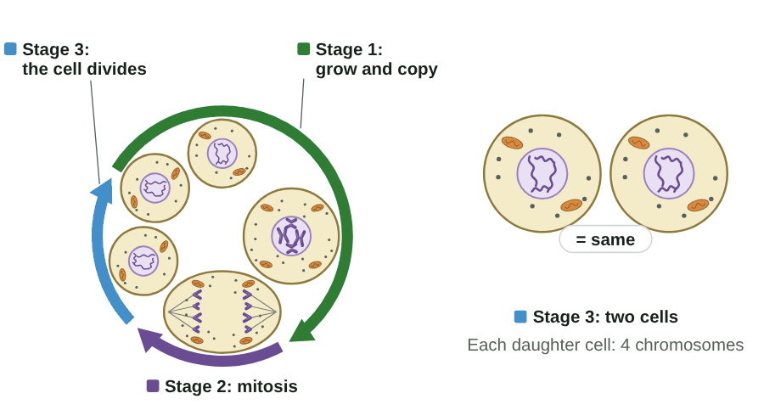
sciencegcse.co.uk · Biology B1 L6 Cell division: mitosis
Online lesson: screen 4 of 12
The cell cycle: three stages
One cell, round the cycle
Step by step
1
Stage 1, grow: the cell grows and makes more sub-cellular structures, such as ribosomes and mitochondria.
2
Stage 1, copy: the DNA replicates to form two copies of each chromosome.
3
Stage 2, mitosis: one set of chromosomes is pulled to each end of the cell, and the nucleus divides.
4
Stage 3, divide: the cytoplasm and cell membrane divide to form two cells.
The two daughter cells are genetically identical.
▶ Online lesson, screen 4: The cell cycle: three stages
A diagram is simplified: this model cell has only 4 chromosomes. A human body cell has 46.
7
B1 L6 · sciencegcse.co.uk
Notes:
Run screen 4 of the online lesson with Next step, or let the GIF play (print and PDF show its first frame). One step a click, the same 4 steps as the step-by-step screen in the online lesson. At step 2 ask: why must the DNA be copied before the cell divides? (So each new cell gets a full set of chromosomes.) Why make more ribosomes and mitochondria? (So each new cell has enough of them.) Common errors: thinking mitosis is the whole cycle (it is only stage 2, when the nucleus divides); thinking the DNA is copied during mitosis (it is copied before, in stage 1, while the cell grows). Careful with 'pair': the two copies joined in an X are not a pair. A pair is two matching chromosomes of the same size (the long pair and the short pair in the model); why they come in pairs is B6. You do not need the names of the phases of mitosis: describe what the chromosomes do. Most of the cycle is stage 1: a human cell cycle takes about 24 hours, and mitosis only about 1 hour of it. (The wheel is not to scale.)

Slide 8
sciencegcse.co.uk · Biology B1 L6 Cell division: mitosis
Online lesson: screen 5 of 12
Checkpoint 1
✓
CHECKPOINT 1 of 3
Quick check on slides 4 to 7 (online screens 1 to 4). Show A, B or C on your whiteboard.
Question 1
Question 2
Question 3
Most cells in the root tip painting show a round nucleus but no separate chromosomes. Why?
Which sentence about genes is correct?
When is the DNA copied in the cell cycle?
A. These cells have no chromosomes.
A. A gene is a structure that contains many chromosomes.
A. In stage 1, while the cell grows.
B. They are not dividing, so their chromosomes are long, thin threads.
B. A gene is the same thing as a chromosome.
B. During mitosis, as the chromosomes are pulled apart.
C. The stain has washed out of these cells.
C. A gene is a small section of DNA on a chromosome.
C. After the cell has split into two.
✓ Check your answers on the next slide
8
B1 L6 · sciencegcse.co.uk
Notes:
Hinge check. Everyone shows A, B or C at the same time. Q1 A tests 'chromosomes only appear when a cell divides'; Q2 A and B test the gene and chromosome mix-up; Q3 B tests 'the DNA is copied in mitosis'. If several get Q1 wrong, go back to slide 5; Q2, slide 6; Q3, slide 7.

Slide 9
sciencegcse.co.uk · Biology B1 L6 Cell division: mitosis
Online lesson: screen 5 of 12
Checkpoint 1 answers
✓
CHECKPOINT 1 of 3
Quick check on slides 4 to 7 (online screens 1 to 4). Show A, B or C on your whiteboard.
Question 1
Question 2
Question 3
Most cells in the root tip painting show a round nucleus but no separate chromosomes. Why?
Which sentence about genes is correct?
When is the DNA copied in the cell cycle?
A. These cells have no chromosomes.
A. A gene is a structure that contains many chromosomes.
A. In stage 1, while the cell grows.
A. In stage 1, while the cell grows. ✓
B. They are not dividing, so their chromosomes are long, thin threads.
B. They are not dividing, so their chromosomes are long, thin threads. ✓
B. A gene is the same thing as a chromosome.
B. During mitosis, as the chromosomes are pulled apart.
C. The stain has washed out of these cells.
C. A gene is a small section of DNA on a chromosome.
C. A gene is a small section of DNA on a chromosome. ✓
C. After the cell has split into two.
Chromosomes only show as separate threads when a cell divides.
Each chromosome carries a large number of genes.
The DNA replicates before mitosis, so there are two copies of each chromosome.
Got one wrong? Look back: Q1 slide 5 · Q2 slide 6 · Q3 slide 7
9
B1 L6 · sciencegcse.co.uk
Notes:
1 B, 2 C, 3 A. Each click shows one answer and why. Ask a student who got each one right to explain why. Follow-up for Q3: what would happen if a cell divided without copying its DNA first? (Each new cell would get only some of the chromosomes.)

Slide 10
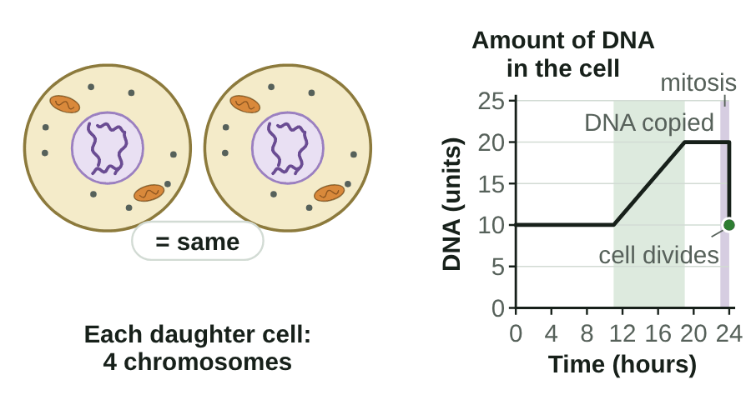
sciencegcse.co.uk · Biology B1 L6 Cell division: mitosis
Online lesson: screen 6 of 12
Copy, then share: two identical cells
Copy, then share
What to look for
Stage 1: the DNA is copied. The amount of DNA in the cell doubles.
Mitosis shares the chromosomes out equally: one copy of each goes to each end.
When the cell divides, the DNA in each new cell halves, back to the starting amount.
A human body cell has 46 chromosomes. Each daughter cell also has 46, not 23.
The two daughter cells are genetically identical to each other and to the parent cell.
▶ Online lesson, screen 6: Copy, then share: two identical cells
10
B1 L6 · sciencegcse.co.uk
Notes:
Run screen 6 of the online lesson, or let the GIF play: watch the graph as the cell goes round (print and PDF show its first frame). Ask: why does the DNA double before the cell divides? (So that, when it is shared out, each new cell gets a full set.) Ask: how many chromosomes are in each new skin cell made by mitosis? Many students say 23: halving the number happens only in sex cells, made by a different division, meiosis (B6 Inheritance, variation and evolution). Mitosis keeps the number the same: 46 → 46. Mitosis makes two cells, not four. The units of DNA on the graph are arbitrary units: only the pattern matters (same, double, back to the same). Flip the online switch to Human cell: 46 chromosomes go to each end. One line a click.

Slide 11
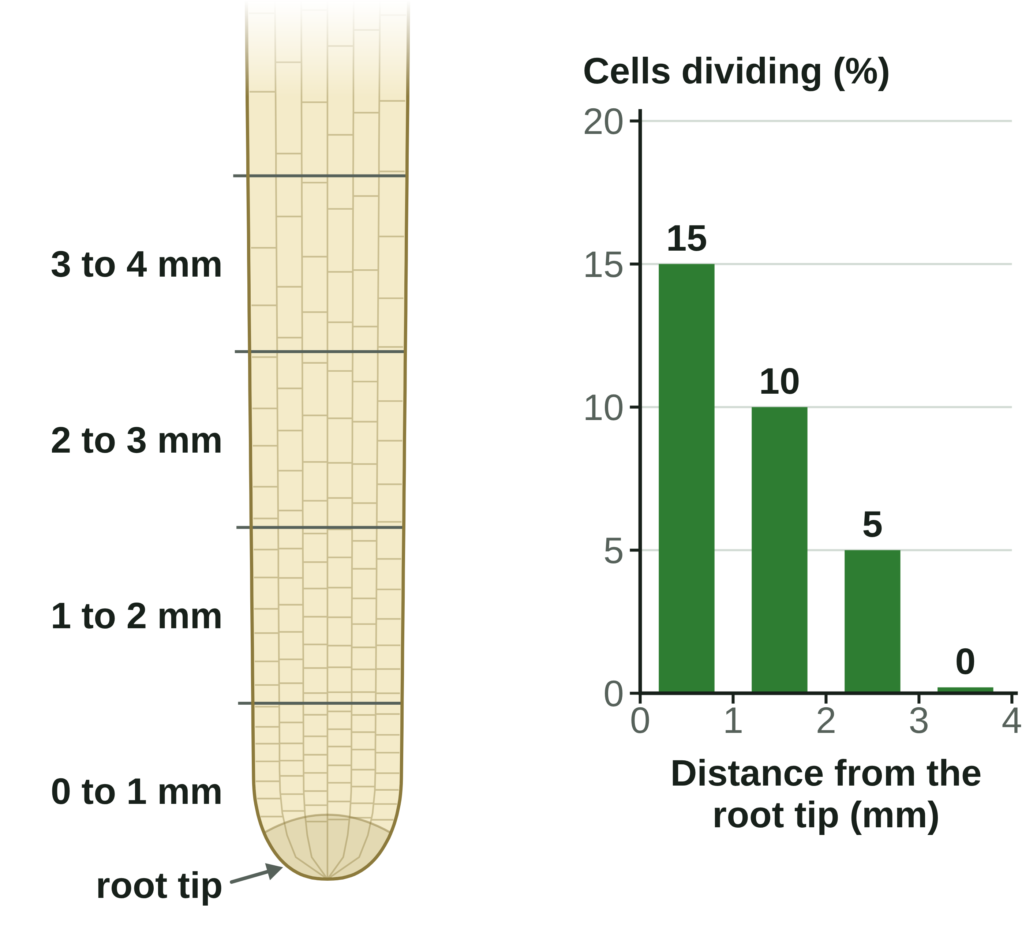
sciencegcse.co.uk · Biology B1 L6 Cell division: mitosis
Online lesson: screen 7 of 12
Counting dividing cells
Dividing cells along a root
Dividing cells along an onion root
Distance from the root tip
Cells counted
Cells dividing
Percentage dividing (%)
0 to 1 mm
40
6
15
1 to 2 mm
40
4
10
2 to 3 mm
40
2
5
3 to 4 mm
40
0
0
Worked examples
percentage of cells dividing = cells dividing ÷ total cells × 100
Example 1: 6 of 40 cells are dividing. 6 ÷ 40 × 100 = 15 %.
Example 2: 12 of 200 cells are dividing. 12 ÷ 200 = 0.06. 0.06 × 100 = 6 %. Check: 6 % of 200 = 12. ✓
Most cell division happens close to the root tip. Further back, cells stop dividing, get longer and become specialised.
Each part of the root: 40 cells counted.
11
B1 L6 · sciencegcse.co.uk
Notes:
Run screen 7 of the online lesson: tap each part of the root and count along with the rings. Scientists count dividing cells in a stained root tip squash to find where a root grows. Ask: which part of the root is growing fastest? (0 to 1 mm from the tip: 15 % of its cells are dividing.) Common errors: dividing the total by the number dividing (40 ÷ 6), and forgetting to multiply by 100 (0.15 instead of 15 %). Check that the answer is sensible: it must be less than 100 %, and 15 % of 40 is 6. Further from the tip, cells stop dividing: they get longer and become specialised (B1 L5 Specialised cells). In the painting on screen 1, 6 of the 60 cells were dividing: 10 %. One row of the table a click, then the worked examples one line a click.

Slide 12
sciencegcse.co.uk · Biology B1 L6 Cell division: mitosis
Online lesson: screen 8 of 12
Checkpoint 2
✓
CHECKPOINT 2 of 3
Quick check on slides 10 and 11 (online screens 6 and 7). Show A, B or C on your whiteboard.
Question 1
Question 2
Question 3
A human skin cell has 46 chromosomes. It divides by mitosis. How many chromosomes are in each new cell?
Why are the two cells made by mitosis genetically identical?
In a root tip, 8 of 160 cells are dividing. What percentage of the cells are dividing?
A. The DNA is copied exactly, and each cell gets one copy of every chromosome.
A. 0.05 %
A. 23
B. 92
B. Each cell gets half of the parent cell's chromosomes.
B. 5 %
C. 46
C. Both cells are the same size.
C. 20 %
✓ Check your answers on the next slide
12
B1 L6 · sciencegcse.co.uk
Notes:
Hinge check: everyone shows A, B or C at the same time. Q1 A is the 23 trap (halving the number happens only in sex cells, B6); Q1 B forgets that the copies are shared out; Q2 B is the 'half the chromosomes' trap; Q3 A forgets the × 100 and Q3 C divides the wrong way round. If several get Q1 or Q2 wrong, go back to slide 10; Q3, slide 11.

Slide 13
sciencegcse.co.uk · Biology B1 L6 Cell division: mitosis
Online lesson: screen 8 of 12
Checkpoint 2 answers
✓
CHECKPOINT 2 of 3
Quick check on slides 10 and 11 (online screens 6 and 7). Show A, B or C on your whiteboard.
Question 1
Question 2
Question 3
A human skin cell has 46 chromosomes. It divides by mitosis. How many chromosomes are in each new cell?
Why are the two cells made by mitosis genetically identical?
In a root tip, 8 of 160 cells are dividing. What percentage of the cells are dividing?
A. The DNA is copied exactly, and each cell gets one copy of every chromosome.
A. The DNA is copied exactly, and each cell gets one copy of every chromosome. ✓
A. 0.05 %
A. 23
B. Each cell gets half of the parent cell's chromosomes.
B. 5 %
B. 92
B. 5 % ✓
C. 46
C. Both cells are the same size.
C. 20 %
C. 46 ✓
The chromosome number stays the same: each daughter cell has 46, like the parent cell.
So both cells have exactly the same genetic material as the parent cell.
8 ÷ 160 × 100 = 5 %.
Got one wrong? Look back: Q1 and Q2 slide 10 · Q3 slide 11
13
B1 L6 · sciencegcse.co.uk
Notes:
1 C, 2 A, 3 B. Each click shows one answer and why. Follow-up for Q3: check the answer: 5 % of 160 = 160 ÷ 100 × 5 = 8. ✓

Slide 14
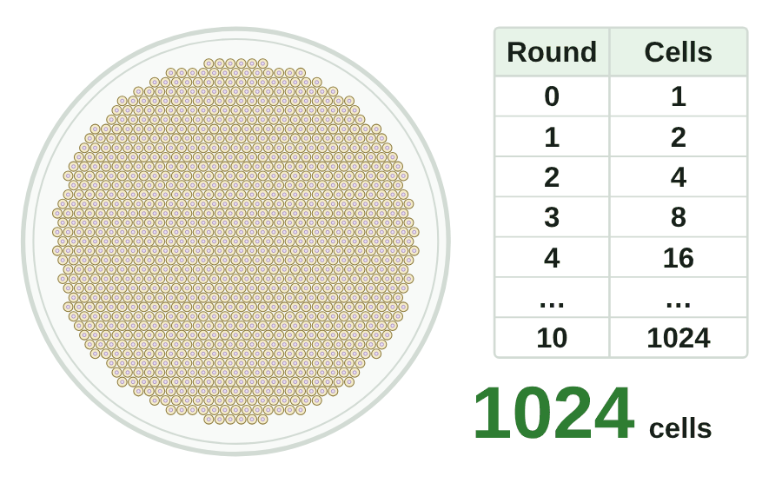
sciencegcse.co.uk · Biology B1 L6 Cell division: mitosis
Online lesson: screen 9 of 12
Mitosis for growth
Doubling
Growth by mitosis
Multicellular organisms grow by making new cells by mitosis.
If every cell divides once, the number of cells doubles: 1 → 2 → 4 → 8 → 16.
After n rounds of division: number of cells = 2^{n}.
Worked example: after 10 rounds, 2¹⁰ = 1024 cells, about 1 × 10³.
One cell becomes many genetically identical cells.
▶ Online lesson, screen 9: Mitosis for growth
14
B1 L6 · sciencegcse.co.uk
Notes:
Run screen 9 of the online lesson with Next step, or let the GIF play (print and PDF show its first frame). The lines wipe in one by one, like the doubling, then the green line. Ask: how many cells after 5 rounds? (2⁵ = 2 × 2 × 2 × 2 × 2 = 32.) On a calculator, use the power key: 2, xʸ (or ^), 10, = 1024. Standard form is from B1 L4 Magnification and cell size: 1024 is about 1 × 10³. A human cell cycle takes about 24 hours, so 10 rounds would take about 10 days. Cell division by mitosis is important in the growth and development of multicellular organisms: you grew from one cell. This is a model: in a real organism, not every cell keeps dividing, and many cells become specialised (B1 L5 Specialised cells). Plants grow at the tips of their roots and shoots.

Slide 15
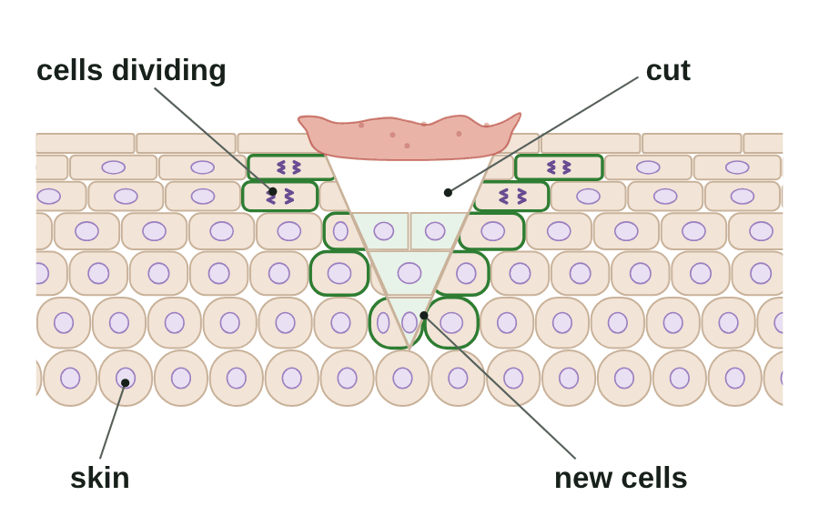
sciencegcse.co.uk · Biology B1 L6 Cell division: mitosis
Online lesson: screen 10 of 12
Repair and replacement
Healing a cut
Why else do cells divide?
Repair: cells beside a cut divide by mitosis to fill the gap.
Replacement: cells deep in the skin divide to replace the cells that rub off the surface.
In adult animals, most mitosis is for repair and replacement.
Plants keep growing at their root and shoot tips all their lives.
Mitosis: for growth, repair and replacement.
▶ Online lesson, screen 10: Repair and replacement
A diagram is simplified. Real skin cells are much smaller.
15
B1 L6 · sciencegcse.co.uk
Notes:
Run screen 10 of the online lesson and flip between Repair a cut and Replace worn cells (the GIF shows the cut healing; print and PDF show its first frame). Ask: why are the new skin cells the same as the old ones? (They are made by mitosis, so they are genetically identical to the cells they came from.) Scientists estimate that your body replaces about 330 billion cells every day, mostly blood cells and cells lining the gut. Once you are fully grown, most mitosis is for repair and replacement. Pointers: some organisms use mitosis to reproduce, making offspring identical to the parent (asexual reproduction, B6 Inheritance, variation and evolution). Changes in cells that lead to uncontrolled division can cause a tumour (B2 L11 Health, risk factors and cancer). Next lesson, B1 L7 Stem cells: the cells that divide to make new cells for growth and repair. One line a click.

Slide 16
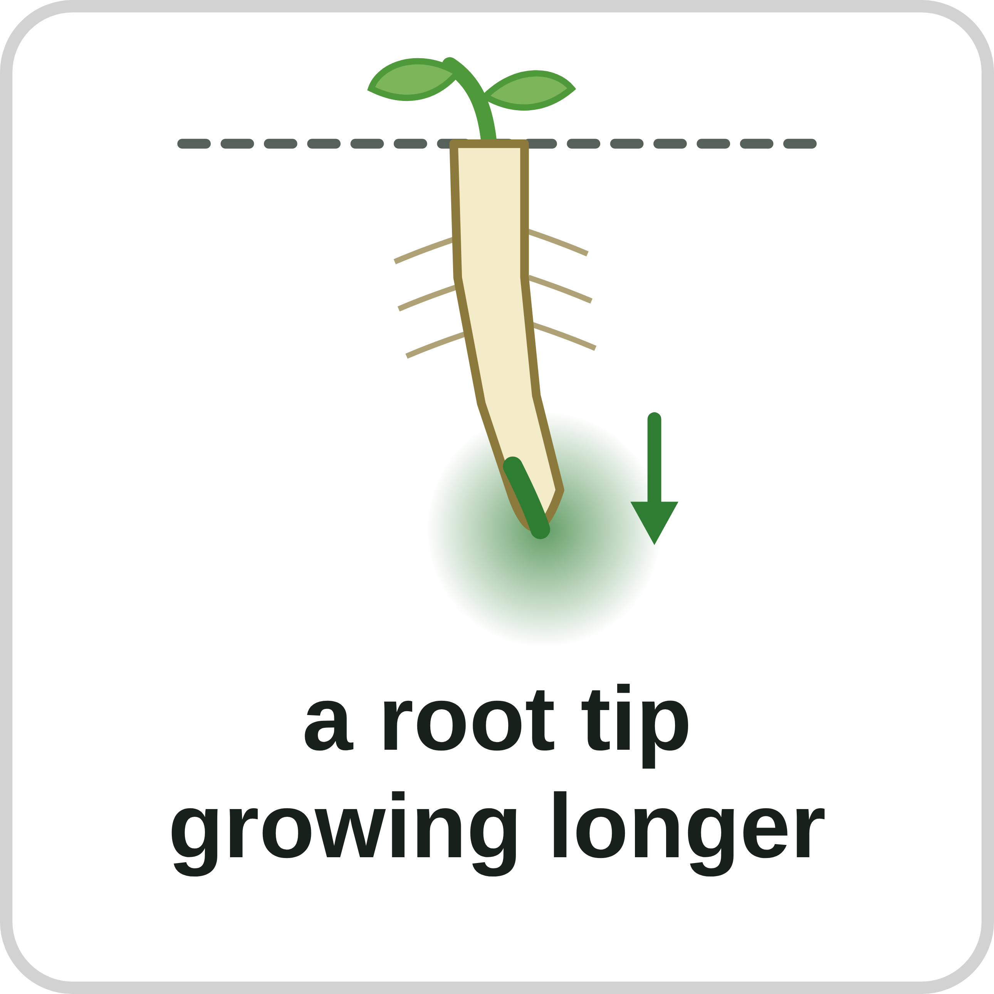
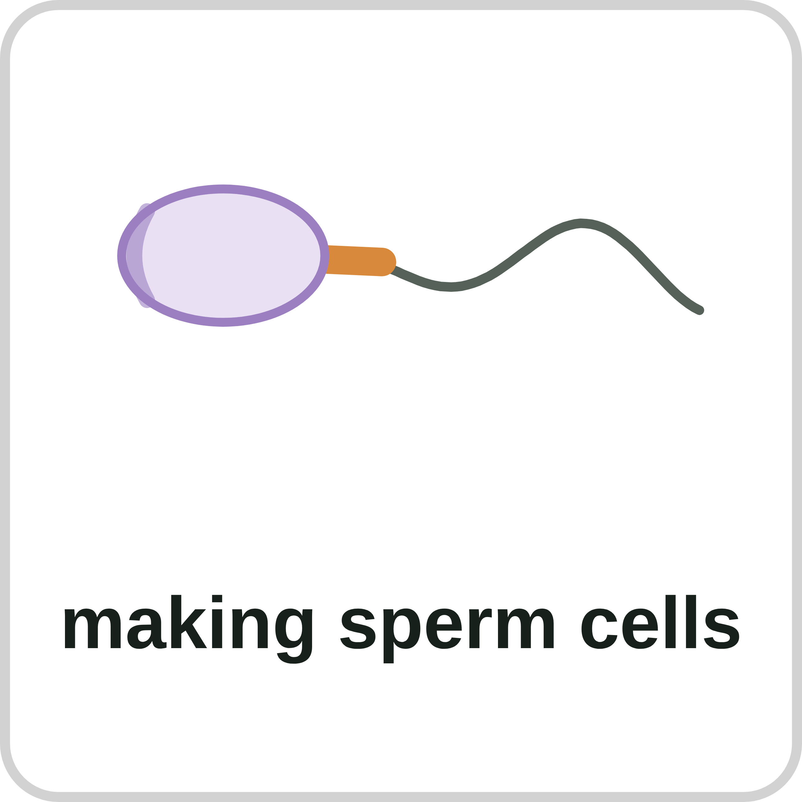
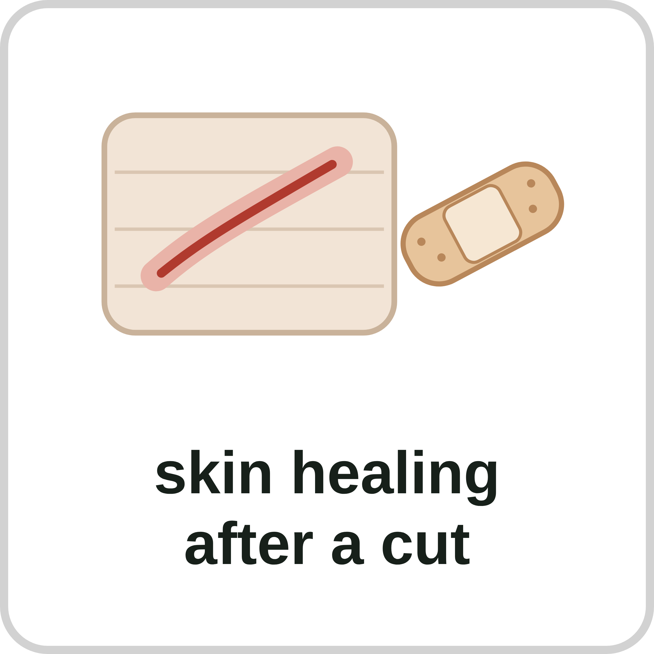
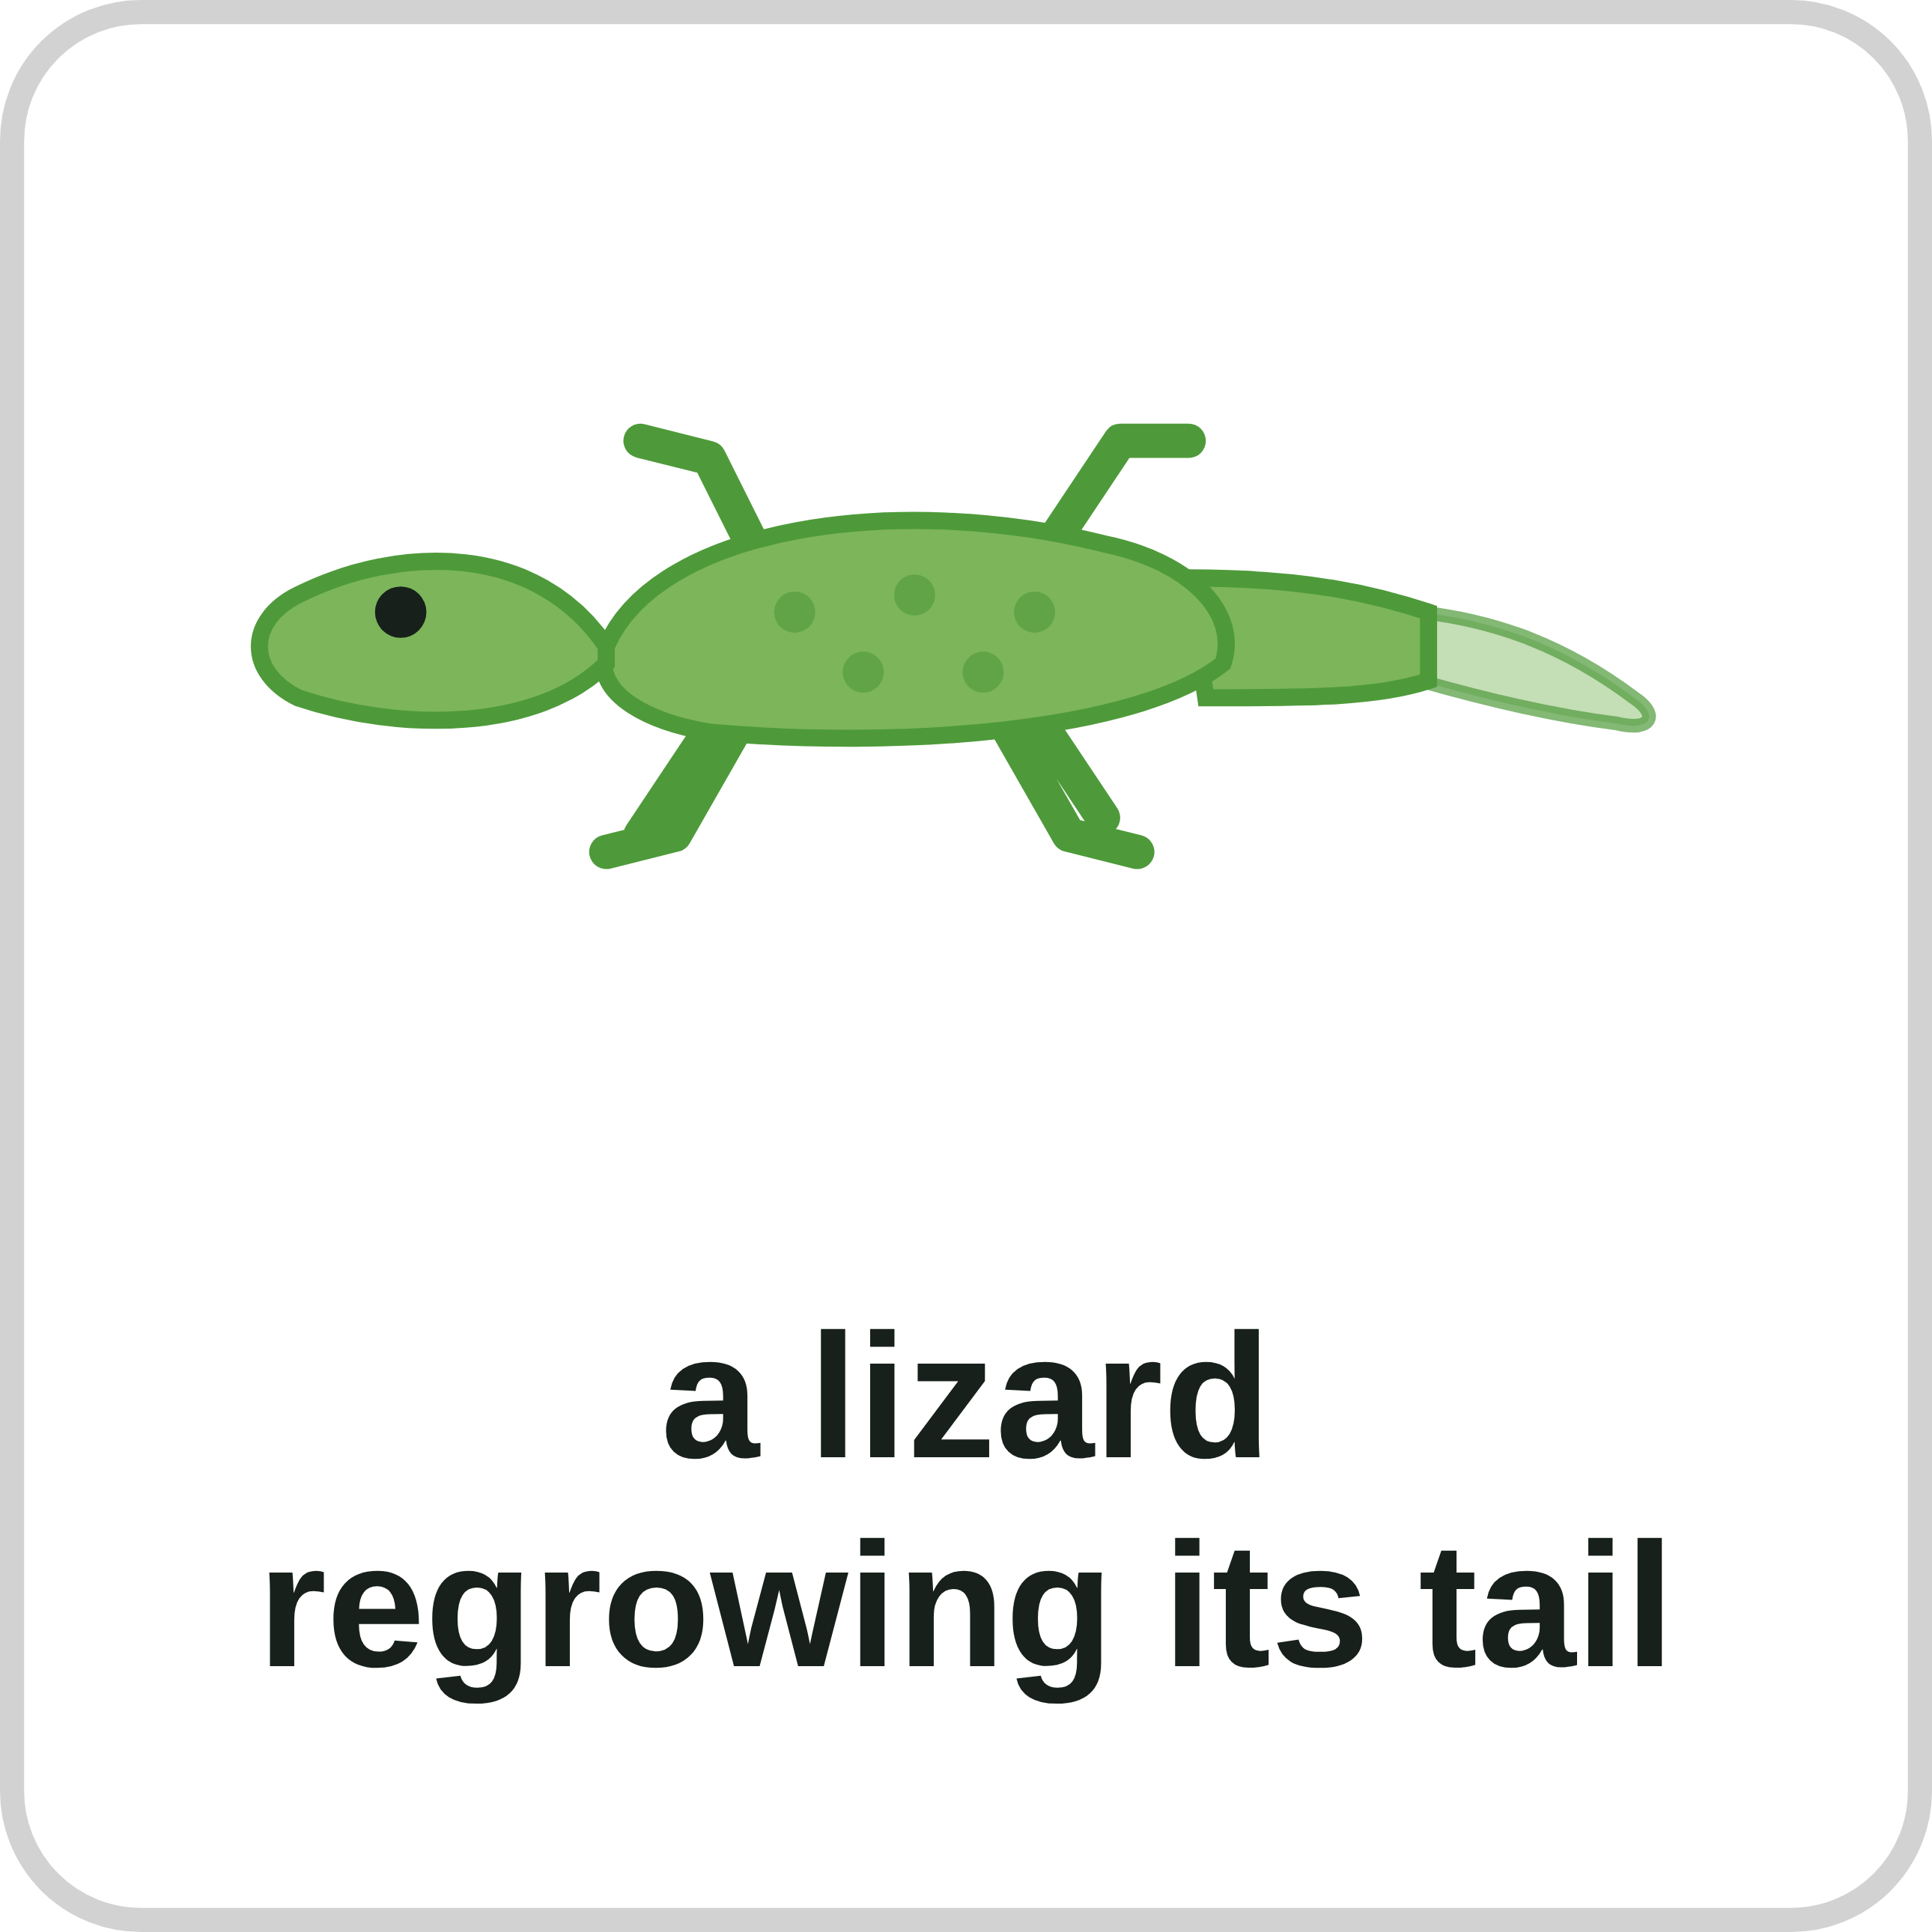
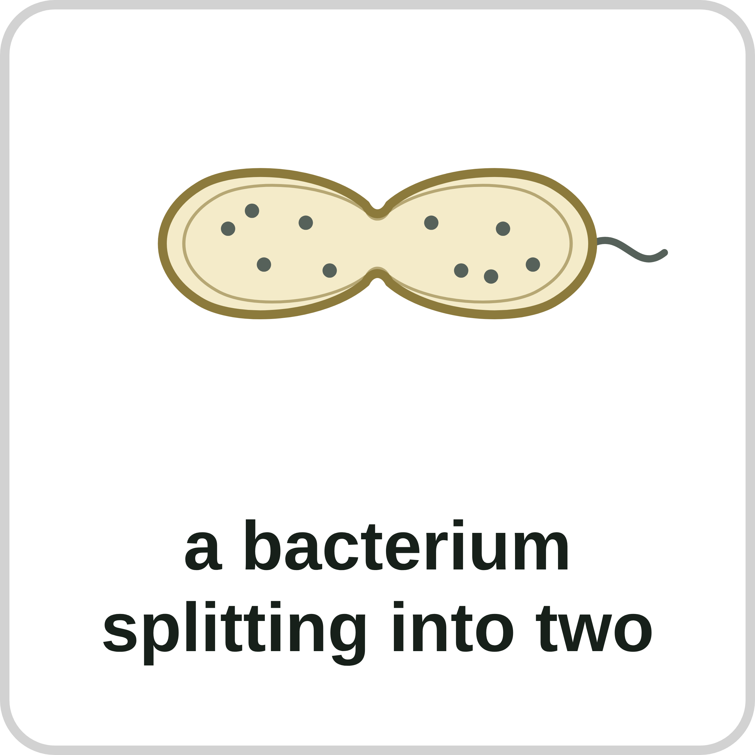
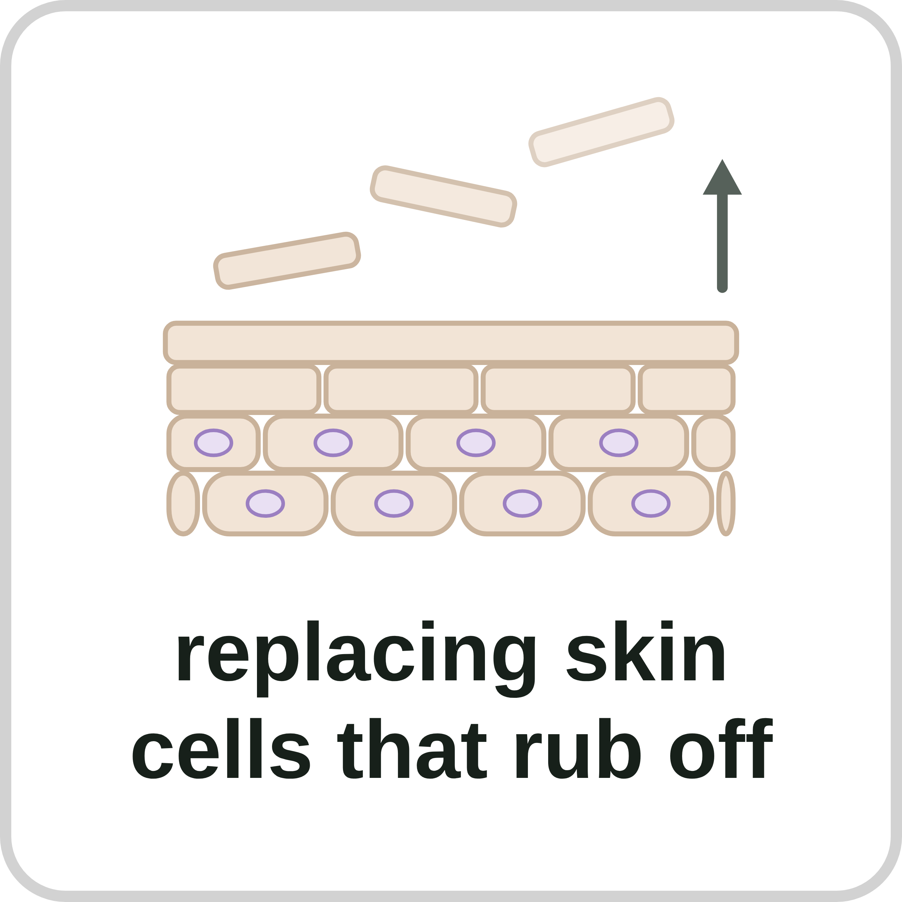
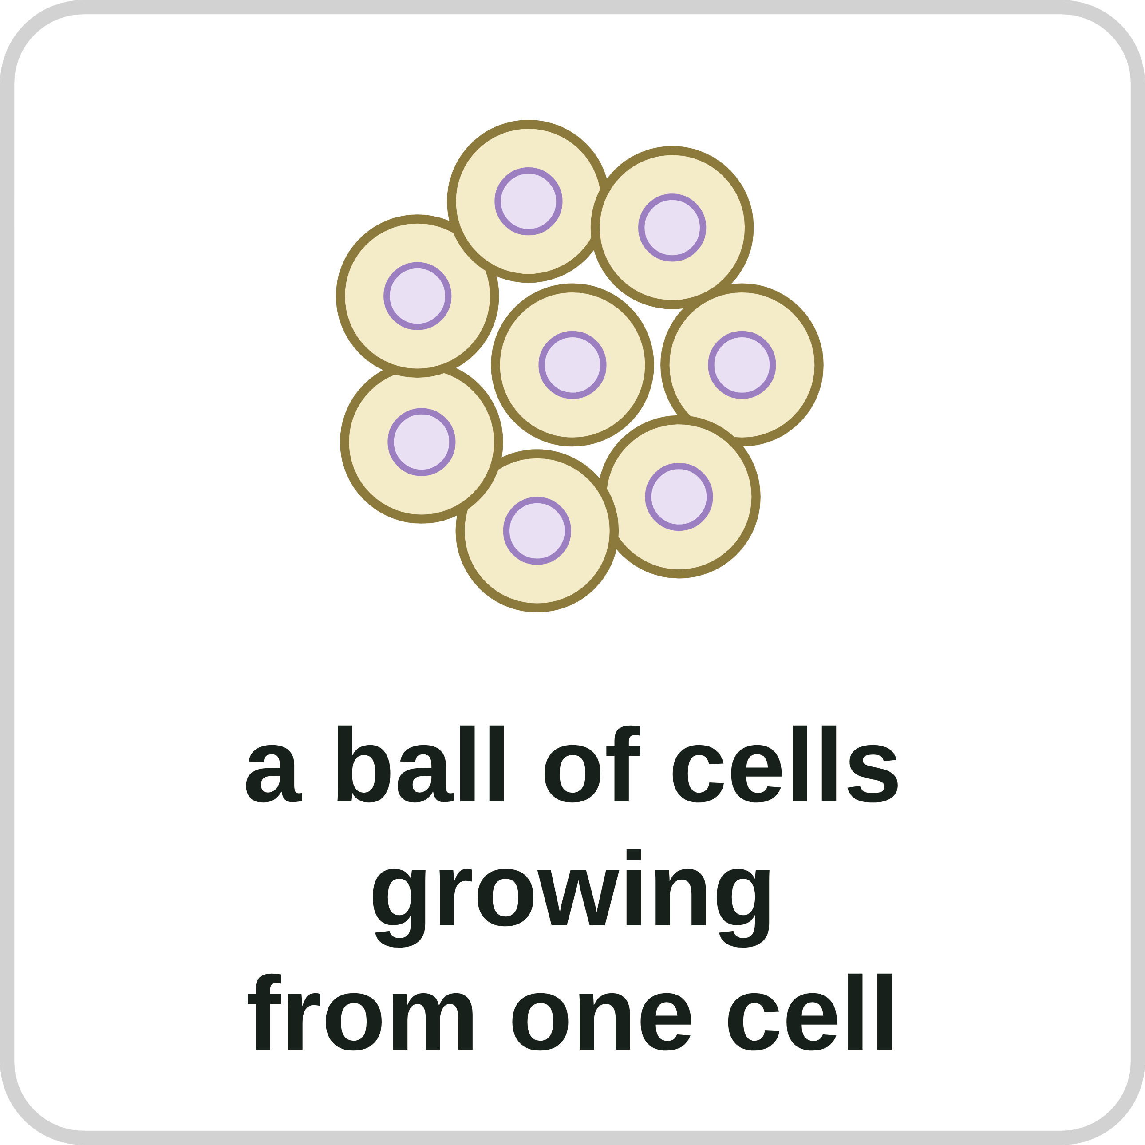
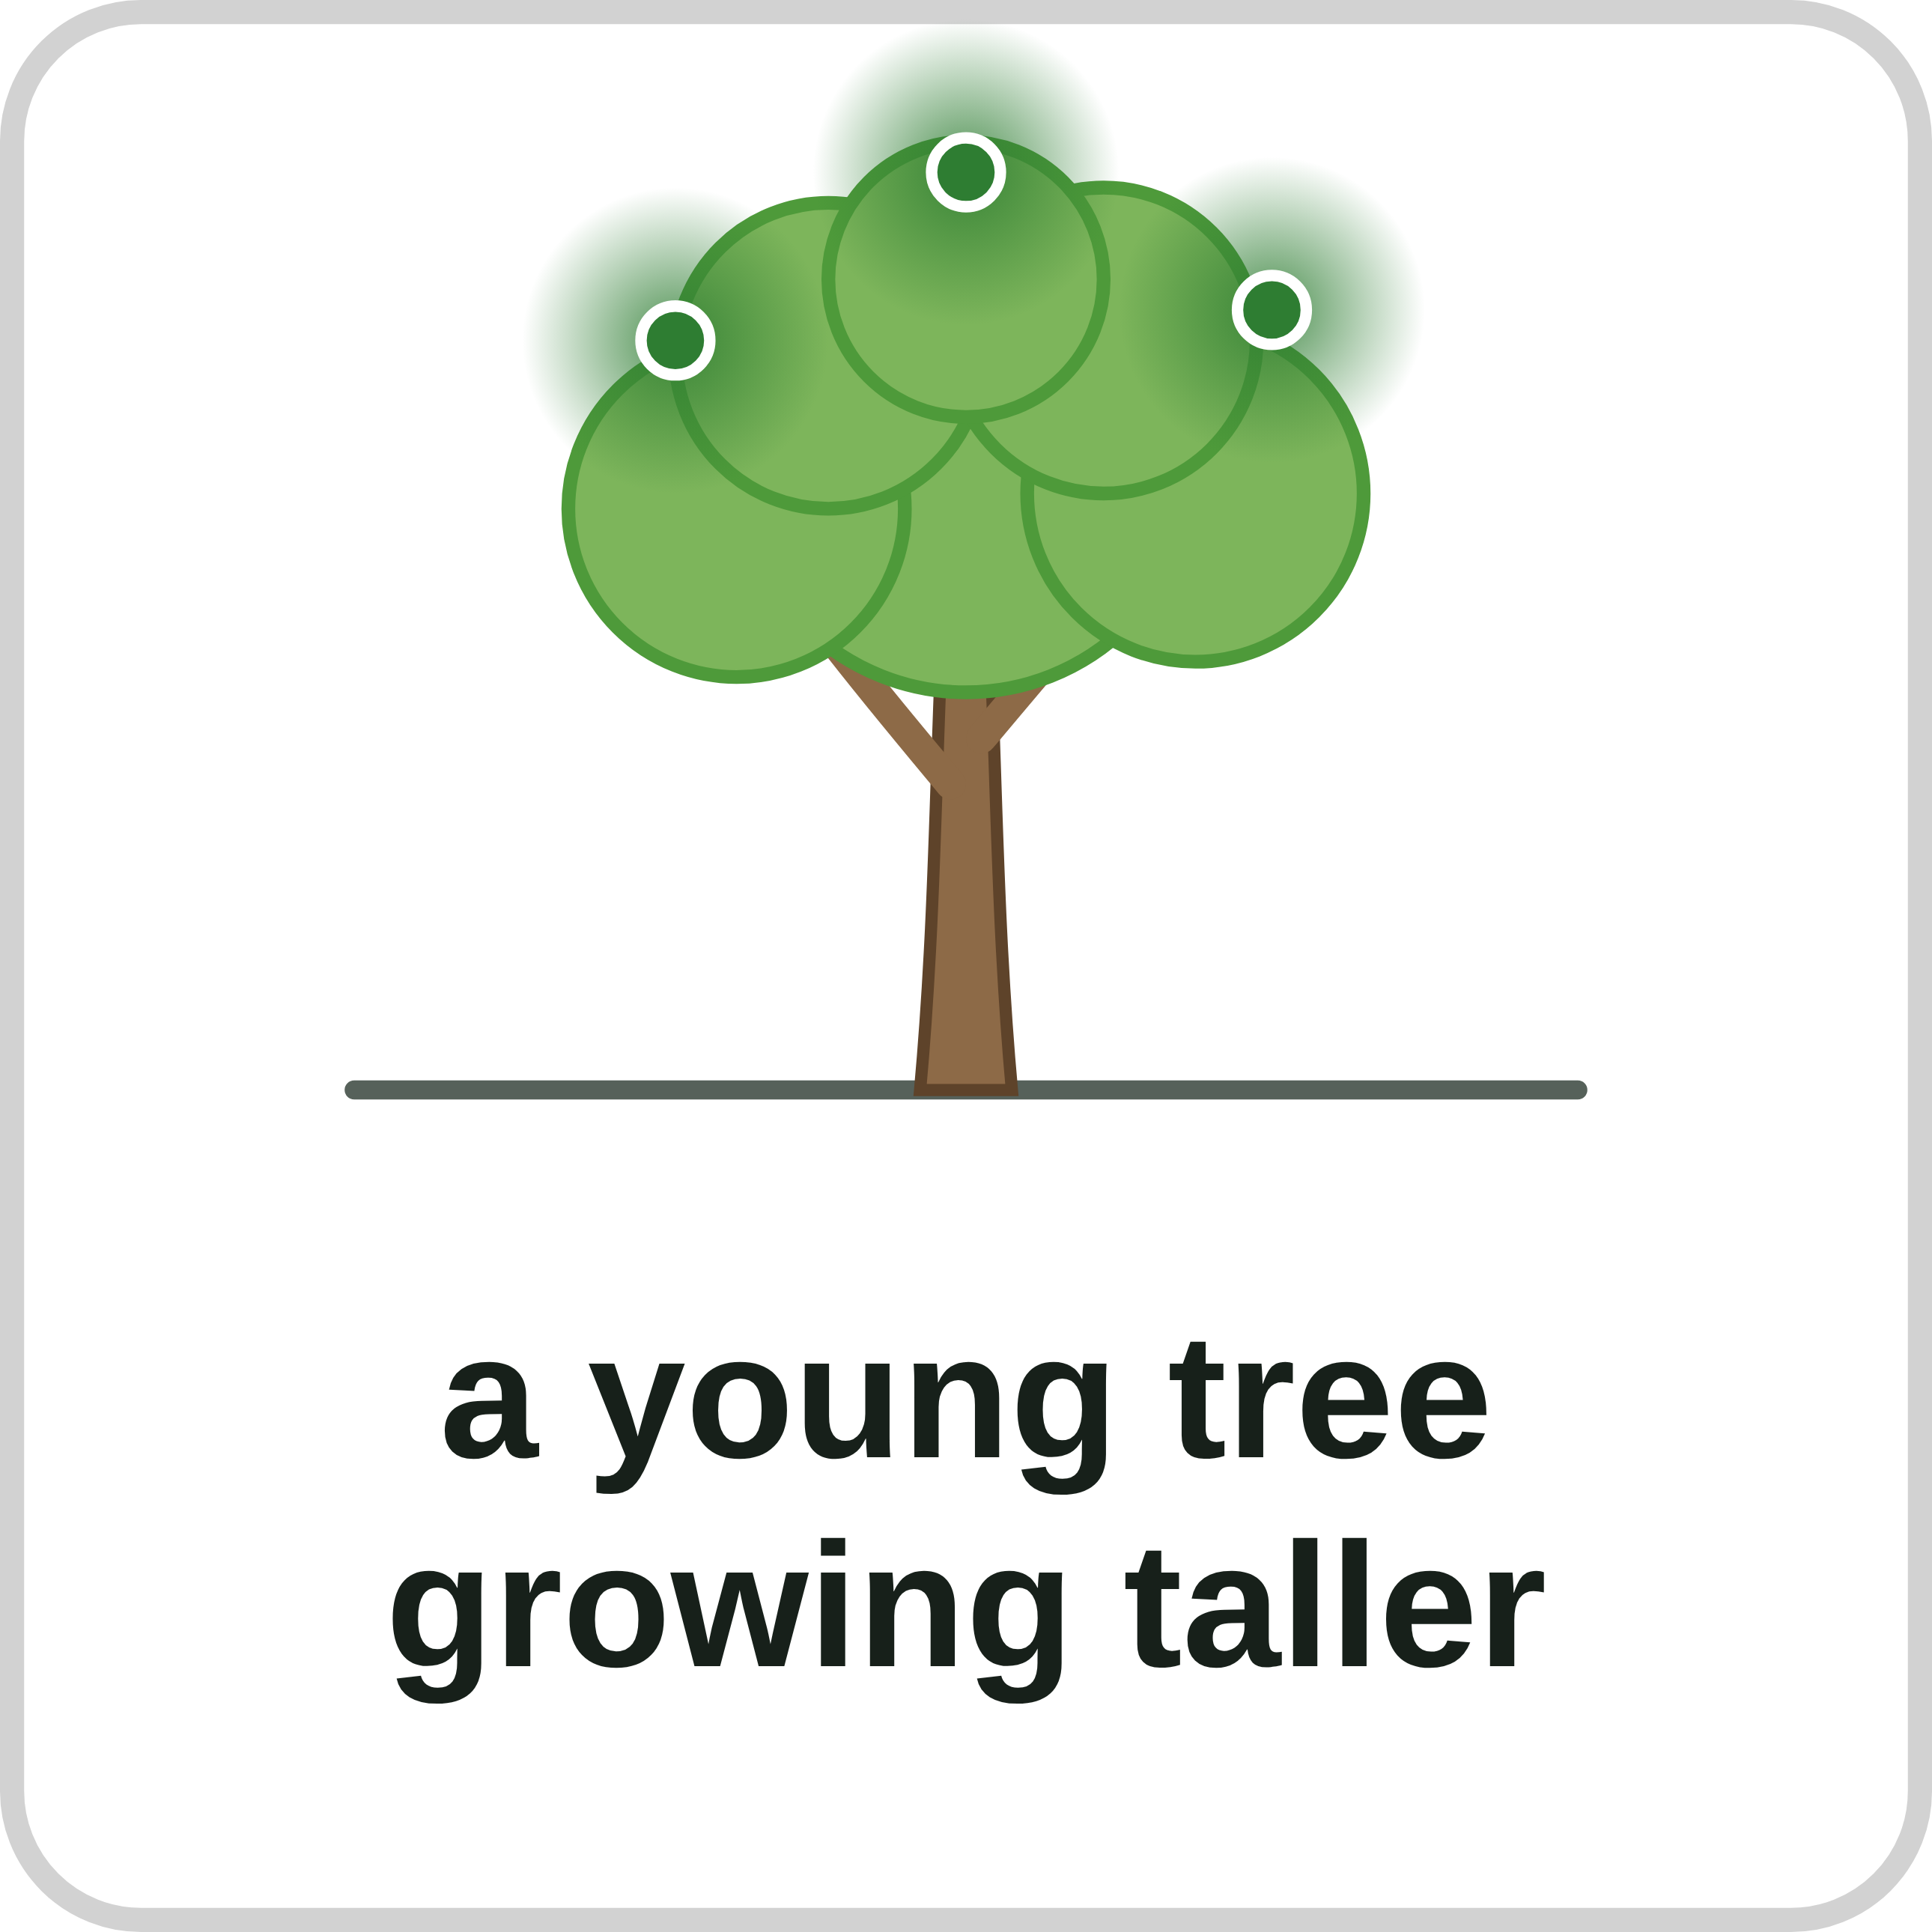
sciencegcse.co.uk · Biology B1 L6 Cell division: mitosis
Online lesson: screen 11 of 12
Where is mitosis happening?
Mitosis or not?
Watch out!
Mitosis happens wherever cells are needed for growth, repair or replacement.
Mitosis makes two cells, not four.
Sex cells (sperm and egg cells) are made by a different division, meiosis (B6).
Bacteria have no nucleus, so they do not divide by mitosis.
Ask: is the organism growing, repairing or replacing cells?
✓ mitosis
✗ not mitosis
✓ mitosis
✓ mitosis
✗ not mitosis
✓ mitosis
✓ mitosis
✓ mitosis
▶ Online lesson, screen 11: sort the cards yourself
16
B1 L6 · sciencegcse.co.uk
Notes:
Before you click, read out the eight cards. Pairs sort them into Mitosis and Not mitosis on a whiteboard (2 minutes), then click to reveal one row at a time, then the Watch out lines one a click. Six are mitosis: growth (the root tip, the young tree, the ball of cells), repair (the cut, the lizard's tail) and replacement (skin cells). Two are not: sperm cells are sex cells, made by meiosis, with half the number of chromosomes (B6); a bacterium has no nucleus (B1 L2 Bacterial cells), so it cannot do mitosis, the division of the nucleus. In the exam, 'recognise where mitosis is happening' means: look for growth, repair or replacement. The online lesson, screen 11, has the same cards to sort.

Slide 17
sciencegcse.co.uk · Biology B1 L6 Cell division: mitosis
Online lesson: screen 12 of 12
Checkpoint 3
✓
CHECKPOINT 3 of 3
Quick check on slides 14 to 16 (online screens 9 to 11). Show A, B or C on your whiteboard.
Question 1
Question 2
Question 3
One cell divides by mitosis. In each round, every cell divides once. How many cells are there after 4 rounds?
Which of these is mitosis used for in an adult human?
A cut in the skin heals. How are the new skin cells made?
A. 16
A. Making sperm and egg cells
A. Each skin cell splits into four new cells.
B. 8
B. Bacteria in the gut splitting into two
B. By mitosis: cells beside the cut divide.
C. 4
C. Replacing skin cells that rub off
C. White blood cells turn into skin cells.
✓ Check your answers on the next slide
17
B1 L6 · sciencegcse.co.uk
Notes:
Hinge check: everyone shows A, B or C at the same time. Q1 B and C test doubling (B stops a round early; C gives the number of rounds, not cells); Q2 A is the sex cells trap and Q2 B the bacteria trap; Q3 A is the 'four cells' trap. If several get Q1 wrong, go back to slide 14; Q2, slide 16; Q3, slide 15.

Slide 18
sciencegcse.co.uk · Biology B1 L6 Cell division: mitosis
Online lesson: screen 12 of 12
Checkpoint 3 answers
✓
CHECKPOINT 3 of 3
Quick check on slides 14 to 16 (online screens 9 to 11). Show A, B or C on your whiteboard.
Question 1
Question 2
Question 3
One cell divides by mitosis. In each round, every cell divides once. How many cells are there after 4 rounds?
Which of these is mitosis used for in an adult human?
A cut in the skin heals. How are the new skin cells made?
A. 16
A. 16 ✓
A. Making sperm and egg cells
A. Each skin cell splits into four new cells.
B. 8
B. Bacteria in the gut splitting into two
B. By mitosis: cells beside the cut divide.
B. By mitosis: cells beside the cut divide. ✓
C. 4
C. Replacing skin cells that rub off
C. Replacing skin cells that rub off ✓
C. White blood cells turn into skin cells.
1 → 2 → 4 → 8 → 16: the number doubles each round, so 2⁴ = 16.
In adults, mitosis is mainly for repair and replacement.
The new cells are genetically identical to the cells they came from.
Got one wrong? Look back: Q1 slide 14 · Q2 slide 16 · Q3 slide 15
18
B1 L6 · sciencegcse.co.uk
Notes:
1 A, 2 C, 3 B. Each click shows one answer and why. Next: spot the dividing cells in the root tip painting.

Slide 19
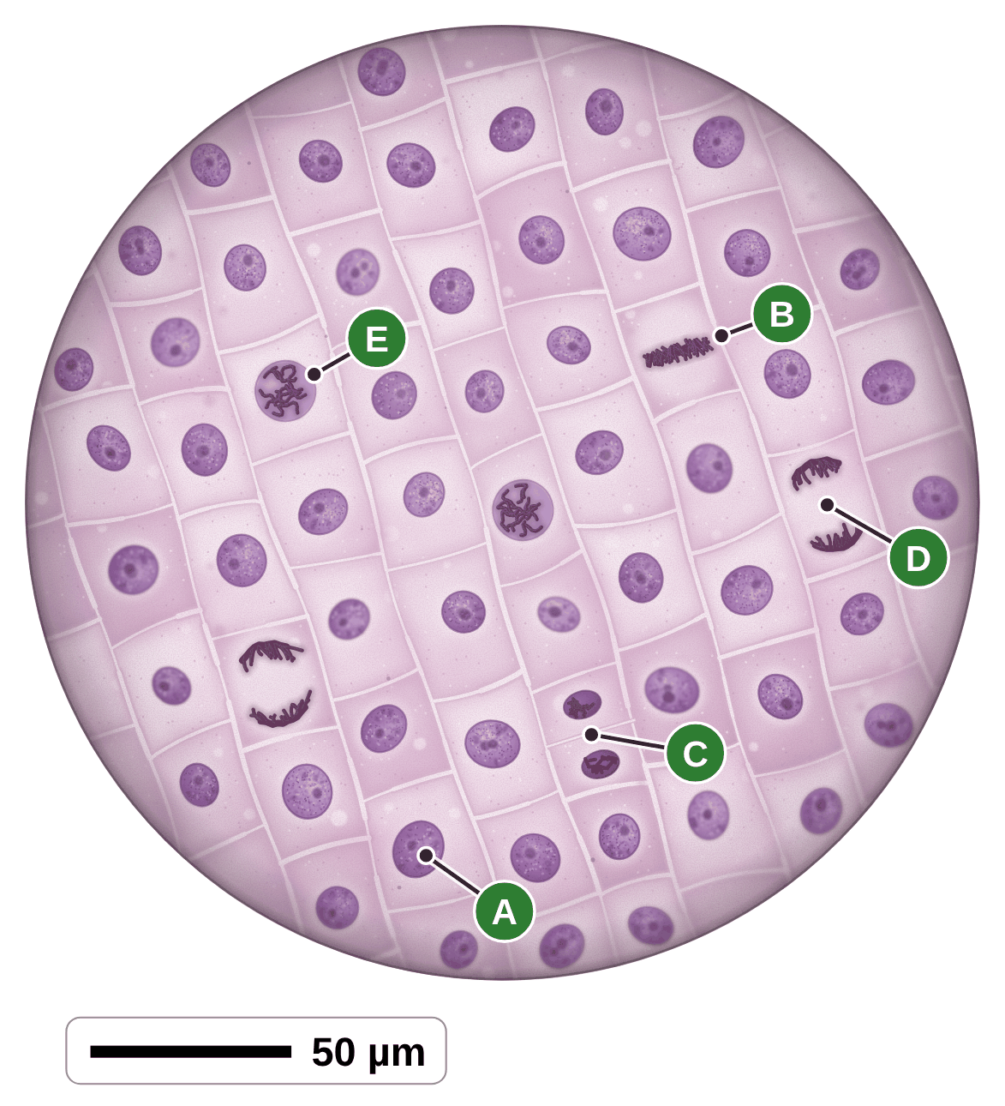
sciencegcse.co.uk · Biology B1 L6 Cell division: mitosis
Practice: Spot the dividing cells
A root tip
Questions
1. Which letter shows a cell that is not dividing?
______________
2. Which letter shows chromosomes being pulled to each end of the cell?
______________
3. Which letter shows a cell splitting into two new cells?
______________
4. Put the cells B, C and D in the order the stages happen.
______________
5. Why can you see separate chromosomes in B but not in A?
______________
6. This view has 60 cells. 6 are dividing. Calculate the percentage of cells that are dividing.
______________
A painting based on a light micrograph. Stains colour the chromosomes.
19
B1 L6 · sciencegcse.co.uk
Notes:
Pairs, 4 minutes. Every lettered cell is a real stage. Remind students that the chromosomes are in every nucleus all the time: they only show up when a cell divides.

Slide 20
sciencegcse.co.uk · Biology B1 L6 Cell division: mitosis
Spot the dividing cells: answers
A root tip
Answers
1. Which letter shows a cell that is not dividing?
A
2. Which letter shows chromosomes being pulled to each end of the cell?
D
3. Which letter shows a cell splitting into two new cells?
C
4. Put the cells B, C and D in the order the stages happen.
B, D, C
5. Why can you see separate chromosomes in B but not in A?
B is dividing: its chromosomes have coiled up, short and thick, so the stain shows them. In A they are long, thin threads spread through the nucleus, too thin to see one by one.
6. This view has 60 cells. 6 are dividing. Calculate the percentage of cells that are dividing.
6 ÷ 60 × 100 = 10 %
A painting based on a light micrograph. Stains colour the chromosomes.
20
B1 L6 · sciencegcse.co.uk
Notes:
A not dividing; E chromosomes showing as threads (the start of division); B lined up; D pulled to each end; C two new cells. So the whole order is E, B, D, C. Q5 is the trap: 'A has no chromosomes' is wrong. Q6: cells dividing ÷ total cells × 100.

Slide 21
sciencegcse.co.uk · Biology B1 L6 Cell division: mitosis
Exam practice
1. Describe what happens to the chromosomes during mitosis. [2]
The (copied) chromosomes line up across the middle of the cell (1). One set of chromosomes / one copy of each chromosome is pulled to each end of the cell (1). Allow: a new nucleus forms round each set / the nucleus divides, for 1 mark.
2. Before a cell divides, it makes more ribosomes and mitochondria. Suggest why. [2]
So that each new cell gets enough of them (1). Ribosomes make proteins and mitochondria release energy by respiration, which the new cells need (1).
21
B1 L6 · sciencegcse.co.uk
Notes:
Model answers with mark points in brackets. Students try each question first, then mark their own work in green. Q1: 'the chromosomes split' scores nothing: say one set goes to each end. Do not use the phase names. Q2: energy is released by respiration, never 'made'. For more, the B1 L6 Exam questions worksheet (PDF) has 5 questions, 20 marks; its mark scheme is at the end of this PowerPoint. The same questions are in the online lesson, after the quiz.

Slide 22
sciencegcse.co.uk · Biology B1 L6 Cell division: mitosis
Exit ticket
Answer on your own
How confident am I?
1. Name the stage of the cell cycle in which the nucleus divides. [1]
I can describe chromosomes, DNA and genes.
2. What is a gene? [1]
I can describe the three stages of the cell cycle.
3. Name one place in a plant where cells divide by mitosis. [1]
4. A human skin cell divides by mitosis. Describe the two new cells it makes. [2]
I can explain why the new cells are identical.
22
B1 L6 · sciencegcse.co.uk
Notes:
Students answer on their own, then rate their confidence. Q4 comes back to the 23 trap from checkpoint 2 on purpose.

Slide 23
sciencegcse.co.uk · Biology B1 L6 Cell division: mitosis
Exit ticket answers
Answers
Next lesson
1. Mitosis (stage 2).
2. A small section of DNA on a chromosome.
3. A root tip or a shoot tip.
4. They are genetically identical, to each other and to the parent cell (1). Each has 46 chromosomes, the same as the parent cell (1).
Next: B1 L7 Stem cells
What stem cells are, where they come from, and how they might be used.
Worksheets:
• Mandatory (everyone)
• Alternative (easier, with key notes)
• Challenge (when you finish the Mandatory)
• Exam questions (exam style, 20 marks, homework)
▶ Online lesson: quiz and exam questions
23
B1 L6 · sciencegcse.co.uk
Notes:
Go through the answers. Q3: allow 'meristem'. Q4: '23 chromosomes' or 'four cells' scores 0 for that mark. After this slide: the B1 L6 revision notes (4 printable pages), then the worksheets with answers in green: Mandatory (everyone), Challenge (stretch) and Alternative (easier: key notes and very simple tasks). The B1 L6 Exam questions worksheet (exam style, black and white, 20 marks) is a separate PDF for homework; its mark scheme is the last two slides. Homework: the online lesson quiz and the B1 L6 Exam questions worksheet.

Slide 24
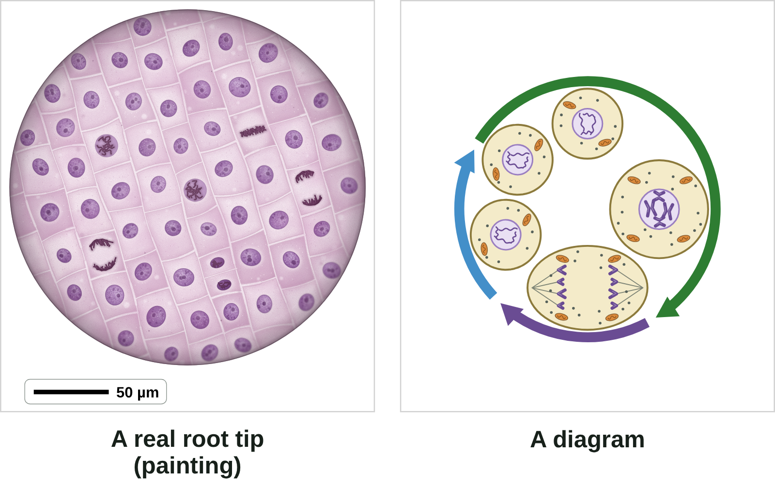

B1 L6 Revision notes 1 of 4
Cell division: mitosis
Why cells divide, chromosomes, DNA and genes, and a real root tip
1. Why cells divide
3. A real root tip and a diagram
A multicellular organism, such as a human or a tree, is made of many cells. You started as one cell. To grow, an organism needs more cells, so its cells divide to make new cells. New body cells are made by mitosis.
Cells divide for:
growth and development: making a bigger organism, such as a root growing longer;
repair: mending damage, such as a cut in the skin;
replacement: replacing cells that wear out, such as skin cells that rub off.
Before a cell divides, it copies its genetic material, so that each new cell gets a full set (section 6).
A painting based on a light micrograph. Stains colour the chromosomes; most cells are not dividing.
Both show cells with one round nucleus, and dividing cells with one set of chromosomes pulled to each end.
2. Chromosomes, DNA and genes
The nucleus of a cell contains chromosomes. A chromosome is made of one very long, coiled molecule of DNA, the chemical that carries the genetic instructions for a cell. Each chromosome carries a large number of genes. A gene is a small section of DNA on a chromosome.
In body cells, chromosomes are normally found in pairs.
Roots grow at their tips, so this is where cells divide. To see them, a thin root tip is squashed on a slide and stained, then looked at with a light microscope (B1 L3 Using a microscope). A picture of what you see is a light micrograph.
Exam pictures of the cell cycle are usually diagrams. A diagram is simplified on purpose:
Most real cells are not dividing: many are growing and copying their DNA, ready to divide. The diagram gives every stage its own picture.
In real cells, chromosomes show as separate threads only when a cell divides. The diagram draws them in every cell.
A real onion cell has 16 chromosomes. The diagram cell has only 4 (2 pairs), so they are easy to count.
The purple is a stain: real chromosomes are colourless. The diagram colours them so you can see them.
Real cells are packed together in rows, sharing their walls. The diagram draws one cell on its own.
A diagram is simplified: this model cell has only 4 chromosomes. A human body cell has 46.
Cell | Chromosomes | Pairs
a human body cell | 46 | 23
an onion cell | 16 | 8
the model cell in diagrams | 4 | 2
Watch out: a gene is not a whole chromosome. It is a small section of the DNA in a chromosome. From smallest to largest: gene, chromosome, nucleus, cell.
Watch out: chromosomes are in the nucleus all the time. Between divisions they are long, thin threads, so you cannot see them one by one. When a cell divides, they coil up, short and thick, and show up.
B1 L6 · Cell division: mitosis · sciencegcse.co.uk · free GCSE science resources
Notes:
Revision notes page 1 of 4 (or use B1_L6_Revision_notes.pdf). These pages are the textbook for B1 L6: students read them before the worksheets. Page 1: why cells divide, chromosomes, DNA and genes, and the real root tip beside a diagram. Ask: which is bigger, a gene or a chromosome?

Slide 25
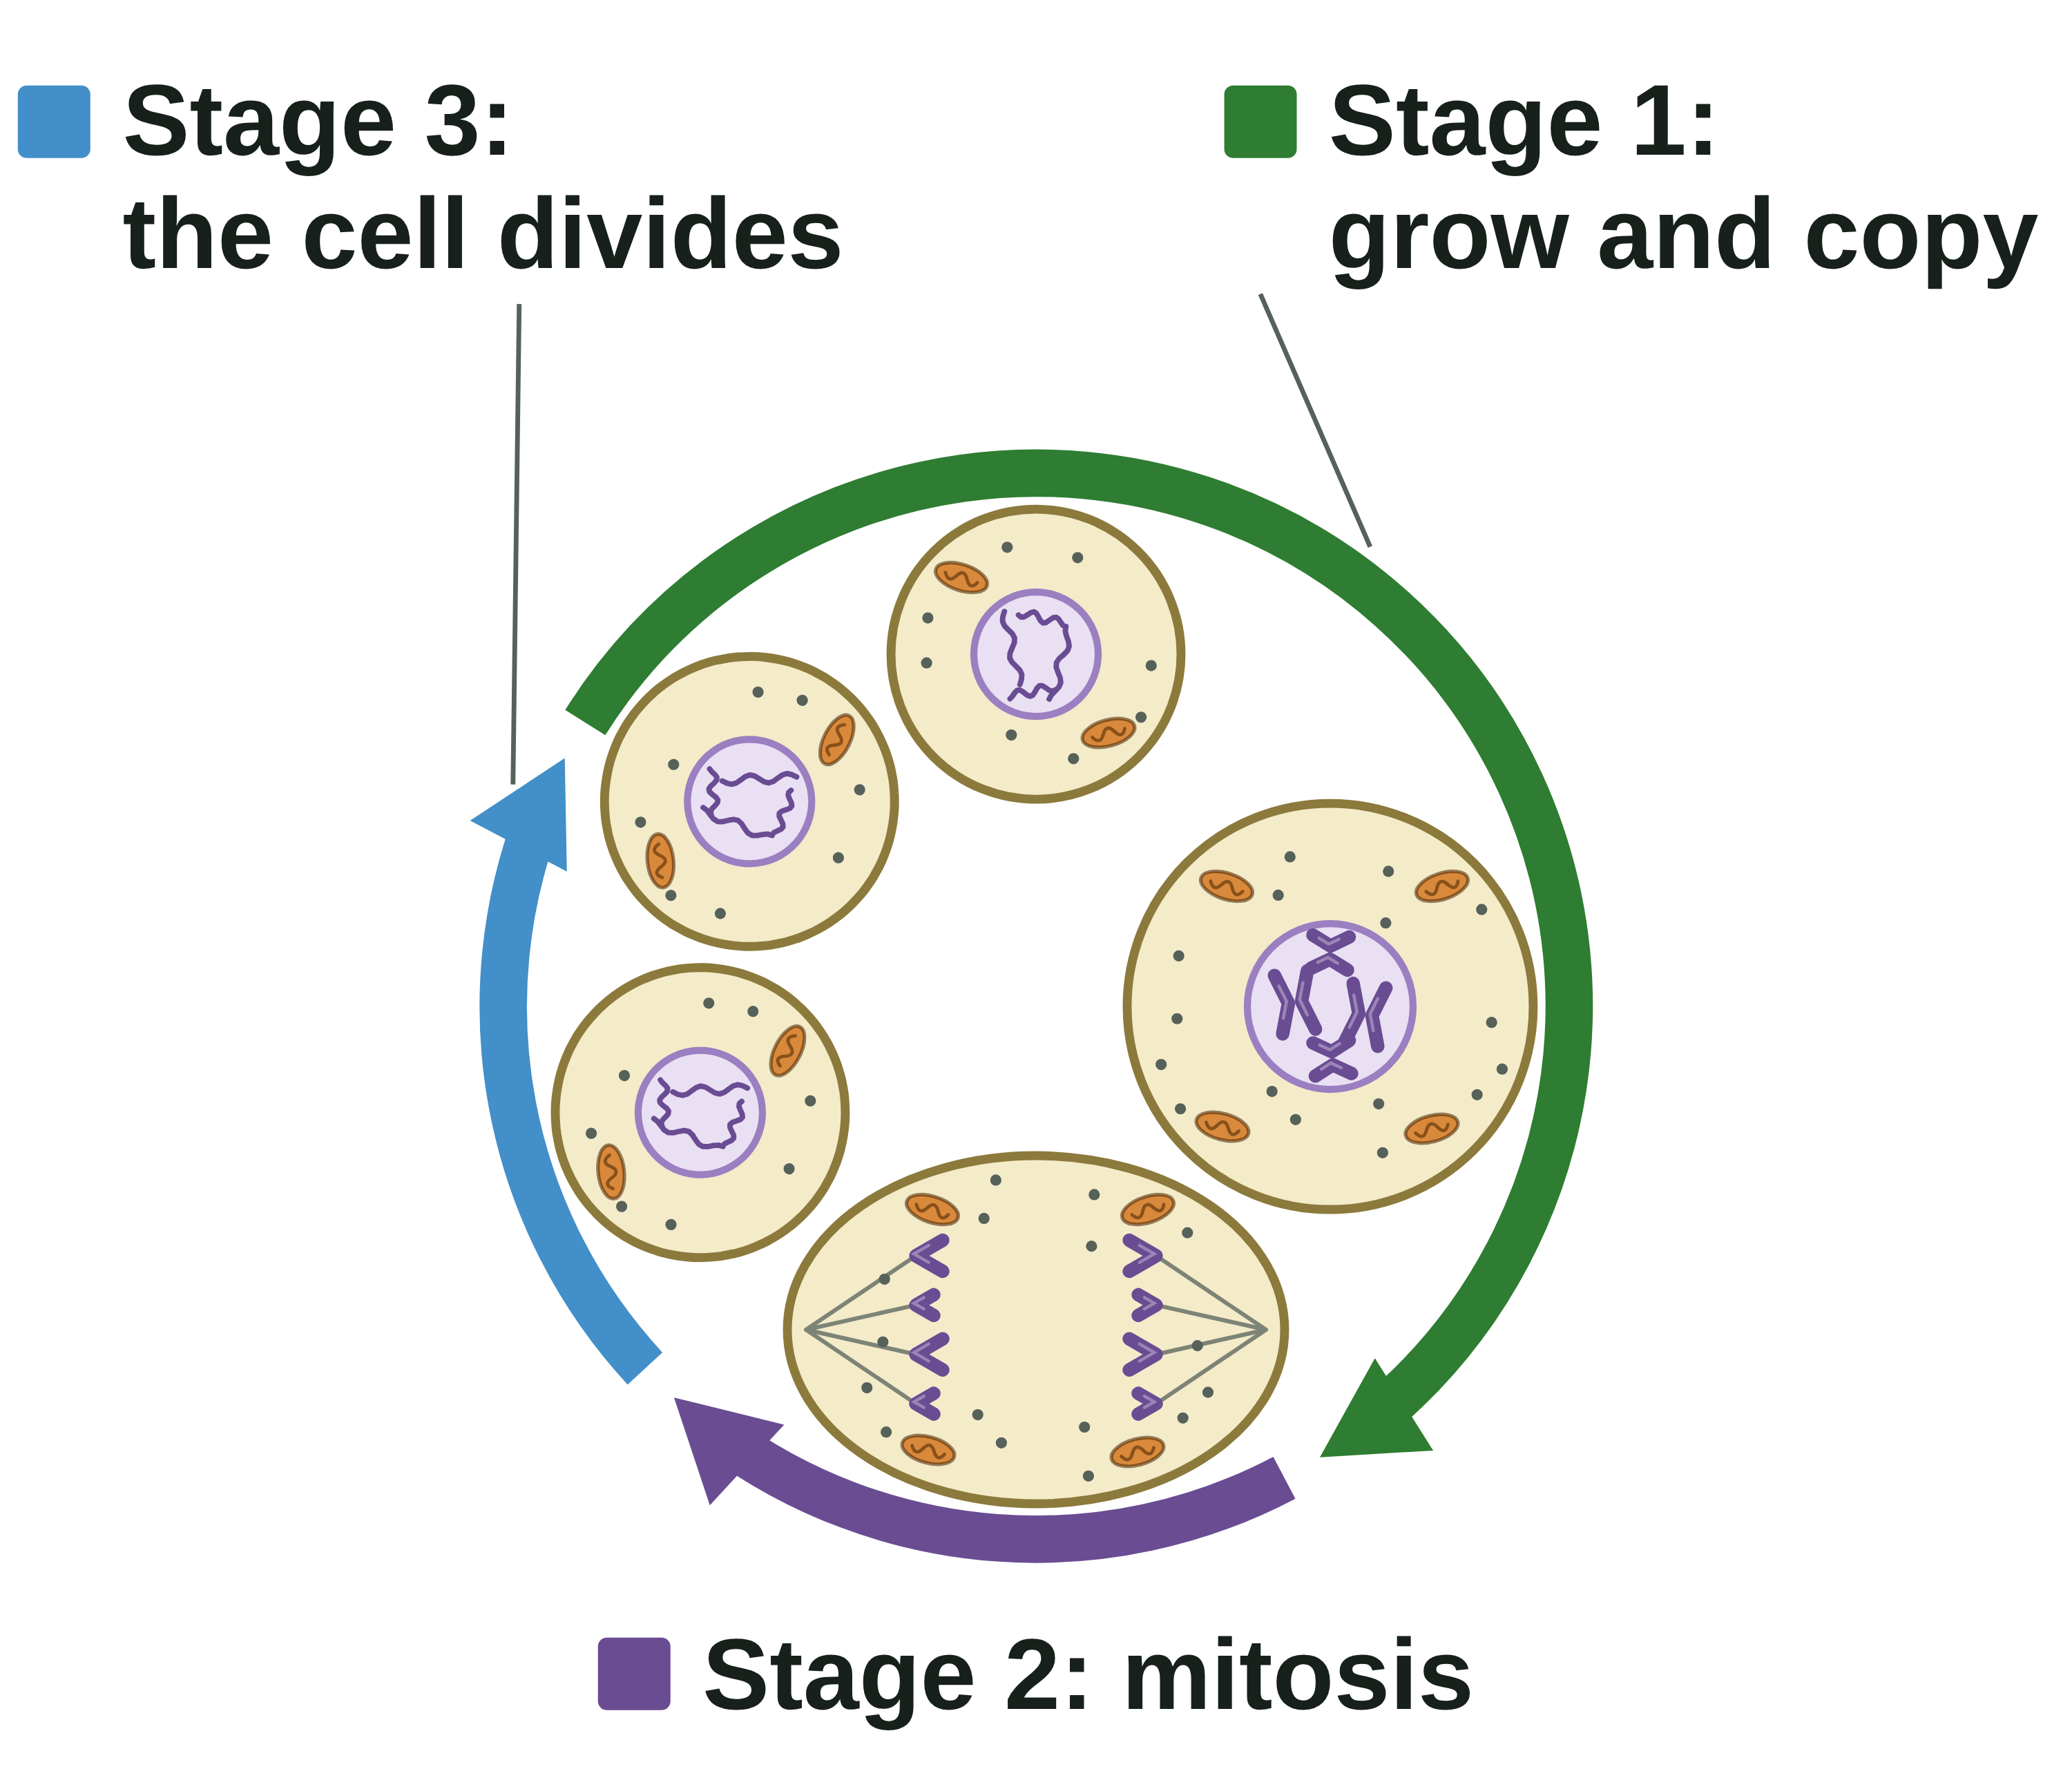
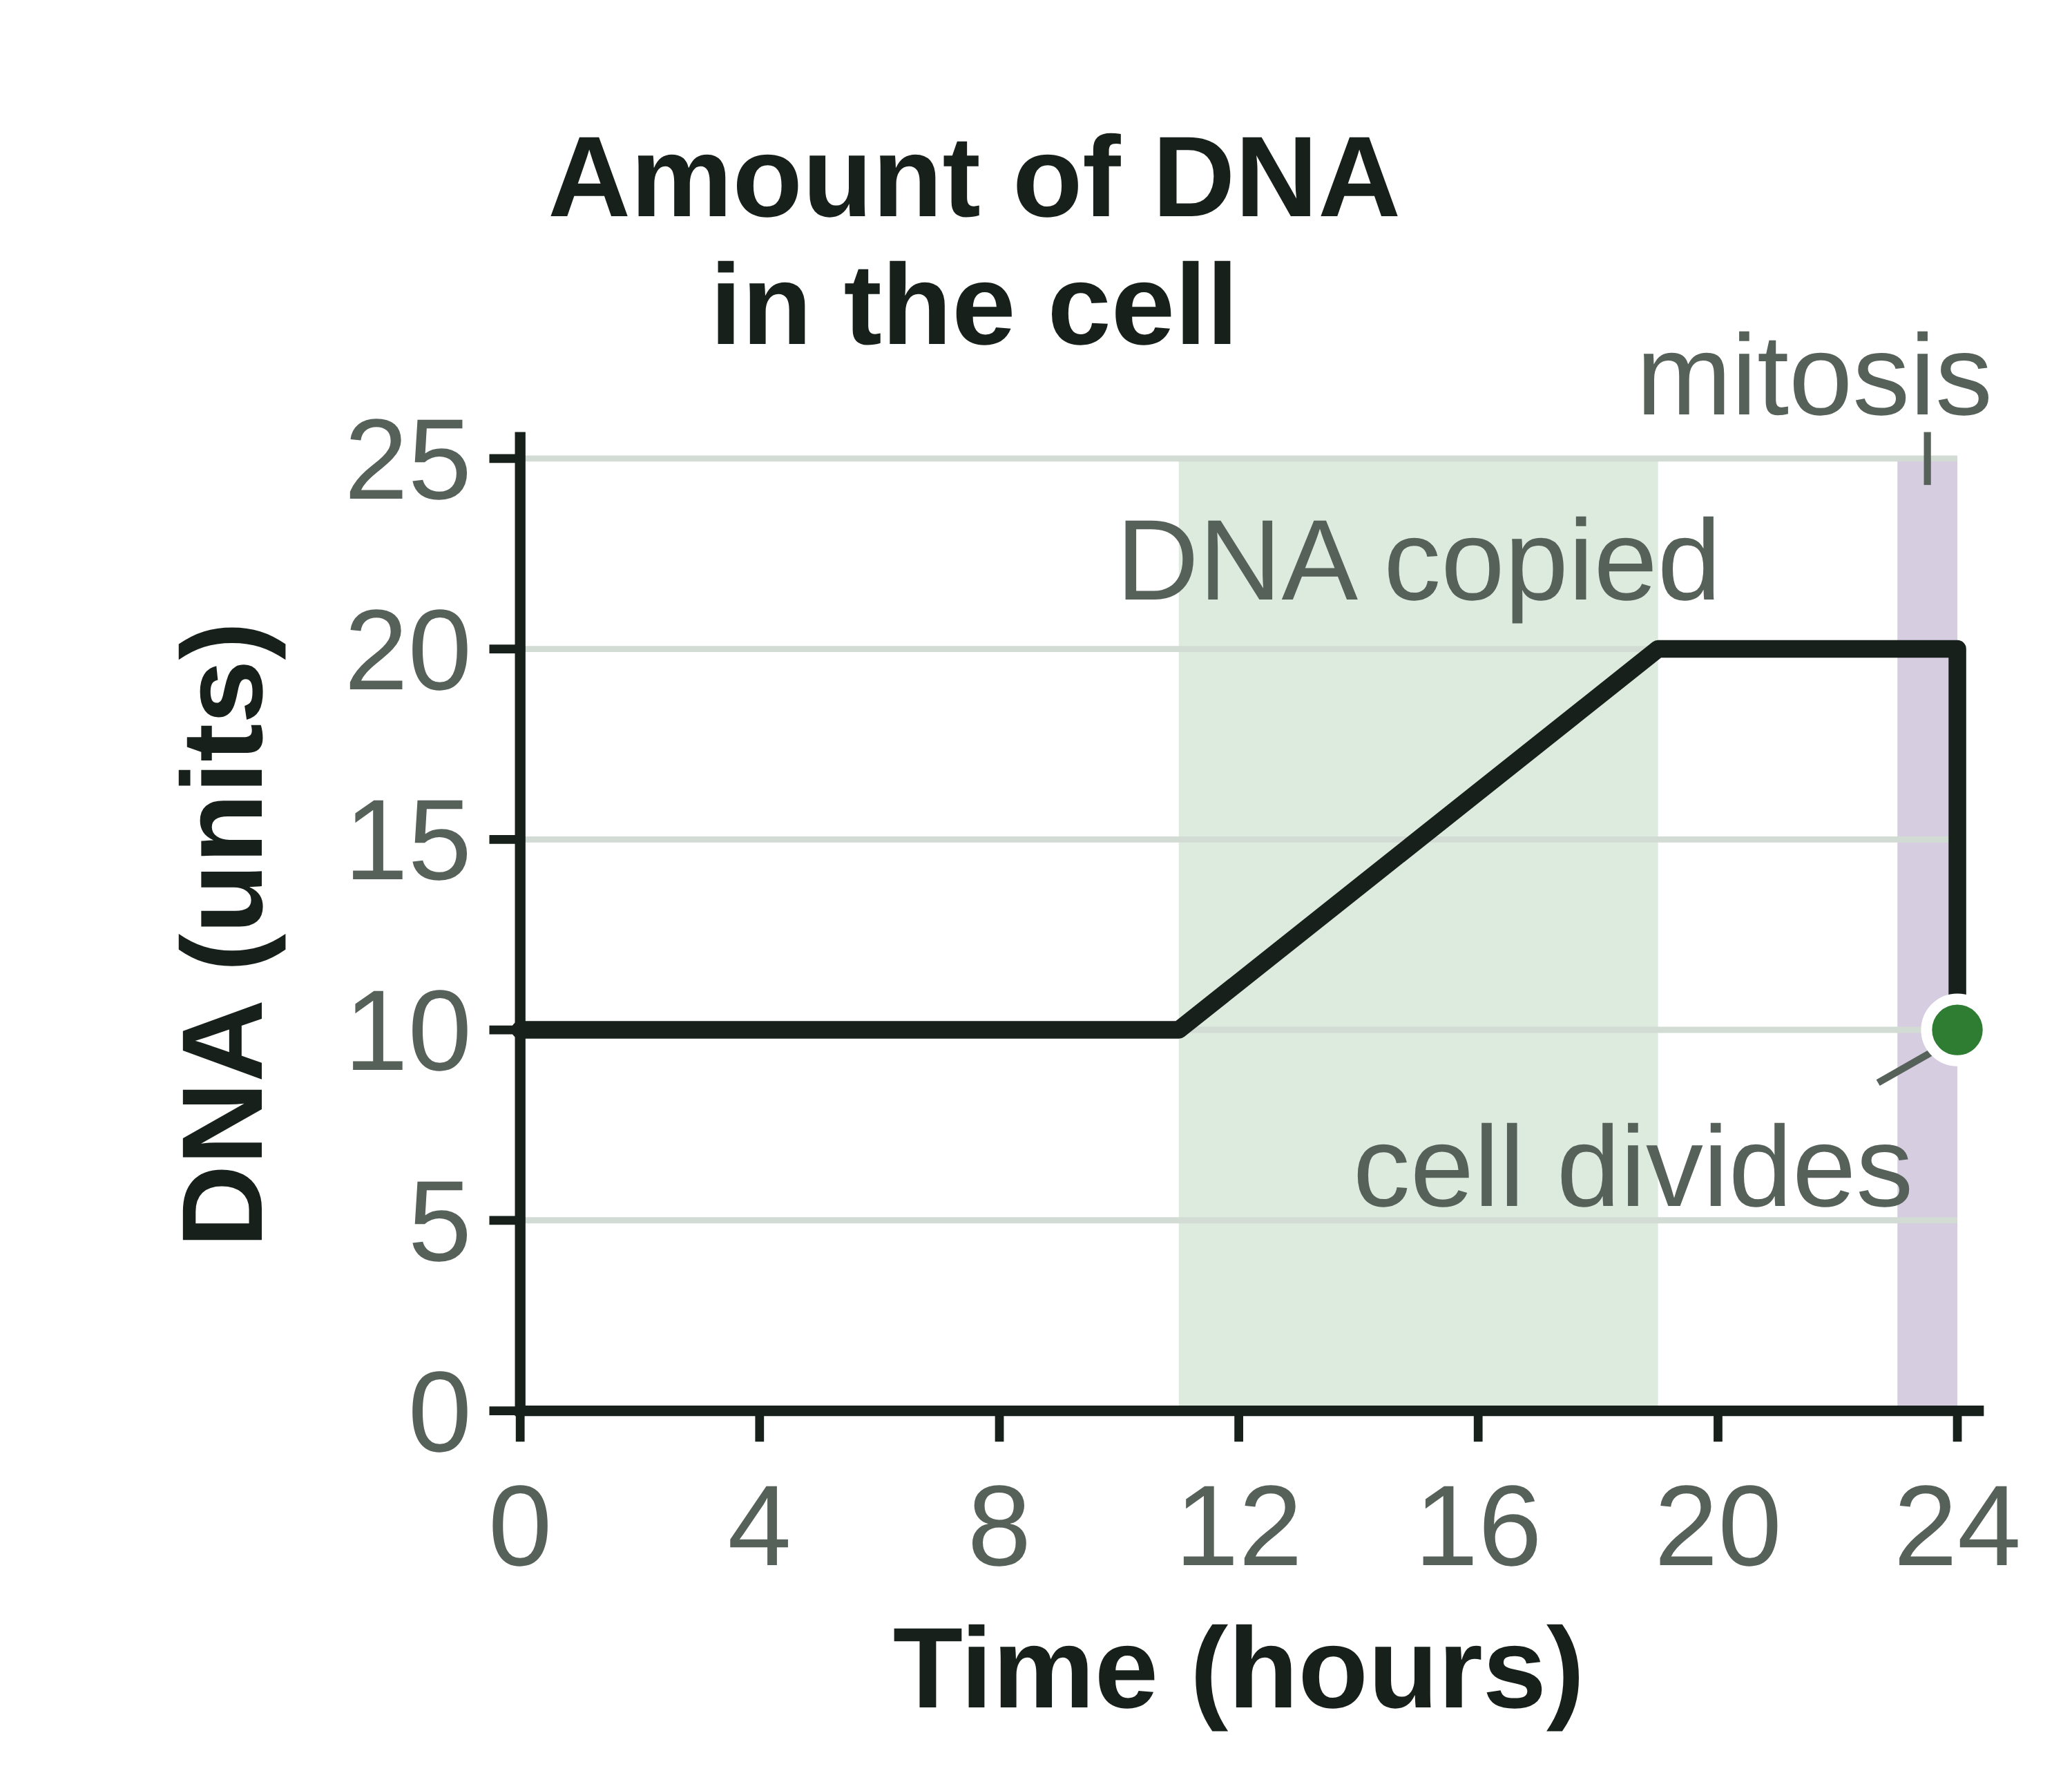
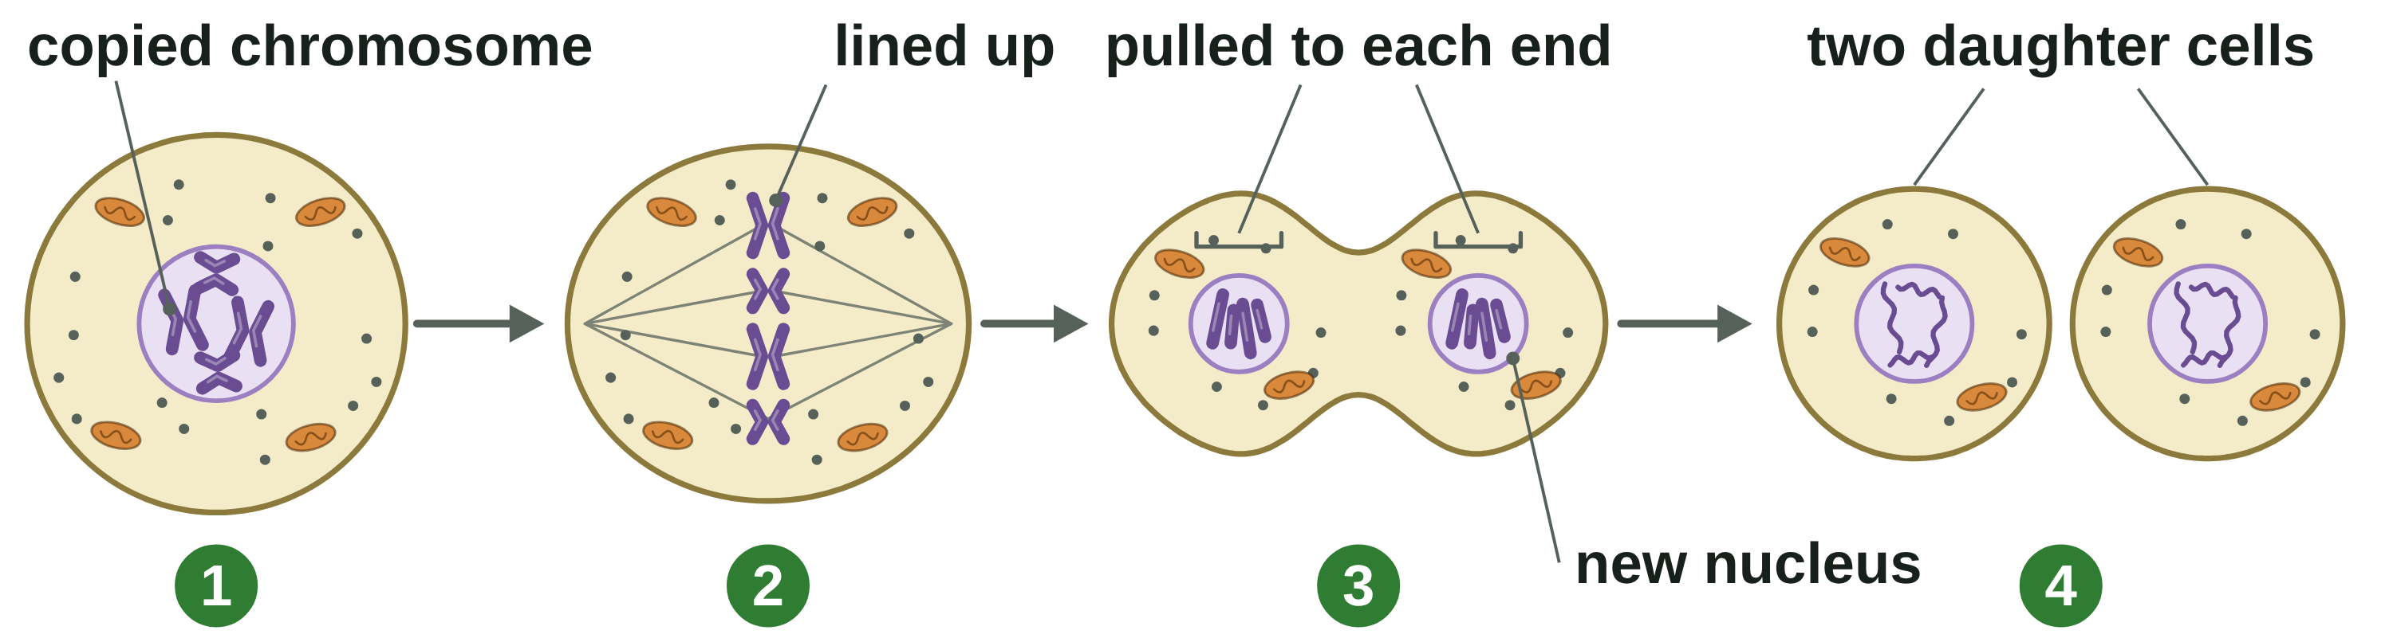
B1 L6 Revision notes 2 of 4
Cell division: mitosis
The cell cycle, mitosis and two identical cells
4. The cell cycle
6. Two genetically identical cells
Stage | What happens
Stage 1: grow and copy | The cell grows and makes more sub-cellular structures, such as ribosomes and mitochondria. The DNA replicates to form two copies of each chromosome.
Stage 2: mitosis | One set of chromosomes is pulled to each end of the cell, and the nucleus divides.
Stage 3: the cell divides | The cytoplasm and cell membrane divide to form two identical cells.
During the cell cycle the genetic material is doubled and then divided into two identical cells:
In stage 1, the DNA is copied, so the amount of DNA in the cell doubles.
In mitosis, one copy of every chromosome goes to each end of the cell.
When the cell divides, each daughter cell has the starting amount of DNA again.
Cells divide in a series of stages called the cell cycle. A human cell cycle takes about 24 hours. Mitosis takes only about 1 hour of it: most of the time, a cell is growing and copying its DNA.
5. Mitosis step by step
So the two daughter cells are genetically identical: they have exactly the same genetic material as each other and as the parent cell. They have the same number of chromosomes as the parent cell. A human body cell with 46 chromosomes makes two daughter cells with 46 each.
Watch out: mitosis is only stage 2, when the nucleus divides. The DNA is copied before mitosis, in stage 1, while the cell grows.
Watch out: mitosis makes two cells, not four. Each new cell has 46 chromosomes, not 23. Halving the number happens only when sex cells are made, by a different division, meiosis (B6 Inheritance, variation and evolution).
Watch out: a pair is two matching chromosomes of the same size (why they come in pairs is B6). The two copies made when the DNA is copied are not a pair: they are exact copies, and mitosis shares them out, one to each new cell.
1. Each chromosome has been copied. The two copies are joined together.
2. The chromosomes line up across the middle of the cell.
3. The copies are pulled apart: one set of chromosomes goes to each end of the cell. A new nucleus forms round each set, so the nucleus has divided.
4. The cytoplasm and cell membrane divide. There are now two daughter cells.
You do not need the names of the phases of mitosis. Describe what the chromosomes do.
B1 L6 · Cell division: mitosis · sciencegcse.co.uk · free GCSE science resources
Notes:
Revision notes page 2 of 4. The three stages of the cell cycle, mitosis step by step, and why the two daughter cells are genetically identical. Ask: how many chromosomes are in each daughter cell when a human skin cell divides? (46.)

Slide 26
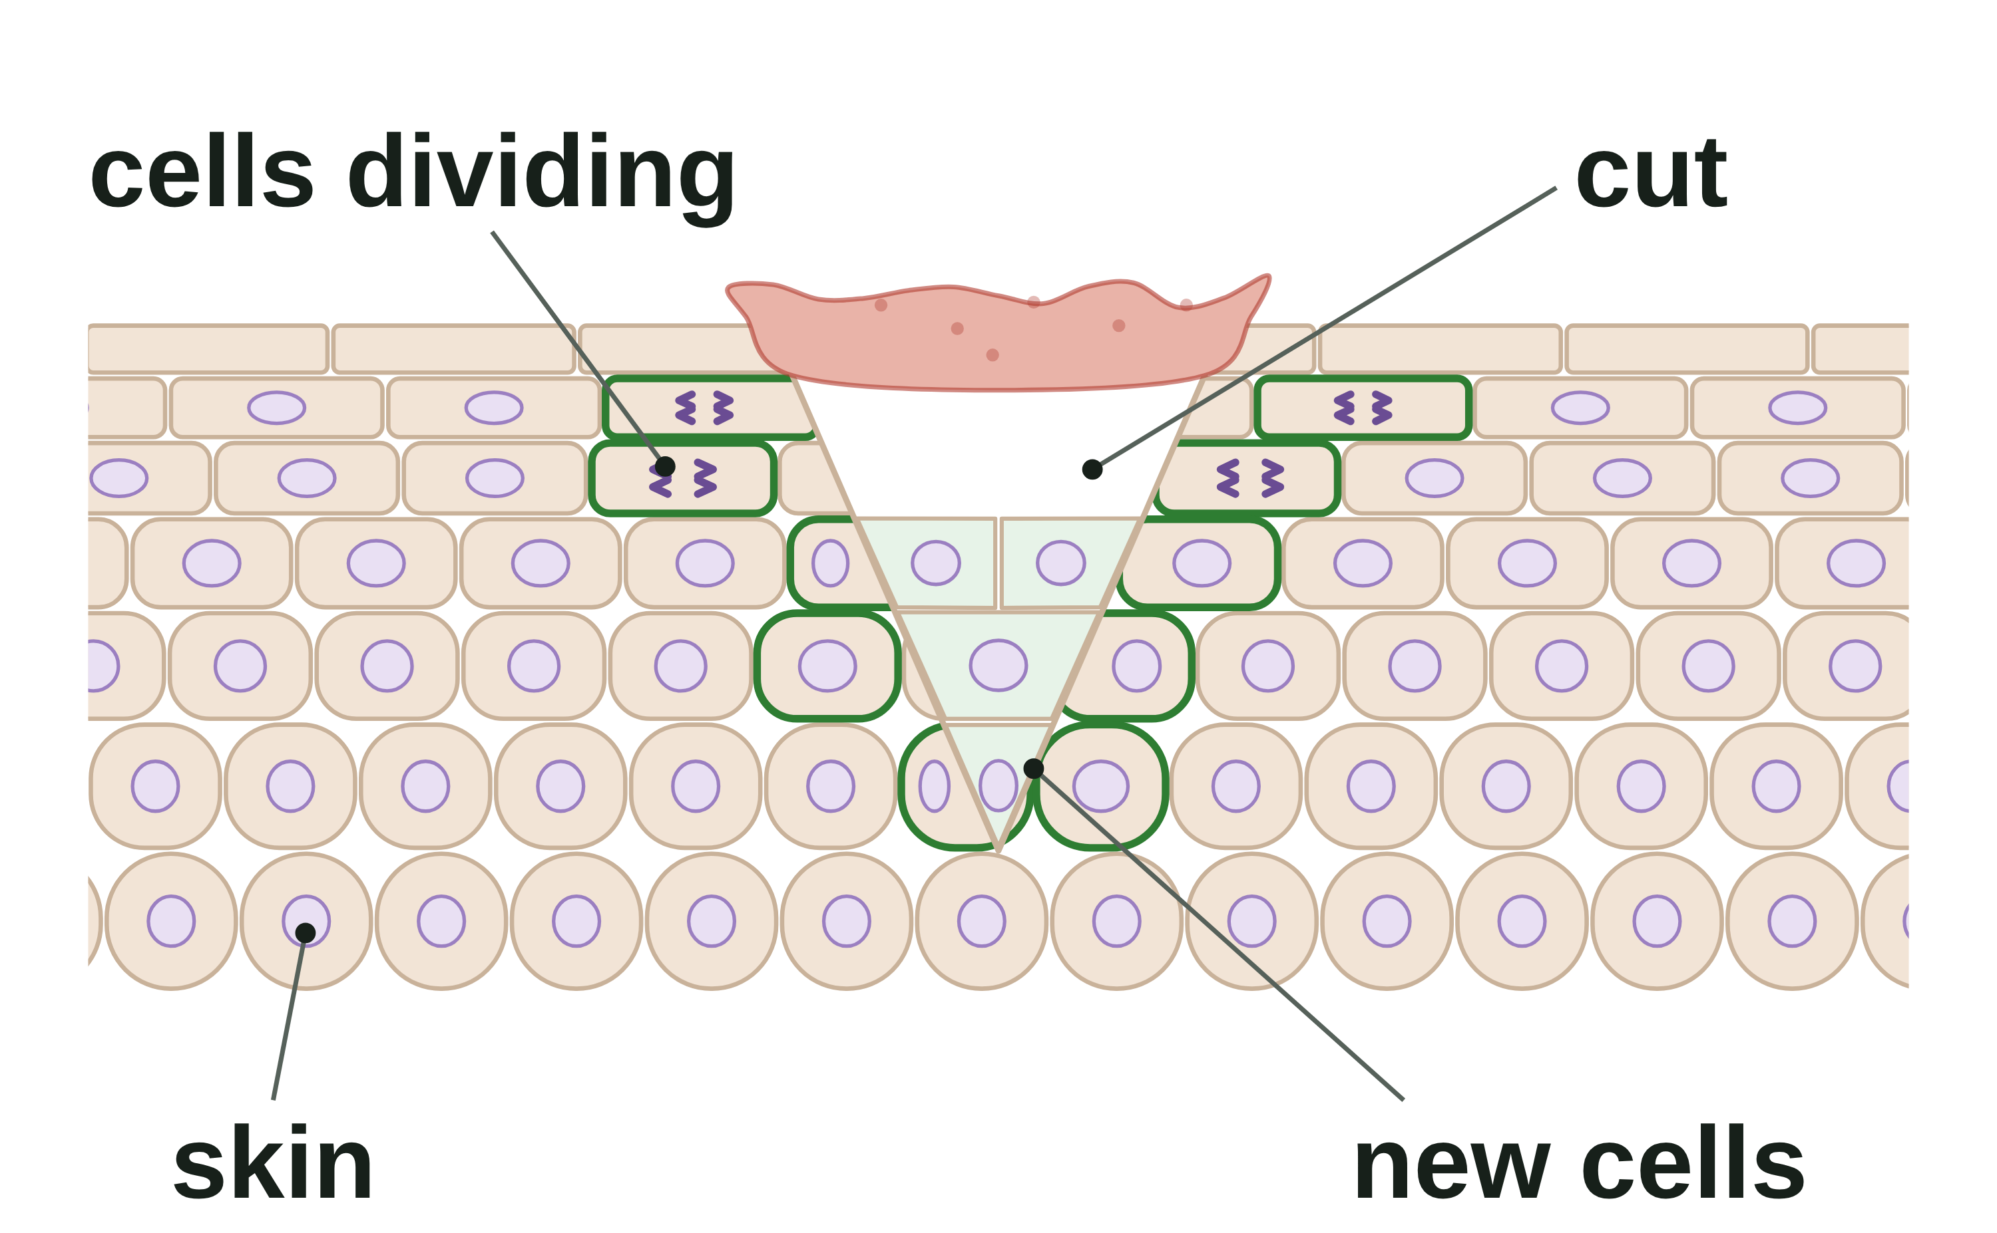
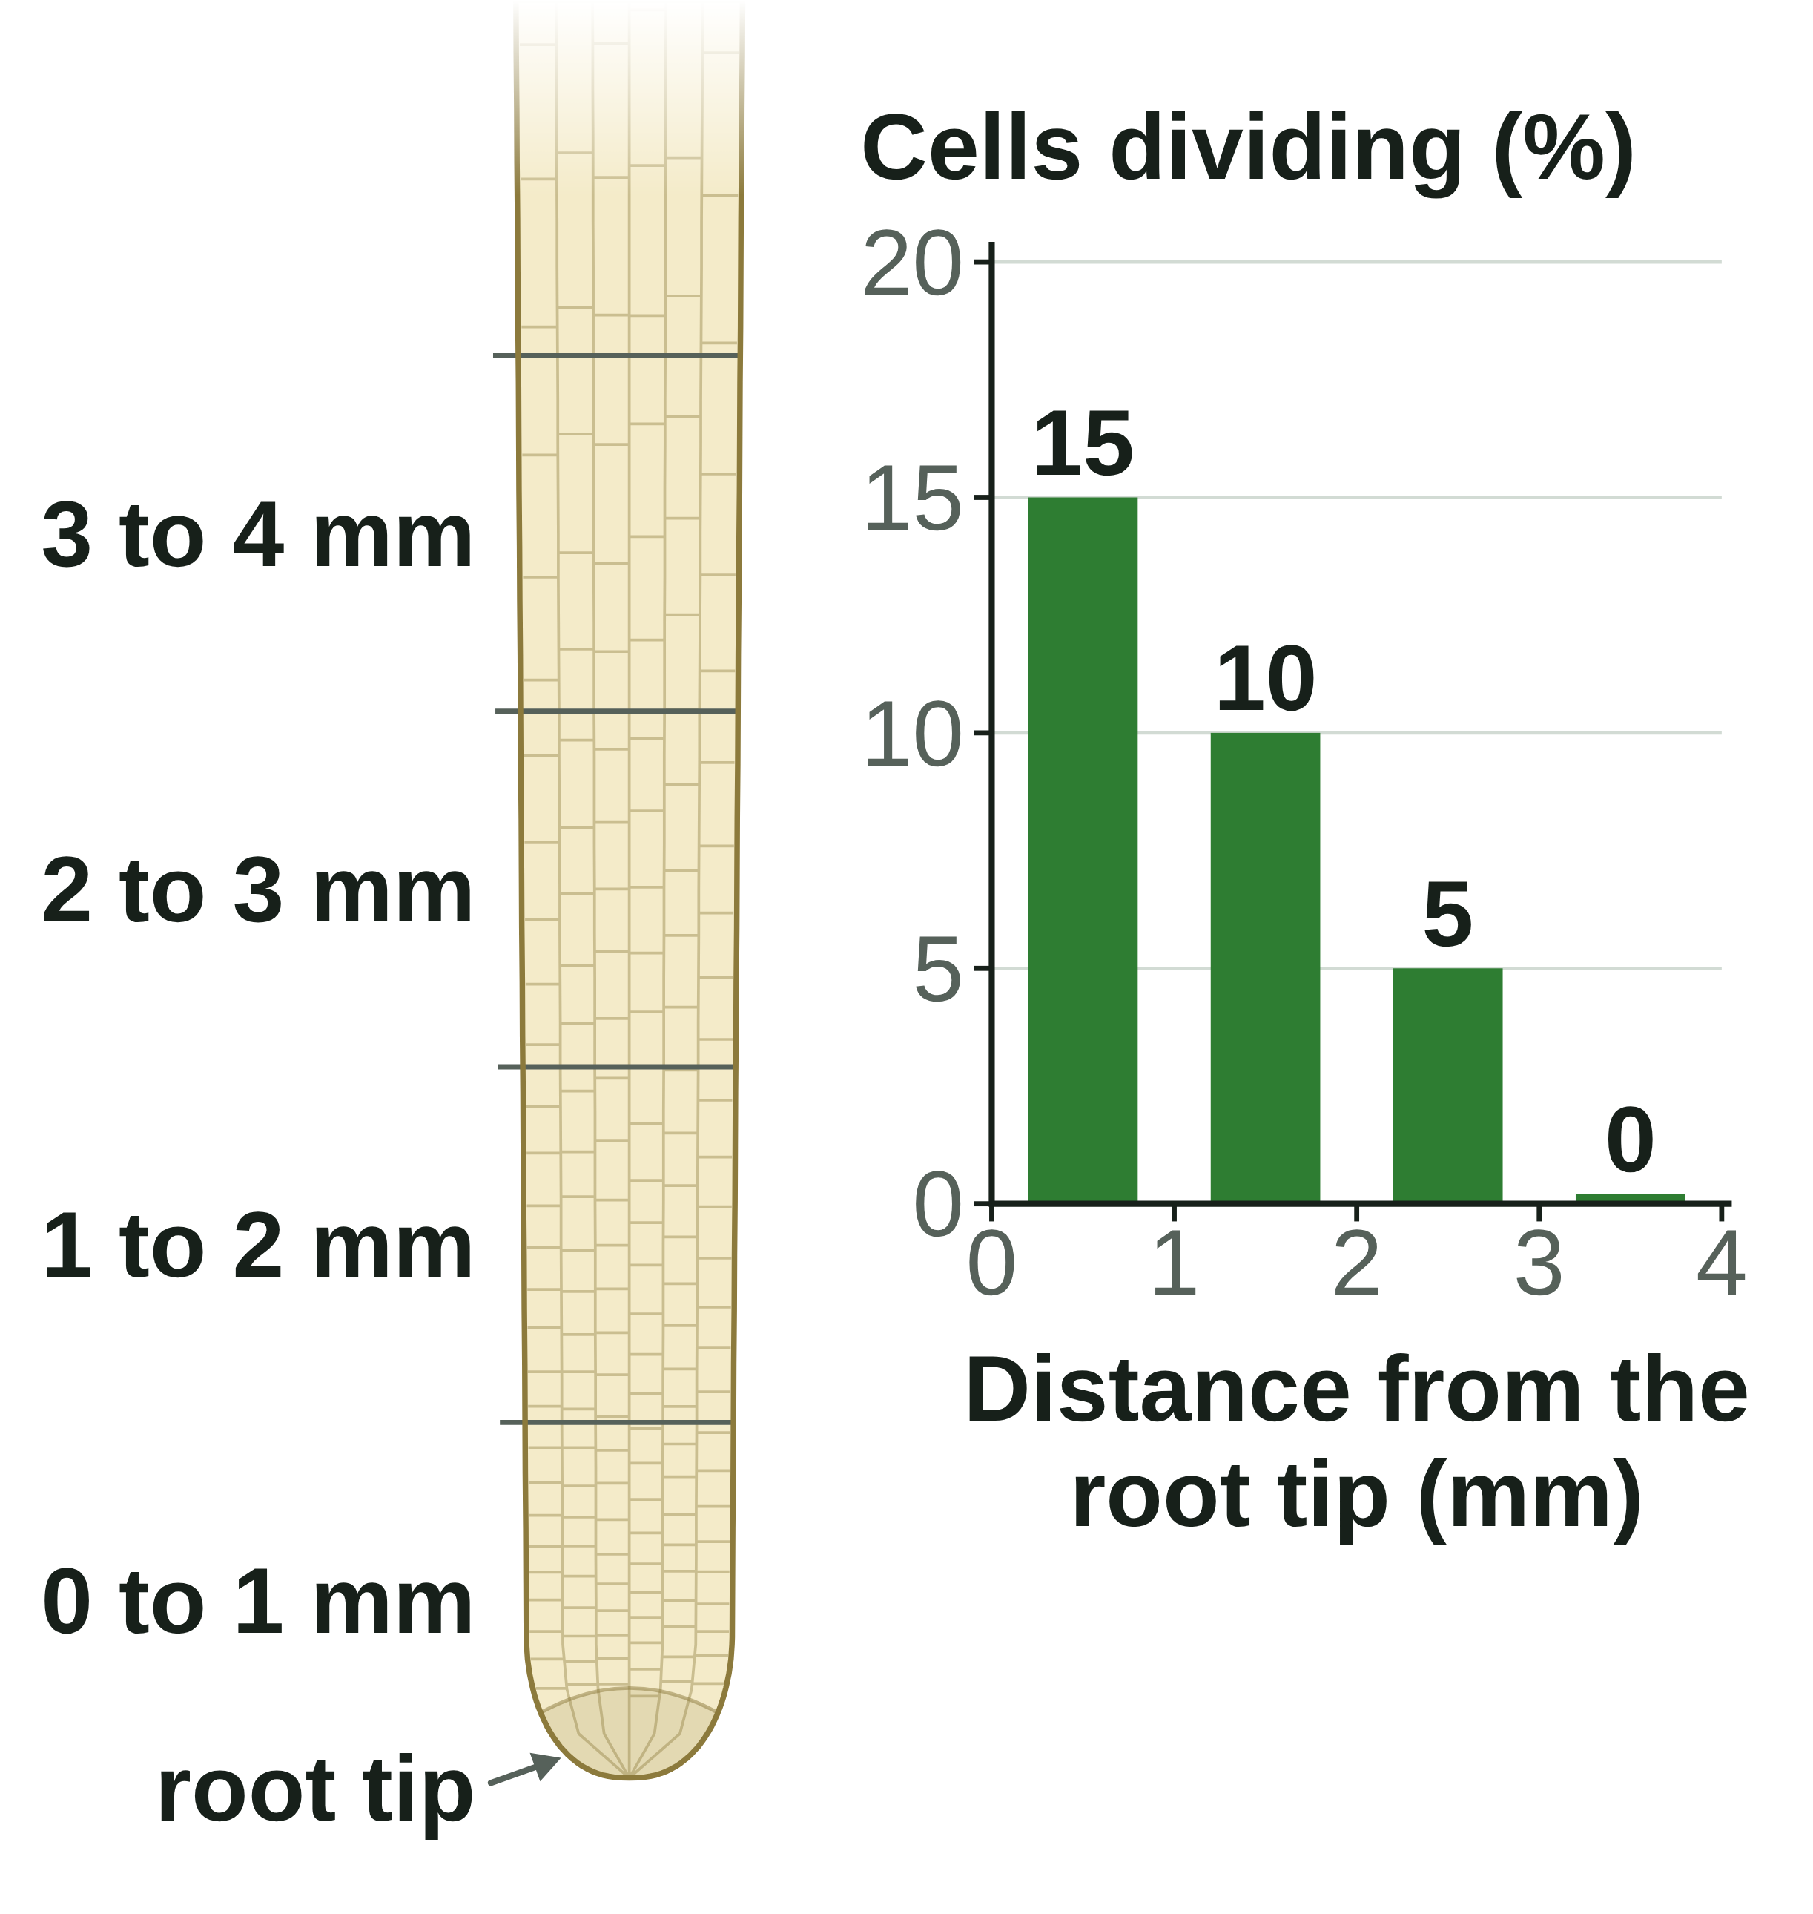
B1 L6 Revision notes 3 of 4
Cell division: mitosis
Growth, repair and replacement, and the maths
7. Where does mitosis happen?
9. Counting dividing cells
Cell division by mitosis is important in the growth and development of multicellular organisms. It is also used for repair and replacement.
In adult animals, most mitosis is for repair and replacement. Plants keep growing at their root and shoot tips all their lives.
Not mitosis: making sex cells (sperm and egg cells are made by meiosis, B6); a bacterium splitting into two (it has no nucleus, B1 L2 Bacterial cells).
Scientists count the dividing cells in a stained root tip to find where the root grows fastest. Close to the tip, many cells are dividing; further back, cells stop dividing, get longer and become specialised.
percentage of cells dividing = cells dividing ÷ total cells × 100
Worked example: 9 of 180 cells in a root tip are dividing. What percentage of the cells are dividing?
Step 1: 9 ÷ 180 = 0.05.
Step 2: 0.05 × 100 = 5 %.
Answer: 5 %.
Check: 5 % of 180 = 180 ÷ 100 × 5 = 9. ✓
Job | Example | Which cells divide
growth and development | a root growing longer; a young tree growing taller; one cell growing into a ball of cells | cells at the root and shoot tips; every cell in the ball
repair | a cut in the skin healing; a lizard regrowing its tail | cells beside the cut; cells at the end of the tail
replacement | replacing skin cells that rub off | cells deep in the skin
Watch out: divide the number of cells dividing by the total, not the other way round, and multiply by 100. A percentage of cells can never be more than 100 %.
Some organisms reproduce using mitosis: asexual reproduction (B6). Cells that divide to make new cells for growth and repair: B1 L7 Stem cells. Changes in cells that lead to uncontrolled division can cause a tumour (B2 L11 Health, risk factors and cancer).
Time in a stage (stretch): the more cells you see in a stage, the longer that stage lasts.
time in mitosis = (cells in mitosis ÷ total cells) × time for one cell cycle
For example, 10 of 240 cells are in mitosis, and the cycle takes 24 hours: 10 ÷ 240 × 24 = 1 hour.
Spot it: in a question, look for an organism that is growing, repairing damage or replacing cells. That is where mitosis is happening.
8. Doubling
10. Answering cell cycle questions
If every cell divides once in each round, the number of cells doubles: 1 → 2 → 4 → 8 → 16.
Give the stages in order, and use the key words: grows, sub-cellular structures, the DNA replicates (is copied), one set of chromosomes pulled to each end, the nucleus divides, the cytoplasm and cell membrane divide, two genetically identical cells.
Question: "Explain why a cell must copy its DNA before it divides."
Model answer: "So that each daughter cell gets a full set of chromosomes. The DNA replicates to form two copies of each chromosome. In mitosis, one copy of each chromosome goes to each end of the cell. If the DNA were not copied, each new cell would get only some of the chromosomes."
"The chromosomes split" or "the cell splits into four" scores nothing: say one set of chromosomes is pulled to each end, and two cells are made.
Rounds | 0 | 1 | 2 | 3 | 4 | 5 | 10
Cells | 1 | 2 | 4 | 8 | 16 | 32 | 1024
after n rounds, number of cells = 2^{n}
Worked example: a cell divides by mitosis every 24 hours, and every new cell does the same. How many cells are there after 10 days, starting from one cell?
Step 1: 10 days = 10 rounds of division.
Step 2: 2¹⁰ = 2 × 2 × 2 × 2 × 2 × 2 × 2 × 2 × 2 × 2 = 1024.
Answer: 1024 cells, about 1 × 10³ in standard form (B1 L4 Magnification and cell size).
B1 L6 · Cell division: mitosis · sciencegcse.co.uk · free GCSE science resources
Notes:
Revision notes page 3 of 4. Growth, repair and replacement, doubling (2ⁿ) and counting dividing cells, with worked examples, and how to answer cell cycle questions. Go through both worked examples on the board.

Slide 27
B1 L6 Revision notes 4 of 4
Cell division: mitosis
Key words, exam tips and check yourself
Key words
Check yourself
Cover the answers, then check.
Cell cycle: the series of stages in which a cell grows, copies its DNA and divides into two identical cells.
Chromosome: a structure in the nucleus, made of DNA, that carries a large number of genes.
Daughter cells: the two new cells made when a cell divides.
DNA: the chemical that carries the genetic instructions for a cell.
Gene: a small section of DNA on a chromosome.
Genetically identical: having exactly the same genetic material.
Light micrograph: a picture of something seen through a light microscope.
Mitosis: the stage of the cell cycle in which one set of chromosomes is pulled to each end of the cell and the nucleus divides.
Multicellular organism: an organism made of many cells, such as a human or a tree.
Nucleus: the part of a cell that contains the genetic material, which controls the activities of the cell.
Stain: a dye that colours cells, or parts of cells, so they are easier to see.
Sub-cellular structure: a part inside a cell that has a particular job, such as the nucleus or a mitochondrion.
1. What is a chromosome made of, and what does it carry?
2. How many chromosomes are in a human body cell, and how are they arranged?
3. Name the three stages of the cell cycle.
4. What happens to the number of sub-cellular structures in stage 1?
5. Describe what happens in mitosis.
6. Why are the two daughter cells genetically identical?
7. Give three reasons why cells divide by mitosis.
8. One cell divides by mitosis. In each round, every cell divides once. How many cells are there after 6 rounds?
Answers
1. DNA. It carries a large number of genes.
2. 46, in 23 pairs.
3. Stage 1: the cell grows and copies its DNA. Stage 2: mitosis. Stage 3: the cytoplasm and cell membrane divide.
4. It increases: the cell makes more of them, such as ribosomes and mitochondria.
5. One set of chromosomes is pulled to each end of the cell, and the nucleus divides.
6. The DNA is copied, and each daughter cell gets one copy of every chromosome.
7. Growth (and development), repair and replacement.
8. 2⁶ = 64 cells.
Exam tips
Learn the three stages in order: grow and copy the DNA; mitosis; the cytoplasm and cell membrane divide.
Mitosis is the stage when one set of chromosomes is pulled to each end and the nucleus divides.
Say "two genetically identical cells", and give the chromosome number: 46 → 46.
Do not use the phase names: describe what the chromosomes do.
In percentage questions, write the formula, show your working and check the answer is sensible.
Energy is released by respiration in mitochondria. Never write that energy is "made".
Common mistakes
Wrong: "Mitosis makes four cells." Right: mitosis makes two cells.
Wrong: "Each new cell has 23 chromosomes." Right: it has 46, the same as the parent cell.
Wrong: "The DNA is copied during mitosis." Right: it is copied before, in stage 1.
Wrong: "Chromosomes appear when a cell divides." Right: they are there all the time; they only show up then.
B1 L6 · Cell division: mitosis · sciencegcse.co.uk · free GCSE science resources
Notes:
Revision notes page 4 of 4. Key words, exam tips and Check yourself: students cover the answers, try all eight, then check. The common mistakes box sums up the lesson's traps.

Slide 28
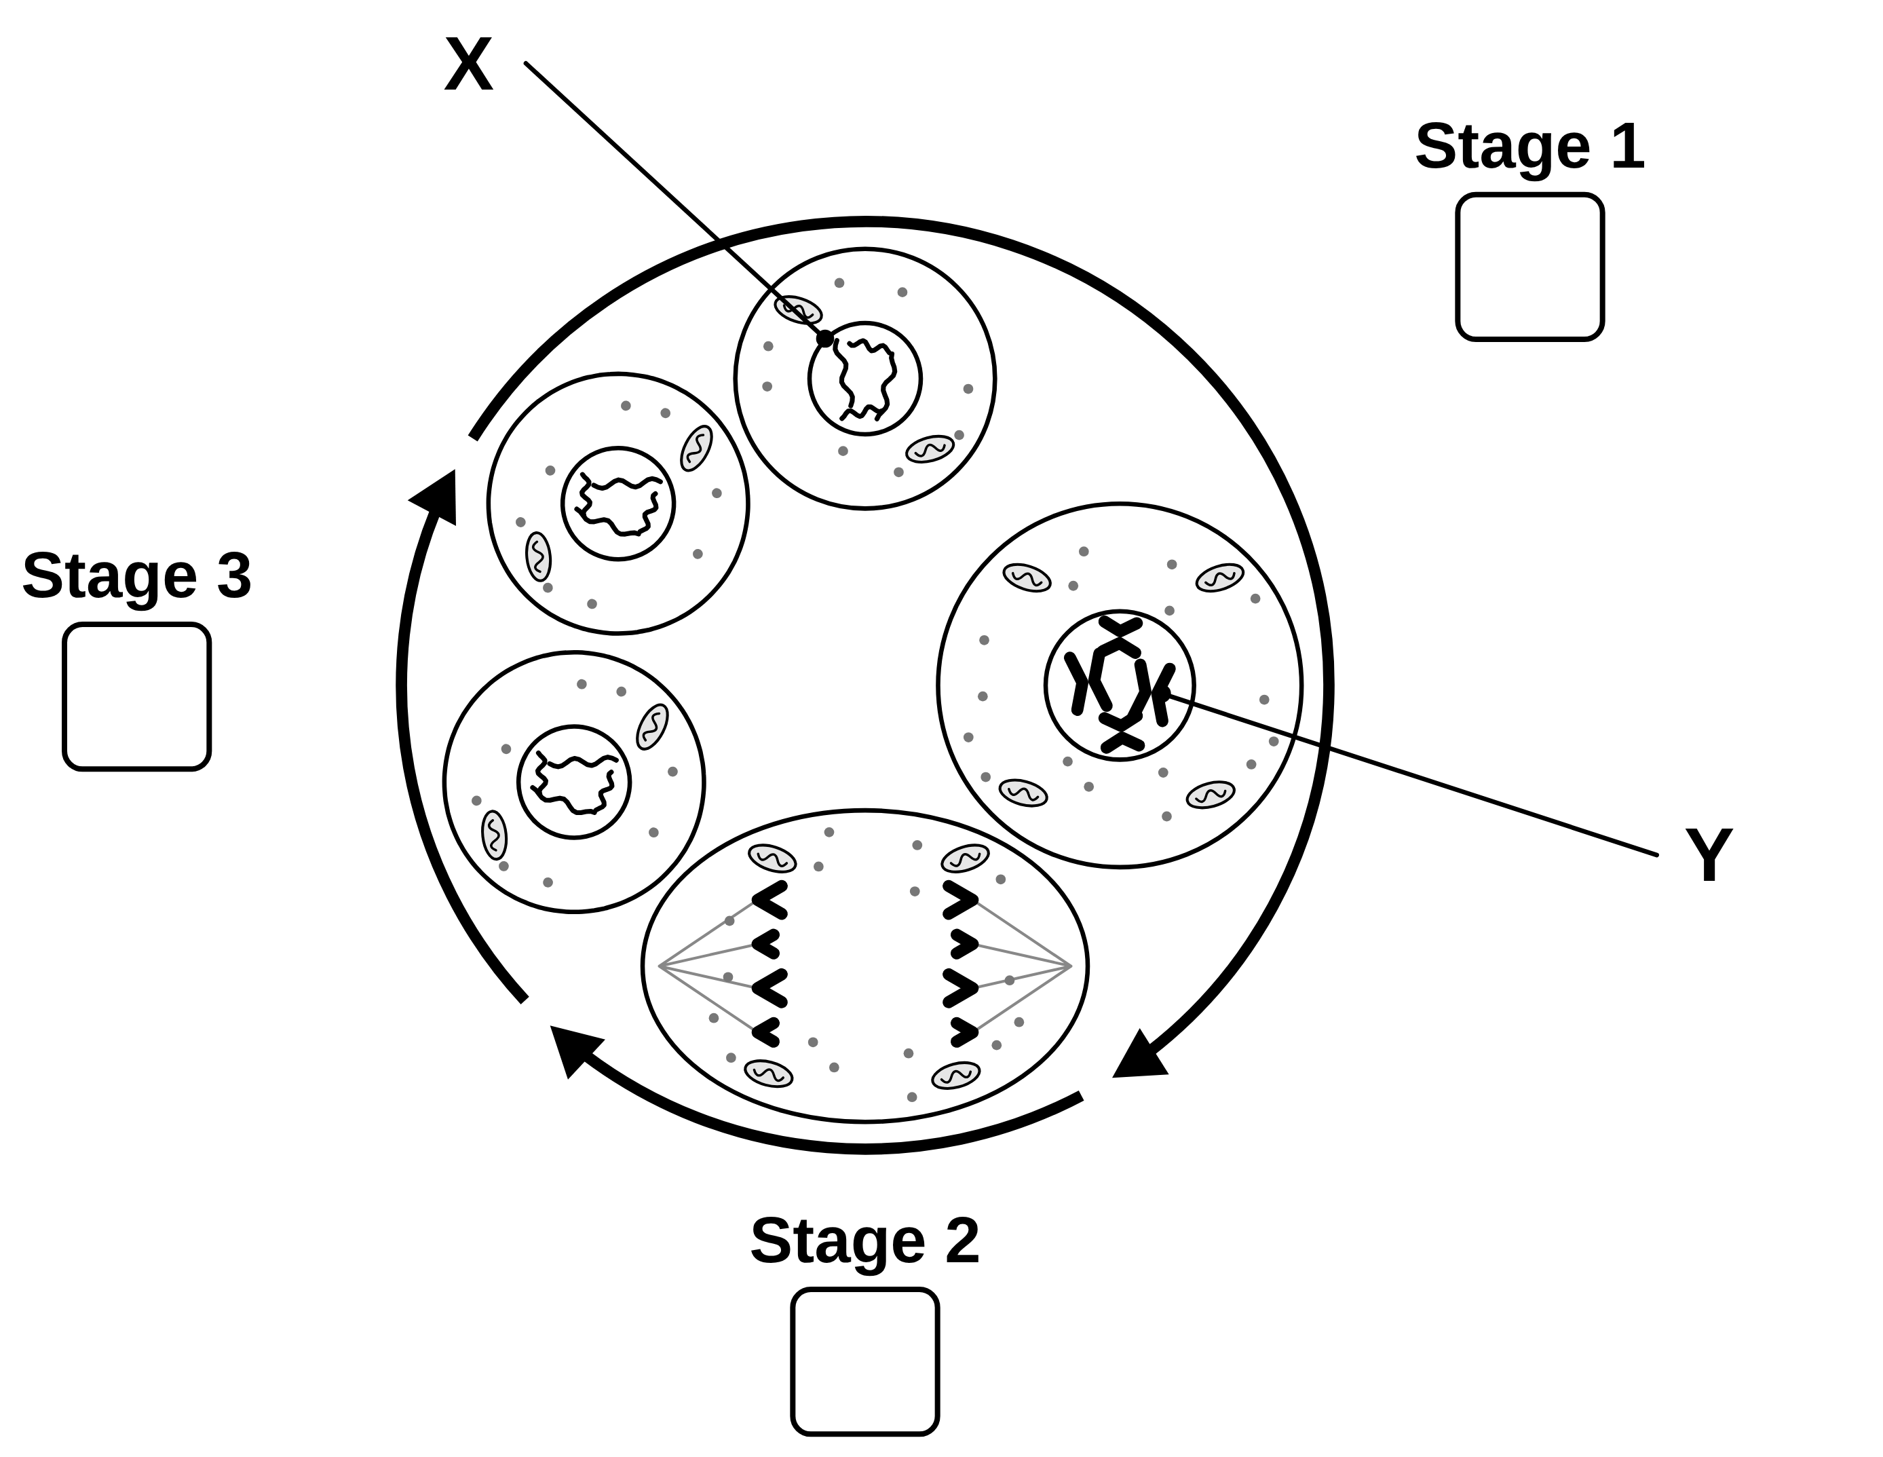
B1 L6 Mandatory worksheet: Cell division: mitosis
Page 1 of 2
Name: ______________________________ Class: __________
A. The cell cycle
B. Fill in the gaps
[7]
[5]
Help: online screens 2 and 4
Help: online screen 3
The diagram shows one cell going round the cell cycle.
Use words from the box. Use each word once. Two words are not needed.
(a) Write the letter P, Q or R in each stage box on the diagram. [3]
23
46
DNA
genes
nucleus
pairs
ribosomes
P
The cytoplasm and cell membrane divide.
1. Chromosomes are found in the ____________ of a cell.
2. Chromosomes are made of a chemical called ____________.
3. Each chromosome carries a large number of ____________.
Q
The cell grows and copies its DNA.
4. In body cells, chromosomes are normally found in ____________.
5. A human body cell has ____________ chromosomes.
R
One set of chromosomes is pulled to each end, and the nucleus divides.
C. Which stage?
[6]
Help: online screen 4
Tick (✓) one box in each row.
What happens | Stage 1 | Stage 2 (mitosis) | Stage 3
1. The cell copies its DNA.
2. One set of chromosomes is pulled to each end of the cell.
3. The cytoplasm and cell membrane divide.
4. The cell makes more ribosomes and mitochondria.
5. The nucleus divides.
6. Two separate daughter cells are formed.
(b) Name the parts labelled X and Y. [2]
X
Y
(c) The cell at the top of the diagram has 4 chromosomes. How many chromosomes are in each new cell at the end of the cycle? [1]
chromosomes
(d) How many new cells are made from one cell in one cell cycle? [1]
cells
B1 L6 · Cell division: mitosis · sciencegcse.co.uk · free GCSE science resources

Slide 29
B1 L6 Mandatory worksheet: Cell division: mitosis
Page 2 of 2
Name: ______________________________ Class: __________
D. Short answers
E. Calculate
[8]
[4]
Help: online screens 1, 4, 6, 9, 10 and 11
Help: online screens 7 and 9
1. What does “genetically identical” mean? [1]
(a) Every cell divides once in each round. Complete the table. [2]
Rounds of division | 0 | 1 | 2 | 3 | 4
Number of cells | 1 | 2
2. Give one way a dividing cell looks different from a cell that is not dividing, in a stained root tip. [1]
Use: percentage of cells dividing = cells dividing ÷ total cells × 100
(b) In a root tip, 16 of 200 cells are dividing. Calculate the percentage of cells that are dividing. Show your working. [2]
3. Give two reasons why a multicellular organism needs mitosis. [2]
%
4. An onion cell has 16 chromosomes. It divides by mitosis. How many chromosomes are in each new cell? [1]
F. Explain
[3]
Help: online screen 6
chromosomes
A cell divides by mitosis to make two daughter cells. Explain why the two daughter cells are genetically identical to the parent cell. [3]
5. Mitosis is one stage of the cell cycle. What divides during mitosis? [1]
6. A bacterium has no nucleus. Explain why it cannot divide by mitosis. [2]
B1 L6 · Cell division: mitosis · sciencegcse.co.uk · free GCSE science resources

Slide 30
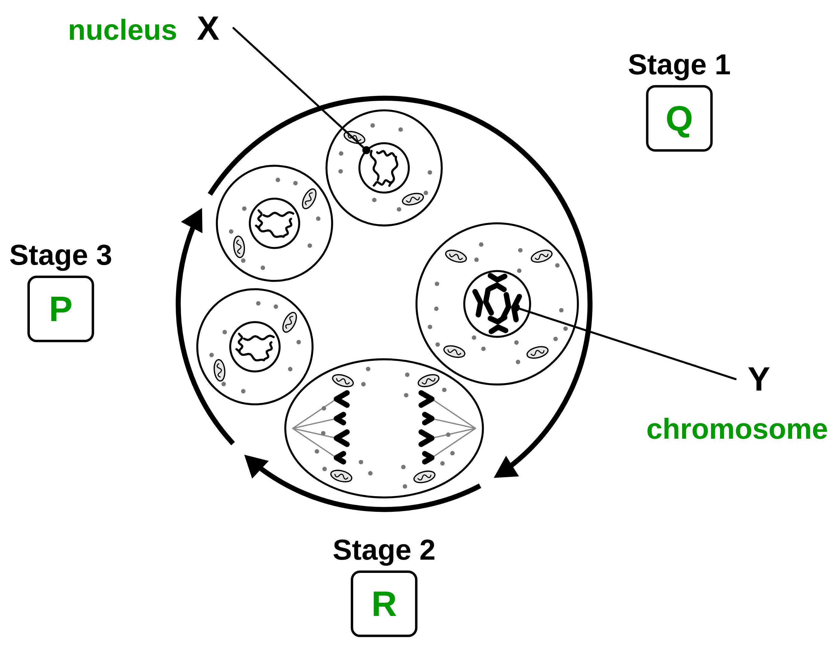
B1 L6 Mandatory worksheet answers - page 1
Answers 1 of 2
A. The cell cycle
B. Fill in the gaps
[7]
[5]
The diagram shows one cell going round the cell cycle.
Use words from the box. Use each word once. Two words are not needed.
(a) Write the letter P, Q or R in each stage box on the diagram. [3]
23
46
DNA
genes
nucleus
pairs
ribosomes
P
The cytoplasm and cell membrane divide.
1. Chromosomes are found in the nucleus (1) of a cell.
2. Chromosomes are made of a chemical called DNA (1).
3. Each chromosome carries a large number of genes (1).
4. In body cells, chromosomes are normally found in pairs (1).
5. A human body cell has 46 (1) chromosomes.
Do not accept 23 for 5 (23 is the number of pairs).
Q
The cell grows and copies its DNA.
R
One set of chromosomes is pulled to each end, and the nucleus divides.
C. Which stage?
[6]
1 mark for each correct row. No mark if two boxes in a row are ticked.
What happens | Stage 1 | Stage 2 (mitosis) | Stage 3
1. The cell copies its DNA. | ✓
2. One set of chromosomes is pulled to each end of the cell. |  | ✓
3. The cytoplasm and cell membrane divide. |  |  | ✓
4. The cell makes more ribosomes and mitochondria. | ✓
5. The nucleus divides. |  | ✓
6. Two separate daughter cells are formed. |  |  | ✓
(a)
Stage 1: Q (1) Stage 2: R (1) Stage 3: P (1)
(b)
X: nucleus (1) Y: chromosome (1)
Allow “copied chromosome” for Y. Do not accept “DNA” or “gene” for Y.
(c)
4 (1)
Each new cell has the same number of chromosomes as the parent cell. Do not accept 2 or 8.
(d)
2 (1)
Do not accept 4.
Do not accept Stage 2 for row 1: the DNA is copied before mitosis.
B1 L6 · Cell division: mitosis · sciencegcse.co.uk · free GCSE science resources

Slide 31
B1 L6 Mandatory worksheet answers - page 2
Answers 2 of 2
D. Short answers
E. Calculate
[8]
[4]
1. What does “genetically identical” mean? [1]
(a) Every cell divides once in each round. Complete the table. [2]
Having exactly the same genetic material / the same DNA / the same genes (1).
Do not accept “looking the same” or “the same size”.
Rounds of division | 0 | 1 | 2 | 3 | 4
Number of cells | 1 | 2 | 4 | 8 | 16
2. Give one way a dividing cell looks different from a cell that is not dividing, in a stained root tip. [1]
(a)
4, 8, 16: all three correct (2); two correct (1).
Any one (1): its chromosomes show as separate (dark) threads; its chromosomes are lined up across the middle; its chromosomes are being pulled to each end; it has no round nucleus.
Do not accept “it has chromosomes” (every cell has chromosomes, all the time).
(b)
16 ÷ 200 × 100 (1) = 8 (%) (1)
Correct answer with no working scores 2. Allow 0.08 for 1 mark (not multiplied by 100). Do not accept 12.5 (200 ÷ 16: divided the wrong way round).
Model answers
3. Give two reasons why a multicellular organism needs mitosis. [2]
(a) 4, 8, 16.
(b) 16 ÷ 200 = 0.08. 0.08 × 100 = 8 %.
Any two (1 each): growth / development; repair (of damage / a cut); replacement (of worn-out cells).
Allow asexual reproduction for 1 mark. Do not accept “to make sex cells”.
F. Explain
4. An onion cell has 16 chromosomes. It divides by mitosis. How many chromosomes are in each new cell? [1]
[3]
Any three (max 3):
Before the cell divides / in stage 1, the DNA is copied / replicates (1).
So there are two (identical) copies of each chromosome (1).
In mitosis, one set of chromosomes / one copy of each chromosome is pulled to each end / goes to each new cell (1).
So each daughter cell gets the same / a full set of chromosomes / the same genetic material (1).
Do not accept “each cell gets half of the chromosomes”. Ignore the names of the phases of mitosis.
Model answer: Before the cell divides, its DNA is copied, so there are two copies of each chromosome. In mitosis, one set of chromosomes is pulled to each end of the cell. So each daughter cell gets one copy of every chromosome: the same genetic material as the parent cell.
16 (1).
Do not accept 8 or 32.
5. Mitosis is one stage of the cell cycle. What divides during mitosis? [1]
The nucleus (1).
Do not accept “the cell” or “the cytoplasm”.
6. A bacterium has no nucleus. Explain why it cannot divide by mitosis. [2]
In mitosis, the nucleus divides / chromosomes are pulled to each end and a new nucleus forms (1);
a bacterium has no nucleus to divide (so it divides in a different way) (1).
Do not accept “bacteria are too small” or “bacteria do not divide”.
B1 L6 · Cell division: mitosis · sciencegcse.co.uk · free GCSE science resources

Slide 32
B1 L6 Challenge worksheet: Cell division: mitosis
Page 1 of 2
Name: ______________________________ Class: __________
A. Chromosome numbers
B. Time spent in mitosis
[5]
[5]
Help: online screens 3, 6 and 9
Help: online screen 7
Table 1 shows the number of chromosomes in a body cell of five organisms.
A student looked at an onion root tip squash. She counted 400 cells. 30 of them were in mitosis. One cell cycle in these cells takes 20 hours.
Table 1
Organism | Number of chromosomes in a body cell
human | 46
dog | 78
horse | 64
onion | 16
fruit fly | 8
(a) A dog skin cell divides by mitosis. How many chromosomes are in each daughter cell? [1]
(a) Calculate the percentage of cells that were in mitosis. [1]
chromosomes
(b) How many pairs of chromosomes are in a horse body cell? [1]
%
pairs
(b) Calculate how long mitosis takes in these cells. Give your answer in minutes. [3]
(c) A student says: “The more chromosomes an organism has, the more complex it is.” Use Table 1 to explain whether the student is right. [2]
Use: time in mitosis =
(cells in mitosis ÷ total cells) × time for one cell cycle
(d) One fruit fly body cell divides by mitosis. In each round, every cell divides once. After 3 rounds, how many cells are there, and how many chromosomes does each one have? [1]
minutes
(c) Suggest one way the student could make her estimate more accurate. [1]
B1 L6 · Cell division: mitosis · sciencegcse.co.uk · free GCSE science resources

Slide 33
B1 L6 Challenge worksheet: Cell division: mitosis
Page 2 of 2
Name: ______________________________ Class: __________
C. Doubling
D. Extended response
[5]
[6]
Help: online screen 9
Help: online screens 4, 6 and 10
Skin cells can be grown in a lab dish to make new skin for people with bad burns. A skin cell taken from the patient divides by mitosis every 24 hours. Every new cell divides in the same way.
A student grazes her knee. Over the next two weeks, the skin heals. Describe how the cell cycle makes new skin cells, and explain why the new skin cells have the same genetic material as the old ones. [6]
(a) How many cells are there after 5 days? [1]
In your answer, describe all three stages of the cell cycle.
cells
(b) Calculate how many cells there are after 20 days. Give your answer in standard form to 2 significant figures. [2]
cells
(c) Suggest one reason why the real number of cells grows more slowly than this. [1]
(d) Explain why all the cells in the dish are genetically identical to the patient’s skin cell. [1]
B1 L6 · Cell division: mitosis · sciencegcse.co.uk · free GCSE science resources

Slide 34
B1 L6 Challenge worksheet answers - page 1
Answers 1 of 2
A. Chromosome numbers
B. Time spent in mitosis
[5]
[5]
Table 1 shows the number of chromosomes in a body cell of five organisms.
A student looked at an onion root tip squash. She counted 400 cells. 30 of them were in mitosis. One cell cycle in these cells takes 20 hours.
Table 1
Organism | Number of chromosomes in a body cell
human | 46
dog | 78
horse | 64
onion | 16
fruit fly | 8
(a)
78 (1)
Do not accept 39 or 156.
(a)
30 ÷ 400 × 100 = 7.5 % (1)
(b)
30 ÷ 400 = 0.075 (1)
0.075 × 20 = 1.5 (hours) (1)
1.5 × 60 = 90 (minutes) (1)
Correct answer with no working scores 3. 1.5 hours with no conversion scores 2. Allow an error carried forward from (a) (7.5 ÷ 100 × 20 = 1.5).
(b)
32 (1)
(c)
Count more cells / count cells in more fields of view / look at more root tips and find a mean (1).
Do not accept “use a better microscope” on its own.
(c)
The student is not right / the data do not support this (1);
a horse (64) or a dog (78) has more chromosomes than a human (46) (1).
The second mark needs a comparison using the table.
Model answers
(a) 30 ÷ 400 × 100 = 7.5 %.
(b) 30 ÷ 400 = 0.075. 0.075 × 20 = 1.5 hours. 1.5 × 60 = 90 minutes.
(c) Count the cells in more fields of view, or more root tips, so the result is based on more cells.
(d)
8 cells, each with 8 chromosomes (1).
Both numbers are needed for the mark.
Model answers
(a) 78.
(b) 64 ÷ 2 = 32 pairs.
(c) The student is not right: a horse cell has 64 chromosomes and a dog cell 78, which are both more than the 46 in a human cell.
(d) 2³ = 8 cells, each with 8 chromosomes.
B1 L6 · Cell division: mitosis · sciencegcse.co.uk · free GCSE science resources

Slide 35
B1 L6 Challenge worksheet answers - page 2
Answers 2 of 2
C. Doubling
D. Extended response
[5]
[6]
Skin cells can be grown in a lab dish to make new skin for people with bad burns. A skin cell taken from the patient divides by mitosis every 24 hours. Every new cell divides in the same way.
Level 3 (5–6 marks): A detailed and coherent answer. All three stages are described in the correct order, including growth, making more sub-cellular structures and copying the DNA before mitosis, and the explanation links copying the DNA and sharing one set of chromosomes to each end with genetically identical daughter cells.
Level 2 (3–4 marks): At least two stages are described correctly, with some explanation of why the new cells are identical. The order or the link to copying the DNA may be missing.
Level 1 (1–2 marks): Simple statements, such as “the cells divide” or “the new cells are the same”, with little or no link between them.
0 marks: No relevant content.
Indicative content
cells beside the graze divide by mitosis (repair)
stage 1: the cell grows; it makes more sub-cellular structures such as ribosomes and mitochondria
the DNA replicates / two copies of each chromosome form
stage 2, mitosis: the chromosomes line up and one set is pulled to each end of the cell; the nucleus divides
stage 3: the cytoplasm and cell membrane divide; two daughter cells
each daughter cell gets one copy of every chromosome, so it has the same number of chromosomes (46) as the parent cell
so the cells are genetically identical to each other and to the parent cell
the cycle repeats until the gap is filled
Do not accept “four cells” or “half the chromosomes” (that point scores nothing). Ignore the names of the phases of mitosis.
The Level 3 model answer is in the box on the left, under task C.
(a)
2⁵ = 32 (1)
(b)
2²⁰ = 1 048 576 (1) = 1.0 × 10⁶ (1)
Allow 1 × 10⁶ for 2 marks. 1 048 576 not in standard form scores 1.
(c)
Any one (1): not every cell divides / some cells die / the cells run out of space or nutrients / some cells take longer than 24 hours to divide.
(d)
They are all made by mitosis, so each new cell gets an exact copy of the DNA / the same genetic material (1).
Model answers
(a) 2⁵ = 32 cells.
(b) 2²⁰ = 1 048 576 = 1.0 × 10⁶ cells.
(c) Some cells die, and not every cell keeps dividing.
(d) Every cell was made by mitosis, so each one has an exact copy of the first cell’s DNA.
D. Model answer (Level 3)
Skin cells beside the graze divide by mitosis to repair the skin. First, in stage 1, each cell grows and makes more sub-cellular structures, such as ribosomes and mitochondria. Its DNA replicates, so there are two copies of each chromosome. In stage 2, mitosis, the chromosomes line up across the middle of the cell and one set is pulled to each end. The nucleus divides. In stage 3, the cytoplasm and cell membrane divide to make two daughter cells. Because the DNA was copied first and each new cell gets one copy of every chromosome, each daughter cell has 46 chromosomes and exactly the same genetic material as the old cell. The cells keep dividing until the gap is filled.
B1 L6 · Cell division: mitosis · sciencegcse.co.uk · free GCSE science resources

Slide 36
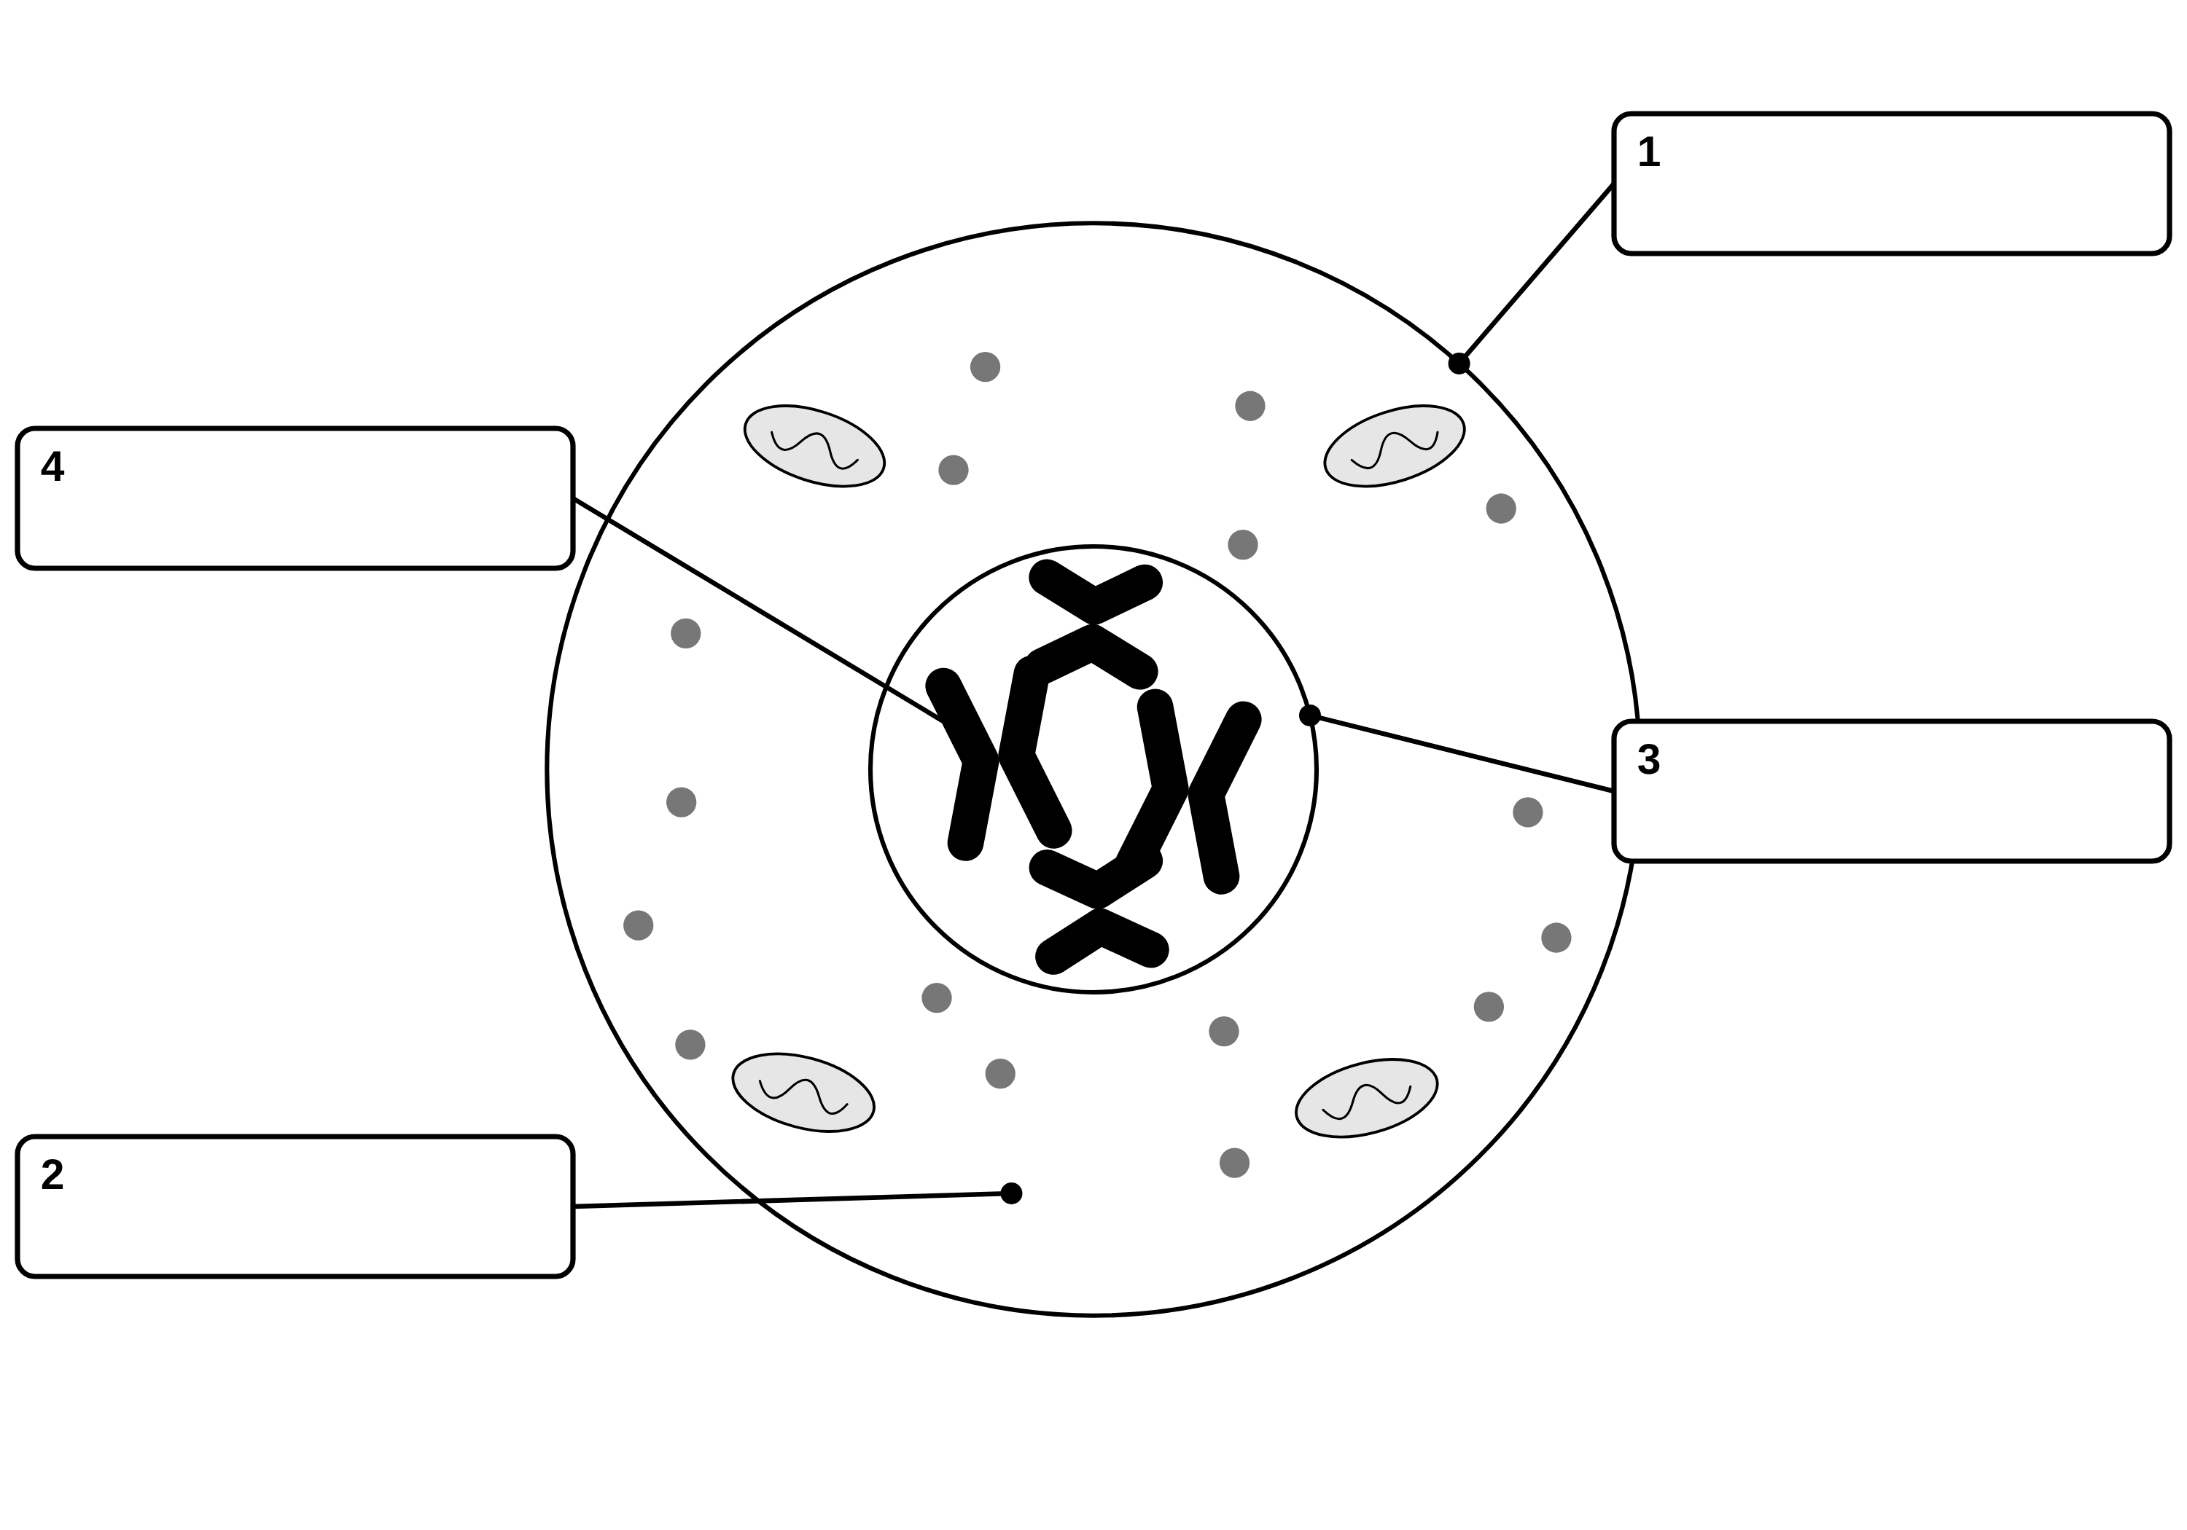
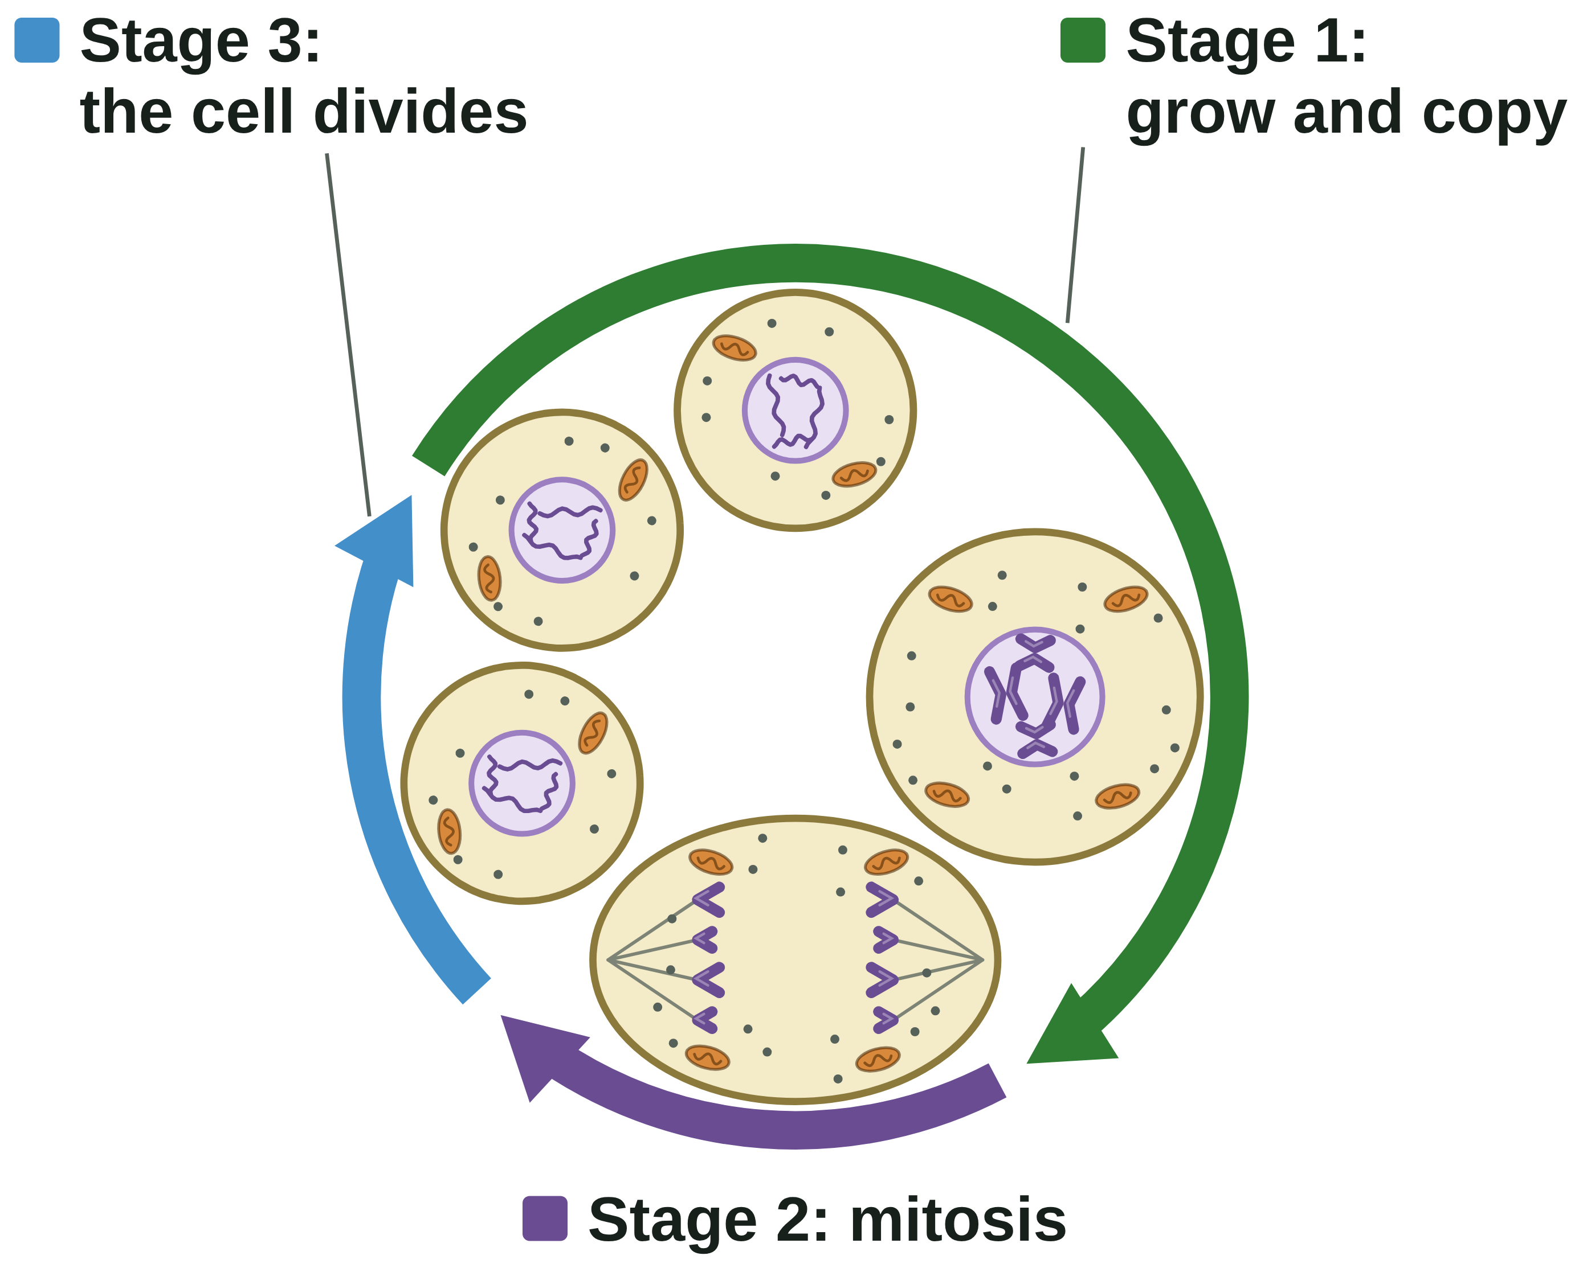
B1 L6 Alternative worksheet: Cell division: mitosis
Page 1 of 2
Name: ______________________________ Class: __________
Key facts
A. Label the cell
[4]
Help: online screens 3 and 4
The nucleus contains chromosomes. Chromosomes are made of DNA.
A gene is a small section of DNA on a chromosome.
A human body cell has 46 chromosomes, in pairs.
Cells divide in a series of stages called the cell cycle.
Stage 1: the cell grows and copies its DNA.
Stage 2: mitosis. One set of chromosomes is pulled to each end. The nucleus divides.
Stage 3: the cytoplasm and cell membrane divide. Now there are two new cells.
The two new cells are genetically identical: they have exactly the same genetic material.
Mitosis is for growth, repair and replacement.
This cell is getting ready to divide. Write a word from the box in each label box.
cell membrane
chromosome
cytoplasm
nucleus
The cell cycle: one cell makes two identical cells.
A diagram is simplified: this model cell has only 4 chromosomes. A human body cell has 46.
Tip: the chromosomes are inside the nucleus.
B1 L6 · Cell division: mitosis · sciencegcse.co.uk · free GCSE science resources

Slide 37
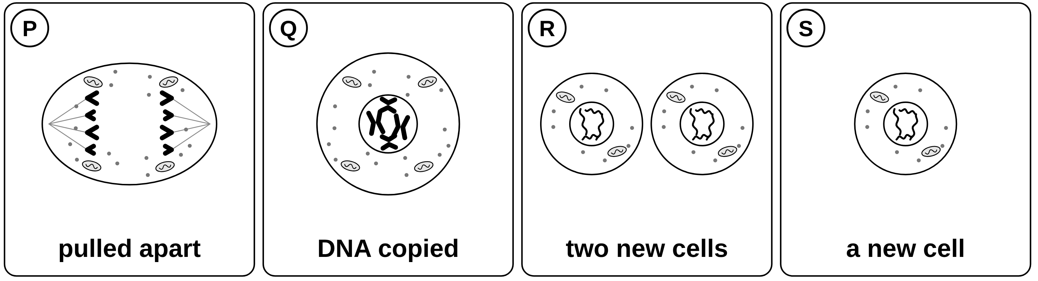
B1 L6 Alternative worksheet: Cell division: mitosis
Page 2 of 2
Name: ______________________________ Class: __________
B. Put the pictures in order
C. Match the word to its meaning
[4]
[4]
Help: online screen 4
Help: online screens 3 and 4
The pictures show one cell going round the cell cycle. Write the letters in order. The first one is a new cell.
Draw a line from each word to its meaning.
chromosome
a small section of DNA on a chromosome
the stage of the cell cycle in which one set of chromosomes is pulled to each end of the cell and the nucleus divides
gene
DNA
a structure in the nucleus, made of DNA, that carries a large number of genes
1st
2nd
3rd
4th
mitosis
the chemical that carries the genetic instructions for a cell
D. Fill the gaps
[6]
Help: online screens 4, 6 and 10
E. True or false?
[7]
Use the words in the box. Use each word once.
Help: online screens 1, 3, 4, 6 and 9
Tick (✓) True or False for each sentence.
copies
grows
identical
repair
two
46
Sentence | True | False
1. Chromosomes are made of DNA.
2. A gene is a small section of DNA.
3. Mitosis makes four new cells.
4. The new cells have half the number of chromosomes.
5. A cell copies its DNA before it divides.
6. Mitosis helps you to grow.
7. Most cells in a root tip are dividing.
1. Before a cell divides, it __________ and makes more ribosomes and mitochondria.
2. The cell __________ its DNA.
3. Mitosis makes __________ new cells.
4. The new cells are genetically __________.
5. A human body cell has __________ chromosomes.
6. Mitosis makes new cells to __________ a cut in the skin.
B1 L6 · Cell division: mitosis · sciencegcse.co.uk · free GCSE science resources

Slide 38
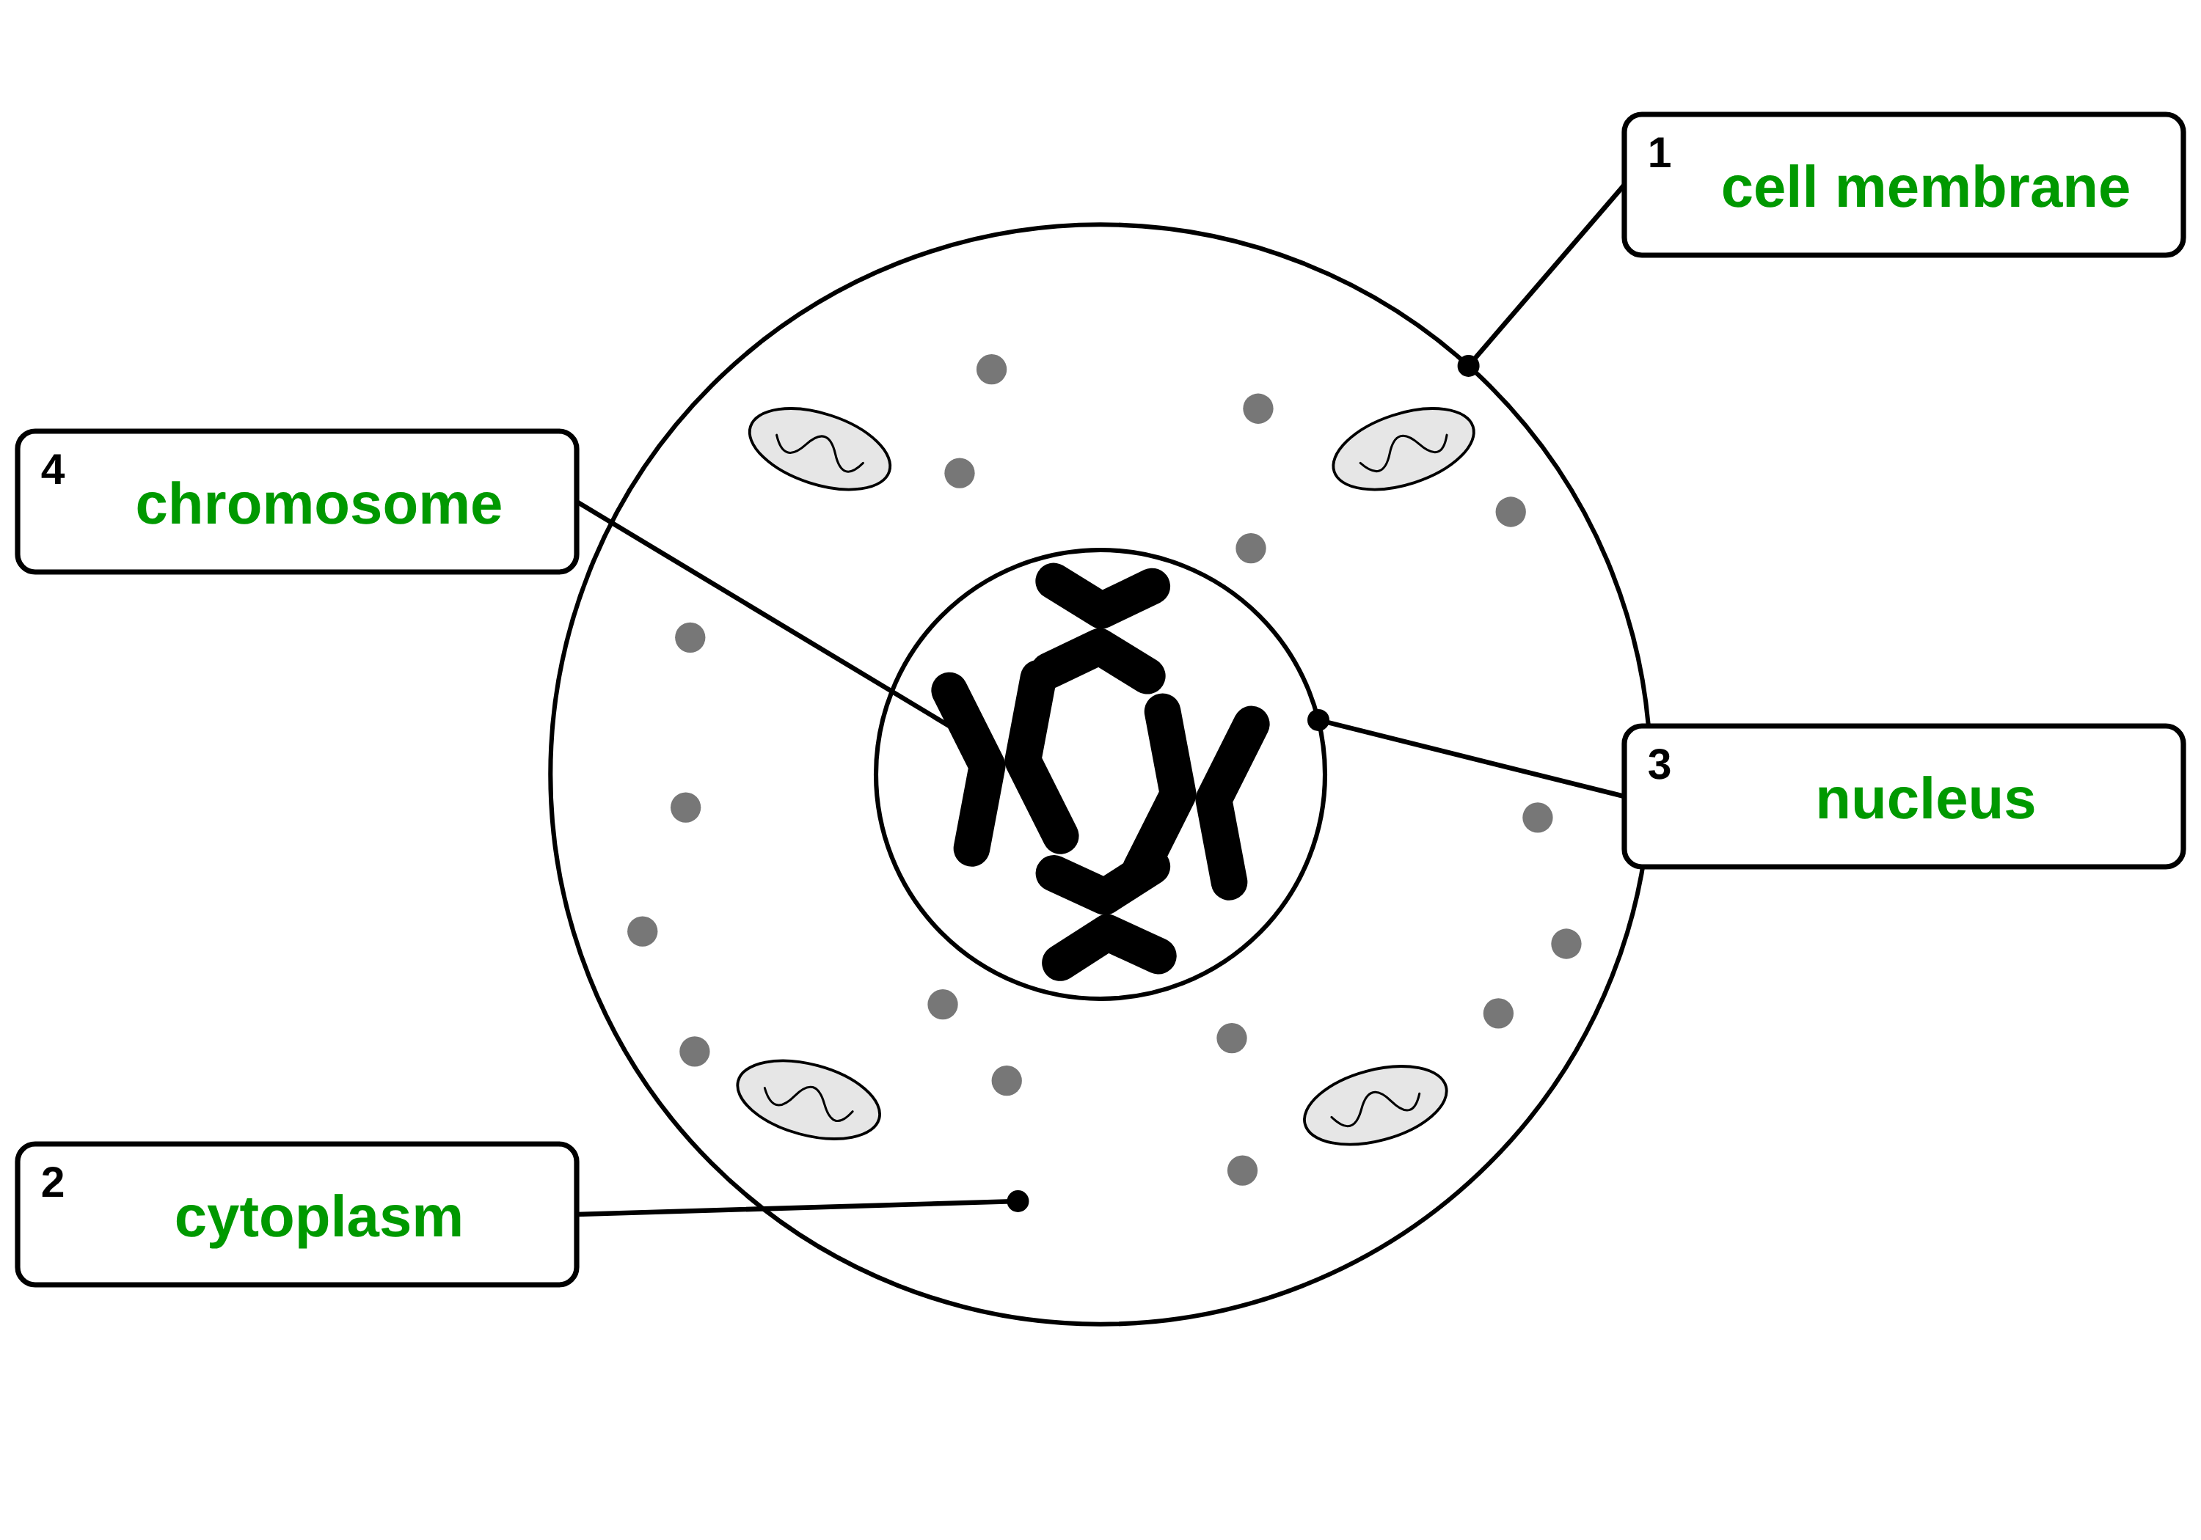
B1 L6 Alternative worksheet answers - page 1
Answers 1 of 2
Key facts
A. Label the cell
[4]
The nucleus contains chromosomes. Chromosomes are made of DNA.
A gene is a small section of DNA on a chromosome.
A human body cell has 46 chromosomes, in pairs.
Cells divide in a series of stages called the cell cycle.
Stage 1: the cell grows and copies its DNA.
Stage 2: mitosis. One set of chromosomes is pulled to each end. The nucleus divides.
Stage 3: the cytoplasm and cell membrane divide. Now there are two new cells.
The two new cells are genetically identical: they have exactly the same genetic material.
Mitosis is for growth, repair and replacement.
This cell is getting ready to divide. Write a word from the box in each label box.
cell membrane
chromosome
cytoplasm
nucleus
1 cell membrane (1); 2 cytoplasm (1); 3 nucleus (1); 4 chromosome (1).
Allow small spelling errors if the word is clear.
The cell cycle: one cell makes two identical cells.
A diagram is simplified: this model cell has only 4 chromosomes. A human body cell has 46.
B1 L6 · Cell division: mitosis · sciencegcse.co.uk · free GCSE science resources

Slide 39
B1 L6 Alternative worksheet answers - page 2
Answers 2 of 2
B. Put the pictures in order
C. Match the word to its meaning
[4]
[4]
1 mark for each letter in the correct place: S, Q, P, R.
1 mark for each correct line.
chromosome
a small section of DNA on a chromosome
the stage of the cell cycle in which one set of chromosomes is pulled to each end of the cell and the nucleus divides
gene
DNA
a structure in the nucleus, made of DNA, that carries a large number of genes
1st
S
2nd
Q
3rd
P
4th
R
mitosis
the chemical that carries the genetic instructions for a cell
D. Fill the gaps
[6]
E. True or false?
Use the words in the box. Use each word once.
[7]
1. Chromosomes are made of DNA. True. (1)
2. A gene is a small section of DNA. True. (1)
3. Mitosis makes four new cells. False. Mitosis makes two new cells. (1)
4. The new cells have half the number of chromosomes. False. They have the same number as the parent cell. (1)
5. A cell copies its DNA before it divides. True. (1)
6. Mitosis helps you to grow. True. (1)
7. Most cells in a root tip are dividing. False. Most cells are not dividing at that moment: many are growing and copying their DNA, ready to divide. (1)
copies
grows
identical
repair
two
46
1. Before a cell divides, it grows (1) and makes more ribosomes and mitochondria.
2. The cell copies (1) its DNA.
3. Mitosis makes two (1) new cells.
4. The new cells are genetically identical (1).
5. A human body cell has 46 (1) chromosomes.
6. Mitosis makes new cells to repair (1) a cut in the skin.
B1 L6 · Cell division: mitosis · sciencegcse.co.uk · free GCSE science resources

Slide 40
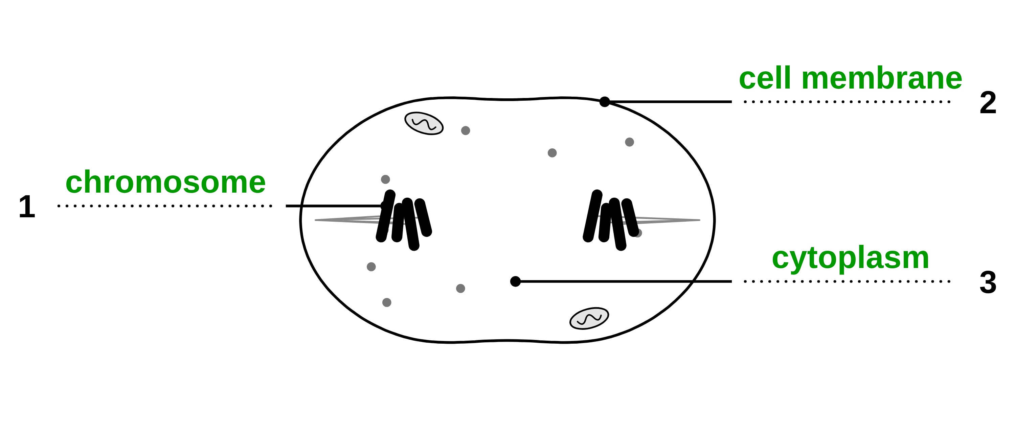
B1 L6 Exam questions worksheet mark scheme - page 1
Answers 1 of 2
01 A cell in mitosis
03 Before mitosis
[4]
[3]
01.1 Complete Figure 1. Choose answers from the box. [3]
1 chromosome (1)
2 cell membrane (1)
3 cytoplasm (1)
1 mark for each correct label. If more than one word from the box is written on one line, do not give that mark. do not accept nucleus for 1 or cell wall for 2
03 Describe what happens to a cell before mitosis starts. [3]
the cell grows (1)
it makes more sub-cellular structures / ribosomes / mitochondria (1)
its DNA replicates / is copied / two copies of each chromosome form (1)
allow "the chromosomes are copied" for the third mark. do not accept "the cell divides" or "the nucleus divides" (that is mitosis). ignore the names of the phases
01.2 What is happening to the cell in Figure 1? [1]
One set of chromosomes is being pulled to each end of the cell (1)
If more than one box is ticked, give 0 marks.
02 Dividing cells in a root
04 DNA in a cell
[4]
[3]
02.1 Calculate the percentage of cells dividing 1 mm from the root tip. [2]
30 ÷ 250 × 100 (1) = 12 % (1)
Correct answer with no working = 2 marks. allow 0.12 for 1 mark. do not accept 833
02.2 Describe the pattern in the results in Table 1. [1]
the further from the root tip, the fewer cells are dividing (1)
allow the reverse. allow "the number of dividing cells goes down as the distance goes up"
02.3 Suggest why very few cells are dividing 5 mm from the root tip. [1]
the cells there are getting longer / are becoming specialised / are differentiating (1)
allow "growth (cell division) happens at the root tip". ignore "they have stopped dividing" on its own (it repeats the question). ignore "they are old"
04.1 At what time did the cell start to copy its DNA? [1]
8 hours (1)
04.2 Explain why the amount of DNA halves at X. [2]
the cell divides (into two) / the cytoplasm and cell membrane divide (1)
one copy of each chromosome goes into each new cell / the copied DNA is shared equally between the two cells (1)
allow "half the DNA goes into each daughter cell" for the second mark. do not accept "half the chromosomes are lost / destroyed"
B1 L6 · Cell division: mitosis · sciencegcse.co.uk · free GCSE science resources

Slide 41
B1 L6 Exam questions worksheet mark scheme - page 2
Answers 2 of 2
05 Extended response
[6]
05 Root tips grow because their cells divide by mitosis. Describe what happens during the cell cycle of a root tip cell. Explain how the cell cycle allows the root to grow. [6]
Level descriptors
Level 3 (5-6 marks): A detailed and coherent answer. All three stages of the cell cycle are described in the correct order, including copying the DNA before mitosis, and growth of the root is clearly explained by more cells being made by mitosis, again and again.
Level 2 (3-4 marks): At least two stages are described correctly, with a simple link to growth, such as "more cells are made". The order or some detail may be missing.
Level 1 (1-2 marks): Simple statements, such as "the cell splits in two" or "the root gets more cells", with little or no link between them.
0 marks: No relevant content.
Model answer (Level 3)
In stage 1, the root tip cell grows and makes more sub-cellular structures, such as ribosomes and mitochondria. Its DNA replicates, so there are two copies of each chromosome. In stage 2, mitosis, the chromosomes line up and one set is pulled to each end of the cell, and the nucleus divides. In stage 3, the cytoplasm and cell membrane divide, making two daughter cells. They are genetically identical, with the same number of chromosomes as the parent cell. The new cells grow and divide again, so the number of cells at the root tip keeps increasing. More cells make the root longer, so the root grows. Further from the tip, the cells stop dividing and get longer.
Indicative content
stage 1: the cell grows
it makes more sub-cellular structures, such as ribosomes and mitochondria
the DNA replicates to form two copies of each chromosome
stage 2, mitosis: the chromosomes line up, and one set of chromosomes is pulled to each end of the cell
the nucleus divides
stage 3: the cytoplasm and cell membrane divide (a new cell wall forms between the cells)
two daughter cells are made, genetically identical to each other and to the parent cell
each new cell has the same number of chromosomes as the parent cell (16 in an onion cell)
the new cells grow and divide again, so the number of cells keeps doubling
more cells make the root longer: growth
cells further from the tip stop dividing, get longer and become specialised
ignore the names of the phases of mitosis; allow "meristem" for the root tip; do not accept "four cells are made"
B1 L6 · Cell division: mitosis · sciencegcse.co.uk · free GCSE science resources

