Slide 1
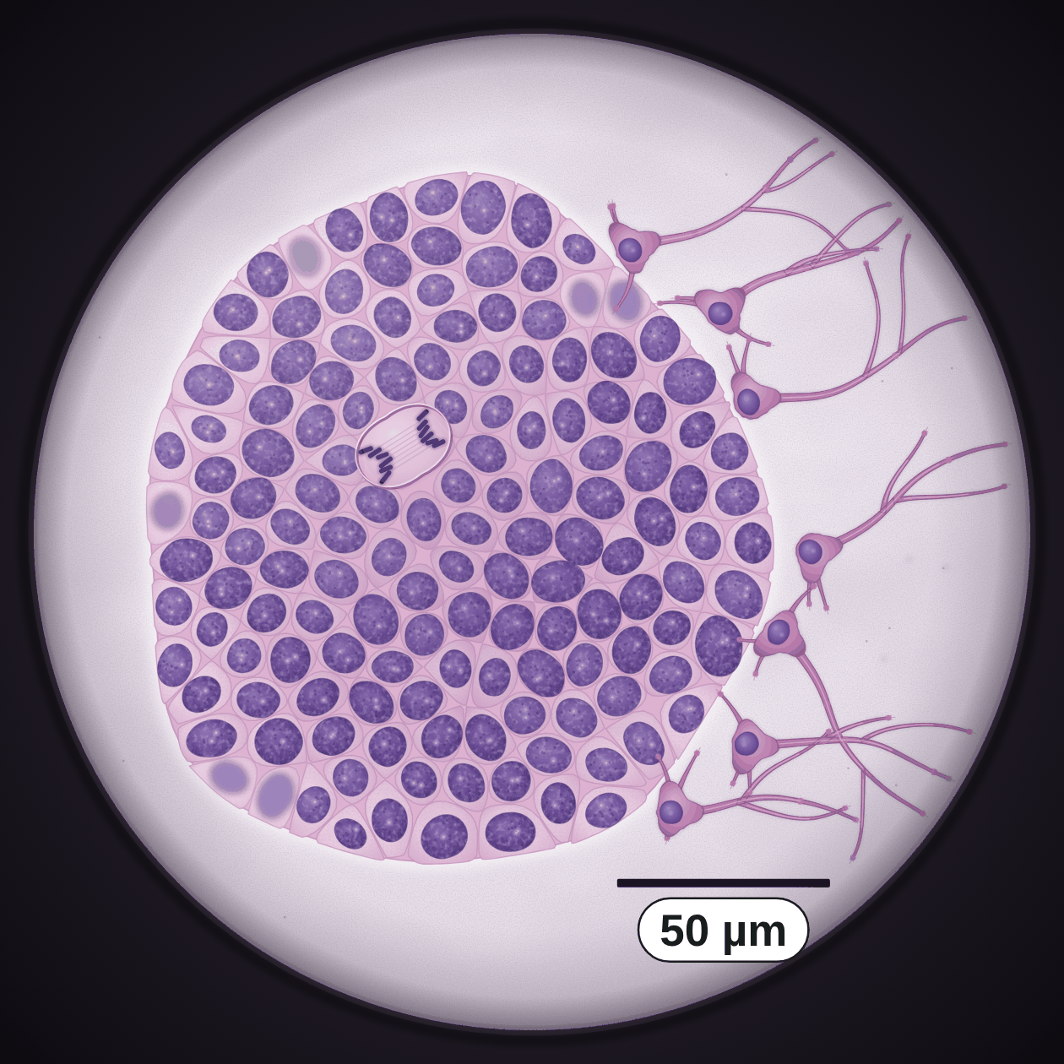
sciencegcse.co.uk · Biology B1 L7
DATE
B1 L7: Stem cells
24/09/2026
DO NOW
KEYWORDS
1. How many cells are made when one cell divides by mitosis?
2. What are chromosomes made of?
3. What is it called when a cell becomes specialised?
Stem cell
Undifferentiated
Embryonic stem cell
Meristem
Therapeutic cloning
A painting based on a light micrograph. Stains colour the cells.
B1 Cell biology
AQA Combined Science
Notes:
Do now: retrieval from B1 L6 (Q1, Q2) and B1 L5 (Q3). Sensitive topic: embryos, and ethical and religious views on stem cells. Keep it factual and balanced, respect every view, and say that anyone with questions can talk to a trusted adult. Picture: a painting based on a light micrograph of stem cells growing in a dish. Most of it is a colony of small, plain cells that all look alike; at the right edge some cells have grown long branches: they have become nerve cells. Ask: what do you notice about most of these cells? (They look the same: small, round, mostly nucleus.) What has happened to the cells at the edge? (They have changed shape: they have become specialised.) Before you teach: this lesson includes embryos, medical conditions, and ethical and religious views. Some students hold strong personal or religious views, and some may live with diabetes, paralysis or a blood disorder such as leukaemia, or have family members who do. Agree ground rules before slide 16: listen, respect every view, disagree with the idea, not the person. Use kind, factual words: 'people with diabetes'; treatments 'may be able to help'. Anyone with questions or worries can talk to a trusted adult: a parent or carer, a teacher, the school nurse or a counsellor. The NHS website has reliable information about stem cells and about donating bone marrow. Timing (60 minutes): slides 1 to 3, 7 minutes; slides 4 to 9, 15 minutes; slides 10 to 13, 9 minutes; slides 14 to 18, 13 minutes; practice and exam practice, slides 19 to 21, 6 minutes; Mandatory worksheet, 5 minutes to start (finish for homework); exit ticket, slides 22 and 23, 5 minutes. Homework: the online lesson quiz and the B1 L7 Exam questions worksheet.

Slide 2
sciencegcse.co.uk · Biology B1 L7: Stem cells
Do now answers and lesson focus
Do now answers
In this lesson
1. Two.
2. DNA.
3. Differentiation.
• Say what a stem cell is, and compare real stem cells with a diagram.
• Describe how stem cells divide and differentiate.
• Describe where stem cells are found: embryos, adult bone marrow and plant meristems.
• Describe how stem cells may be used: medicine, therapeutic cloning and cloning plants.
• Weigh up the benefits, risks and ethical issues.
Key idea
A stem cell is not yet specialised.
It can divide to make more cells, and differentiate into other types of cell.
2
B1 L7 · sciencegcse.co.uk
Notes:
Go through the answers quickly. Q1 and Q2 link to mitosis (B1 L6): stem cells divide by mitosis. Q3 is the key word for today: a stem cell is a cell that has not yet differentiated. Then share the lesson focus. The online lesson (sciencegcse.co.uk, B1 L7) follows the same 12 screens as this PowerPoint, so students can go over it at home. There are three checkpoints along the way.

Slide 3
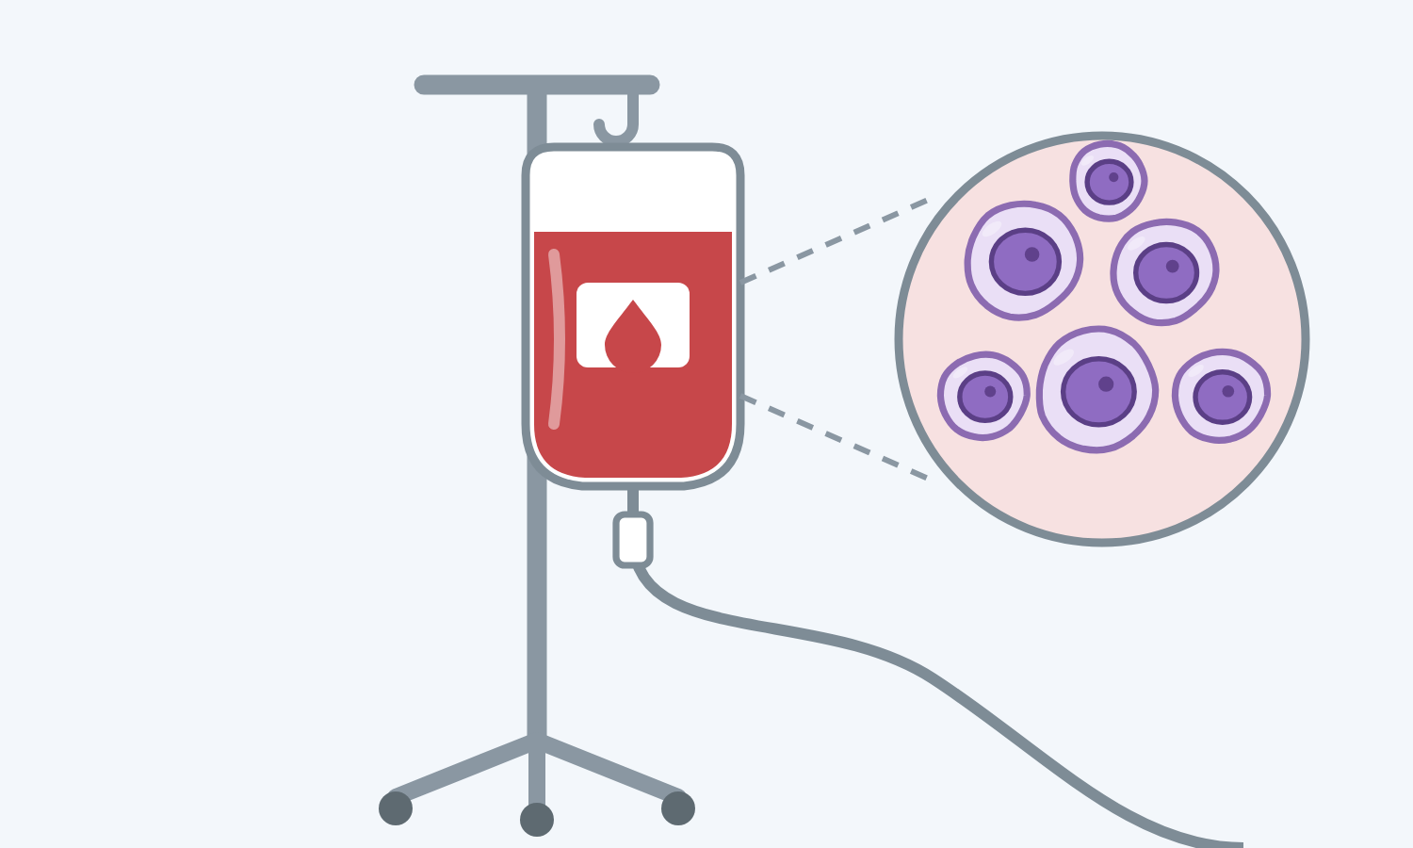
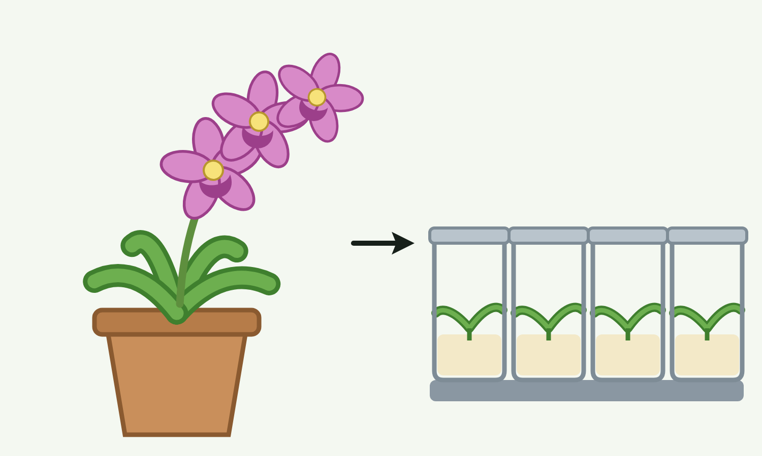
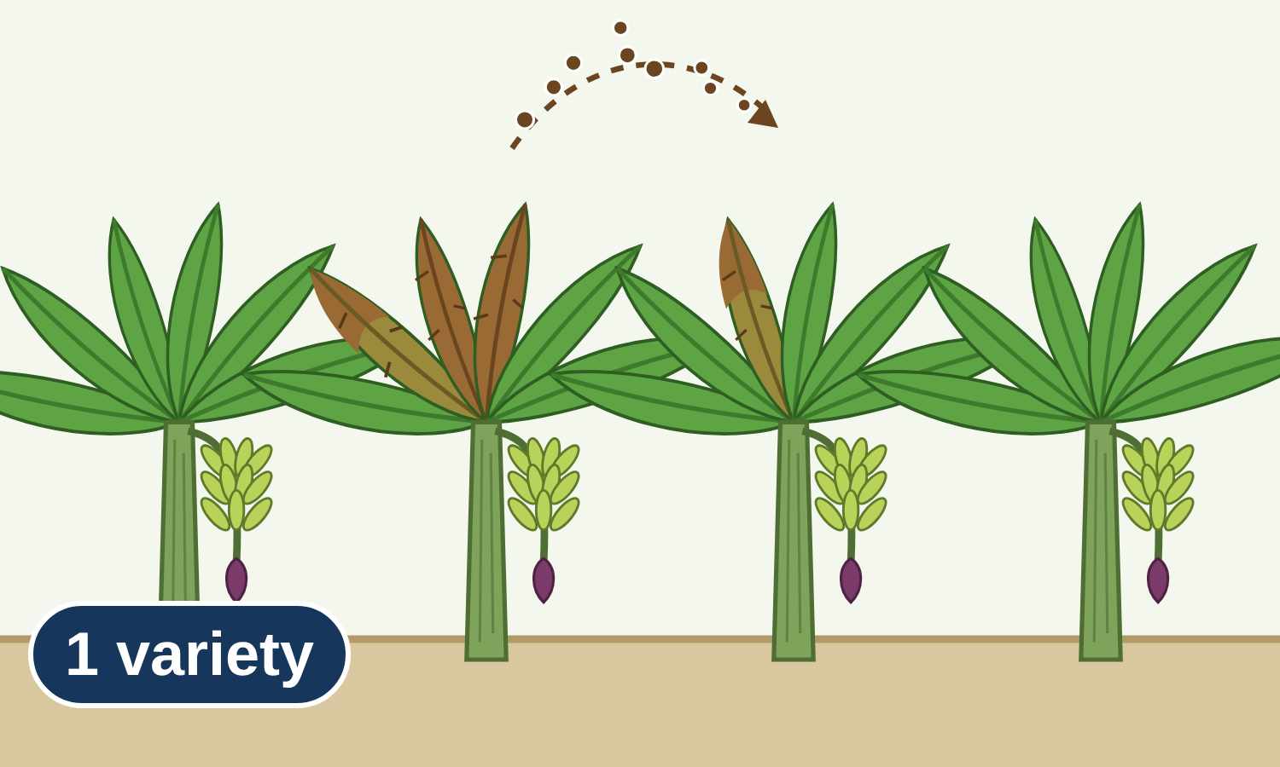
sciencegcse.co.uk · Biology B1 L7: Stem cells
Why this matters in the real world
Stem cells already help some people, and scientists are testing new ways to use them.
Bone marrow transplants
Saving rare plants
Bananas
Stem cells from a donor's bone marrow already help people with some blood disorders, such as leukaemia.
Rare plants can be cloned from meristem cells to protect them from extinction.
These banana plants are clones. A new fungal disease that attacks this variety is spreading on banana farms around the world.
Used now
Plant clones
No variation
3
B1 L7 · sciencegcse.co.uk
Notes:
Hook: one card a click. Ask: what do these three stories have in common? (Stem cells, or cells that can still differentiate.) Bone marrow (and blood stem cell) transplants have been used for decades; donors join a register, and the NHS website explains how. Rare plants: botanic gardens clone rare plants from meristems to grow many from one plant. Bananas: almost all export bananas are one variety (Cavendish), grown as clones. A fungus (Panama disease) that this variety cannot resist is spreading: with no variation, whole farms are at risk. We come back to this on slide 11.

Slide 4
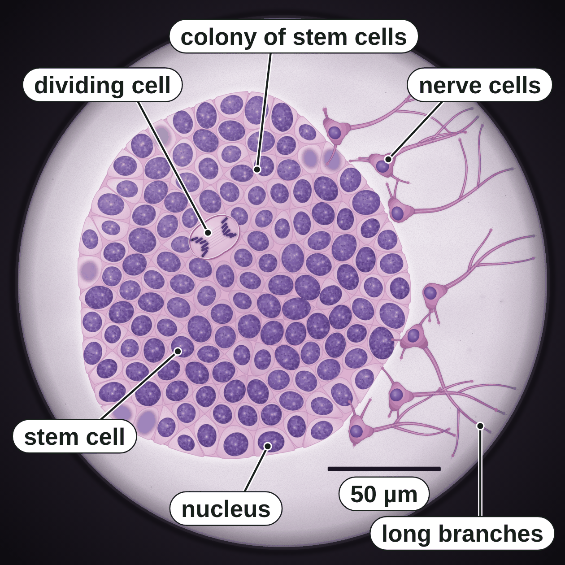
sciencegcse.co.uk · Biology B1 L7: Stem cells
Online lesson: screen 1 of 12
What is a stem cell?
Stem cells in a dish (a painting)
Key facts
A stem cell is undifferentiated: it is not yet specialised for a particular job.
It can divide to make many more cells of the same type.
It can differentiate into certain other types of cell.
Stem cells look plain: a big nucleus, a thin layer of cytoplasm and no special structures.
At the edge of this dish, some stem cells have differentiated into nerve cells.
Not specialised yet, so it can still become other types of cell.
A painting based on a light micrograph. Stains colour the cells.
4
B1 L7 · sciencegcse.co.uk
Notes:
Start with the picture: most cells look the same: small, round, plain, mostly nucleus. Ask: do any of these cells look as if they have a job yet? (No: no tail, no branches, no chloroplasts.) Then point to the right edge: these cells have grown long branches; they have become nerve cells. Undifferentiated means 'not yet specialised'. One cell in the colony is dividing (link to mitosis, B1 L6). The cells are tiny: the scale bar is 50 µm, so each stem cell is about 10 µm across. Avoid calling stem cells 'special cells': they are the opposite, they have not specialised yet. Clicks: one key fact a click. The picture is the painting on screen 1 of the online lesson (labels on).

Slide 5
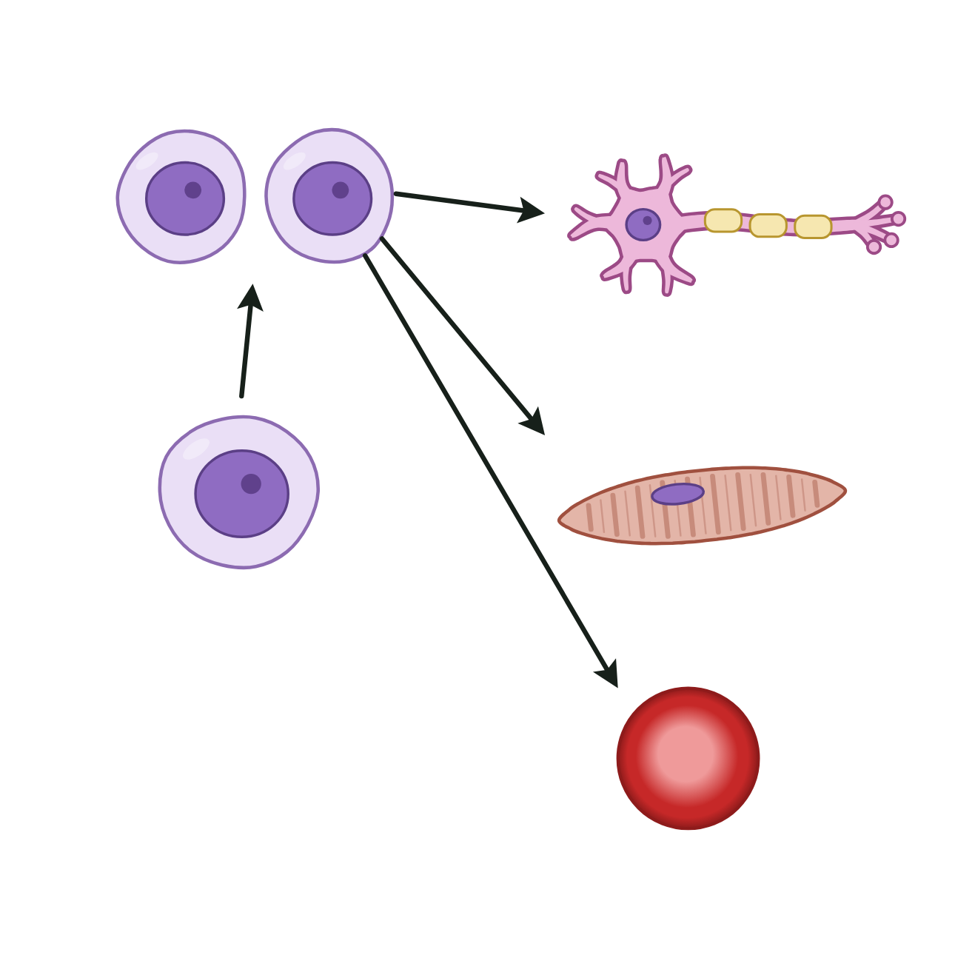
sciencegcse.co.uk · Biology B1 L7: Stem cells
Online lesson: screen 2 of 12
Real stem cells and a diagram
Same thing, two ways
Spot the differences
1
Plain cells: Real stem cells all look alike: small and plain, mostly nucleus, with no special structures. The diagram draws each type of cell with its own shape and colour.
2
3
2
A colony: Real stem cells grow packed together in a colony of hundreds of cells. The diagram shows one stem cell, then two.
3
2
3
Branches: At the edge of the dish, some cells have differentiated into nerve cells: they grow long, thin branches. The diagram draws a finished nerve cell at the end of an arrow.
1
1
4
4
5
4
Colour: Stains colour the real cells: purple nuclei and pale pink-purple cells. Without stains they are almost colourless. The diagram's colours only show the types of cell.
5
Stem cells in a dish (a painting)
A diagram
5
Size: Real stem cells are tiny: about 10 µm across (the scale bar is 50 µm). The diagram draws every cell big, so you can see it.
Stem cells look plain: they have not yet developed the structures of a specialised cell. The painting's colours are stains; in the diagram, colours show the types of cell.
Both show plain, undifferentiated stem cells, and nerve cells that differentiated from them.
5
B1 L7 · sciencegcse.co.uk
Notes:
Cover the right panel and ask: what is different between the painting and the diagram? Take ideas, then reveal the five differences: each click shows one difference and puts its number on both pictures; the last click shows what is the same in both. Key message: a diagram is simplified on purpose. It shows one stem cell and the cells it can become, all drawn big. Real stem cells grow in a colony and all look the same, because they have not specialised yet. The painting's colours are stains; real cells are almost colourless. The nerve cells at the edge differentiated from stem cells in this same dish. The online lesson, screen 2, has the same pictures and differences.

Slide 6
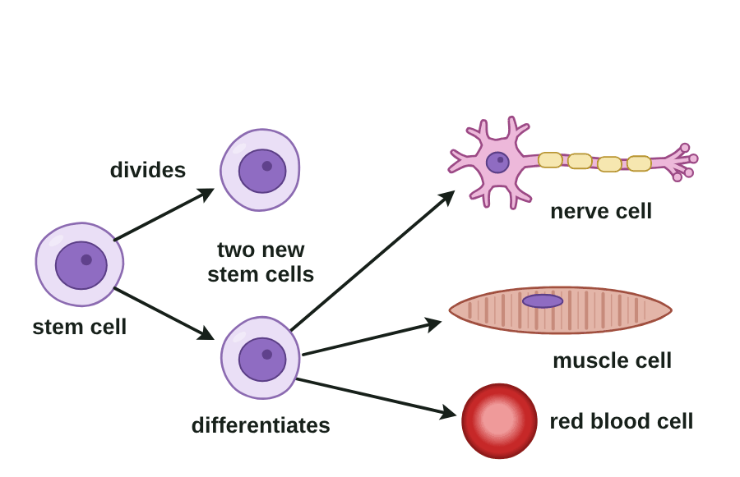
sciencegcse.co.uk · Biology B1 L7: Stem cells
Online lesson: screen 3 of 12
Divide and differentiate
From one stem cell
Step by step
1
A stem cell: plain, with a big nucleus.
2
Divide: mitosis makes two identical stem cells.
3
Stay: some stay as stem cells, to divide again.
4
Differentiate: others gain the structures they need for one job.
5
Specialised: a nerve cell, a muscle cell, a red blood cell.
Division makes more cells. Differentiation changes what a cell can do.
▶ Online lesson, screen 3: Divide and differentiate
Press Next step. At each step, say: is the cell dividing or differentiating?
6
B1 L7 · sciencegcse.co.uk
Notes:
Run screen 3 online, one step at a time. At each step ask: dividing or differentiating? Steps 2 and 3 are division (mitosis, B1 L6): the cells stay plain and identical. Step 4 is differentiation (B1 L5): the cells change shape and gain sub-cellular structures. A common mistake is 'the stem cell divides into a nerve cell': it divides into stem cells, and some of them then differentiate. Stem cells from embryos can be cloned (grown into many identical cells) and made to differentiate in a lab. Clicks: one step a click, then the green line. (The picture is an animated GIF: it moves when the slide show runs; print and PDF show its first frame.) The GIF runs the same five steps as the step-by-step screen of the online lesson.

Slide 7
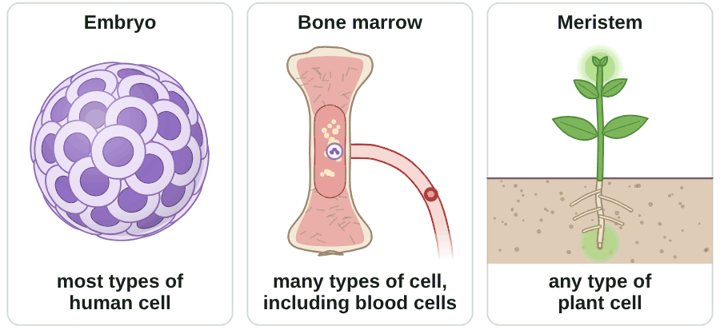
sciencegcse.co.uk · Biology B1 L7: Stem cells
Online lesson: screen 4 of 12
Where stem cells are found
Three sources
Key facts
Embryo: its stem cells make all the cells of the body as it grows. In a lab, they can be made to differentiate into most types of human cell.
Adult bone marrow: stem cells can form many types of cell, including blood cells. They replace cells that wear out.
Meristem (tips of roots and shoots): cells can differentiate into any type of plant cell, throughout the life of the plant.
Adult stem cells form fewer types of cell than embryonic stem cells.
Most, many, any: embryo, adult, plant.
▶ Online lesson, screen 4: Where stem cells are found
Tap each chip. Most, many or any: which word goes with each source?
7
B1 L7 · sciencegcse.co.uk
Notes:
Function of stem cells: in an embryo, they make all the cells of the body as it develops; in an adult they repair and replace cells (for example, bone marrow makes blood cells); in a plant, meristems make new cells so the plant keeps growing all through its life. Most animal cells lose the ability to differentiate early (B1 L5); many plant cells keep it. An early human embryo at about 5 days is a ball of about 100 to 200 cells, about 0.1 to 0.2 mm across. Keep to the three AQA words: most (embryo), many (adult bone marrow), any (meristem). Clicks: one key fact a click. (The picture is an animated GIF: it moves when the slide show runs; print and PDF show its first frame.) Each panel lights up in turn, as the chips do on the online lesson, screen 4.

Slide 8
sciencegcse.co.uk · Biology B1 L7: Stem cells
Online lesson: screen 5 of 12
Checkpoint 1
✓
CHECKPOINT 1 of 3
Quick check on slides 4 to 7 (online screens 1 to 4). Show A, B or C on your whiteboard.
Question 1
Question 2
Question 3
Which of these describes a stem cell?
A stem cell divides by mitosis. What does it make?
Which stem cells can differentiate into any type of plant cell, all through the plant's life?
A. A specialised cell with one job
A. Two genetically identical stem cells
A. Adult bone marrow stem cells
B. A cell that can no longer divide
B. Two specialised cells
B. Meristem cells
C. An undifferentiated cell that can divide and differentiate into other types of cell
C. One bigger stem cell
C. Embryonic stem cells
✓ Check your answers on the next slide
8
B1 L7 · sciencegcse.co.uk
Notes:
Checkpoint 1: a hinge check. Everyone writes A, B or C for each question on a mini whiteboard and shows on 3, 2, 1, all at the same time. What each wrong option tests: Q1 A is the 'special cell' mistake (a stem cell is the opposite: not yet specialised); Q2 B mixes up dividing and differentiating; Q3 A and C mix up most, many and any (embryonic stem cells: most types of human cell; adult bone marrow: many types; meristems: any type of plant cell). If several get Q1 wrong, go back to slide 4; Q2, slide 6; Q3, slide 7.

Slide 9
sciencegcse.co.uk · Biology B1 L7: Stem cells
Online lesson: screen 5 of 12
Checkpoint 1 answers
✓
CHECKPOINT 1 of 3
Quick check on slides 4 to 7 (online screens 1 to 4). Show A, B or C on your whiteboard.
Question 1
Question 2
Question 3
Which of these describes a stem cell?
A stem cell divides by mitosis. What does it make?
Which stem cells can differentiate into any type of plant cell, all through the plant's life?
A. A specialised cell with one job
A. Two genetically identical stem cells
A. Two genetically identical stem cells ✓
A. Adult bone marrow stem cells
B. A cell that can no longer divide
B. Two specialised cells
B. Meristem cells
B. Meristem cells ✓
C. An undifferentiated cell that can divide and differentiate into other types of cell
C. An undifferentiated cell that can divide and differentiate into other types of cell ✓
C. One bigger stem cell
C. Embryonic stem cells
It is not yet specialised, so it can become other types of cell.
Mitosis makes two identical cells. Differentiation is a separate step.
Meristems are at the tips of roots and shoots.
Got one wrong? Look back: Q1 slide 4 · Q2 slide 6 · Q3 slide 7
9
B1 L7 · sciencegcse.co.uk
Notes:
1 C, 2 A, 3 B. Each click shows one answer and why. Ask a student who got it right to explain why. Q2: dividing makes more cells; differentiating changes them. Follow-up for Q3: which word goes with embryonic stem cells? (Most types of human cell.)

Slide 10
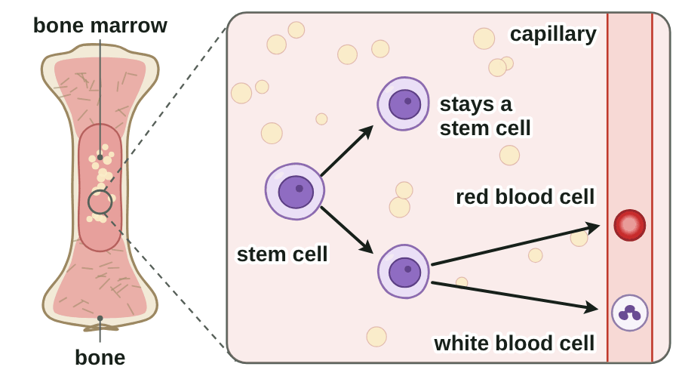
sciencegcse.co.uk · Biology B1 L7: Stem cells
Online lesson: screen 6 of 12
Bone marrow makes new blood cells
Inside a bone
Key facts
Adult stem cells repair the body and replace cells that wear out.
Bone marrow is the soft tissue inside some bones, where blood cells are made.
Its stem cells divide all the time. Some new cells differentiate into red blood cells or white blood cells.
A red blood cell lasts only about 120 days. Your bone marrow makes about 2 million new ones every second.
A bone marrow transplant from a donor already helps people with some blood disorders, such as leukaemia.
▶ Online lesson, screen 6: Bone marrow makes new blood cells
Watch one stem cell. Which new cell stays a stem cell?
10
B1 L7 · sciencegcse.co.uk
Notes:
Bone marrow transplants are the stem cell treatment used most now. A donor gives healthy bone marrow stem cells (today they are often collected from the donor's blood). In the patient, these stem cells divide and differentiate into healthy blood cells. The donor must be a good match, or the cells may be rejected by the patient's body. Leukaemia is a cancer of the blood: some students may know someone who has had it, so keep it calm and factual. Anyone can find out about donating on the NHS website. Ask: which new cell stays a stem cell? (One of the two new cells, each time: so the supply never runs out.) Clicks: one key fact a click. (The picture is an animated GIF: it moves when the slide show runs; print and PDF show its first frame.) The GIF shows one loop making a red blood cell, then one making a white blood cell, as on the online lesson, screen 6.

Slide 11
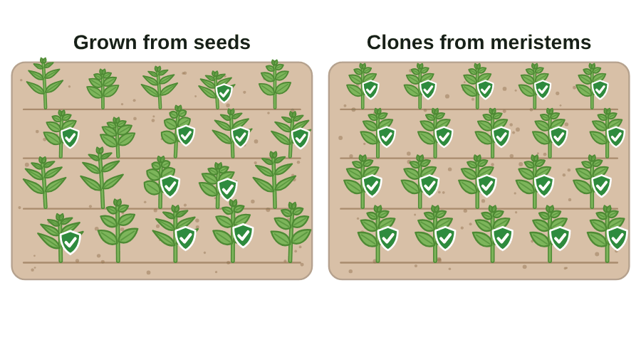
sciencegcse.co.uk · Biology B1 L7: Stem cells
Online lesson: screen 7 of 12
Cloning plants from meristems
Seeds or clones?
Key facts
Meristem cells can clone plants quickly and economically.
The clones are genetically identical, so they all have the parent's useful features.
Rare plants are cloned to save them from extinction; crops are cloned for features such as disease resistance.
Plants grown from one parent plant in one year (example data, not real)
Method
Plants grown
With the useful feature
Affected by a new disease
Seeds
400
200 (50 %)
120 (30 %)
Clones from meristems
10 000
10 000 (100 %)
10 000 (100 %)
Seeds: 200 ÷ 400 × 100 = 50 % have the useful feature.
▶ Online lesson, screen 7: Cloning plants from meristems
Press Grow the plants, then A new disease arrives. Which field does better?
Watch out: Clones have no variation. If a new disease can attack one, it can attack them all.
11
B1 L7 · sciencegcse.co.uk
Notes:
Percentage = number with the feature ÷ total number × 100. Work the seed line together, then ask for the percentage of seed plants affected by the new disease (120 ÷ 400 × 100 = 30 %). Cloning is quick and cheap because each tiny piece of meristem can grow into a whole plant, and the clones keep the parent's features. The downside is no variation: one new disease could wipe out a whole crop (bananas, slide 3). The name of the lab method is not needed. The green shield means the plant resists an old disease; the new disease is a different one. Clicks: key facts 1 to 3, then the table, then the worked line, then the Watch out box. (The picture is an animated GIF: it moves when the slide show runs; print and PDF show its first frame.) The GIF: one parent plant; its shoot tip (meristem) grows into identical plantlets; the two fields grow; a new disease arrives.

Slide 12
sciencegcse.co.uk · Biology B1 L7: Stem cells
Online lesson: screen 8 of 12
Checkpoint 2
✓
CHECKPOINT 2 of 3
Quick check on slides 10 and 11 (online screens 6 and 7). Show A, B or C on your whiteboard.
Question 1
Question 2
Question 3
What do stem cells in adult bone marrow do?
Which treatment using stem cells is already used to treat some blood disorders, such as leukaemia?
A farmer grows 500 cloned plants of one crop variety. A new disease arrives that this variety cannot resist. What is most likely to happen?
A. They make new blood cells to replace old ones.
A. A blood test
A. About half of the plants will be affected.
B. They can become any type of human cell.
B. A bone marrow transplant
B. None of the plants will be affected, because clones are strong.
C. They stop dividing once a person is an adult.
C. Cloning meristem cells
C. All the plants are likely to be affected.
✓ Check your answers on the next slide
12
B1 L7 · sciencegcse.co.uk
Notes:
Checkpoint 2: a hinge check. Mini whiteboards: A, B or C, shown all at the same time. Listen for: Q1 B (adult stem cells form many types of cell, not any); Q2 C (meristems are in plants); Q3 B (clones are not stronger: they all have the same genes). If several get Q1 or Q2 wrong, go back to slide 10; Q3, slide 11.

Slide 13
sciencegcse.co.uk · Biology B1 L7: Stem cells
Online lesson: screen 8 of 12
Checkpoint 2 answers
✓
CHECKPOINT 2 of 3
Quick check on slides 10 and 11 (online screens 6 and 7). Show A, B or C on your whiteboard.
Question 1
Question 2
Question 3
What do stem cells in adult bone marrow do?
Which treatment using stem cells is already used to treat some blood disorders, such as leukaemia?
A farmer grows 500 cloned plants of one crop variety. A new disease arrives that this variety cannot resist. What is most likely to happen?
A. They make new blood cells to replace old ones.
A. They make new blood cells to replace old ones. ✓
A. A blood test
A. About half of the plants will be affected.
B. They can become any type of human cell.
B. A bone marrow transplant
B. A bone marrow transplant ✓
B. None of the plants will be affected, because clones are strong.
C. They stop dividing once a person is an adult.
C. Cloning meristem cells
C. All the plants are likely to be affected.
C. All the plants are likely to be affected. ✓
They divide all through life, and some new cells become blood cells.
Stem cells from a donor's bone marrow make healthy blood cells.
The clones are genetically identical, so if one cannot resist the disease, none can.
Got one wrong? Look back: Q1 and Q2 slide 10 · Q3 slide 11
13
B1 L7 · sciencegcse.co.uk
Notes:
1 A, 2 B, 3 C. Each click shows one answer and why. Q3: no variation is the key idea; ask why plants grown from seed would do better. (They vary, so some may be able to resist the new disease.)

Slide 14
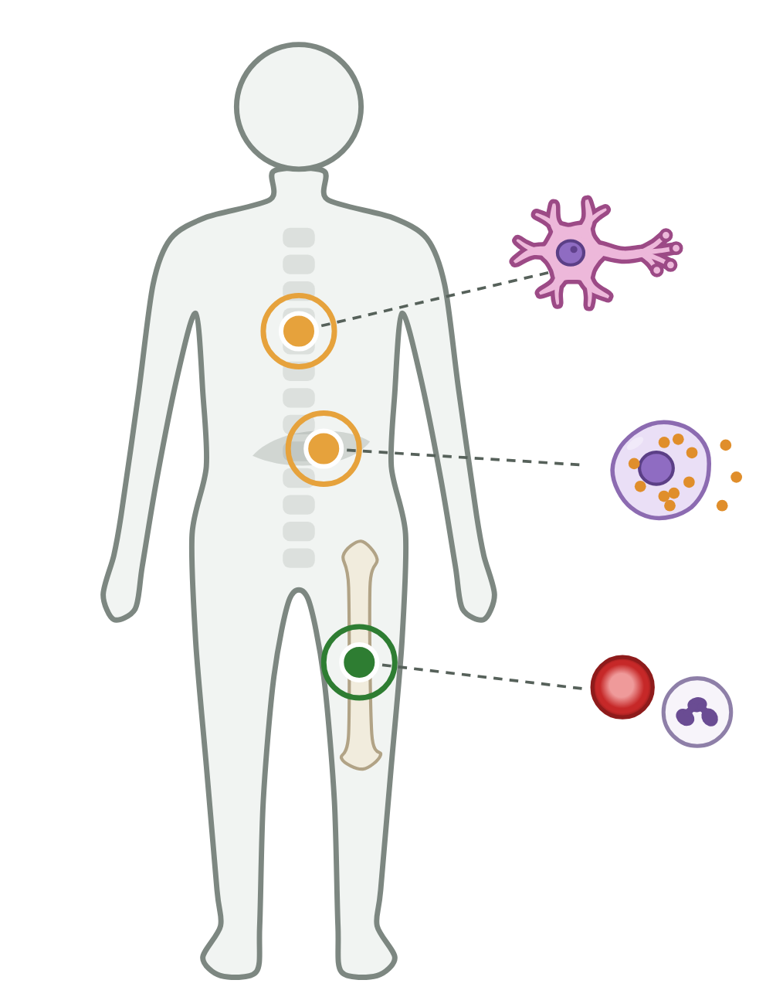
sciencegcse.co.uk · Biology B1 L7: Stem cells
Online lesson: screen 9 of 12
Stem cells in medicine
Possible treatments
Key facts
Paralysis
Stem cells could be made to differentiate into the cells a patient needs.
Used now: bone marrow transplants for some blood disorders, such as leukaemia.
Being researched: new cells for people with diabetes, and new nerve cells for people with paralysis.
A new treatment needs many years of tests to check it is safe and that it works.
Say stem cells may be able to help. Most treatments are not yet cures.
New nerve cells to repair damaged nerves
Being researched
Diabetes
New cells that make insulin, a hormone that controls blood sugar
Being researched
Blood disorders, such as leukaemia
New blood cells from a donor's bone marrow stem cells
Used now
14
B1 L7 · sciencegcse.co.uk
Notes:
Students may live with diabetes, or have family members with diabetes, paralysis or a blood disorder: keep it factual and hopeful but honest. Some stem cell treatments are in trials; most are not yet available. Headlines sometimes say 'cure': ask students to spot the difference between 'may be able to help' and 'cures'. How insulin works is in B5 Homeostasis and response. The outline shows where each treatment would act: the bone marrow in the thigh bone (green: used now), the pancreas (amber) and the nerves in the spine (amber), each with the cells it would need. Clicks: the three rows (blood disorders, diabetes, paralysis), then the five key facts. On the online lesson, screen 9, tapping a row lights its marker.

Slide 15
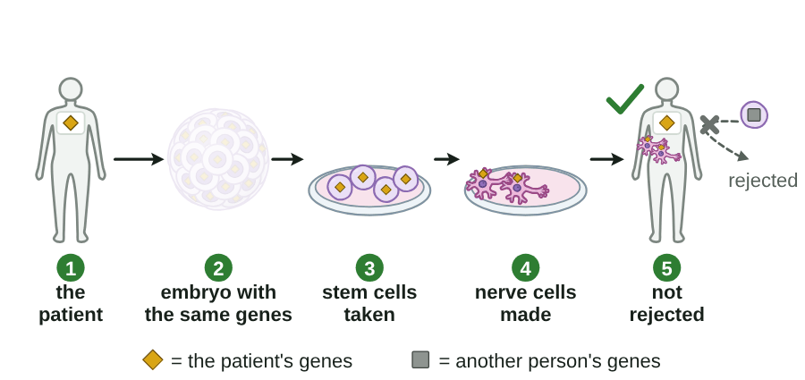
sciencegcse.co.uk · Biology B1 L7: Stem cells
Online lesson: screen 10 of 12
Therapeutic cloning
Same genes, not rejected
Step by step
1
The patient needs new cells.
2
An embryo is produced with the same genes as the patient.
3
Its stem cells are taken. This destroys the embryo.
4
The stem cells are made to differentiate into the cells needed.
5
The new cells have the same genes, so they are not rejected by the patient's body.
▶ Online lesson, screen 10: Therapeutic cloning
Press Next step. Why are the new cells not rejected?
Therapeutic cloning makes an embryo for its stem cells, never a baby.
15
B1 L7 · sciencegcse.co.uk
Notes:
No technique is needed for AQA: just 'an embryo is produced with the same genes as the patient'. The key link: same genes, so not rejected. Stem cells from someone else, even a well-matched donor, may be rejected. The embryo is a tiny ball of cells; in the UK, research on embryos is licensed and allowed only up to 14 days. Therapeutic cloning is still at the research stage: it is not yet used to treat patients. It does not remove every risk: cells grown in a lab could still carry a virus or divide out of control. In the GIF, ◆ = the patient's genes and ■ = another person's genes. Clicks: each step wipes in from the left, then the green line. (The picture is an animated GIF: it moves when the slide show runs; print and PDF show its first frame.) The online lesson, screen 10, has the same five steps with Next step.

Slide 16
sciencegcse.co.uk · Biology B1 L7: Stem cells
Online lesson: screen 11 of 12
Benefits, risks and views
Benefits and risks
Ethical and religious views
Benefits
Risks
An ethical issue is a question about whether something is morally right or wrong.
Taking stem cells from an embryo destroys the embryo.
Some people, including some religious groups, believe an early embryo should have the same right to life as a person.
Others think helping patients matters more, especially when spare embryos would not be used anyway.
In the UK, research embryos are usually spare embryos from fertility treatment, given with consent. Research is allowed only up to 14 days.
Give both sides fairly, then your own reasoned view.
May help people with diabetes or paralysis
A virus could be passed on with the cells
Cells made by therapeutic cloning are not rejected
Cells might divide out of control and form a tumour
Helps scientists find out how diseases develop
Treatments are new, and long-term effects are not yet known
16
B1 L7 · sciencegcse.co.uk
Notes:
Set ground rules first: listen, respect every view, and disagree with the idea, not the person. Do not ask students to share their own religious beliefs. A risk is something that could go wrong (practical); an ethical issue is about right and wrong. Many religious groups hold a range of views. Students who want to talk more can speak to a trusted adult. Practice for the 6-mark evaluate question: benefits, risks, ethical issues, then a conclusion with a reason. Clicks: the three table rows, then the six lines. On the online lesson, screen 11, students sort nine cards into Benefit, Risk and View.

Slide 17
sciencegcse.co.uk · Biology B1 L7: Stem cells
Online lesson: screen 12 of 12
Checkpoint 3
✓
CHECKPOINT 3 of 3
Quick check on slides 14 to 16 (online screens 9 to 11). Show A, B or C on your whiteboard.
Question 1
Question 2
Question 3
Which statement about stem cells and paralysis is correct?
In therapeutic cloning, why are the new cells not rejected by the patient's body?
Which of these is a risk of using stem cells in medicine?
A. Stem cells are already used to cure paralysis.
A. Because they are stem cells
A. A virus could be passed to the patient with the cells.
B. New nerve cells made from stem cells may be able to repair damage.
B. Because they are very young cells
B. Some religious groups object to using embryos.
C. Stem cells cannot become nerve cells.
C. Because they have the same genes as the patient
C. The cells could replace damaged cells.
✓ Check your answers on the next slide
17
B1 L7 · sciencegcse.co.uk
Notes:
Checkpoint 3: a hinge check. Mini whiteboards: A, B or C, shown all at the same time. Listen for: Q1 A (treatments for paralysis are being researched: they are not yet a cure); Q2 A and B (it is the genes that matter, not that they are stem cells or young); Q3 B (a view, not a risk) and C (a benefit). If several get Q1 wrong, go back to slide 14; Q2, slide 15; Q3, slide 16.

Slide 18
sciencegcse.co.uk · Biology B1 L7: Stem cells
Online lesson: screen 12 of 12
Checkpoint 3 answers
✓
CHECKPOINT 3 of 3
Quick check on slides 14 to 16 (online screens 9 to 11). Show A, B or C on your whiteboard.
Question 1
Question 2
Question 3
Which statement about stem cells and paralysis is correct?
In therapeutic cloning, why are the new cells not rejected by the patient's body?
Which of these is a risk of using stem cells in medicine?
A. Stem cells are already used to cure paralysis.
A. Because they are stem cells
A. A virus could be passed to the patient with the cells.
A. A virus could be passed to the patient with the cells. ✓
B. New nerve cells made from stem cells may be able to repair damage.
B. New nerve cells made from stem cells may be able to repair damage. ✓
B. Because they are very young cells
B. Some religious groups object to using embryos.
C. Stem cells cannot become nerve cells.
C. Because they have the same genes as the patient
C. Because they have the same genes as the patient ✓
C. The cells could replace damaged cells.
This is being researched now.
The embryo is produced with the same genes as the patient.
This is a practical risk.
Got one wrong? Look back: Q1 slide 14 · Q2 slide 15 · Q3 slide 16
18
B1 L7 · sciencegcse.co.uk
Notes:
1 B, 2 C, 3 A. Each click shows one answer and why. Q3: ask students to sort the two wrong answers: B is a view, C is a benefit. Next: practise the journey from stem cell to specialised cell.

Slide 19
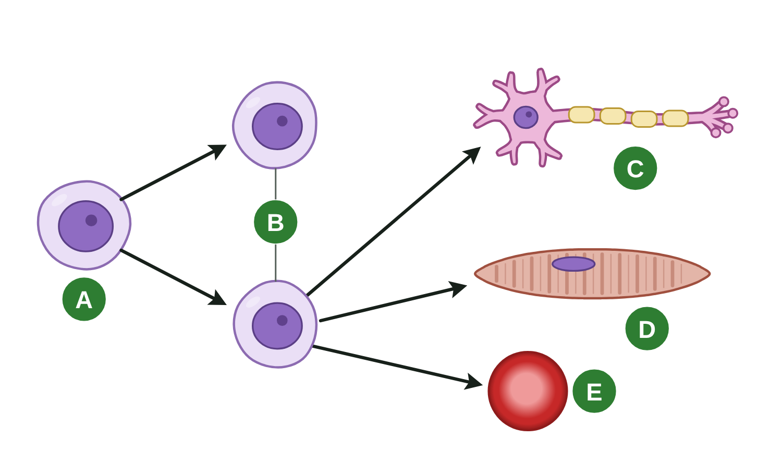
sciencegcse.co.uk · Biology B1 L7: Stem cells
Practice: from stem cell to specialised cell
Stem cell to specialised cell
Questions
1. Which letter shows the stem cell that all the other cells came from?
______________
2. Cells B are genetically identical to cell A. Name the type of cell division that made them.
______________
3. Which letters show specialised cells?
______________
4. Name the process that turned stem cells into cells C, D and E.
______________
5. Cell C carries electrical impulses. Name cell C.
______________
6. In an adult, where are the stem cells that make cells like E?
______________
19
B1 L7 · sciencegcse.co.uk
Notes:
Students answer on whiteboards or in books, in pairs, 4 minutes. The letters follow the arrows. Q2 and Q4: dividing and differentiating are two different processes.

Slide 20
sciencegcse.co.uk · Biology B1 L7: Stem cells
From stem cell to specialised cell: answers
Stem cell to specialised cell
Answers
1. Which letter shows the stem cell that all the other cells came from?
A
2. Cells B are genetically identical to cell A. Name the type of cell division that made them.
Mitosis.
3. Which letters show specialised cells?
C, D and E.
4. Name the process that turned stem cells into cells C, D and E.
Differentiation.
5. Cell C carries electrical impulses. Name cell C.
A nerve cell.
6. In an adult, where are the stem cells that make cells like E?
In the bone marrow.
20
B1 L7 · sciencegcse.co.uk
Notes:
Q3: B are still stem cells (plain, undifferentiated). Q6: bone marrow stem cells make red and white blood cells all through life. Common errors: 'differentiation' for Q2 and 'mitosis' for Q4.

Slide 21
sciencegcse.co.uk · Biology B1 L7: Stem cells
Exam practice
1. Describe two differences between embryonic stem cells and adult stem cells from bone marrow. [2]
Embryonic stem cells can differentiate into most types of human cell; adult stem cells from bone marrow can form fewer types, such as blood cells (1). Treatments with adult bone marrow stem cells are used now (bone marrow transplants); treatments with embryonic stem cells are still being researched (1).
2. Describe the function of stem cells in an embryo, in an adult and in the meristems of a plant. [3]
In an embryo, stem cells differentiate to make all the types of cell in the body (1). In an adult, stem cells replace and repair cells, for example bone marrow makes new blood cells (1). In a plant, meristem cells divide and differentiate so the plant can grow, all through its life (1).
21
B1 L7 · sciencegcse.co.uk
Notes:
Exam-style, 5 minutes. Model answers with mark points in brackets. Students try each question first, then mark their own work in green. Q1: 'describe two differences' needs both sides of each difference. Also accept: taking embryonic stem cells destroys an embryo, while an adult donor can agree to give bone marrow (1). Do not accept 'one comes from an embryo, the other from bone marrow': the question gives the sources. Q2: one mark for each place. For more, the B1 L7 Exam questions worksheet (PDF) has five questions, 20 marks; its mark scheme is at the end of this PowerPoint. The same questions are in the online lesson, after the quiz.

Slide 22
sciencegcse.co.uk · Biology B1 L7: Stem cells
Exit ticket
Answer on your own
How confident am I?
1. What is a stem cell? [1]
I can say what a stem cell is.
2. Name the tissue in plants that contains stem cells. [1]
I can describe where stem cells are found.
3. Give one risk of using stem cells in medical treatment. [1]
4. Explain why all the plants in a cloned crop could be affected by one new disease. [2]
I can weigh up the benefits, risks and views.
22
B1 L7 · sciencegcse.co.uk
Notes:
Students answer on their own, then rate their confidence. Collect in or check at the door.

Slide 23
sciencegcse.co.uk · Biology B1 L7: Stem cells
Exit ticket answers
Answers
Next lesson
1. An undifferentiated cell that can divide to make more cells, and differentiate into other types of cell.
2. Meristem (at the tips of roots and shoots).
3. A virus (viral infection) could be passed on with the cells. (Allow: the cells might divide out of control.)
4. They are clones, so they are genetically identical (1). There is no variation, so if one plant cannot resist the disease, none can (1).
Next: B1 L8 Diffusion
How particles spread from a higher to a lower concentration, and what speeds this up.
Worksheets:
• Mandatory (everyone)
• Alternative (easier, with key notes)
• Challenge (when you finish the Mandatory)
• Exam questions (exam style, 20 marks, homework)
▶ Online lesson: quiz and exam questions
23
B1 L7 · sciencegcse.co.uk
Notes:
Go through the answers. Q1: allow 'a cell that is not yet specialised' or 'an undifferentiated cell'; do not accept 'a special cell'. Q4 needs both points: identical, and so no plant can resist. After this slide: the B1 L7 revision notes (4 printable pages), then the worksheets with answers in green: the Mandatory worksheet (everyone), the Challenge worksheet (stretch) and the Alternative worksheet (easier: key notes and very simple tasks). The B1 L7 Exam questions worksheet (exam style, black and white, 20 marks) is a separate PDF for homework; its mark scheme is the last two slides. Homework: the online lesson quiz and the B1 L7 Exam questions worksheet.

Slide 24
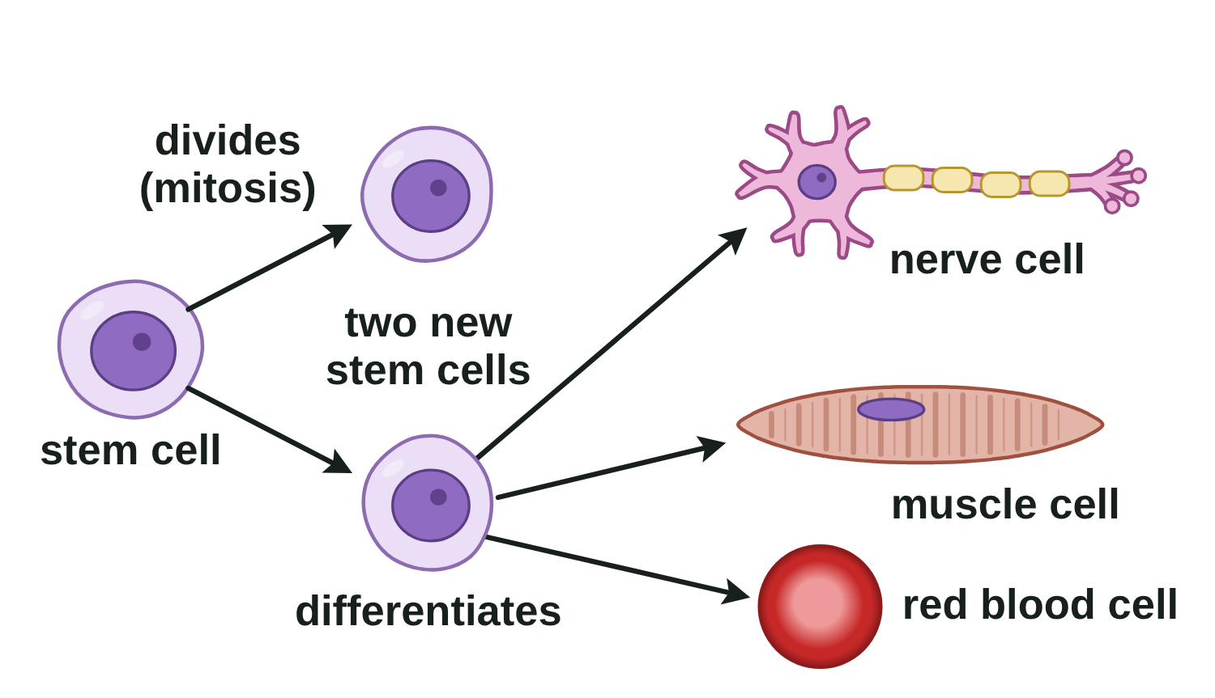
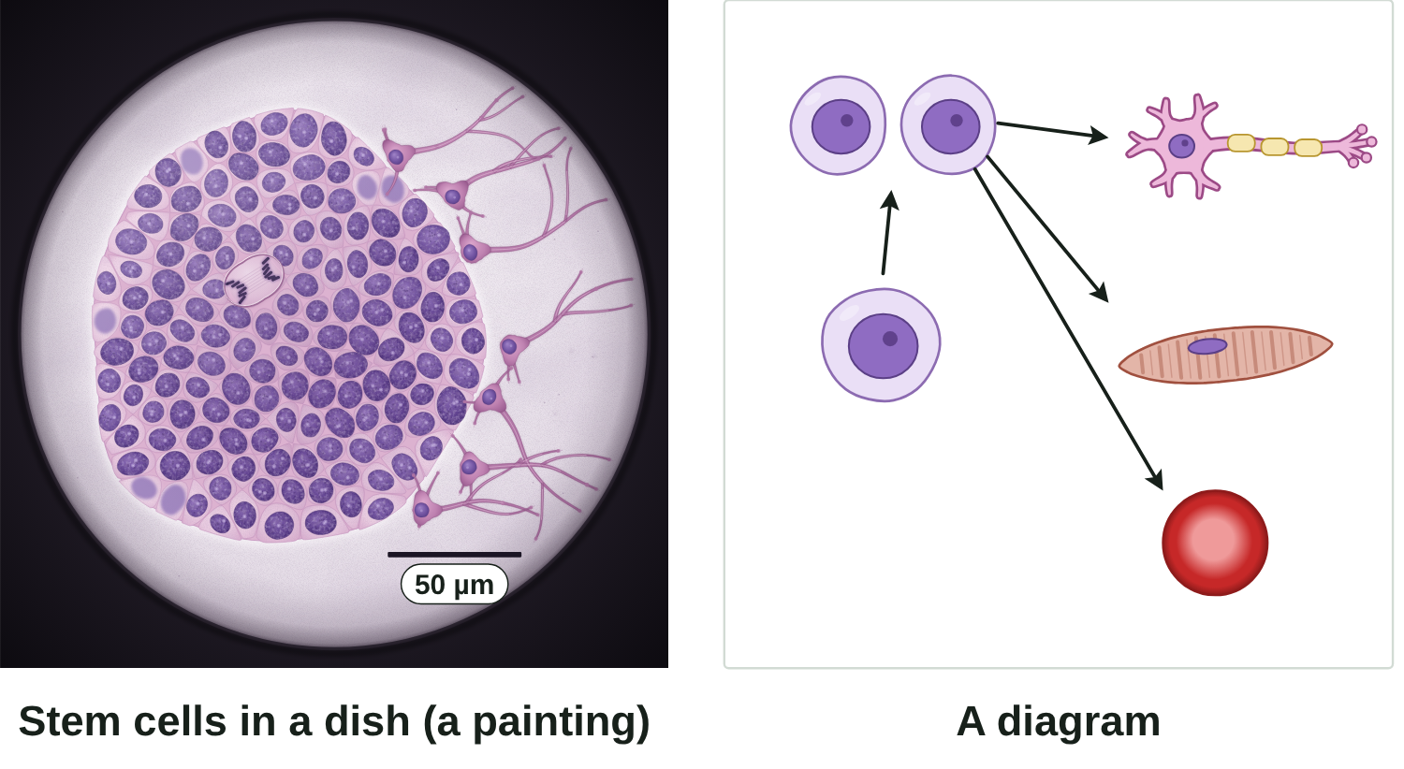
B1 L7 Revision notes 1 of 4
Stem cells
What stem cells are: real stem cells and a diagram, divide and differentiate
1. What is a stem cell?
3. Divide and differentiate
A stem cell is an undifferentiated cell that can divide to make many more cells of the same type, and can differentiate into certain other types of cell.
Undifferentiated means not yet specialised for a particular job.
Differentiation is the process by which a cell becomes specialised, gaining the sub-cellular structures it needs for its job.
Watch out: a stem cell is not a "special" cell. It is the opposite: it has not specialised yet.
2. Real stem cells and a diagram
A stem cell divides by mitosis to make two genetically identical stem cells.
Some new cells stay as stem cells, so there is always a supply.
Others differentiate into specialised cells, such as nerve cells, muscle cells and red blood cells.
Watch out: division makes more cells; differentiation changes what a cell can do. A stem cell does not "divide into a nerve cell".
4. Stem cells in a growing organism
A painting based on a light micrograph. Stains colour the cells.
In an embryo, stem cells make all the cells of the body as it grows.
In an adult, stem cells repair the body and replace cells that wear out.
In a plant, stem cells in the meristems make new cells so the plant can grow all through its life.
Most animal cells lose the ability to differentiate early. Many plant cells keep it.
Real stem cells look plain and alike, and they grow packed together in a colony.
They are tiny: about 10 µm across.
The painting's colours are stains. In a diagram, colours only show the types of cell.
Stem cells look plain: they have not yet developed the structures of a specialised cell.
B1 L7 · Stem cells · sciencegcse.co.uk · free GCSE science resources
Notes:
Revision notes page 1 of 4 (or use B1_L7_Revision_notes.pdf). These pages are the textbook for B1 L7: students read them before the lesson, use them to catch up, or revise from them. Page 1: what a stem cell is, the painting beside the diagram (the key line), division then differentiation, and what stem cells do in an embryo, an adult and a plant.

Slide 25
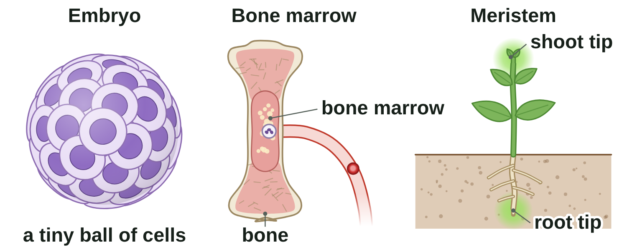
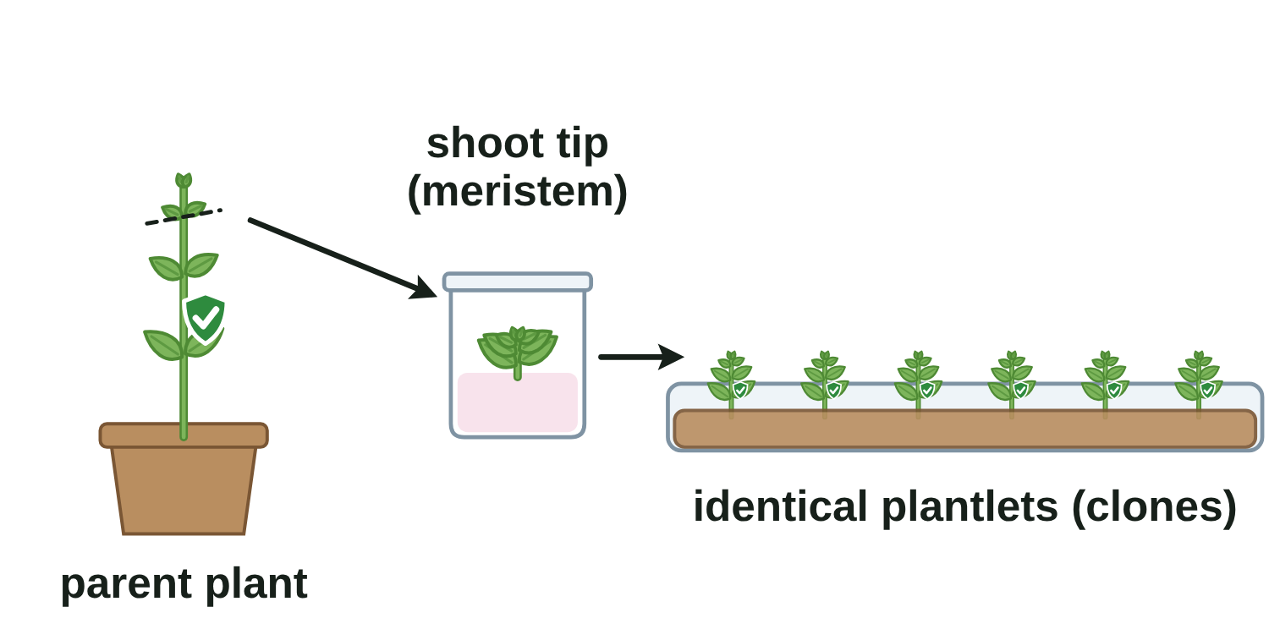
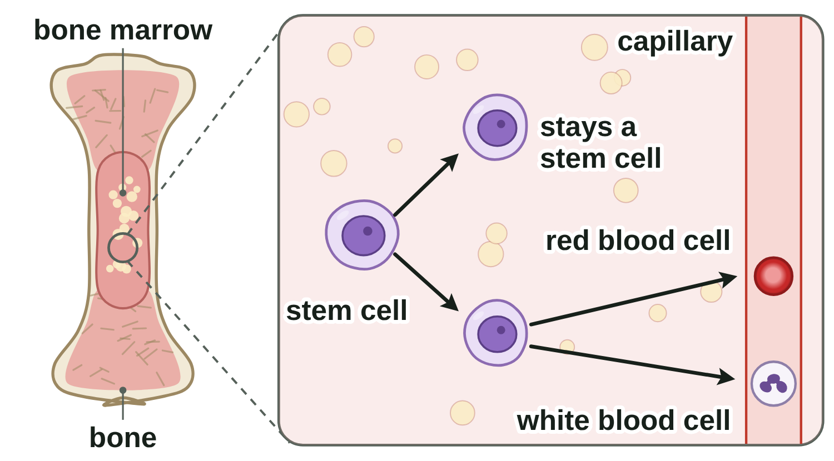
B1 L7 Revision notes 2 of 4
Stem cells
Where stem cells come from: embryos, bone marrow and meristems; cloning plants
5. Three sources of stem cells
7. Cloning plants from meristems
Stem cells from embryos can be cloned (grown into many identical cells) and made to differentiate into most types of human cell.
Source | Where | What the stem cells can become
Embryo | an early embryo: a tiny ball of cells | most types of human cell
Adult bone marrow | the soft tissue inside some bones | many types of cell, including blood cells
Plant meristem | the tips of roots and shoots | any type of plant cell, throughout the life of the plant
A clone is a genetically identical copy of a cell or an organism. Meristem cells can be used to clone plants quickly and economically.
Rare plants can be cloned to protect them from extinction.
Crop plants with special features, such as disease resistance, can be cloned to give farmers large numbers of identical plants.
Watch out: most (embryo), many (adult bone marrow), any (meristem). Adult stem cells form fewer types of cell than embryonic stem cells.
Watch out: clones have no variation. If a new disease can attack one plant, it can attack them all.
6. Bone marrow makes new blood cells
Stem cells in the bone marrow divide all the time. Some new cells become red blood cells or white blood cells.
A bone marrow transplant from a donor already helps people with some blood disorders, such as leukaemia.
8. Maths: percentages from a table
percentage = number with the feature ÷ total number × 100
Worked example: 400 plants are grown from seed. 200 have a useful feature. 200 ÷ 400 × 100 = 50 %.
Clones from a plant with the feature: all of them have it (100 %).
B1 L7 · Stem cells · sciencegcse.co.uk · free GCSE science resources
Notes:
Revision notes page 2 of 4: the three sources (most / many / any), bone marrow making blood cells, cloning plants from meristems, and percentages from a table. The worked example follows the slide 11 method: number with the feature ÷ total × 100.

Slide 26
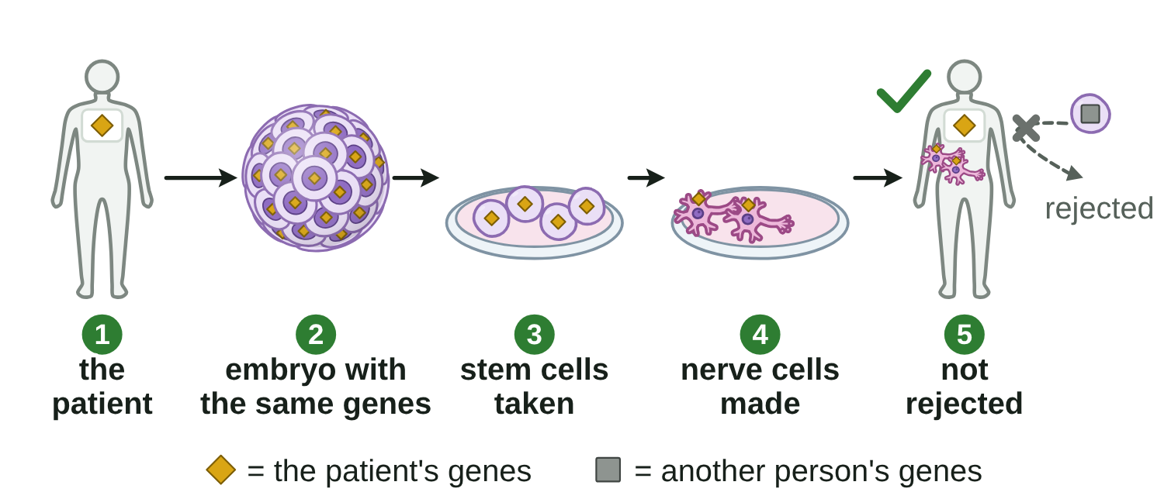
B1 L7 Revision notes 3 of 4
Stem cells
Using stem cells: medicine, therapeutic cloning, risks, and ethical and religious issues
9. Stem cells in medicine
11. Risks
Condition | How stem cells might help | Now?
Blood disorders, such as leukaemia | new blood cells from donated bone marrow stem cells | used now
Diabetes | new cells that make insulin | being researched
Paralysis | new nerve cells to repair damaged nerves | being researched
A virus (viral infection) could be passed on with the cells.
The cells might divide out of control and form a tumour.
The treatments are new, so long-term effects are not yet known.
12. Ethical and religious issues
Watch out: write "may be able to help". Most stem cell treatments are not yet cures.
An ethical issue is a question about whether something is morally right or wrong.
Taking stem cells from an embryo destroys the embryo.
Some people, including some religious groups, believe an early embryo should have the same right to life as a person.
Others think helping patients matters more, especially when spare embryos from fertility treatment would not be used anyway.
In the UK, research embryos are usually spare embryos from fertility treatment, given with consent; the law allows research only up to 14 days.
10. Therapeutic cloning
Therapeutic cloning is producing an embryo with the same genes as the patient, so that its stem cells are not rejected by the patient's body.
13. How to evaluate
1. Give the benefits: for example, stem cells may help people with diabetes or paralysis, and cells made by therapeutic cloning are not rejected.
2. Give the risks.
3. Give the ethical issues, both sides.
4. Then give your own conclusion with a reason.
There is no single right answer. People reach different views. In an exam, give both sides, then your own reasoned view.
Watch out: a risk is something that could go wrong, such as a virus being passed on. An ethical issue is about right and wrong, such as destroying an embryo. Do not give one as the other.
The stem cells are made to differentiate into the cells the patient needs.
Watch out: the embryo is grown only for its stem cells, never to make a baby. The cells are not rejected because they have the same genes as the patient, not because they are stem cells.
Questions or worries about anything here? Talk to a trusted adult. The NHS website has reliable information about stem cells and donating bone marrow.
B1 L7 · Stem cells · sciencegcse.co.uk · free GCSE science resources
Notes:
Revision notes page 3 of 4: what stem cells are used for now and what is being researched, therapeutic cloning (same genes, so not rejected), risks, ethical and religious views on both sides, and how to evaluate. Point out the help box at the bottom right; read it aloud if the class seems affected.

Slide 27
B1 L7 Revision notes 4 of 4
Stem cells
Key words, exam tips and check yourself
Key words
Check yourself
Cover the answers, then check.
Adult stem cell: a stem cell found in adult tissue, such as bone marrow, which can form many types of cell, including blood cells.
Bone marrow: the soft tissue inside some bones, where blood cells are made.
Clone: a genetically identical copy of a cell or an organism.
Differentiation: the process by which a cell becomes specialised, gaining the sub-cellular structures it needs for its job.
Embryo: an organism at its earliest stage of development; an early human embryo is a tiny ball of cells.
Embryonic stem cell: a stem cell from an early embryo, which can differentiate into most types of human cell.
Ethical issue: a question about whether something is morally right or wrong.
Genetically identical: having exactly the same genetic material.
Meristem: tissue at the growing tips of shoots and roots, where cells divide to make new cells.
Specialised cell: a cell with a structure that suits it to one job.
Stem cell: an undifferentiated cell that can divide to make many more cells of the same type, and can differentiate into certain other types of cell.
Therapeutic cloning: producing an embryo with the same genes as the patient, so that its stem cells are not rejected by the patient's body.
Undifferentiated: not yet specialised for a particular job.
1. What does "undifferentiated" mean?
2. Name the two processes that turn one stem cell into many specialised cells.
3. Name two sources of human stem cells.
4. Meristem cells can differentiate into which types of plant cell, and for how long?
5. Give two conditions that stem cells may be able to help.
6. In therapeutic cloning, how do the embryo's genes compare with the patient's genes?
7. Give one ethical or religious objection to using embryonic stem cells.
8. In a group of 300 plants grown from seed, 45 have a useful feature. Calculate the percentage.
Answers
1. Not yet specialised for a particular job.
2. Division (by mitosis) and differentiation.
3. Early embryos and adult bone marrow.
4. Any type of plant cell, throughout the life of the plant.
5. Diabetes and paralysis.
6. They are the same.
7. Taking the stem cells destroys the embryo; some people believe an early embryo should have the same right to life as a person.
8. 45 ÷ 300 × 100 = 15 %.
Exam tips
Learn the definition: a stem cell is undifferentiated, and it can divide and differentiate.
Most, many, any: embryonic stem cells, most types of human cell; adult bone marrow stem cells, many types, including blood cells; meristem cells, any type of plant cell, all through the plant's life.
Write "may be able to help", not "cures". Bone marrow transplants are the treatment used now.
Therapeutic cloning: write both parts: same genes as the patient, so not rejected.
"Evaluate" means benefits, risks and ethical issues (both sides), then a conclusion with a reason.
For a percentage, write number ÷ total × 100, and show your working.
B1 L7 · Stem cells · sciencegcse.co.uk · free GCSE science resources
Notes:
Revision notes page 4 of 4: the key words for B1 L7 in alphabetical order, exam tips, and 8 check-yourself questions with short answers. Students cover the answers box, answer the questions, then check and correct in a different colour.

Slide 28
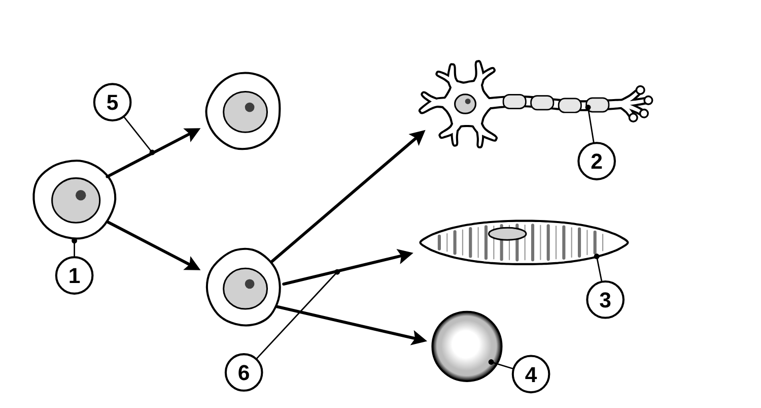
B1 L7 Mandatory worksheet: Stem cells
Page 1 of 2
Name: ______________________________ Class: __________
A. Label the diagram
B. Fill in the gaps
[6]
[6]
Help: online screen 3
Help: online screens 1, 3 and 4
The diagram shows a stem cell and some of the cells it can become. Write the name of each numbered cell or process on its line.
Use words from the box. Use each word once at most. Two words are not needed.
undifferentiated
divide
differentiate
embryos
bone marrow
meristems
specialised
leaves
A stem cell is an ____________ cell: it is not yet specialised.
Stem cells can ____________ to make many more cells of the same type.
They can also ____________ into other types of cell.
In humans, stem cells are found in early ____________ and in adult ____________.
In plants, stem cells are found in ____________ at the tips of roots and shoots.
C. Which stem cells?
[6]
Help: online screens 4, 6 and 10
Tick (✓) one box in each row.
Statement | Embryo | Adult bone marrow | Plant meristem
1. Can become most types of human cell.
2. Make new red and white blood cells.
3. Found at the tips of roots and shoots.
4. Can become any type of plant cell.
5. Used to treat some blood disorders.
6. Taking them destroys an early embryo.
1
4
2
5
3
6
B1 L7 · Stem cells · sciencegcse.co.uk · free GCSE science resources

Slide 29
B1 L7 Mandatory worksheet: Stem cells
Page 2 of 2
Name: ______________________________ Class: __________
D. Short answers
E. Seeds or clones?
[9]
[4]
Help: online screens 7, 9, 10 and 11
Help: online screen 7
1. Name one condition that stem cells may be able to help in the future. [1]
A grower has two groups of a crop plant.
Group A: 240 plants grown from seeds. 60 of them have a useful feature: they resist a disease.
Group B: 240 clones made from meristem cells of one plant that has the feature. All 240 have the feature.
2. Give one risk to a patient who is given stem cells from another person. [1]
3. Doctors could use therapeutic cloning to make stem cells for a patient.
(a) Calculate the percentage of plants in group A that have the useful feature.
Use: percentage = number with the feature ÷ total number × 100 [2]
(a) What is special about the genes of the embryo that is produced? [1]
Working:
%
(b) Why does this mean the stem cells are not rejected by the patient's body? [1]
(b) Explain why all the plants in group B have the useful feature. [2]
4. Give one reason why some people object to using embryos to get stem cells. [1]
F. Explain
[3]
5. Name the plant tissue that growers use to clone plants. [1]
Help: online screen 6
A patient has leukaemia, a blood disorder. Doctors give the patient a bone marrow transplant from a donor. Explain how the transplant can help the patient. [3]
6. Give two reasons why growers clone plants from meristems. [2]
7. Stem cells may be able to help people with paralysis. Why does the sentence say “may”? [1]
B1 L7 · Stem cells · sciencegcse.co.uk · free GCSE science resources

Slide 30
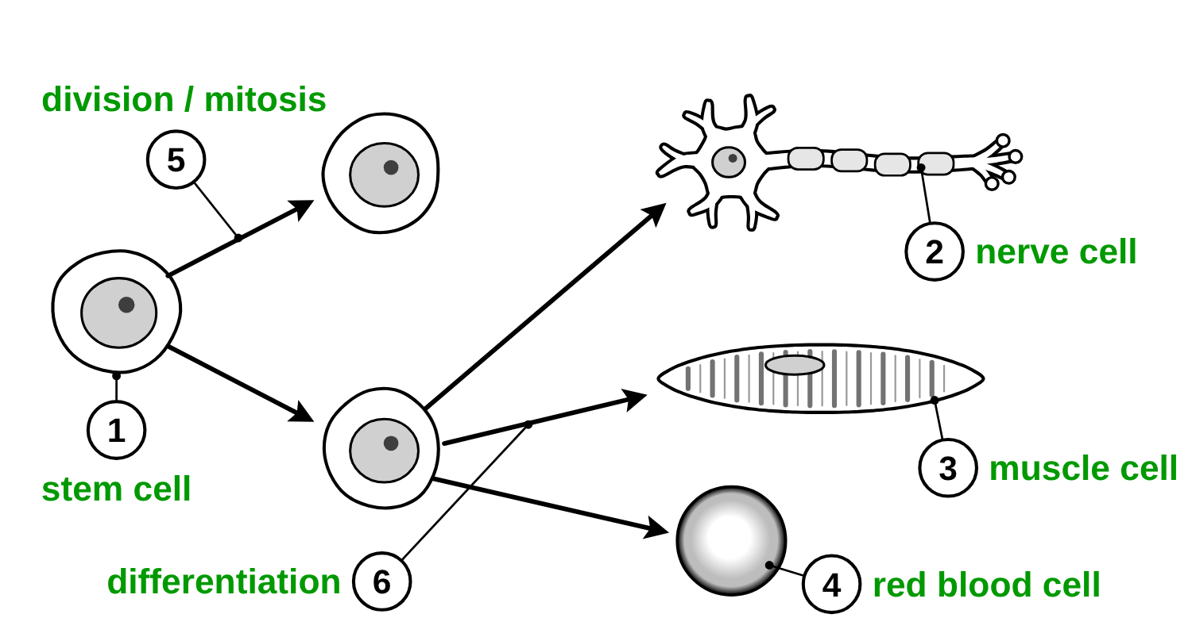
B1 L7 Mandatory worksheet answers - page 1
Answers 1 of 2
A. Label the diagram
B. Fill in the gaps
[6]
[6]
1 mark for each correct name.
1 mark for each correct gap.
undifferentiated
divide
differentiate
embryos
bone marrow
meristems
specialised
leaves
A stem cell is an undifferentiated (1) cell: it is not yet specialised.
Stem cells can divide (1) to make many more cells of the same type.
They can also differentiate (1) into other types of cell.
In humans, stem cells are found in early embryos (1) and in adult bone marrow (1).
In plants, stem cells are found in meristems (1) at the tips of roots and shoots.
Gap 1: do not accept “specialised”.
C. Which stem cells?
[6]
1 mark for each correct row. More than one tick in a row: no mark.
1
stem cell (1)
4
red blood cell (1)
Statement | Embryo | Adult bone marrow | Plant meristem
1. Can become most types of human cell. | ✓
2. Make new red and white blood cells. |  | ✓
3. Found at the tips of roots and shoots. |  |  | ✓
4. Can become any type of plant cell. |  |  | ✓
5. Used to treat some blood disorders. |  | ✓
6. Taking them destroys an early embryo. | ✓
2
nerve cell (1)
5
division / mitosis (1)
3
muscle cell (1)
6
differentiation (1)
5: allow “divides”. Do not accept “differentiation”.
6: allow “differentiates”. Do not accept “mitosis”.
B1 L7 · Stem cells · sciencegcse.co.uk · free GCSE science resources

Slide 31
B1 L7 Mandatory worksheet answers - page 2
Answers 2 of 2
D. Short answers
E. Seeds or clones?
[9]
[4]
1. Name one condition that stem cells may be able to help in the future. [1]
(a)
60 ÷ 240 × 100 (1)
= 25 % (1)
Correct answer with no working scores 2.
Diabetes / paralysis (1).
Allow another condition being researched, such as Parkinson's disease.
2. Give one risk to a patient who is given stem cells from another person. [1]
(b)
They are clones of one plant that has the feature (1).
So they are genetically identical / have the same genes (1).
Model answer: The plants in group B are clones of one plant that has the feature, so they are genetically identical. They all have the same genes, so they all have the feature.
A virus (viral infection) could be passed on (1).
Allow: the cells may be rejected; the cells might divide out of control / form a tumour.
3. Doctors could use therapeutic cloning to make stem cells for a patient.
(a) What is special about the genes of the embryo that is produced? [1]
They are the same as the patient's genes (1).
(b) Why does this mean the stem cells are not rejected by the patient's body? [1]
They have the same genes as the patient, so the body does not treat them as foreign / the body recognises them as its own / the cells match the patient (1).
Do not accept “because they are stem cells” or “because they are young”.
4. Give one reason why some people object to using embryos to get stem cells. [1]
Taking the stem cells destroys the embryo / they believe an embryo has the same right to life as a person / religious beliefs (1).
F. Explain
5. Name the plant tissue that growers use to clone plants. [1]
[3]
Meristem (1).
Any three (1 each):
Bone marrow contains (adult) stem cells (1).
The stem cells divide (to make more cells) (1).
The new cells differentiate into (healthy) blood cells (1).
These replace the patient's faulty blood cells (1).
Allow “make new red and white blood cells”.
Model answer: The donor's bone marrow contains stem cells. In the patient, the stem cells divide, and the new cells differentiate into healthy blood cells. These replace the patient's faulty blood cells.
6. Give two reasons why growers clone plants from meristems. [2]
Any two (1 each): it is quick; it is cheap / economical; it makes large numbers of plants; all the plants have the parent's useful features (such as disease resistance); it can save rare species from extinction.
7. Stem cells may be able to help people with paralysis. Why does the sentence say “may”? [1]
The treatment is still being researched / it is not yet known if it works or is safe (1).
Do not accept “because it cures it”.
B1 L7 · Stem cells · sciencegcse.co.uk · free GCSE science resources

Slide 32
B1 L7 Challenge worksheet: Stem cells
Page 1 of 2
Name: ______________________________ Class: __________
A. A new treatment for diabetes
B. How big is an early embryo?
[5]
[3]
Help: online screen 9
Help: online screens 4 and 10
Some people with diabetes need to inject insulin every day. Scientists tested a new stem cell treatment. Table 1 shows their results.
An early human embryo is a tiny ball of cells about 0.15 mm across. One of its cells is about 12 µm across.
Table 1 (example data, not real)
1 mm = 1000 µm
Group | Number of people | Number who needed fewer insulin injections after 1 year
Given the stem cell treatment | 24 | 9
Not given the treatment | 24 | 1
(a) Convert 0.15 mm into micrometres (µm). [1]
µm
(b) Calculate about how many cells, side by side, would fit across the embryo. [2]
Working:
cells
(a) Calculate the percentage of the treated group who needed fewer insulin injections. [2]
C. Spare or cloned embryo?
[4]
Working:
Help: online screens 10 and 11
%
A patient needs new cells.
Embryonic stem cells could come from a spare embryo given by a couple after fertility treatment, or from an embryo produced by therapeutic cloning.
(b) A newspaper headline says “Stem cells cure diabetes”. Use the data to explain why the headline is wrong. [2]
(a) Explain why stem cells from the spare embryo might be rejected by the patient's body, but stem cells from therapeutic cloning would not. [2]
(b) Give one ethical issue that applies to both sources. [1]
(c) Suggest why the scientists also studied a group who were not given the treatment. [1]
(c) Give one practical risk that applies to both sources. [1]
B1 L7 · Stem cells · sciencegcse.co.uk · free GCSE science resources

Slide 33
B1 L7 Challenge worksheet: Stem cells
Page 2 of 2
Name: ______________________________ Class: __________
D. Banana farms
[3]
Help: online screen 7
Almost all the bananas sold in UK shops come from one variety. The plants are clones, grown from pieces of plant that contain meristems. A fungus that kills this variety is spreading around the world.
(a) Give one reason why farmers grow bananas as clones. [1]
(b) Suggest what scientists could do to protect banana farms in the future. [2]
E. Extended response
[6]
Help: online screens 4, 6, 9, 10 and 11
Scientists can get stem cells from embryos or from adult bone marrow. Compare the two sources of stem cells for treating a patient. [6]
In your answer, compare what the cells can become, the risks and the ethical issues.
B1 L7 · Stem cells · sciencegcse.co.uk · free GCSE science resources

Slide 34
B1 L7 Challenge worksheet answers - page 1
Answers 1 of 2
A. A new treatment for diabetes
B. How big is an early embryo?
[5]
[3]
Some people with diabetes need to inject insulin every day. Scientists tested a new stem cell treatment. Table 1 shows their results.
(a)
0.15 × 1000 = 150 µm (1).
(b)
150 ÷ 12 (1)
= 12.5, so about 12 (or 13) cells (1).
Allow 12.5. Allow their (a) ÷ 12, correctly calculated.
Model answer: 0.15 mm × 1000 = 150 µm. 150 ÷ 12 = 12.5, so about 12 cells fit across the embryo.
Table 1 (example data, not real)
Group | Number of people | Number who needed fewer insulin injections after 1 year
Given the stem cell treatment | 24 | 9
Not given the treatment | 24 | 1
(a)
9 ÷ 24 × 100 (1)
= 37.5 % (1)
Allow 37 % or 38 %. Correct answer with no working scores 2.
C. Spare or cloned embryo?
[4]
(b)
Only 9 out of 24 / 37.5 % of the treated people improved (1).
They needed fewer injections, but still needed insulin, so they were not cured / it is a small trial (1).
(a)
The spare embryo has different genes from the patient (1).
The cloned embryo has the same genes as the patient, so its cells are not rejected (1).
Model answer: The spare embryo comes from other people, so its cells have different genes from the patient, and the body may reject them. An embryo made by therapeutic cloning has the same genes as the patient, so its cells are not rejected.
(c)
To compare, so they can tell whether the change was caused by the treatment (1).
Model answers
(b)
An embryo is destroyed when its stem cells are taken / some people believe an embryo has the same right to life as a person (1).
(a)
9 ÷ 24 × 100 = 37.5 %.
(c)
A virus could be passed on / the cells might divide out of control / long-term effects are not known (1).
Do not accept an ethical issue for (c).
(b)
Only 9 of the 24 treated people (37.5 %) needed fewer injections, and they still needed insulin, so they were not cured. The trial was also small.
(c)
So they could compare the two groups, and tell whether the change was caused by the treatment and not by something else.
B1 L7 · Stem cells · sciencegcse.co.uk · free GCSE science resources

Slide 35
B1 L7 Challenge worksheet answers - page 2
Answers 2 of 2
D. Banana farms
[3]
Almost all the bananas sold in UK shops come from one variety. The plants are clones, grown from pieces of plant that contain meristems. A fungus that kills this variety is spreading around the world.
(a) Give one reason why farmers grow bananas as clones. [1]
(b) Suggest what scientists could do to protect banana farms in the future. [2]
Any one (1): every plant has the same useful features; it is quick and cheap; it gives large numbers of plants.
Find (or breed) a banana plant that resists the fungus (1).
Clone it from its meristems to make large numbers of resistant plants for farmers (1).
Allow: grow several different varieties, so that there is variation (1) and one fungus cannot kill them all (1).
E. Extended response
[6]
Level 3 (5–6 marks): A detailed, balanced comparison of both sources, covering what the cells can become, the risks and the ethical issues, with clear links between the two sources (for example “whereas”, “but”).
both carry a risk of viral infection
embryonic cells might divide out of control
Level 2 (3–4 marks): A comparison with some detail on both sources, covering at least two of: types of cell, risks, ethics.
taking embryonic stem cells destroys an embryo, and some people, including some religious groups, object
a donor of bone marrow can give consent, so there are fewer ethical objections
Level 1 (1–2 marks): Simple points about one or both sources, with little comparison.
Model answer: Embryonic stem cells can differentiate into most types of human cell, so they may be able to help with more conditions, such as diabetes or paralysis. Adult stem cells from bone marrow can form fewer types of cell, mainly blood cells, but bone marrow transplants are already used to treat some blood disorders, such as leukaemia. If an embryo is made by therapeutic cloning, its stem cells have the same genes as the patient, so they are not rejected; cells from a bone marrow donor may be rejected if they are not a good match. Both sources could pass on a virus. Taking stem cells from an embryo destroys the embryo, and some people, including some religious groups, believe this is wrong, while a bone marrow donor is an adult who can agree to give the cells. So embryonic stem cells may help with more conditions, but adult bone marrow stem cells are already used, and fewer people object to them.
0 marks: Nothing worthy of credit.
Indicative content:
embryonic stem cells can differentiate into most types of human cell
adult bone marrow stem cells form many types, including blood cells, but fewer types
therapeutic cloning gives embryonic cells with the patient's genes, so they are not rejected
adult cells from a donor may be rejected unless well matched (a patient's own adult cells would not be)
bone marrow transplants are used now; embryonic treatments are mostly being researched
B1 L7 · Stem cells · sciencegcse.co.uk · free GCSE science resources

Slide 36
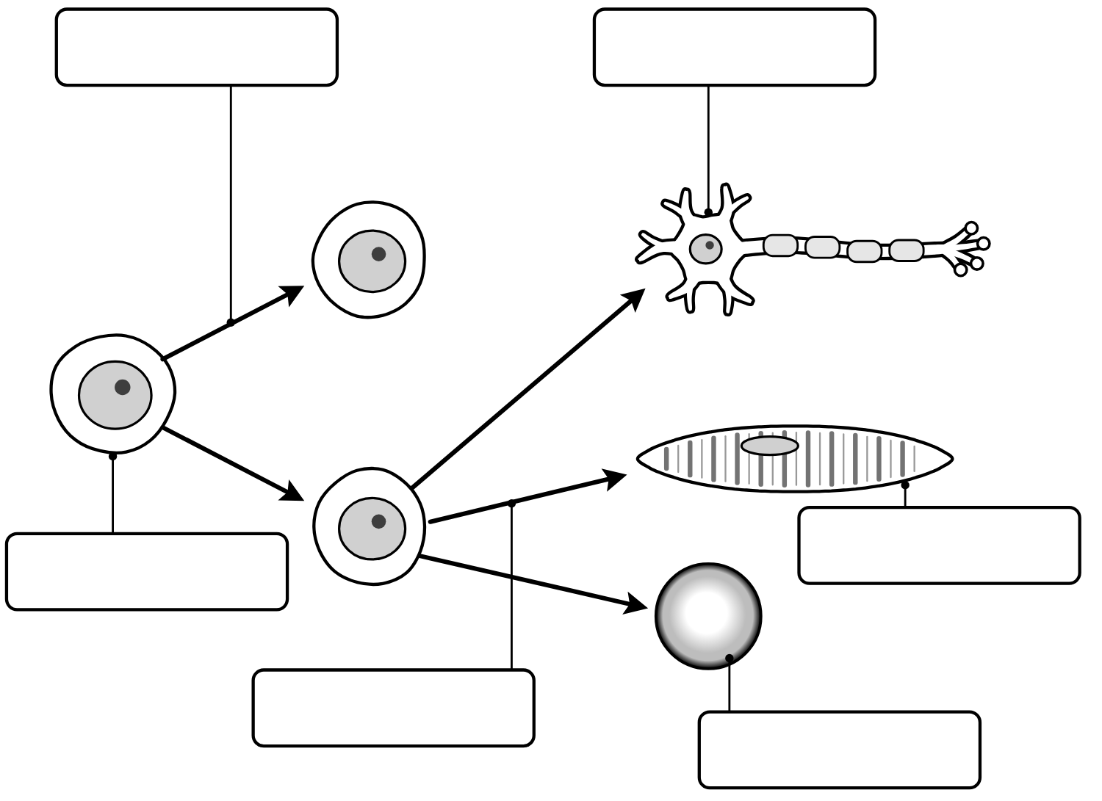
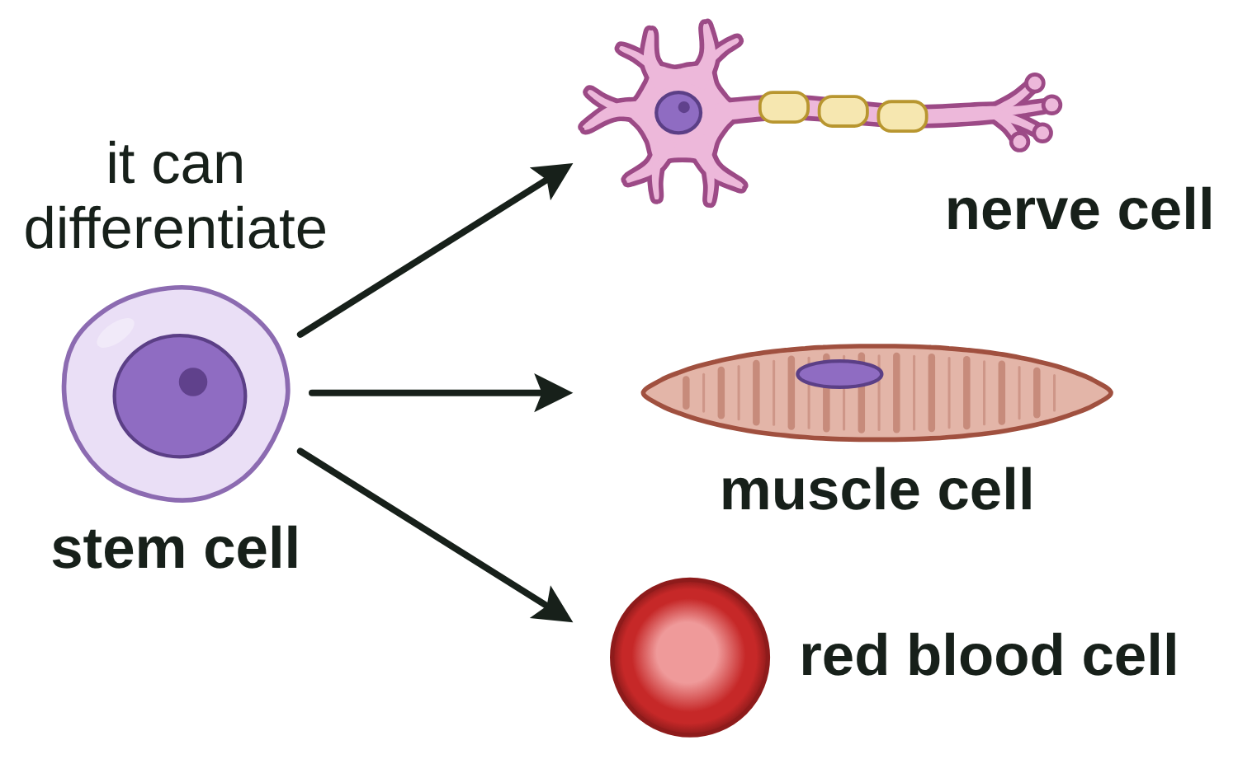
B1 L7 Alternative worksheet: Stem cells
Page 1 of 2
Name: ______________________________ Class: __________
Key facts
A. Label the diagram
[7]
Help: online screen 3
A stem cell is not specialised yet. It can divide to make more cells.
It can become other types of cell. This is called differentiation.
Stem cells look plain: they have not yet developed the structures of a specialised cell.
Embryos have stem cells that can become most types of human cell.
Adult bone marrow has stem cells that make blood cells.
Plants have stem cells in meristems, at the tips of roots and shoots.
Plants can be cloned from meristems. Clones are genetically identical.
Stem cells may be able to help people with diabetes or paralysis.
A risk: a virus could be passed on with the cells.
Some people object to using embryos, for ethical or religious reasons.
1. Use words from the box to label the diagram. [6]
2. Colour all the stem cells in the diagram the same colour. [1]
stem cell
nerve cell
muscle cell
red blood cell
divide
differentiate
Real stem cells
A painting based on a light
micrograph. Stains colour the cells.
A diagram
A stem cell can become
other types of cell.
B1 L7 · Stem cells · sciencegcse.co.uk · free GCSE science resources

Slide 37
B1 L7 Alternative worksheet: Stem cells
Page 2 of 2
Name: ______________________________ Class: __________
B. Match the word to its meaning
D. True or false?
[5]
[6]
Help: online screens 1, 4 and 7
Help: online screens 1, 3, 4, 9 and 10
Draw a line from each word to its meaning.
Circle True or False.
stem cell
the soft tissue inside some bones, where blood cells are made.
1. A stem cell is already specialised.
True
False
an undifferentiated cell that can divide to make many more cells of the same type, and can differentiate into certain other types of cell.
2. Stem cells can divide to make more stem cells.
True
False
undifferentiated
3. Embryonic stem cells can become most types of human cell.
True
False
meristem
a genetically identical copy of a cell or an organism.
4. Meristem cells can only become leaf cells.
True
False
bone marrow
not yet specialised for a particular job.
5. Therapeutic cloning makes a baby.
True
False
clone
tissue at the growing tips of shoots and roots, where cells divide to make new cells.
6. Stem cells may be able to help people with paralysis.
True
False
C. Fill the gaps
E. Benefit, risk or view?
[6]
[6]
Help: online screens 4, 6, 7, 10 and 11
Help: online screen 11
Use the words in the box. Use each word once.
Write B (benefit), R (risk) or V (view) in each box.
embryo
blood
tips
identical
same
virus
1. Stem cells may help people with diabetes.
1. An early ____________ is a tiny ball of cells.
2. Stem cells in bone marrow make new ____________ cells.
3. Meristems are found at the ____________ of roots and shoots.
4. Clones are genetically ____________.
5. In therapeutic cloning, the embryo has the ____________ genes as the patient.
6. A ____________ could be passed to a patient with the stem cells.
2. A virus could be passed on with the stem cells.
3. Some people believe an embryo should not be destroyed.
4. Cells from therapeutic cloning are not rejected.
5. The new cells might divide out of control.
6. Some religious groups object to using embryos.
B1 L7 · Stem cells · sciencegcse.co.uk · free GCSE science resources

Slide 38
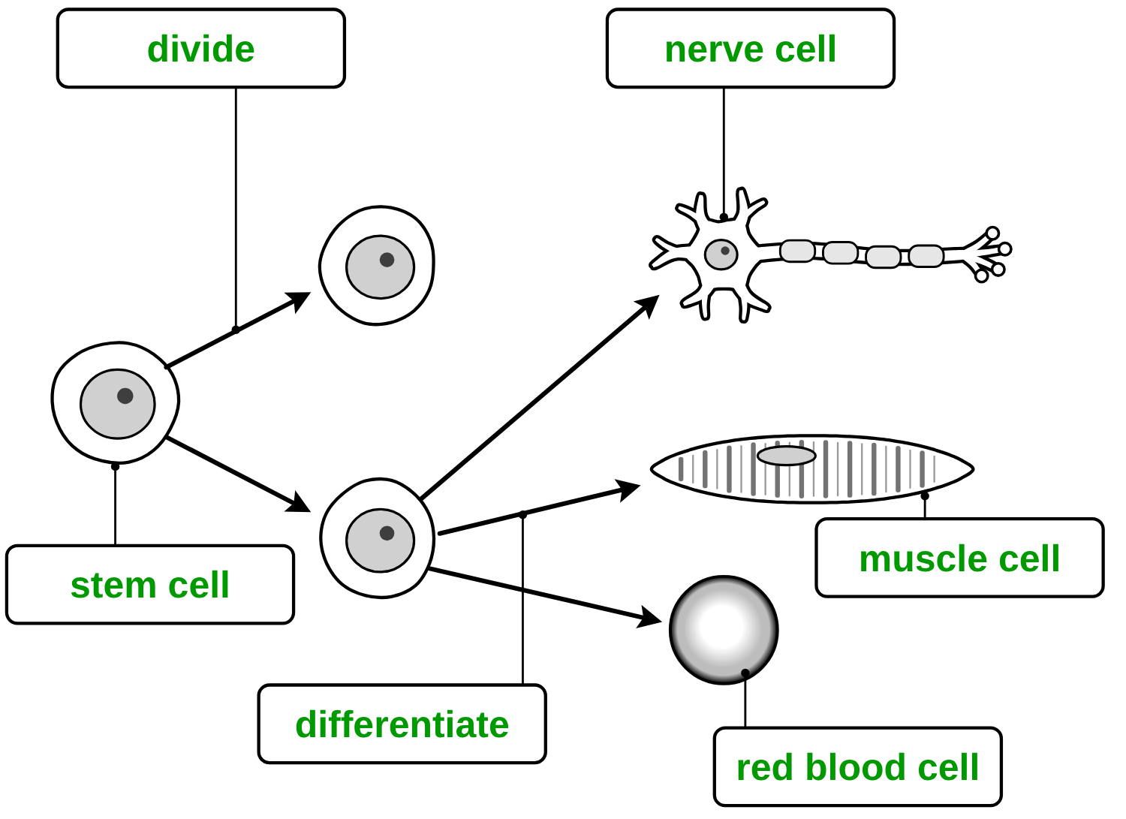
B1 L7 Alternative worksheet answers - page 1
Answers 1 of 2
Key facts
A. Label the diagram
[7]
A stem cell is not specialised yet. It can divide to make more cells.
It can become other types of cell. This is called differentiation.
Stem cells look plain: they have not yet developed the structures of a specialised cell.
Embryos have stem cells that can become most types of human cell.
Adult bone marrow has stem cells that make blood cells.
Plants have stem cells in meristems, at the tips of roots and shoots.
Plants can be cloned from meristems. Clones are genetically identical.
Stem cells may be able to help people with diabetes or paralysis.
A risk: a virus could be passed on with the cells.
Some people object to using embryos, for ethical or religious reasons.
Part 1: 1 mark for each correct label box (6).
stem cell
nerve cell
muscle cell
red blood cell
divide
differentiate
Part 2: the three stem cells are coloured (ringed in green here): the first cell and the two new stem cells. No other cell is coloured (1).
Real stem cells
A painting based on a light
micrograph. Stains colour the cells.
A diagram
A stem cell can become
other types of cell.
B1 L7 · Stem cells · sciencegcse.co.uk · free GCSE science resources

Slide 39
B1 L7 Alternative worksheet answers - page 2
Answers 2 of 2
B. Match the word to its meaning
D. True or false?
[5]
[6]
1 mark for each correct line.
1 mark for each correct answer.
stem cell
the soft tissue inside some bones, where blood cells are made.
1. A stem cell is already specialised.
True
False
an undifferentiated cell that can divide to make many more cells of the same type, and can differentiate into certain other types of cell.
2. Stem cells can divide to make more stem cells.
True
False
undifferentiated
3. Embryonic stem cells can become most types of human cell.
True
False
meristem
a genetically identical copy of a cell or an organism.
4. Meristem cells can only become leaf cells.
True
False
bone marrow
not yet specialised for a particular job.
5. Therapeutic cloning makes a baby.
True
False
clone
tissue at the growing tips of shoots and roots, where cells divide to make new cells.
6. Stem cells may be able to help people with paralysis.
True
False
C. Fill the gaps
E. Benefit, risk or view?
[6]
[6]
1 mark for each correct gap.
1 mark for each correct letter.
embryo
blood
tips
identical
same
virus
1. Stem cells may help people with diabetes.
B
(1)
2. A virus could be passed on with the stem cells.
R
1. An early embryo is a tiny ball of cells. (1)
2. Stem cells in bone marrow make new blood cells. (1)
3. Meristems are found at the tips of roots and shoots. (1)
4. Clones are genetically identical. (1)
5. In therapeutic cloning, the embryo has the same genes as the patient. (1)
6. A virus could be passed to a patient with the stem cells. (1)
(1)
3. Some people believe an embryo should not be destroyed.
V
(1)
4. Cells from therapeutic cloning are not rejected.
B
(1)
5. The new cells might divide out of control.
R
(1)
6. Some religious groups object to using embryos.
V
(1)
B1 L7 · Stem cells · sciencegcse.co.uk · free GCSE science resources

Slide 40
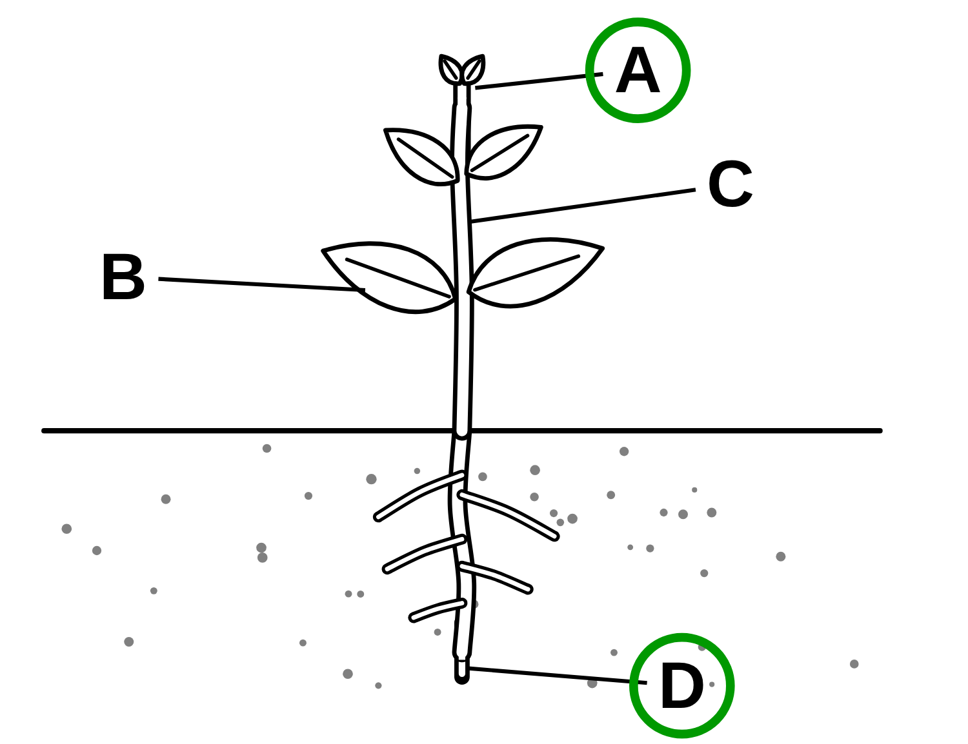
B1 L7 Exam questions worksheet mark scheme - page 1
Answers 1 of 2
01 Where stem cells are found
02 Saving a rare plant
[4]
[5]
01.1 Draw one line from each source of stem cells to what its stem cells can become. [3]
Embryo → Most types of human cell (1)
Adult bone marrow → Many types of cell, including blood cells (1)
Plant meristem → Any type of plant cell (1)
If more than one line is drawn from a source, that source scores 0.
02.1 Calculate the percentage of the seeds that grew into new plants. [2]
18 ÷ 200 × 100 (1) = 9 (%) (1)
Correct answer with no working = 2 marks. allow 0.09 × 100 for the first mark. do not accept 0.09 as the final answer (no × 100) for the second mark.
02.2 Use Table 1 to give one advantage of cloning the plant from meristem cells. [1]
many more new plants (450 compared with 18) (1)
allow many plants from only one shoot tip / from a small piece of one plant. ignore “cheaper” (not in the table).
02.3 Which statement about the 450 cloned plants is correct? [1]
They are all genetically identical. (1)
02.4 Suggest one disadvantage of growing this rare plant only as clones. [1]
there is no (genetic) variation, so one new disease could kill them all (1)
allow no variation; they could all be killed by one disease; they could not adapt to a change in the environment. do not accept “they are all the same” with no link to variation, disease or change.
01.2 Figure 1: which two letters show where meristem tissue is found? [1]
A and D (1)
Both letters needed, in either order. A third letter written: 0 marks.
03 Therapeutic cloning
04 Helping people with paralysis
[3]
[2]
03.1 What is produced in therapeutic cloning? [1]
An embryo with the same genes as the patient (1)
More than one box ticked: 0 marks.
03.2 Explain why stem cells from therapeutic cloning are better for this patient than stem cells from another person. [2]
the cells (from the cloned embryo) have the same genes as the patient (1)
so they are not rejected by the patient's body / cells from another person may be rejected (1)
allow the body recognises the cells as its own. do not accept “because they are stem cells” or “because they are young”.
04 Describe how stem cells might be used to help a person with paralysis. [2]
(embryonic) stem cells could be made to differentiate into nerve cells (1)
these could replace the damaged nerve cells / repair the damage (1)
allow “turned into” for differentiate. allow so the person may be able to move again, for the second mark, if linked to new nerve cells. ignore “cure”. do not accept “stem cells divide into nerve cells” for the first mark.
B1 L7 · Stem cells · sciencegcse.co.uk · free GCSE science resources
Notes:
Exam questions worksheet mark scheme, page 1 of 2: questions 01 to 04 (14 marks). Same wording as B1_L7_Exam_questions_mark_scheme.pdf. Students mark in a different colour: one tick for each mark point, and check the allow / ignore / do not accept notes. 01.2: the shoot tip (A) and the root tip (D) are ringed.

Slide 41
B1 L7 Exam questions worksheet mark scheme - page 2
Answers 2 of 2
05 Extended response
[6]
05 Scientists are researching the use of embryonic stem cells to treat conditions such as diabetes. Evaluate the use of embryonic stem cells in medical treatments. [6]
Level descriptors
Level 3 (5–6 marks): A detailed and balanced evaluation. Benefits, at least one practical risk and at least one ethical or religious issue are described, and a conclusion is given with a supporting reason.
Level 2 (3–4 marks): Benefits and at least one risk or ethical issue are described, with some balance, or one side only is described in detail. A conclusion may be given without a clear reason.
Level 1 (1–2 marks): Simple statements about benefits or objections, with little detail.
0 marks: No relevant content.
Model answer (Level 3)
Embryonic stem cells can differentiate into most types of human cell, so they may be able to help people with conditions such as diabetes or paralysis by replacing damaged cells. If the embryo is made by therapeutic cloning, the cells have the same genes as the patient, so they are not rejected. However, there are risks: a virus could be passed on with the cells, and the cells might divide out of control and form a tumour. The treatments are still being researched, so we do not know if they are safe in the long term. Taking the stem cells destroys the embryo. Some people, including some religious groups, believe an embryo has the same right to life as a person, so they object. Others think helping patients matters more, especially when spare embryos would not be used anyway. I think the research should continue, because it may help many people, but only with strict laws and careful testing.
Indicative content
Benefits: embryonic stem cells can differentiate into most types of human cell; they may be able to help conditions such as diabetes and paralysis; they could replace damaged cells
in therapeutic cloning the embryo has the same genes as the patient, so the cells are not rejected; research helps scientists understand how diseases develop
Risks: a viral infection could be passed on with the cells; the cells might divide out of control (a tumour)
treatments are new, still being researched, and long-term effects are not known; treatments may not work
Ethical and religious issues: taking the stem cells destroys the embryo; some people, including some religious groups, believe an early embryo should have the same right to life as a person
others think the benefits to patients matter more; spare embryos from fertility treatment would not be used anyway; in the UK, research is allowed only on embryos up to 14 days old, with consent
Conclusion: any conclusion with a reason (for, against, or “only if ...”) scores the same as the one in the model answer
An answer about only one side (only benefits, or only objections) cannot reach Level 3. ignore “it is wrong” / “it is fine” with no reason.
B1 L7 · Stem cells · sciencegcse.co.uk · free GCSE science resources
Notes:
Exam questions worksheet mark scheme, page 2 of 2: question 05, the 6-mark evaluate question. Decide the level first (is it balanced? is there a conclusion with a reason?), then the mark within the level. Any reasoned conclusion can reach Level 3: there is no single right answer.

