Slide 1
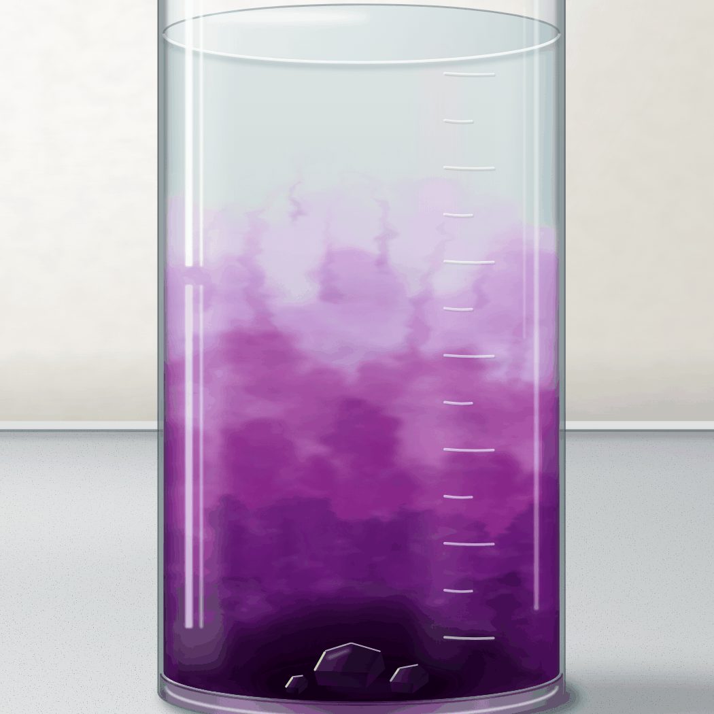
sciencegcse.co.uk · Biology B1 L8
DATE
B1 L8: Diffusion
24/09/2026
DO NOW
KEYWORDS
1. Where are stem cells found in plants?
2. Where are the adult stem cells that make blood cells found?
3. Which part of a cell controls what goes in and out?
Diffusion
Concentration
Concentration gradient
Net movement
Urea
A painting of a purple crystal dissolving in still water.
B1 Cell biology
AQA Combined Science
Notes:
Do now: retrieval from B1 L7 (Q1, Q2) and B1 L1 (Q3). The picture is a painting of a purple crystal dissolving at the bottom of a beaker of still water: the purple is darkest near the crystal and fades upwards. Ask the class what they can see, and what the beaker will look like in an hour, and tomorrow. Q3 leads into today: the cell membrane controls what goes in and out of a cell, and diffusion is one of the ways substances cross it. Suggested 60 min: slides 1-3 (8 min); slides 4-9 (15 min); slides 10-13 (10 min); slides 14-18 (12 min); Mandatory worksheet started in class (10 min), finished for homework; exit ticket slides 22-23 (5 min). Use slides 19-21 if time allows. Homework: online lesson quiz and the B1 L8 Exam questions worksheet.

Slide 2
sciencegcse.co.uk · Biology B1 L8: Diffusion
Do now answers and lesson focus
Do now answers
In this lesson
1. In meristems (the tips of roots and shoots).
2. In the bone marrow.
3. The cell membrane.
• Compare a real beaker of purple water with a particle diagram.
• Describe diffusion as the net movement of particles.
• Give examples of diffusion in the body: oxygen, carbon dioxide and urea.
• Explain the four factors that affect the rate of diffusion.
• Calculate a rate of diffusion and read a graph.
Key idea
Diffusion is the net movement of particles from a higher to a lower concentration.
Diffusion does not need energy from respiration.
2
B1 L8 · sciencegcse.co.uk
Notes:
Go through the answers. Then share the lesson focus. The online lesson (sciencegcse.co.uk, B1 L8) follows the same 12 screens as this PowerPoint, so students can go over it at home. There are three checkpoints along the way. Link Q3 to today: the cell membrane controls what goes in and out, and many small substances, such as oxygen and carbon dioxide, cross it by diffusion. Look at the demonstration beaker now, if you set one up: how far has the purple spread?

Slide 3
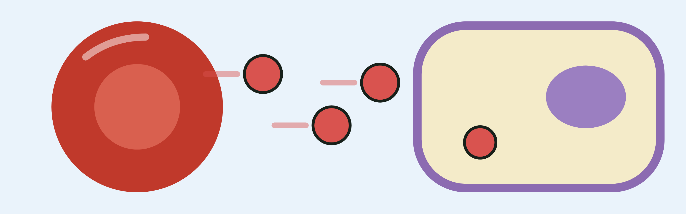
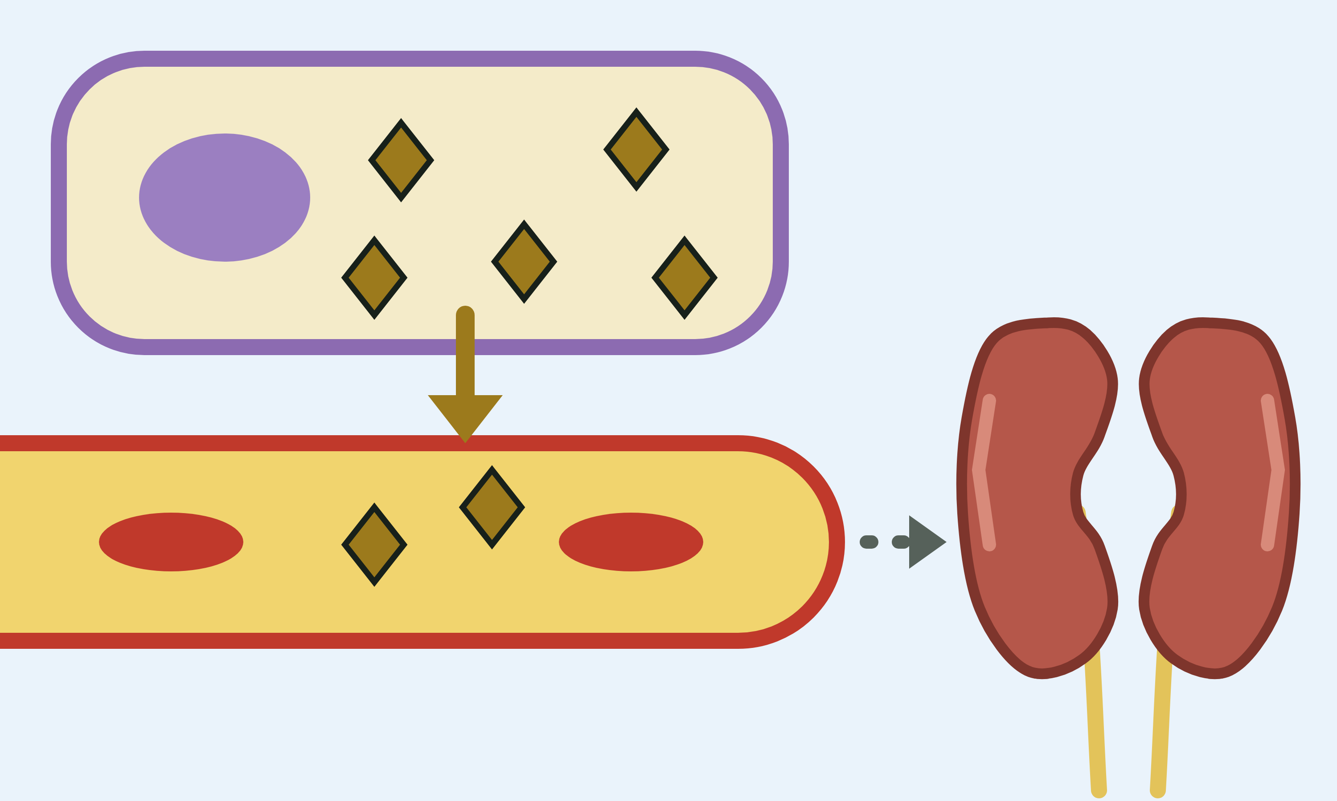
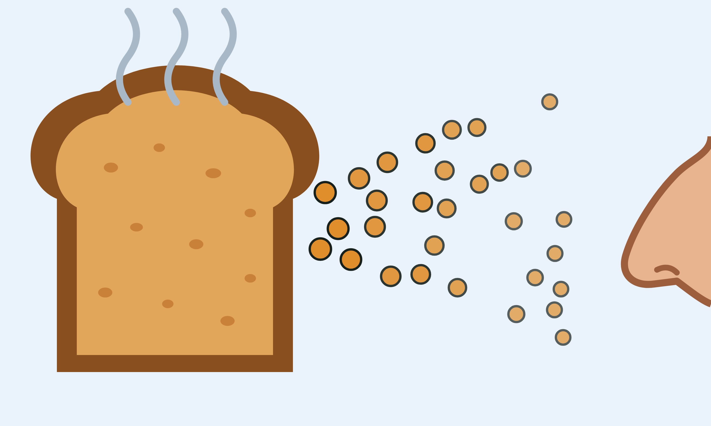
sciencegcse.co.uk · Biology B1 L8: Diffusion
Why this matters in the real world
Diffusion moves substances into and out of every cell in your body, without energy from respiration.
Oxygen for every cell
Cleaning your blood
A smell spreads
250 cm³
of oxygen a minute, at rest
At rest, about 250 cm³ of oxygen diffuses into your blood every minute. Then it diffuses into your cells.
Your cells make a waste called urea. It diffuses into your blood, and your kidneys remove it.
Particles from hot toast spread through the air. Some reach your nose, so you smell it.
Gas exchange
Excretion
Diffusion in a gas
3
B1 L8 · sciencegcse.co.uk
Notes:
Hook. Ask: how does the smell of toast reach you from the other side of the kitchen? (Its particles spread out through the air by diffusion; moving air carries them too, which speeds it up.) Ask: your cells make urea all the time. What would happen if it could not get out of them? (It would build up; we come back to this on slide 10.) 'Gas exchange' and 'excretion' are only tags here: the lungs are B2 L9.

Slide 4
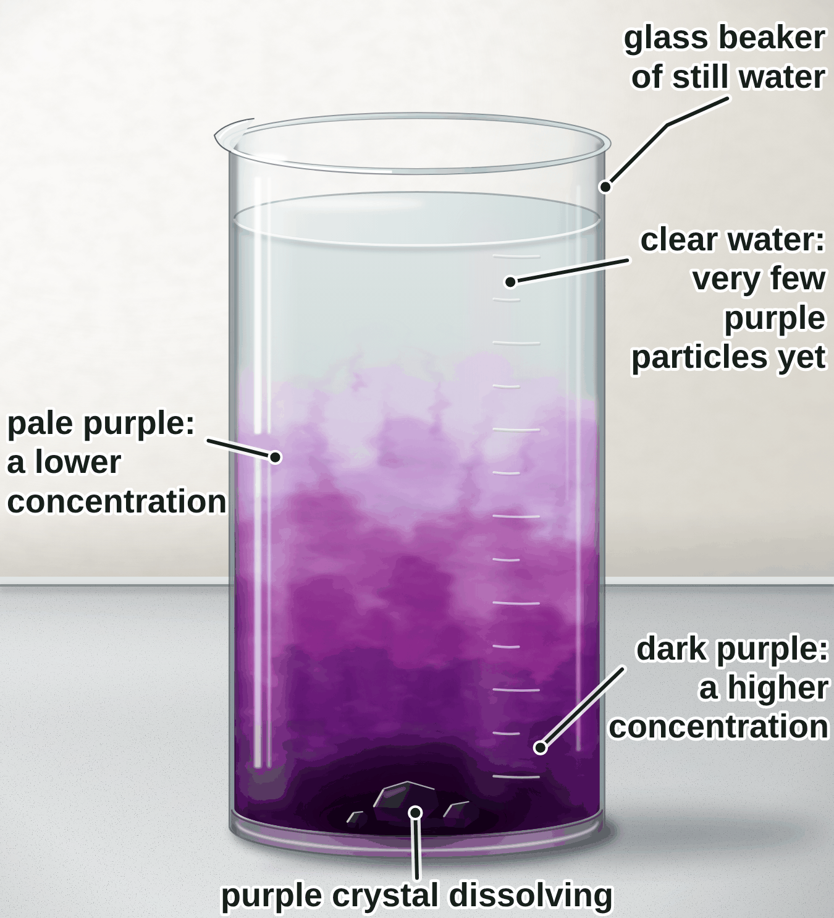
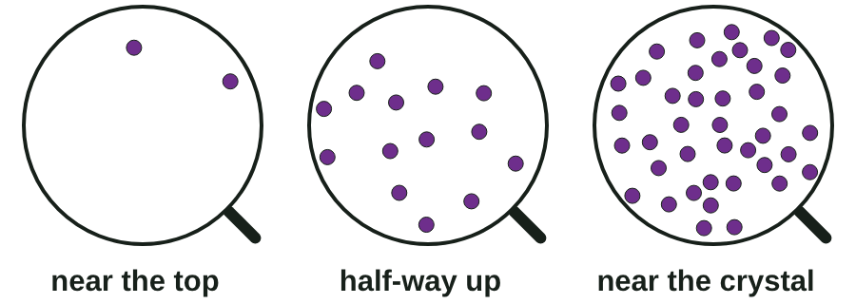
sciencegcse.co.uk · Biology B1 L8: Diffusion
Online lesson: screen 1 of 12
Diffusion: particles spreading out
A purple crystal in still water
Key facts
The purple crystal is potassium manganate(VII). It dissolves in the water.
Its purple particles spread out on their own, from where they are crowded.
The colour is dark where there are lots of particles: a high concentration.
This is diffusion. It happens in gases and in solutions.
The particles spread from a higher concentration to a lower concentration.
Zoom in
A painting, not a photograph.
Potassium manganate(VII) dissolving.
4
B1 L8 · sciencegcse.co.uk
Notes:
Show a real demonstration if you can, before the slide: drop one small crystal of potassium manganate(VII) (also called potassium permanganate) into a tall beaker of still water with tweezers, and leave it on the front bench all lesson. Teacher demonstration only: it is harmful, an oxidiser and stains skin and clothes; wear eye protection. Food colouring dropped gently down the side of the beaker works too. Do not stir: the water must be still. Ask: what is moving? (Particles of the dye: they are far too small to see; the colour shows where they are.) Point at the three zoom circles: more particles in the same volume means a higher concentration. Concentration is the amount of a substance in a given volume. Diffusion happens in gases too: a smell spreading through a room. Link to B1 L1: the cell membrane controls what goes in and out of a cell; many small substances cross it by diffusion. Come back to the beaker at the end of the lesson: the colour will have spread further. Clicks: one key fact a click (the last one green), then the zoom circles. The painting is the same picture as screen 1 of the online lesson, where students can zoom in on three places. The picture is an animated GIF: it moves when the slide show runs; print and PDF show its first frame, a finished still.

Slide 5
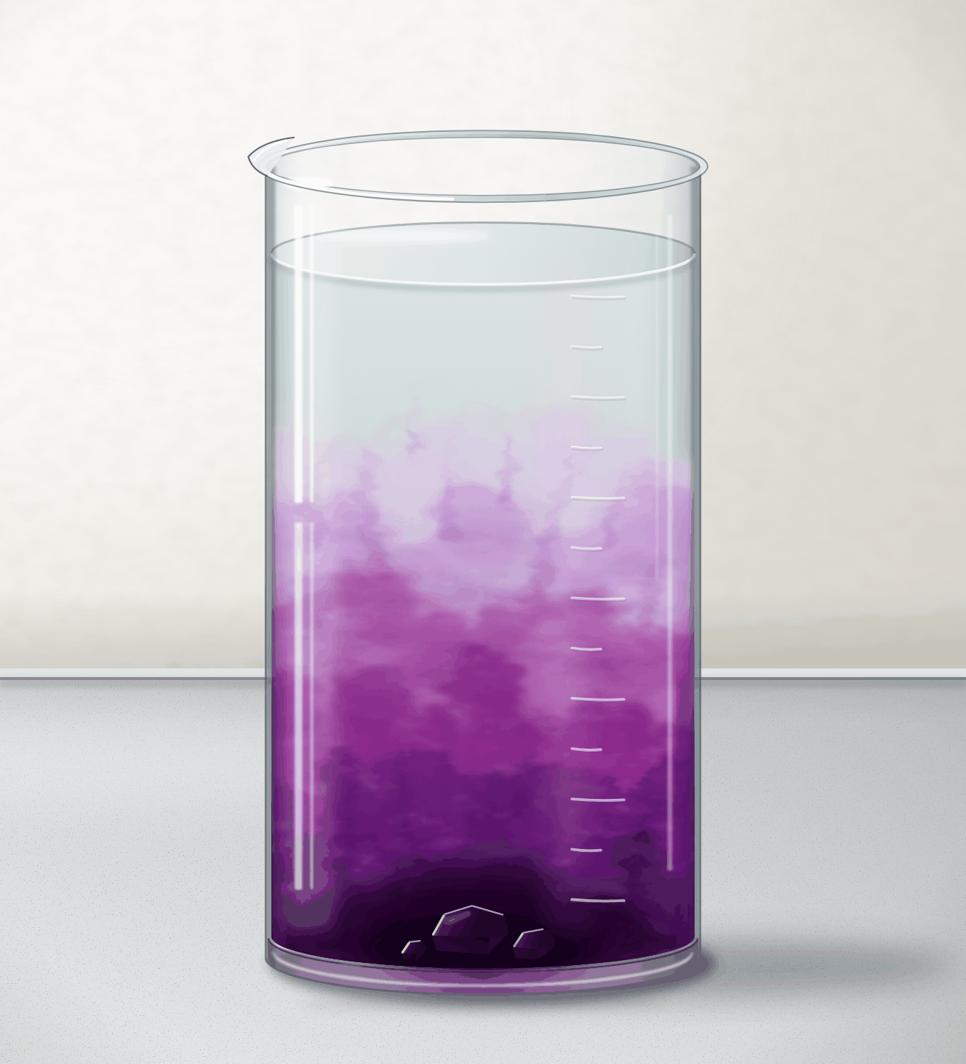
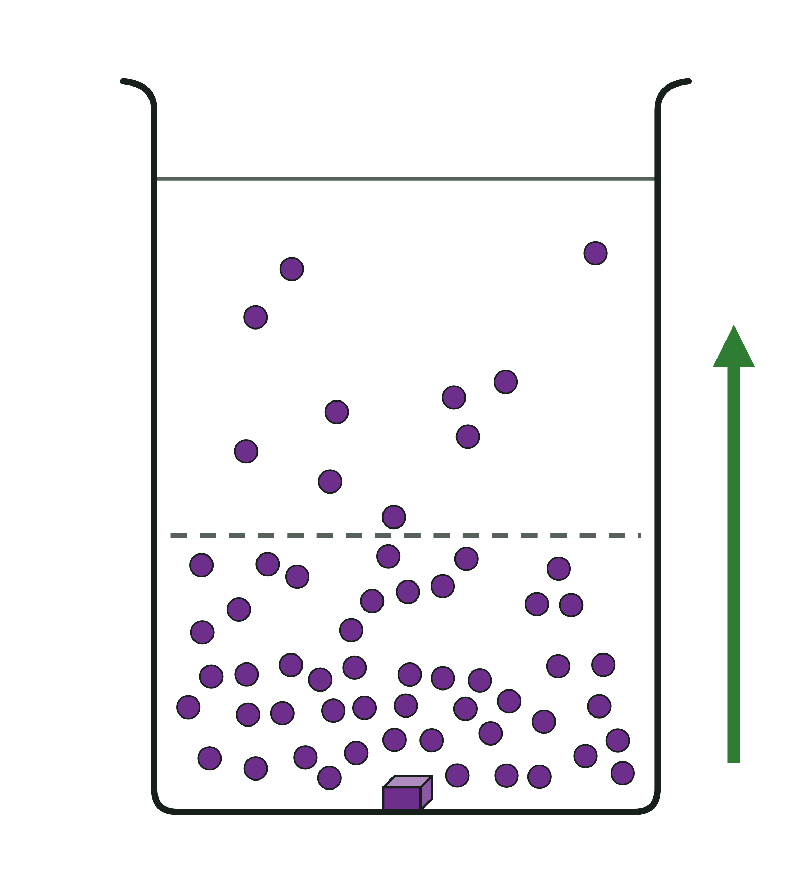
sciencegcse.co.uk · Biology B1 L8: Diffusion
Online lesson: screen 2 of 12
A real beaker and a particle diagram
Same thing, two ways
Spot the differences
1
Particles: Real particles are far too small to see, even with a light microscope. The diagram draws each particle as a dot: it is a model.
2
No line: In the beaker the colour fades gradually from dark to pale. The diagram draws a dashed line to split the water into two areas. The line is not a barrier.
2
4
5
3
How many: A real beaker holds billions of billions of purple particles. The diagram draws a few dozen dots.
2
4
1
5
4
Movement: Each real particle moves at random, in every direction. The arrow in the diagram shows only the net movement.
3
3
1
5
3D: The real purple spreads in three dimensions: up, sideways and all round the beaker. The diagram is flat.
A real beaker
A particle diagram
Particles are far too small to see: the dots in the diagram are a model. The purple colour shows where the particles are.
Both show a higher concentration at the bottom and a lower concentration at the top, with a net movement upwards.
5
B1 L8 · sciencegcse.co.uk
Notes:
Cover the differences and ask: what is different between the painting and the diagram? Take ideas, then reveal them one by one (each click puts its number on both pictures; the last click shows what is the same). Key message: a particle diagram is a model, simplified on purpose. A small crystal holds about a hundred billion billion particles (10²⁰); no diagram could draw them. The dashed line only helps us count particles on each side: it is not a wall, and particles cross it both ways. The arrow shows the net movement only; each particle zig-zags at random, which is the next slide. Both pictures agree on the science: a higher concentration at the bottom, a net movement upwards. The online lesson, screen 2, has the same pictures and differences.

Slide 6
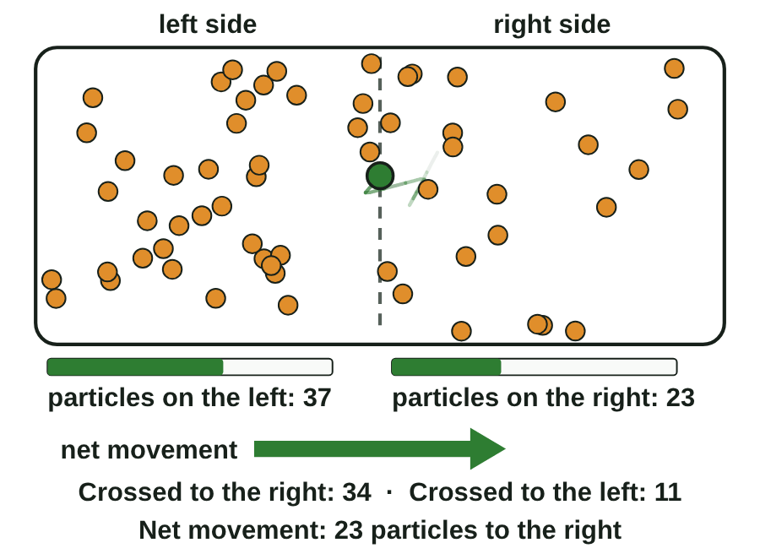
sciencegcse.co.uk · Biology B1 L8: Diffusion
Online lesson: screen 3 of 12
Particles move at random
Watch the particles
What to look for
Every particle moves at random, in all directions.
Particles cross the dashed line both ways. More cross from the crowded side.
Net movement: the overall movement in one direction, after taking away the movement the other way.
Watch out: particles do not “want” to spread out. Diffusion is a net movement: they move both ways.
Diffusion: the net movement of particles from an area of higher concentration to an area of lower concentration.
Each dot is a particle. Real particles are far too small to see.
▶ Online lesson, screen 3: watch the particles and the counters
6
B1 L8 · sciencegcse.co.uk
Notes:
Let the GIF run, then open screen 3 online and press Follow one particle: it zig-zags at random and often goes back the way it came. No particle 'knows' where the crowded side is. Then look at the counters: particles cross both ways, but more cross from the left, simply because there are more of them on the left. Net movement = the number crossing one way minus the number crossing back. Example: the counters on the slide show 34 crossing to the right and 11 crossing back: a net movement of 34 − 11 = 23 to the right. The concentration gradient is the difference in concentration between the two sides; the bigger the difference, the faster the net movement. Diffusion needs no energy from respiration: the particles move on their own (their kinetic energy, in physics words). Clicks: one line a click, the definition last (green). The picture is an animated GIF: it moves when the slide show runs; print and PDF show its first frame, a finished still.

Slide 7
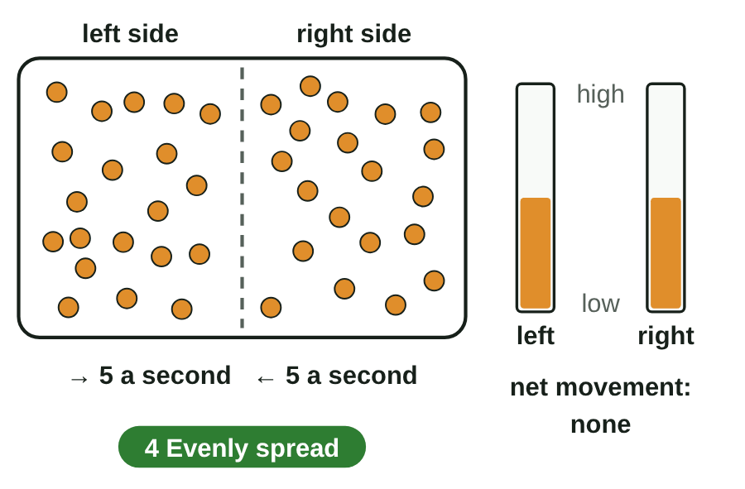
sciencegcse.co.uk · Biology B1 L8: Diffusion
Online lesson: screen 4 of 12
Evenly spread: no net movement
Spreading out
Step by step
1
Start: All the particles start on one side: a steep concentration gradient.
2
Spreading: Many more cross one way than come back: a fast net movement.
3
Nearly even: A smaller difference in concentration: a slower net movement.
4
Evenly spread: The particles still move, but there is no net movement.
Evenly spread particles keep moving. Only the net movement stops.
▶ Online lesson, screen 4: Evenly spread: no net movement
Each dot is a particle. Real particles are far too small to see.
7
B1 L8 · sciencegcse.co.uk
Notes:
Ask before step 4: when the particles are evenly spread, do they stop moving? Most students say yes. They never stop: particles in a liquid or a gas are always moving. What stops is the net movement, because the same number cross each way. The concentration stays the same everywhere. This is why the purple in the demonstration beaker will end up an even pale purple, not clear. Notice the net movement slows down as it goes: the smaller the difference in concentration, the slower the net movement. That idea comes back on slide 14. Clicks: one step a click, then the green line. The online lesson, screen 4, has the same four steps with Next step. The picture is an animated GIF: it moves when the slide show runs; print and PDF show its first frame, a finished still.

Slide 8
sciencegcse.co.uk · Biology B1 L8: Diffusion
Online lesson: screen 5 of 12
Checkpoint 1
✓
CHECKPOINT 1 of 3
Quick check on slides 4 to 7 (online screens 1 to 4). Show A, B or C on your whiteboard.
Question 1
Question 2
Question 3
Why can you not see the purple particles one by one in the beaker?
Particles move at random. Why is there still a net movement from a higher to a lower concentration?
The particles are now evenly spread. What happens next?
A. They have dissolved, so they have gone.
A. The particles want to spread out.
A. They keep moving, but there is no net movement.
B. They are far too small to see.
B. Energy from respiration pushes the particles.
B. They stop moving.
C. The water hides them.
C. More particles move out of the crowded area than move into it.
C. They move back to where they started.
✓ Check your answers on the next slide
8
B1 L8 · sciencegcse.co.uk
Notes:
Hinge check. Everyone shows A, B or C at the same time. Q1 A tests 'dissolved means gone'; Q2 A tests 'particles want to spread out' and Q2 B 'diffusion needs energy'; Q3 B is the big one: 'evenly spread particles stop moving'. If several get Q1 wrong, go back to slide 5; Q2, slide 6; Q3, slide 7.

Slide 9
sciencegcse.co.uk · Biology B1 L8: Diffusion
Online lesson: screen 5 of 12
Checkpoint 1 answers
✓
CHECKPOINT 1 of 3
Quick check on slides 4 to 7 (online screens 1 to 4). Show A, B or C on your whiteboard.
Question 1
Question 2
Question 3
Why can you not see the purple particles one by one in the beaker?
Particles move at random. Why is there still a net movement from a higher to a lower concentration?
The particles are now evenly spread. What happens next?
A. They have dissolved, so they have gone.
A. The particles want to spread out.
A. They keep moving, but there is no net movement.
A. They keep moving, but there is no net movement. ✓
B. They are far too small to see.
B. They are far too small to see. ✓
B. Energy from respiration pushes the particles.
B. They stop moving.
C. The water hides them.
C. More particles move out of the crowded area than move into it.
C. More particles move out of the crowded area than move into it. ✓
C. They move back to where they started.
Each one is far too small to see, so a particle diagram draws them as dots.
There are more particles in the crowded area, so more of them cross out of it.
The same number cross each way, so the concentration stays the same.
Got one wrong? Look back: Q1 slide 5 · Q2 slide 6 · Q3 slide 7
9
B1 L8 · sciencegcse.co.uk
Notes:
1 B, 2 C, 3 A. Each click shows one answer and why. Follow-up for Q3: so how could you tell, by looking, that the particles in the beaker are still moving when the colour is even? (You cannot see it; the model tells us. Under a microscope, tiny specks of dust in water jiggle about because moving water particles bump into them: this is called Brownian motion, in physics.)

Slide 10
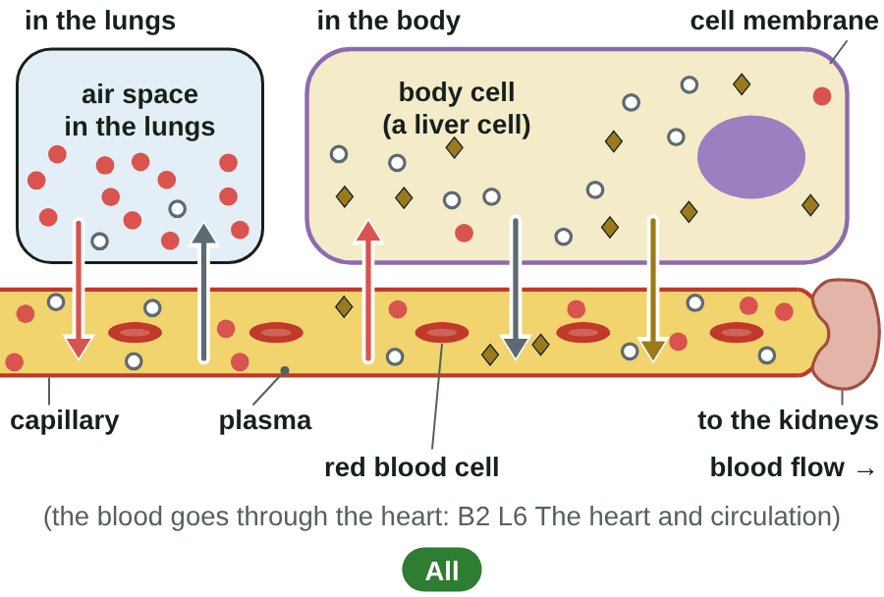
sciencegcse.co.uk · Biology B1 L8: Diffusion
Online lesson: screen 6 of 12
Diffusion in the body
In the lungs and in the body
Into and out of cells
Substance
Diffuses from
Diffuses to
oxygen
the air in the lungs
the blood
oxygen
the blood
respiring body cells
carbon dioxide
respiring body cells
the blood (then out in the lungs)
urea
cells (mostly liver cells)
the blood plasma (then to the kidneys)
Watch out!
Excretion: the removal of waste products made in the body. The kidneys excrete urea.
Water crossing a cell membrane is a special case of diffusion, called osmosis (B1 L9 Osmosis).
Each substance moves from a higher to a lower concentration of that substance.
● oxygen ○ carbon dioxide ◆ urea
A diagram is simplified. Real particles are far too small to see.
▶ Online lesson, screen 6: tap each substance
10
B1 L8 · sciencegcse.co.uk
Notes:
AQA names these examples: oxygen and carbon dioxide in gas exchange, and urea from cells into the blood plasma for excretion in the kidney. Run screen 6 online and tap each chip. Ask for each substance: where is its concentration higher, and why? Oxygen: the cells use it in respiration, so it is low inside them. Carbon dioxide and urea: the cells make them, so they are high inside. Each substance diffuses down its own gradient, at the same time, through the same membrane. The lungs are B2 L9 Lungs and gas exchange; the heart, which pumps the blood between the lungs and the body, is B2 L6. Excretion means removing waste products made in the body: the kidneys excrete urea in urine. Water is the exception students meet next lesson: water across a membrane is osmosis. Clicks: the four table rows, then the two Watch out lines. The GIF lights oxygen, carbon dioxide and urea in turn, as the chips do online. The picture is an animated GIF: it moves when the slide show runs; print and PDF show its first frame, a finished still.

Slide 11
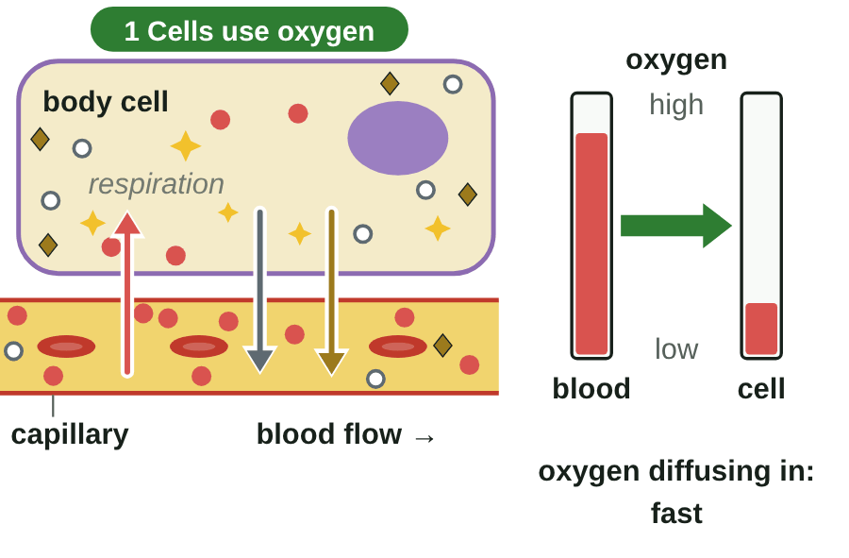
sciencegcse.co.uk · Biology B1 L8: Diffusion
Online lesson: screen 7 of 12
Keeping the gradient steep
A body cell and a capillary
Step by step
1
Cells use oxygen: Respiration uses oxygen, so oxygen stays low inside the cell.
2
Blood keeps flowing: Fresh blood keeps the oxygen in the blood high.
3
Waste is carried away: The blood takes carbon dioxide and urea to the lungs and kidneys.
4
If the blood stopped: The difference in concentration would shrink: slower diffusion.
Watch out: diffusion needs no energy from respiration. Respiration only keeps the gradient steep.
▶ Online lesson, screen 7: Keeping the gradient steep
● oxygen ○ carbon dioxide ◆ urea. A diagram is simplified.
11
B1 L8 · sciencegcse.co.uk
Notes:
The concentration gradient is the difference in concentration between two areas. In the body it stays steep because cells keep using oxygen and making waste, and the blood keeps moving. Ask the step 4 question before revealing it: what if the blood stopped? (The blood next to the cell would lose its oxygen and fill with waste; no big difference, so very little net movement.) The heart keeps the blood moving (B2 L6 The heart and circulation). Common error: students write that respiration gives the oxygen energy to move into the cell. It does not: the oxygen moves by diffusion; respiration just uses it up, which keeps the concentration inside low. Clicks: one step a click, then the green line. The online lesson, screen 7, has the same four steps. The picture is an animated GIF: it moves when the slide show runs; print and PDF show its first frame, a finished still.

Slide 12
sciencegcse.co.uk · Biology B1 L8: Diffusion
Online lesson: screen 8 of 12
Checkpoint 2
✓
CHECKPOINT 2 of 3
Quick check on slides 10 and 11 (online screens 6 and 7). Show A, B or C on your whiteboard.
Question 1
Question 2
Question 3
Liver cells make urea. It diffuses from the liver cells into the blood plasma. Where is the concentration of urea higher?
Respiration in a body cell makes carbon dioxide. Which way does the carbon dioxide diffuse?
How does flowing blood help oxygen keep diffusing into a body cell?
A. In the blood plasma
A. Out of the cell, into the blood
A. It pumps oxygen into the cell.
B. It is the same in the cells and in the plasma
B. Out of the blood, into the cell
B. It keeps bringing fresh blood with a high oxygen concentration.
C. Inside the liver cells
C. It stays inside the cell
C. It stops oxygen particles moving back out of the cell.
✓ Check your answers on the next slide
12
B1 L8 · sciencegcse.co.uk
Notes:
Mini whiteboards: A, B or C. Listen for 'the same' in Q1 (if the concentrations were the same there would be no net movement) and 'into the cell' in Q2 (that is the way oxygen goes, not carbon dioxide). If several get Q1 or Q2 wrong, go back to slide 10; Q3, slide 11.

Slide 13
sciencegcse.co.uk · Biology B1 L8: Diffusion
Online lesson: screen 8 of 12
Checkpoint 2 answers
✓
CHECKPOINT 2 of 3
Quick check on slides 10 and 11 (online screens 6 and 7). Show A, B or C on your whiteboard.
Question 1
Question 2
Question 3
Liver cells make urea. It diffuses from the liver cells into the blood plasma. Where is the concentration of urea higher?
Respiration in a body cell makes carbon dioxide. Which way does the carbon dioxide diffuse?
How does flowing blood help oxygen keep diffusing into a body cell?
A. In the blood plasma
A. Out of the cell, into the blood
A. Out of the cell, into the blood ✓
A. It pumps oxygen into the cell.
B. It is the same in the cells and in the plasma
B. Out of the blood, into the cell
B. It keeps bringing fresh blood with a high oxygen concentration.
B. It keeps bringing fresh blood with a high oxygen concentration. ✓
C. Inside the liver cells
C. Inside the liver cells ✓
C. It stays inside the cell
C. It stops oxygen particles moving back out of the cell.
The liver cells make urea, so its concentration is higher inside them than in the plasma.
Respiration makes carbon dioxide, so its concentration is higher in the cell than in the blood.
The oxygen concentration in the blood stays higher than in the cell, so the gradient stays steep.
Got one wrong? Look back: Q1 and Q2 slide 10 · Q3 slide 11
13
B1 L8 · sciencegcse.co.uk
Notes:
1 C, 2 A, 3 B. Each click shows one answer and why. Follow-up: so what would happen to the diffusion of urea out of liver cells if the kidneys stopped removing urea from the blood? (Urea would build up in the blood, the difference in concentration would get smaller, and urea would diffuse out of the cells more slowly.)

Slide 14
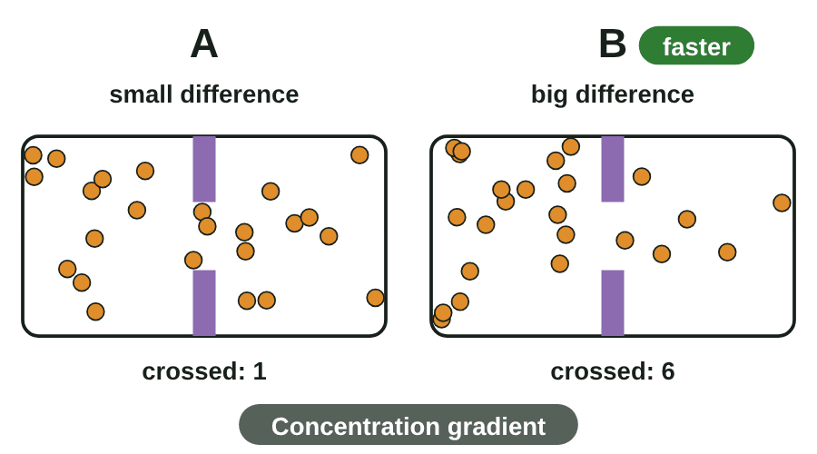
sciencegcse.co.uk · Biology B1 L8: Diffusion
Online lesson: screen 9 of 12
Four factors: faster or slower?
Diffusion races
Faster diffusion
Factor
Faster when ...
Why
concentration gradient
the difference in concentration is bigger
more particles cross than come back
temperature
it is warmer
particles have more energy and move faster
surface area of the membrane
it is larger
more particles can cross at once
distance
it is shorter (a thinner membrane)
particles have less far to go
Watch out!
When they are heated, particles do not expand or get bigger. They move faster.
Concentration gradient: the difference in concentration between two areas. A bigger (steeper) gradient means a bigger difference.
Each dot is a particle. A diagram is simplified.
▶ Online lesson, screen 9: predict, then run the races
14
B1 L8 · sciencegcse.co.uk
Notes:
AQA names three factors: the difference in concentration (concentration gradient), the temperature, the surface area of the membrane. The distance is the fourth: a thin membrane gives a short diffusion distance (B1 L10 Active transport and exchange surfaces explains why exchange surfaces are thin and have a large surface area). Run the races on screen 9 online: students predict first, on whiteboards, then watch. In explanations, always give the reason: 'warmer, so the particles have more energy and move faster', never 'warmer, so the particles expand'. A bigger concentration gradient and a steeper concentration gradient mean the same: a bigger difference in concentration. Clicks: the four table rows, then the two Watch out lines. The GIF runs the four races in turn: concentration gradient, temperature, surface area, distance. The picture is an animated GIF: it moves when the slide show runs; print and PDF show its first frame, a finished still.

Slide 15
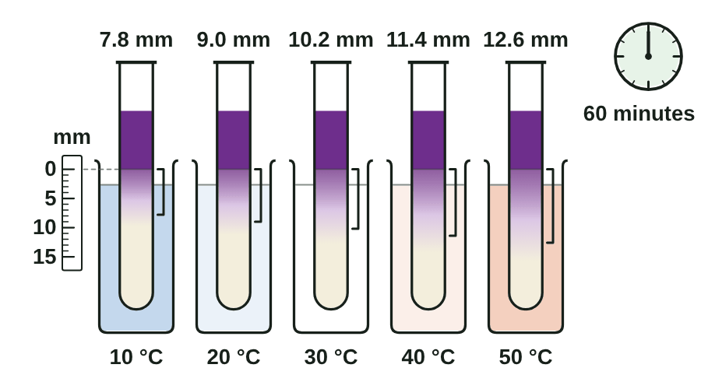
sciencegcse.co.uk · Biology B1 L8: Diffusion
Online lesson: screen 10 of 12
Measuring the rate of diffusion
Dye in jelly at five temperatures
Results after 60 minutes
Temperature (°C)
Distance (mm)
Rate (mm/min)
10
7.8
0.13
20
9.0
0.15
30
10.2
0.17
40
11.4
0.19
50
12.6
0.21
Worked examples
rate of diffusion = distance ÷ time
1. At 30 °C: 10.2 mm ÷ 60 minutes = 0.17 mm per minute.
2. A dye moves 1.2 cm in 40 minutes. Change cm to mm first: 1.2 cm = 12 mm. 12 ÷ 40 = 0.3 mm per minute.
Check: rate × time = distance (0.3 × 40 = 12 mm).
Example results. The colour shows where the dye particles are.
▶ Online lesson, screen 10: run 60 minutes, then try it
15
B1 L8 · sciencegcse.co.uk
Notes:
How to run it as a class practical or demonstration: half-fill test tubes with agar jelly (it sets like table jelly but does not melt in warm water); stand them in water baths at different temperatures; add the same volume of the same dye on top of each; after a set time, measure how far the colour has moved down with a ruler. Jelly is used because it is still: in water, currents would carry the dye too. Variables: independent, the temperature; dependent, the distance moved in 60 minutes (or the rate); control, the same dye, the same concentration and volume of dye, the same jelly, the same size of tube, the same time. Safety: eye protection; take care with hot water. Maths: rate = distance ÷ time, in mm per minute. Put both quantities in the right units first (worked example 2). Check by multiplying back. This is a mean (average) rate: the dye slows down as it spreads further, because the difference in concentration gets smaller. The graph of these results is on the practice slide (19). Clicks: the five table rows, then the four worked-example lines. Online, screen 10 has a Try it calculator. The picture is an animated GIF: it moves when the slide show runs; print and PDF show its first frame, a finished still.

Slide 16
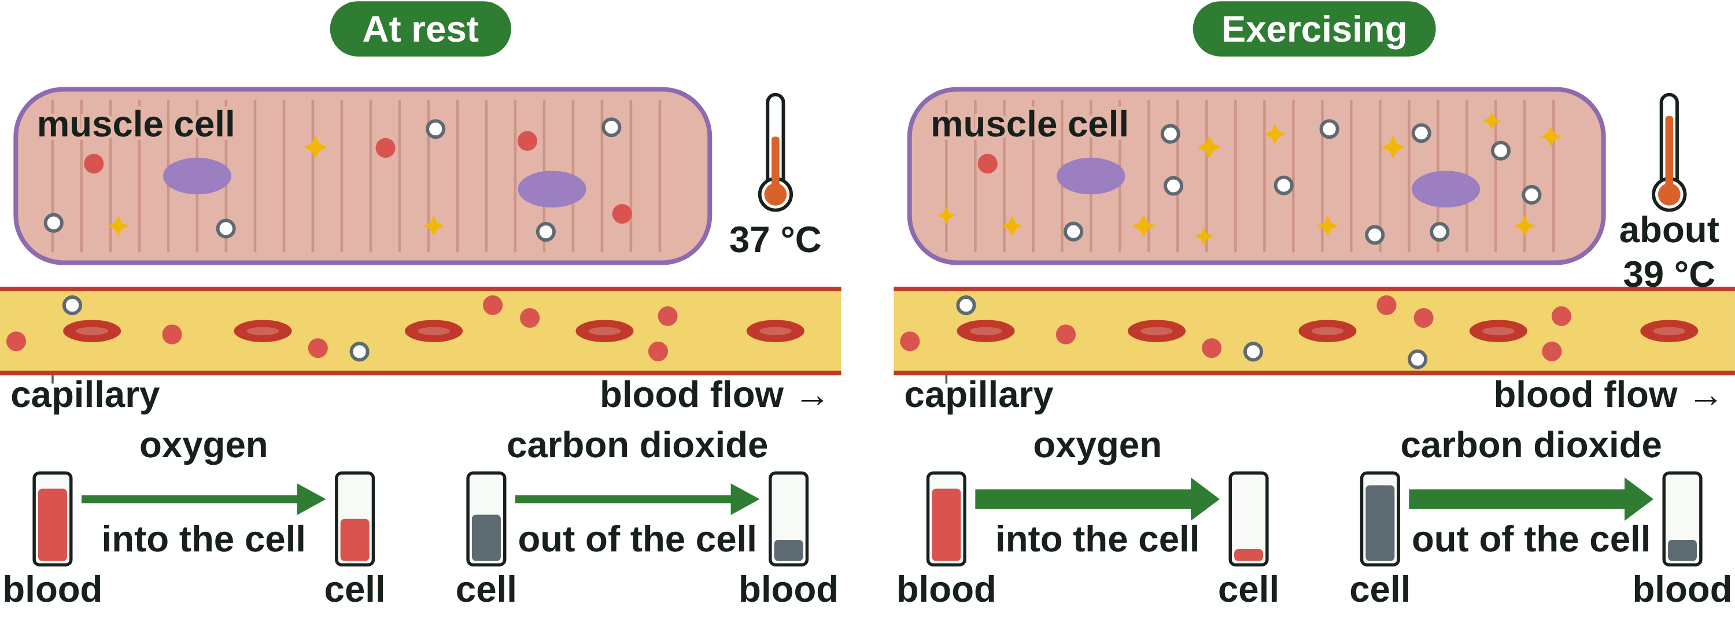
sciencegcse.co.uk · Biology B1 L8: Diffusion
Online lesson: screen 11 of 12
Apply it: muscles during exercise
At rest and exercising
During exercise
Muscle cells respire faster.
They use oxygen faster, so the oxygen inside them falls lower.
They make more carbon dioxide, so it builds up higher inside them.
● oxygen ○ carbon dioxide. A diagram is simplified.
Three changes
Change
Effect on diffusion
a steeper oxygen gradient
oxygen diffuses into the cells faster
a steeper carbon dioxide gradient
carbon dioxide diffuses out faster
the muscle is a little warmer
the particles move faster
16
B1 L8 · sciencegcse.co.uk
Notes:
This applies slides 11 and 14 to a new situation. Ask first: when you sprint, what happens to the oxygen inside your leg muscle cells? (It is used faster, so its concentration falls.) Then: what does that do to the difference in concentration between the blood and the cells? (Bigger: a steeper gradient, so faster diffusion.) Carbon dioxide is the mirror image. Working muscles warm up to about 39 °C, so diffusion is a little faster too. The heart beats faster and you breathe faster, so the blood keeps the gradients steep (B2 L6 and B2 L9). Respiration releases energy for the muscles to contract; never write that it makes or produces energy. Clicks: the three 'During exercise' lines (this is the online switch moving to Exercising), then the three table rows wipe in from the left. The picture shows both states side by side, at rest on the left and exercising on the right; online, screen 11 switches between them.

Slide 17
sciencegcse.co.uk · Biology B1 L8: Diffusion
Online lesson: screen 12 of 12
Checkpoint 3
✓
CHECKPOINT 3 of 3
Quick check on slides 14 to 16 (online screens 9 to 11). Show A, B or C on your whiteboard.
Question 1
Question 2
Question 3
Which change makes diffusion faster?
A dye moves 12 mm into jelly in 60 minutes. What is its rate of diffusion?
During exercise, why does oxygen diffuse into muscle cells faster?
A. A larger surface area of the membrane
A. 5 mm per minute
A. The muscle cells need less oxygen.
B. A lower temperature
B. 0.2 mm per minute
B. The muscle cells pump the oxygen in.
C. A thicker membrane
C. 720 mm per minute
C. The cells use oxygen faster, so the concentration gradient is steeper.
✓ Check your answers on the next slide
17
B1 L8 · sciencegcse.co.uk
Notes:
Mini whiteboards. Q2 is the calculation: anyone who picks A divided the wrong way round; write 'rate = distance ÷ time' on the board. Q1 B and C are the two 'slower' changes. If several get Q1 wrong, go back to slide 14; Q2, slide 15; Q3, slide 16.

Slide 18
sciencegcse.co.uk · Biology B1 L8: Diffusion
Online lesson: screen 12 of 12
Checkpoint 3 answers
✓
CHECKPOINT 3 of 3
Quick check on slides 14 to 16 (online screens 9 to 11). Show A, B or C on your whiteboard.
Question 1
Question 2
Question 3
Which change makes diffusion faster?
A dye moves 12 mm into jelly in 60 minutes. What is its rate of diffusion?
During exercise, why does oxygen diffuse into muscle cells faster?
A. A larger surface area of the membrane
A. A larger surface area of the membrane ✓
A. 5 mm per minute
A. The muscle cells need less oxygen.
B. A lower temperature
B. 0.2 mm per minute
B. 0.2 mm per minute ✓
B. The muscle cells pump the oxygen in.
C. A thicker membrane
C. 720 mm per minute
C. The cells use oxygen faster, so the concentration gradient is steeper.
C. The cells use oxygen faster, so the concentration gradient is steeper. ✓
A larger surface area lets more particles cross at the same time.
Rate = distance ÷ time = 12 ÷ 60 = 0.2 mm per minute.
Less oxygen inside the cells makes the concentration gradient steeper.
Got one wrong? Look back: Q1 slide 14 · Q2 slide 15 · Q3 slide 16
18
B1 L8 · sciencegcse.co.uk
Notes:
1 A, 2 B, 3 C. Each click shows one answer and why. Next: practise reading the graph of the jelly results.

Slide 19
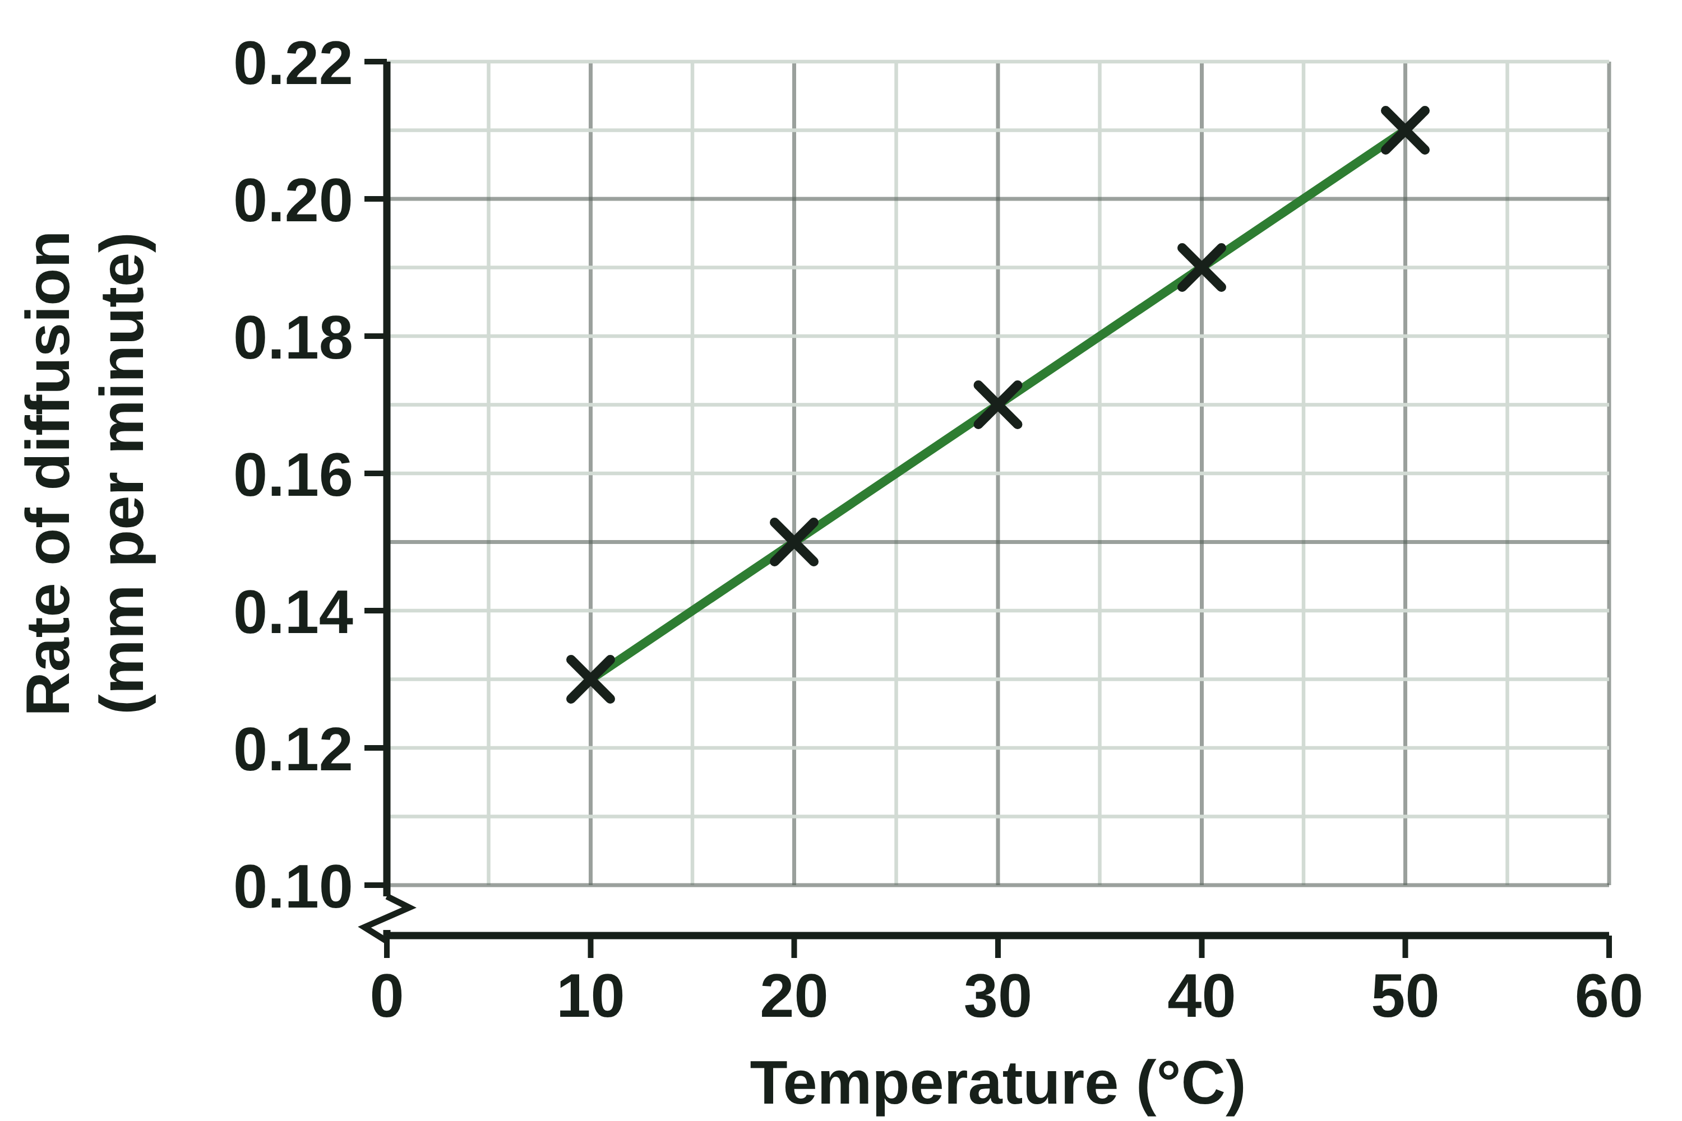
sciencegcse.co.uk · Biology B1 L8: Diffusion
Practice: Read the graph
Rate of diffusion and temperature
Questions
1. What is the rate of diffusion at 20 °C?
______________
2. At which temperature was the rate 0.19 mm per minute?
______________
3. Describe the pattern shown by the graph.
________________________________________
4. Use the line to estimate the rate at 25 °C.
______________
5. Use your answer to question 4 to predict how far the dye would move in 60 minutes at 25 °C.
________________________________________
6. Give one variable that must be kept the same in every tube.
______________
Example results: dye in agar jelly for 60 minutes.
19
B1 L8 · sciencegcse.co.uk
Notes:
Pairs, 5 minutes. Read across from the axis to the line, then down (or across) to the other axis. Use a ruler on the screen if you can. Q4 is between two points: read it from the line of best fit, not from a point. The graph shows the results from slide 15.

Slide 20
sciencegcse.co.uk · Biology B1 L8: Diffusion
Read the graph: answers
Rate of diffusion and temperature
Answers
1. What is the rate of diffusion at 20 °C?
0.15 mm per minute
2. At which temperature was the rate 0.19 mm per minute?
40 °C
3. Describe the pattern shown by the graph.
As the temperature increases, the rate of diffusion increases.
4. Use the line to estimate the rate at 25 °C.
About 0.16 mm per minute
5. Use your answer to question 4 to predict how far the dye would move in 60 minutes at 25 °C.
0.16 × 60 = 9.6 mm
6. Give one variable that must be kept the same in every tube.
Any one: the type of dye; the concentration or volume of the dye; the jelly; the size of the tube; the time (60 minutes).
Example results: dye in agar jelly for 60 minutes.
20
B1 L8 · sciencegcse.co.uk
Notes:
Q3: a full answer says what happens to both variables. Q5 uses rate × time = distance, the check from slide 15: 9.6 mm sits between 9.0 mm (20 °C) and 10.2 mm (30 °C), so it makes sense. Q6: the temperature is the independent variable, so it is the one thing that changes.

Slide 21
sciencegcse.co.uk · Biology B1 L8: Diffusion
Exam practice
1. A drop of food colouring is placed in a beaker of still water. Describe what happens to the food colouring particles over the next few days. [3]
The particles move at random, in all directions (1). There is a net movement from the higher concentration (where the drop is) to the lower concentration (1). In the end they are evenly spread: they keep moving, but there is no net movement (1).
2. Carbon dioxide diffuses out of a respiring cell into the blood. Explain why. [2]
Respiration in the cell makes carbon dioxide, so its concentration is higher in the cell than in the blood (1). It diffuses from a higher to a lower concentration, out of the cell (1).
21
B1 L8 · sciencegcse.co.uk
Notes:
Model answers with mark points in brackets. Students try each question first, then mark their own work in green. Q1: 'the particles want to spread out' scores 0 for that point; 'the colour spreads out' is not enough for the first mark, which needs random movement of particles. Q2: 'the cell pushes it out' scores 0: no energy is used. For more, the B1 L8 Exam questions worksheet (PDF) has five questions, 20 marks; its mark scheme is at the end of this PowerPoint. The same questions are in the online lesson, after the quiz.

Slide 22
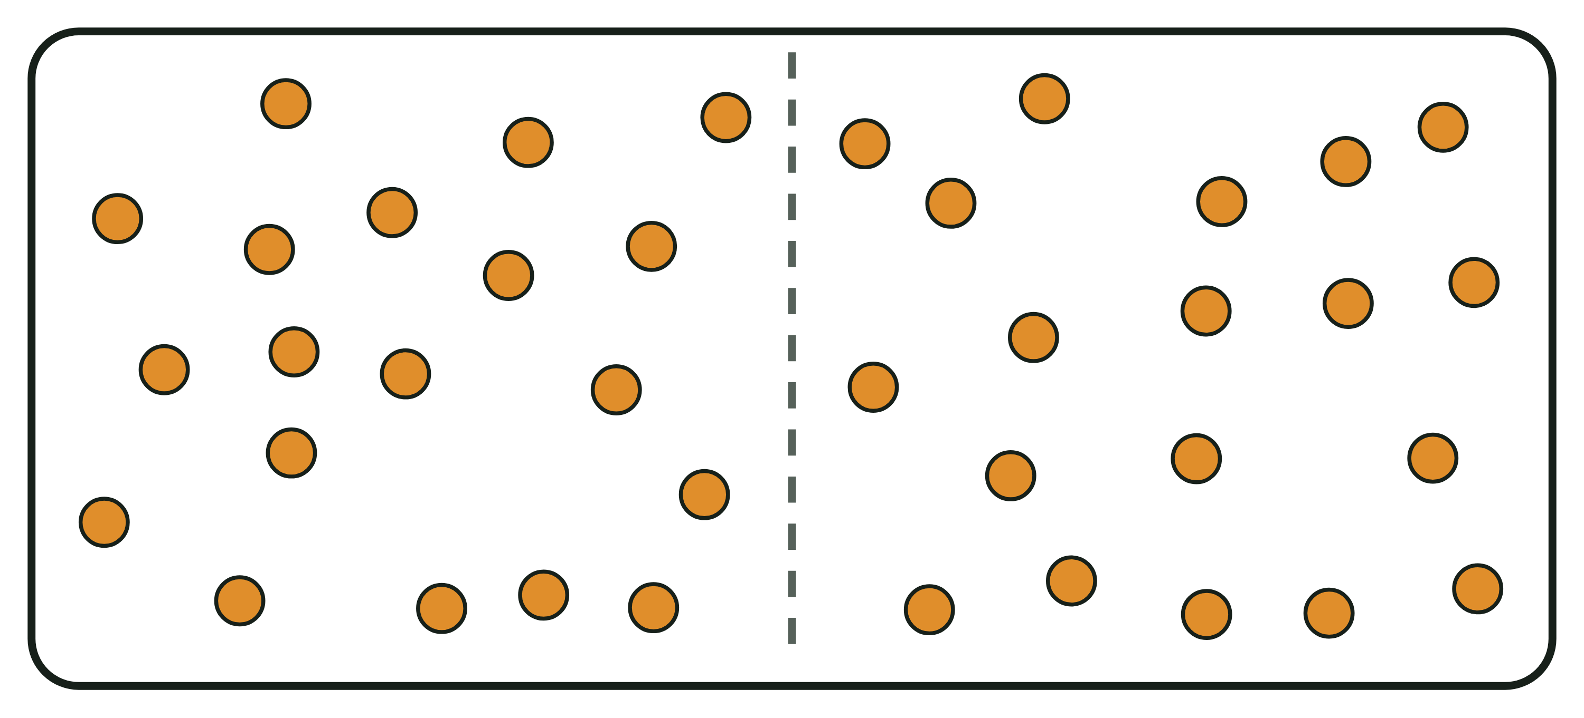
sciencegcse.co.uk · Biology B1 L8: Diffusion
Exit ticket
Answer on your own
How confident am I?
1. Name the process in which particles spread from a higher to a lower concentration. [1]
I can describe diffusion as a net movement.
2. Which gas do respiring cells use up, so that it keeps diffusing into them? [1]
I can give examples of diffusion in the body.
Particles evenly spread in a liquid
3. A student wants a dye to diffuse faster through jelly. Give one thing they could change. [1]
I can explain what makes diffusion faster.
4. Particles are evenly spread out in a liquid. Explain why there is no net movement, even though the particles are still moving. [2]
22
B1 L8 · sciencegcse.co.uk
Notes:
Students answer on their own, then rate their confidence. Q4 checks the big misconception of the lesson: evenly spread particles do not stop moving. The picture shows particles evenly spread, with no arrow: there is no net movement.

Slide 23
sciencegcse.co.uk · Biology B1 L8: Diffusion
Exit ticket answers
Answers
Next lesson
1. Diffusion.
2. Oxygen.
3. Any one: a higher temperature; a more concentrated dye (a bigger concentration gradient); a larger surface area.
4. The particles move at random, in all directions (1). The same number move each way, so the concentration stays the same (1).
Next: B1 L9 Osmosis
How water moves into and out of cells by osmosis, and how to measure it with potato cylinders.
Worksheets:
• Mandatory (everyone)
• Alternative (easier, with key notes)
• Challenge (when you finish the Mandatory)
• Exam questions (exam style, 20 marks, homework)
▶ Online lesson: quiz and exam questions
23
B1 L8 · sciencegcse.co.uk
Notes:
Go through the answers. Q3: 'make the jelly thinner' also works (a shorter distance). Homework: the online lesson quiz and the B1 L8 Exam questions worksheet. Look at the demonstration beaker one last time: the purple has spread further, and it will end up an even pale purple. After this slide: the B1 L8 revision notes (4 printable pages), then the worksheets with answers in green: the Mandatory worksheet (everyone), the Challenge worksheet (stretch) and the Alternative worksheet (easier: key notes and very simple tasks). The exam questions mark scheme is the last two slides.

Slide 24
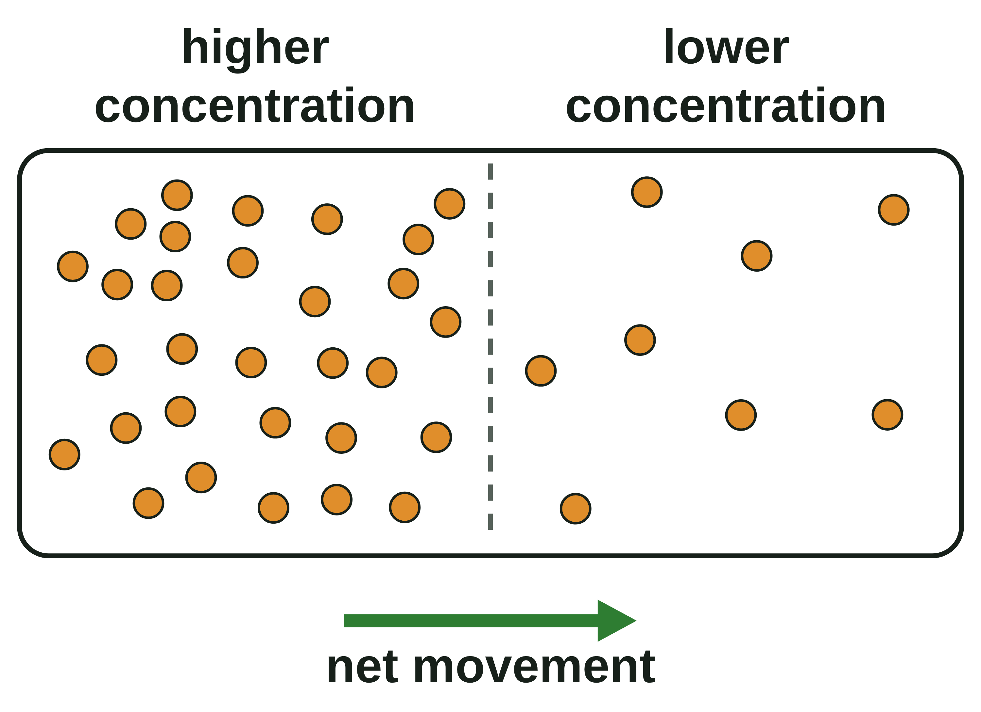
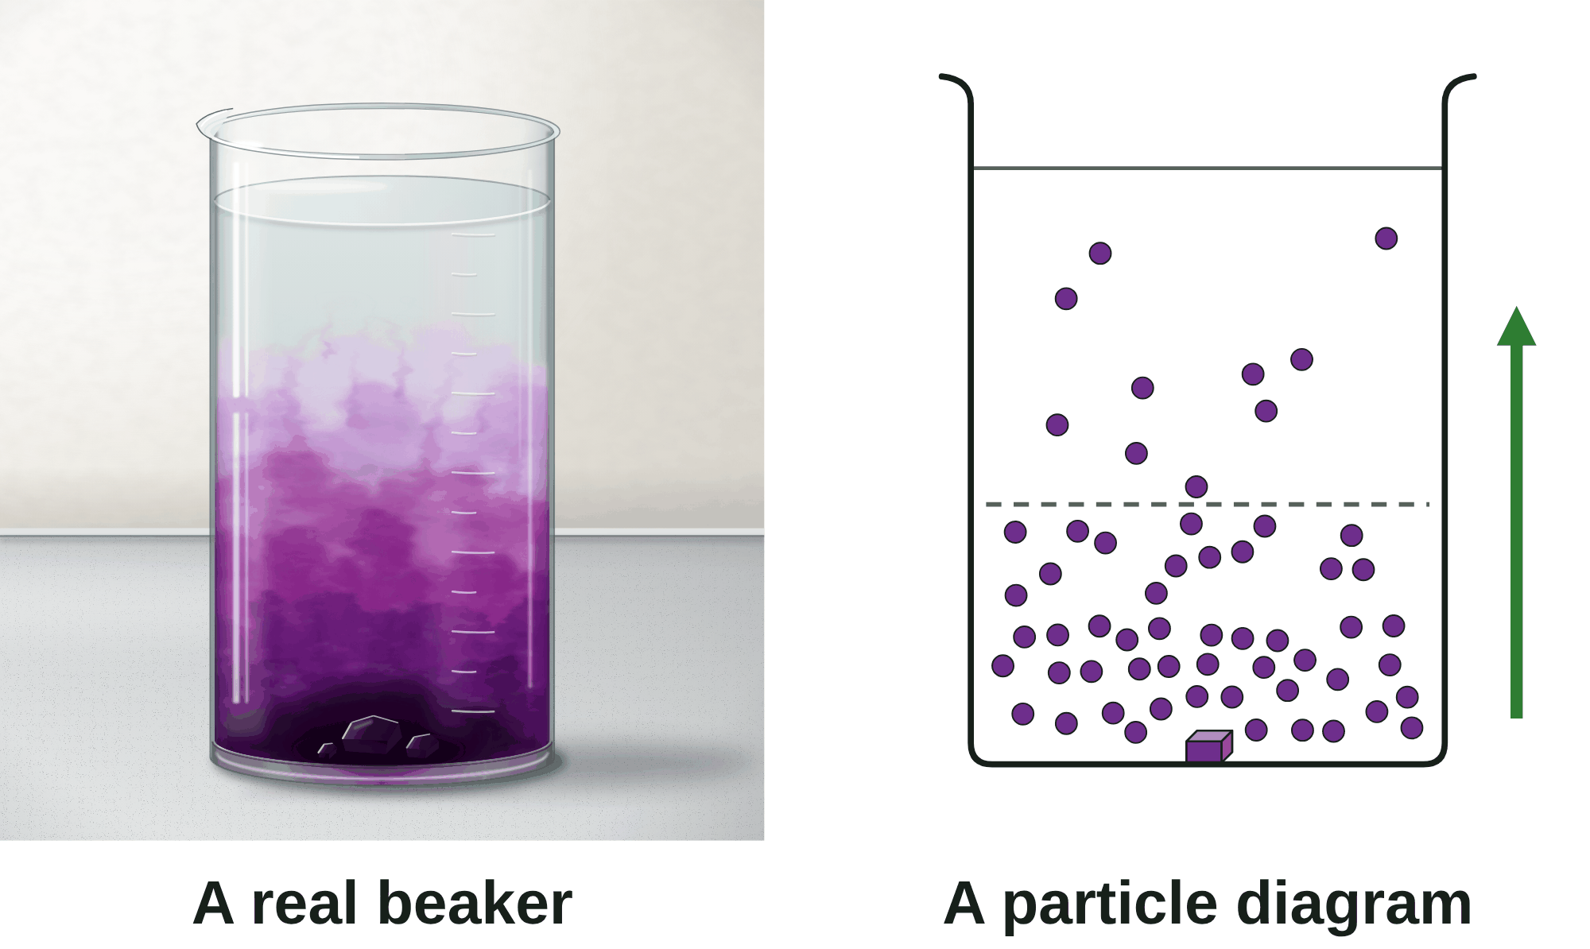
B1 L8 Revision notes 1 of 4
Diffusion
Diffusion, a real beaker and a particle diagram, random movement
1. What diffusion is
Movement: each real particle moves at random. The arrow in a diagram shows only the net movement.
3D: the real colour spreads in every direction. A diagram is flat.
Both show the same science: a higher concentration at the bottom and a net movement upwards.
Drop a crystal of purple potassium manganate(VII) into a beaker of still water. It dissolves, and the purple slowly spreads out through the water on its own. Nobody stirs it.
The purple colour shows where the purple particles are. Where the colour is dark, there are lots of particles in a small volume: a high concentration. Concentration is the amount of a substance in a given volume.
Diffusion is the net movement of particles from an area of higher concentration to an area of lower concentration.
Diffusion happens in solutions (a substance dissolved in a liquid) and in gases. A smell spreading across a room is diffusion in a gas.
Diffusion does not need energy from respiration. The particles move on their own.
Substances move into and out of cells across the cell membrane by diffusion (B1 L1: the cell membrane controls the movement of substances into and out of the cell).
3. Particles move at random
Particles in a liquid or a gas are always moving, at random, in all directions.
They cross from one area to the other both ways.
There are more particles in the crowded area, so more of them move out of it than move into it.
Net movement is the overall movement in one direction, after taking away the movement the other way.
Worked example: in one second, 30 particles cross from the left to the right and 8 cross back. The net movement is 30 − 8 = 22 particles to the right.
Watch out: diffusion happens in gases and in solutions. Water crossing a cell membrane is a special case of diffusion, called osmosis (B1 L9 Osmosis).
2. A real beaker and a particle diagram
Exam questions use particle diagrams. A particle diagram is a model, simplified on purpose:
Particles: real particles are far too small to see, even with a light microscope. The diagram draws each one as a dot.
No line: in the beaker the colour fades gradually. The diagram may draw a dashed line to split the water into two areas. The line is not a barrier.
How many: a beaker holds billions of billions of particles. A diagram draws a few dozen.
Each dot is a particle. Real particles are far too small to see.
A concentration gradient is the difference in concentration between two areas. A bigger, or steeper, concentration gradient (a bigger difference in concentration) gives a faster net movement.
Watch out: particles do not "want" to spread out, and they do not all move one way. They move at random. Diffusion is a net movement.
4. Evenly spread: no net movement
As the particles spread out, the difference in concentration gets smaller, so the net movement slows down.
When the particles are evenly spread, they keep moving. The same number cross each way, so the concentration stays the same everywhere. There is no net movement.
This is why the purple beaker ends up an even pale purple, not clear.
Particles are far too small to see: the dots in the diagram are a model. The purple colour shows where the particles are.
Watch out: evenly spread particles do not stop moving. Only the net movement stops.
B1 L8 · Diffusion · sciencegcse.co.uk · free GCSE science resources
Notes:
Revision notes page 1 of 4. These pages are the textbook for B1 L8: students read them before the lesson, use them to catch up, or revise from them. Page 1 covers screens 1 to 4: what diffusion is, the real beaker and the particle diagram, random movement and net movement, and what happens when the particles are evenly spread.

Slide 25
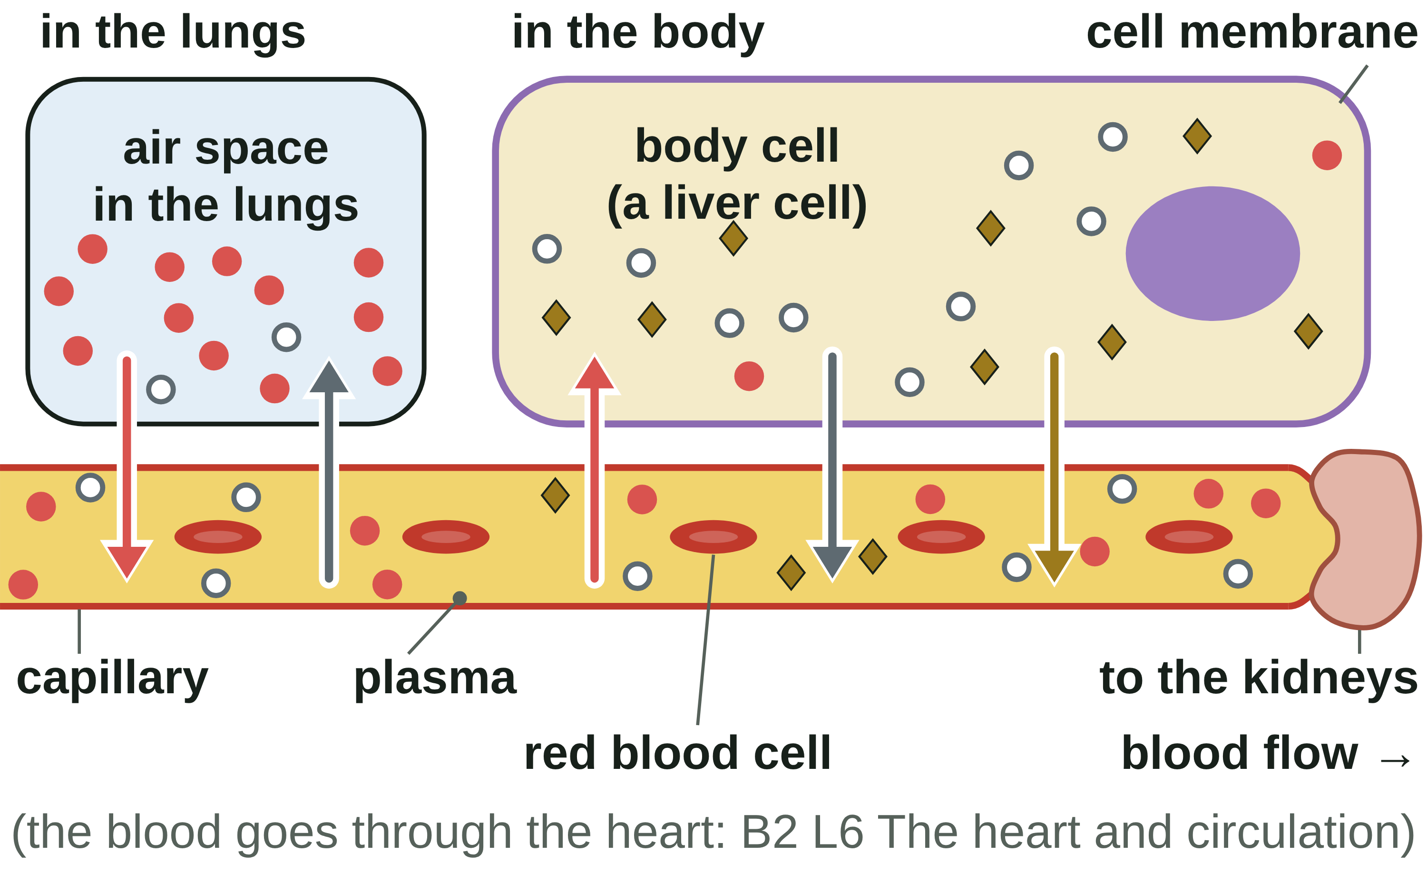
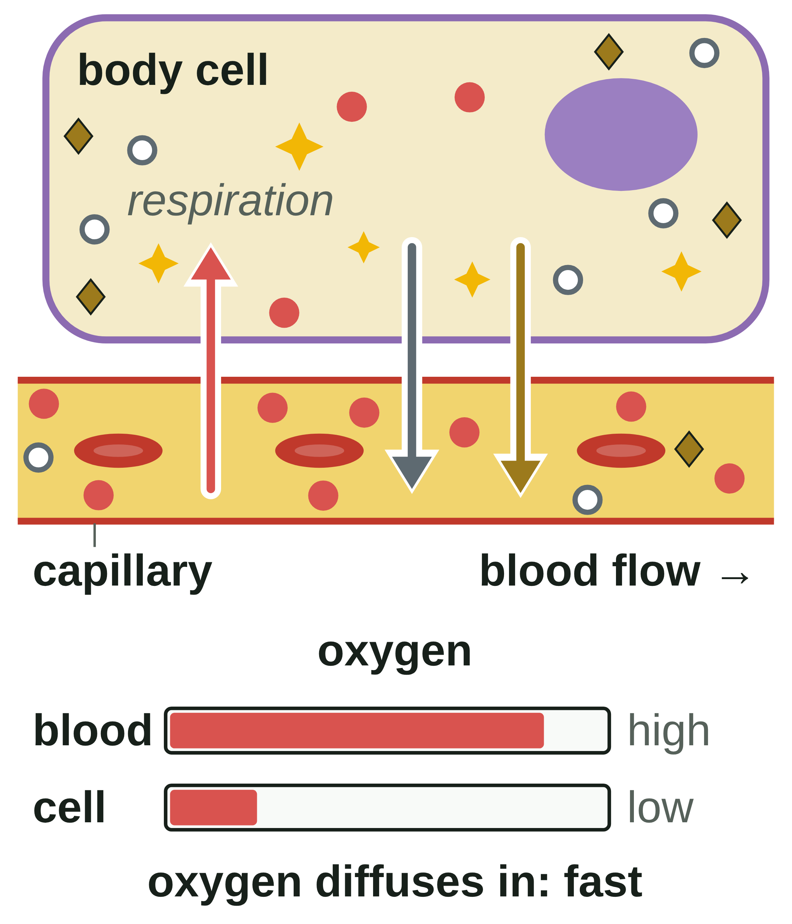
B1 L8 Revision notes 2 of 4
Diffusion
Diffusion in the body, urea, keeping the gradient steep
5. Diffusion into and out of cells
6. Urea and excretion
Urea is a waste product that diffuses from cells into the blood plasma and is removed from the body by the kidneys. Most urea is made in liver cells.
Plasma is the pale yellow liquid part of the blood, which carries blood cells and dissolved substances.
The blood carries the urea to the kidneys. The kidneys remove it from the blood, in urine.
Excretion is the removal of waste products made in the body.
If the kidneys stopped removing urea, it would build up in the blood. The difference in concentration between the cells and the blood would get smaller, so urea would diffuse out of the cells more slowly.
7. Keeping the gradient steep
Diffusion stays fast only while the concentration gradient stays steep. In the body:
Cells use oxygen in respiration all the time, so the oxygen concentration inside them stays low.
Flowing blood keeps bringing oxygen, so the oxygen concentration in the blood stays high.
Flowing blood carries away carbon dioxide and urea, so their concentration next to the cells stays low.
The heart keeps the blood moving (B2 L6 The heart and circulation).
If the blood stopped flowing, the difference in concentration would shrink and diffusion would slow down.
● oxygen ○ carbon dioxide ◆ urea. A diagram is simplified. Real particles are far too small to see.
Substance | Diffuses from | Diffuses to | Why
oxygen | the air in the lungs | the blood | there is more oxygen in the air
oxygen | the blood | respiring body cells | cells use oxygen in respiration
carbon dioxide | respiring body cells | the blood (then out in the lungs) | cells make carbon dioxide in respiration
urea | cells (mostly liver cells) | the blood plasma | cells make urea as a waste product
Each substance diffuses from where its concentration is higher to where it is lower. Several substances can diffuse across the same membrane at the same time, in different directions.
Respiration is a chemical reaction in every living cell that releases energy. It uses oxygen and makes carbon dioxide (B4 Bioenergetics).
● oxygen ○ carbon dioxide ◆ urea
Watch out: water crossing a partially permeable membrane, such as a cell membrane, is a special case of diffusion called osmosis (B1 L9 Osmosis).
Watch out: diffusion needs no energy from respiration. Respiration only keeps the gradient steep, by using oxygen. Energy is released by respiration; never write that it is "made".
B1 L8 · Diffusion · sciencegcse.co.uk · free GCSE science resources
Notes:
Revision notes page 2 of 4. These pages are the textbook for B1 L8: students read them before the lesson, use them to catch up, or revise from them. Page 2 covers screens 6 and 7: oxygen, carbon dioxide and urea, and how the body keeps the concentration gradients steep.

Slide 26
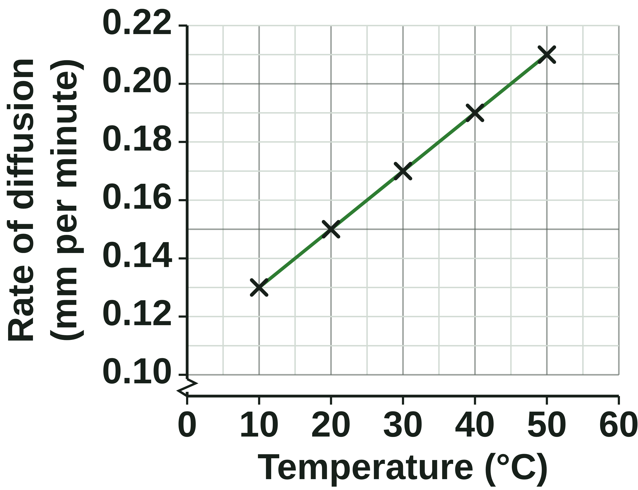
B1 L8 Revision notes 3 of 4
Diffusion
The rate of diffusion
8. Four factors that affect the rate of diffusion
10. Maths skills: the rate of diffusion
AQA lists three factors: the difference in concentration (concentration gradient), the temperature, the surface area of the membrane. The distance is a fourth. A bigger concentration gradient, a higher temperature, a larger surface area and a shorter distance each make diffusion faster.
rate of diffusion = distance ÷ time
Temperature (°C) | Distance moved in 60 minutes (mm) | Rate of diffusion (mm/min)
10 | 7.8 | 0.13
20 | 9.0 | 0.15
30 | 10.2 | 0.17
40 | 11.4 | 0.19
50 | 12.6 | 0.21
Factor | Diffusion is faster when ... | Why
concentration gradient | the difference in concentration is bigger (a steeper gradient) | more particles move out of the crowded area than move back
temperature | the temperature is higher | the particles have more energy and move faster
surface area of the membrane | the surface area is larger | more particles can cross at the same time
distance | the distance is shorter (a thin membrane) | the particles have less far to go
Reading the graph: go up from 35 °C to the line, then across: the rate is about 0.18 mm per minute.
Exchange surfaces in the body, such as the alveoli in the lungs, have a large surface area and a thin membrane: B1 L10 Active transport and exchange surfaces explains them.
Worked example 1: a dye moves 8.4 mm in 35 minutes.
Rate = 8.4 ÷ 35 = 0.24 mm per minute. Check: 0.24 × 35 = 8.4 mm.
Worked example 2 (change the units first): a dye moves 1.1 cm in 1 hour 40 minutes.
1.1 cm = 11 mm (1 cm = 10 mm). 1 hour 40 minutes = 100 minutes (1 hour = 60 minutes).
Rate = 11 ÷ 100 = 0.11 mm per minute.
Always show your working and give the unit (mm per minute).
This is a mean (average) rate. The dye slows down as it spreads further, because the difference in concentration gets smaller.
Watch out: when they are heated, particles do not expand or get bigger. They have more energy and move faster.
9. Measuring the rate of diffusion
A coloured dye spreads into clear agar jelly. Jelly is still, so there are no currents: the dye moves only by diffusion.
1. Half-fill five test tubes with agar jelly.
2. Stand them in water baths at 10, 20, 30, 40 and 50 °C.
3. Add the same volume of the same dye on top of each.
4. After 60 minutes, measure how far the colour has moved down, with a ruler (mm).
Independent variable: the temperature. Dependent variable: the distance the dye moves (or the rate).
Control variables: the same dye, the same concentration and volume of dye, the same jelly, the same size of tube, the same time.
Safety: wear eye protection; take care with hot water.
11. Apply it: muscles during exercise
During exercise, muscle cells respire faster:
They use oxygen faster, so the oxygen inside them falls lower. The oxygen gradient is steeper, so oxygen diffuses in faster.
They make more carbon dioxide, so it builds up inside them. The carbon dioxide gradient is steeper, so it diffuses out faster.
Working muscles get a little warmer (about 39 °C), so the particles move faster.
B1 L8 · Diffusion · sciencegcse.co.uk · free GCSE science resources
Notes:
Revision notes page 3 of 4. These pages are the textbook for B1 L8: students read them before the lesson, use them to catch up, or revise from them. Page 3 covers screens 9 to 11: the four factors, measuring the rate of diffusion with dye in jelly, the maths, and muscles during exercise.

Slide 27
B1 L8 Revision notes 4 of 4
Diffusion
Key words, exam tips and check yourself
Key words
Check yourself
Cover the answers, then check.
Cell membrane: a thin layer around the cell that controls the movement of substances into and out of the cell.
Concentration: the amount of a substance in a given volume.
Concentration gradient: the difference in concentration between two areas.
Diffusion: the net movement of particles from an area of higher concentration to an area of lower concentration.
Excretion: the removal of waste products made in the body.
Net movement: the overall movement in one direction, after taking away the movement the other way.
Particle: a tiny piece of a substance, far too small to see.
Plasma: the pale yellow liquid part of the blood, which carries blood cells and dissolved substances.
Rate of diffusion: how quickly diffusion happens, such as the distance a substance spreads in one minute.
Respiration: a chemical reaction in every living cell that releases energy.
Urea: a waste product that diffuses from cells into the blood plasma and is removed from the body by the kidneys.
1. Write the definition of diffusion.
2. Diffusion happens in gases. Where else does it happen?
3. What is a concentration gradient?
4. Particles are evenly spread. Are they still moving? Is there a net movement?
5. Does diffusion need energy from respiration?
6. Name three substances that diffuse into or out of cells in the body.
7. Give the four factors that affect the rate of diffusion.
8. A dye moves 5.6 mm in 20 minutes. Calculate the rate of diffusion.
Answers
1. The net movement of particles from an area of higher concentration to an area of lower concentration.
2. In solutions (substances dissolved in a liquid).
3. The difference in concentration between two areas.
4. Yes, they keep moving. No, there is no net movement.
5. No. The particles move on their own, at random, using their own (kinetic) energy.
6. Oxygen, carbon dioxide and urea.
7. The difference in concentration (concentration gradient), the temperature, the surface area of the membrane, and the distance.
8. 5.6 ÷ 20 = 0.28 mm per minute.
Exam tips
Write "net movement" and "from a higher concentration to a lower concentration": never just "from high to low".
Say what moves and where: "oxygen diffuses from the blood into the cell".
Particles move at random. Never write that they "want" to spread out. Diffusion needs no energy from respiration.
Temperature: "the particles have more energy and move faster". Never "the particles expand".
A steeper concentration gradient means a bigger difference in concentration.
Rate = distance ÷ time. Change cm to mm and hours to minutes first, and give the unit.
B1 L8 · Diffusion · sciencegcse.co.uk · free GCSE science resources
Notes:
Revision notes page 4 of 4. These pages are the textbook for B1 L8: students read them before the lesson, use them to catch up, or revise from them. Page 4: key words, exam tips and check yourself. Students cover the answers, try every question, then check.

Slide 28
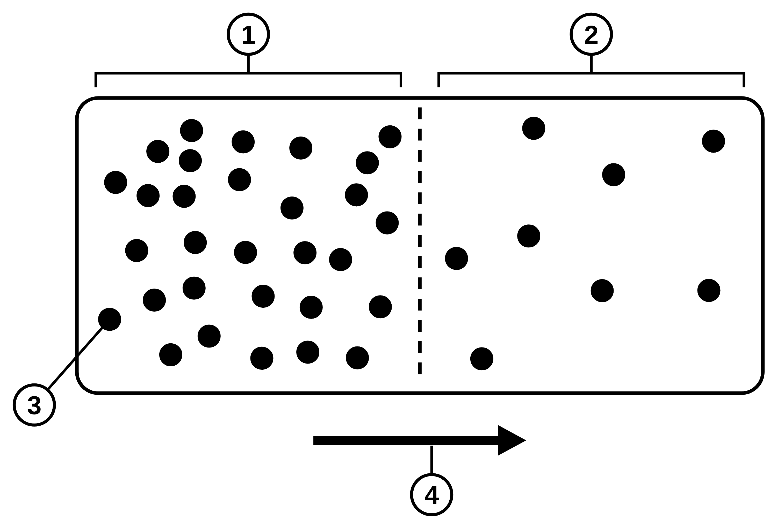
B1 L8 Mandatory worksheet: Diffusion
Page 1 of 2
Name: ______________________________ Class: __________
A. Label the particle diagram
B. Complete the sentences
[5]
[6]
Help: online screens 2 and 3
Help: online screens 1, 3 and 7
The diagram shows particles in a liquid. The dashed line splits the liquid into two areas.
Use words from the box. Each word can be used once. Two words are not needed.
(a) Write what each number on the diagram shows. [4]
net
higher
lower
random
gases
energy
osmosis
water
1. Diffusion is the ____________ movement of particles from an area of ____________ concentration to an area of ____________ concentration. [3]
2. Particles in a liquid or a gas move at ____________. [1]
3. Diffusion happens in solutions and in ____________. [1]
4. Diffusion does not need ____________ from respiration. [1]
C. Into or out of the blood?
[6]
Help: online screen 6
Does each substance move into the blood or out of the blood? Tick (✓) one box in each row.
1
3
Substance and place | Into the blood | Out of the blood
1. oxygen, in the lungs
2. oxygen, next to a respiring muscle cell
3. carbon dioxide, in the lungs
4. carbon dioxide, next to a respiring muscle cell
5. urea, next to a liver cell
6. urea, in the kidneys
2
4
(b) What does the dashed line show? Tick (✓) one box. [1]
a wall that stops the particles
the edge between two areas, not a barrier
the place where the particles stop moving
B1 L8 · Diffusion · sciencegcse.co.uk · free GCSE science resources

Slide 29
B1 L8 Mandatory worksheet: Diffusion
Page 2 of 2
Name: ______________________________ Class: __________
D. Short answers
E. The steepest gradient
[8]
[4]
Help: online screens 2, 3, 6, 9 and 10
Help: online screens 7 and 9
1. What is meant by net movement? [1]
Oxygen diffuses from the blood into four body cells, A to D. The table shows the oxygen concentration in the blood and in each cell (in units).
(a) Complete the table. [2]
2. Give the meaning of concentration gradient. [1]
Cell | Oxygen in the blood | Oxygen in the cell | Difference
A | 100 | 80 | 20
B | 100 | 40
C | 100 | 10
D | 100 | 60 | 40
3. Give one way the real beaker of purple water is different from a particle diagram. [1]
(b) Oxygen diffuses fastest into one cell. Which cell? Give a reason. [2]
4. Name the organ that removes urea from the blood. [1]
5. Diffusion is faster at a higher temperature. Give the reason. [2]
F. Explain
[3]
Help: online screen 3
Explain why there is a net movement of particles from an area of higher concentration to an area of lower concentration, even though the particles move at random. [3]
6. A dye moves 14 mm through jelly in 40 minutes. Calculate the rate of diffusion. Use: rate = distance ÷ time [2]
mm per minute
B1 L8 · Diffusion · sciencegcse.co.uk · free GCSE science resources

Slide 30
B1 L8 Mandatory worksheet answers - page 1
Answers 1 of 2
A. Label the particle diagram
B. Complete the sentences
[5]
[6]
The diagram shows particles in a liquid. The dashed line splits the liquid into two areas.
Use words from the box. Each word can be used once. Two words are not needed.
(a) Write what each number on the diagram shows. [4]
net
higher
lower
random
gases
energy
osmosis
water
1. Diffusion is the net (1) movement of particles from an area of higher (1) concentration to an area of lower (1) concentration. [3]
2. Particles in a liquid or a gas move at random (1). [1]
3. Diffusion happens in solutions and in gases (1). [1]
4. Diffusion does not need energy (1) from respiration. [1]
“osmosis” and “water” are not needed: water crossing a membrane is osmosis (B1 L9).
C. Into or out of the blood?
[6]
1
higher concentration (1)
3
a particle (1)
Does each substance move into the blood or out of the blood? Tick (✓) one box in each row.
2
lower concentration (1)
4
net movement (1)
1: allow “high concentration” or “the crowded area”. 2: allow “low concentration”; do not accept “a particle” (number 3 is the particle).
3: allow “a dye particle”; do not accept “an atom” or “a cell”.
4: allow “the direction of diffusion”; do not accept “the direction every particle moves”.
Substance and place | Into the blood | Out of the blood
1. oxygen, in the lungs | ✓
2. oxygen, next to a respiring muscle cell |  | ✓
3. carbon dioxide, in the lungs |  | ✓
4. carbon dioxide, next to a respiring muscle cell | ✓
5. urea, next to a liver cell | ✓
6. urea, in the kidneys |  | ✓
(b) What does the dashed line show? Tick (✓) one box. [1]
a wall that stops the particles
✓
the edge between two areas, not a barrier
(1)
the place where the particles stop moving
Row 6: the kidneys remove urea from the blood. How they do it is Biology only.
B1 L8 · Diffusion · sciencegcse.co.uk · free GCSE science resources

Slide 31
B1 L8 Mandatory worksheet answers - page 2
Answers 2 of 2
D. Short answers
E. The steepest gradient
[8]
[4]
1. What is meant by net movement? [1]
The overall movement in one direction, after taking away the movement the other way (1).
Allow “more particles move one way than the other”. Do not accept “particles only move one way”.
Model answer: More particles move one way than the other: the overall movement after taking away the movement the other way.
2. Give the meaning of concentration gradient. [1]
The difference in concentration between two areas (1).
3. Give one way the real beaker of purple water is different from a particle diagram. [1]
Any one (1): you cannot see the particles in the beaker (the dots are a model); the colour fades gradually, with no line; there are billions of particles, not a few dots; each particle moves at random (the arrow shows only the net movement); the colour spreads in three dimensions (the diagram is flat).
Do not accept “the diagram is not real” or “the beaker is bigger”.
4. Name the organ that removes urea from the blood. [1]
The kidney(s) (1).
Do not accept “the liver” (it makes urea).
5. Diffusion is faster at a higher temperature. Give the reason. [2]
The particles have more (kinetic) energy (1), so they move faster (1).
Do not accept “the particles expand / get bigger / vibrate”.
Model answer: At a higher temperature the particles have more energy, so they move faster.
6. A dye moves 14 mm through jelly in 40 minutes. Calculate the rate of diffusion. Use: rate = distance ÷ time [2]
14 ÷ 40 (1) = 0.35 mm per minute (1).
Correct answer with no working scores 2. 2.86 (40 ÷ 14) scores 0.
Model answer: 14 ÷ 40 = 0.35 mm per minute.
Oxygen diffuses from the blood into four body cells, A to D. The table shows the oxygen concentration in the blood and in each cell (in units).
(a) Complete the table. [2]
Cell | Oxygen in the blood | Oxygen in the cell | Difference
A | 100 | 80 | 20
B | 100 | 40 | 60 (1)
C | 100 | 10 | 90 (1)
D | 100 | 60 | 40
(b) Oxygen diffuses fastest into one cell. Which cell? Give a reason. [2]
Cell C (1); it has the biggest difference in concentration / the steepest concentration gradient (1).
Do not accept “the cell with the most oxygen” (that is A, the slowest).
Model answer: Cell C, because it has the biggest difference in oxygen concentration (90 units), so it has the steepest concentration gradient.
F. Explain
[3]
Explain why there is a net movement of particles from an area of higher concentration to an area of lower concentration, even though the particles move at random. [3]
The particles move at random, in all directions (1).
There are more particles in the area of higher concentration (1).
So more particles move out of that area than move into it / more cross one way than the other (1).
Do not accept “the particles want to spread out” or “energy from respiration pushes the particles”.
Model answer: The particles move at random, in all directions. There are more particles in the area of higher concentration, so more of them move out of it than move back into it. So, overall, there is a net movement to the area of lower concentration.
B1 L8 · Diffusion · sciencegcse.co.uk · free GCSE science resources

Slide 32
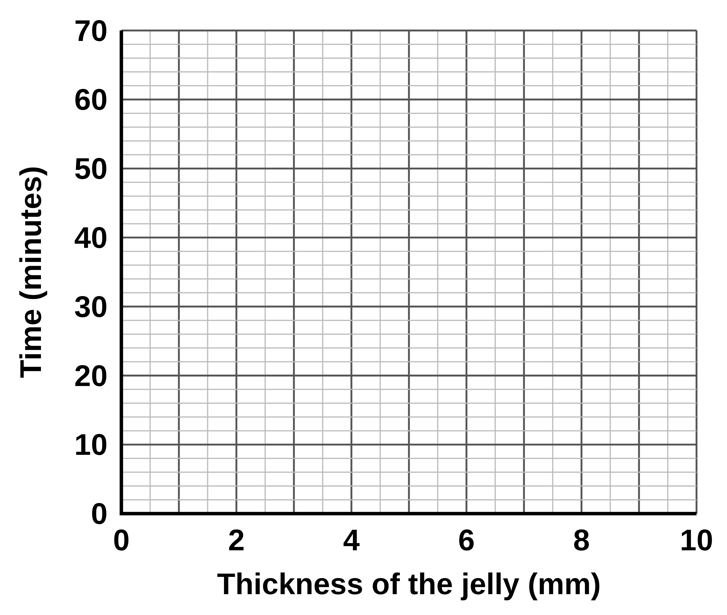
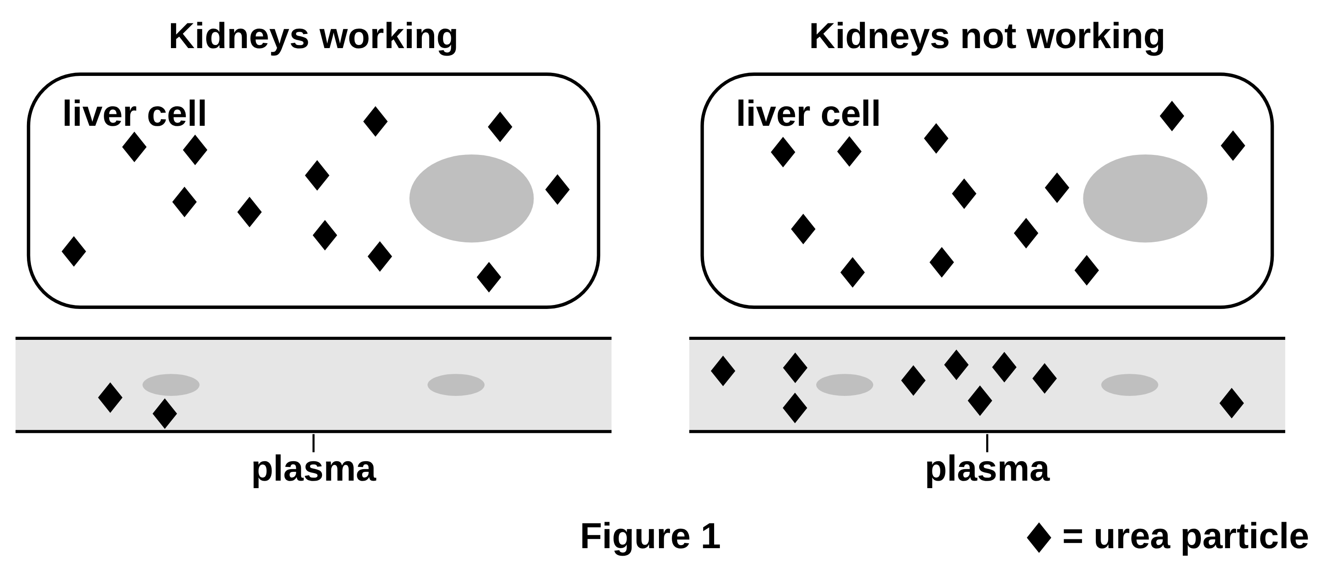
B1 L8 Challenge worksheet: Diffusion
Page 1 of 2
Name: ______________________________ Class: __________
A. Distance and diffusion
B. When the kidneys stop working
[8]
[4]
Help: online screens 9 and 10
Help: online screens 6 and 7
A student puts a layer of clear jelly into four dishes. Each layer is a different thickness. The student adds the same dye on top of each layer and times how long the colour takes to reach the bottom.
The kidneys remove urea from the blood. In some people the kidneys stop working properly. Then urea builds up in the blood plasma. Figure 1 shows urea (◆) in a liver cell and in the plasma next to it.
Table 1
Thickness of the jelly (mm) | Time for the dye to reach the bottom (minutes)
2 | 4
4 | 16
6 | 36
8 | 64
(a) Plot the results on the grid. Draw a smooth curve through the points. [3]
(a) Explain why urea diffuses out of the liver cells more slowly when the kidneys are not working. Use Figure 1. [3]
(b) Calculate the mean rate of diffusion through the 6 mm layer. Give your answer in mm per hour. [3]
mm per hour
(b) In dialysis, a person’s blood flows past a special liquid. The liquid has no urea in it. Urea diffuses out of the blood into the liquid. Suggest why the liquid has no urea in it. [1]
(c) A student says: ‘If the jelly is twice as thick, the dye takes twice as long to reach the bottom.’ Use Table 1 to show that the student is wrong. [2]
B1 L8 · Diffusion · sciencegcse.co.uk · free GCSE science resources

Slide 33
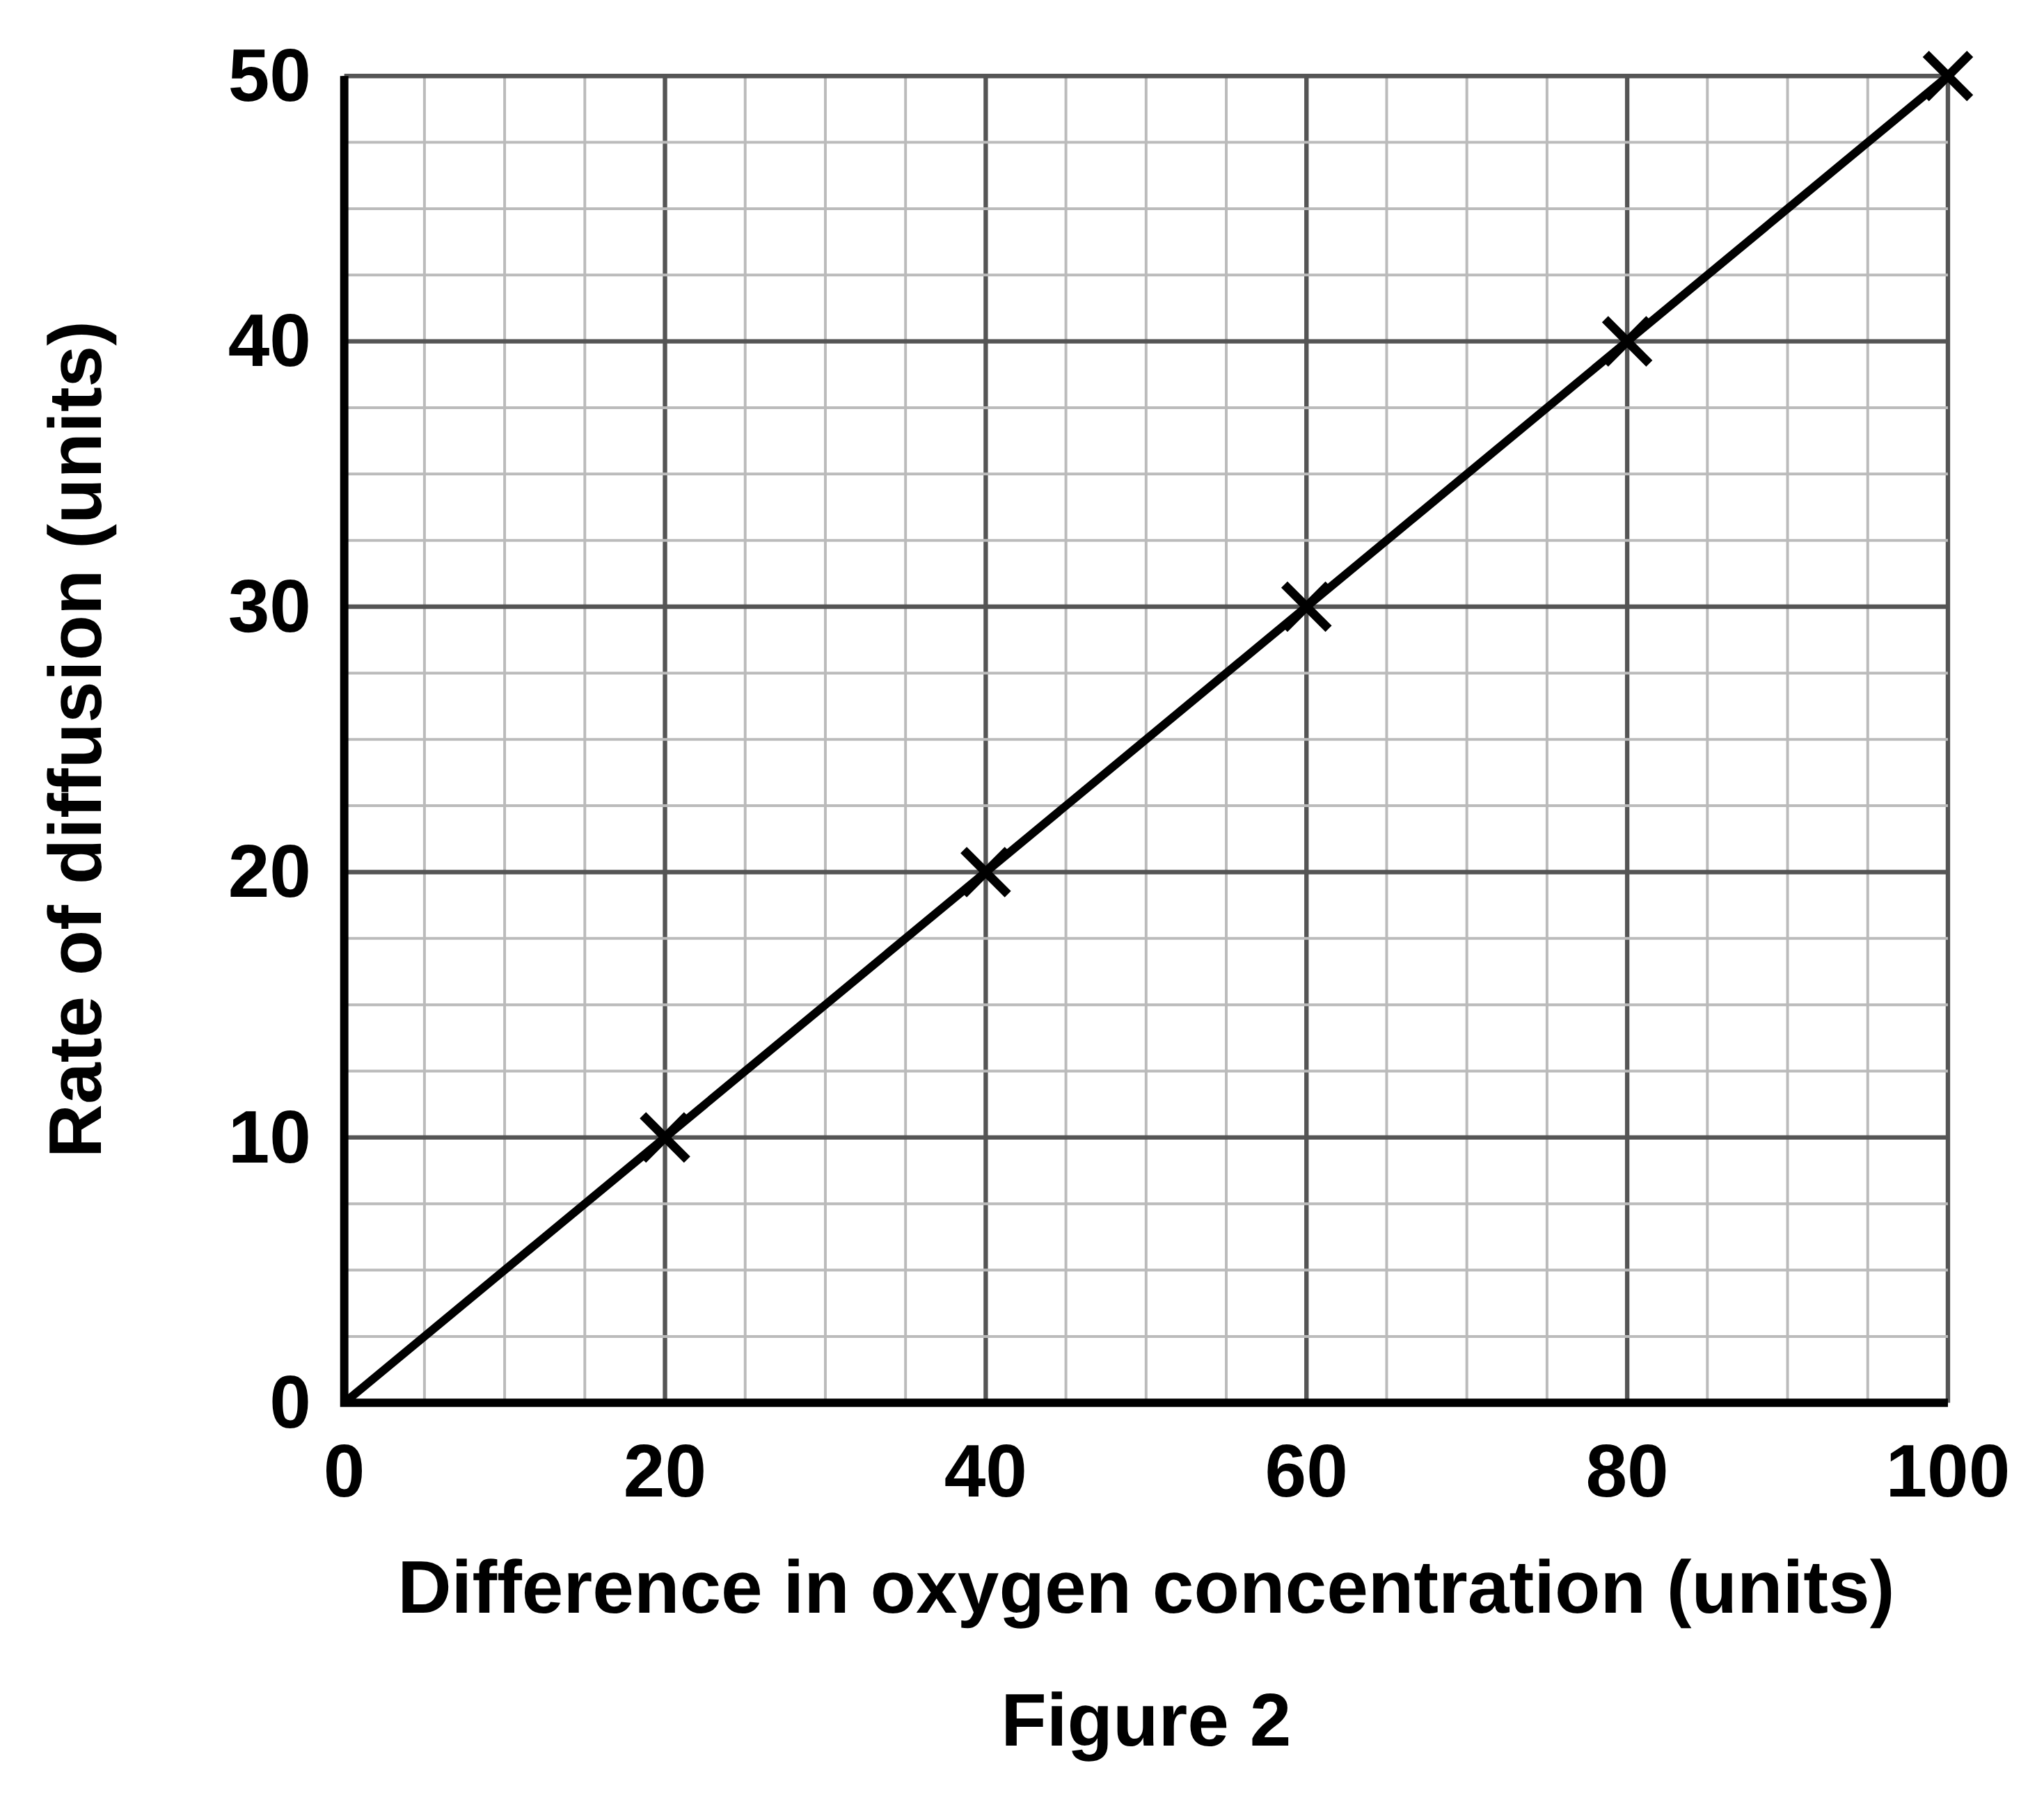
B1 L8 Challenge worksheet: Diffusion
Page 2 of 2
Name: ______________________________ Class: __________
C. Reading a graph
D. Extended response
[5]
[6]
Help: online screens 9 and 11
Help: online screens 7, 9 and 10
A scientist changed the difference in oxygen concentration between the blood and some cells. She measured the rate of diffusion of oxygen into the cells each time. Figure 2 shows the results.
Most body cells are within about 0.1 mm of a capillary. Your toes are more than 1 metre from your lungs. Use your answers to Task A to explain why the body needs blood to carry oxygen to the toes, and why capillaries must pass very close to every cell. [6]
(a) Use Figure 2 to find the rate of diffusion when the difference in concentration is 60 units. [1]
In your answer, think about how the time for diffusion changes when the distance gets bigger.
units
(b) Describe the relationship between the difference in concentration and the rate of diffusion. [2]
(c) During exercise, the oxygen concentration in a muscle cell falls from 40 units to 10 units. The oxygen concentration in the blood stays at 100 units. Use Figure 2 to calculate how many times faster oxygen diffuses into the cell during exercise. [2]
times
B1 L8 · Diffusion · sciencegcse.co.uk · free GCSE science resources

Slide 34
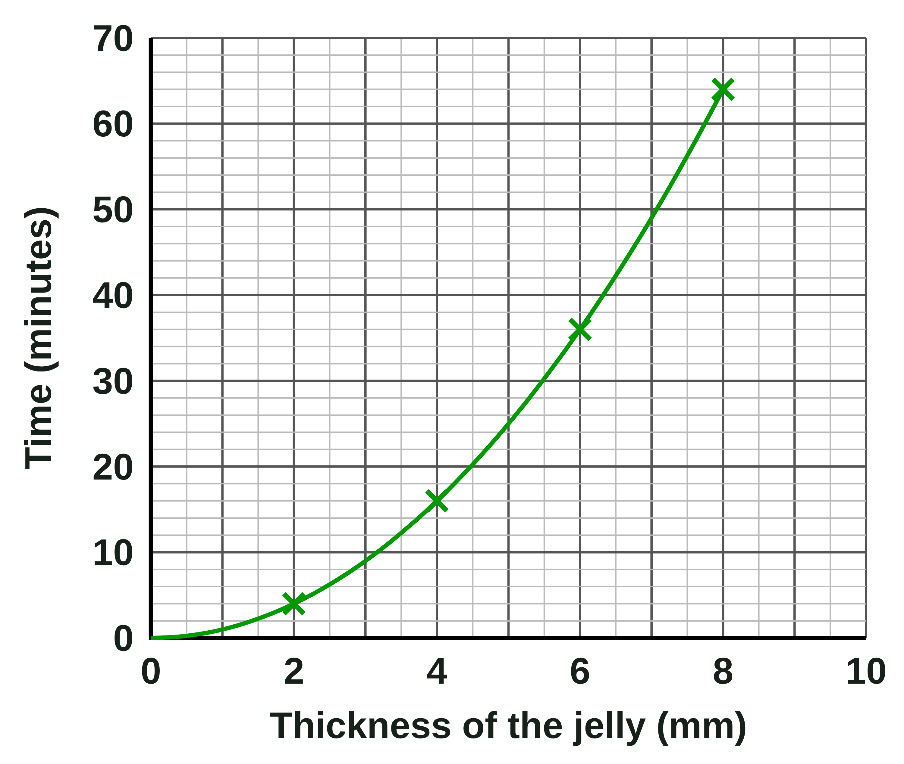
B1 L8 Challenge worksheet answers - page 1
Answers 1 of 2
A. Distance and diffusion
B. When the kidneys stop working
[8]
[4]
(a)
All four points plotted correctly, within half a small square (2); two or three points correct (1).
A smooth curve through the points, not dot to dot with a ruler (1).
Allow the curve to start at (0, 0).
(a)
The urea concentration in the plasma is higher (9 compared with 2) (1).
So the difference in concentration between the liver cell and the plasma is smaller / the concentration gradient is less steep (1).
So the net movement of urea out of the cells is slower (1).
Model answer: When the kidneys are not working, there is more urea in the plasma: 9 particles, not 2. The difference in concentration between the liver cell and the plasma is smaller, so the concentration gradient is less steep. The net movement of urea out of the liver cells is slower.
(b)
So there is a big difference in urea concentration / a steep concentration gradient between the blood and the liquid, so urea diffuses out of the blood (quickly) (1).
Model answer: With no urea in the liquid, the concentration gradient between the blood and the liquid is steep, so urea diffuses out of the blood quickly.
(b)
36 minutes = 36 ÷ 60 = 0.6 hours (1)
Rate = 6 ÷ 0.6 (1) = 10 mm per hour (1)
Allow the route 6 ÷ 36 = 0.167 mm per minute (1), × 60 (1) = 10 (1). Allow 0.17 mm per minute with no conversion for 1 mark only.
Model answer: 36 minutes = 0.6 hours. 6 ÷ 0.6 = 10 mm per hour.
(c)
Uses a pair of values, for example 2 mm takes 4 minutes but 4 mm takes 16 minutes (or 4 mm → 16 and 8 mm → 64) (1).
So twice the thickness takes four times as long, not twice as long (1).
Model answer: A 2 mm layer takes 4 minutes, but a 4 mm layer takes 16 minutes. Doubling the thickness makes the time four times as long, not twice as long.
A kind context: some students may have relatives with kidney disease or on dialysis. Keep it factual. How the kidney and a dialysis machine work is not needed (Biology only).
B1 L8 · Diffusion · sciencegcse.co.uk · free GCSE science resources

Slide 35
B1 L8 Challenge worksheet answers - page 2
Answers 2 of 2
C. Reading a graph
D. Extended response
[5]
[6]
(a)
30 (units) (1).
(b)
As the difference in concentration increases, the rate of diffusion increases (1).
The rate is (directly) proportional to the difference / a straight line through the origin / doubling the difference doubles the rate (1).
Model answer: As the difference in concentration increases, the rate of diffusion increases. The line is straight and goes through the origin, so the rate is directly proportional to the difference.
(c)
The differences are 60 and 90 units, giving rates of 30 and 45 (1).
45 ÷ 30 = 1.5 (times) (1).
Correct answer with no working scores 2.
Model answer: At rest the difference is 100 − 40 = 60 units, so the rate is 30. During exercise it is 100 − 10 = 90 units, so the rate is 45. 45 ÷ 30 = 1.5 times faster.
Level 3 (5–6 marks): A clear, logical explanation that uses the pattern in Task A (twice the distance takes four times as long) to explain that diffusion is fast over very short distances but far too slow over long ones; links this to blood carrying oxygen over the long distance and to capillaries keeping the final diffusion distance short.
Level 2 (3–4 marks): Explains that diffusion is slow over long distances and that blood carries oxygen, or that capillaries make the distance short, with some use of Task A. Some links are missing.
Level 1 (1–2 marks): Simple statements, such as “diffusion is slow” or “blood carries oxygen”, with little or no link to distance.
0 marks: No relevant content.
Indicative content: in Task A, twice the distance takes four times as long; so the time for diffusion rises very steeply with distance; over about 0.1 mm diffusion is very fast; over 1 metre diffusion alone would take far too long (using the Task A pattern, 1000 mm is 125 times 8 mm, so about 125 × 125 × 64 minutes: about 2 years in the jelly); cells need a constant supply of oxygen for respiration, which releases energy; the blood carries oxygen quickly over long distances (it is pumped by the heart); capillaries come within about 0.1 mm of every cell, so the last part of the journey, by diffusion, is short and fast; cells use oxygen, so the concentration gradient between the blood and the cells stays steep.
Do not accept “blood diffuses to the toes” or “energy is made”.
Model answer (Level 3): Task A shows that when the distance doubles, the time for diffusion is four times as long. So diffusion is very fast over a tiny distance like 0.1 mm, but far too slow over a long distance. Using the pattern in Task A, diffusion over 1 metre would take years, and the cells in the toes would not get the oxygen they need for respiration. So the blood carries oxygen quickly from the lungs to the toes, pumped by the heart. Capillaries pass within about 0.1 mm of every cell, so the oxygen only has to diffuse a very short distance, from the blood into the cell. The cells keep using oxygen, so the concentration gradient stays steep and diffusion stays fast.
B1 L8 · Diffusion · sciencegcse.co.uk · free GCSE science resources

Slide 36
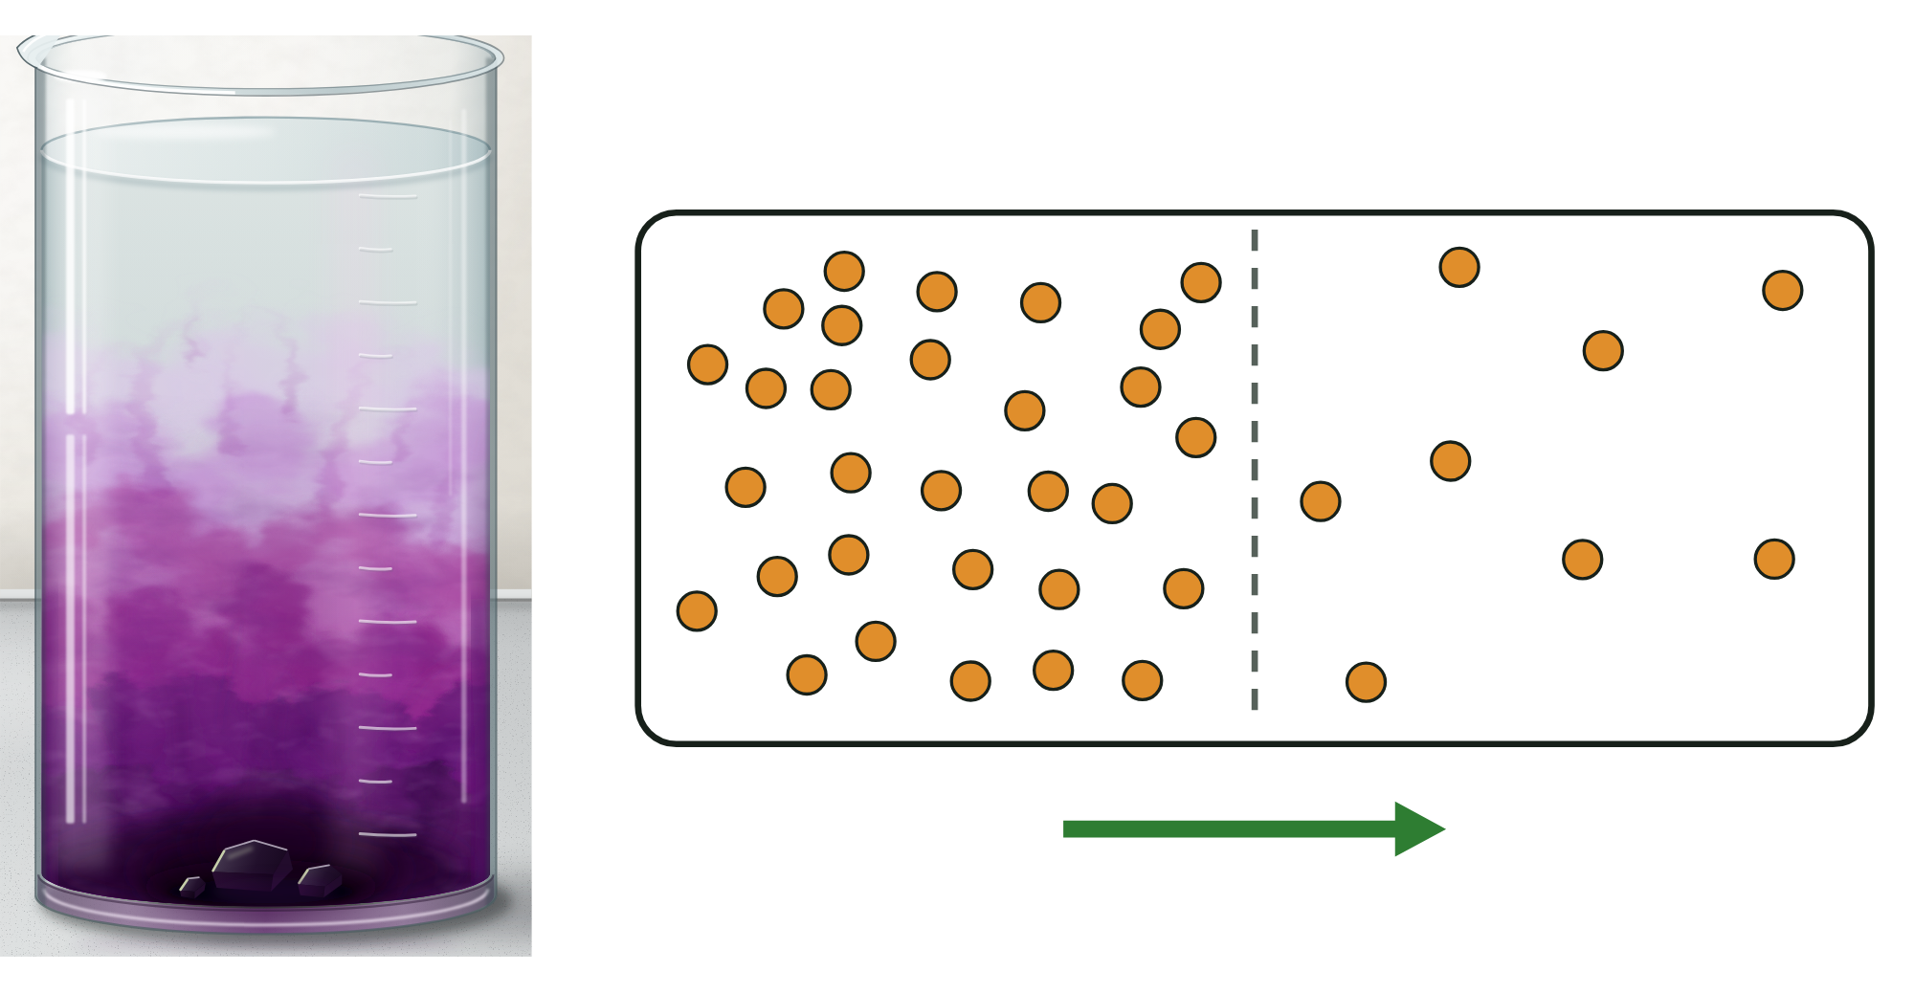
B1 L8 Alternative worksheet: Diffusion
Page 1 of 2
Name: ______________________________ Class: __________
Key facts
A. Label the diagram
[4]
Help: online screens 2 and 3
Diffusion is the net movement of particles from an area of higher concentration to an area of lower concentration.
Concentration is the amount of a substance in a given volume.
Particles move at random, all the time. Diffusion needs no energy from respiration.
Diffusion happens in gases and in solutions.
When the particles are evenly spread, they keep moving, but there is no net movement.
Oxygen diffuses from the blood into body cells. Carbon dioxide diffuses out of body cells into the blood.
Urea is a waste product. It diffuses from cells into the blood plasma. The kidneys remove it.
Diffusion is faster with a bigger difference in concentration, a higher temperature, a larger surface area and a shorter distance (a thinner membrane). The opposite of each makes it slower.
Write a word from the box next to each number.
higher concentration
lower concentration
particle
net movement
1
3
2
4
A real beaker (left) and a particle diagram (right).
Real particles are far too small to see. The dots are a model.
Tip: look at where the dots are crowded.
B1 L8 · Diffusion · sciencegcse.co.uk · free GCSE science resources

Slide 37
B1 L8 Alternative worksheet: Diffusion
Page 2 of 2
Name: ______________________________ Class: __________
B. Match up
D. True or false?
[5]
[6]
Help: online screens 1, 3 and 6
Help: online screens 1, 2, 3, 4 and 9
Draw a line from each word to what it means.
Write true or false after each sentence.
diffusion
in any direction, with no pattern
1. Diffusion can happen in a gas.
2. Diffusion needs energy from respiration.
concentration
the organs that remove urea from the blood
3. Particles all move in the same direction.
urea
the net movement of particles from an area of higher concentration to an area of lower concentration
4. You can see one particle of the purple dye in water.
kidneys
a waste product that diffuses from cells into the blood plasma
5. A bigger difference in concentration makes diffusion faster.
6. When particles are evenly spread, they stop moving.
random
the amount of a substance in a given volume
E. Faster or slower?
[6]
Help: online screen 9
C. Fill in the gaps
Does each change make diffusion faster or slower? Tick (✓) one box in each row.
[5]
Help: online screens 4, 6 and 9
Use the words in the box. Use each word once.
Change | Faster | Slower
1. a warmer temperature
2. a colder temperature
3. a bigger difference in concentration
4. a larger surface area
5. a thicker membrane
6. a smaller difference in concentration
oxygen
carbon dioxide
urea
faster
moving
1. ____________ diffuses from the blood into body cells.
2. ____________ diffuses out of body cells into the blood.
3. ____________ is a waste product that the kidneys remove.
4. When particles are evenly spread, they keep ____________.
5. Diffusion is ____________ at a higher temperature.
B1 L8 · Diffusion · sciencegcse.co.uk · free GCSE science resources

Slide 38
B1 L8 Alternative worksheet answers - page 1
Answers 1 of 2
Key facts
A. Label the diagram
[4]
Diffusion is the net movement of particles from an area of higher concentration to an area of lower concentration.
Concentration is the amount of a substance in a given volume.
Particles move at random, all the time. Diffusion needs no energy from respiration.
Diffusion happens in gases and in solutions.
When the particles are evenly spread, they keep moving, but there is no net movement.
Oxygen diffuses from the blood into body cells. Carbon dioxide diffuses out of body cells into the blood.
Urea is a waste product. It diffuses from cells into the blood plasma. The kidneys remove it.
Diffusion is faster with a bigger difference in concentration, a higher temperature, a larger surface area and a shorter distance (a thinner membrane). The opposite of each makes it slower.
Write a word from the box next to each number.
higher concentration
lower concentration
particle
net movement
1
higher concentration (1)
3
particle (1)
2
lower concentration (1)
4
net movement (1)
A real beaker (left) and a particle diagram (right).
Real particles are far too small to see. The dots are a model.
1 mark for each correct label. 2: do not accept “particle” (number 3 is the particle).
B1 L8 · Diffusion · sciencegcse.co.uk · free GCSE science resources

Slide 39
B1 L8 Alternative worksheet answers - page 2
Answers 2 of 2
B. Match up
D. True or false?
[5]
[6]
Draw a line from each word to what it means.
1 mark for each correct line.
1. Diffusion can happen in a gas. True (1)
2. Diffusion needs energy from respiration. False: it needs no energy from respiration (1)
3. Particles all move in the same direction. False: they move at random, in all directions (1)
4. You can see one particle of the purple dye in water. False: particles are far too small to see (1)
5. A bigger difference in concentration makes diffusion faster. True (1)
6. When particles are evenly spread, they stop moving. False: they keep moving; only the net movement stops (1)
diffusion
in any direction, with no pattern
concentration
the organs that remove urea from the blood
urea
the net movement of particles from an area of higher concentration to an area of lower concentration
kidneys
a waste product that diffuses from cells into the blood plasma
random
the amount of a substance in a given volume
E. Faster or slower?
[6]
C. Fill in the gaps
Does each change make diffusion faster or slower? Tick (✓) one box in each row.
[5]
Use the words in the box. Use each word once.
Change | Faster | Slower
1. a warmer temperature | ✓
2. a colder temperature |  | ✓
3. a bigger difference in concentration | ✓
4. a larger surface area | ✓
5. a thicker membrane |  | ✓
6. a smaller difference in concentration |  | ✓
oxygen
carbon dioxide
urea
faster
moving
1. Oxygen (1) diffuses from the blood into body cells.
2. Carbon dioxide (1) diffuses out of body cells into the blood.
3. Urea (1) is a waste product that the kidneys remove.
4. When particles are evenly spread, they keep moving (1).
5. Diffusion is faster (1) at a higher temperature.
B1 L8 · Diffusion · sciencegcse.co.uk · free GCSE science resources

Slide 40
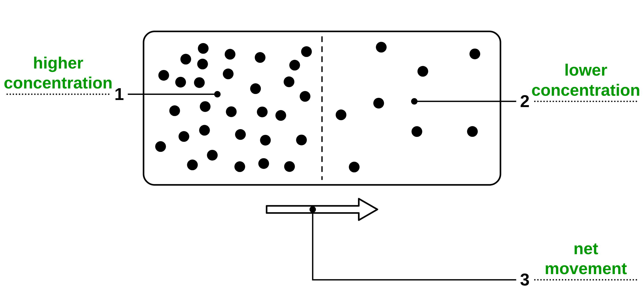
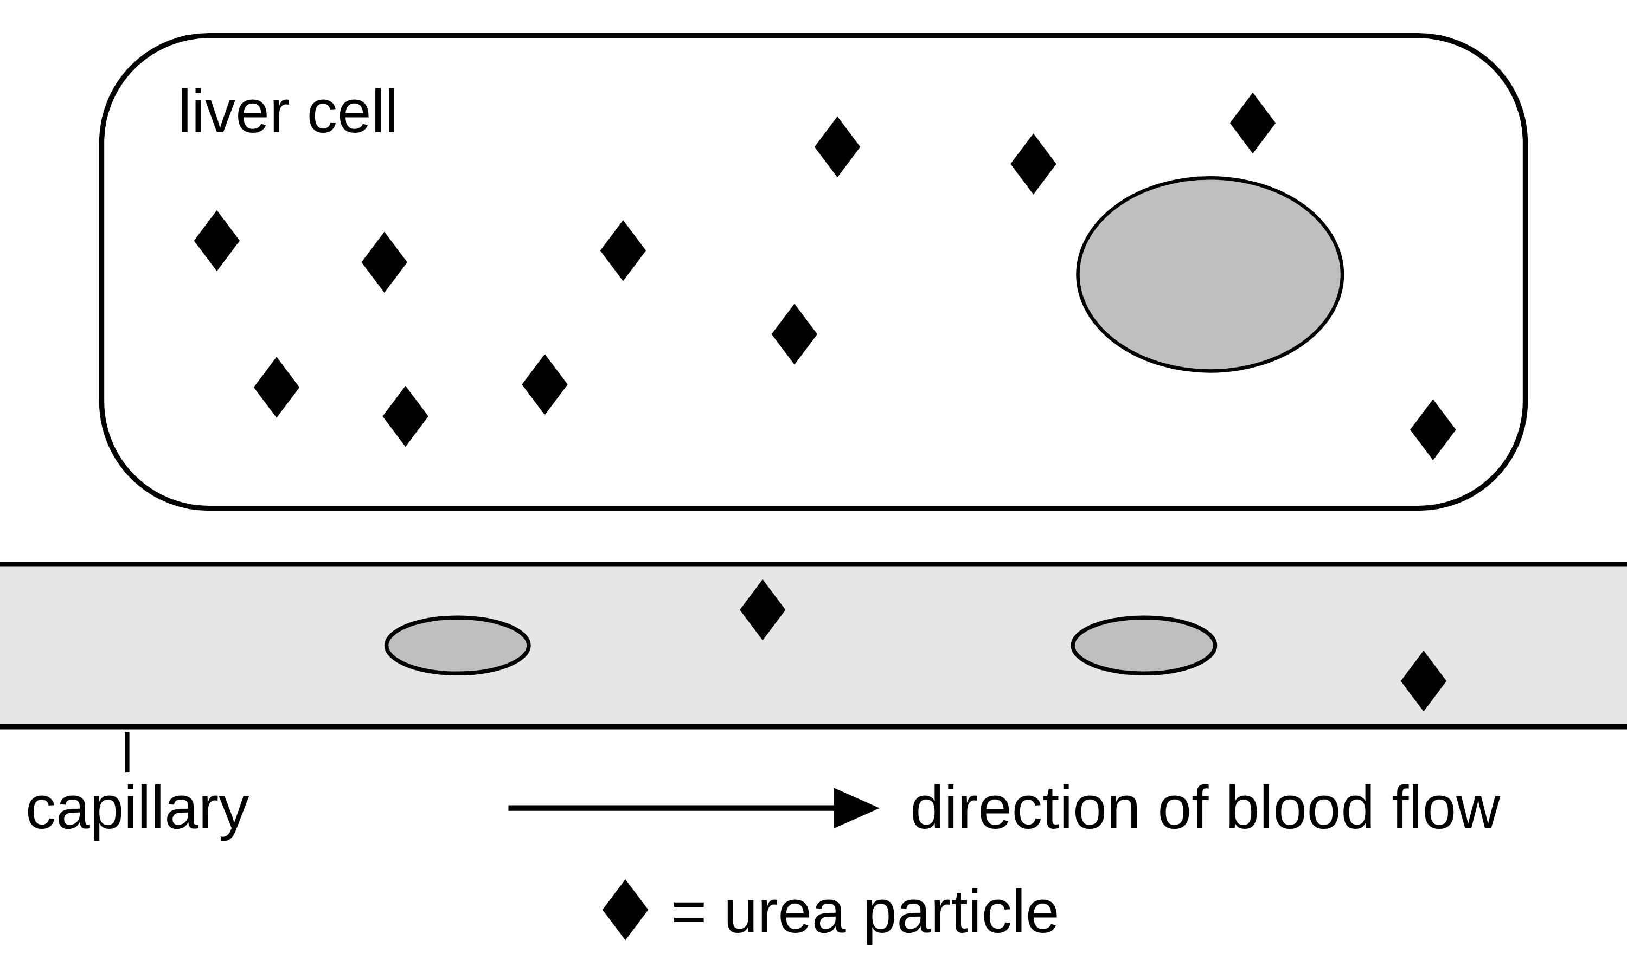
B1 L8 Exam questions worksheet mark scheme - page 1
Answers 1 of 2
01 Particle diagram
03 Urea
[4]
[3]
01.1 Complete Figure 1. Choose answers from the box. [3]
1 higher concentration (1)
2 lower concentration (1)
3 net movement (1)
1 mark for each correct label. If more than one phrase from the box is written on one line, do not give that mark. do not accept ‘osmosis’ or ‘cell wall’.
03.1 What is meant by excretion? [1]
The removal of waste products made in the body (1)
allow ‘getting rid of waste made by the body / by cells’. ignore ‘in urine’ / ‘by the kidneys’.
do not accept ‘getting rid of undigested food / faeces’ or ‘getting rid of waste’ with no idea that the waste is made in the body.
03.2 Explain why urea diffuses from the liver cell into the blood. Use Figure 3. [2]
There are more urea particles / the concentration of urea is higher in the liver cell than in the blood (plasma) (1)
so urea diffuses / there is a net movement from a higher to a lower concentration / down the concentration gradient (1)
allow ‘11 urea particles in the cell and 2 in the blood’ for the first mark. do not accept ‘the cell pushes urea out’ or ‘the kidneys pull urea into the blood’.
01.2 Which statement about diffusion is correct? [1]
Diffusion happens in gases and in solutions. (1)
If more than one box is ticked, give 0 marks.
02 Dye in agar
04 Hot and cold water
[5]
[2]
02.1 Calculate the rate of diffusion of the 8 % dye. [2]
7.5 ÷ 30 (1) = 0.25 (mm per minute) (1)
Correct answer with no working = 2 marks. 4 (30 ÷ 7.5) = 0 marks. allow 0.25 written as 1/4.
02.2 Describe how the concentration of the dye affects the distance it moves. [1]
As the concentration of the dye increases, the distance moved increases (1)
allow ‘the higher the concentration, the further the dye moves’. allow ‘each time the concentration doubles, the distance goes up by 1.5 mm’. do not accept ‘it goes up’ with no variable named.
02.3 Explain why the 8 % dye moved the furthest. [2]
The difference in concentration between the dye and the agar is bigger / the concentration gradient is steeper (1)
so the (net) rate of diffusion is faster / more dye particles diffuse into the agar in the same time (1)
allow ‘more particles move out of the well than move back’. ignore ‘there is more dye’. do not accept ‘the particles have more energy’ (that is temperature).
04 The colour spread out faster in the hot water. Explain why. [2]
In hot water the particles have more (kinetic) energy (1)
so they move faster (so they spread out / diffuse faster) (1)
ignore convection / currents.
do not accept ‘the particles expand / get bigger / melt’.
do not accept ‘the hot water has more energy’ alone for the first mark: the answer must refer to the particles.
Model answer: In the hot water the particles have more energy, so they move faster and spread out faster.
B1 L8 · Diffusion · sciencegcse.co.uk · free GCSE science resources

Slide 41
B1 L8 Exam questions worksheet mark scheme - page 2
Answers 2 of 2
05 Extended response
[6]
05 Body cells need a constant supply of oxygen for respiration. Oxygen diffuses from the blood into the cells. Carbon dioxide diffuses from the cells into the blood. Explain how the concentration gradients of oxygen and carbon dioxide between the blood and the body cells are kept steep, and why this is important for the cells. [6]
Level descriptors
Level 3 (5–6 marks): A detailed and coherent explanation. How both gradients are kept steep is explained (cells use oxygen and make carbon dioxide; the blood keeps flowing), and this is clearly linked to fast diffusion and to why the cells need it (respiration, removal of waste).
Level 2 (3–4 marks): How at least one gradient is kept steep is explained, with some link to faster diffusion or to respiration. The links may be incomplete.
Level 1 (1–2 marks): Simple relevant statements, for example ‘the blood brings oxygen’ or ‘cells use oxygen’, with little or no link to the concentration gradient.
0 marks: No relevant content.
Model answer (Level 3)
Respiration in the cells uses oxygen all the time, so the oxygen concentration inside the cells stays low. The blood keeps flowing, pumped by the heart, so fresh blood with a high oxygen concentration keeps arriving. This keeps the oxygen gradient between the blood and the cells steep. Respiration also makes carbon dioxide, so its concentration inside the cells is high, and the flowing blood carries it away to the lungs, so its concentration in the blood stays low. Steep gradients mean fast diffusion. This is important because the cells need oxygen quickly for respiration, which releases the energy they need, and carbon dioxide is a waste product that must not build up.
Indicative content
cells use oxygen in respiration, so the oxygen concentration inside the cells stays low
flowing blood keeps bringing fresh blood with a high oxygen concentration
so the oxygen concentration is higher in the blood than in the cells: a steep gradient
respiration makes carbon dioxide, so its concentration inside the cells stays high
flowing blood carries carbon dioxide away (to the lungs, where it is breathed out), so its concentration in the blood next to the cells stays low
the heart keeps the blood moving / the blood is replaced all the time
a steeper concentration gradient gives a faster rate of diffusion
so the cells get oxygen fast enough for respiration, which releases energy (for example for muscle contraction)
so carbon dioxide (a waste product) does not build up in the cells
if the blood stopped flowing, the gradients would become less steep and diffusion would slow down
during exercise, cells respire faster, so the gradients become steeper
do not credit ‘respiration gives the oxygen energy to diffuse’ or ‘energy is made / produced’ (these statements do not score; the rest of the answer can still score).
B1 L8 · Diffusion · sciencegcse.co.uk · free GCSE science resources

