Slide 1
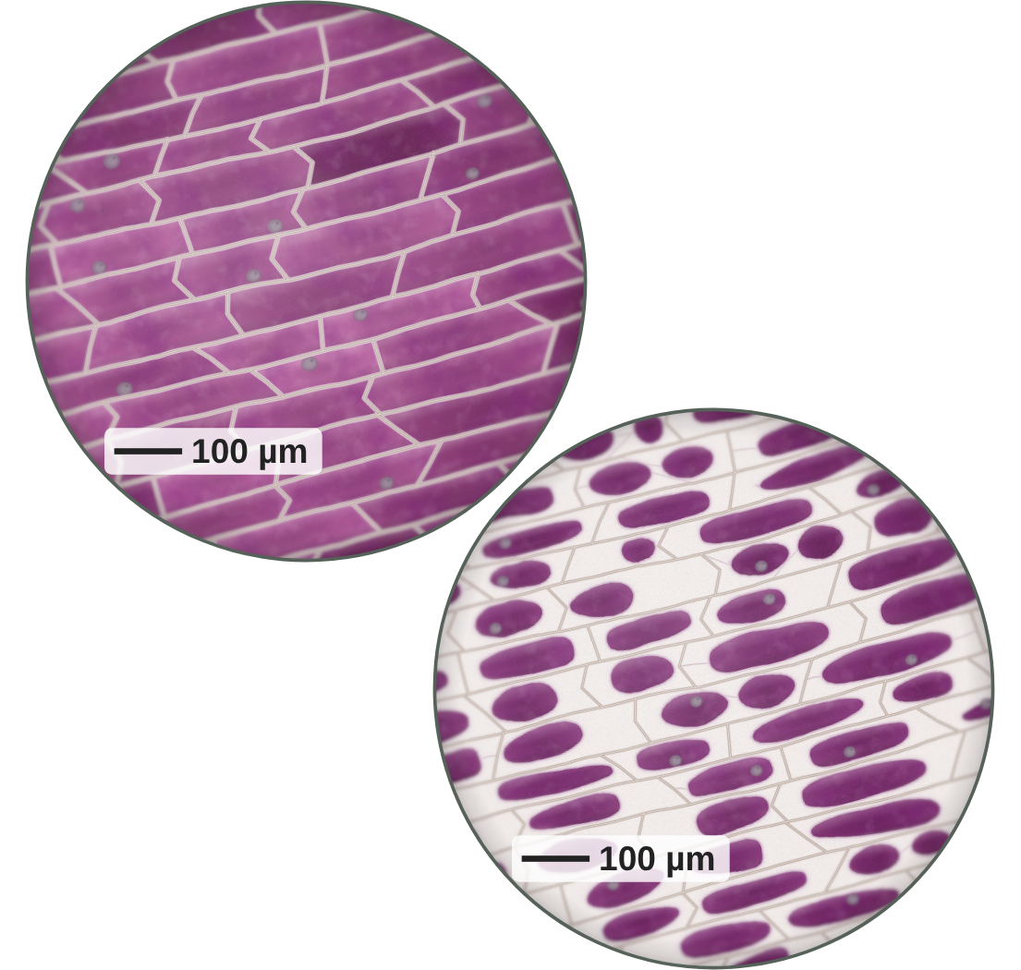
sciencegcse.co.uk · Biology B1 L9
DATE
B1 L9: Osmosis
24/09/2026
Required practical 2 (Combined Science) · 3 (Biology)
DO NOW
KEYWORDS
1. Does diffusion need energy from respiration?
2. Name one factor that increases the rate of diffusion.
3. Which plant cell takes in water from the soil?
Osmosis
Partially permeable membrane
Dilute solution
Concentrated solution
Percentage change in mass
A painting based on light micrographs. The purple is the cell sap's own colour.
B1 Cell biology
AQA Combined Science
Notes:
Do now: retrieval from B1 L8 (Q1, Q2) and B1 L5 (Q3). Link: osmosis is a special case of diffusion, and it needs no energy either; Q3 is where osmosis matters to a plant. The picture is a painting based on light micrographs of red onion cells: top left in pure water, bottom right in strong salt solution. The purple is the cell sap's own colour, not a stain. Ask the class: what has happened to the cells bottom right? (The purple has shrunk away from the walls. Water has left them.) This lesson includes Required practical 2 (Combined Science) · 3 (Biology): the potato cylinders. Suggested 60 min: slides 1-3 (6 min); slides 4-8 (12 min); slides 9-12 (8 min); set up the practical in groups, cut, blot, weigh and leave overnight (15 min); slides 13-18 with the typical results (13 min); exit ticket slides 22-23 (5 min). Weigh the cylinders again next lesson and pool the class results on slide 16. Without the practical: use the virtual lab on slide 13 and the results on slides 15 and 16, with slides 19-21 and the Mandatory worksheet in class. Homework: the online lesson quiz and the B1 L9 Exam questions worksheet. Technician list (per group): one large potato; a cork borer (size 4 or 5); a white tile; a scalpel; a ruler; paper towels; forceps; six boiling tubes in a rack, with labels; sugar solutions 0.0, 0.2, 0.4, 0.6, 0.8 and 1.0 mol/dm³ (or salt solutions); a 10 cm³ measuring cylinder; access to a balance reading to 0.01 g. Optional demonstration: red onion, microscope slides, coverslips, strong salt solution, a light microscope.

Slide 2
sciencegcse.co.uk · Biology B1 L9: Osmosis
Do now answers and lesson focus
Do now answers
In this lesson
1. No.
2. A bigger concentration gradient.
3. The root hair cell.
• Explain osmosis, and compare real onion cells with a diagram.
• Predict what happens to plant and animal cells in different solutions.
• Describe the potato practical and name its variables.
• Calculate percentage change in mass and read the graph.
Key idea
Osmosis is the diffusion of water across a partially permeable membrane.
Water moves from a dilute solution to a more concentrated solution.
2
B1 L9 · sciencegcse.co.uk
Notes:
Go through the answers. Q2: also accept a higher temperature or a larger surface area. Then share the lesson focus. The online lesson (sciencegcse.co.uk, B1 L9) follows the same 12 screens as this PowerPoint, so students can go over it at home. There are three checkpoints along the way.

Slide 3

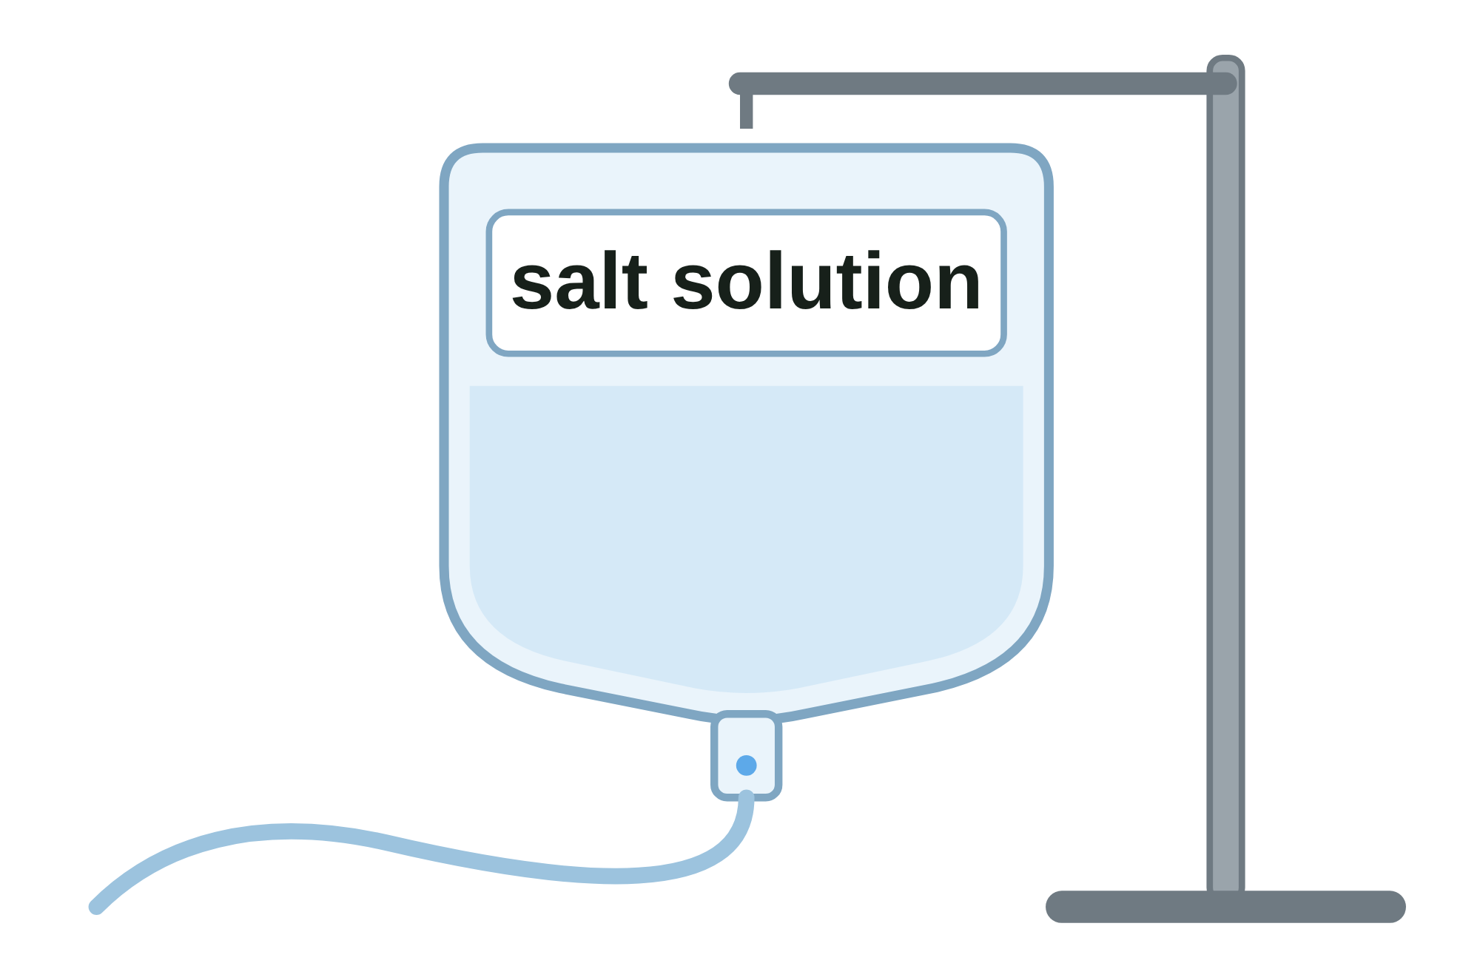
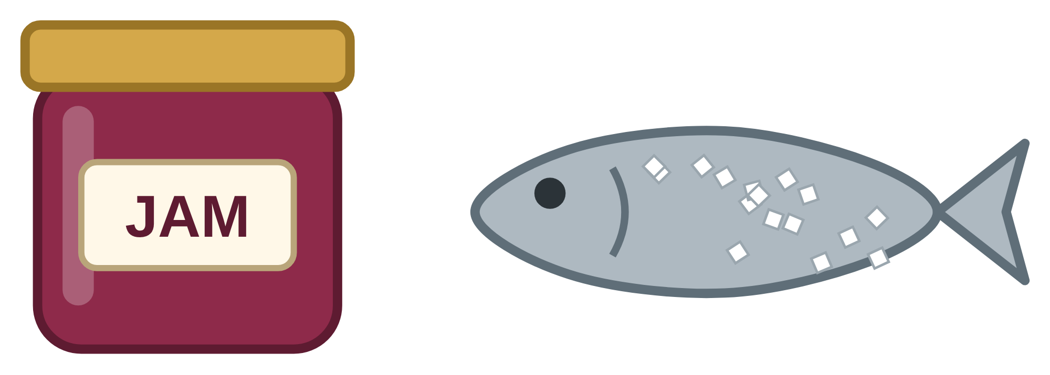
sciencegcse.co.uk · Biology B1 L9: Osmosis
Why this matters in the real world
Osmosis moves water into and out of cells: in plants, in your body and in your kitchen.
Crisp or floppy?
A hospital drip
Keeping food safe
95 %
60 %
of a lettuce is water
sugar in jam
Lettuce goes floppy when its cells lose water. Put it in cold water and it goes crisp again.
A drip is a salt solution about as concentrated as the inside of blood cells, so they do not swell or shrink.
With lots of sugar or salt around them, microorganisms lose water by osmosis, so most cannot grow.
Turgid cells are firm
No net movement
Jam and salted fish keep
3
B1 L9 · sciencegcse.co.uk
Notes:
Hook. Ask: why does a bag of salad go floppy in the fridge, and how could you make it crisp again? (Its cells lose water and become flaccid; in cold water, water moves back in by osmosis and the cells become turgid.) A drip: if pure water went into the blood, water would move into the red blood cells by osmosis and they could burst (slide 10). Jam and salted foods: microorganisms in them lose water by osmosis, so most cannot grow or reproduce. Today we find out why, and measure osmosis with potato cylinders.

Slide 4
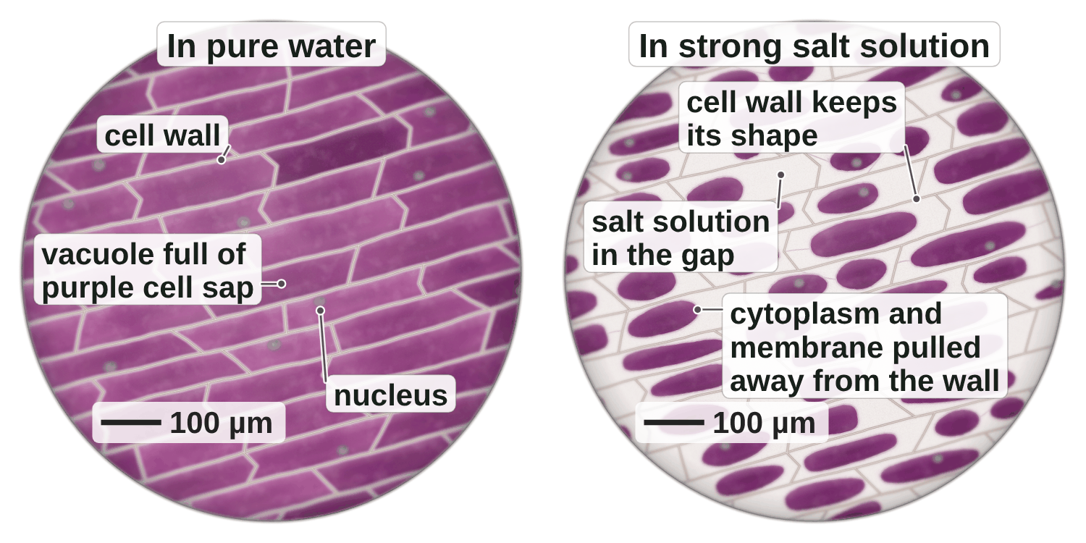
sciencegcse.co.uk · Biology B1 L9: Osmosis
Online lesson: screen 1 of 12
Red onion cells in water and salt
Red onion cells down a microscope
Key facts
Red onion cell sap is purple, so you can see the vacuole without a stain.
In pure water, each vacuole is full. The cells are firm.
In strong salt solution, water leaves the cells. The vacuoles shrink.
The cell wall keeps its shape.
Water moves into and out of cells by osmosis.
A painting based on light micrographs. The purple is the cell sap's own colour: no stain.
4
B1 L9 · sciencegcse.co.uk
Notes:
This is a painting based on light micrographs of red onion skin: one layer of cells, peeled from the outer (purple) surface of one of the onion's fleshy layers. Red onion is used because its cell sap is purple on its own, so you can see the vacuole without a stain. Ask: what is different between the left and the right? (On the right the purple has shrunk away from the walls.) What could have left the cells to make the purple shrink? (Water.) Today: how water moves into and out of cells by osmosis, and the potato required practical: Required practical 2 in Combined Science and 3 in Biology. Optional demonstration (B1 L3 Using a microscope): mount a thin piece of red onion skin in a drop of water under a coverslip and look at it at × 100. Then put a drop of strong salt solution at one edge of the coverslip and draw it under with a piece of paper towel at the other edge. In a few minutes the purple pulls away from the walls, as in the right-hand field. Add water the same way and the cells fill up again. The parts of a plant cell are B1 L1 Animal and plant cells. One key fact a click.

Slide 5
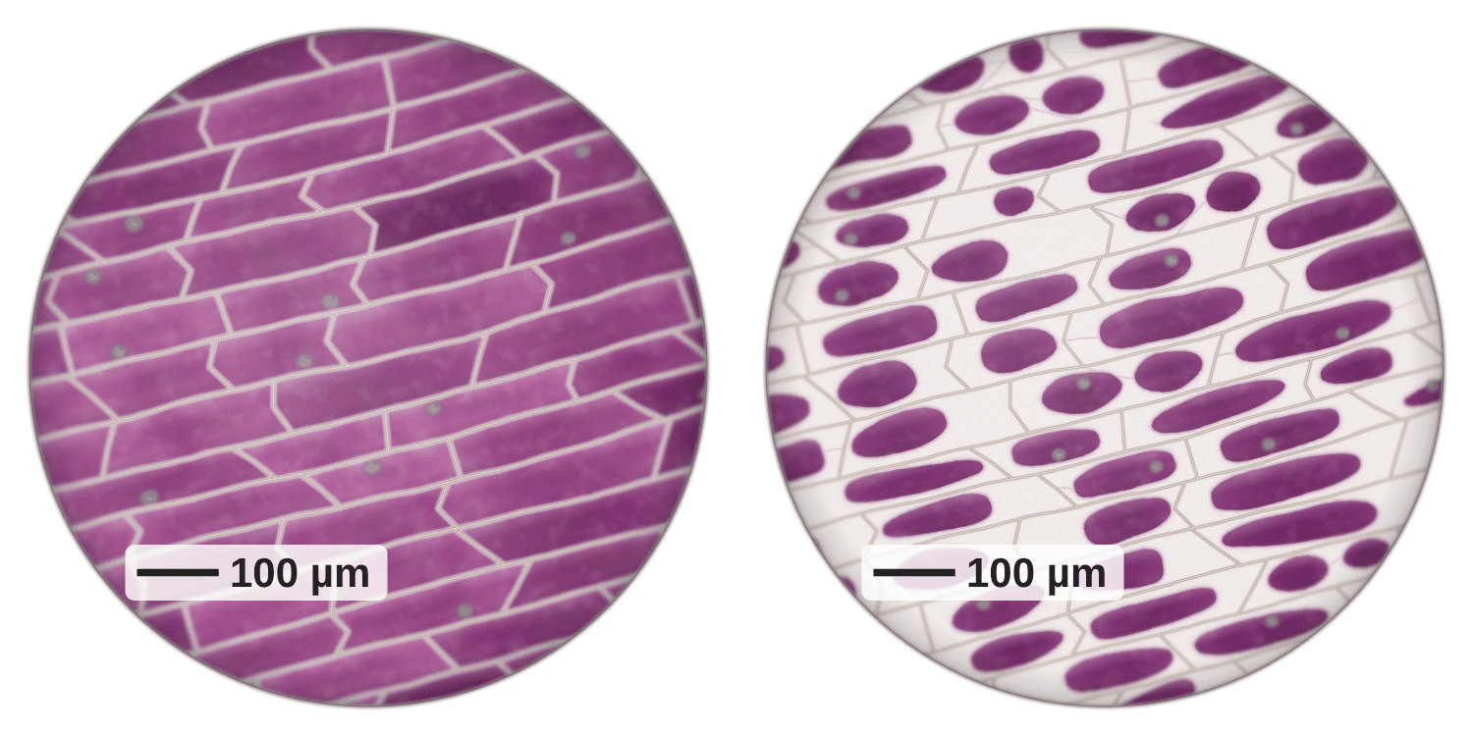
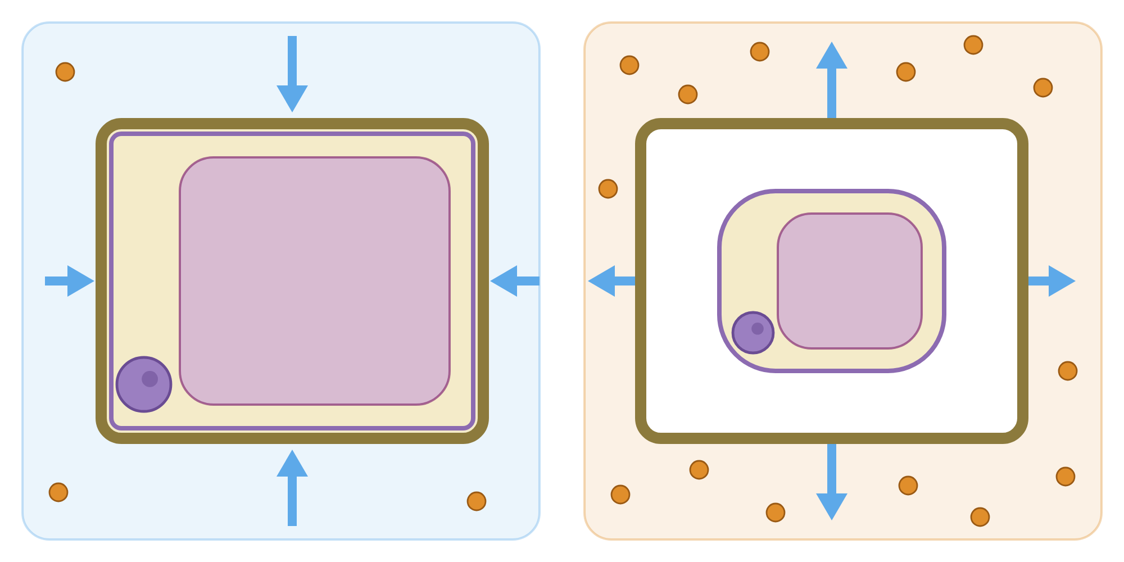
sciencegcse.co.uk · Biology B1 L9: Osmosis
Online lesson: screen 2 of 12
Real onion cells and a diagram
Same thing, two ways
Spot the differences
1
Colour: Red onion cell sap is purple on its own: no stain. The diagram's colours only show the parts.
5
2
Many cells: Real cells are packed together and share their walls. The diagram shows one cell on its own.
1
4
2
4
3
2
1
3
3
Shrinking: Real cells shrink unevenly, often pulling away at the ends first. The diagram shows a neat, even gap.
5
4
The gap: In the real cells the clear gap is full of salt solution, not air. The diagram leaves it white.
Real onion cells
A diagram
← dilute | concentrated →
← dilute | concentrated →
5
Arrows: You cannot see water moving. The diagram's arrows show which way the water goes.
A painting based on light micrographs. The purple is the cell sap's own colour: no stain. Blue arrows show which way water moves. You cannot see water move.
In a dilute solution the vacuole is full. In a concentrated solution it shrinks and pulls away from the cell wall.
5
B1 L9 · sciencegcse.co.uk
Notes:
Cover the right panel and ask: what is different between the painting and the diagram? Take ideas, then reveal the five differences one by one: each click shows one difference and puts its number on both pictures. Key message: exam diagrams are simplified on purpose. The diagram shows one cell in a dilute solution (left) and one in a concentrated solution (right), with arrows for the water. Difference 4 is worth stopping on: the cell wall lets water and salt through, so the gap between the wall and the shrunken cell fills with the salt solution. It is not air and not empty. Only the cell membrane is partially permeable. Both pictures show the same thing: a full vacuole in a dilute solution, a shrunken one in a concentrated solution. The online lesson, screen 2, has the same pictures and differences.

Slide 6
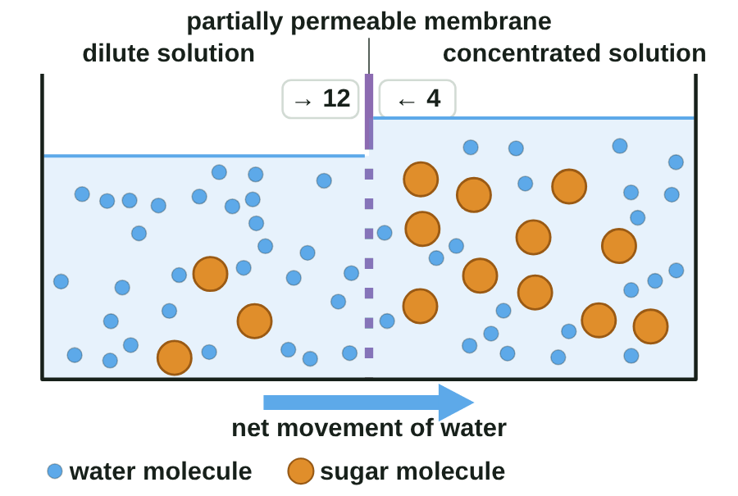
sciencegcse.co.uk · Biology B1 L9: Osmosis
Online lesson: screen 3 of 12
Osmosis: water crosses a membrane
A partially permeable membrane
Key facts
A partially permeable membrane lets water through, but not sugar.
Dilute solution: a little solute, so a high concentration of water. Pure water has the most.
Concentrated solution: a lot of solute, so a low concentration of water.
Water moves both ways. More moves into the concentrated solution: a net movement.
Watch out: only water moves by osmosis. It needs no energy from respiration.
Osmosis is the diffusion of water from a dilute solution to a concentrated solution through a partially permeable membrane.
A model: blue dots = water molecules, orange dots = sugar molecules. Real molecules are far too small to see.
▶ Online lesson, screen 3: Osmosis: water crosses a membrane
6
B1 L9 · sciencegcse.co.uk
Notes:
Osmosis is a special case of diffusion (B1 L8 Diffusion): the diffusion of water across a partially permeable membrane. Watch the counters in the animation: water molecules cross both ways all the time, but more cross into the concentrated side, because there are more water molecules on the dilute side to hit the pores. That difference is the net movement. Sugar molecules are too big to pass through. Two traps: (1) a concentrated solution has LESS water, not more; (2) never write 'water moves from a high concentration to a low concentration' unless you say 'of water' every time: 'from a dilute solution to a more concentrated solution' is safer. Osmosis needs no energy from respiration: it is passive, like diffusion. Cell membranes are partially permeable, so osmosis happens in every cell. Optional demonstration: Visking tubing filled with sugar solution in a beaker of water swells, and the liquid rises up a capillary tube. Visking tubing is a model of a cell membrane. One line a click. The picture is an animated GIF (print and PDF show its first frame: the finished model).

Slide 7
sciencegcse.co.uk · Biology B1 L9: Osmosis
Online lesson: screen 4 of 12
Checkpoint 1
✓
CHECKPOINT 1 of 3
Quick check on slides 4 to 6 (online screens 1 to 3). Show A, B or C on your whiteboard.
Question 1
Question 2
Question 3
The red onion cells in the painting are purple. Why?
Which of these has the highest concentration of water?
A dilute and a concentrated sugar solution are separated by a partially permeable membrane. What happens?
A. A purple stain was added to the cells.
A. A concentrated sugar solution
A. There is a net movement of water into the concentrated solution.
B. Their cell sap is naturally purple.
B. A dilute sugar solution
B. Sugar moves into the dilute solution by osmosis.
C. Water has turned the cells purple.
C. Pure water
C. Water stops moving when it reaches the membrane.
✓ Check your answers on the next slide
7
B1 L9 · sciencegcse.co.uk
Notes:
Checkpoint 1. Hinge check. Everyone shows A, B or C at the same time. Q1 A tests whether students think every coloured cell is stained (B1 L3). Q2 B is the common slip: a dilute solution has a lot of water, but pure water has more. Q3 B tests the idea that sugar moves by osmosis. If several get Q1 wrong, go back to slide 4; Q2 and Q3, slide 6.

Slide 8
sciencegcse.co.uk · Biology B1 L9: Osmosis
Online lesson: screen 4 of 12
Checkpoint 1 answers
✓
CHECKPOINT 1 of 3
Quick check on slides 4 to 6 (online screens 1 to 3). Show A, B or C on your whiteboard.
Question 1
Question 2
Question 3
The red onion cells in the painting are purple. Why?
Which of these has the highest concentration of water?
A dilute and a concentrated sugar solution are separated by a partially permeable membrane. What happens?
A. A purple stain was added to the cells.
A. A concentrated sugar solution
A. There is a net movement of water into the concentrated solution.
A. There is a net movement of water into the concentrated solution. ✓
B. Their cell sap is naturally purple.
B. Their cell sap is naturally purple. ✓
B. A dilute sugar solution
B. Sugar moves into the dilute solution by osmosis.
C. Water has turned the cells purple.
C. Pure water
C. Pure water ✓
C. Water stops moving when it reaches the membrane.
The purple is the cell sap's own colour, so no stain is needed.
Pure water has no solute at all, so it has the highest concentration of water.
Water moves both ways, but more moves into the concentrated solution.
Got one wrong? Look back: Q1 slide 4 · Q2 and Q3 slide 6
8
B1 L9 · sciencegcse.co.uk
Notes:
1 B, 2 C, 3 A. Each click shows one answer and why. Follow-ups: Q2, which has the lowest concentration of water? (The concentrated sugar solution.) Q3, why can water pass through the membrane but sugar cannot? (Water molecules are small enough to fit through; sugar molecules are too big.)

Slide 9
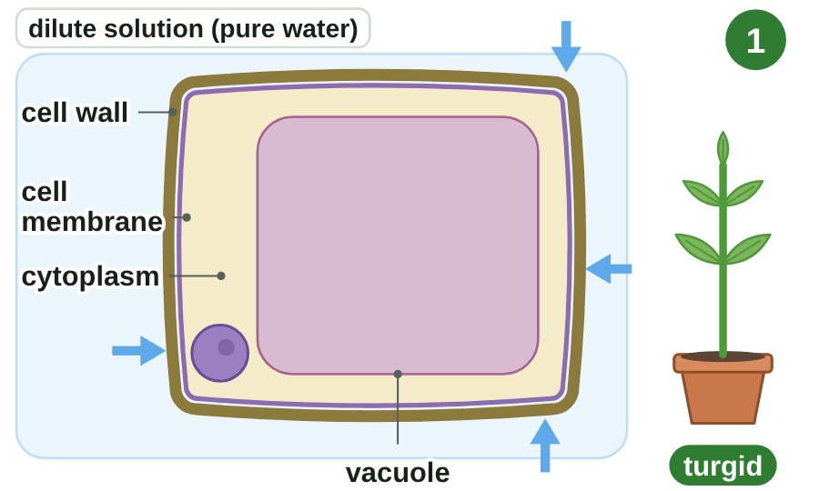
sciencegcse.co.uk · Biology B1 L9: Osmosis
Online lesson: screen 5 of 12
Plant cells in different solutions
One plant cell, three solutions
Step by step
1
Dilute solution: Water moves in by osmosis. The vacuole swells. The cell becomes turgid.
2
Concentrated solution: Water moves out by osmosis. The vacuole shrinks. The cell becomes flaccid.
3
Plasmolysis: More water leaves. The cytoplasm and cell membrane pull away from the cell wall.
Turgid cells hold a plant up. When its cells are flaccid, the plant wilts.
Blue arrows show which way water moves. You cannot see water move.
Watch out! A plant cell never bursts in water: the cell wall stops it.
▶ Online lesson, screen 5: Plant cells in different solutions
9
B1 L9 · sciencegcse.co.uk
Notes:
Run screen 5 of the online lesson step by step. The words: turgid (swollen and firm), flaccid (soft), plasmolysis (the cytoplasm and cell membrane pull away from the wall). The cell wall is strong: when the vacuole presses against it, the wall pushes back, so the cell cannot take in more and never bursts. Turgid cells press against each other, which is what holds up a non-woody plant and keeps leaves flat. Ask: why does a plant wilt on a hot day when the soil is dry? (Its cells lose water and become flaccid, so they no longer hold the plant up. Why the leaves keep losing water is B2 L14 Transpiration and the potometer.) Link to slide 4: the right-hand field of the painting is plasmolysed red onion cells. Plasmolysis is reversible if the cell is put back in water soon enough. Each click shows the next step, then the summary and the Watch out. The picture is an animated GIF (print and PDF show its first frame).

Slide 10
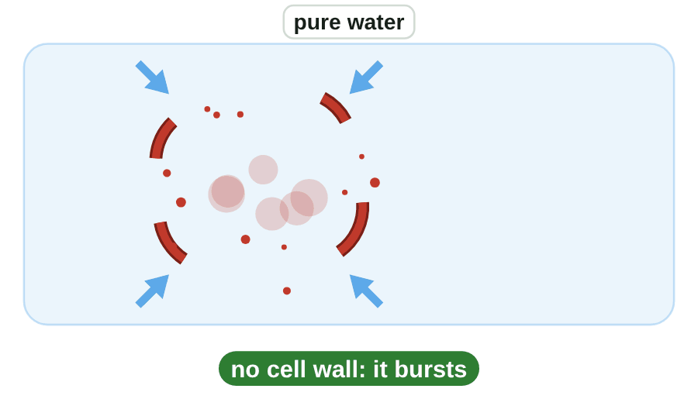
sciencegcse.co.uk · Biology B1 L9: Osmosis
Online lesson: screen 6 of 12
Animal cells and root hair cells
Three cells, three solutions
Animal cells
A red blood cell has a cell membrane but no cell wall.
In pure water, water moves in. The cell swells and may burst.
In a concentrated salt solution, water moves out. The cell shrinks.
No cell wall, so nothing stops an animal cell bursting.
Root hair cells
The water in the soil is more dilute than the inside of a root hair cell.
Root hair cells take in water from the soil by osmosis.
Watch out: water enters by osmosis. Mineral ions enter by active transport (B1 L10 Active transport and exchange surfaces).
Blue arrows show which way water moves. You cannot see water move.
10
B1 L9 · sciencegcse.co.uk
Notes:
Contrast with slide 9: a plant cell in pure water becomes turgid but never bursts, because of its cell wall. An animal cell has no cell wall, so it keeps taking in water until it may burst. This is why a drip in hospital is a salt solution about as concentrated as the inside of blood cells, not pure water (slide 3). Root hair cells: the long, thin extension gives a large surface area (B1 L5 Specialised cells), so more water is taken in by osmosis. The soil water is usually more dilute than the root hair cell's cytoplasm and cell sap, so the net movement of water is into the cell. If the soil water becomes more concentrated (too much fertiliser, or salt spread on roads), water can move out of the roots and the plant wilts (Challenge task E). How mineral ions get in against a concentration gradient is B1 L10 Active transport and exchange surfaces. One line a click. The picture is an animated GIF: the three scenes play one after another (print and PDF show its first frame: the red blood cell in pure water, burst).

Slide 11
sciencegcse.co.uk · Biology B1 L9: Osmosis
Online lesson: screen 7 of 12
Checkpoint 2
✓
CHECKPOINT 2 of 3
Quick check on slides 9 and 10 (online screens 5 and 6). Show A, B or C on your whiteboard.
Question 1
Question 2
Question 3
A plant cell is put in pure water. What happens to it?
Why can a red blood cell burst in pure water, but a plant cell cannot?
The water in the soil is more dilute than the inside of a root hair cell. How does water get into the cell?
A. Water moves out, and the cell becomes flaccid.
A. A red blood cell has no cell wall.
A. By active transport, using energy from respiration
B. Water moves in, and the cell bursts.
B. A red blood cell has no cell membrane.
B. By osmosis, across the cell membrane
C. Water moves in, and the cell becomes turgid.
C. Water enters a red blood cell by active transport.
C. Through the stomata in the root
✓ Check your answers on the next slide
11
B1 L9 · sciencegcse.co.uk
Notes:
Checkpoint 2. Mini whiteboards: A, B or C, all at the same time. Q1 B is the classic error: plant cells do not burst. Q3 A mixes up osmosis and active transport. If several get Q1 wrong, go back to slide 9; Q2 and Q3, slide 10.

Slide 12
sciencegcse.co.uk · Biology B1 L9: Osmosis
Online lesson: screen 7 of 12
Checkpoint 2 answers
✓
CHECKPOINT 2 of 3
Quick check on slides 9 and 10 (online screens 5 and 6). Show A, B or C on your whiteboard.
Question 1
Question 2
Question 3
A plant cell is put in pure water. What happens to it?
Why can a red blood cell burst in pure water, but a plant cell cannot?
The water in the soil is more dilute than the inside of a root hair cell. How does water get into the cell?
A. Water moves out, and the cell becomes flaccid.
A. A red blood cell has no cell wall.
A. A red blood cell has no cell wall. ✓
A. By active transport, using energy from respiration
B. Water moves in, and the cell bursts.
B. A red blood cell has no cell membrane.
B. By osmosis, across the cell membrane
B. By osmosis, across the cell membrane ✓
C. Water moves in, and the cell becomes turgid.
C. Water moves in, and the cell becomes turgid. ✓
C. Water enters a red blood cell by active transport.
C. Through the stomata in the root
The vacuole swells and presses against the cell wall, so the cell is firm.
Water keeps moving in, and there is no cell wall to stop the cell bursting.
Water moves from the dilute soil water into the more concentrated cell by osmosis.
Got one wrong? Look back: Q1 slide 9 · Q2 and Q3 slide 10
12
B1 L9 · sciencegcse.co.uk
Notes:
1 C, 2 A, 3 B. Each click shows one answer and why. Follow-ups: Q1, what would happen to the same cell in a very concentrated sugar solution? (It would lose water, become flaccid, then plasmolysed.) Q3, why does a long root hair help? (A larger surface area, so more water is taken in.)

Slide 13
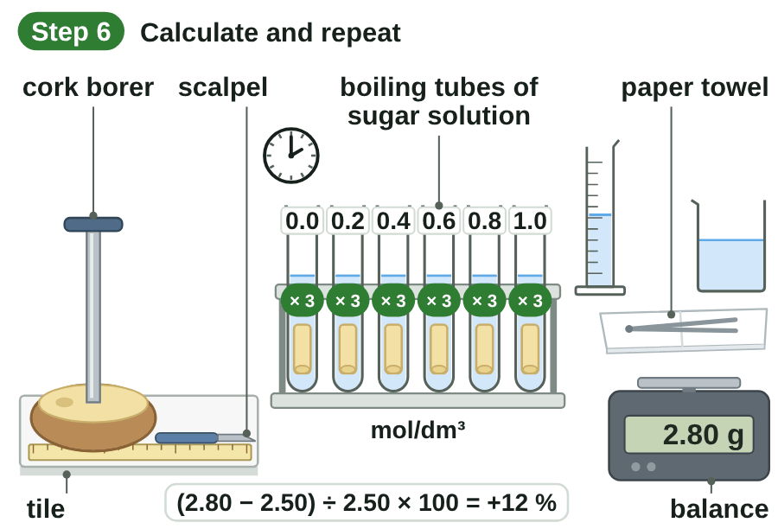
sciencegcse.co.uk · Biology B1 L9: Osmosis
Online lesson: screen 8 of 12
The potato practical: method
The method
Step by step
1
Cut: Use a cork borer to cut potato cylinders. Trim them all to 3 cm with a scalpel on a tile. Take off any skin.
2
Fill the tubes: Put 10 cm³ of sugar solution into each boiling tube: 0.0, 0.2, 0.4, 0.6, 0.8 and 1.0 mol/dm³.
3
Blot and weigh: Blot each cylinder gently with a paper towel. Find its mass on a balance. This is the starting mass.
4
Leave: Put one cylinder into each tube. Leave them overnight at room temperature.
5
Blot and weigh again: Take each cylinder out. Blot it gently in the same way. Find its mass again. This is the final mass.
6
Calculate and repeat: Calculate the percentage change in mass. Do three cylinders at each concentration, and find the mean.
Safety: cut onto a tile, away from your fingers. Wipe up spills. Do not eat the potato.
Cut onto a tile, away from your fingers.
▶ Virtual lab: try the practical online
▶ Online lesson, screen 8: The potato practical: method
13
B1 L9 · sciencegcse.co.uk
Notes:
This is Required practical 2 in Combined Science and 3 in Biology (AQA 4.1.3.2). Run the online lesson, screen 8, step by step, or the virtual lab. Each click shows the next step; the animated GIF runs the six steps on its own (print and PDF show its first frame). Why a cork borer? Every cylinder has the same diameter, so they start the same size. Why take off the skin? The skin does not let water through in the same way as the inside of the potato. Why blot? Solution left on the surface would add to the mass; blot gently and the same way every time, or you squeeze water out. Label the tubes before you start, so the cylinders do not get mixed up. Safety: the cork borer and the scalpel are sharp: push the cork borer into the potato on a tile, twist, and cut away from your fingers. Wipe up spills of sugar solution (sticky, and a slip hazard). Do not eat the potato. The practical is low hazard. How to run it in class: groups of two or three, each group one or two concentrations, three cylinders each; set up in this lesson and weigh again next lesson; pool the class results on the board (slide 16). If there is no time for the practical, use the virtual lab and the results on slides 15 and 16. What goes wrong: cylinders not all the same length; skin left on; blotting too hard (it squeezes water out) or not at all; tubes not labelled; cylinders left out on the bench before weighing, so they dry in the air; a balance that reads only to 0.1 g. Salt solutions work too: the AQA practical says salt or sugar.

Slide 14
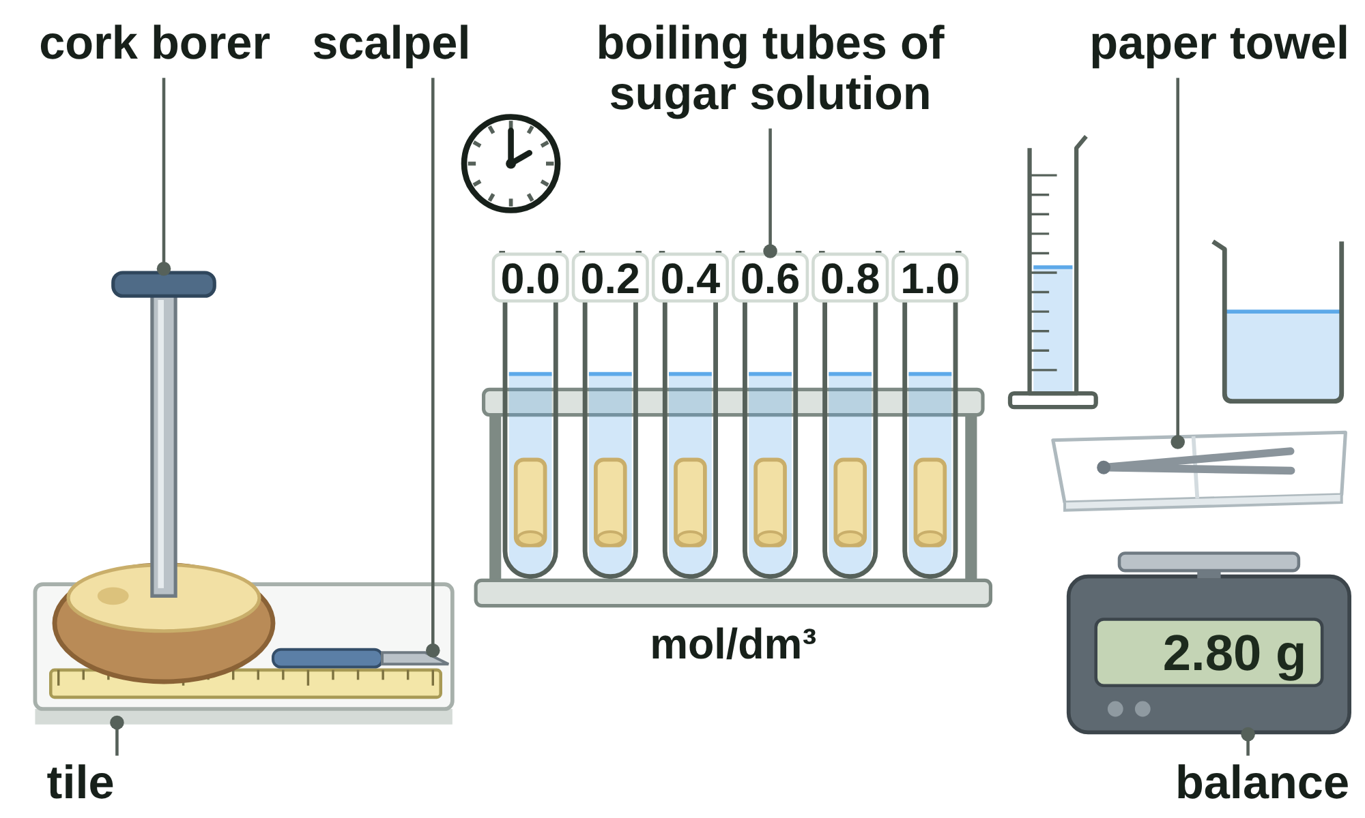
sciencegcse.co.uk · Biology B1 L9: Osmosis
Online lesson: screen 9 of 12
The potato practical: variables
The practical
Three kinds of variable
Variable
In this practical
Independent: you change it
the concentration of the sugar (or salt) solution
Dependent: you measure it
the percentage change in mass
C
I
Control: you keep it the same
the size of each cylinder (cork borer, 3 cm long)
Control
the volume of solution (10 cm³)
Control
the time (overnight) and the temperature
D
Control
the same potato, and blotting the same way
I = independent. D = dependent. C = control.
Change only the concentration. Keep everything else the same: a fair test.
Good results: do three cylinders at each concentration and find the mean.
14
B1 L9 · sciencegcse.co.uk
Notes:
Ask students to point to the part of the bench that sets each variable (the online lesson, screen 9, rings each one on the drawing). One row a click; each letter tag on the picture appears with its row. The independent variable is what we choose to change: the concentration of the sugar (or salt) solution. The dependent variable is what we measure: the mass, from which we calculate the percentage change in mass. Control variables are everything else that could change the result. Name them precisely in the exam: 'the volume of sugar solution', not 'the amount'. Why the same potato? Different potatoes, and even different parts of one potato, can have different concentrations inside their cells. Why the same time? A cylinder left longer has longer to gain or lose water. Temperature: water molecules move faster when it is warmer, so osmosis is faster (B1 L8 Diffusion: the same idea). Repeats show whether the results are repeatable and help you spot an anomaly (slide 16).

Slide 15
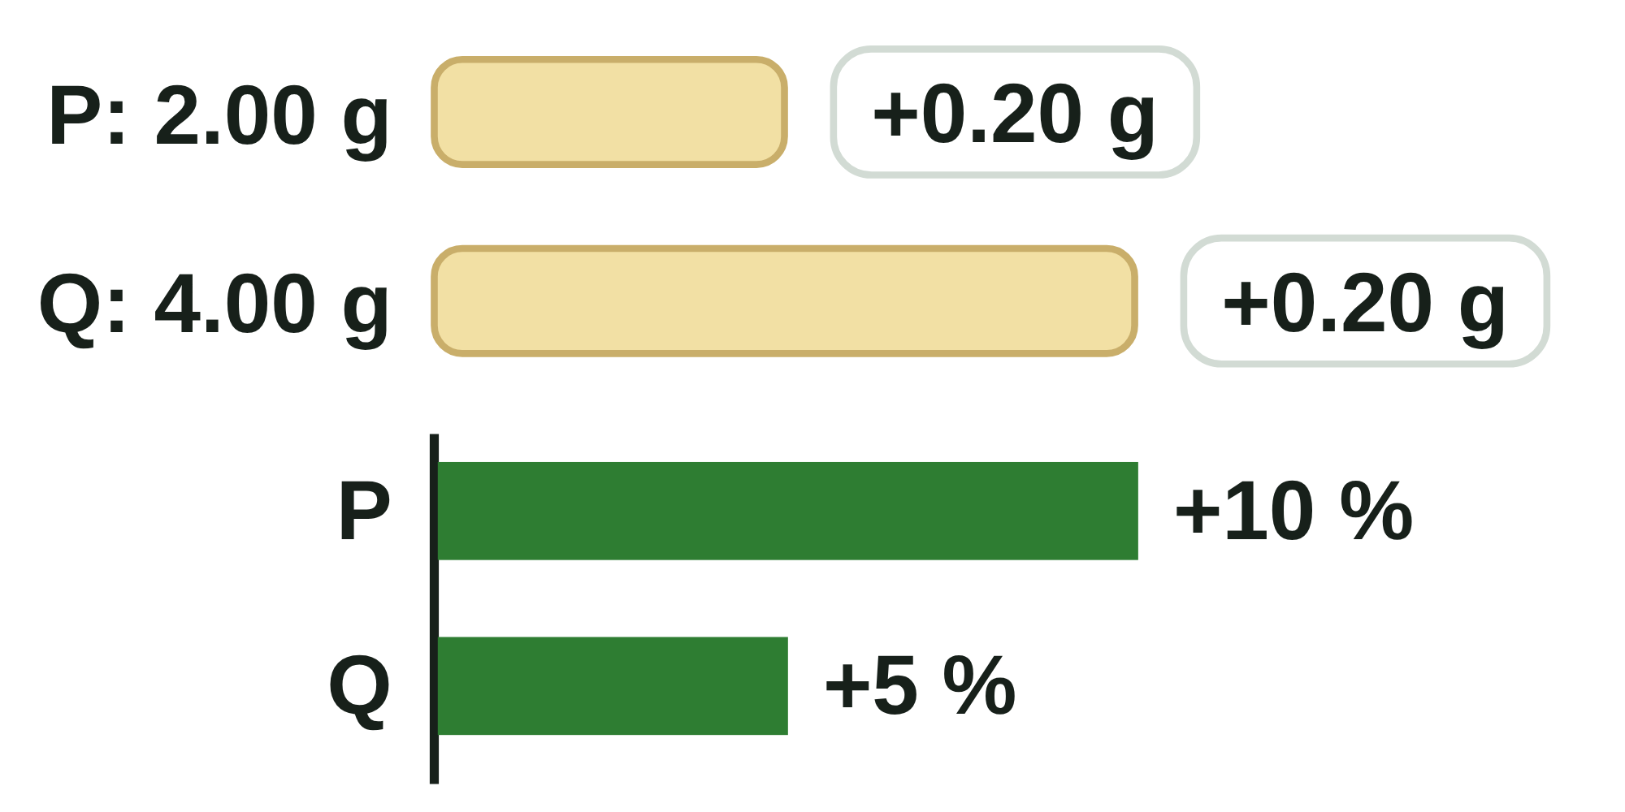
sciencegcse.co.uk · Biology B1 L9: Osmosis
Online lesson: screen 10 of 12
Percentage change in mass
Table 1: one cylinder at each concentration
Calculating it
Concentration (mol/dm³)
Starting mass (g)
Final mass (g)
Change in mass (g)
% change in mass
percentage change in mass = (final mass − starting mass) ÷ starting mass × 100
Example 1, 0.0 mol/dm³: (2.80 − 2.50) ÷ 2.50 × 100 = +12 %
Example 2, 0.6 mol/dm³: (1.70 − 2.00) ÷ 2.00 × 100 = −15 %
Check: the dilute solution gives a gain; the concentrated one gives a loss.
Rate of water uptake = gain in mass ÷ time, in g per hour.
0.0
2.50
2.80
+0.30
+12
0.2
2.40
2.52
+0.12
+5
0.4
2.25
2.16
−0.09
−4
0.6
2.00
1.70
−0.30
−15
0.8
3.00
2.46
−0.54
−18
Why a percentage?
1.0
2.40
1.92
−0.48
−20
The cylinders start with different masses. A percentage lets you compare them fairly.
A + means a gain in mass: water moved in. A − means a loss: water moved out.
15
B1 L9 · sciencegcse.co.uk
Notes:
The clicks follow the step-by-step table on screen 10 of the online lesson: the change column, the percentage column, then the two worked examples, the check and why we use a percentage. Work through both examples: the equation in words, then the numbers, then the answer with its sign and unit, then a check (a dilute solution should give a gain). Subtract first, then divide by the STARTING mass, then multiply by 100. Common errors: dividing by the final mass (2.80 instead of 2.50); forgetting the minus sign for a loss; giving the change in grams instead of the percentage. Why percentages? The 0.8 mol/dm³ cylinder started at 3.00 g and the 0.6 one at 2.00 g: comparing grams would not be fair. A percentage shows each change as a share of that cylinder's own starting mass. Rate of water uptake (AQA asks for simple compound measures): the 0.0 cylinder gained 0.30 g in about 20 hours, so its mean rate of water uptake was 0.30 ÷ 20 = 0.015 g per hour.

Slide 16
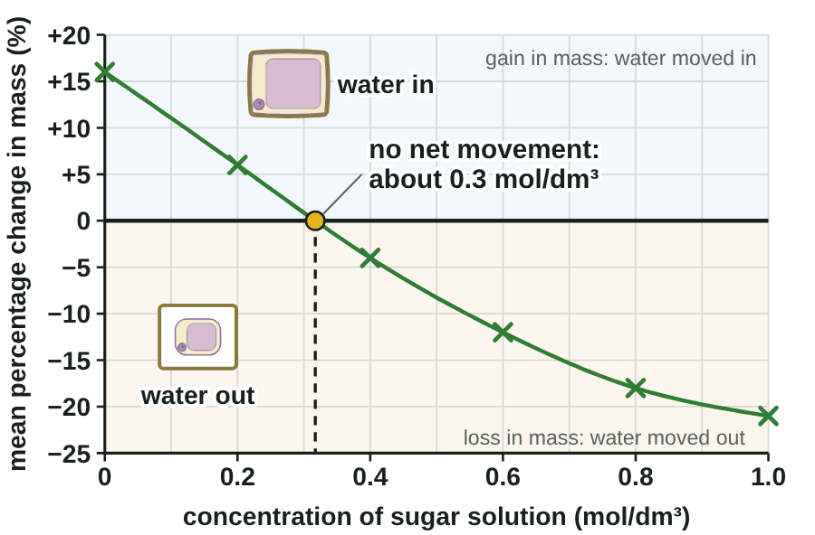
sciencegcse.co.uk · Biology B1 L9: Osmosis
Online lesson: screen 11 of 12
Results, graph and conclusion
Mean percentage change against concentration
Table 2: three cylinders
Conc.
1 (%)
2 (%)
3 (%)
Mean (%)
0.0
+12
+17
+19
+16
0.2
+5
+7
+18
+6
0.4
−4
−3
−5
−4
0.6
−15
−10
−11
−12
0.8
−18
−19
−17
−18
1.0
−20
−22
−21
−21
+18 % is an anomaly: leave it out.
Conclusion
Below about 0.3 mol/dm³ the potato gains mass: water moves in.
Above it, the potato loses mass: water moves out.
At about 0.3 mol/dm³ there is no net movement of water. The potato cells' contents are about as concentrated as this solution.
▶ Online lesson, screen 11: Results, graph and conclusion
16
B1 L9 · sciencegcse.co.uk
Notes:
Ask: which variable goes along the bottom? (The independent variable, the concentration.) Up the side? (The mean percentage change in mass, the dependent variable.) The y-axis must go below zero, because some cylinders lost mass. Plot with small crosses and draw one smooth line of best fit, never dot to dot. Why leave out +18 %? It is far from the other two results at 0.2 mol/dm³: perhaps that cylinder was not blotted, or was cut from a different part of the potato. Where the line crosses 0 %, water still moves both ways across the cell membranes, but there is no net movement: not 'no movement'. That concentration estimates the concentration of the potato cells' contents. Real potatoes vary (about 0.2 to 0.4 mol/dm³); the virtual lab is simulated. Evaluating: blotting that is not the same each time, cylinders drying in the air before weighing, the balance's resolution, and differences between pieces of potato all make results less repeatable; repeats and a mean help. To find the crossing point more exactly, add more concentrations between 0.2 and 0.4 mol/dm³ (0.25, 0.30, 0.35). The animated GIF plots the means, draws the line and finds where it crosses 0 %, as the step-by-step graph on screen 11 does (print and PDF show the finished graph). The table and graph show from the start; the conclusion wipes in one line a click.

Slide 17
sciencegcse.co.uk · Biology B1 L9: Osmosis
Online lesson: screen 12 of 12
Checkpoint 3
✓
CHECKPOINT 3 of 3
Quick check on slides 13 to 16 (online screens 8 to 11). Show A, B or C on your whiteboard.
Question 1
Question 2
Question 3
In the potato practical, which of these must be kept the same in every tube?
Why do we compare the percentage change in mass, and not just the change in grams?
The line of best fit crosses 0 % at 0.3 mol/dm³. What does this show?
A. The concentration of the sugar solution
A. The cylinders do not all start with the same mass.
A. Water stops moving at 0.3 mol/dm³.
B. The volume of solution in each tube
B. It stops water moving out of the potato.
B. The potato loses the most mass at 0.3 mol/dm³.
C. The percentage change in mass
C. A change in grams cannot be negative.
C. There is no net movement of water at 0.3 mol/dm³.
✓ Check your answers on the next slide
17
B1 L9 · sciencegcse.co.uk
Notes:
Checkpoint 3. Mini whiteboards: A, B or C. Q1 A and C test the three kinds of variable. Q3 A names the 'no movement' error. If several get Q1 wrong, go back to slide 14; Q2, slide 15; Q3, slide 16.

Slide 18
sciencegcse.co.uk · Biology B1 L9: Osmosis
Online lesson: screen 12 of 12
Checkpoint 3 answers
✓
CHECKPOINT 3 of 3
Quick check on slides 13 to 16 (online screens 8 to 11). Show A, B or C on your whiteboard.
Question 1
Question 2
Question 3
In the potato practical, which of these must be kept the same in every tube?
Why do we compare the percentage change in mass, and not just the change in grams?
The line of best fit crosses 0 % at 0.3 mol/dm³. What does this show?
A. The concentration of the sugar solution
A. The cylinders do not all start with the same mass.
A. The cylinders do not all start with the same mass. ✓
A. Water stops moving at 0.3 mol/dm³.
B. The volume of solution in each tube
B. The volume of solution in each tube ✓
B. It stops water moving out of the potato.
B. The potato loses the most mass at 0.3 mol/dm³.
C. The percentage change in mass
C. A change in grams cannot be negative.
C. There is no net movement of water at 0.3 mol/dm³.
C. There is no net movement of water at 0.3 mol/dm³. ✓
It is a control variable: 10 cm³ in every tube, so the test is fair.
A percentage shows each change as a share of that cylinder's own starting mass.
The potato cells' contents are about as concentrated as this solution.
Got one wrong? Look back: Q1 slide 14 · Q2 slide 15 · Q3 slide 16
18
B1 L9 · sciencegcse.co.uk
Notes:
1 B, 2 A, 3 C. Each click shows one answer and why. Next: practise predicting which way water moves.

Slide 19
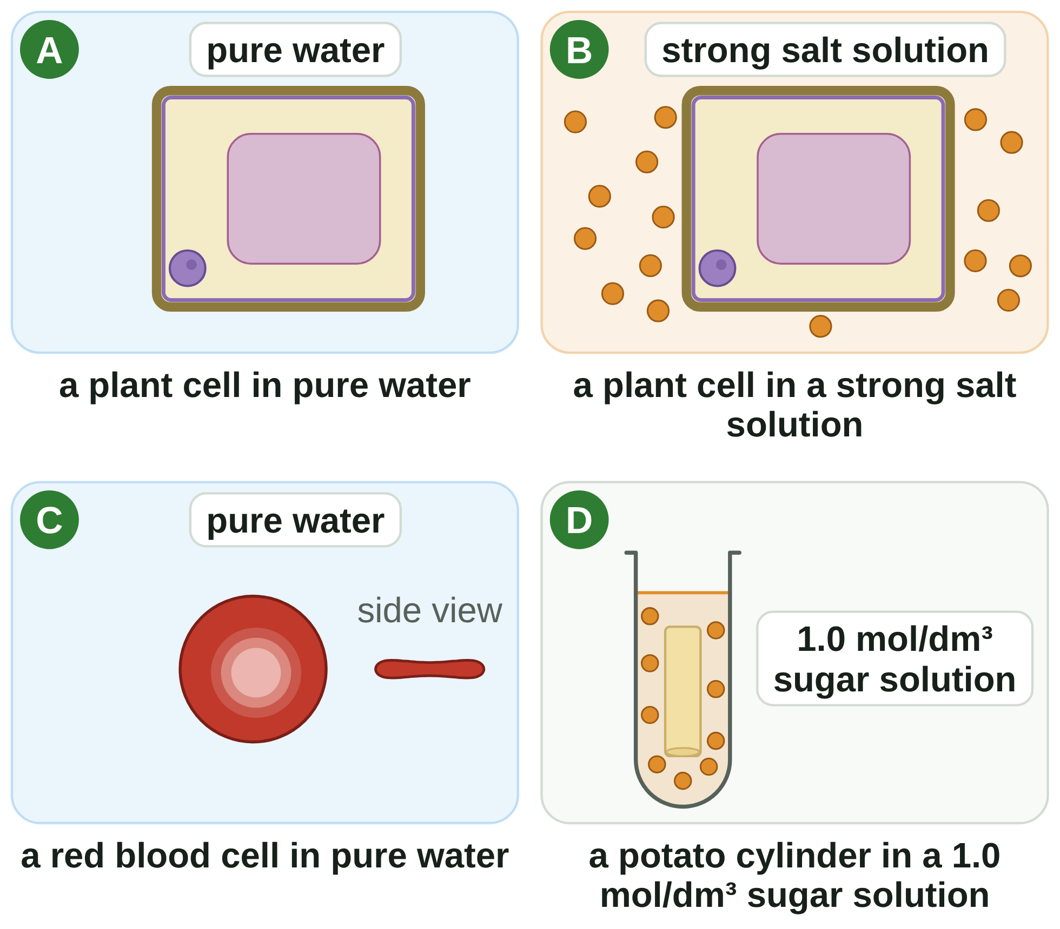
sciencegcse.co.uk · Biology B1 L9: Osmosis
Practice: predict the water movement
Four cells and a cylinder
Questions
1. In which picture does the cell become turgid?
______________
2. Which way does water move in B?
______________
3. In which picture could the cell burst?
______________
4. In A, what stops the cell bursting?
______________
5. Will the cylinder in D gain or lose mass? Why?
______________
6. Which picture could show plasmolysis after a while?
______________
Predict: does water move in or out?
19
B1 L9 · sciencegcse.co.uk
Notes:
Pairs, 4 minutes. For each picture, decide first: is the outside more dilute or more concentrated than the inside of the cell? Then the water moves towards the more concentrated side.

Slide 20
sciencegcse.co.uk · Biology B1 L9: Osmosis
Predict the water movement: answers
Four cells and a cylinder
Answers
1. In which picture does the cell become turgid?
A.
2. Which way does water move in B?
Out of the cell, into the salt solution.
3. In which picture could the cell burst?
C: a red blood cell has no cell wall.
4. In A, what stops the cell bursting?
The cell wall.
5. Will the cylinder in D gain or lose mass? Why?
Lose mass: water moves out of the potato cells by osmosis.
6. Which picture could show plasmolysis after a while?
B.
Predict: does water move in or out?
20
B1 L9 · sciencegcse.co.uk
Notes:
Go through the answers. Q3: animal cells have no cell wall, so C is the only one that can burst. Q5: a 1.0 mol/dm³ sugar solution is more concentrated than the potato cells (about 0.3 mol/dm³), so water moves out and the cylinder loses mass. Q6: B, because a plant cell in a strong salt solution keeps losing water until its cytoplasm pulls away from the wall.

Slide 21
sciencegcse.co.uk · Biology B1 L9: Osmosis
Exam practice
1. A potato cylinder is left in pure water. Explain why its mass goes up. [3]
Pure water is more dilute than the inside of the potato cells (1). Water moves into the cells by osmosis (1), across their partially permeable cell membranes (1).
2. A cylinder's mass went from 3.20 g to 2.88 g. Calculate the percentage change in mass. [2]
(2.88 − 3.20) ÷ 3.20 × 100 (1) = −10 % (1).
21
B1 L9 · sciencegcse.co.uk
Notes:
Model answers with mark points in brackets. Students try each question first, then mark their own work in green. Q1: say 'water', 'osmosis' and 'more dilute' (or 'a higher concentration of water'); the mark is lost for 'from high concentration to low concentration' without 'of water'. Q2: show the substitution for the first mark; keep the minus sign: the mass went down. For more, the B1 L9 Exam questions worksheet (PDF) has five questions, 20 marks; its mark scheme is at the end of this PowerPoint. The same five questions are in the online lesson, after the quiz.

Slide 22
sciencegcse.co.uk · Biology B1 L9: Osmosis
Exit ticket
Answer on your own
How confident am I?
1. Give the word for a plant cell that is swollen and firm with water. [1]
I can explain osmosis.
2. A potato cylinder loses mass in a sugar solution. Which way did water move? [1]
I can predict what happens to cells.
3. Why is each potato cylinder blotted before its mass is found? [1]
4. A cylinder's mass goes from 2.00 g to 2.30 g. Calculate the percentage change in mass. [2]
I can calculate percentage change in mass.
22
B1 L9 · sciencegcse.co.uk
Notes:
Students answer on their own, then rate their confidence: red, amber or green for each line. Q4: look for the substitution (2.30 − 2.00) ÷ 2.00 × 100 as well as the answer, with its + sign. Use the red and amber lines to plan the start of the next lesson.

Slide 23
sciencegcse.co.uk · Biology B1 L9: Osmosis
Exit ticket answers
Answers
Next lesson
1. Turgid.
2. Out of the potato, into the sugar solution.
3. To remove the solution from its surface, so only the potato's mass is measured.
4. (2.30 − 2.00) ÷ 2.00 × 100 (1) = +15 % (1).
Next: B1 L10 Active transport and exchange surfaces
How cells take in substances against a concentration gradient, and how exchange surfaces are adapted.
Worksheets:
• Mandatory (everyone)
• Alternative (easier, with key notes)
• Challenge (when you finish the Mandatory)
• Exam questions (exam style, 20 marks, homework)
▶ Online lesson: quiz and exam questions
23
B1 L9 · sciencegcse.co.uk
Notes:
Go through the answers. Q2: say 'out of the potato cells by osmosis'. Q3: also accept 'to dry the outside, so extra solution does not add to the mass'; 'to dry it' on its own is not enough. After this slide: the B1 L9 revision notes (4 printable pages), then the worksheets with answers in green: the Mandatory worksheet (everyone), the Challenge worksheet (stretch) and the Alternative worksheet (easier: key notes and very simple tasks). The B1 L9 Exam questions worksheet (exam style, black and white, 20 marks) is a separate PDF for homework; its mark scheme is the last two slides. The link bar opens the online lesson's quiz and exam questions. Homework: the online lesson quiz and the B1 L9 Exam questions worksheet.

Slide 24
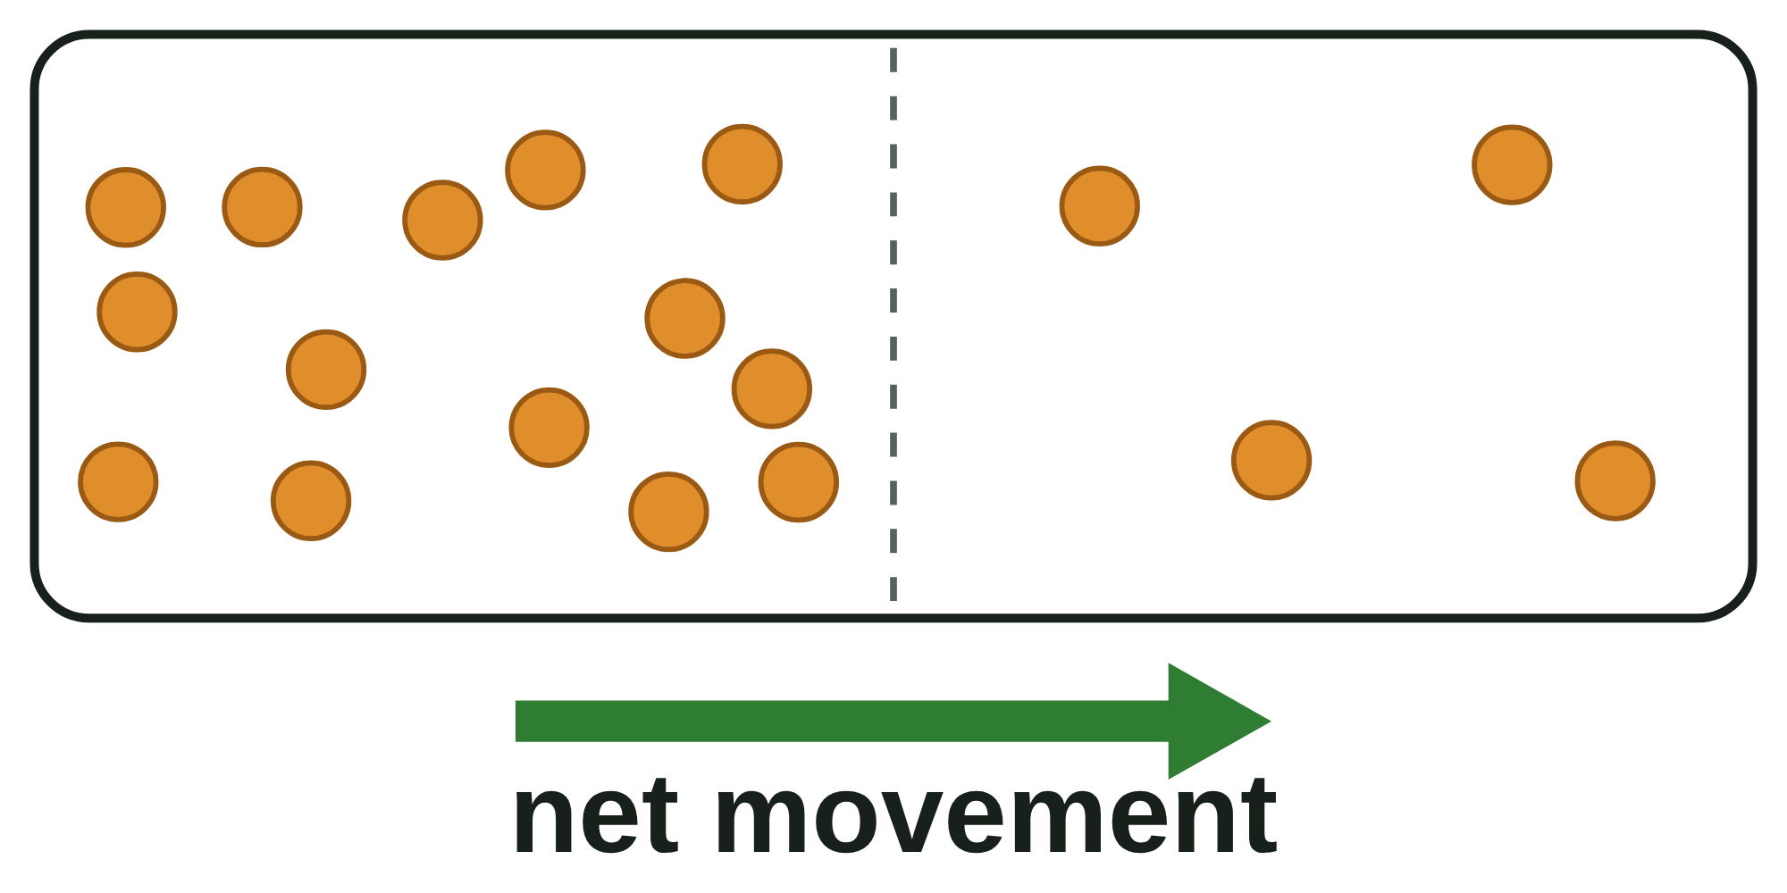
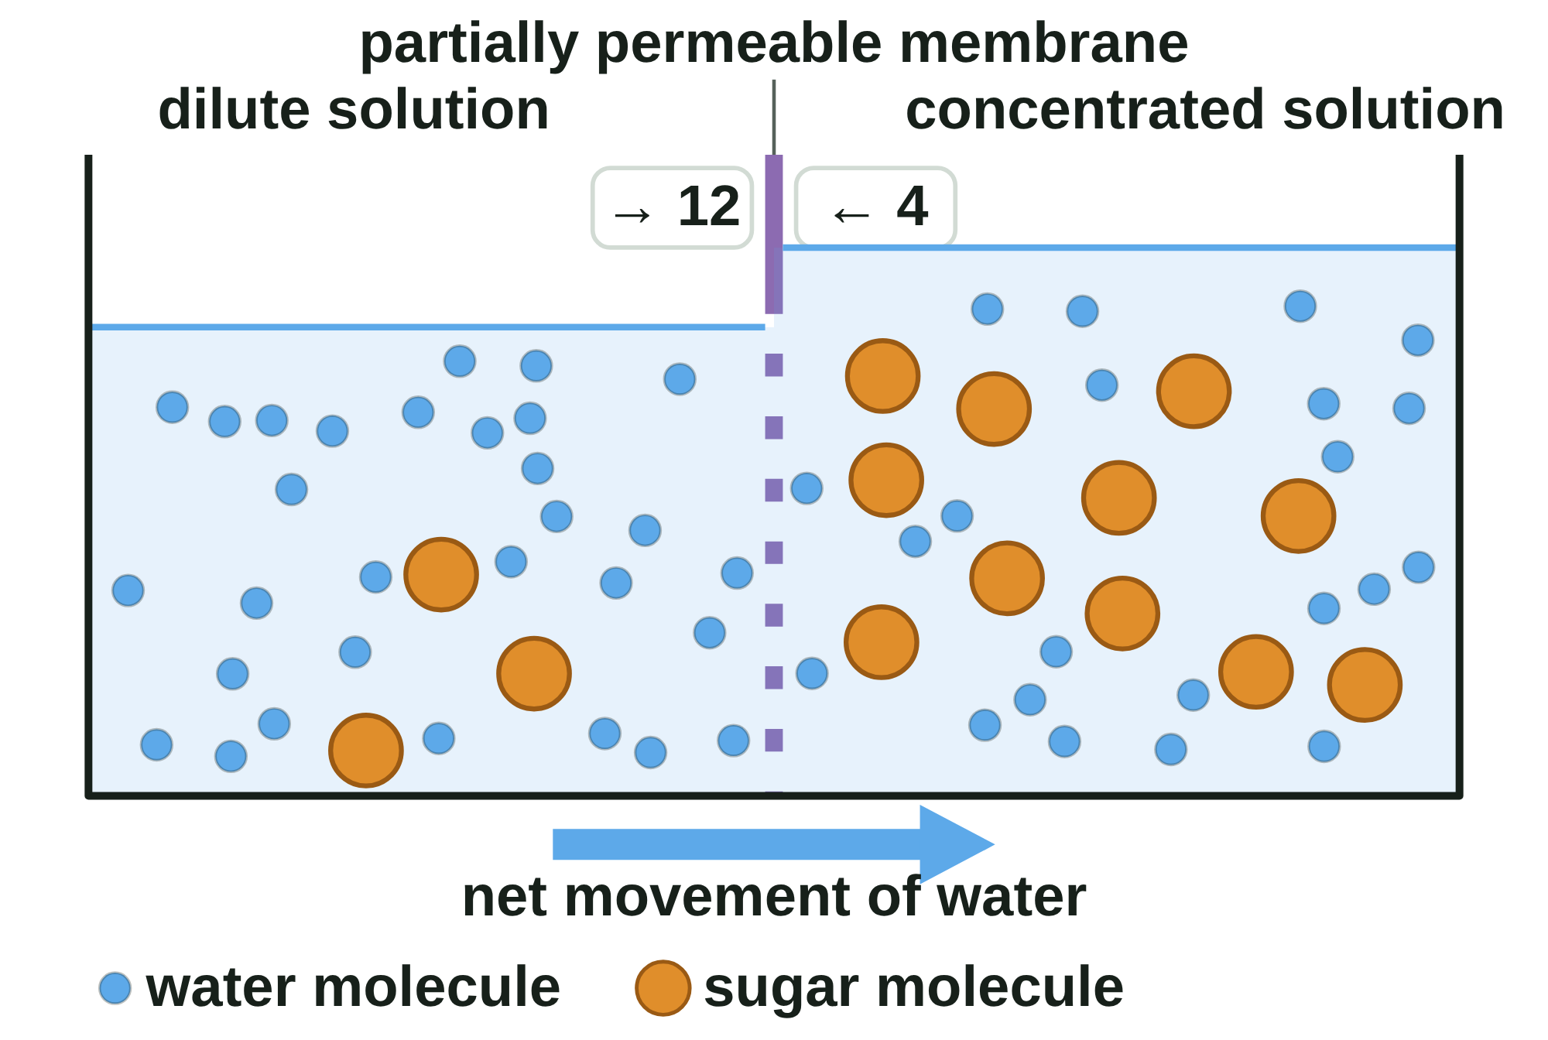
B1 L9 Revision notes 1 of 4
Osmosis
Osmosis, partially permeable membranes, and real cells beside a diagram
1. What osmosis is
3. Dilute and concentrated solutions
In B1 L8 Diffusion you met diffusion: the net movement of particles from an area of higher concentration to an area of lower concentration.
Osmosis is a special case of diffusion. It is the diffusion of water from a dilute solution to a concentrated solution through a partially permeable membrane.
Water moves into and out of every cell by osmosis, across the cell membrane.
A solution is made when a solute, such as sugar or salt, dissolves in a liquid, such as water.
 | Dilute solution | Concentrated solution
Solute | a little | a lot
Concentration of water | high | low
Water moves by osmosis (across a partially permeable membrane between them) | out of it | into it
Pure water has no solute, so it has the highest concentration of water.
2. Partially permeable membranes
Watch out: write “water moves from a dilute solution to a more concentrated solution”. If you write about high and low concentrations, say “of water” every time. A concentrated solution has less water, not more.
A partially permeable membrane lets small molecules, such as water, pass through, but not larger ones, such as sugar.
The cell membrane is partially permeable. The cell wall is not: it lets water and dissolved substances through.
Water molecules move all the time, in every direction. They cross the membrane both ways.
More water molecules cross from the dilute side, because there are more of them there to hit the membrane. So there is a net movement of water into the more concentrated solution.
Osmosis needs no energy from respiration. (Active transport does: B1 L10 Active transport and exchange surfaces.)
4. Real cells and a diagram
Real red onion cells (painting)
A diagram
A painting based on light micrographs. The purple is the cell sap's own colour: no stain.
A model: blue dots = water molecules, orange dots = sugar molecules. Real molecules are far too small to see.
Red onion cells have purple cell sap in their permanent vacuole, so you can see the vacuole without a stain.
In pure water (left), each vacuole is full and presses against the cell wall.
In strong salt solution (right), water leaves by osmosis. The vacuole shrinks and the cytoplasm pulls away from the wall.
A diagram is simplified: it shows one neat cell in each solution, with arrows for the water. Real cells are packed together and share walls, they shrink unevenly, and you cannot see the water move. The clear gap in a shrunken cell is full of salt solution, not air.
Watch out: only water moves by osmosis. Sugar and salt do not move by osmosis: the membrane stops them.
B1 L9 · Osmosis · sciencegcse.co.uk · free GCSE science resources
Notes:
Revision notes page 1 of 4 (or use B1_L9_Revision_notes.pdf). These pages are the textbook for B1 L9: students read them before the lesson, use them to catch up, or revise from them. Page 1: what osmosis is, partially permeable membranes, dilute and concentrated solutions, and the real red onion cells beside the diagram.

Slide 25
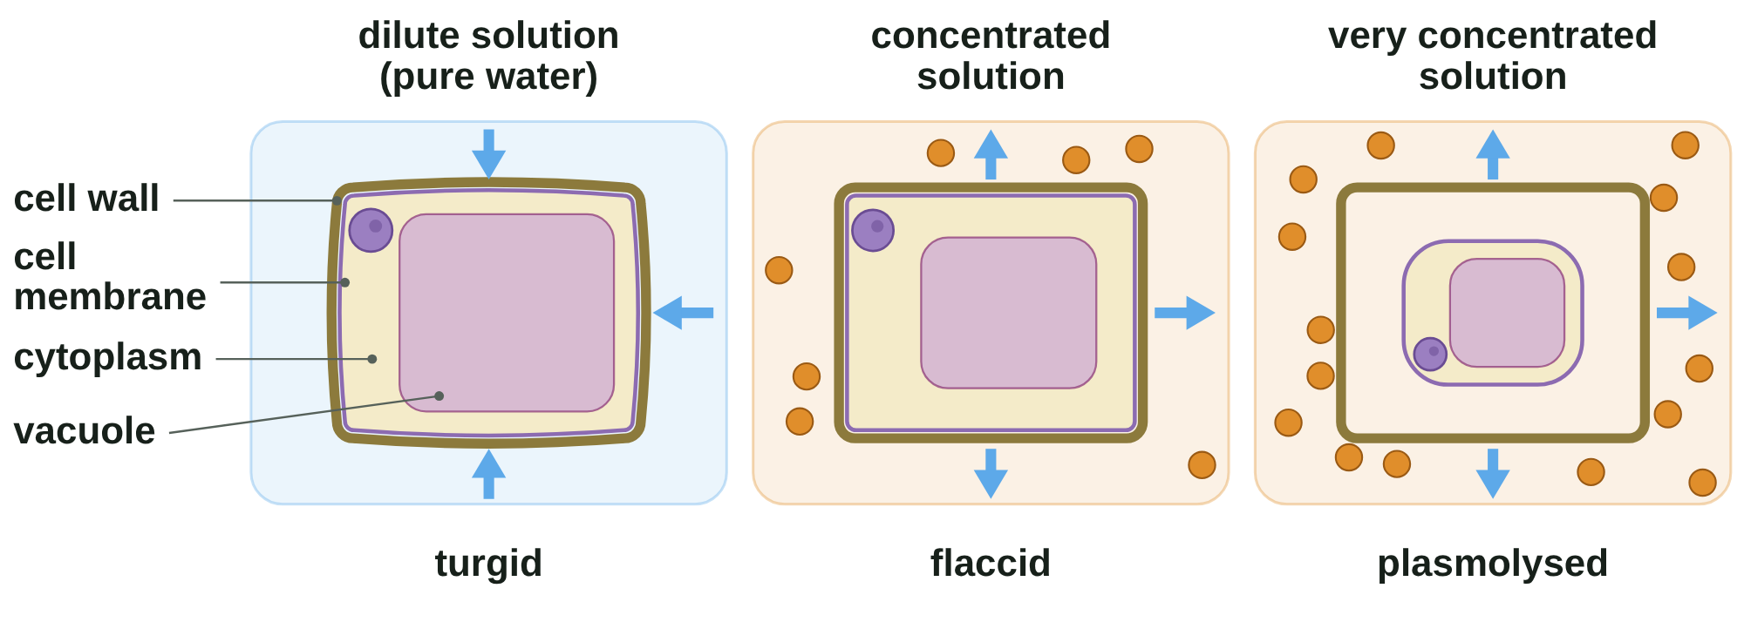
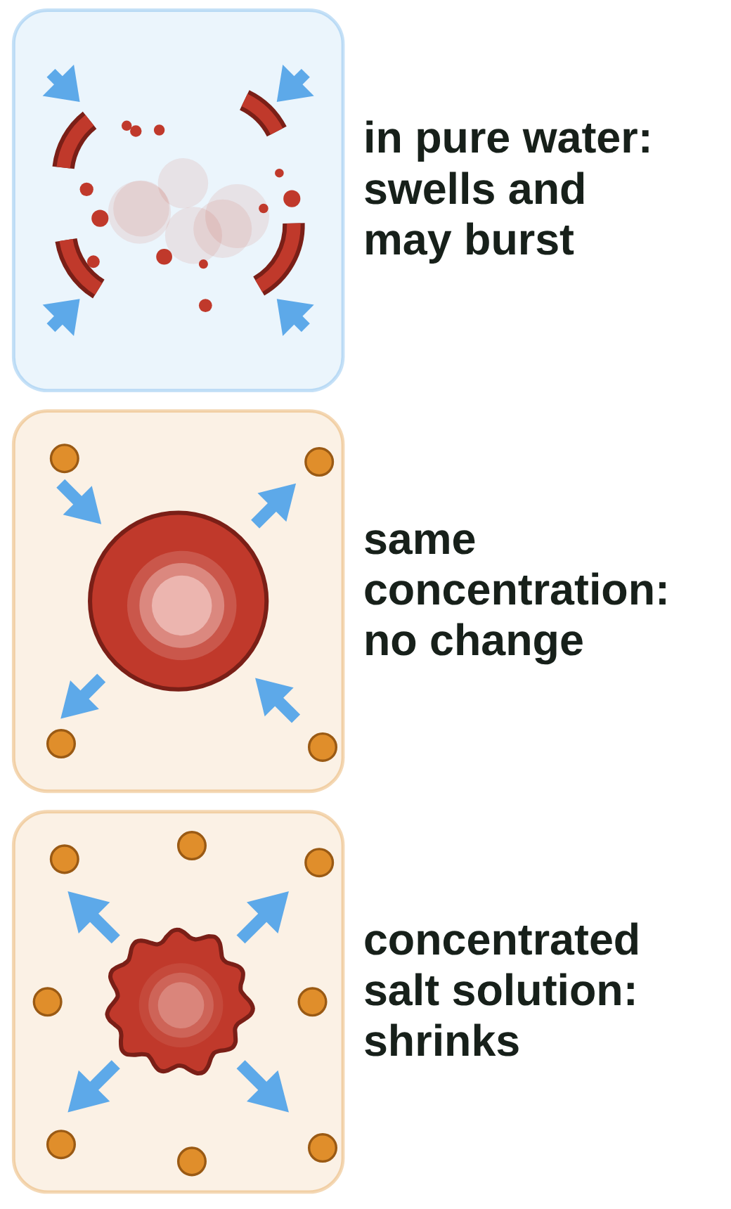
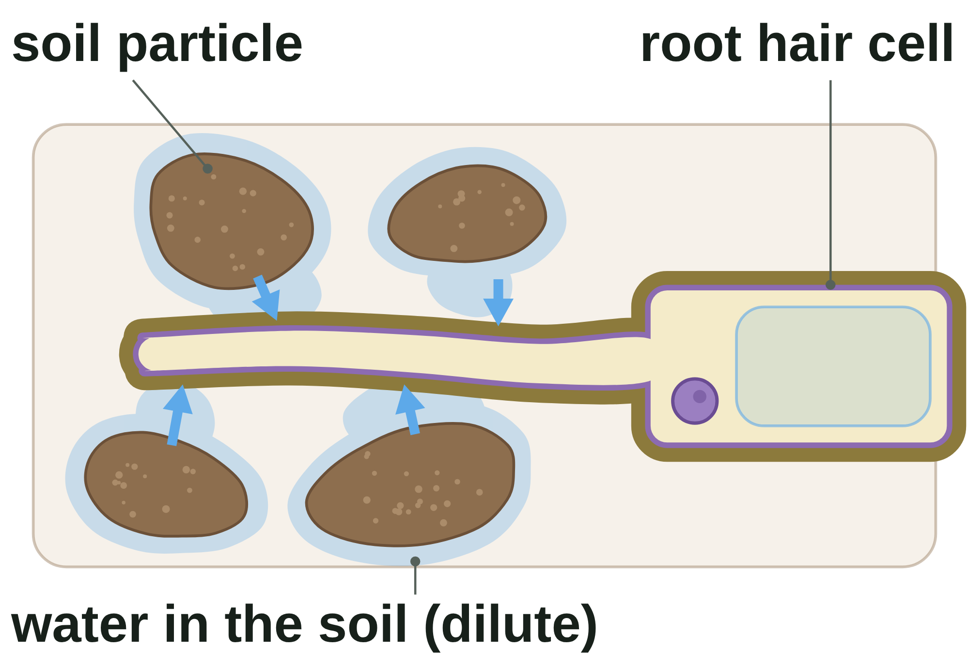
B1 L9 Revision notes 2 of 4
Osmosis
Plant cells, animal cells and root hair cells
5. Plant cells
7. Animal cells
Animal cells, such as red blood cells, have a cell membrane but no cell wall.
In pure water, water moves in by osmosis. Nothing stops the cell swelling, so it may burst.
In a solution with the same concentration as the cell, there is no net movement of water.
In a concentrated salt solution, water moves out by osmosis and the cell shrinks.
This is why a hospital drip is a salt solution about as concentrated as the inside of blood cells, and never pure water.
Blue arrows show which way water moves. You cannot see water move.
Watch out: an animal cell may burst in pure water, but a plant cell never does. Use turgid for plant cells only.
In a dilute solution (such as pure water), the cell's contents are more concentrated than the solution. Water moves in by osmosis. The vacuole swells and pushes the cytoplasm against the cell wall. The cell is turgid: swollen and firm.
The cell wall is strong. It pushes back, so the cell cannot take in more water. A plant cell never bursts.
In a concentrated solution, water moves out by osmosis. The vacuole shrinks. The cell is flaccid: soft.
If the cell loses more water, the cytoplasm and cell membrane pull away from the cell wall. This is plasmolysis. The wall keeps its shape, and the gap fills with the outside solution.
8. Root hair cells
Watch out: plant cells do not burst in water. The cell wall stops them.
Root hair cells take in water from the soil by osmosis. The water in the soil is more dilute than the inside of the root hair cell, so the net movement of water is into the cell.
The long, thin extension gives a large surface area, so more water is taken in (B1 L5 Specialised cells).
Mineral ions enter root hair cells a different way, by active transport (B1 L10 Active transport and exchange surfaces).
6. Why plants wilt
Turgid cells press against each other. This holds up the stems and leaves of plants that are not woody, and keeps leaves flat to the light.
When a plant is short of water, its cells lose water and become flaccid. They no longer hold the plant up, so it wilts. Water it, and water moves back into the cells by osmosis: they become turgid again. (Why leaves keep losing water is B2 L14 Transpiration and the potometer.)
B1 L9 · Osmosis · sciencegcse.co.uk · free GCSE science resources
Notes:
Revision notes page 2 of 4. What happens to plant cells and animal cells in dilute and concentrated solutions, why plants wilt, and how root hair cells take in water.

Slide 26
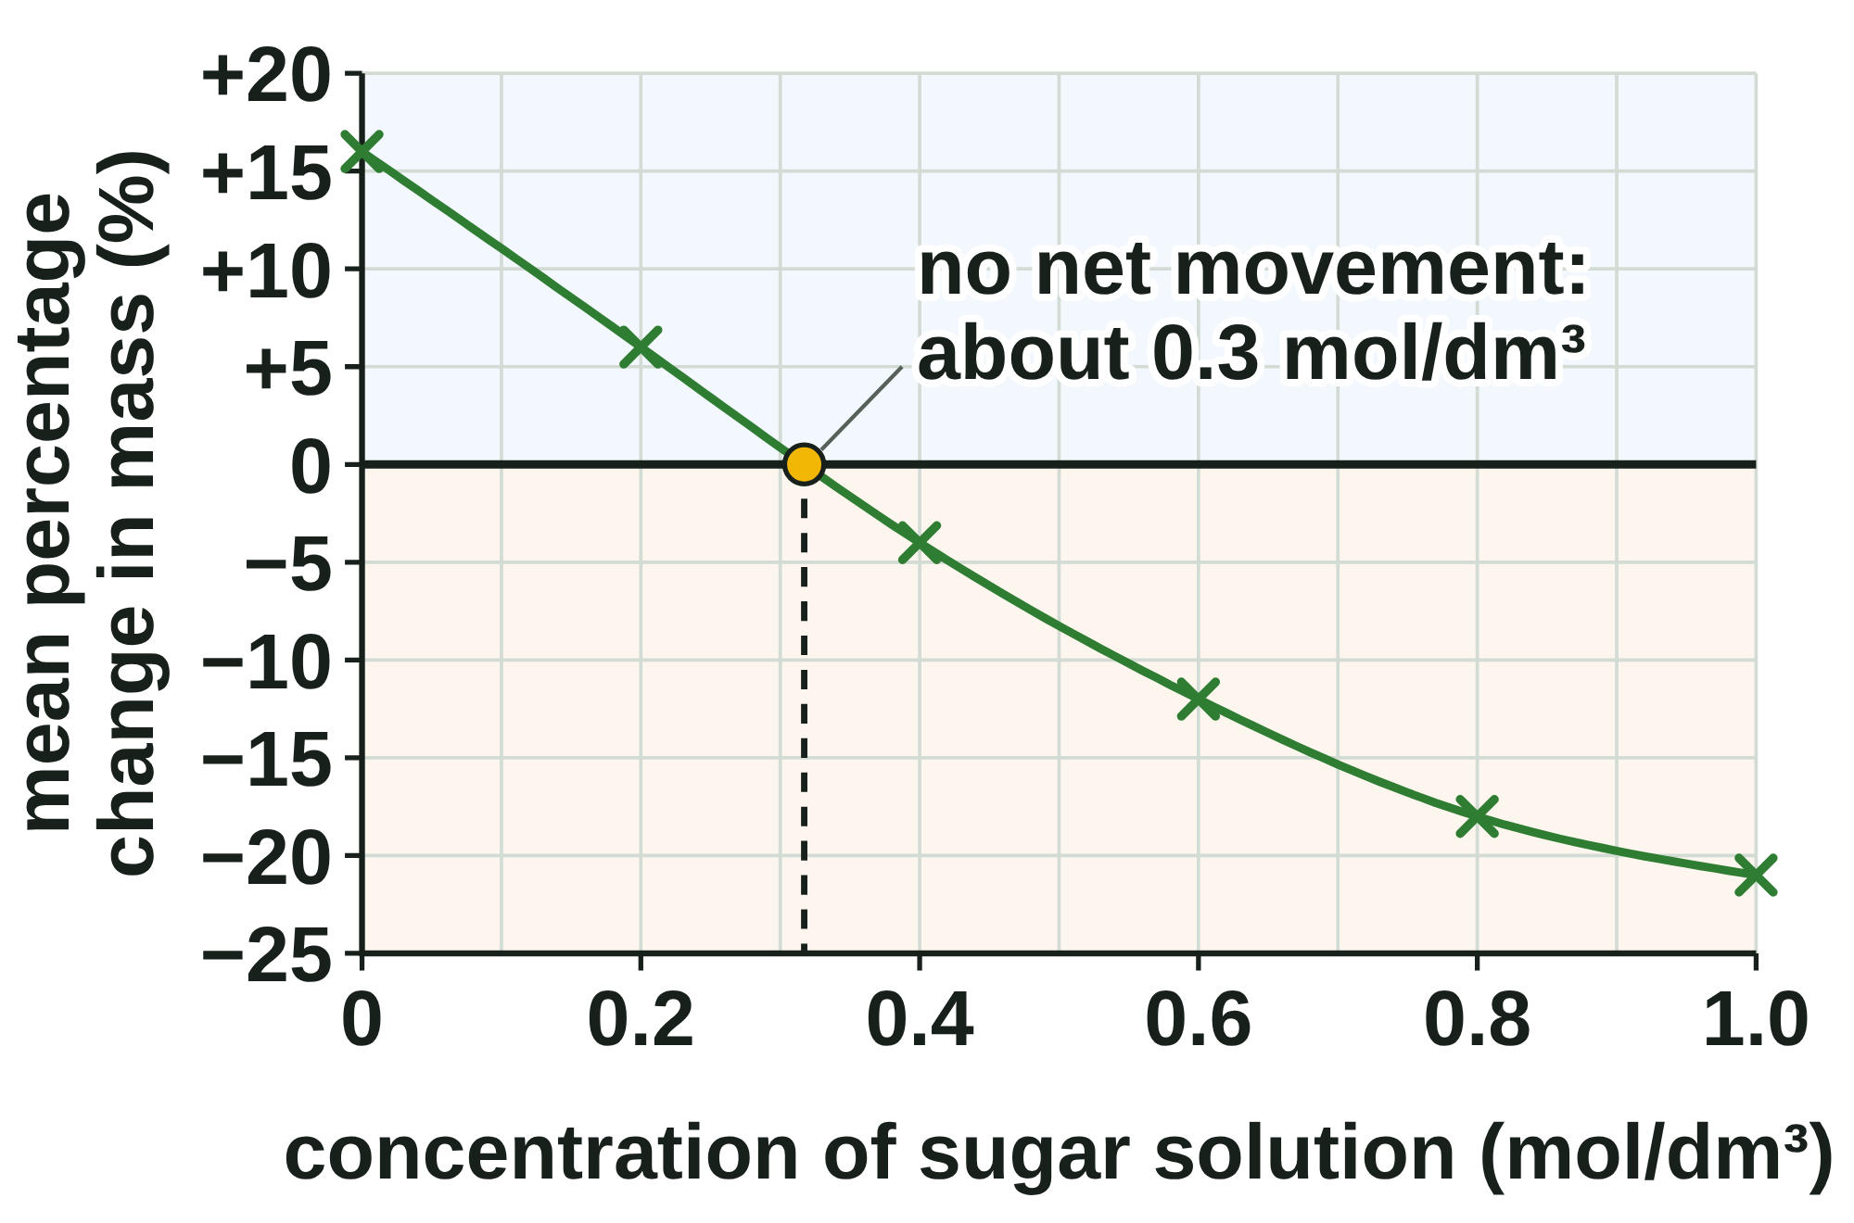
B1 L9 Revision notes 3 of 4
Osmosis
Required practical 2 (Combined Science) · 3 (Biology): potato cylinders
9. The method
11. Results, the graph and the conclusion
Aim: find out how the concentration of a sugar (or salt) solution affects the mass of potato tissue.
1. Use a cork borer to cut potato cylinders. Trim them all to 3 cm with a scalpel on a tile. Take off any skin.
2. Put 10 cm³ of sugar solution into each of six labelled boiling tubes: 0.0, 0.2, 0.4, 0.6, 0.8 and 1.0 mol/dm³.
3. Blot each cylinder gently with a paper towel. Find its mass on a balance: the starting mass.
4. Put one cylinder into each tube. Leave them overnight at room temperature.
5. Take each cylinder out, blot it gently in the same way, and find its mass again: the final mass.
6. Calculate the percentage change in mass. Do three cylinders at each concentration and find the mean.
Safety: cut onto a tile, away from your fingers; take care with the cork borer and the scalpel; wipe up spills; do not eat the potato.
Concentration (mol/dm³) | 0.0 | 0.2 | 0.4 | 0.6 | 0.8 | 1.0
Cylinder 1 (%) | +12 | +5 | −4 | −15 | −18 | −20
Cylinder 2 (%) | +17 | +7 | −3 | −10 | −19 | −22
Cylinder 3 (%) | +19 | +18 (anomaly) | −5 | −11 | −17 | −21
Mean (%) | +16 | +6 | −4 | −12 | −18 | −21
At 0.2 mol/dm³, +18 % is an anomaly: it does not fit the pattern of the other results. Leave it out. Mean = (5 + 7) ÷ 2 = +6 %.
Put the concentration along the bottom and the mean percentage change up the side.
The y-axis must go below zero: some cylinders lost mass.
Plot small crosses. Draw one smooth line of best fit, not dot to dot.
Conclusion. Below about 0.3 mol/dm³ the potato gains mass: the solution is more dilute than the potato cells, so water moves in by osmosis.
Variable | In this practical
Independent (you change it) | the concentration of the sugar (or salt) solution
Dependent (you measure it) | the percentage change in mass
Control (you keep it the same) | the same potato; the size of the cylinders; the volume of solution; the time; the temperature; blotting the same way
10. Percentage change in mass
Above about 0.3 mol/dm³ the potato loses mass: water moves out.
Where the line crosses 0 %, at about 0.3 mol/dm³, there is no net movement of water. The potato cells' contents are about as concentrated as this solution.
percentage change in mass = (final mass − starting mass) ÷ starting mass × 100
Worked example: a cylinder in 0.6 mol/dm³ goes from 2.00 g to 1.70 g.
Change in mass = 1.70 − 2.00 = −0.30 g.
Percentage change = −0.30 ÷ 2.00 × 100 = −15 %.
Check: the solution is concentrated, so the cylinder should lose mass. It did: the answer is negative.
A gain (+) means water moved in. A loss (−) means water moved out.
Use a percentage because the cylinders start with different masses: it compares them fairly.
Rate of water uptake = gain in mass ÷ time. A cylinder that gains 0.30 g in 20 hours takes in water at 0.30 ÷ 20 = 0.015 g per hour.
Watch out: at 0 % change, water still moves both ways. There is no net movement, not “no movement”.
12. Evaluating
Blotting: blotting harder or more gently changes the mass. Blot every cylinder the same way.
Drying: a cylinder left out on the bench loses water to the air. Find the mass straight away.
The balance: a balance that reads to 0.01 g has a better resolution than one that reads to 0.1 g: it shows smaller changes in mass.
Different pieces of potato can behave differently. Use one potato, and do three cylinders at each concentration: if the results are close, they are repeatable.
Watch out: divide by the starting mass, not the final mass. Keep the minus sign for a loss.
B1 L9 · Osmosis · sciencegcse.co.uk · free GCSE science resources
Notes:
Revision notes page 3 of 4. The required practical: the method, the variables, safety, percentage change in mass, the graph, the conclusion and evaluating.

Slide 27
B1 L9 Revision notes 4 of 4
Osmosis
Key words, exam tips and check yourself
Key words
Check yourself
Cover the answers, then check.
Anomaly: a result that does not fit the pattern of the other results.
Concentrated solution: a solution with a lot of solute dissolved in it, so it has a low concentration of water.
Control variable: a variable that is kept the same, so the test is fair.
Cork borer: a metal tube with a sharp end, used to cut cylinders of tissue with the same diameter.
Dependent variable: the variable that you measure.
Diffusion: the net movement of particles from an area of higher concentration to an area of lower concentration.
Dilute solution: a solution with only a little solute dissolved in it, so it has a high concentration of water.
Flaccid: describes a plant cell that is soft because it has lost water.
Independent variable: the variable that you change.
Mean: the total of the results divided by the number of results.
Net movement: the overall movement in one direction, after taking away the movement the other way.
Osmosis: the diffusion of water from a dilute solution to a concentrated solution through a partially permeable membrane.
Partially permeable membrane: a membrane that lets small molecules, such as water, pass through, but not larger ones, such as sugar.
Percentage change in mass: the change in mass divided by the starting mass, multiplied by 100.
Plasmolysis: when a plant cell loses so much water that its cytoplasm and cell membrane pull away from the cell wall.
Solute: the substance that dissolves in a liquid, such as sugar or salt.
Solution: a mixture made when a solute dissolves in a liquid, such as water.
Turgid: describes a plant cell that is swollen and firm because its vacuole is full of water.
1. Give the definition of osmosis.
2. What does a partially permeable membrane let through, and what does it stop?
3. Which has more water in it: a dilute solution or a concentrated solution?
4. A plant cell is put in pure water. Which way does water move, and what word describes the cell afterwards?
5. What is plasmolysis?
6. Why can a red blood cell burst in pure water when a plant cell cannot?
7. A potato cylinder goes from 1.60 g to 1.48 g. Calculate the percentage change in mass.
8. On the graph of the potato practical, what does the point where the line crosses 0 % show?
Answers
1. The diffusion of water from a dilute solution to a concentrated solution through a partially permeable membrane.
2. It lets small molecules such as water through, but stops larger ones such as sugar.
3. A dilute solution.
4. Into the cell, by osmosis. The cell becomes turgid.
5. When a plant cell loses so much water that its cytoplasm and cell membrane pull away from the cell wall.
6. A red blood cell has no cell wall. A plant cell's wall stops it bursting.
7. (1.48 − 1.60) ÷ 1.60 × 100 = −7.5 %.
8. No net movement of water: the solution is about as concentrated as the inside of the potato cells.
Exam tips
Say water every time: osmosis is the movement of water, never of sugar or salt.
Write “from a dilute solution to a more concentrated solution”. If you use “high” and “low”, add “of water”.
Use the words turgid, flaccid and plasmolysis for plant cells. Animal cells swell and may burst, or shrink.
Say why a plant cell does not burst: the cell wall.
Percentage change = (final − starting) ÷ starting × 100. Keep the minus sign for a loss.
At 0 % change there is no net movement of water, not “no movement”.
B1 L9 · Osmosis · sciencegcse.co.uk · free GCSE science resources
Notes:
Revision notes page 4 of 4. Key words, exam tips, and check-yourself questions with answers. Students cover the answers box, answer the questions, then check and correct in a different colour.

Slide 28
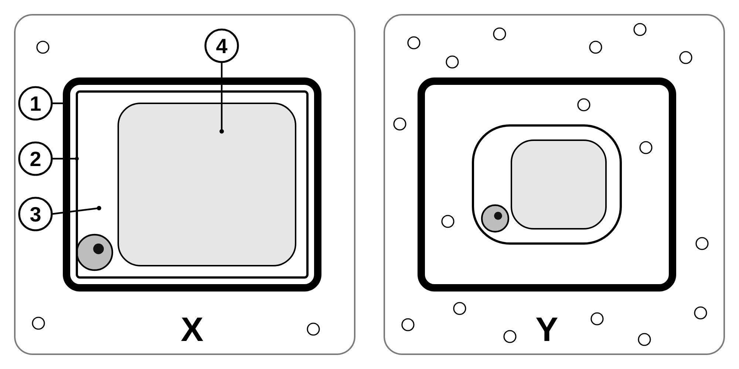
B1 L9 Mandatory worksheet: Osmosis
Page 1 of 2
Name: ______________________________ Class: __________
A. Plant cells in two solutions
B. In or out?
[6]
[6]
Help: online screens 2 and 5
Help: online screens 5, 6 and 10
Figure 1 shows the same kind of plant cell in two solutions, X and Y.
Tick (✓) one box in each row. Does water move into the cells, or out of them?
Cells and solution | Water moves in | Water moves out
1. A potato cylinder in pure water
2. A red blood cell in a very concentrated salt solution
3. A root hair cell in moist soil
4. A red onion cell in a strong salt solution
5. A red blood cell in pure water
6. A potato cylinder in a 1.0 mol/dm³ sugar solution
C. Short answers
[7]
Help: online screens 3 and 5
Figure 1
1. Complete the sentence. [3]
(a) Name the parts labelled 1 to 4. [4]
Osmosis is the diffusion of ____________ from a ____________ solution
to a ____________ solution through a partially permeable membrane.
1
3
2. Give the word for a plant cell that is soft because it has lost water. [1]
2
4
3. What stops a plant cell bursting when it takes in a lot of water? [1]
(b) Which cell, X or Y, is turgid? [1]
4. Describe what happens to the cytoplasm and cell membrane of a plant cell during plasmolysis. [2]
(c) Name the process that moved water out of cell Y. [1]
B1 L9 · Osmosis · sciencegcse.co.uk · free GCSE science resources

Slide 29
B1 L9 Mandatory worksheet: Osmosis
Page 2 of 2
Name: ______________________________ Class: __________
D. Results
E. The potato practical
[6]
[7]
Help: online screens 10 and 11
Help: online screens 8 and 9
A student did the practical. Table 1 shows the results.
(a) The steps of the method are mixed up. Write the letters in the right order.
percentage change in mass = change in mass ÷ starting mass × 100
P
Leave the cylinders in the solutions overnight.
Q
Blot each cylinder and find its starting mass.
Concentration (mol/dm³) | Starting mass (g) | Final mass (g) | Change in mass (g) | % change in mass
0.0 | 2.00 | 2.28 | +0.28 | (a)
0.3 | 2.50 | 2.50 | 0.00 | 0
0.5 | 2.40 | 2.16 | (b) | −10
0.8 | 2.00 | 1.64 | −0.36 | (c)
R
Cut cylinders with a cork borer and trim them to the same length.
S
Blot each cylinder again and find its final mass.
T
Put each cylinder into a tube of sugar solution.
First
→
→
→
→
Last [4]
(b) Name the independent variable. [1]
(a) Calculate the percentage change in mass at 0.0 mol/dm³. [2]
(c) Give two control variables. [2]
1
%
2
(b) Calculate the change in mass at 0.5 mol/dm³. [1]
g
F. Explain
[3]
Help: online screen 6
(c) Calculate the percentage change in mass at 0.8 mol/dm³. [2]
A red blood cell is put in pure water. Explain what happens to it. [3]
%
(d) At which concentration was there no net movement of water? [1]
mol/dm³
B1 L9 · Osmosis · sciencegcse.co.uk · free GCSE science resources

Slide 30
B1 L9 Mandatory worksheet answers - page 1
Answers 1 of 2
A. Plant cells in two solutions
B. In or out?
[6]
[6]
Figure 1 shows the same kind of plant cell in two solutions, X and Y.
1 mark for each correct row. Both boxes ticked in a row: no mark for that row.
Cells and solution | Water moves in | Water moves out
1. A potato cylinder in pure water | ✓
2. A red blood cell in a very concentrated salt solution |  | ✓
3. A root hair cell in moist soil | ✓
4. A red onion cell in a strong salt solution |  | ✓
5. A red blood cell in pure water | ✓
6. A potato cylinder in a 1.0 mol/dm³ sugar solution |  | ✓
C. Short answers
[7]
Figure 1
1. water (1); dilute (1); concentrated / more concentrated (1).
Do not accept “particles”, “sugar” or “solute” for the first gap. Do not accept “high concentration” and “low concentration” for the second and third gaps unless “of water” is added.
2. Flaccid (1).
Do not accept “plasmolysed” (that is when the cytoplasm has pulled away from the wall).
3. The cell wall (1).
Do not accept “the cell membrane”.
4. They shrink / pull away (1) from the cell wall (1).
Model answer: The cytoplasm and cell membrane shrink and pull away from the cell wall.
(a) Name the parts labelled 1 to 4. [4]
1
cell wall (1)
3
cytoplasm (1)
2
cell membrane (1)
4
(permanent) vacuole (1)
Allow “vacuole” or “cell sap” for 4. Allow small spelling errors if the word is clear. Do not accept “cell wall” for 2.
(b) X (1).
(c) Osmosis (1).
Do not accept “diffusion” on its own; allow “diffusion of water”.
B1 L9 · Osmosis · sciencegcse.co.uk · free GCSE science resources

Slide 31
B1 L9 Mandatory worksheet answers - page 2
Answers 2 of 2
D. Results
E. The potato practical
[6]
[7]
percentage change in mass = change in mass ÷ starting mass × 100
(a) The steps of the method are mixed up. Write the letters in the right order.
P
Leave the cylinders in the solutions overnight.
Concentration (mol/dm³) | Starting mass (g) | Final mass (g) | Change in mass (g) | % change in mass
0.0 | 2.00 | 2.28 | +0.28 | +14
0.3 | 2.50 | 2.50 | 0.00 | 0
0.5 | 2.40 | 2.16 | −0.24 | −10
0.8 | 2.00 | 1.64 | −0.36 | −18
Q
Blot each cylinder and find its starting mass.
R
Cut cylinders with a cork borer and trim them to the same length.
S
Blot each cylinder again and find its final mass.
T
Put each cylinder into a tube of sugar solution.
First
R
→
Q
→
T
→
P
→
S
Last [4]
(a) R first (1); Q before T (1); T before P (1); S last (1).
(b) The concentration of the sugar (or salt) solution (1).
Do not accept “sugar” or “the solution” alone.
(c) Any two (1 each): the volume of solution; the size / length / diameter of the cylinders; the time left in the solution; the temperature; the same potato; blotting the same way.
Do not accept “the amount” without saying of what, or “the concentration” (it is the independent variable).
(a) 0.28 ÷ 2.00 × 100 (1); = +14 (%) (1).
Allow 14 without the + sign. Correct answer with no working scores 2.
(b) −0.24 (g) (1).
Allow 0.24 if “lost” is written.
(c) −0.36 ÷ 2.00 × 100 (1); = −18 (%) (1).
Allow 18 for 1 mark only if the sign is missing.
(d) 0.3 (mol/dm³) (1).
Model answer: (a) 2.28 − 2.00 = +0.28 g; 0.28 ÷ 2.00 × 100 = +14 %. (b) 2.16 − 2.40 = −0.24 g. (c) −0.36 ÷ 2.00 × 100 = −18 %. (d) At 0.3 mol/dm³ the mass did not change, so there was no net movement of water.
F. Explain
[3]
Pure water is more dilute than the inside of the cell / has a higher concentration of water (1).
Water moves into the cell by osmosis (1).
The cell swells and may burst, because it has no cell wall (1).
Max 3. Do not accept “the cell becomes turgid” (turgid is for plant cells) or “salt moves out by osmosis”.
Model answer: Pure water is more dilute than the inside of the red blood cell. Water moves into the cell by osmosis. The cell has no cell wall, so it swells and may burst.
B1 L9 · Osmosis · sciencegcse.co.uk · free GCSE science resources

Slide 32
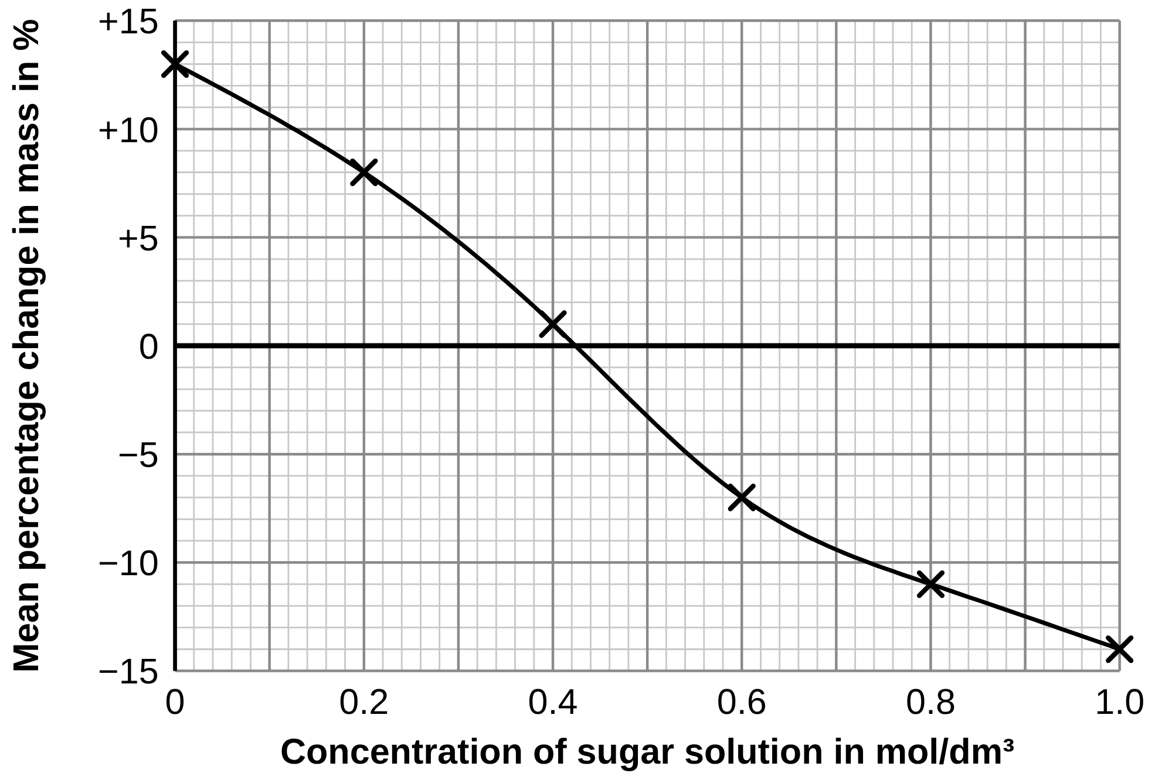
B1 L9 Challenge worksheet: Osmosis
Page 1 of 2
Name: ______________________________ Class: __________
A. Carrot cylinders
B. Unit conversions and a rate
[6]
[5]
Help: online screen 11
Help: online screen 10
A student did the practical with carrot instead of potato. Figure 1 shows the mean percentage change in mass at each concentration of sugar solution.
A cylinder's starting mass was 2400 mg. After 24 hours in pure water, its final mass was 2.70 g.
(a) Convert 2400 mg into grams. [1]
g
(b) Calculate the percentage change in mass. [2]
(a) Use Figure 1 to find the concentration at which there is no net movement of water. [1]
%
(c) Calculate the mean rate of water uptake in mg per hour. [2]
mol/dm³
Figure 1
(b) Explain why the carrot gained mass in the 0.0 mol/dm³ solution. [2]
mg per hour
C. Spot the problem
[3]
Help: online screens 8 and 9
(c) A student says: “At this concentration, water stops moving in and out of the carrot.” Explain why this is wrong. [1]
A student took the cylinders out of the tubes and left them on the bench for 20 minutes before finding their final masses.
Suggest how this affects the percentage change in mass. Explain your answer. [3]
(d) For potato, the line crossed 0 % at 0.30 mol/dm³. Which vegetable's cells had the more concentrated contents? Give a reason. [2]
B1 L9 · Osmosis · sciencegcse.co.uk · free GCSE science resources

Slide 33
B1 L9 Challenge worksheet: Osmosis
Page 2 of 2
Name: ______________________________ Class: __________
D. Extended response
E. Too much fertiliser
[6]
[4]
Help: online screens 5 and 6
Help: online screens 5 and 6
A student puts plant cells and animal cells into pure water and into a concentrated salt solution. Describe and explain what happens to each type of cell in each solution. [6]
A gardener puts far too much fertiliser on a lawn. The fertiliser dissolves in the water in the soil. A day later the grass wilts, even though the soil is wet.
Explain why the grass wilts. [4]
Use the words osmosis, turgid, flaccid and plasmolysis in your answer.
B1 L9 · Osmosis · sciencegcse.co.uk · free GCSE science resources

Slide 34
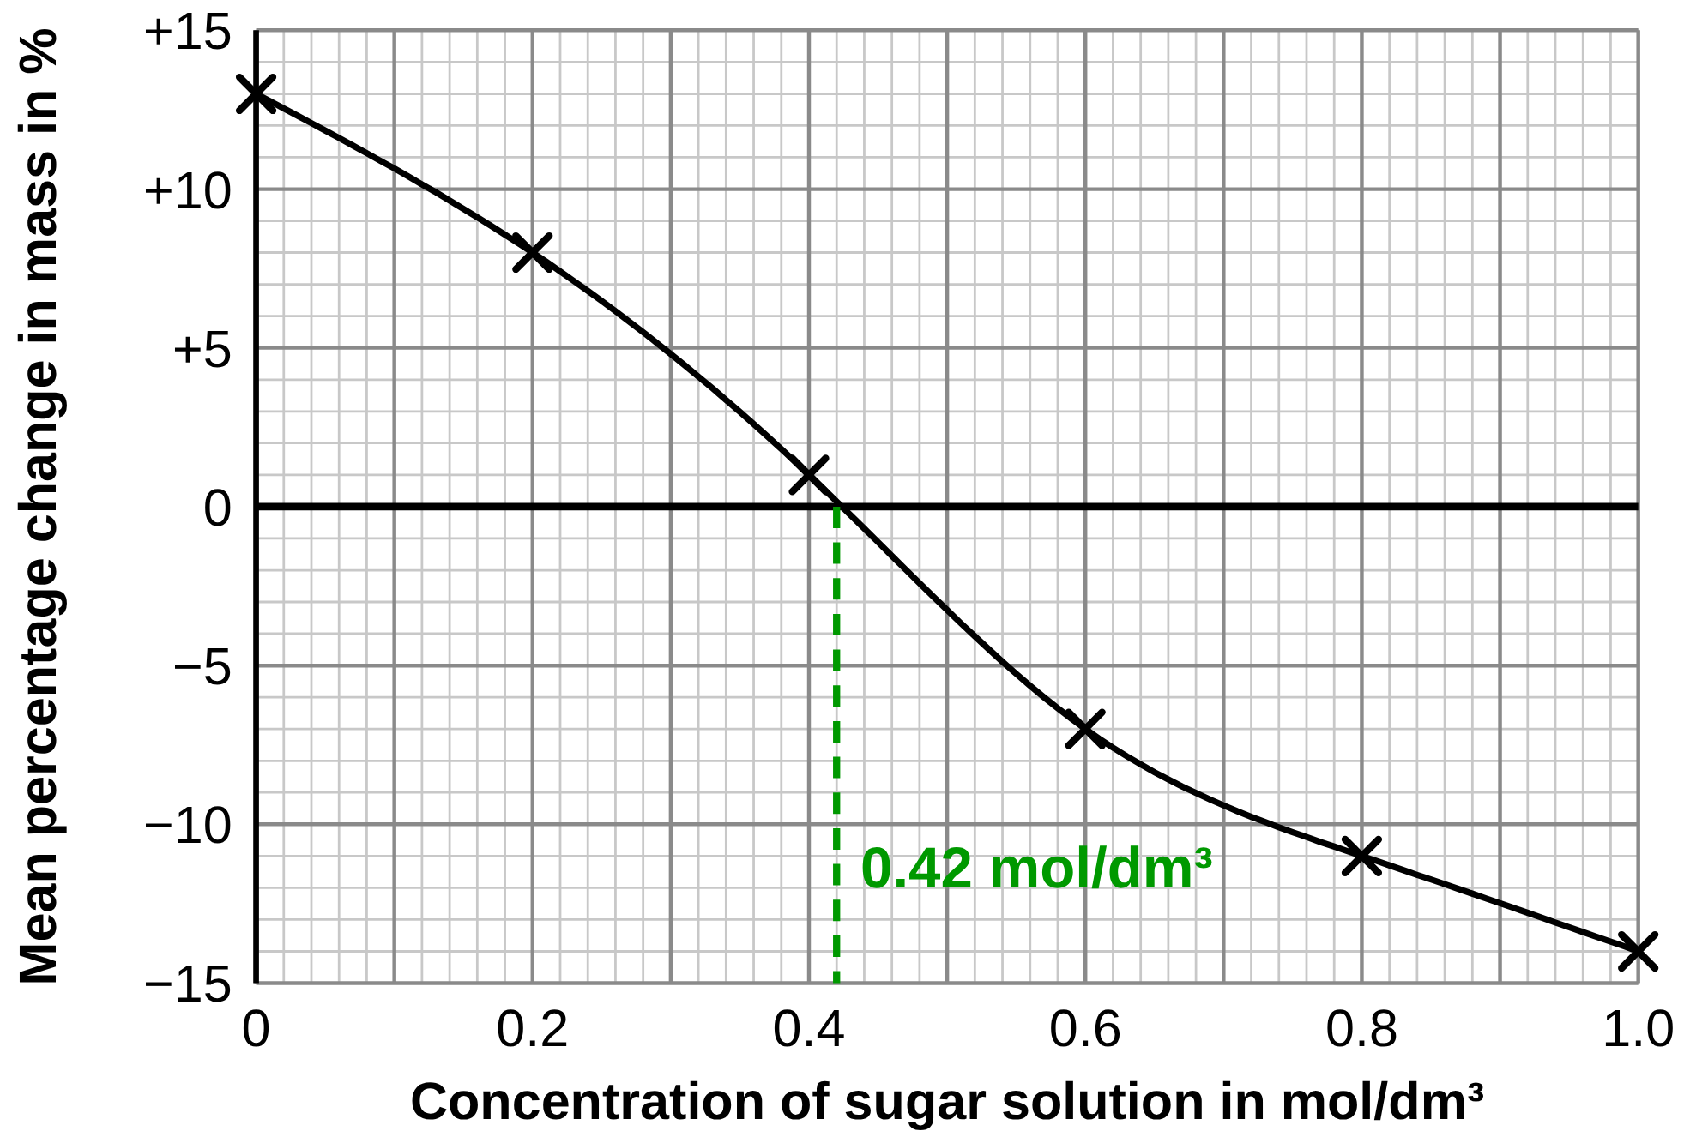
B1 L9 Challenge worksheet answers - page 1
Answers 1 of 2
A. Carrot cylinders
B. Unit conversions and a rate
[6]
[5]
(a) 0.42 (mol/dm³) (1).
Allow 0.40 to 0.44.
Read across from 0 % to the line, then down to the x-axis.
(a) 2.40 g (1). (1000 mg = 1 g.)
(b) (2.70 − 2.40) ÷ 2.40 × 100 (1); = +12.5 (%) (1).
Allow 12.5 or 13. Allow their (a) used correctly.
(c) 2.70 − 2.40 = 0.30 g = 300 mg (or 0.30 ÷ 24 = 0.0125 g per hour) (1); 300 ÷ 24 = 12.5 mg per hour (1).
Correct answer with no working scores 2.
Model answer: (a) 2400 ÷ 1000 = 2.40 g. (b) (2.70 − 2.40) ÷ 2.40 × 100 = +12.5 %. (c) Gain = 0.30 g = 300 mg; 300 ÷ 24 = 12.5 mg per hour.
(b) The solution (pure water) is more dilute than the carrot cells / the carrot cells have a lower concentration of water (1); water moved into the cells by osmosis (1).
(c) Water still moves in and out / both ways; there is just no net movement (1).
(d) Carrot (1); its line crosses 0 % at a higher concentration / it needs a more concentrated solution to stop the net movement of water (1).
Allow their (a) value used correctly.
Model answers
(b) Pure water is more dilute than the inside of the carrot cells, so water moved into the cells by osmosis.
(c) Water molecules still cross the membranes both ways; the amounts in and out are equal, so there is no net movement.
(d) Carrot: its line crosses 0 % at about 0.42 mol/dm³, which is more concentrated than 0.30 mol/dm³ for potato.
C. Spot the problem
[3]
Water evaporates from the cylinders / the cylinders dry out in the air (1).
So the final masses are lower than they should be (1).
So every percentage change is lower / more negative (gains look smaller, losses look bigger) (1).
Allow: find each mass straight after blotting (1) as an improvement, in place of one point. Max 3.
Model answer: Water evaporates from the cylinders while they sit on the bench, so each final mass is lower than it should be. So every percentage change is too low: the gains look smaller and the losses look bigger. The student should find each mass straight after blotting.
B1 L9 · Osmosis · sciencegcse.co.uk · free GCSE science resources

Slide 35
B1 L9 Challenge worksheet answers - page 2
Answers 2 of 2
D. Extended response
E. Too much fertiliser
[6]
[4]
Level 3 (5–6 marks): A clear, detailed answer for both types of cell in both solutions. The direction of water movement is linked to which solution is more dilute or more concentrated, osmosis is named, and the different results are explained by the cell wall (plant cells turgid but not burst; animal cells may burst).
Level 2 (3–4 marks): Correct outcomes for at least three of the four cases, with some explanation, for example osmosis named or the cell wall mentioned. The link to concentration may be incomplete.
Level 1 (1–2 marks): Simple statements, for example “the animal cell bursts” or “the plant cell shrinks”, with little or no explanation.
0 marks: No relevant content.
Indicative content: pure water is more dilute than the inside of the cells; water moves into both cells by osmosis (across the partially permeable cell membrane); the plant cell's vacuole swells and the cell becomes turgid; the cell wall stops the plant cell bursting; the animal cell has no cell wall, so it swells and may burst; the concentrated salt solution is more concentrated than the inside of the cells; water moves out of both cells by osmosis; the plant cell becomes flaccid; with more water lost, its cytoplasm and membrane pull away from the cell wall: plasmolysis; the animal cell shrinks; salt does not move by osmosis.
Do not credit “the plant cell bursts”.
Model answer: Pure water is more dilute than the inside of both cells, so water moves into them by osmosis across their partially permeable cell membranes. The plant cell's vacuole swells and presses against the cell wall, so the cell becomes turgid; the strong cell wall stops it bursting. The animal cell has no cell wall, so it keeps swelling and may burst. The concentrated salt solution is more concentrated than the inside of the cells, so water moves out of both by osmosis. The plant cell becomes flaccid, and as it loses more water its cytoplasm and cell membrane pull away from the cell wall: plasmolysis. The animal cell shrinks.
The soil water becomes more concentrated than the inside of the root hair cells (1).
So water moves out of the root hair cells (into the soil) by osmosis / the roots cannot take in water (1).
The plant's cells lose water and become flaccid (1).
Flaccid cells cannot hold the grass up, so it wilts (1).
Max 4. Do not accept “water moves out by active transport” or “the fertiliser moves in by osmosis”.
Model answer: The fertiliser makes the soil water more concentrated than the inside of the root hair cells. Water moves out of the root hair cells by osmosis, so the grass cannot take in water. Its cells lose water and become flaccid, so they can no longer hold the grass up, and it wilts.
B1 L9 · Osmosis · sciencegcse.co.uk · free GCSE science resources

Slide 36
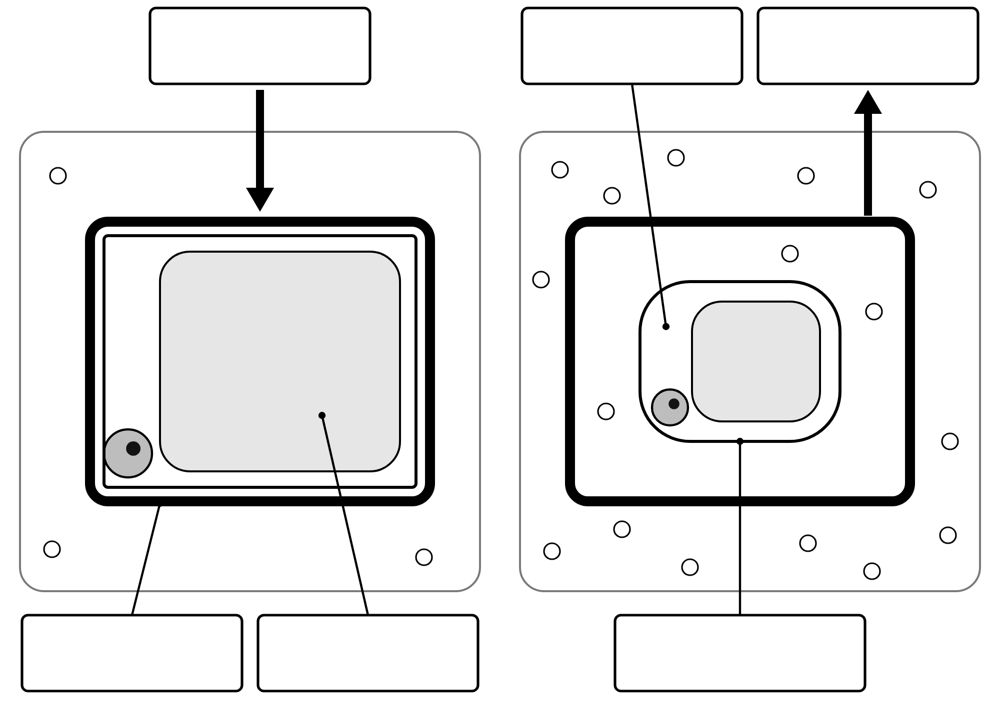
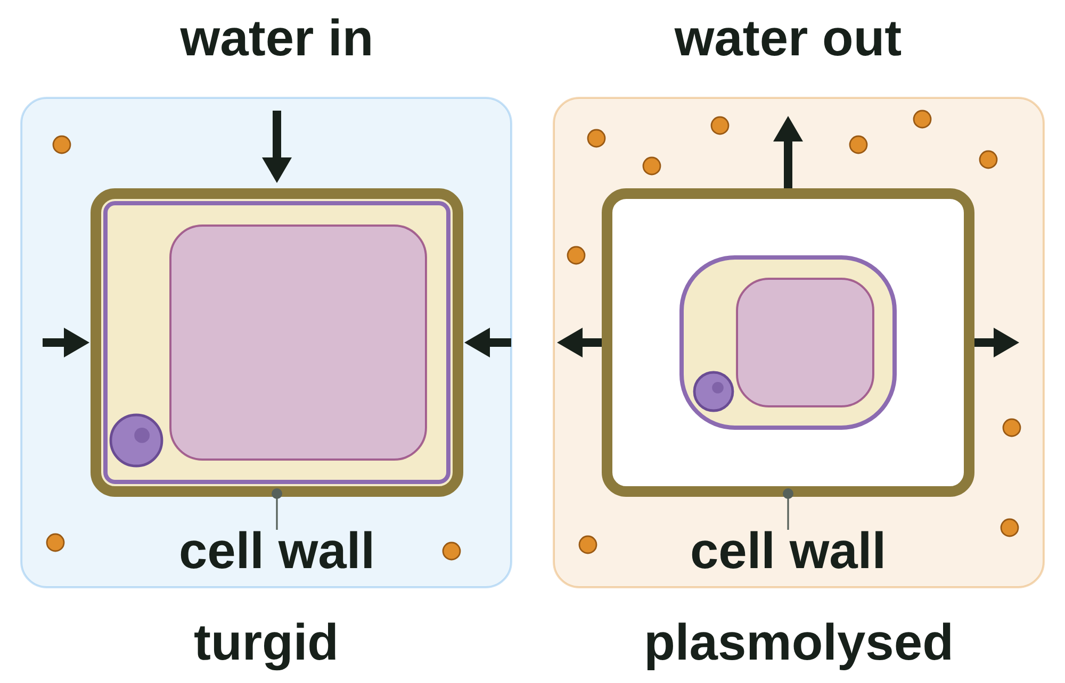
B1 L9 Alternative worksheet: Osmosis
Page 1 of 2
Name: ______________________________ Class: __________
Key facts
A. Label the cells
[6]
Help: online screens 2 and 5
Osmosis is the movement of water across a partially permeable membrane.
A partially permeable membrane lets water through, but not sugar.
A dilute solution has lots of water. A concentrated solution has less water.
Water moves from the dilute solution to the concentrated solution.
A plant cell in water swells and becomes turgid (firm). The cell wall stops it bursting.
A plant cell in a strong salt or sugar solution loses water and becomes flaccid (soft).
An animal cell has no cell wall. In pure water it can burst.
A potato gains mass when water moves in. It loses mass when water moves out.
Write a word from the box in each label box.
cell wall
cell membrane
vacuole
cytoplasm
water in
water out
Real red onion cells
in water | in salt solution
A diagram
water in, water out
Osmosis is always about water.
Tip: the arrows show which way the water goes.
B1 L9 · Osmosis · sciencegcse.co.uk · free GCSE science resources

Slide 37
B1 L9 Alternative worksheet: Osmosis
Page 2 of 2
Name: ______________________________ Class: __________
B. Match the word to its meaning
C. Fill the gaps
[5]
[6]
Help: online screens 3 and 5
Help: online screens 3, 5, 6 and 10
Draw a line from each word to its meaning.
Use the words in the box. Use each word once.
water
dilute
gains
loses
cell wall
burst
osmosis
soft, because it has lost water
turgid
has a lot of solute and less water
1. Osmosis is the movement of ____________.
2. Water moves from a ____________ solution to a concentrated solution.
flaccid
water moving across a partially permeable membrane
3. A potato in pure water ____________ mass.
dilute
has lots of water
4. A potato in a strong sugar solution ____________ mass.
concentrated
swollen and firm
5. The ____________ stops a plant cell bursting.
6. A red blood cell in pure water can ____________.
D. True or false?
E. Work it out
[6]
[4]
Help: online screens 3, 5 and 6
Help: online screen 10
Tick (✓) True or False for each sentence.
1. A potato cylinder starts at 1.50 g. It ends at 1.65 g. [1]
Sentence | True | False
1. Osmosis is the movement of sugar.
2. A partially permeable membrane lets water through.
3. Plant cells burst in pure water.
4. A concentrated solution has less water than a dilute solution.
5. Water moves both ways across the membrane.
6. Osmosis needs energy from respiration.
Circle:
gained mass
/
lost mass
2. Change in mass = 1.65 − 1.50 = ____________ g [1]
3. Percentage change = 0.15 ÷ 1.50 × 100 = ____________ % [1]
4. Another cylinder lost mass. [1]
Circle: water moved
in
/
out
B1 L9 · Osmosis · sciencegcse.co.uk · free GCSE science resources

Slide 38
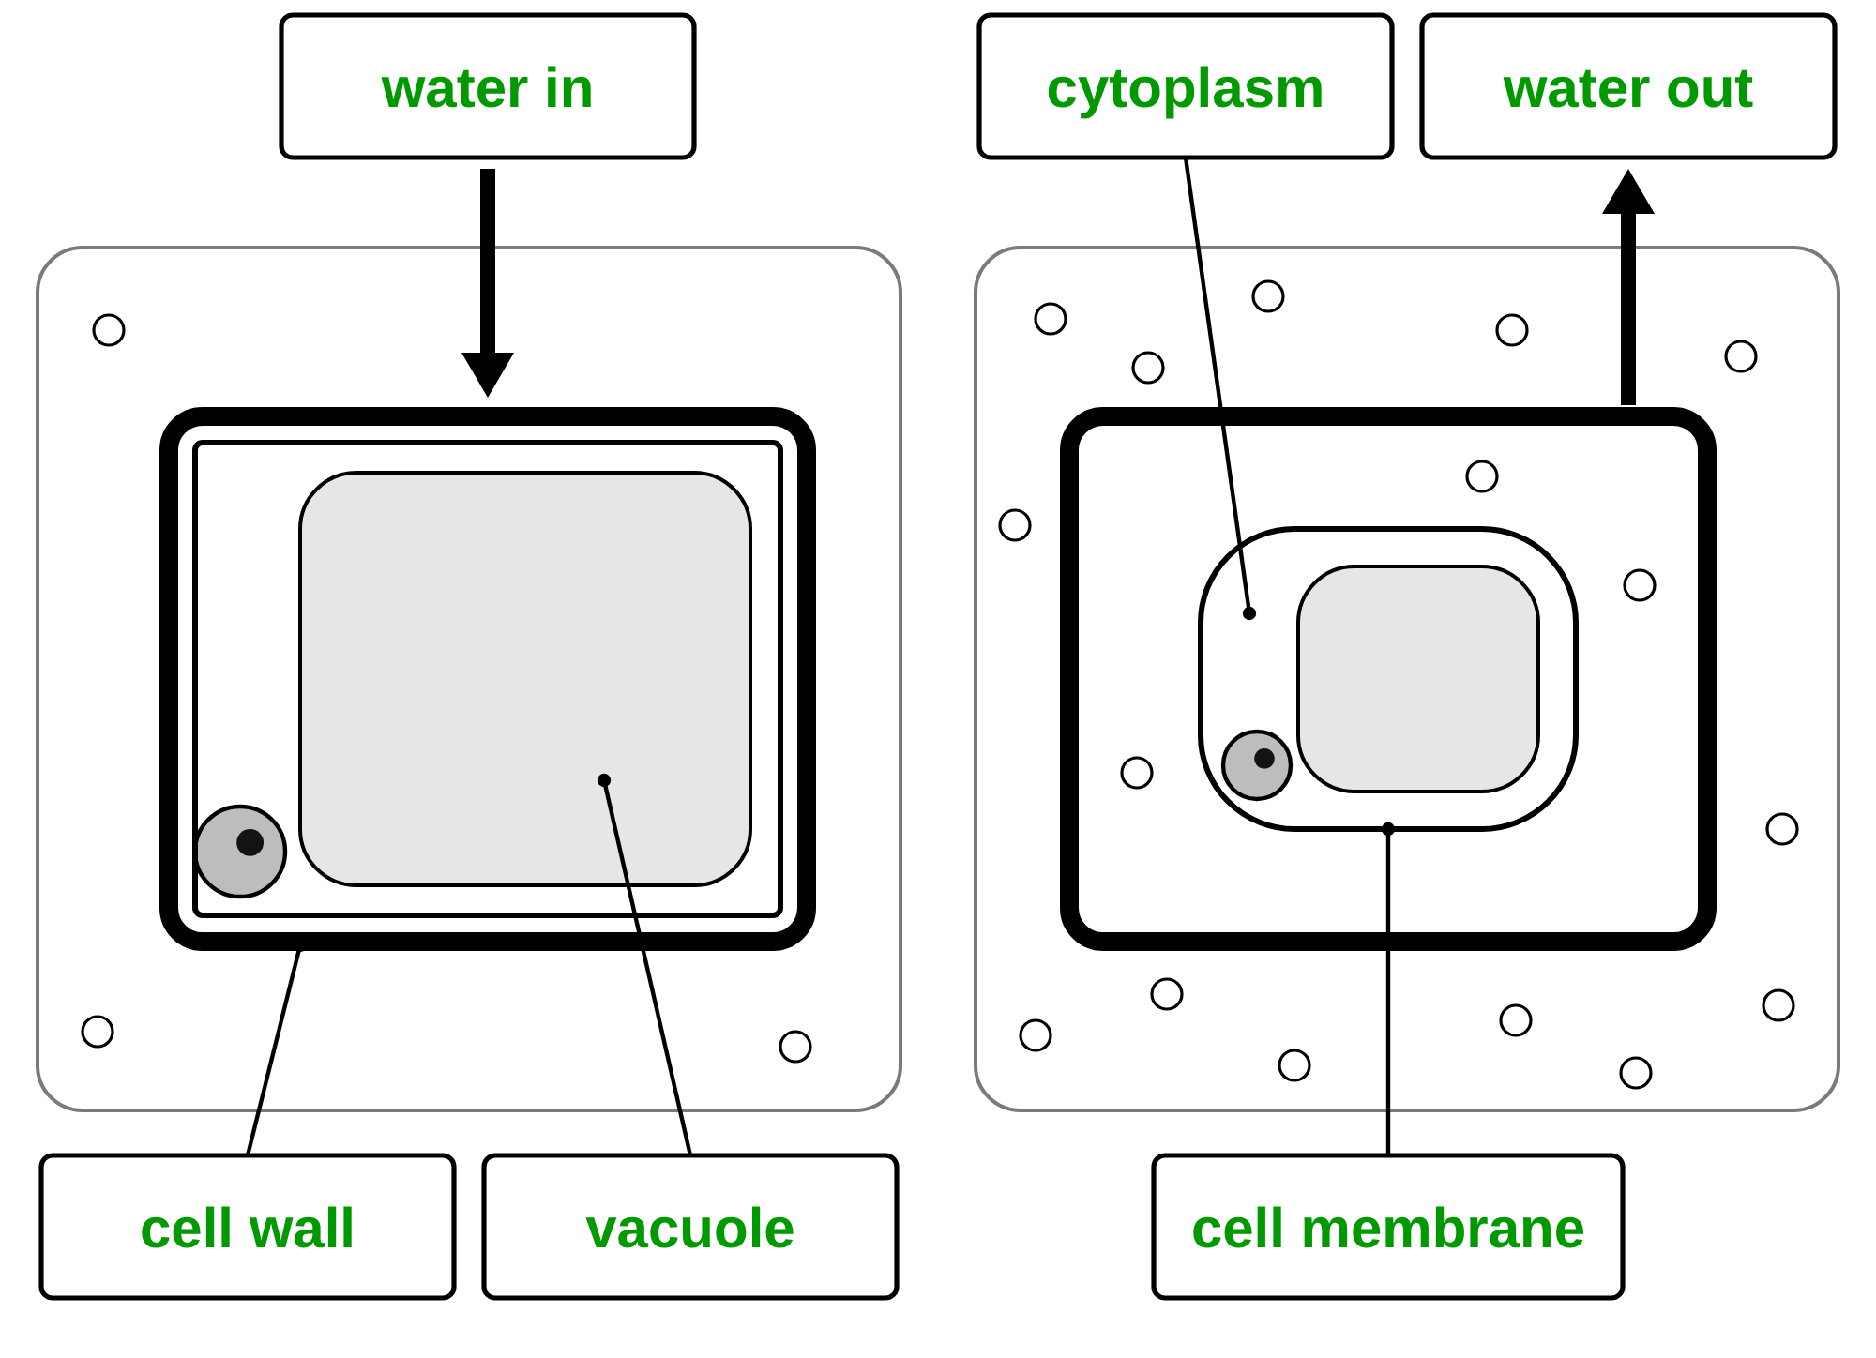
B1 L9 Alternative worksheet answers - page 1
Answers 1 of 2
Key facts
A. Label the cells
[6]
Osmosis is the movement of water across a partially permeable membrane.
A partially permeable membrane lets water through, but not sugar.
A dilute solution has lots of water. A concentrated solution has less water.
Water moves from the dilute solution to the concentrated solution.
A plant cell in water swells and becomes turgid (firm). The cell wall stops it bursting.
A plant cell in a strong salt or sugar solution loses water and becomes flaccid (soft).
An animal cell has no cell wall. In pure water it can burst.
A potato gains mass when water moves in. It loses mass when water moves out.
1 mark for each correct label box.
cell wall
cell membrane
vacuole
cytoplasm
water in
water out
Real red onion cells
in water | in salt solution
A diagram
water in, water out
cell wall (1) cell membrane (1) cytoplasm (1) vacuole (1)
water in (1) water out (1)
Osmosis is always about water.
Water in on the left (dilute solution); water out on the right (concentrated solution).
B1 L9 · Osmosis · sciencegcse.co.uk · free GCSE science resources

Slide 39
B1 L9 Alternative worksheet answers - page 2
Answers 2 of 2
B. Match the word to its meaning
C. Fill the gaps
[5]
[6]
1 mark for each correct line.
Use the words in the box. Use each word once.
water
dilute
gains
loses
cell wall
burst
osmosis
soft, because it has lost water
turgid
has a lot of solute and less water
1. Osmosis is the movement of water. (1)
2. Water moves from a dilute solution to a concentrated solution. (1)
flaccid
water moving across a partially permeable membrane
3. A potato in pure water gains mass. (1)
dilute
has lots of water
4. A potato in a strong sugar solution loses mass. (1)
concentrated
swollen and firm
5. The cell wall stops a plant cell bursting. (1)
6. A red blood cell in pure water can burst. (1)
D. True or false?
E. Work it out
[6]
[4]
1 mark for each correct row.
1. A potato cylinder starts at 1.50 g. It ends at 1.65 g.
Sentence | True | False
1. Osmosis is the movement of sugar. Osmosis is the movement of water. |  | ✓
2. A partially permeable membrane lets water through. | ✓
3. Plant cells burst in pure water. The cell wall stops them bursting. |  | ✓
4. A concentrated solution has less water than a dilute solution. | ✓
5. Water moves both ways across the membrane. | ✓
6. Osmosis needs energy from respiration. Osmosis needs no energy. |  | ✓
Circle:
gained mass
/
lost mass
(1)
2. Change in mass = 1.65 − 1.50 = 0.15 g (1)
3. Percentage change = 0.15 ÷ 1.50 × 100 = 10 % (1)
4. Another cylinder lost mass.
Circle: water moved
in
/
out
(1)
A gain means water moved in. A loss means water moved out.
B1 L9 · Osmosis · sciencegcse.co.uk · free GCSE science resources

Slide 40
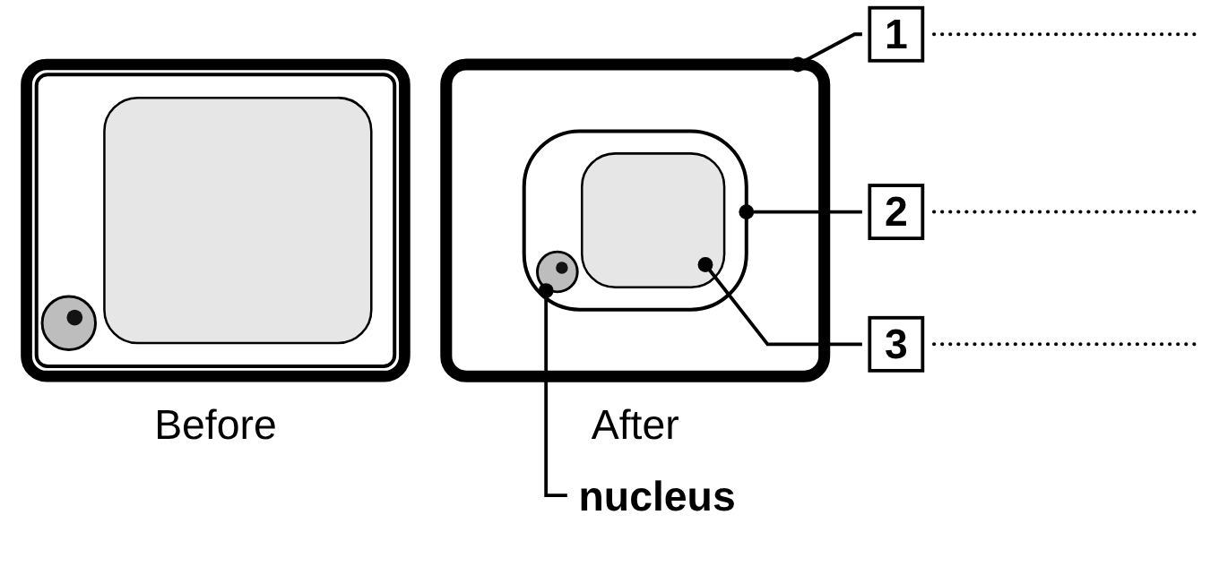
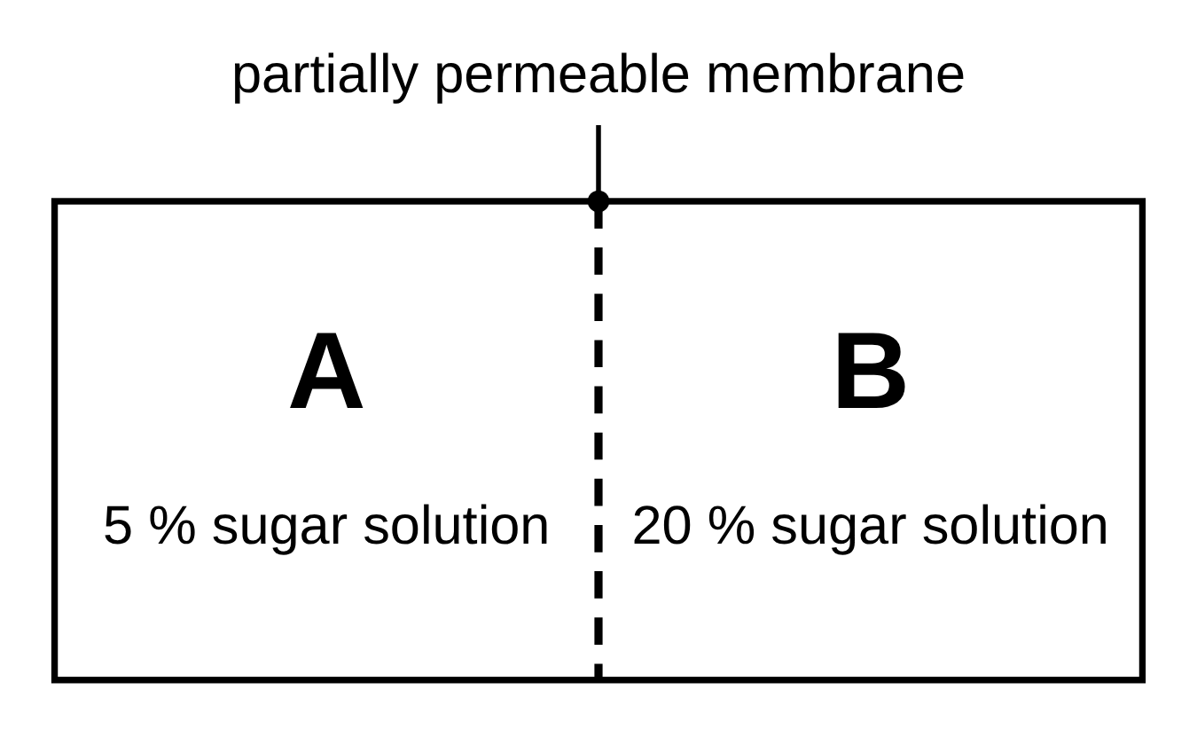
B1 L9 Exam questions worksheet mark scheme - page 1
Answers 1 of 2
01 A cell in salt solution
03 Root hair cells
[4]
[2]
01.1 Complete Figure 1. Choose answers from the box. [3]
1 cell wall (1)
2 cell membrane (1)
3 permanent vacuole (1)
03 Root hair cells take in water from the soil. Explain how. [2]
the water in the soil is more dilute than the inside of the root hair cell / the cell has a lower concentration of water (1)
water moves into the cell by osmosis (across the partially permeable cell membrane) (1)
do not accept “from a high concentration to a low concentration” without “of water” for the first mark. do not accept “by active transport” for the second mark.
Model answer: The water in the soil is more dilute than the inside of the root hair cell, so water moves into the cell by osmosis.
1 mark for each correct label. If more than one word from the box is written on one line, do not give that mark. allow “vacuole” for line 3.
01.2 What has happened to the cell in Figure 1? [1]
It has lost water by osmosis. (1)
If more than one box is ticked, 0 marks.
02 The potato results
04 Two sugar solutions
[6]
[2]
02.1 Calculate value X. [2]
(1.56 − 1.50) ÷ 1.50 × 100 (1) = (+)4(.0) (%) (1)
allow 4 or +4. Correct answer with no working = 2 marks. do not accept −4 for the answer mark.
02.2 Why calculate the percentage change in mass? [1]
the cylinders had different starting masses / so the results can be compared fairly (1)
do not accept “to make it accurate”. ignore “to make it fair” on its own.
02.3 Give one variable the student should control. [1]
any one from: volume of (sugar) solution / size (length, diameter, surface area) of the cylinders / time in the solution / temperature / type of potato / how the cylinders are blotted (1)
do not accept “the concentration” (it is the independent variable). ignore “the amount” with no detail.
02.4 Estimate the concentration with no net movement of water. [1]
0.3 (mol/dm³) (1)
allow any value from 0.25 to 0.35.
02.5 Give one reason why each cylinder was blotted. [1]
to remove (sugar) solution / water from the surface, so only the mass of the potato is measured / so the mass is not too high (1)
allow “to remove excess water”. ignore “to dry it” on its own.
04 In which direction will there be a net movement of water? Explain your answer. [2]
(net movement of water) from A to B (1)
because A is more dilute / has a higher concentration of water / B is more concentrated / has a lower concentration of water (1)
The second mark depends on the first. allow “into B” for the first mark. do not accept “sugar moves from B to A”. do not accept “from high concentration to low concentration” without “of water”.
Model answer: There is a net movement of water from A to B, because A is the more dilute solution (it has the higher concentration of water).
B1 L9 · Osmosis · sciencegcse.co.uk · free GCSE science resources

Slide 41
B1 L9 Exam questions worksheet mark scheme - page 2
Answers 2 of 2
05 Extended response
[6]
05 A student wants to find the concentration of sugar solution that causes no change in the mass of potato tissue. Describe a method the student could use. You should include how the student would make it a fair test and how they would use the results. [6]
Level descriptors
Level 3 (5–6 marks): A detailed and coherent method in a logical order that would give valid results. It includes a range of concentrations, finding the mass before and after, at least two control variables, and how the results are used to find the concentration with no change in mass (a percentage change and a graph crossing 0 %, or the concentration between a gain and a loss).
Level 2 (3–4 marks): A method with the main steps in a mostly sensible order. Some detail is missing, for example the control variables or how the concentration with no change is found. At least one control variable is given.
Level 1 (1–2 marks): Simple statements about the method, for example “put potato in sugar solution” or “weigh it”. The order may be unclear, with little about making it fair.
0 marks: No relevant content.
Note: An answer that never finds the mass both before and after cannot reach Level 2.
Indicative content
cut potato cylinders with a cork borer, all the same diameter
trim them to the same length with a scalpel (on a tile); remove the skin
make up a range of sugar solutions, for example 0.0, 0.2, 0.4, 0.6, 0.8 and 1.0 mol/dm³
put the same volume of each solution (for example 10 cm³) into labelled boiling tubes
blot each cylinder and find its starting mass on a balance
put one cylinder in each tube and leave them for the same time (for example overnight) at the same temperature
remove, blot in the same way and find the final mass
calculate the percentage change in mass
repeat (for example three cylinders at each concentration) and calculate the mean
plot percentage change in mass against concentration and draw a line of best fit
where the line crosses 0 % there is no change in mass / no net movement of water: read off that concentration
control variables: the same potato, the same size of cylinder, the same volume, the same time, the same temperature
safety: cut away from the fingers, onto a tile
Model answer (Level 3)
Use a cork borer to cut potato cylinders of the same diameter, and trim them all to 3 cm with a scalpel on a tile. Put 10 cm³ of sugar solution into each of six labelled boiling tubes: 0.0, 0.2, 0.4, 0.6, 0.8 and 1.0 mol/dm³. Blot each cylinder and find its starting mass on a balance. Put one cylinder in each tube and leave them all overnight at the same temperature. Take them out, blot them in the same way and find the final masses. Use the same potato for every cylinder. Calculate the percentage change in mass for each one. Do three cylinders at each concentration and find the mean. Plot the mean percentage change against the concentration and draw a line of best fit. The concentration where the line crosses 0 % is where there is no change in mass.
B1 L9 · Osmosis · sciencegcse.co.uk · free GCSE science resources

